Slide 1
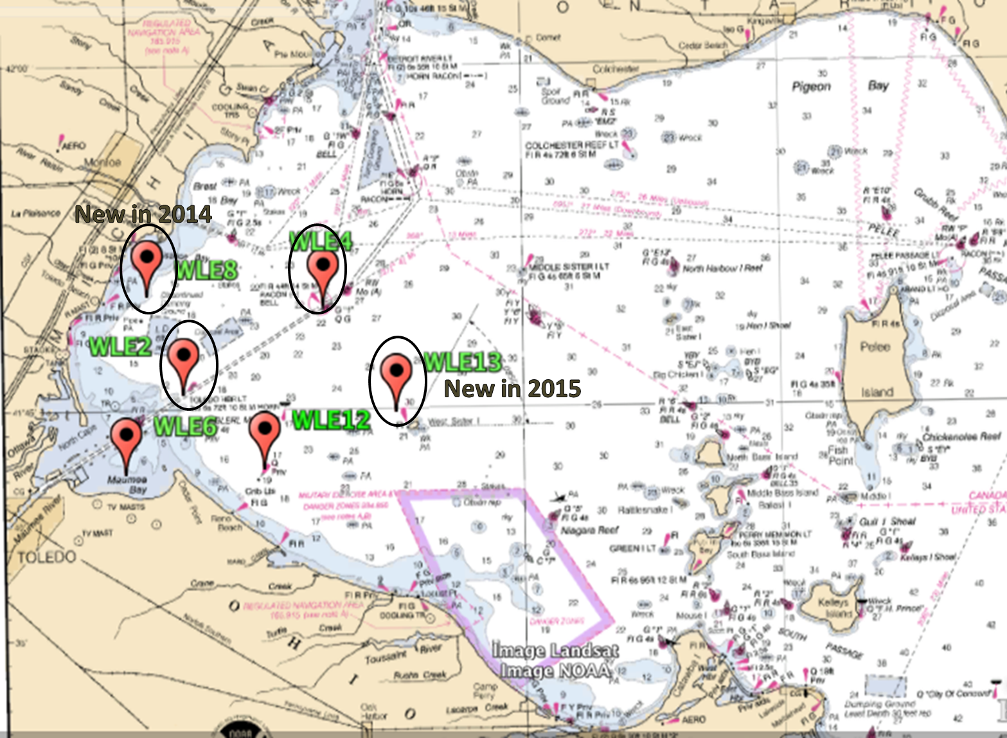
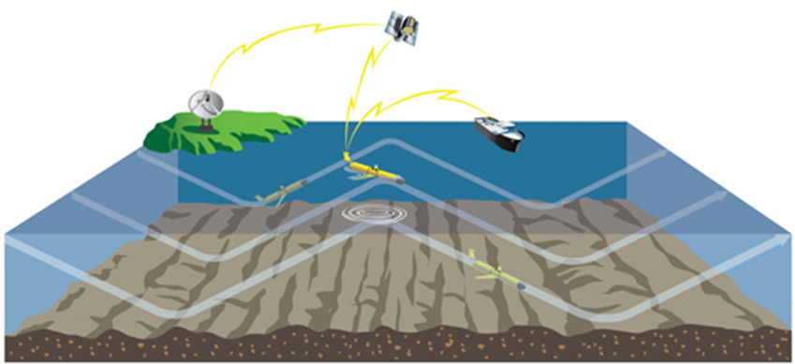
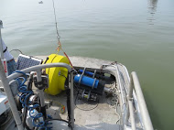
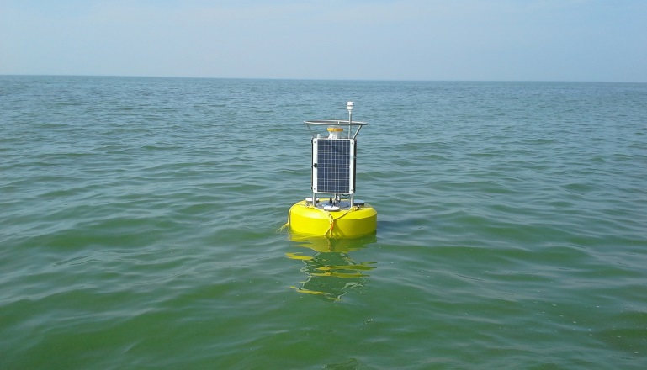
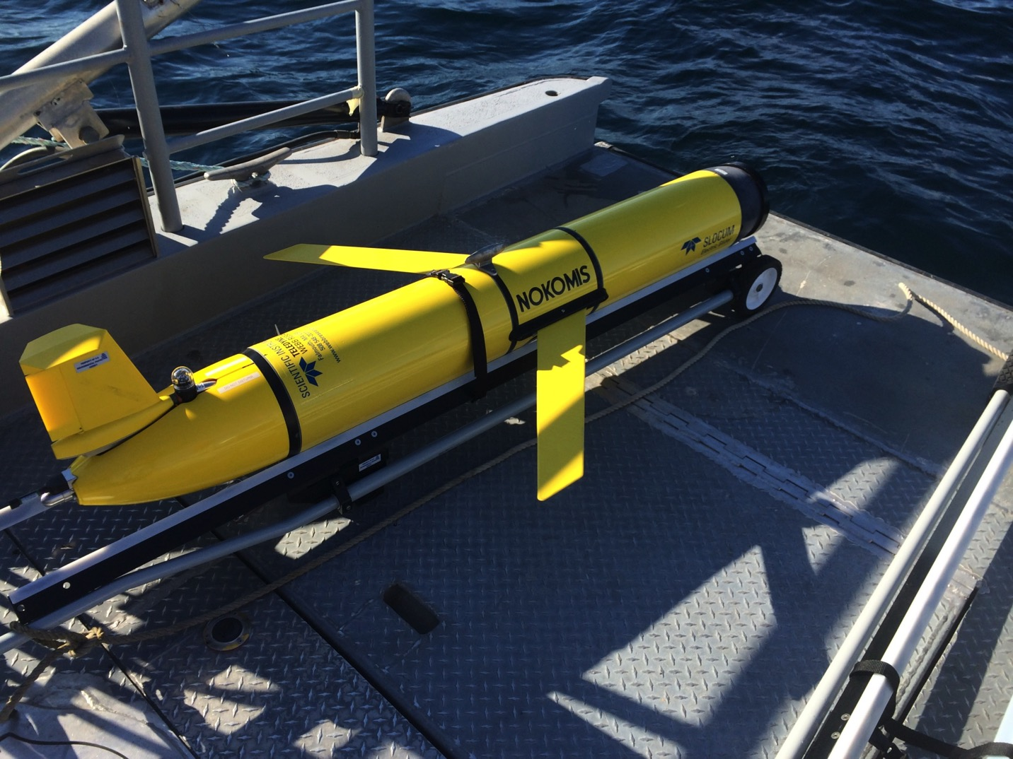
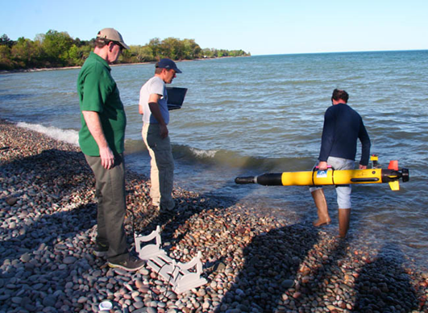
Application of Buoy and Mobile Platform
Observing Technologies
T.H. Johengen¹, S.A. Ruberg², R. Miller¹, D. Palladino¹, D. Stuart¹, H. Purcell¹, S. Constant² and R. Muzzi²
¹Cooperative Institute for Limnology and Ecosystems Research; ²NOAA-GLERL
Western Lake Erie Buoy Network
GLOS-CILER Mobile Platforms
Notes:
*CDOM isn’t listed yet under monitoring
HAB: Harmful Algal Bloom
CTD: Conductivity, Temperature, Depth
DO: Dissolved Oxygen
TP & TDP: Total and Total Dissolved Phosphorus
SRP: Soluble Reactive Phosphorus
NO3: Nitrate
NH4: Ammonia
CHN: Carbon, Hydrogen and Nitrogen
DOC: Dissolved Organic Carbon
CDOM: Colored Dissolved Organic Material
CHL: Chlorophyll
TSS/VSS: Total Suspended Solids and Volatile Suspended Solids
PC: Phycocyanin
SpCond: Specific Conductivity
ESP: Environmental Sample Processor

Slide 2
Application of Buoy and Mobile Platform
Observing Technologies
T.H. Johengen¹, S.A. Ruberg², R. Miller¹, D. Palladino¹, D. Stuart¹, H. Purcell¹, S. Constant² and R. Muzzi²
¹Cooperative Institute for Limnology and Ecosystems Research; ²NOAA-GLERL
Western Lake Erie Buoy Monitoring Network
Research Drivers
Disseminate hourly summary of water quality conditions to better inform the public on the timing and distribution of HABs
Inform the Great Lakes Water Quality Annex 4 adaptive management process to establish new target nutrient loads
Evaluate the importance of resuspension versus riverine inputs for initiating, sustaining, and dispersing blooms (nutrients and seed-stocks)
Support calibration and verification of remote sensed estimations produced for the operational HAB Bulletin and developmental HAB Tracker
Support calibration and verification of N-P-Z based ecological forecasts
Research Approach
Developed a network of 4 realtime continuous monitoring buoys to support HABs monitoring and forecasting.
Data disseminated on GLERL HABs web site and GLOS.
Buoys deployed from May – October and serviced approximately monthly.
Nutrient concentrations determined hourly.
CTD, fluorometry, pH, DO measured every 15 min
Weekly discrete monitoring provides ground truth, direct measurement of particulate and dissolved toxicity levels, and samples for metagenomics
Monitoring
CTD profiles
TP
TDP
SRP
NO3
NH4
CHN
DOC
CHL
PC
Composition
Toxicity
Turbidity
TSS/VSS
Buoys
SRP
Temp
Cond
CHL
PC
Turbidity
CDOM,
pH,
DO

Slide 3
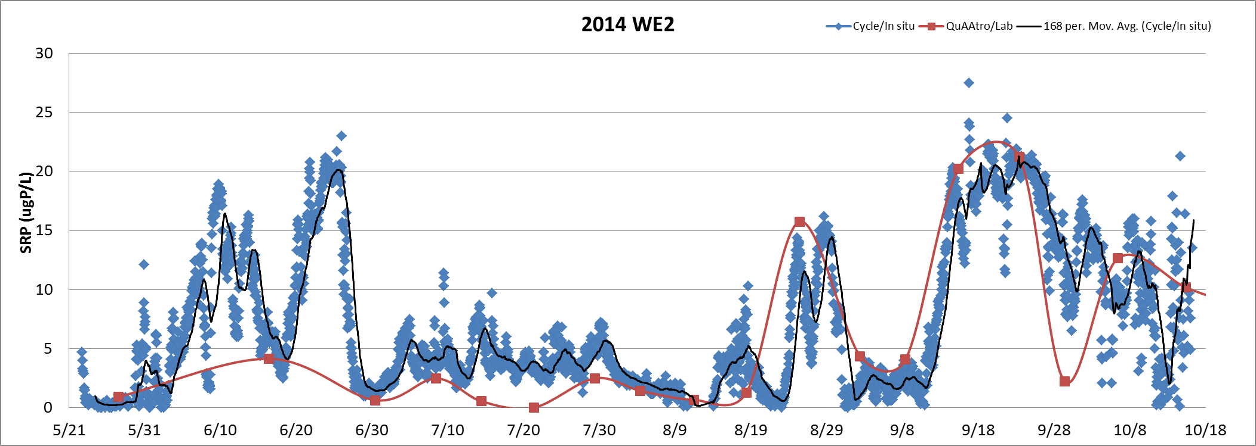
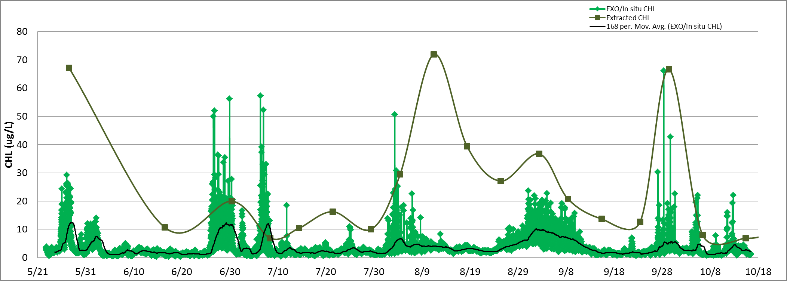
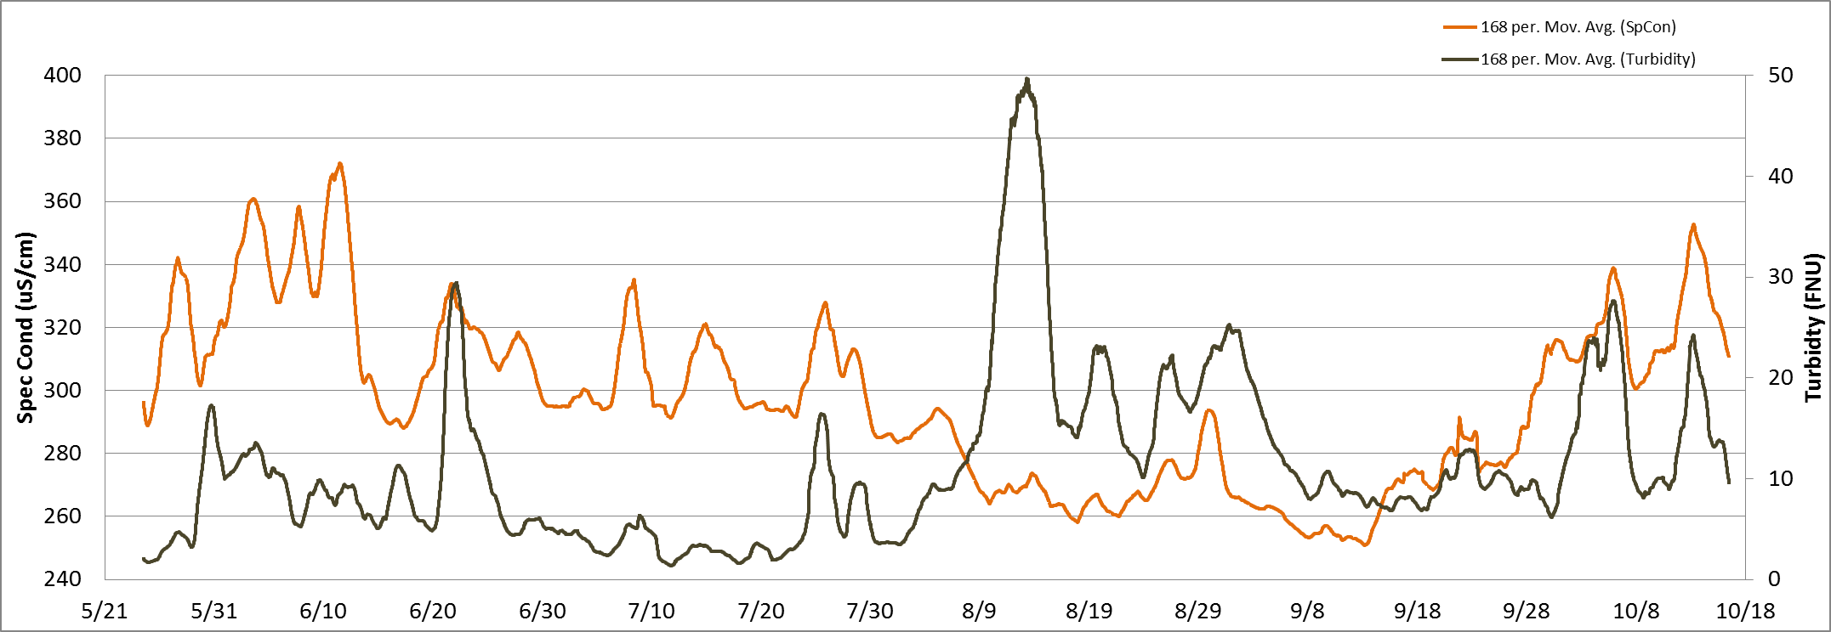
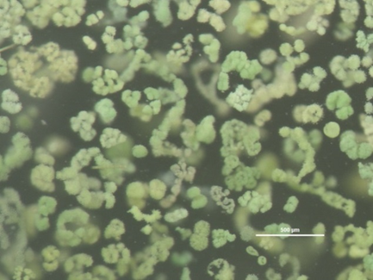
Application of Buoy and Mobile Platform
Observing Technologies
T.H. Johengen¹, S.A. Ruberg², R. Miller¹, D. Palladino¹, D. Stuart¹, H. Purcell¹, S. Constant² and R. Muzzi²
¹Cooperative Institute for Limnology and Ecosystems Research; ²NOAA-GLERL
Western Lake Erie Buoy Monitoring Network
Project Results and Outcomes
Buoys reveal dynamic water quality changes on hourly to daily time-scales
Changes occur from both internal resuspension and advection of River plume
Buoys can provide significant improvement in ‘advanced warnings’ of blooms
Internal nutrient supplies may rival tributary loading at local scales and extend size and duration of blooms
Non-quantitative relationship between in-situ fluorescence and HAB density

Slide 4
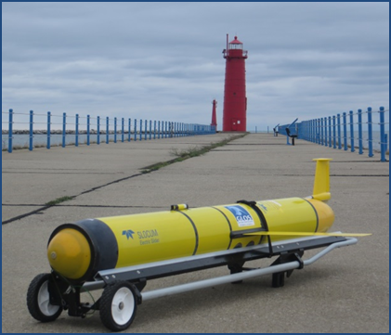
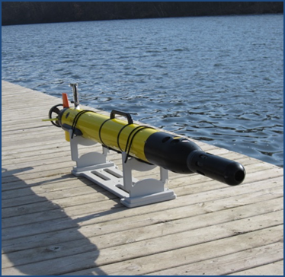
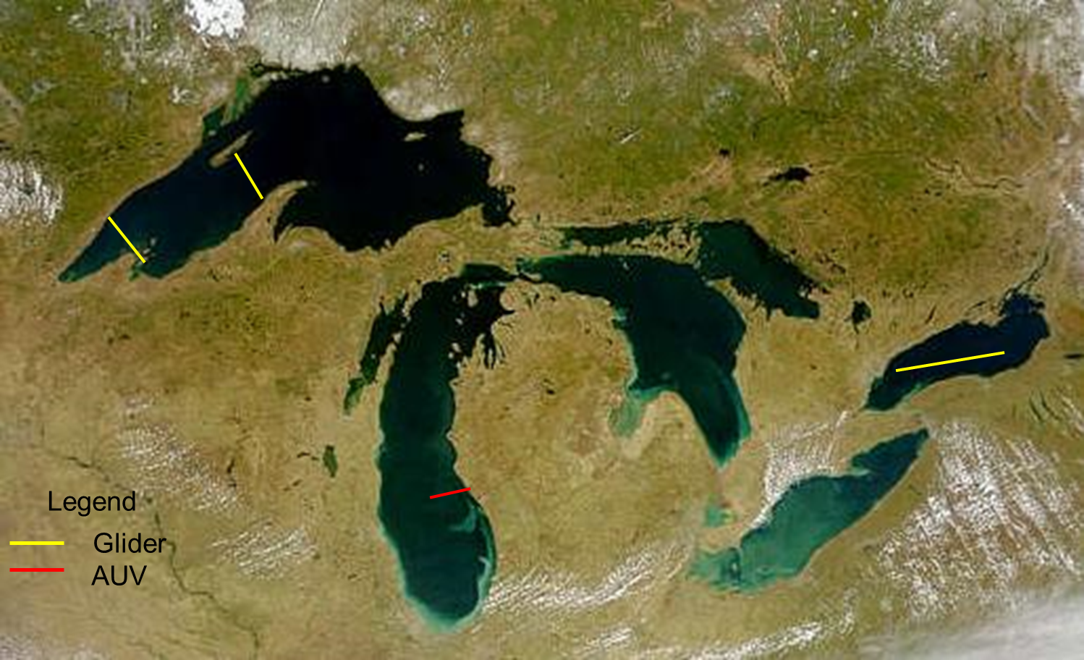
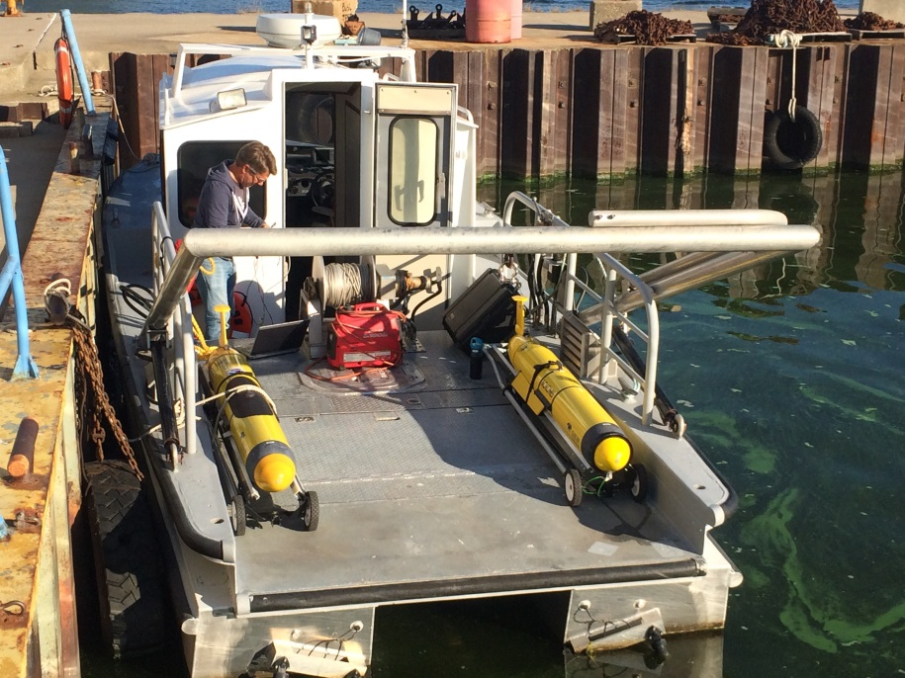
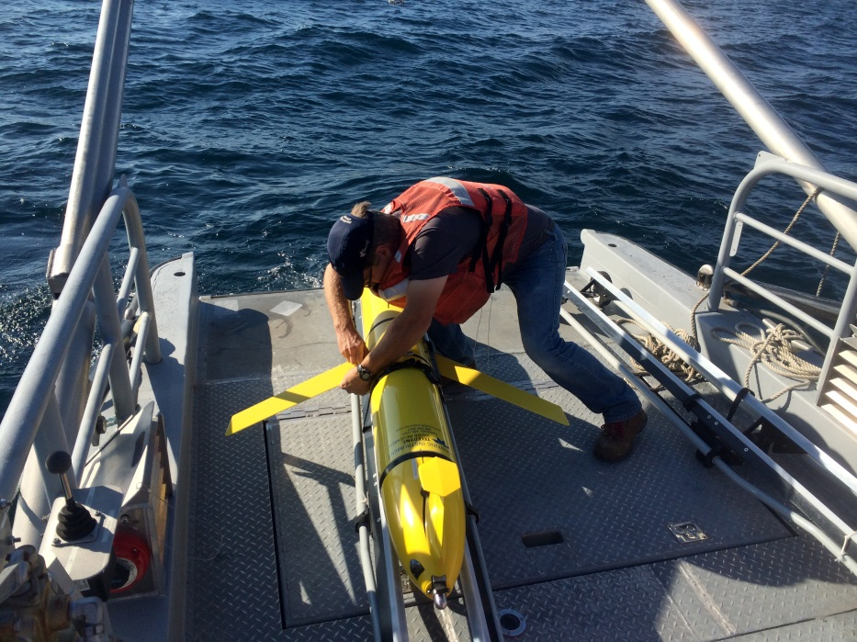
Application of Buoy and Mobile Platform
Observing Technologies
T.H. Johengen¹, S.A. Ruberg², R. Miller¹, D. Palladino¹, D. Stuart¹, H. Purcell¹, S. Constant² and R. Muzzi²
¹Cooperative Institute for Limnology and Ecosystems Research; ²NOAA-GLERL
GLOS-CILER Mobile Platforms
Research Drivers
Provide detailed spatial and temporal patterns of riverine inputs, thermal structure, and lower food web structure to support lake-scale ecological forecasting and GLERL’s LTR programs
Map distribution of invasive Quagga mussels and bottom habitat characteristics
Map distributions of HABs as related to river plume and water quality characteristics
Track vertical migration of HABs to support models and forecasts
Slocum G2 Glider
IVER-2 AUV
Research Approach
Work with Federal (NOAA, EPA, USGS ) and Academic Partners (UMD, MTU, UWM, SUNY-ESF) to operate the platforms regionally
Support local and regional monitoring priorities
Platform | Deployed / Retrieved | # days | # transects | # water column profiles | Linear Distance (km)
AUV | 9-25-14 | 1 | 2 |  | 50 km
Glider | 9-18-14 10-17-14 | 30 | MILW boxes 2 lake crossings | 3600 | 660 km
Glider | 7-25-14 8-28-14 | 32 | MUSK-MILW 6 lake crossings | 2800 | 784 km
Glider | 5-19-14 6-19-14 | 31 | G.H. /MILW boxes 4 lake crossings | 2950 | 679 km
Glider | 9-27-13 10-28-13 | 31 | MUSK-MILW 6 crossings | 2375 | 726 km
Glider | 6-26-13 7-11-13 | 16 | MUSK/NDBC/MILW 2 crossings | 780 | 266 km
Joint mission with EPA and USGS in support of the
2015 Lake Michigan Coordinated Science Monitoring Initiative
Summary of mission days for GLIDER and AUV applications in 2014

Slide 5
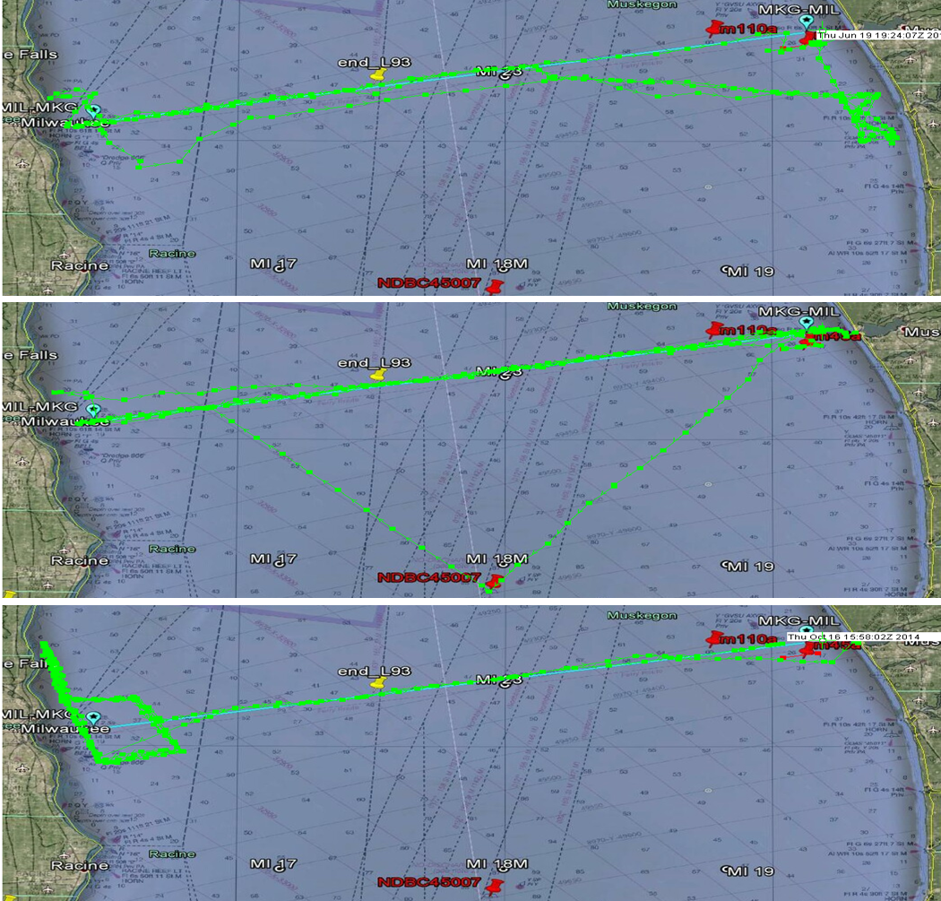
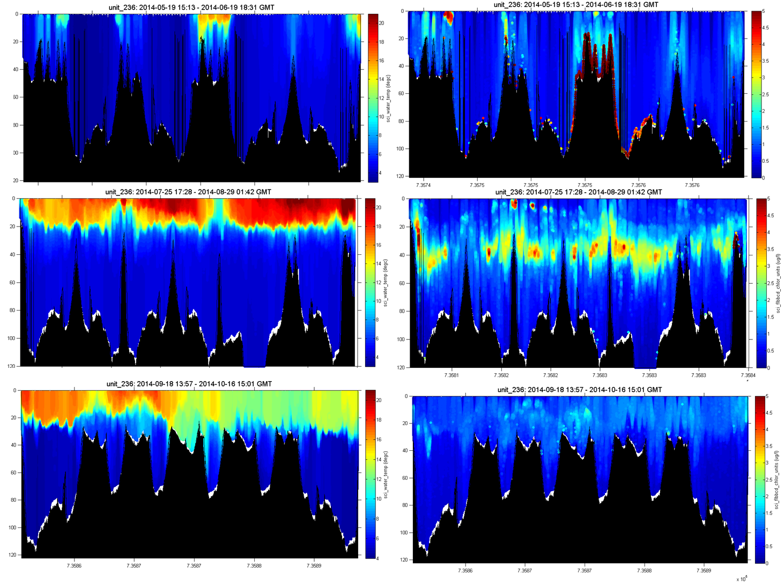
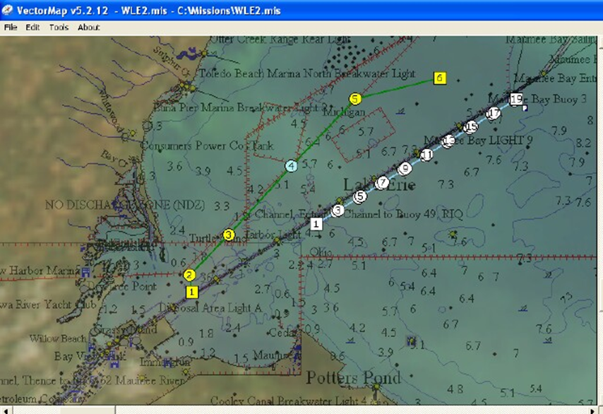
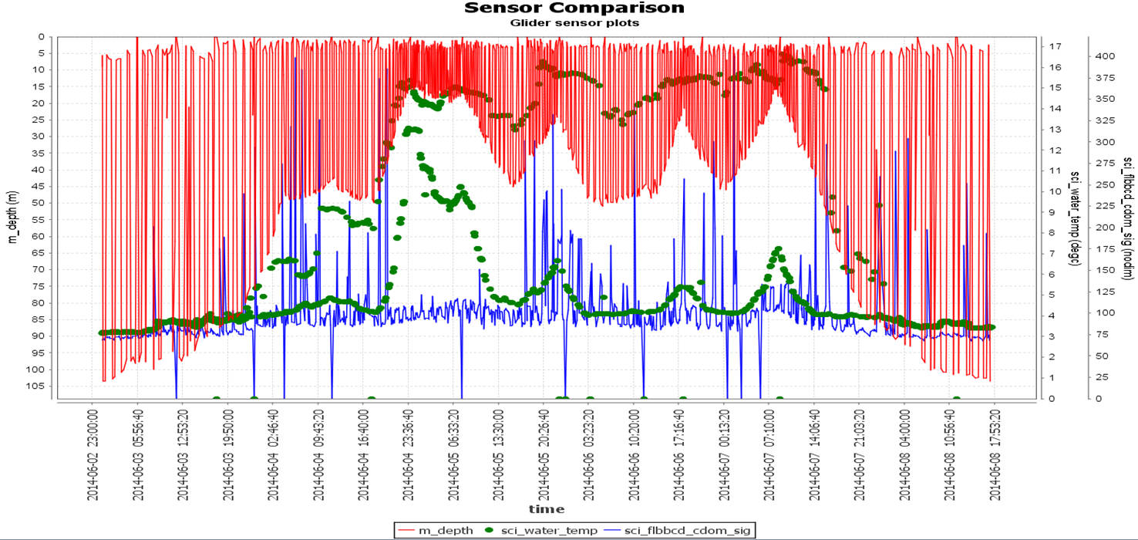
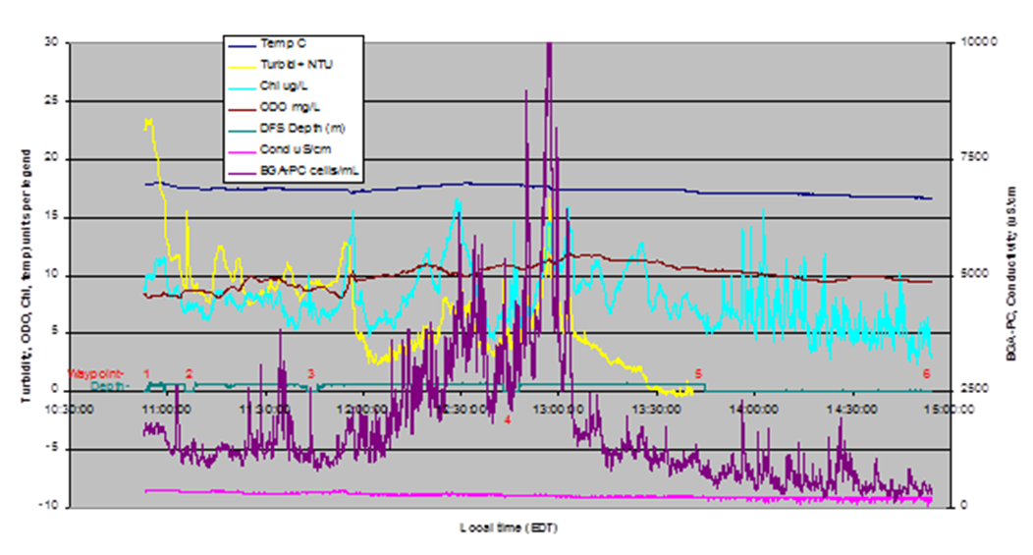
Application of Buoy and Mobile Platform
Observing Technologies
T.H. Johengen¹, S.A. Ruberg², R. Miller¹, D. Palladino¹, D. Stuart¹, H. Purcell¹, S. Constant² and R. Muzzi²
¹Cooperative Institute for Limnology and Ecosystems Research; ²NOAA-GLERL
GLOS-CILER Mobile Platforms
Project Results and Outcomes
Repeated cross-lake mapping of timing and spatial distribution of thermocline formation and development of deep chlorophyll layer.
Detailed Nearshore mapping of river plume
Data comparisons made with Ferry surface mapping, NDBC buoy, and GLERL LTR surveys.
May – June
July – Aug
Sept - Oct
GLIDER tracking river plume distribution in coastal L. Michigan. Can support FVCOM nearshore water quality forecasts (FIBs, spills, HABs)
AUV tracking of river plume and boundaries of HABs in W. Lake Erie

Slide 6
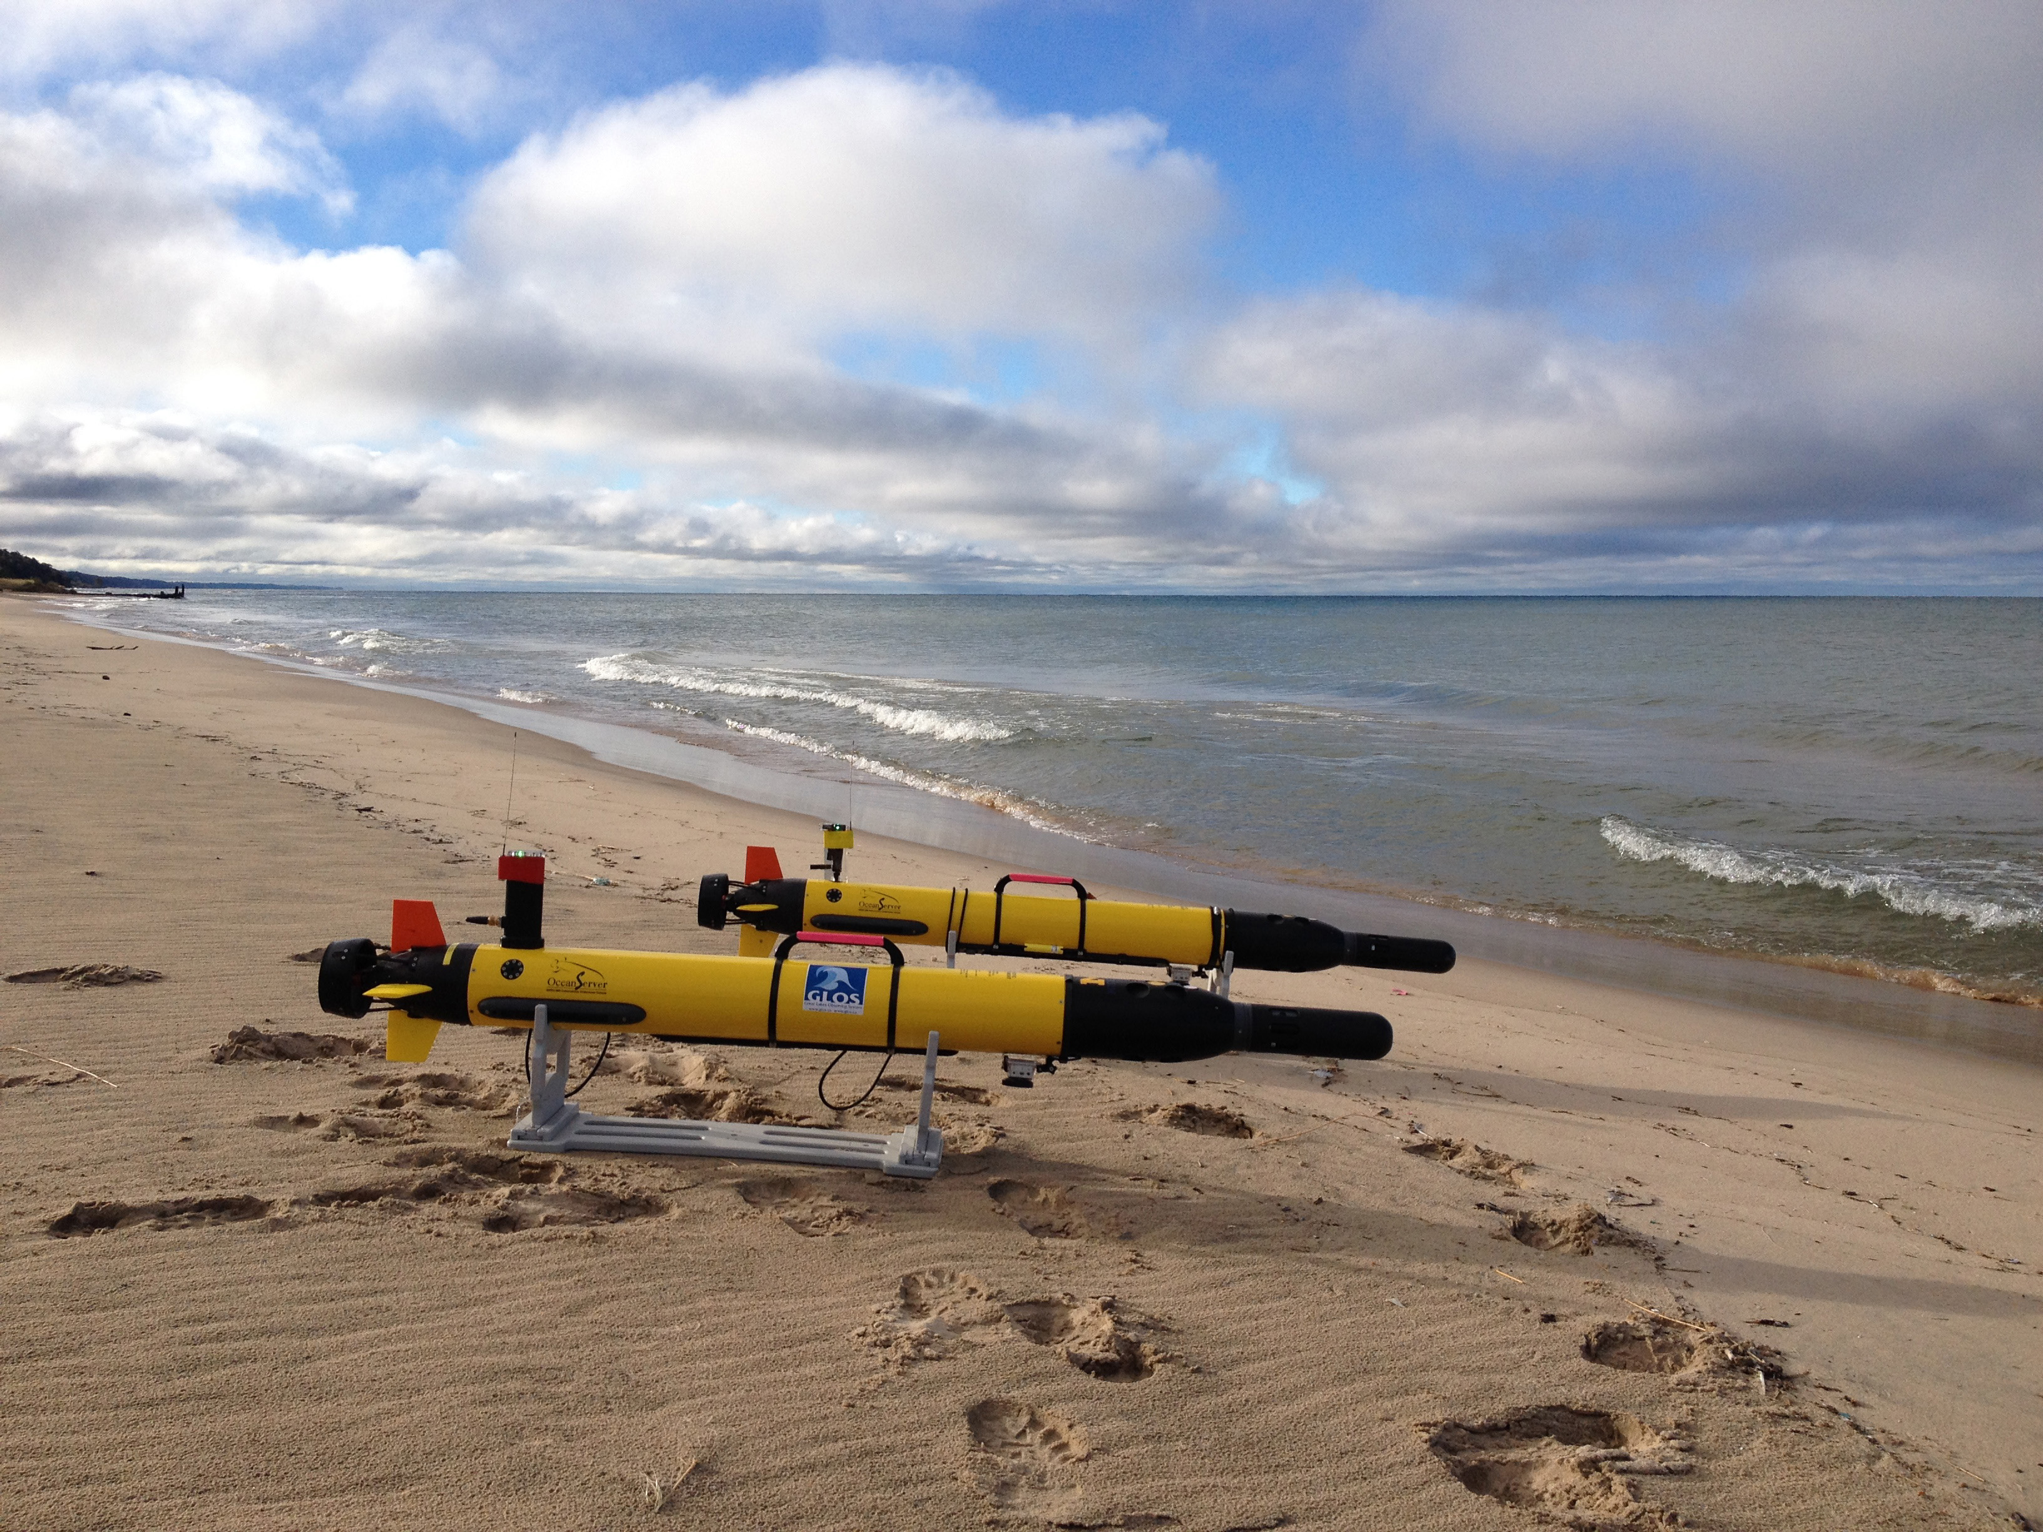
Application of Buoy and Mobile Platform
Observing Technologies
T.H. Johengen¹, S.A. Ruberg², R. Miller¹, D. Palladino¹, D. Stuart¹, H. Purcell¹, S. Constant² and R. Muzzi²
¹Cooperative Institute for Limnology and Ecosystems Research; ²NOAA-GLERL
Questions?

