Slide 1
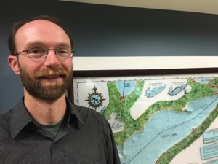
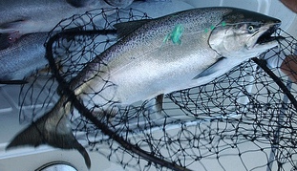
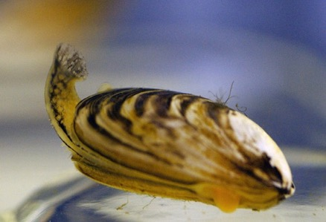
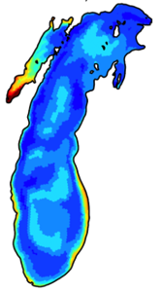
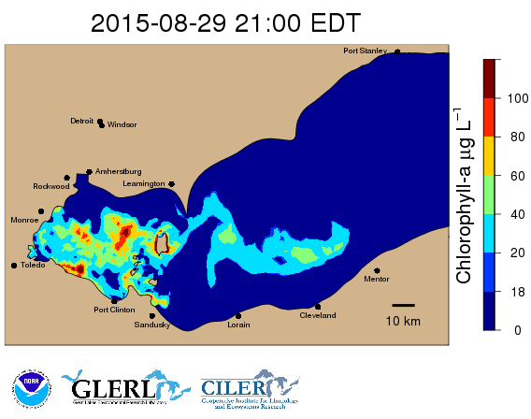
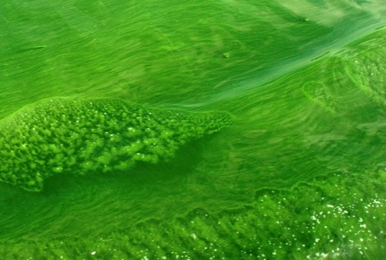
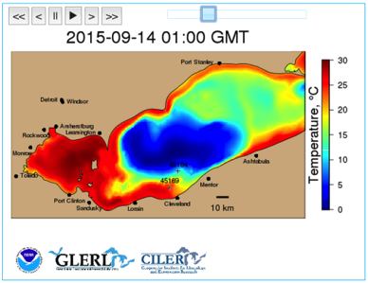
Biophysical Modeling
Mark Rowe
Ecosystem Dynamics
University of Michigan, CILER
Place Photo Here
1/15
Notes:
This work aligns with the following NOAA Goals:
Science: Climate Adaptation and Mitigation
Improved scientific understanding of the changing climate system and its impacts
Assessments of current and future states of the climate system that identify potential impacts and inform science, service, and stewardship decisions
A climate-literate public that understands its vulnerabilities to a changing climate and makes informed decisions
Science: Weather-Ready Nation
Reduced loss of life, property, and disruption from high-impact events
Improve freshwater resource management
Healthy people and communities due to improved air and water quality services
A more productive and efficient economy through information relevant to key sectors of the U.S. economy
Science: Healthy Oceans
Improved understanding of ecosystems to inform resource management decisions
Sustainable fisheries and safe seafood for healthy populations and vibrant communities
Science: Resilient Coastal Communities and Economies
Resilient coastal communities that can adapt to the impacts of hazards and climate change
Improved coastal water quality supporting human health and coastal ecosystem services
Education: Science-Informed Society
Formal and informal educators integrate NOAA-related sciences into their curricula, practices, and programs
Formal and informal education organizations integrate NOAA-related science content and collaborate with NOAA scientists on the development of exhibits, media, materials, and programs that support NOAA’s mission
Education: Safety and Preparedness
Youth and adults from all backgrounds are aware of, prepare for, and appropriately respond to environmental hazards that impact health, safety, and the economy in their communities
Formal and informal education institutions integrate water, weather, and climate hazard awareness, preparedness, and response information into curricula, exhibits, and programs that create learning opportunities for youth and adults
Education: Future Workforce
Postsecondary students, particularly from underrepresented groups, pursue and complete degrees in disciplines critical to NOAA’s mission
Education: Organizational Excellence
NOAA educators and partners collaborate at local, regional, and national levels to coordinate efforts, build capacity, and better serve educational audiences

Slide 2
EcoDyn | Biophysical Modeling
Biophysical modeling integrates and synthesizes information from each branch at GLERL
OSAT
Observing Systems & Advanced Technology
IPEMF
Integrated Physical & Ecological Modeling and Forecasting
EcoDyn
Ecosystem Dynamics
Observations
Physical models
Ecological monitoring
& process studies
Biophysical Modeling
Understand the dynamics of Great Lakes ecosystems
Develop forecasts and applications
IS
Information Services
Feedback influences research questions and approaches
Stakeholders
& public
2/15
Notes:
Biophysical modeling integrates and synthesizes information from each branch at GLERL
with the goals of understanding the dynamics of Great Lakes ecosystems, and developing forecasts and applications.
Scientific insights feed back to influence research questions and approaches of the branches.

Slide 3
EcoDyn | Biophysical Modeling
Biophysical modeling research questions tied to NOAA’s strategic plan
Research questions
How will invasive mussels affect Great Lakes productivity?
How will changing climate affect lake dynamics and the impact of invasive mussels on phytoplankton abundance?
How can we use hydrodynamic forecasts to provide early warning of changing source water quality for public water systems due to HABs and hypoxia?
NOAA’s core goals
Healthy Oceans: Fisheries, habitats, biodiversity, healthy and productive ecosystems
Climate Adaptation and Mitigation
Weather-Ready Nation
Resilient Coastal Communities and Economies
3/15
Notes:
In this presentation, I will give some examples of recent work that addresses research questions tied to NOAA’s strategic plan.

Slide 4
EcoDyn | Biophysical Modeling
How will invasive mussels affect Great Lakes productivity?
How will changing climate affect lake dynamics and the impact of invasive mussels on phytoplankton abundance?
4/15
Notes:
I’ll start with some examples addressing the first two questions related to impacts of invasive quagga mussels on the productivity of Lake Michigan.

Slide 5
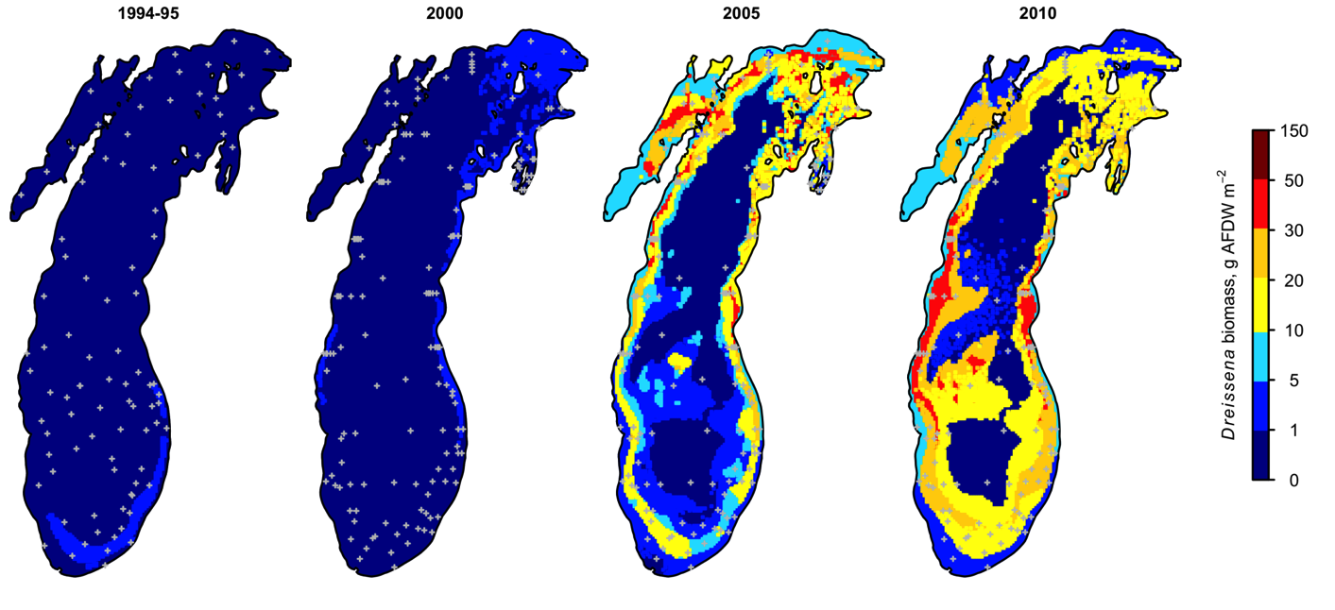
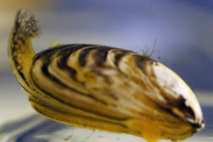
EcoDyn | Biophysical Modeling
Quagga mussel: A prolific invader that has dramatically altered freshwater systems worldwide
Publicly-available spatial data set
Benthic surveys
Geostatistical model
1994-95 2000 2005 2010
M.D. Rowe, D.R. Obenour, T.F. Nalepa,
H.A. Vanderploeg, F. Yousef, W.C. Kerfoot. 2015. Freshwater Biology, 60(11): 2270-85
5/15
Notes:
High densities of quagga mussels became established in Lake Michigan between 2000 and 2005, as documented by GLERL’s long-term benthic monitoring program.
In order to develop a spatial data set of quagga mussel biomass for use in various modeling applications, we applied a geostatistical model to the benthic survey data to estimate biomass at locations where it was not measured.
We produced a spatial data set that we made available to the public in the supplement to this paper in Freshwater Biology.
M.D. Rowe, D.R. Obenour, T.F. Nalepa, H.A. Vanderploeg, F. Yousef, W.C. Kerfoot. 2015. Freshwater Biology, 60(11): 2270-85

Slide 6
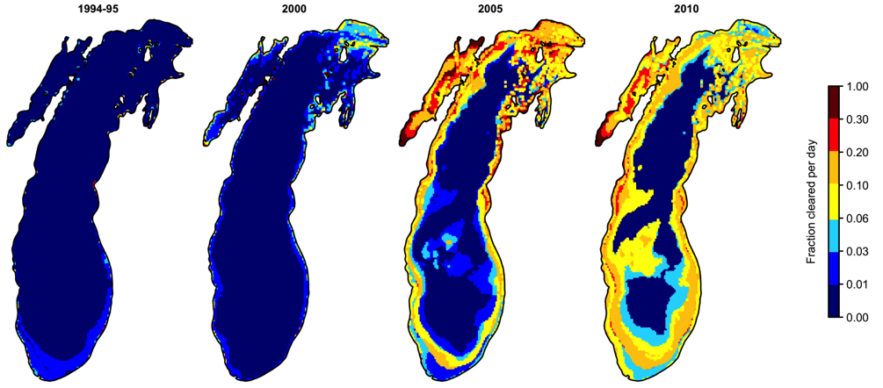
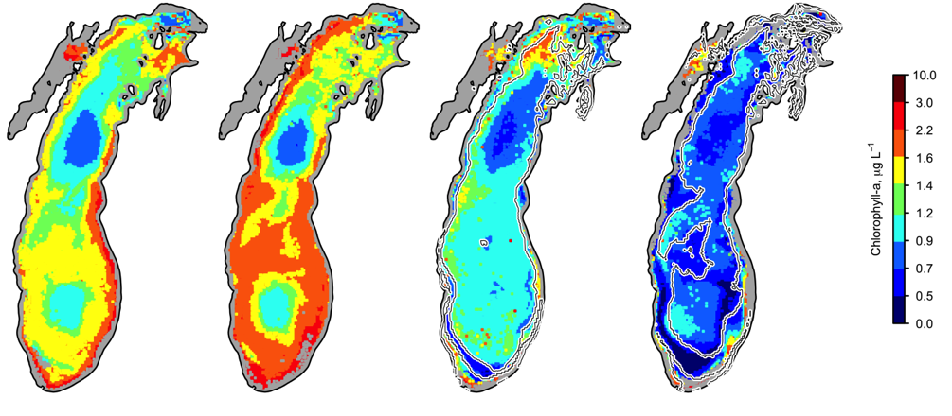
EcoDyn | Biophysical Modeling
Chlorophyll depletion in Lake Michigan is spatially associated with quagga mussel filter feeding intensity
1994-95 2000 2005 2010
Dreissenid filter feeding intensity
April
satellite chlorophyll
M.D. Rowe, et al. Freshwater Biology, 60(11): 2270-85
6/15
Notes:
In the same paper, we showed for the first time a spatial association between mussel filter-feeding intensity and reduction in chlorophyll concentration observed in satellite imagery.
In the upper set of maps, we combined the biomass spatial distribution with mussel clearance rate measured by the Ecosystem Dynamics group and bathymetry to estimate the fraction of the water column cleared per day by filter feeding, under vertically-mixed conditions as occurs during the spring bloom in April.

Slide 7
EcoDyn | Biophysical Modeling
Chlorophyll depletion in Lake Michigan is spatially associated with quagga mussel filter feeding intensity
1994-95 2000 2005 2010
Dreissenid filter feeding intensity
April
satellite chlorophyll
M.D. Rowe, et al. Freshwater Biology, 60(11): 2270-85
6/15
Notes:
We showed a statistically significant spatial association between filter feeding intensity and reduction in chlorophyll from pre to post invasion.
M.D. Rowe, D.R. Obenour, T.F. Nalepa, H.A. Vanderploeg, F. Yousef, W.C. Kerfoot. 2015. Freshwater Biology, 60(11): 2270-85

Slide 8
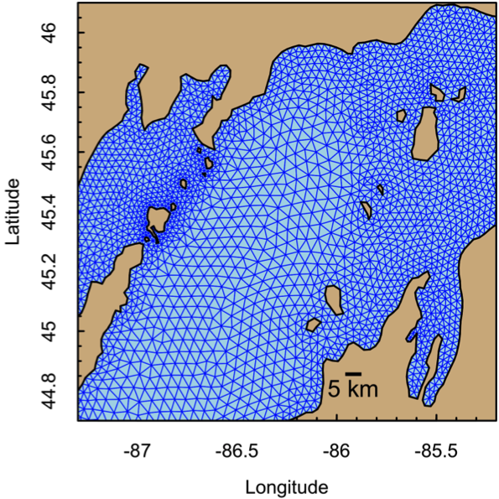
EcoDyn | Biophysical Modeling
Finite Volume Community Ocean Model (FVCOM)
Great Lakes Coastal Forecasting System models are being replaced with FVCOM (Eric Anderson)
Nearshore water quality is of current interest because of invasive mussel impacts and Great Lakes Water Quality Protocol of 2012
Unstructured grid provides new opportunities for nearshore biophysical modeling
Conforms to shoreline morphology
Provides increased resolution nearshore
M.D. Rowe, E.J. Anderson, J. Wang, H.A. Vanderploeg. 2015. J. Great Lakes Research, 41(S3):49-65
7/15
Notes:
The Great Lakes Coastal Forecasting System models are being replaced with FVCOM models.
Eric Anderson will present more on this tomorrow.
Nearshore water quality is currently of great interest because of invasive dreissenid mussels, and the revised Great Lakes Water Quality Protocol of 2012 has new language requiring US EPA and Environment Canada to consider nearshore water quality for the first time.
The unstructured grid FVCOM model conforms to complex shoreline morphologies and allows for increased resolution nearshore, resulting in new opportunities for nearshore biophysical modeling that did not exist with the previous generation of models with a 2km structured grid.
In the examples I am showing here, grid resolution on the shoreline was ~600 m, but the Michigan-Huron model for the updated forecasting system will have a nearshore resolution of 200 m.

Slide 9
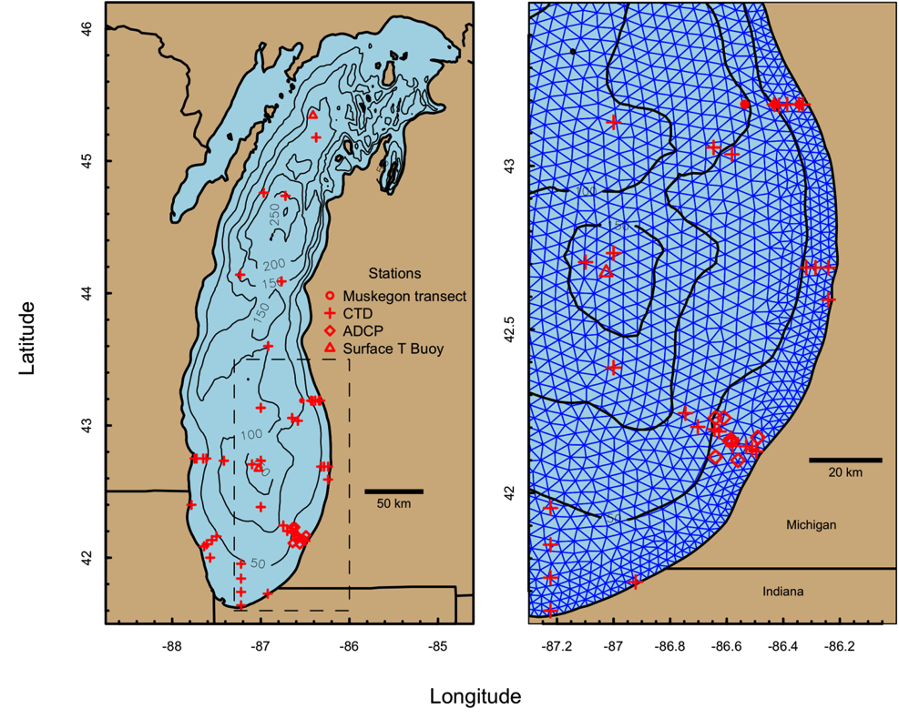
EcoDyn | Biophysical Modeling
Lake Michigan FVCOM was skill assessed for biophysical modeling
Interpolated meteorological forcing resulted in greater skill compared to North American Regional Reanalysis (NARR)
Currents
Temperature
Spatial extent and duration of summer and winter stratification
Enlarged area
M.D. Rowe, E.J. Anderson, J. Wang, H.A. Vanderploeg. 2015. J. Great Lakes Research, 41(S3):49-65
8/15
Notes:
We conducted a skill assessment of a Lake Michigan FVCOM unstructured grid hydrodynamic model,
paying particular attention to the ecologically significant winter to summer transition period,
and including nearshore and offshore observations.
We found that interpolated meteorological forcing resulted in greater skill than NARR forcing for currents, temperature,
and the spatial extent and during of summer and winter stratification, which have a strong influence on phytoplankton model simulations.
M.D. Rowe, E.J. Anderson, J. Wang, H.A. Vanderploeg. 2015. J. Great Lakes Research, 41(S3):49-65

Slide 10
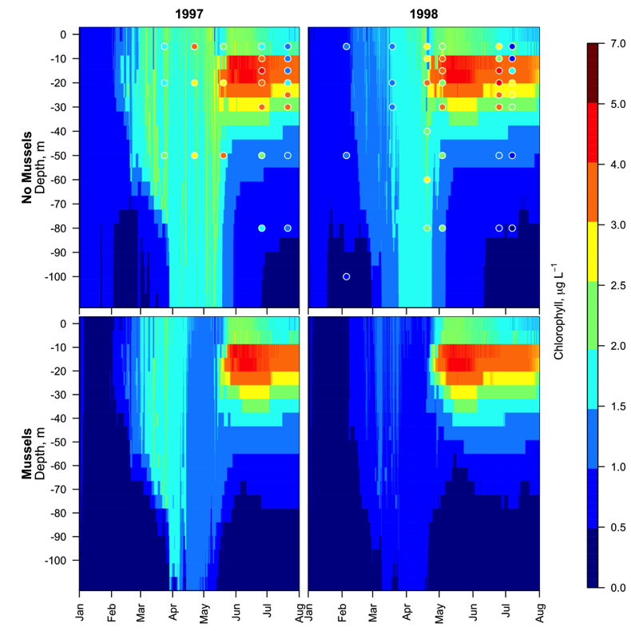
EcoDyn | Biophysical Modeling
Quagga mussels have greater impact on Lake Michigan spring bloom under warm spring climate scenario
Cool spring Warm spring
Warm and cool climate meteorological scenarios
Measured quagga mussel clearance rates
3-D hydrodynamic model (FVCOM)
vertical mixing
Mussels No mussels
1-D phytoplankton - quagga mussel model
M.D. Rowe, E.J. Anderson, J. Wang, H.A. Vanderploeg. 2015. J. Great Lakes Research, 41(S3):49-65
9/15
Notes:
In the same paper, we showed that quagga mussels can have greater impact on the Lake Michigan spring phytoplankton bloom under a warm spring climate scenario.
We combined warm and cool climate meteorological scenarios, quagga mussel clearance rates measured by EcoDyn, and a 1D phytoplankton-quagga mussel model with realistic vertical mixing from the 3D hydrodynamic model.

Slide 11
EcoDyn | Biophysical Modeling
Quagga mussels have greater impact on Lake Michigan spring bloom under warm spring climate scenario
Cool spring Warm spring
Warm and cool climate meteorological scenarios
Measured quagga mussel clearance rates
3-D hydrodynamic model (FVCOM)
vertical mixing
Mussels No mussels
1-D phytoplankton - quagga mussel model
M.D. Rowe, E.J. Anderson, J. Wang, H.A. Vanderploeg. 2015. J. Great Lakes Research, 41(S3):49-65
9/15
Notes:
We found that the cold-spring scenario (1997) led to greater winter stratification in March and early April than the warm spring scenario (1998).
The maximum density of freshwater is at 4 C.
Winter stratification occurs when surface water cools below 4 C, resulting in colder (less dense) water floating on warmer water.
Winter stratification enhanced the early spring phytoplankton bloom through two mechanisms
Limited mixed layer depth reduced light limitation, and stimulated phytoplankton growth
Reduced vertical mixing limited transport of phytoplankton from the euphotic zone to mussels on the bottom.
The first mechanism was seen in observations from the Muskegon transect Long Term Research program data (colored circles in the figure, also see paper).
The second mechanism was shown in a model sensitivity simulation that included quagga mussel filter feeding.
M.D. Rowe, E.J. Anderson, J. Wang, H.A. Vanderploeg. 2015. J. Great Lakes Research, 41(S3):49-65

Slide 12
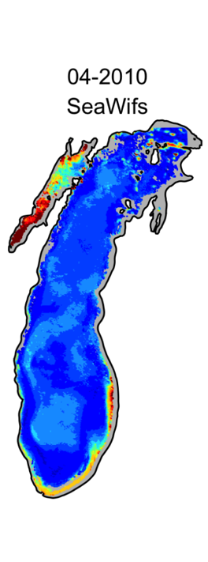
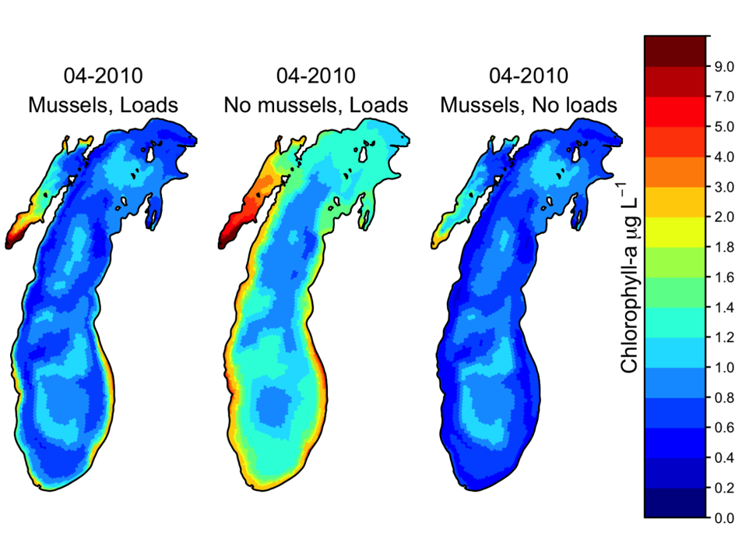
EcoDyn | Biophysical Modeling
Separating the effects of quagga mussels and nutrient loads on Lake Michigan chlorophyll
April 2010 Lake Michigan Chlorophyll concentration, μg/L
Satellite | 3D Biophysical model
Effect of dreissenid mussels
Effect of phosphorus loads
10/15
Notes:
As a further ecological application of the Lake Michigan unstructured grid hydrodynamic model, we developed a 3D biophysical model.
in order to separate the effects of quagga mussels and declining phosphorus concentrations on the spatial distribution of chlorophyll.
Spring total phosphorus concentrations have declined over the same period that quagga mussels invaded Lake Michigan, so there has been some controversy regarding to what extent declining chlorophyll is due to benthic filter feeders versus declining nutrient availability.
To explore this question, we ran the biophysical model with and without mussels and nutrient loads.

Slide 13
EcoDyn | Biophysical Modeling
Separating the effects of quagga mussels and nutrient loads on Lake Michigan chlorophyll
April 2010 Lake Michigan Chlorophyll concentration, μg/L
Satellite | 3D Biophysical model
Effect of dreissenid mussels
Effect of phosphorus loads
10/15
Notes:
The map on the left shows observed mean April chlorophyll in 2010 from SeaWiFS OC4 satellite retrieval.

Slide 14
EcoDyn | Biophysical Modeling
Separating the effects of quagga mussels and nutrient loads on Lake Michigan chlorophyll
April 2010 Lake Michigan Chlorophyll concentration, μg/L
Satellite | 3D Biophysical model
Effect of dreissenid mussels
Effect of phosphorus loads
10/15
Notes:
The map in the middle shows the historical model simulation with mussels and nutrient loads,
which produced low chlorophyll in mid-depth regions where filter feeding intensity is high, similar what was observed in the satellite imagery.

Slide 15
EcoDyn | Biophysical Modeling
Separating the effects of quagga mussels and nutrient loads on Lake Michigan chlorophyll
April 2010 Lake Michigan Chlorophyll concentration, μg/L
Satellite | 3D Biophysical model
Effect of dreissenid mussels
Effect of phosphorus loads
10/15
Notes:
The map in the middle shows the historical model simulation with mussels and nutrient loads,
which produced low chlorophyll in mid-depth regions where filter feeding intensity is high, similar what was observed in the satellite imagery.

Slide 16
EcoDyn | Biophysical Modeling
Separating the effects of quagga mussels and nutrient loads on Lake Michigan chlorophyll
April 2010 Lake Michigan Chlorophyll concentration, μg/L
Satellite | 3D Biophysical model
Effect of dreissenid mussels
Effect of phosphorus loads
10/15
Notes:
The simulation without mussels shows a spatial distribution of chlorophyll similar to the pre-mussel spring bloom with high chlorophyll in mid-depth regions, even though spring total phosphorus concentrations declined in the post-invasion period.

Slide 17
EcoDyn | Biophysical Modeling
Separating the effects of quagga mussels and nutrient loads on Lake Michigan chlorophyll
April 2010 Lake Michigan Chlorophyll concentration, μg/L
Satellite | 3D Biophysical model
Effect of dreissenid mussels
Effect of phosphorus loads
10/15
Notes:
Finally, the simulation without tributary phosphorus loads shows that phosphorus loads maintain higher productivity in the nearshore, even in the presence of deep-water quagga mussels.
Nearshore productivity has provided an increasingly important resource to the food web now that offshore productivity is so low.

Slide 18
EcoDyn | Biophysical Modeling
How can we use hydrodynamic forecasts to provide early warning of changing source water quality for public water systems due to HABs and hypoxia?
11/15
Notes:
I will move on to give some examples of recent and proposed work in Lake Erie

Slide 19
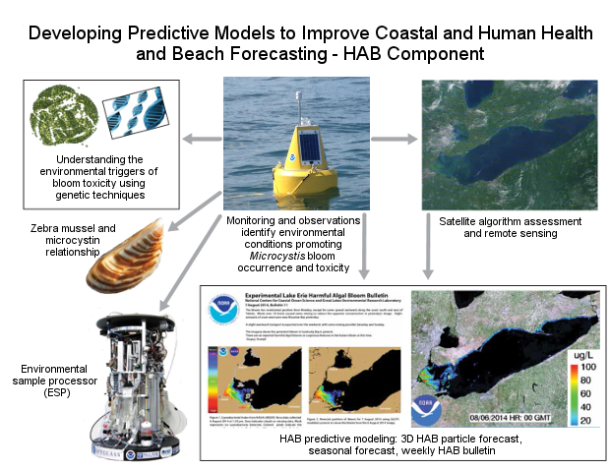
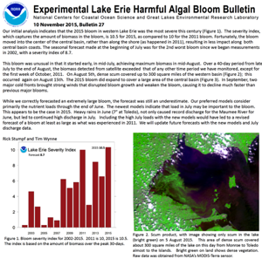
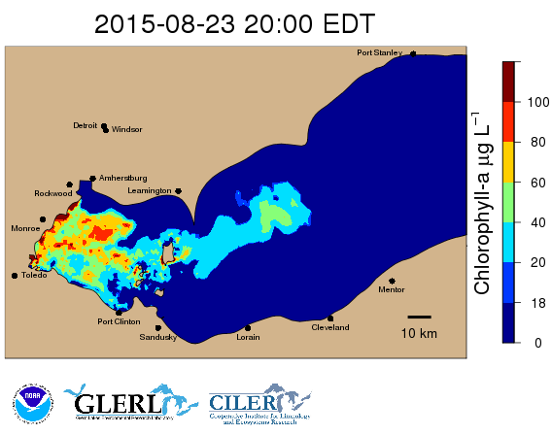
EcoDyn | Harmful Algal Blooms
An integrated approach to studying HABs
Notes:
As part of GLERL’s HAB program that Tim Davis described earlier,
GLERL collaborates with NCCOS to provide a nowcast and forecast for HABs in Lake Erie.

Slide 20
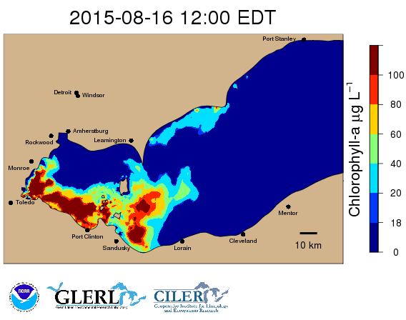
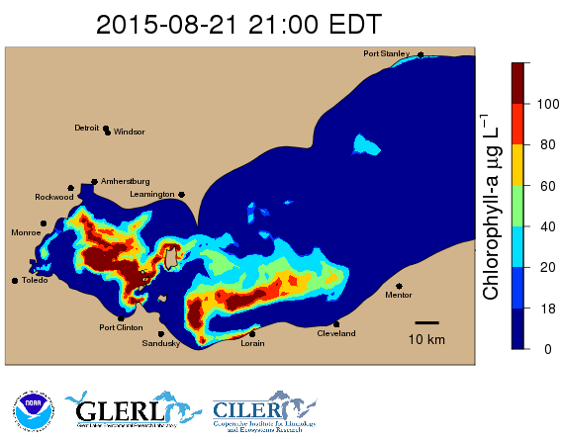
EcoDyn | Biophysical Modeling
GLERL provides a nowcast/forecast of harmful algal bloom distribution in Lake Erie: HAB Tracker
Nowcast
Five-day forecast
Initialize bloom location and intensity in a Lagrangian particle tracking model based on satellite remote sensing imagery
Five-day forecast of bloom intensity and location based on
Forecast meteorology
Currents from a hydrodynamic model
Lagrangian particle tracking model
12/15
Notes:
The nowcast is initialized from a satellite retrieval.
The OSAT group and CILER provided satellite retrievals for the first research versions of the HAB Tracker.
In 2015, HAB Tracker transitioned to use the cyanobacterial index retrieval from NCCOS for consistency with the HAB Bulletin.
Forecast is based on
Forecast meteorology
Currents from a hydrodynamic model
Lagrangian particle tracking model
In August 2014, the City of Toledo detected the cyanobacterial toxin microcystin in their treated water, and issued a “do not drink” order that affected a half million people for two days, and received international attention.
After the Toledo water crisis NOAA’s Lake Erie HAB information products, including the HAB Tracker nowcast/forecast, have received increased attention from regional stakeholders.

Slide 21
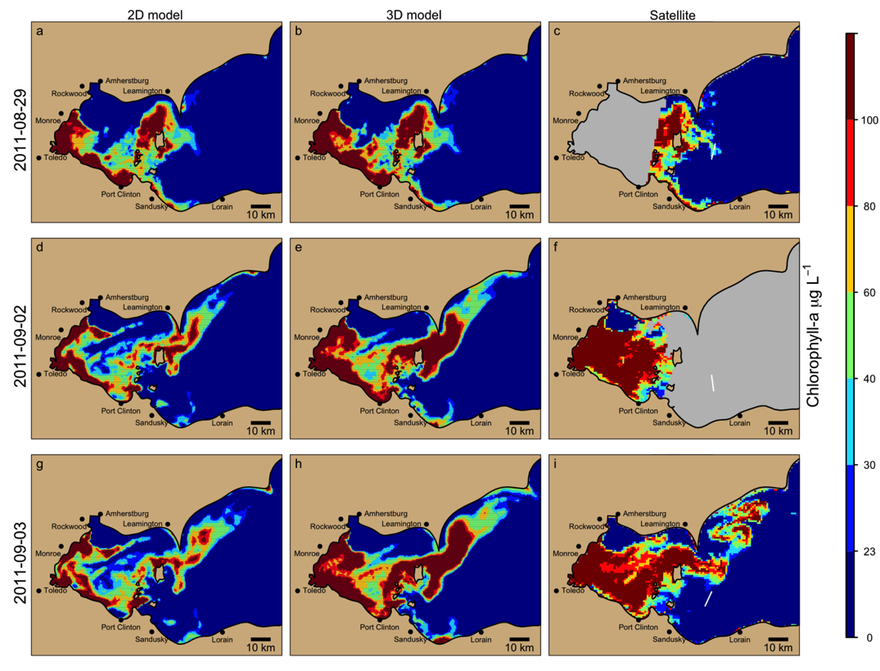
EcoDyn | Biophysical Modeling
Improved model for short term forecast of Lake Erie HABs including vertical mixing of buoyant Microcystis
2D simulation
3D simulation
Satellite observed
Model initialized
Day 4
Day 5
M.D. Rowe, E.J. Anderson, T. T. Wynne, R. P. Stumpf, D. L. Fanslow, K. Kijanka, H. A. Vanderploeg, T. W. Davis. J. Geophysical Research, submitted
13/15
Notes:
We developed an improved model for short term forecasts of Lake Erie HABs that includes vertical mixing of buoyant Microcystis colonies, using field and laboratory data from the EcoDyn group.

Slide 22
EcoDyn | Biophysical Modeling
Improved model for short term forecast of Lake Erie HABs including vertical mixing of buoyant Microcystis
2D simulation
3D simulation
Satellite observed
Model initialized
Day 4
Day 5
M.D. Rowe, E.J. Anderson, T. T. Wynne, R. P. Stumpf, D. L. Fanslow, K. Kijanka, H. A. Vanderploeg, T. W. Davis. J. Geophysical Research, submitted
13/15
Notes:
This figure shows hindcast simulations from 2011 with the 2D model that assumes HABs are always on the surface,
As in the current version of the HAB Tracker forecast model.

Slide 23
EcoDyn | Biophysical Modeling
Improved model for short term forecast of Lake Erie HABs including vertical mixing of buoyant Microcystis
2D simulation
3D simulation
Satellite observed
Model initialized
Day 4
Day 5
M.D. Rowe, E.J. Anderson, T. T. Wynne, R. P. Stumpf, D. L. Fanslow, K. Kijanka, H. A. Vanderploeg, T. W. Davis. J. Geophysical Research, submitted
13/15
Notes:
The 3D model includes estimated vertical distribution of buoyant HAB as a function of vertical mixing from the LEOFS model.
Particles are assigned a floating velocity by sampling from a frequency distribution of floating velocity,
which was developed from measured size distribution and buoyant velocities by the EcoDyn group.

Slide 24
EcoDyn | Biophysical Modeling
Improved model for short term forecast of Lake Erie HABs including vertical mixing of buoyant Microcystis
2D simulation
3D simulation
Satellite observed
Model initialized
Day 4
Day 5
M.D. Rowe, E.J. Anderson, T. T. Wynne, R. P. Stumpf, D. L. Fanslow, K. Kijanka, H. A. Vanderploeg, T. W. Davis. J. Geophysical Research, submitted
13/15
Notes:
This hindcast simulation was initialized using the partial satellite image in the upper right.
To initialize the model in areas where satellite data were missing, the HAB distribution in the western basin was carried forward from a previous model run.
This method provides a complete nowcast estimate of the HAB distribution in the presence of missing satellite data.

Slide 25
EcoDyn | Biophysical Modeling
Improved model for short term forecast of Lake Erie HABs including vertical mixing of buoyant Microcystis
2D simulation
3D simulation
Satellite observed
Model initialized
Day 4
Day 5
M.D. Rowe, E.J. Anderson, T. T. Wynne, R. P. Stumpf, D. L. Fanslow, K. Kijanka, H. A. Vanderploeg, T. W. Davis. J. Geophysical Research, submitted
13/15
Notes:
On day 4, both models simulated a major advection event that carried HABs into the central basin, which was confirmed in the satellite image on Day 5.
The 3D model better simulated the spatial distribution of HAB in the western basin on day 5.
We showed a statistically significant improvement in skill statistics for the 3D model, compared to the 2D model,
in a series of 26 hindcast simulations from the record 2011 HAB season, which is documented in this manuscript that was submitted to the Journal of Geophysical Research.
Some of these improvements were included in the 2015 real-time model that was available to the public through the GLERL website, and the full 3D model will be used in the 2016 season.

Slide 26
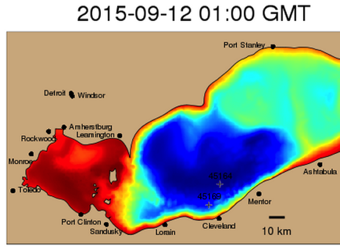
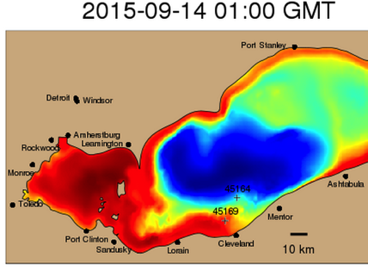
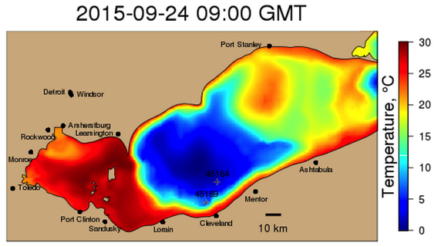
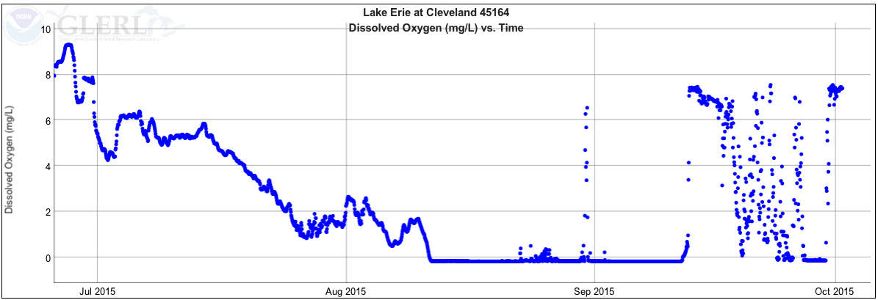
EcoDyn | Biophysical Modeling
Future work: Proposed hypoxia forecast model for
Lake Erie public water systems
Cleveland
early warning real-time buoy
Bottom dissolved oxygen, mg L⁻¹
14/15
Notes:
Moving on to future work, GLERL and CILER collaborated on a proposal to develop a hypoxia forecast model for Lake Erie public water systems.

Slide 27
EcoDyn | Biophysical Modeling
Future work: Proposed hypoxia forecast model for
Lake Erie public water systems
Cleveland
early warning real-time buoy
Bottom dissolved oxygen, mg L⁻¹
14/15
Notes:
In 2015, we included these animations of forecast Lake Erie bottom water temperature from the LEOFS model on GLERL’s Hypoxia Warning System website. This series of graphics illustrates dynamic movement of the hypolimnion that causes variable source water quality at public water system intakes along the Erie shoreline,

Slide 28
EcoDyn | Biophysical Modeling
Future work: Proposed hypoxia forecast model for
Lake Erie public water systems
Cleveland
early warning real-time buoy
Bottom dissolved oxygen, mg L⁻¹
14/15
Notes:
as indicated by this time series of bottom water dissolved oxygen from the early-warning buoy installed offshore of Cleveland by the OSAT branch.

Slide 29
EcoDyn | Biophysical Modeling
Future work: Proposed hypoxia forecast model for
Lake Erie public water systems
Cleveland
early warning real-time buoy
Bottom dissolved oxygen, mg L⁻¹
14/15
Notes:
On September 12, there was cold, hypoxic, hypolimnetic water at the buoy location.
The cold bottom water is indicated in blue in the temperature color bar scale on these maps.
When hypoxia occurs, it is associated with the cold water of the hypolimnion.
These maps show temperature, not hypoxia, but short-term dynamics of hypoxia are often driven by movement of the cold water of the hypolimnion.

Slide 30
EcoDyn | Biophysical Modeling
Future work: Proposed hypoxia forecast model for
Lake Erie public water systems
Cleveland
early warning real-time buoy
Bottom dissolved oxygen, mg L⁻¹
14/15
Notes:
A wind event on September 13 caused downwelling of warm, oxygenated epilimnetic water to the bottom.

Slide 31
EcoDyn | Biophysical Modeling
Future work: Proposed hypoxia forecast model for
Lake Erie public water systems
Cleveland
early warning real-time buoy
Bottom dissolved oxygen, mg L⁻¹
14/15
Notes:
The hypolimnion later oscillated back and caused a return of hypoxia at the buoy location.
A hypoxia forecast model would provide advance warning to public water systems of lake dynamics that are likely to bring changing source water quality to their intakes.

Slide 32
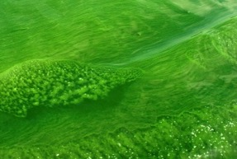
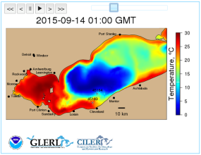
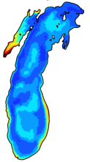
EcoDyn | Biophysical Modeling
Future work: GLERL’s draft strategic plan
Milestones related to biophysical modeling
Improved representation of Microcystis buoyancy and growth in Lake Erie HAB Tracker model
Customers:
Public water systems, anglers, beach users, recreational boaters
Develop a Lake Erie hypoxia model for nowcast/forecast and scenario-based simulations
Customers:
Public water systems, anglers, fisheries managers, USEPA (nutrient management)
Develop nearshore-resolving water quality and lower food web models for Lakes Michigan and Erie
Customers:
USEPA (nutrient management), fisheries managers
15/15
Notes:
I’ll wrap up by mentioning some milestones in GLERL’s draft strategic plan related to biophysical modeling.

Slide 33
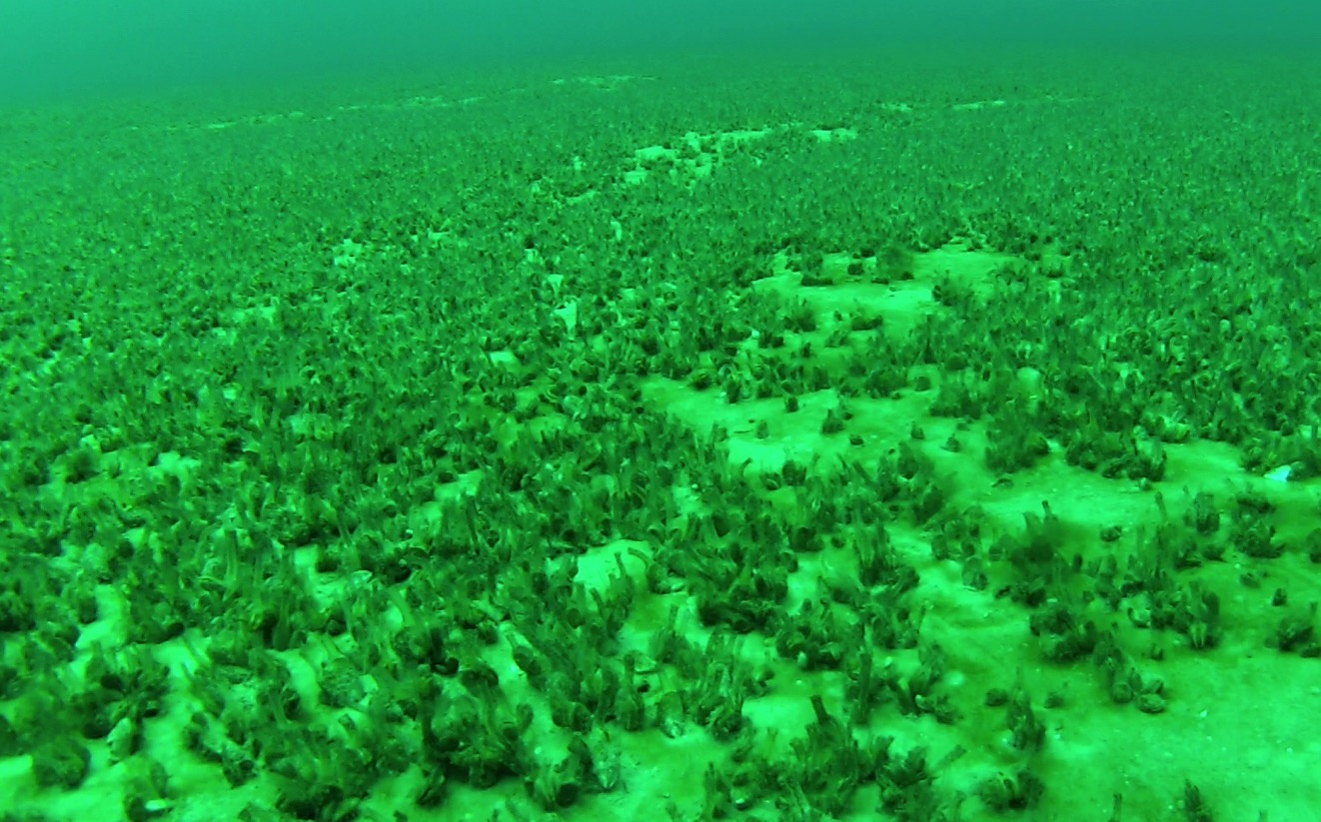
EcoDyn | Biophysical Modeling
Questions?
Place Photo Here
Quagga mussels in Lake Michigan: Steve Ruberg, NOAA GLERL
15/15

