Slide 1
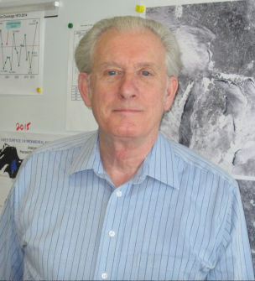
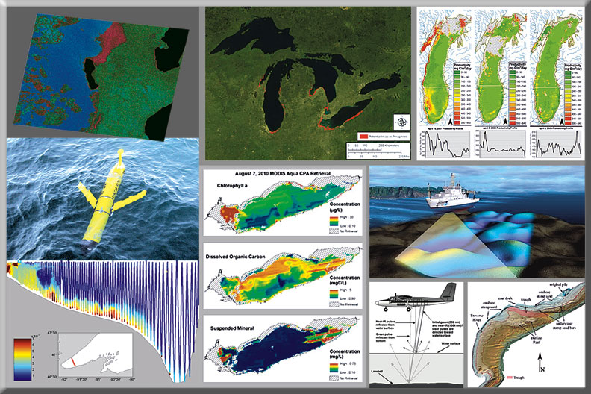
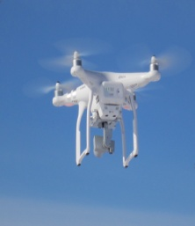
CoastWatch Satellite Research & Product Development
George Leshkevich
Observing Systems & Advanced Technology
Place Photo Here
1/15
Notes:
Illustrations include (left to right) satellite SAR ice type classification, phragmites mapping, primary productivity, UAS in situ measurements, satellite color producing agent (CPA) retrievals, ship-based sonar measurements, airborne lidar measurements.
This work aligns with the following NOAA Goals:
Science: Climate Adaptation and Mitigation
Improved scientific understanding of the changing climate system and its impacts
Science: Weather-Ready Nation
Improve freshwater resource management
Improve transportation efficiency and safety
Science: Healthy Oceans
Improved understanding of ecosystems to inform resource management decisions
Science: Resilient Coastal Communities and Economies
Comprehensive ocean and coastal planning and management
Safe, efficient and environmentally sound marine transportation
Improved coastal water quality supporting human health and coastal ecosystem services
Education: Science-Informed Society
Youth and adults from all backgrounds improve their understanding of NOAA-related sciences by participating in education and outreach opportunities
Formal and informal educators integrate NOAA-related sciences into their curricula, practices, and programs
Formal and informal education organizations integrate NOAA-related science content and collaborate with NOAA scientists on the development of exhibits, media, materials, and programs that support NOAA’s mission
Education: Organizational Excellence
NOAA develops and supports a coordinated portfolio of products, programs, and partnerships that improves education opportunities in NOAA-related content areas for underserved audiences

Slide 2
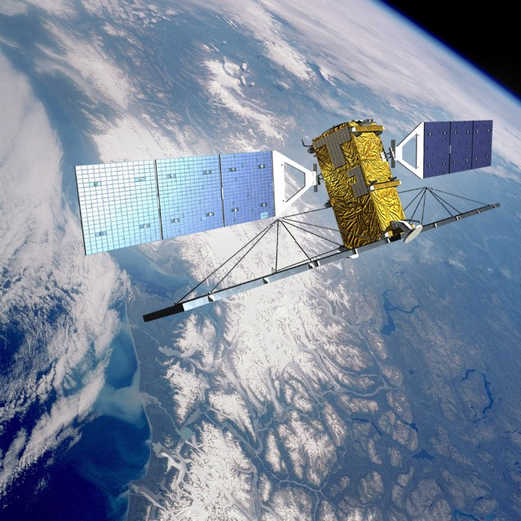
OSAT | CoastWatch Satellite Research & Product Development
Need for Great Lakes Satellite Research
Great Lakes specific algorithms are needed for satellite retrieval of key parameters owing to several factors:
Ocean algorithms often do not work well in time or space on the Great Lakes
Ocean algorithms often are not tuned to the parameters we need (eg. ice types)
Vast difference in resolution and spatial coverage needs
Freshwater vs. saltwater
2/15
Notes:
Radarsat-2

Slide 3
OSAT | CoastWatch Satellite Research & Product Development
Prototype Great Lakes Ice Type
Classification Product
Description of this work:
Development of Great Lakes specific algorithms to create image products from existing and new satellite and airborne sensors
3/15
Notes:
Currently transferring Great Lakes ice type classification algorithm to NOAA NESDIS for evaluation to produce operationally for the Great Lakes.

Slide 4
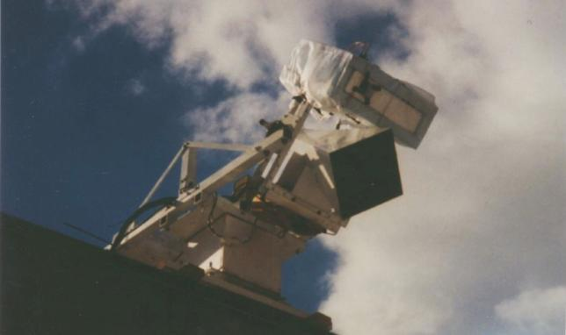
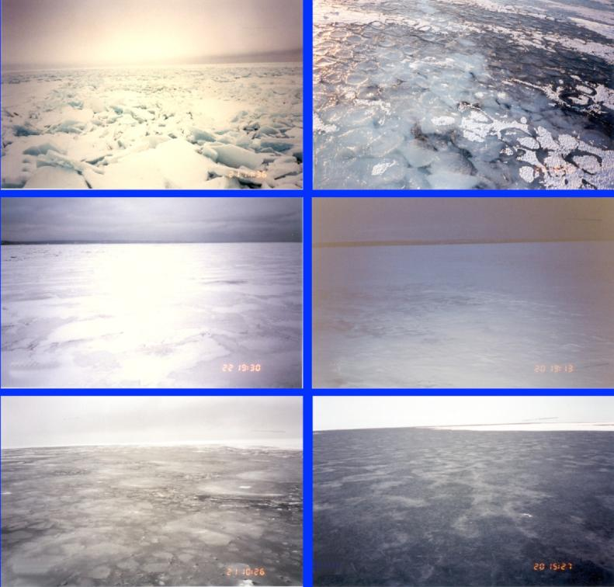
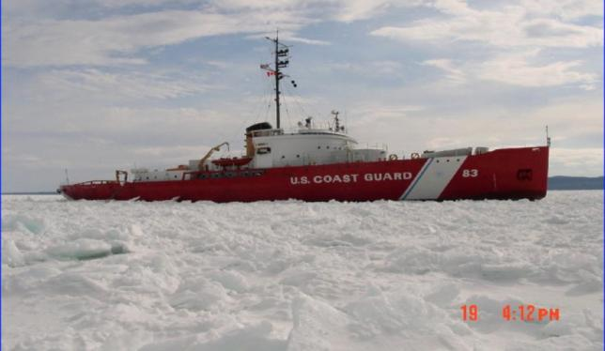
OSAT | CoastWatch Satellite Research & Product Development
Methodology for Great Lakes Ice Classification Prototype
Great Lakes Winter Experiment
Jet Propulsion Lab Scatterometer used on USCGC Mackinaw
Brash ice
Pancake ice
Patchy snow cover on snow ice over black ice
Black ice with patchy and rough snow cover
Rough consolidated ice floes
Black (Lake) ice
USCGC Mackinaw in Whitefish Bay
Library of backscatter signatures from different ice types on Lake Superior measured using Jet Propulsion Lab C-band scatterometer during Great Lakes Winter Experiment.
4/15

Slide 5
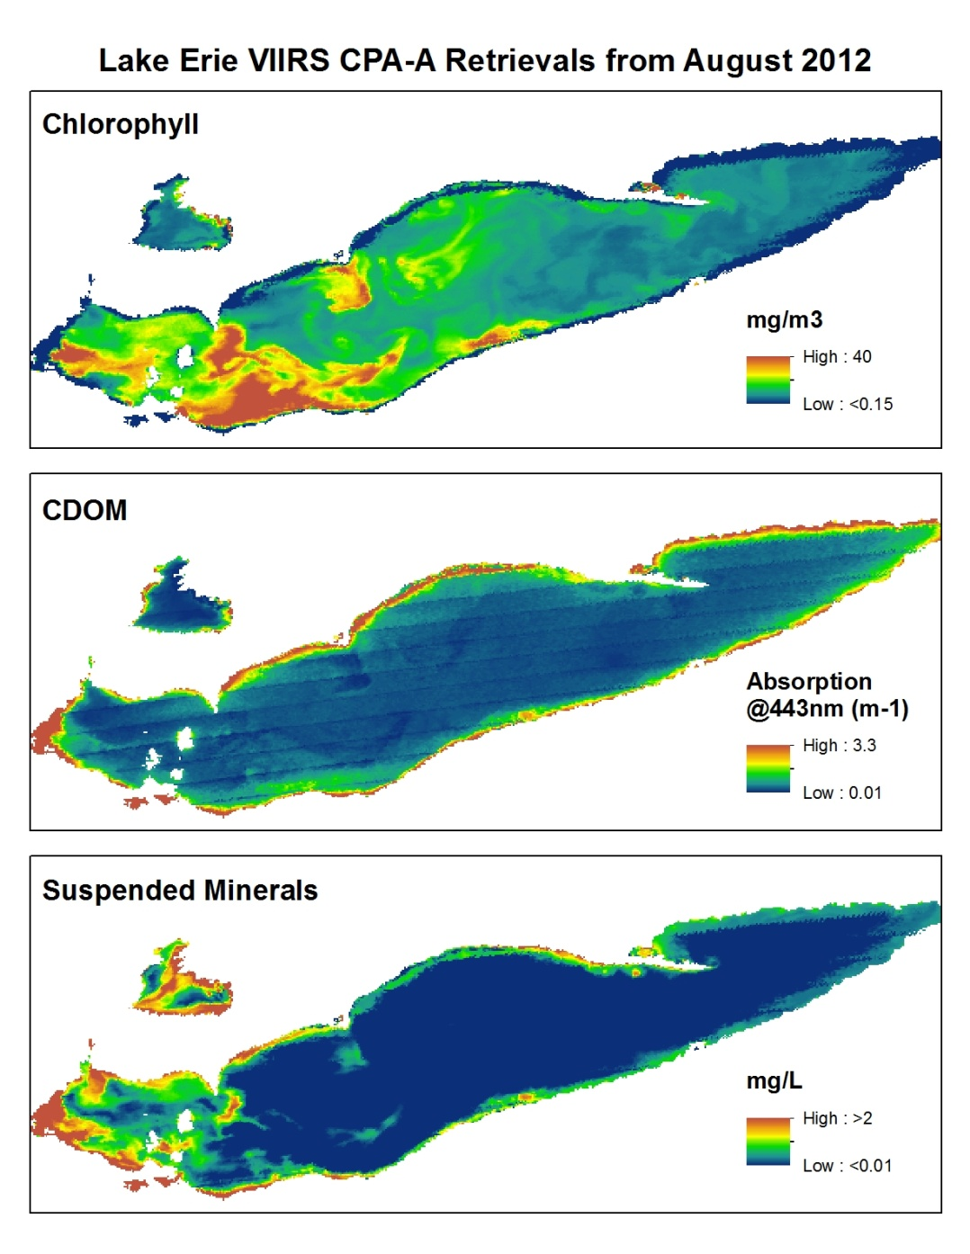
OSAT | CoastWatch Satellite Research & Product Development
Prototype for Great Lakes
Color Producing Agents Product
Key Scientific Drivers:
Can satellite and airborne remotely sensed data provide accurate, synoptic retrievals of key Great Lakes parameters?
5/15
Notes:
Chlorophyll retrieval ratioing algorithms found not to work well in the Great Lakes in time or space. Our CPA algorithm is based on hydro-optical models of the Great Lakes. The Visible Infrared Imaging Radiometer Suite (VIIRS) collects visible and infrared imagery and radiometric measurements of the land, atmosphere, cryosphere, and oceans. CDOM = color dissolved organic matter.

Slide 6
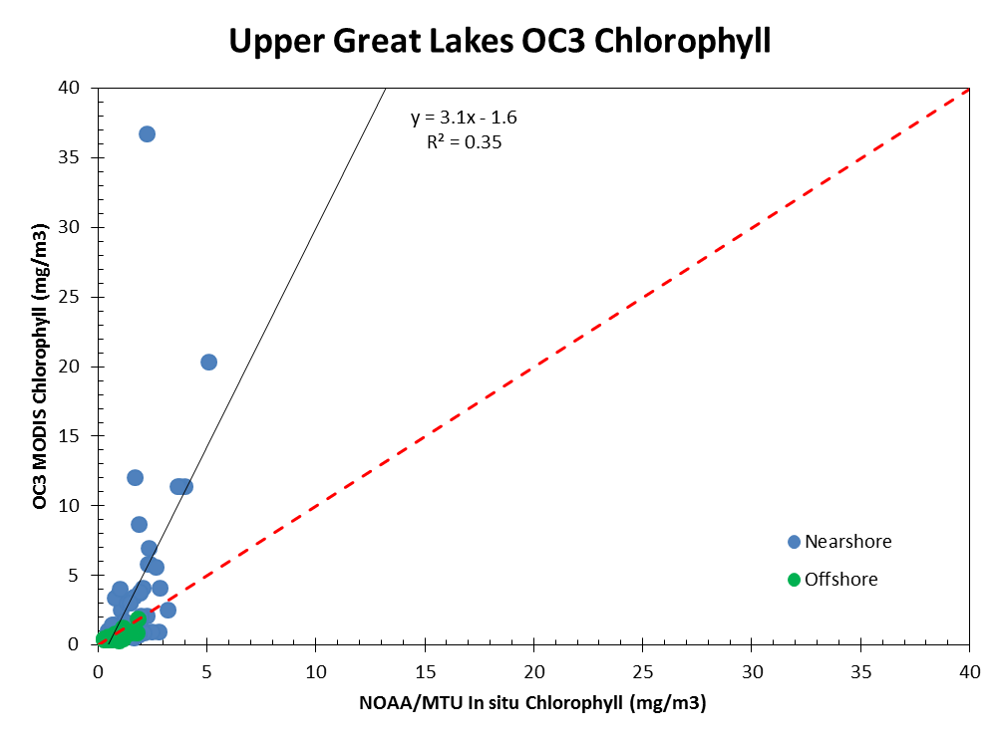
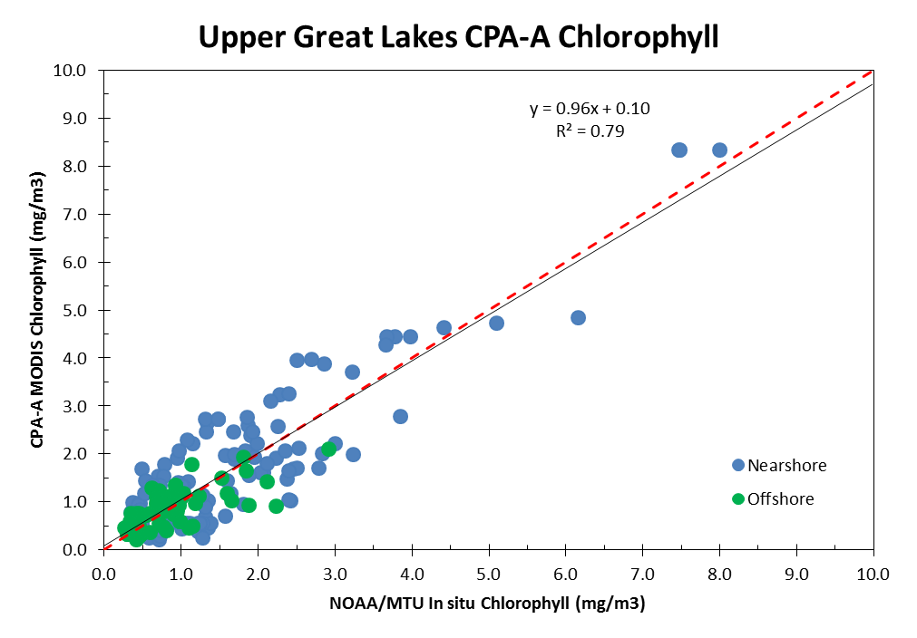
Comparison of OC3 Ratioing and CPA Algorithms (2009-2012)
OSAT | CoastWatch Satellite Research & Product Development
Ocean Color v3 (OC3 Ratioing)
Color Producing Agent (CPA)
Samples = 85
Samples = 156
CPA algorithm outperforms OC3 algorithm for chlorophyll retrieval
CPA algorithm can retrieve all three colorants concurrently
CPA algorithm outperforms other algorithms in optically complex waters
The two plots further confirm the supposition that ratioing chlorophyll retrieval approaches can work relatively well in open water areas of the Great Lakes but do not perform well in Lakes Erie, Ontario, or nearshore environments. (optically complex waters) waters
6/15
7/10
Notes:
These two plots summarize the performance of the completed CPA-A algorithm for the upper three Great Lakes (Lakes Superior, Michigan, Huron). The plot on the right utilized 156 independent in situ chlorophyll measurements compared to near simultaneous CPA-A chlorophyll retrievals (+/- 2 days). The plot indicates the robust performance of the CPA-A in both nearshore and offshore locations. The plot on the left is the NASA standard OC3 chlorophyll retrievals for the same dataset. Note the reduced performance of the OC3 and inability to successfully retrieve all 156 locations.
The two plots further confirm the supposition that standard chlorophyll retrieval approaches work relatively well in offshore areas of the Great Lakes but perform non-optimally in the nearshore environment.

Slide 7
OSAT | CoastWatch Satellite Research & Product Development
Latest Color Producing Agent Retrieval Algorithm Results
Great Lakes Water Quality Products Suite
July 2013 Monthly Average Products for Lake Michigan
7/15
Notes:
Currently transferring CPA algorithm to NOAA NESDIS for evaluation to produce operationally for the Great Lakes.

Slide 8
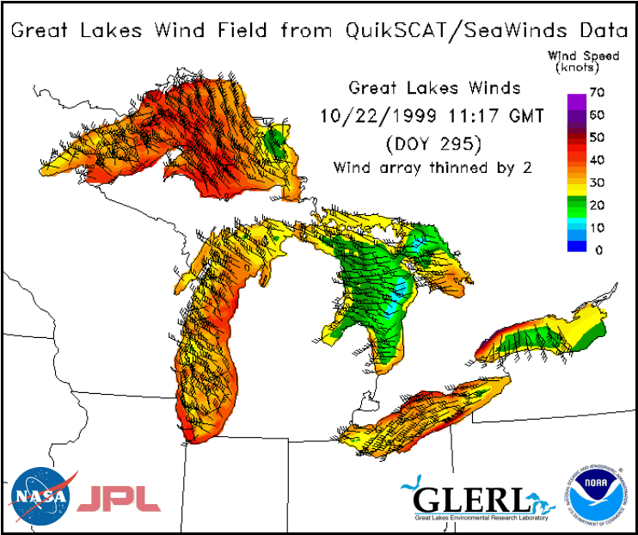
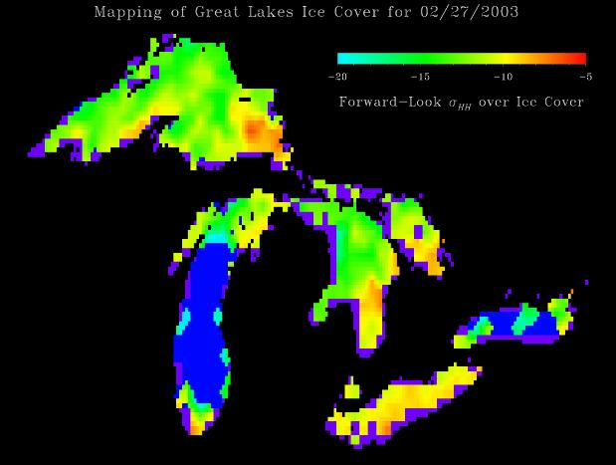
OSAT | CoastWatch Satellite Research & Product Development
Prototype of CoastWatch Great Lakes Scatterometer Wind and Ice Cover Products
What are the specific products and/or services resulting from this work?
Synthetic aperture radar (SAR) ice type classification and mapping
Satellite retrieval of chlorophyll, CDOM (DOC), and suspended mineral
Scatterometer ice mapping
High resolution scatterometer winds
Ice thickness mapping (airborne)
Early HAB detection (hyperspectral)
Upwelling detection / classification
Real-time ice reconnaisance (drone)
Prototype of Great Lakes wind-field product derived from Scatterometer Data
Mapping of Great Lakes Ice Cover for 02/27/2003
-20 -15 -10 -5
Forward –Look σ HH
over Ice Cover
Prototype of Scatterometer Ice Cover Product for the Great Lakes
8/15
Notes:
A radar scatterometer is designed to determine the normalized radar cross section (sigma-0) of the surface. Scatterometers operate by transmitting a pulse of microwave energy towards the Earth’s surface and measuring the reflected energy.

Slide 9
OSAT | CoastWatch Satellite Research & Product Development
Users of Great Lakes CoastWatch Products
Support GLERL internal research projects
Support operational mandates within NOAA and sister agencies
Support Regional users via the NOAA CoastWatch Great Lakes Node
- Environmental science
- Decision making
Supporting research
Support educational and recreational activities
Application to Climate Research
Application to Climate Research
Using scatterometer data, the dates of ice freeze-up and break-up can be determined – useful for regional climate change analysis
9/15

Slide 10
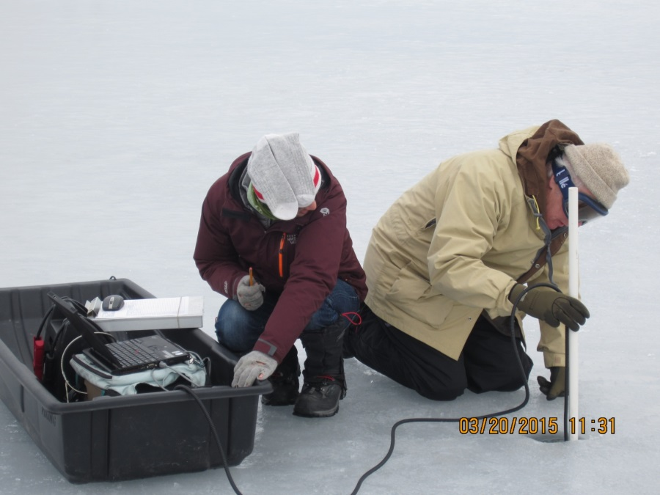
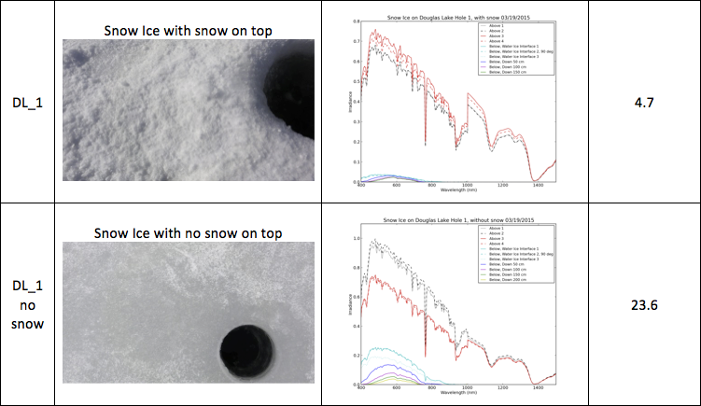
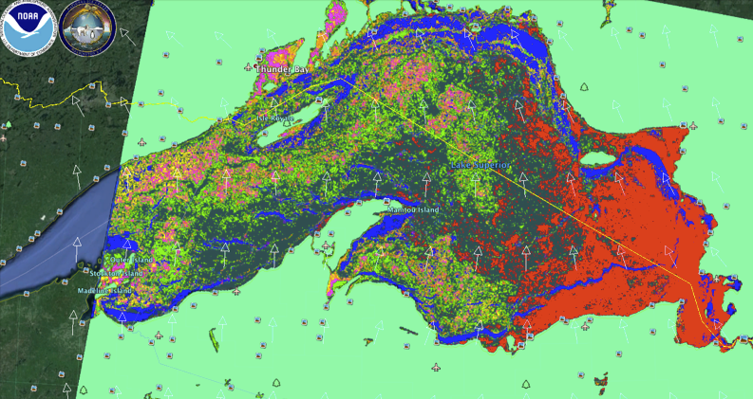
OSAT | CoastWatch Satellite Research & Product Development
Measuring Light Transmittance Through Ice Cover
Application to Under Ice Ecology (Winter Primary Productivity)
Light Attenuation Through Snow Ice on Lake Ice With and Without a Snow cover
0.8
Irradiance (Wm⁻² nm⁻¹)
0.0
400
Wavelength (nm)
1400
1.0
Irradiance (Wm⁻² nm⁻¹)
Lake Superior ice types - March 20, 2014 from RADARSAT-2 Ice type classification maps can be matched with average transmission loss for each ice type to produce maps of
lake-wide light transmission
0.0
400
Wavelength (nm)
1400
10/15

Slide 11
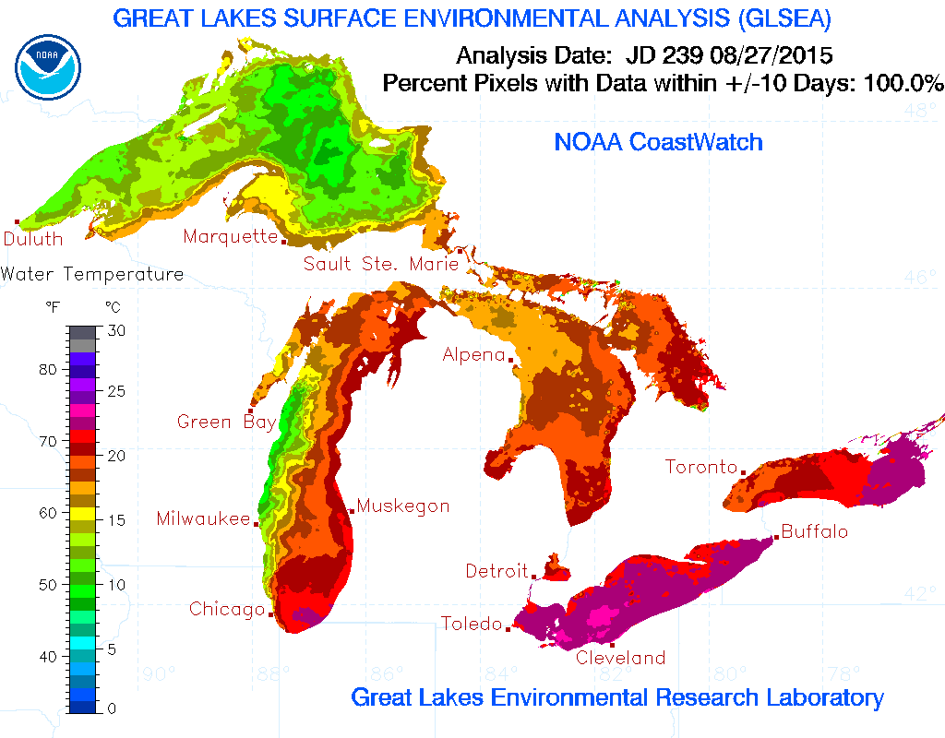
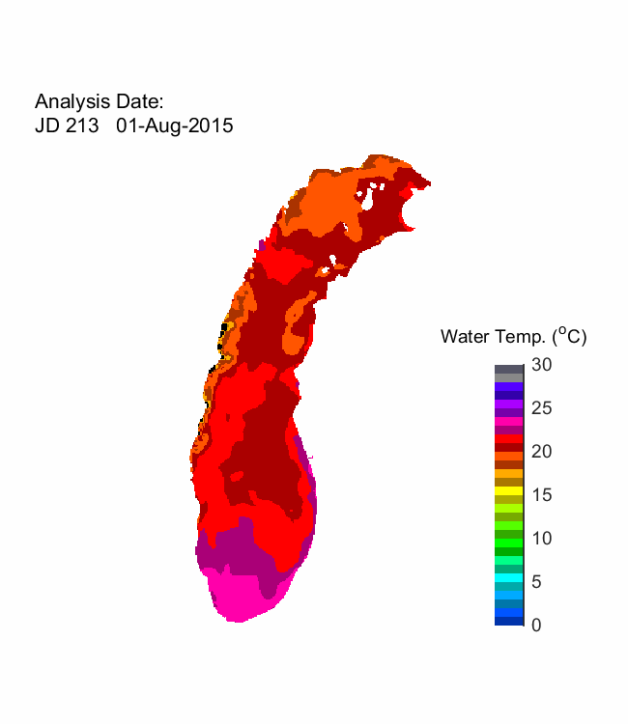
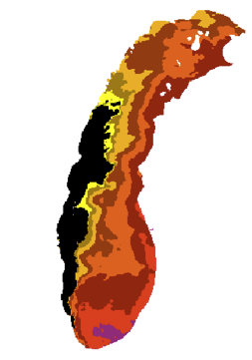
OSAT | CoastWatch Satellite Research & Product Development
Application to Fisheries Research Upwelling Product (Prototype)
Animation showing long lasting upwellings (area shown in black) during 2015. Note: upwelling movement from west to east side of Lake Michigan
Upwelling
11/15
Notes:
New upwelling classification algorithm for the Great Lakes can identify and map upwellings important to fisheries management and research

Slide 12
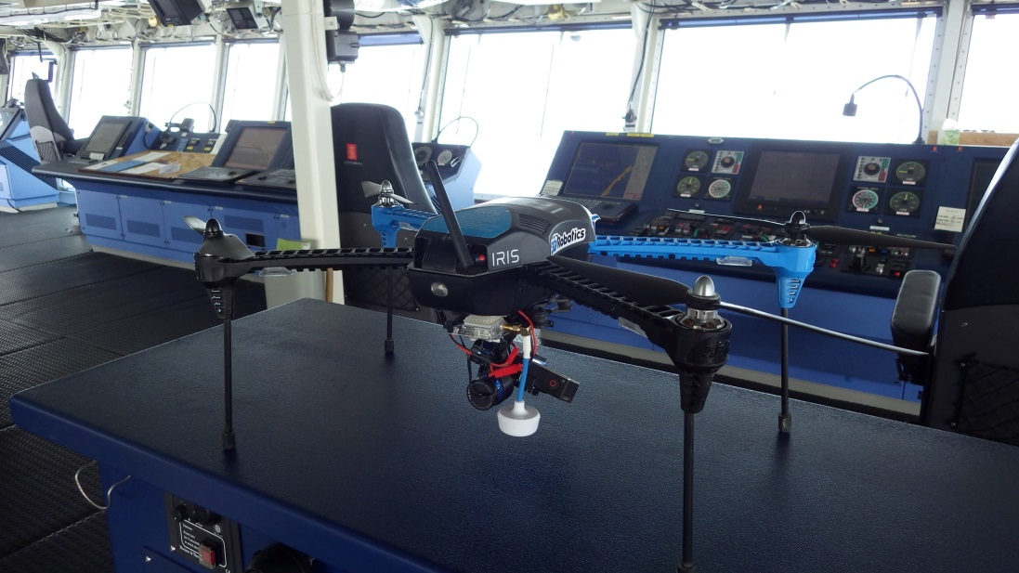
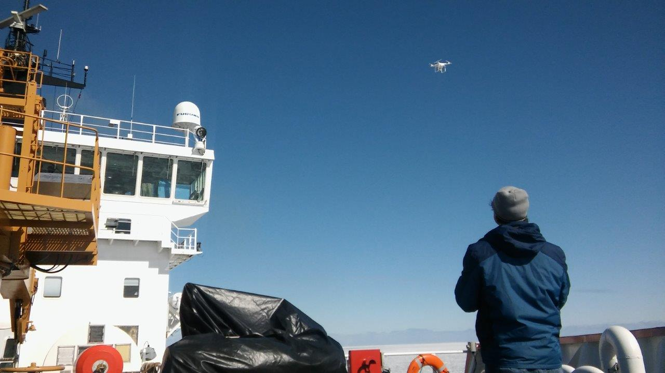
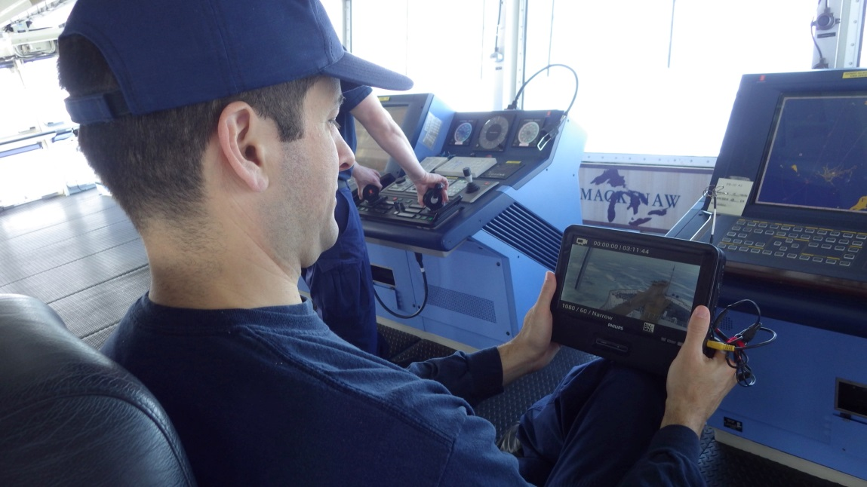
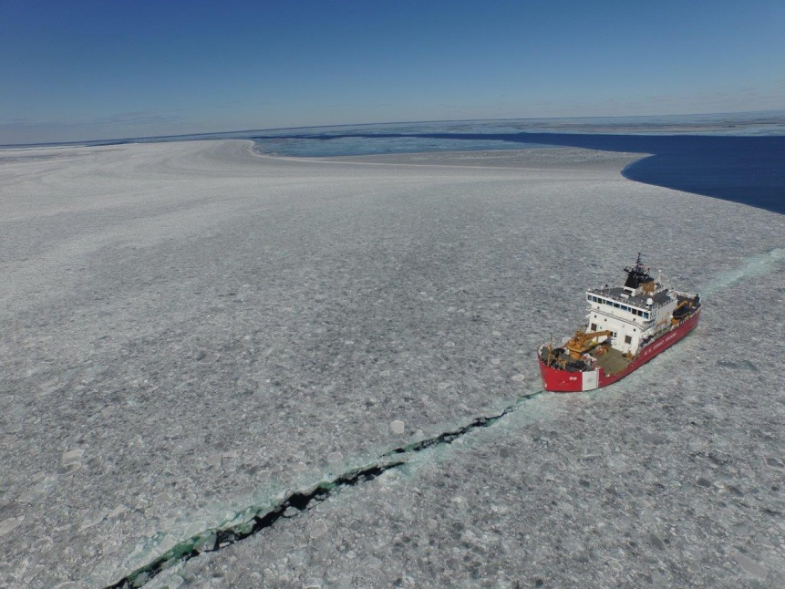
OSAT | CoastWatch Satellite Research & Product Development
Application of Drone for Real-time Ice Reconnaissance for Coast Guard Ice Breaking Operations
3D Robotics Quad-copter with Video Camera
Quad-copter Take off from USCGC Mackinaw
Captain viewing Video Monitor on Bridge
View of USCGC Mackinaw in Ice from Quad-copter
12/15
Notes:
At request of the Coast Guard, demonstration of drone (quad-copter) capability for real-time ice reconnaissance in support of Coast Guard ice breaking operations. Demonstration aboard the USCGC Mackinaw in the Straits of Mackinac and Green Bay during March 1-3, 2016. A video camera was used to send real-time imagery to the bridge of the USCGC Mackinaw. Other sensors, such as a ground penetrating radar (GPR) for transects of ice thickness, may be used depending on the size and capability of the drone.

Slide 13
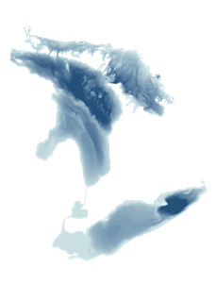
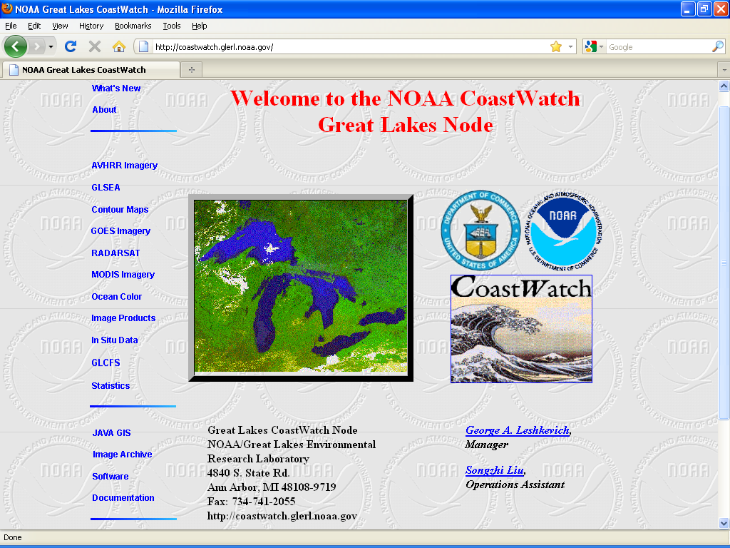
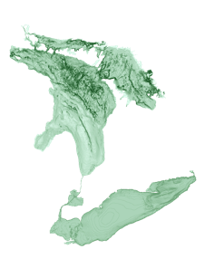
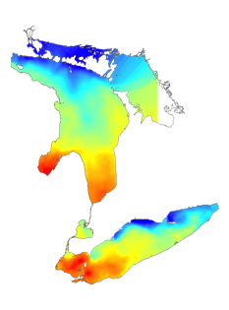
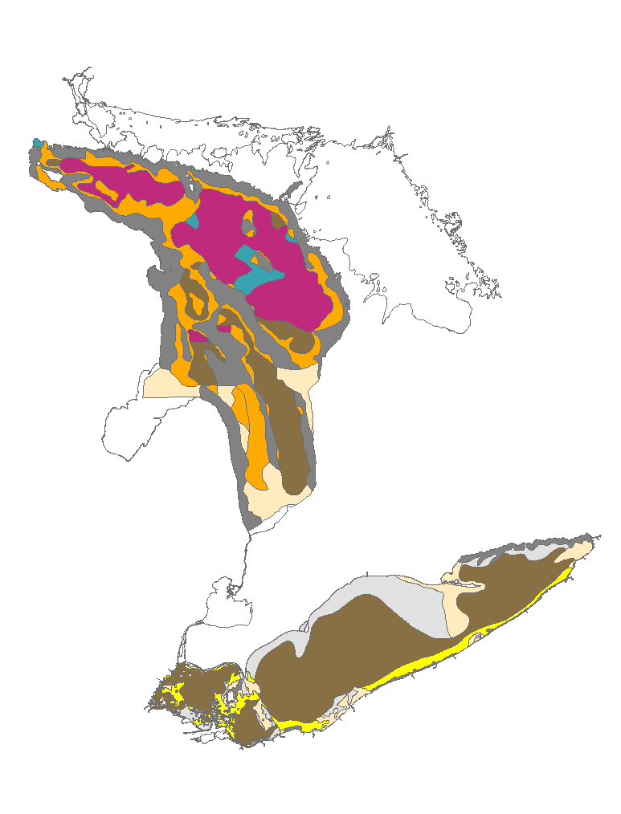
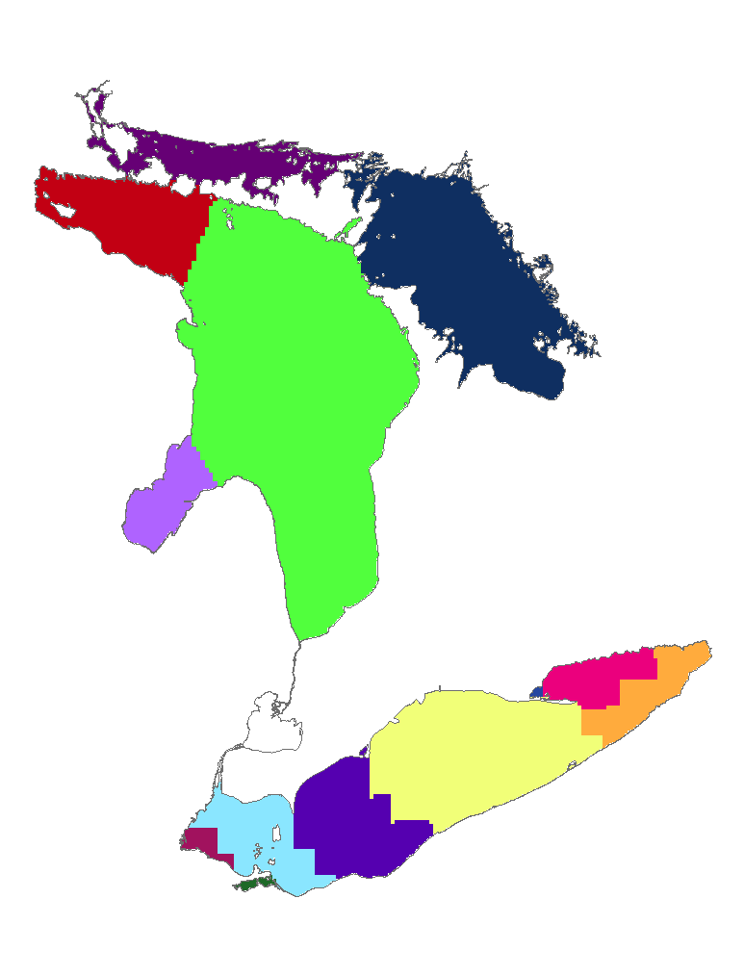
CoastWatch Great Lakes Home Page with Planned Decision Support Tool
OSAT | CoastWatch Satellite Research & Product Development
Future Work
Bathymetry
Slope
Temp
Substrate
Google Earth®
CoastWatch Great Lakes Website Domain
Decision Support
13/15

Slide 14
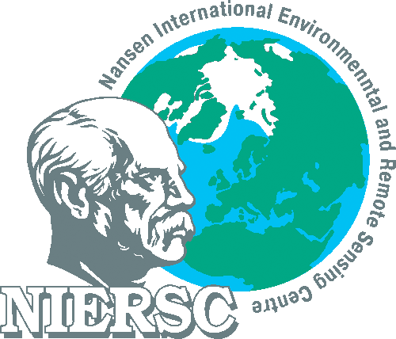
OSAT | CoastWatch Satellite Research & Product Development
Collaborators
National Aeronautics and Space Administration (NASA)
Goddard Space Flight Center
GLENN Research Center
Jet Propulsion Laboratory (JPL)
Michigan Tech Research Institute (MTRI)
Nansen International Environmental and Remote Sensing Center, St. Petersburg (NIERSC)
Upstate Freshwater Institute (UFI)
Cooperative Institute for Limnology and Ecosystem Research (CILER)
U.S. Coast Guard (USCG)
Canadian Coast Guard (CCG)
Environmental Protection Agency (EPA)
NOAA National Environmental Satellite, Data, and Information Service (NESDIS)
14/15

Slide 15
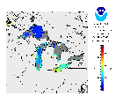
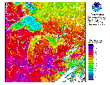
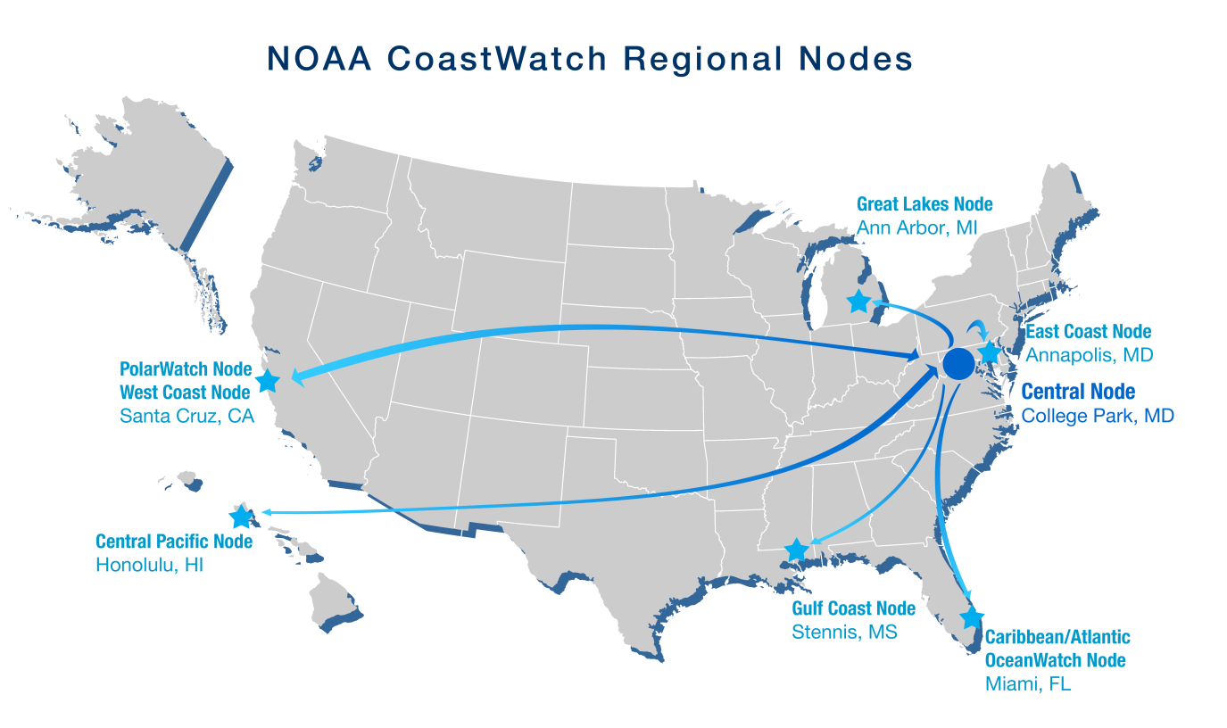
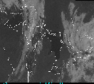
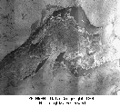
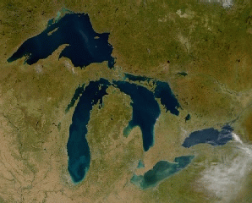
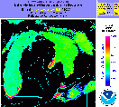
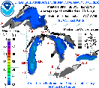
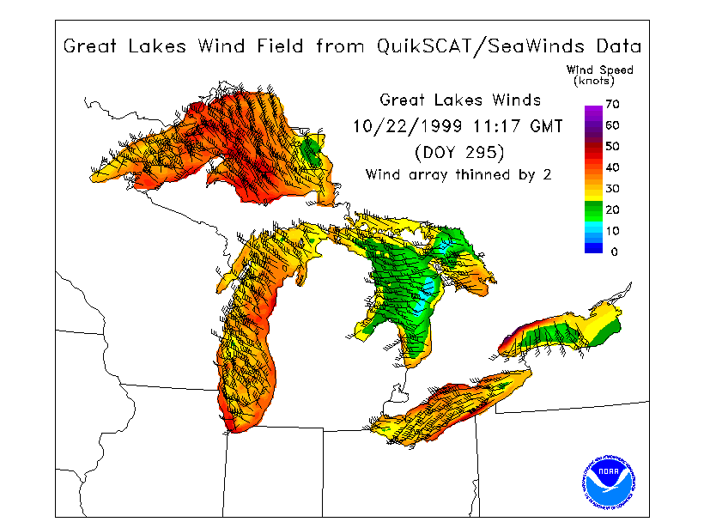
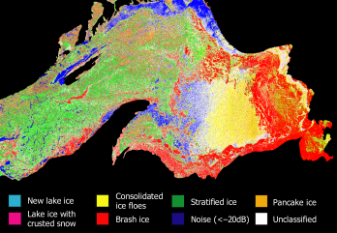
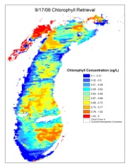
OSAT | CoastWatch Satellite Research & Product Development
Questions?
http://coastwatch.glerl.noaa.gov
Goes SST
CoastWatch Regional Nodes
AVHRR SST
VIIRS SST
Place Photo Here
Goes VIS/IR
RADARSAT
MODIS True Color
Turbidity
(Prototype)
(Prototype)
(Prototype)
GLSEA
Scatterometer Ice
(prototype)
Scatterometer Winds
(prototype)
SAR Ice
(prototype)
Chl, CDOM, Mineral
(prototype)
15/15

Slide 16
OSAT | CoastWatch Satellite Research & Product Development
Additional Information

