Slide 1
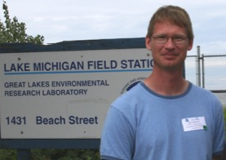
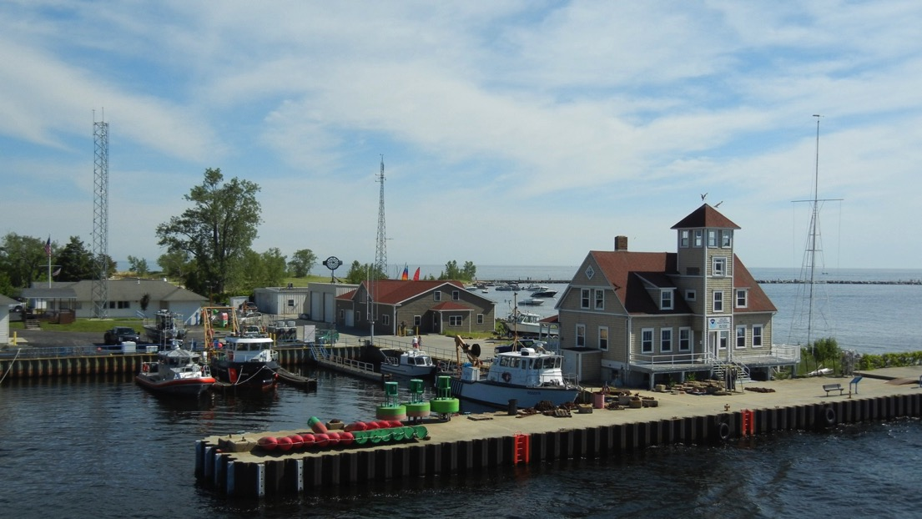
Core LTR Seasonal Nutrient, Plankton, & Fisheries Research Monitoring
Steven Pothoven
Ecosystem Dynamics
Place Photo Here
1/11
Notes:
The science for this program is based out of Muskegon at the Lake Michigan Field Station. The direct access to the lake provides for sampling flexibility to sample during events (e.g., spring flooding, upwelling) and to sample during short weather windows for the ships during certain times of the year.
This work aligns with the following NOAA goals:
Science: Weather-Ready Nation
Improve freshwater resource management
Science: Healthy Oceans
Improved understanding of ecosystems to inform resource management decisions
Sustainable fisheries and safe seafood for healthy populations and vibrant communities
Science: Resilient Coastal Communities and Economies
Comprehensive ocean and coastal planning and management
Education: Science-Informed Society
Youth and adults from all backgrounds improve their understanding of NOAA-related sciences by participating in education and outreach opportunities
Formal and informal educators integrate NOAA-related sciences into their curricula, practices, and programs
Formal and informal education organizations integrate NOAA-related science content and collaborate with NOAA scientists on the development of exhibits, media, materials, and programs that support NOAA’s mission

Slide 2
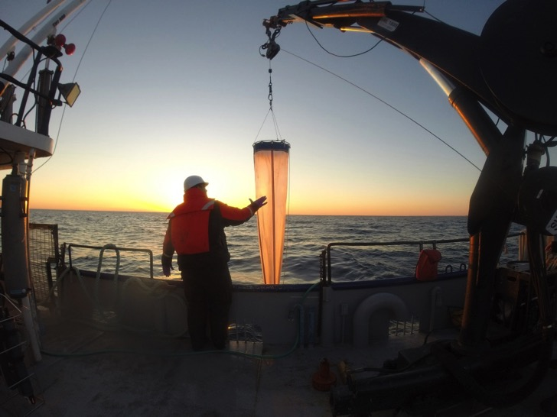
EcoDyn | Core LTR Seasonal Nutrient, Plankton, & Fisheries Research Monitoring
Program Goal
Document and understand long-term food web changes in response to various stressors
Document
Characterize critical state variables (observations)
Understand
Couple process research with the observations
Inputs to forecasting and ecological models
2/11

Slide 3
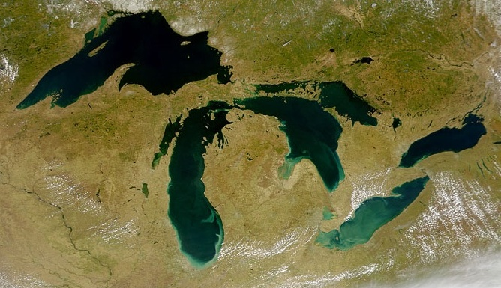
EcoDyn | Core LTR Seasonal Nutrient, Plankton, & Fisheries Research Monitoring
5th largest lake in the world
12 million people living in its watershed
Only Great Lake entirely within U.S. jurisdiction
Slide Text
Muskegon
Lake Michigan
Ann Arbor
4/10
Notes:
Long-term research program physically located on Lake Michigan
Addresses concepts and issues that reach beyond Lake Michigan
But given the importance and size of Lake Michigan, one could argue for the importance of studying Lake Michigan for its own sake.

Slide 4
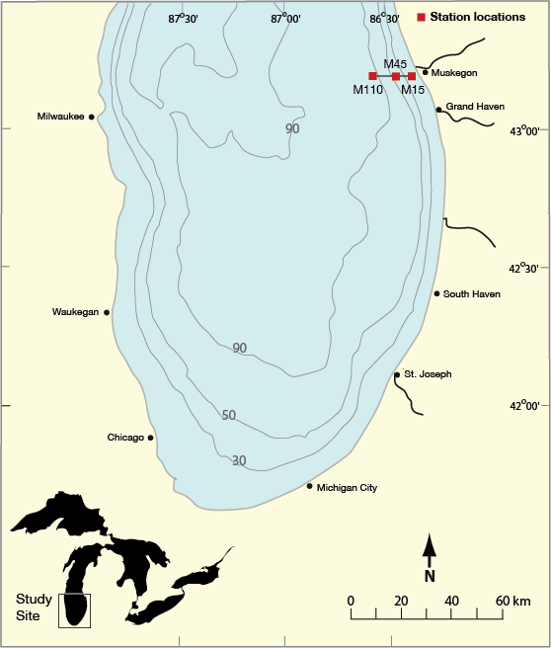
EcoDyn | Core LTR Seasonal Nutrient, Plankton, & Fisheries Research Monitoring
Research plan
Collect data on core lower food-web variables
Collect samples March-December
+ overwinter moorings
Data going back to 1983
Sample along a nearshore to offshore gradient
Analyze critical variables within 1-year
Publish results in timely fashion
2010-2015: 22 publications from this project
4/11
Notes:
Activities: temperature, nutrients, chlorophyll, zooplankton, Mysis, mussels, fish diets, fish condition, overwinter thermistors and fluorometers
Quick turnaround of data is critical for ongoing evaluation of ecosystem changes and for adaptive sampling responses as needed; also provides partners with up to date information
2010-2015: 22 publications from this project
Our research approach of high intensity sampling throughout the year along a nearshore to offshore gradient has been integrated into other agencies sampling for lower food web variables

Slide 5
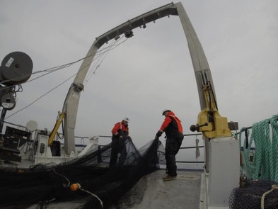
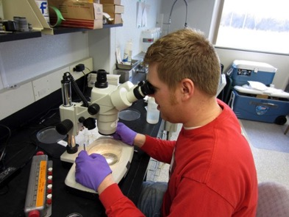
EcoDyn | Core LTR Seasonal Nutrient, Plankton, & Fisheries Research Monitoring
Research focus evolves to address critical issues
1980s
Phosphorus load reductions on Great Lakes water quality and fisheries management
1990s
Weather/climate impacts on long-term water quality
2000s
Dreissenid impacts and implications for fisheries management practices
2010s
Impact of multiple stressors on ecosystem function
5/11
Notes:
The robust data set positions us to answer yet to be identified i.e., research questions of the future, new stressors, new issues, new invaders

Slide 6
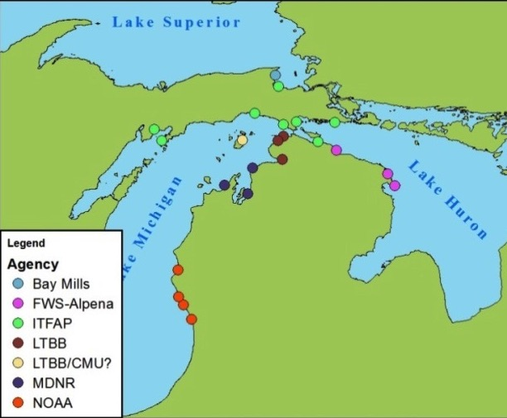
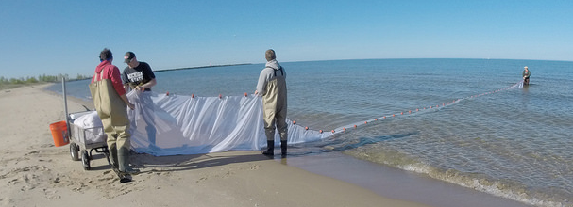
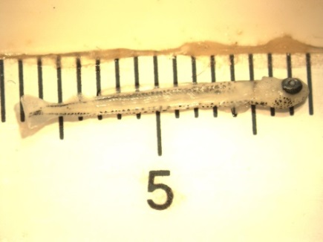
EcoDyn | Core LTR Seasonal Nutrient, Plankton, & Fisheries Research Monitoring
Adaptive strategy for research
Increased emphasis on the nearshore region
Figure 1 Sites proposed by various agencies that will be sampled during the 2014 field season (updated Feb 27, 2014).
6/11

Slide 7
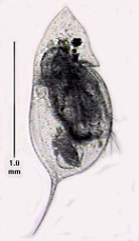
EcoDyn | Core LTR Seasonal Nutrient, Plankton, & Fisheries Research Monitoring
Importance of high frequency sampling
Year-to-year variation
Within year temporal variation
Offshore (110-m) Daphnia abundance
Abundance (#/m²)
Day of Year
7/11
Notes:
Daphnia is a large zooplankton species that is important for planktivorous fish production in the Great Lakes
Long term observations help put shorter term process studies into an ‘environmental context’

Slide 8
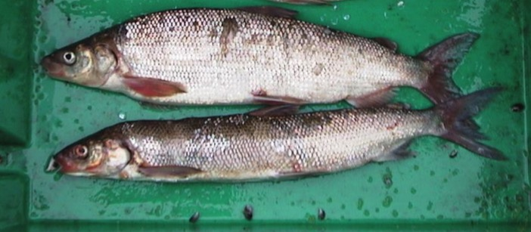
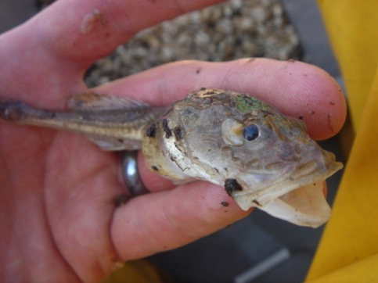
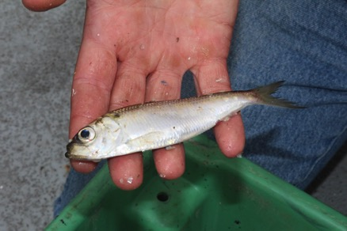
EcoDyn | Core LTR Seasonal Nutrient, Plankton, & Fisheries Research Monitoring
Establish linkages between lower food web and fish production
R. Owens
Lake Whitefish
Deepwater sculpin
Age-1 alewife energy content
Log_{e} energy (Joules)
Alewife
1998
1999
2010
2011
2013
Year
8/11
Notes:
Recent changes in lower food web following the dreissenid invasion have been linked to changes in fish growth and condition.
Lake whitefish-the primary commercial species in the Great Lakes. Lower condition affects growth to harvestable size and marketability of fish in some cases.
Deepwater sculpin-a glacial relict that is considered an indicator species.
Alewife-an invasive species that supports the stocked salmonine fishery; model results indicate that changes in energy content of alewife have affected salmon consumption demands.
This work is done closely with research partners at the DNR and USGS GLSC, so that each agencies strengths are combined to fill critical information gaps

Slide 9
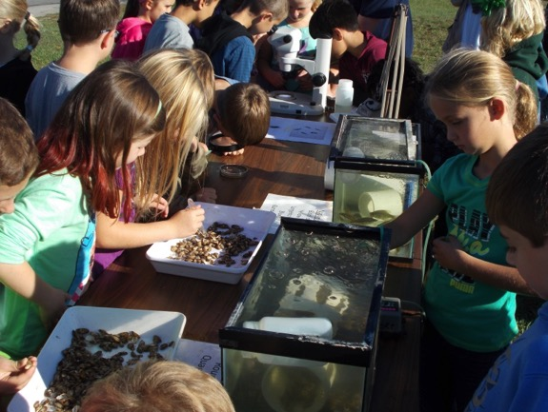
EcoDyn | Core LTR Seasonal Nutrient, Plankton, & Fisheries Research Monitoring
Customers and collaborators
1) Informed resource managers and policy makers
Great Lakes Fishery Commission
Lake Michigan Committee, Lake Michigan Technical Committee, Lower Food Web Task Group
State Department of Natural Resources
Tribal partners
Chippewa Ottawa Resource Authority
International Joint Commission
2) Informed public
Sea Grant fishery workshops
Sport fishing clubs
Commercial fishermen
Educators
3) Information to research partners
GLERL
U.S. Geological Survey Great Lakes Science Center
University of Michigan, Michigan State University, Purdue University, Grand Valley State University, Central Michigan University
9/11
Notes:
Data is readily available to share with research partners and others

Slide 10
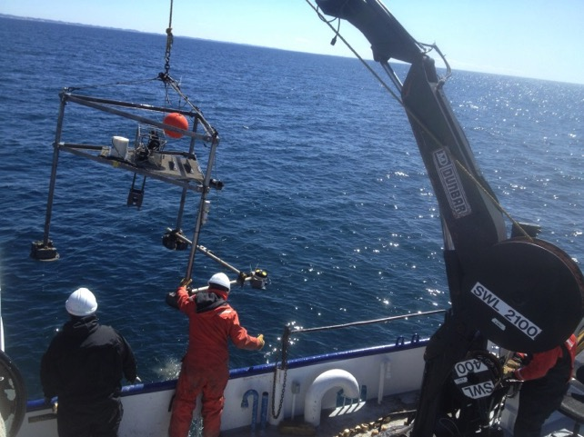
EcoDyn | Core LTR Seasonal Nutrient, Plankton, & Fisheries Research Monitoring
Long-term vision
Adapt to new issues and management needs
Incorporate new technology
Data management
Incorporate more physical observations
Facility improvement-LMFS
maintain and enhance lab capabilities
10/11

Slide 11
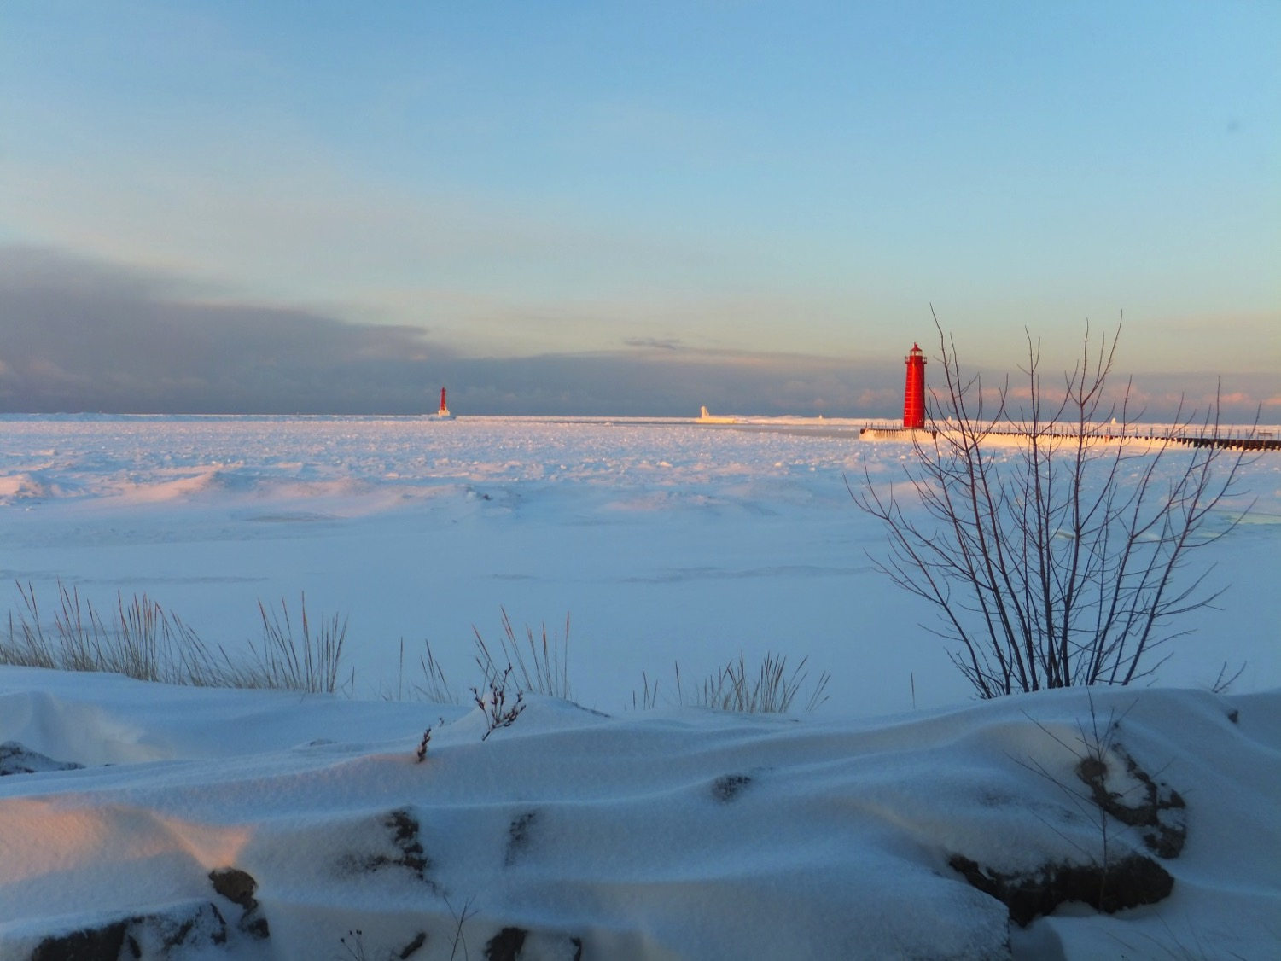
EcoDyn | Core LTR Seasonal Nutrient, Plankton, & Fisheries Research Monitoring
Questions?
11/11

