Slide 1
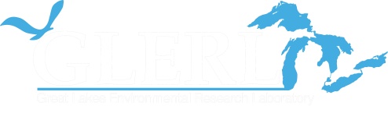

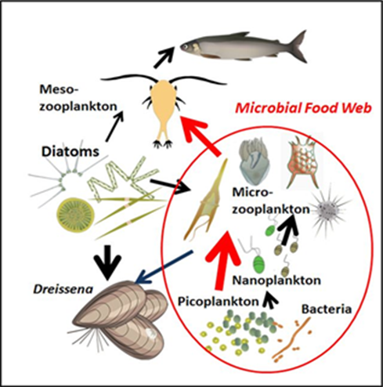
Ecosystem Dynamics Overview
Hank Vanderploeg
Ecosystem Dynamics
Place Photo Here
Observations → Experiments → Concepts → Models/Applications
1/5

Slide 2


EcoDyn | Overview
EcoDyn Essence & Guiding Principles
EcoDyn research strives to develop understanding and tools to improve capacity for managing water quality, fisheries, and ecosystem and human health.
Guiding Principles:
Collaborative effort with focus on priority ecological problems in the Great Lakes.
Quantitative measurements of important ecosystem variables at appropriate time and space scales
Complement observations with experiments and models for understanding
Develop forecasts and applications that are built on a solid foundation of empirical observations and understanding
In following these principles, EcoDyn completes all elements of the R&D production chain shown below
Observations → Experiments → Concepts → Models/Applications
2/5
Notes:
Paraphrased from the GLERL Strategic Plan 2016-2020 found at: http://www.glerl.noaa.gov/review2016/reviewer_docs/GLERLStrategicPlan2016.pdf

Slide 3
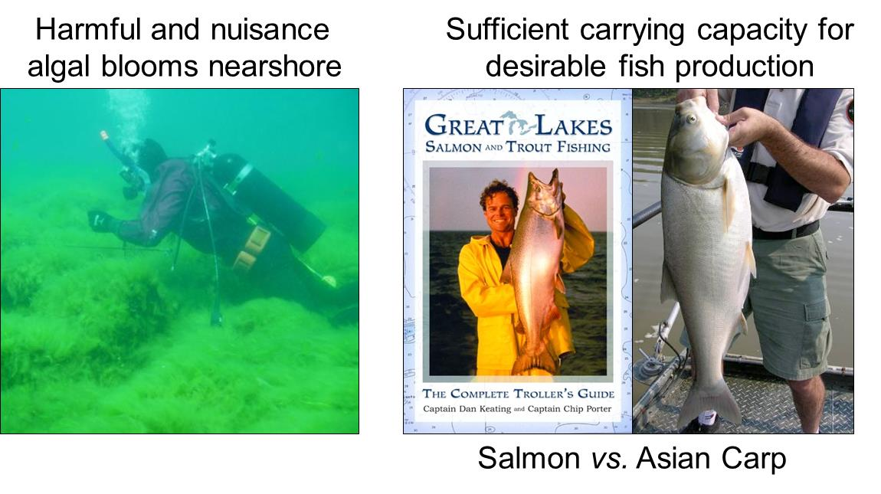
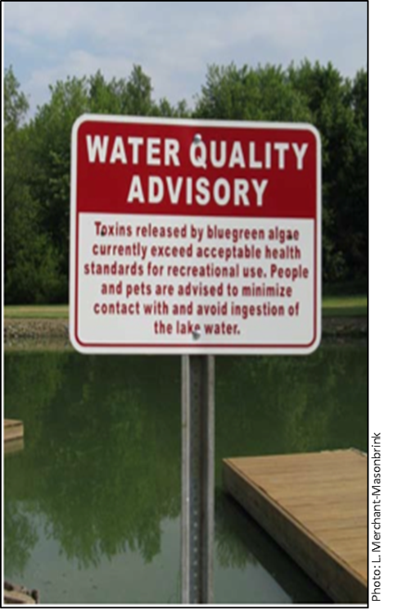
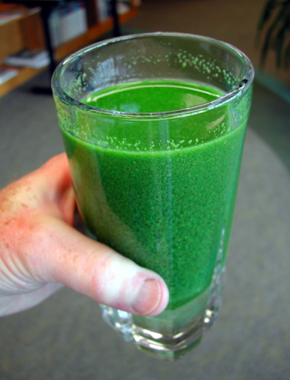
EcoDyn | Overview
Some Great Lakes Management Issues
Slide Text
+ How will climate change affect this?
3/5

Slide 4
EcoDyn | Q & A
EcoDyn research goals address Great Lakes management needs and align with NOAA Goals
EcoDyn Broad Research Goals ↔ NOAA Goals:
Goal 1: A holistic understanding of the role of established and potential future invasive species on Great Lakes ecosystems | ↔ | Healthy Oceans
Goal 2: An integrated understanding of the spatial organization of nutrient loads and food webs | ↔ | Healthy Oceans
Goal 3: The capacity to forecast effects of climate change on Great Lakes food webs | ↔ | Climate Adaptation
Goal 4: A quantitative understanding of the drivers of HABs to predict their concentration, extent, movement, and toxicity | ↔ | Resilient Coastal Communities and Economies
Observations → Experiments → Concepts → Models/Applications
4/5
Notes:
From the GLERL Strategic Plan 2016-2020 found at: http://www.glerl.noaa.gov/review2016/reviewer_docs/GLERLStrategicPlan2016.pdf
Goals 1 & 2 Healtlhy Oceans
Improved understanding of ecosystems to inform resource management decisions
Sustainable fishersi and safe seafood for heatlhy populations and vibrant communities
Goal 3 Climate Adaptation and Mitigation
Improved scientific understanding of the changing climate system and its impacts
Goal 4 Resilient Coastal Communities and Economies
Improved coastal water quality supporting human health and coastal ecosystem services

Slide 5
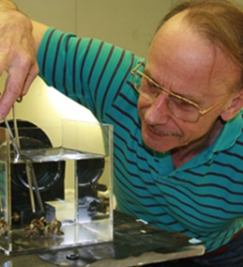
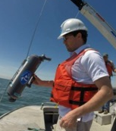
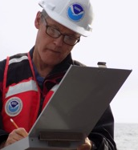
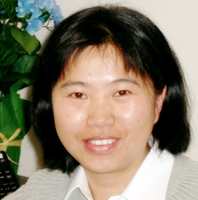
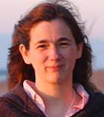
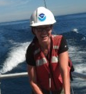
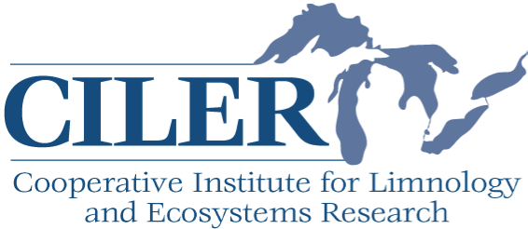
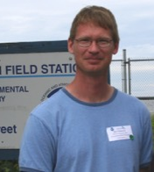
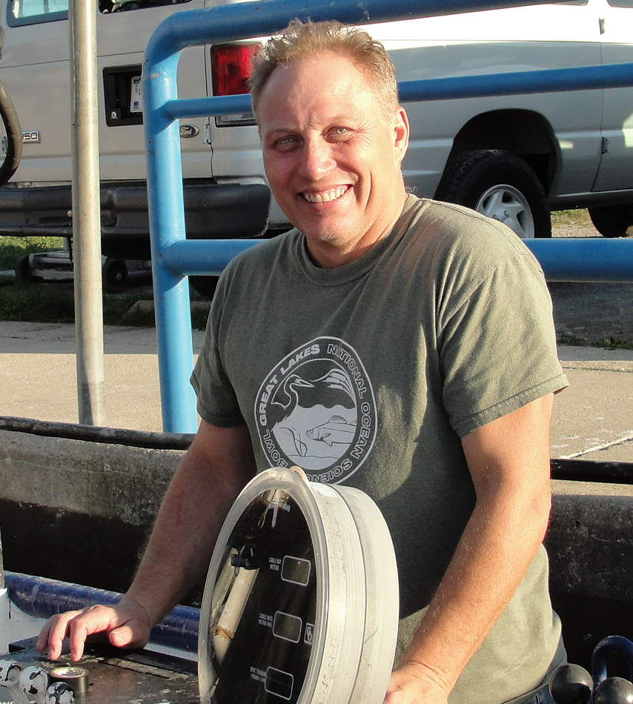
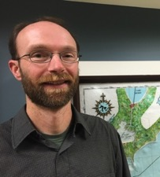
EcoDyn | Q&A
The EcoDyn Team Presenters
Hank Vanderploeg
(Theme Lead)
Overview
Experiments & Concepts
Tim Davis Harmful Algal Blooms from Satellites to Genomes
Ed Rutherford Forecasting Invasive Species Impacts and Distributions in the Great Lakes
Hongyan Zhang
What if Asian Carp Establish in the Great Lakes?
Rochelle Sturtevant Great Lakes Nonindigenous Species
Information System
Ashley Baldridge Dreissenid Mussel Population Dynamics and Processes
Steve Pothoven
Core LTR Seasonal Nutrient, Plankton,
and Fisheries Research Monitoring
Mark Rowe Biophysical Modeling
Doran Mason
Fine-scale Spatial and Temporal Dynamics of the Food Web
5/5
Notes:
The presenters are a mix of GLERL, CILER, and Sea Grant folks who are reporting out on significant ongoing research of interest. Much EcoDyn’s base-funded research is focused on subprojects associated with observations, experiments, and modeling associated with the LTR program. Expansion of the LTR program in some years has been supported by the Coordinated Science and Monitoring Initiative (CSMI). The program on HABs, the other major focus of the group, is heavily supported by GLRI. GLANSIS and work on Asian carps have also been subsidized by external funds.
The EcoDyn group federal PI staff includes: Hank Vanderploeg, Ashley Baldridge, Tim Davis, Doran Mason, Steve Pothoven, and Ed Rutherford
The federal support staff includes: Joann Cavaletto, Dave Fanslow, Duane Gossiaux, Nancy Morehead
We are also heavily dependent on CILER and contract support staff.
You will get a chance to meet the support staff during the lab tour and one-on-one session with support folks.

