Slide 1


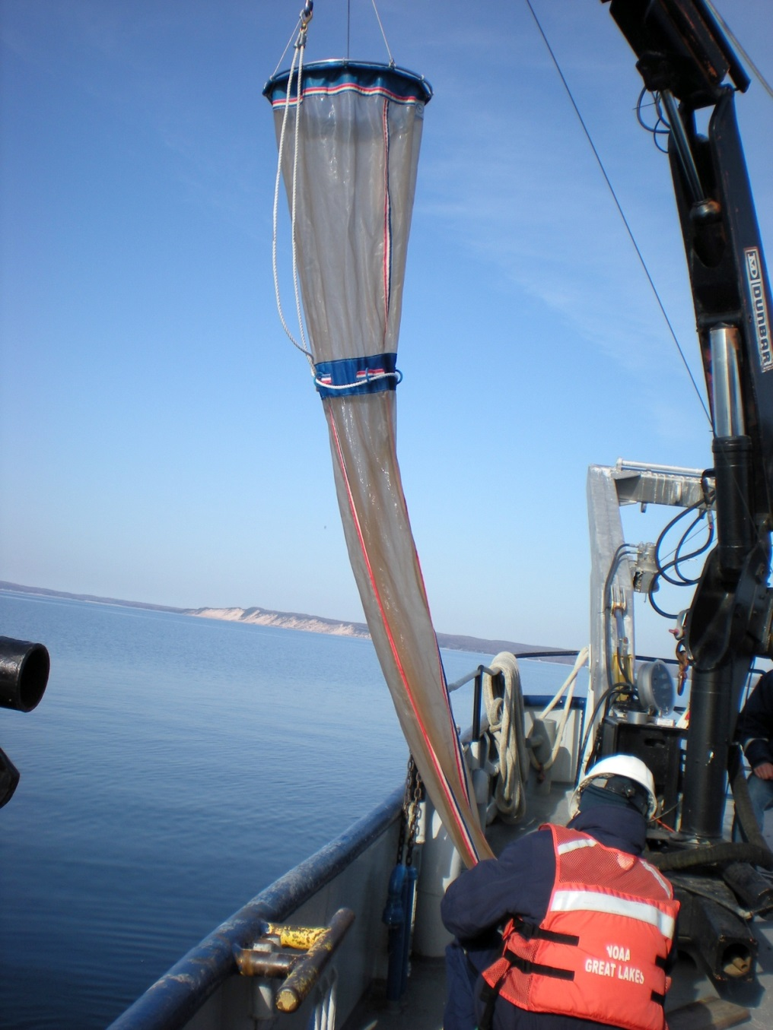
Ecosystem Dynamics (EcoDyn)
Question & Answer Session

Slide 2


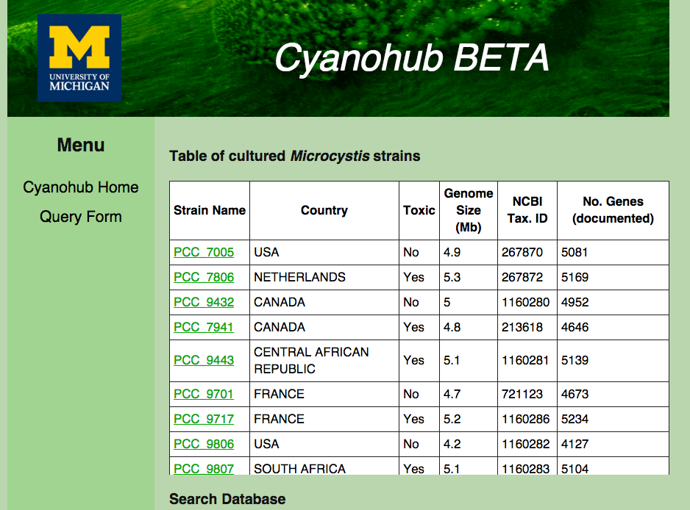
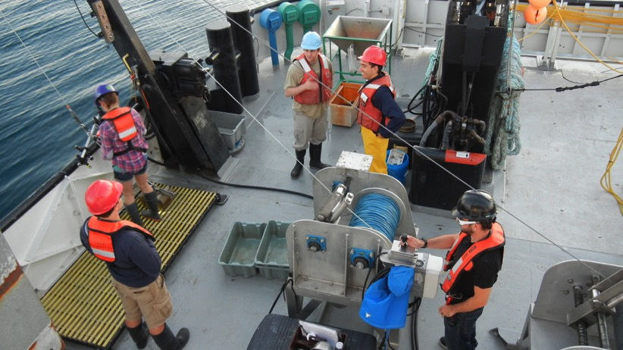
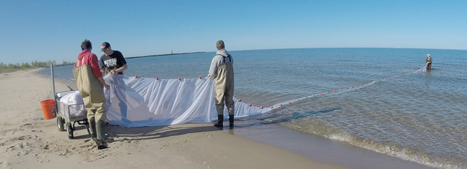
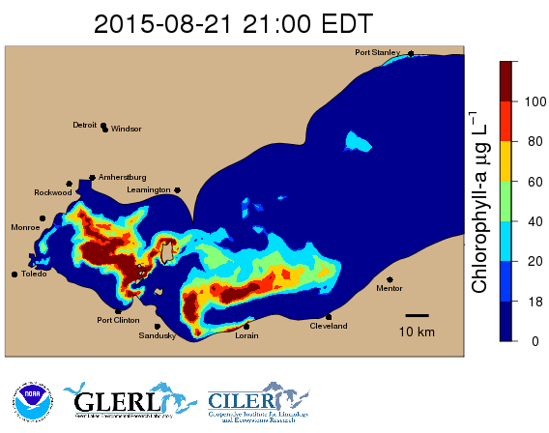
EcoDyn | Overview
EcoDyn Take Home Messages
The EcoDyn Branch is a small group of remarkable productivity working on the most critical problems in the Great Lakes
There are no stand-alone projects, all are mutually reinforcing to serve the larger goals of understanding and forecasting
EcoDyn on its own or with the help of its many collaborators completes whole research chain necessary to promote mission-oriented products: Observations → Experiments → Concepts → Models/Applications
Much of the research fits in “Pasteur’s Quadrant” in that it pushes boundaries of fundamental science in service of mission needs.
Observations → Experiments → Concepts → Models/Applications
2/5
Notes:
Reference:
Stokes, D.E. 1997. Pasteur’s Quadrant: Basic Science and Technological Innovation. Brookings Institution Press. Washington, D.C.

Slide 3
EcoDyn Research Paths
EcoDyn | Overview
Path 1: Strengthen LTR program on critical food web and physical variables in nearshore and offshore Lake Michigan and other Great Lakes to meet management and forecasting needs.
Consider expanding LTR to northern Lake Michigan, Lake Huron, and Superior with help of collaborators
Path 2: Define and understand spatial interactions of nutrients and food-web components from microbes to fishes in lakes Michigan and Huron.
Path 3: Monitor the status of benthic macroinvertebrate and dreissenid mussel populations in Lake Michigan (and other lakes) and conduct experiments to evaluate factors that affect mussel abundance, feeding, growth, and condition in the Great Lakes as well as mussel impacts on Great Lakes food webs.
Path 4: Understand the drivers of HAB dynamics in Lake Erie for development of tools to predict spatial distribution, extent, seasonal dynamics and toxicity, and effects on ecosystem and human health.
Observations → Experiments → Concepts → Models/Applications
3/5
Notes:
Paraphrased from the GLERL Strategic Plan 2016-2020 found at: http://www.glerl.noaa.gov/review2016/reviewer_docs/GLERLStrategicPlan2016.pdf

Slide 4
EcoDyn | Overview
Potential challenges along paths
Need expertise in lower food web including primary production/microbial food web & biogeochemist positions
    We are addressing this through our staffing plan
  Many support scientists are near retirement
Infrastructure and equipment needs in some areas, such as renewal of radioisotope license
Observations → Experiments → Concepts → Models/Applications
4/5
Notes:
Infrastructure: We need to reinstate radioisotope license, as it is limiting our ability to measure primary production and P and C cycling in the food web.
Equipment and infrastructure needs are outlined in Lifecycle Management of Critical Equipment in Appendix H of the Strategic Plan

Slide 5
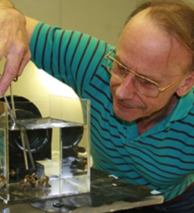
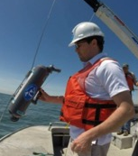
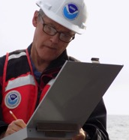
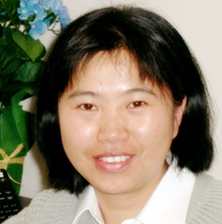
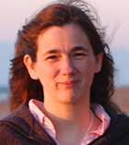
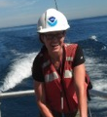

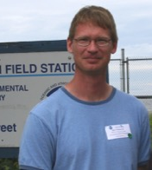
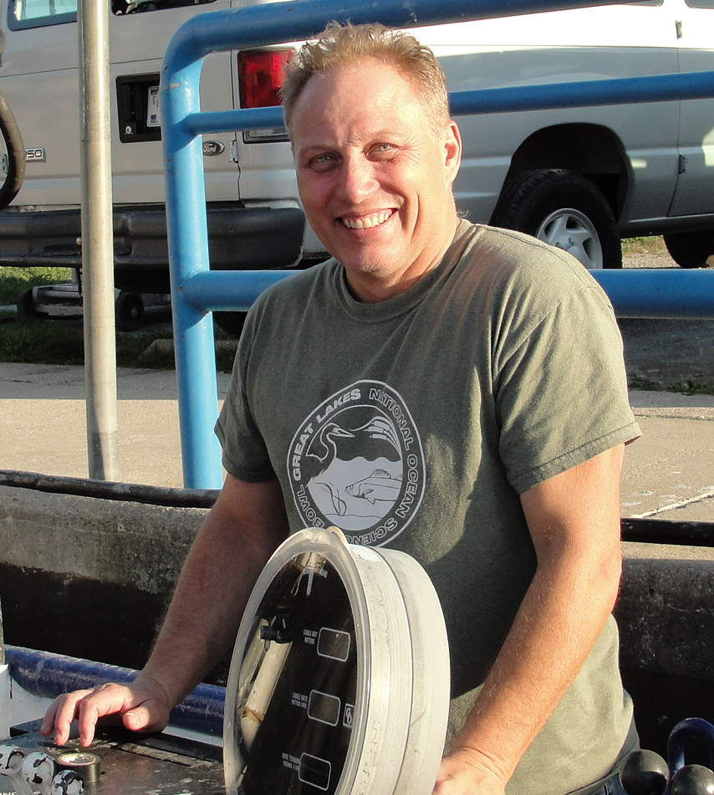
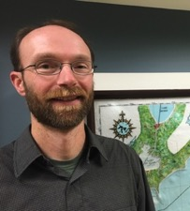
EcoDyn | Q&A
Questions for the EcoDyn Team?
Hank Vanderploeg
(Theme Lead)
Overview
Experiments & Concepts
Tim Davis Harmful Algal Blooms from Satellites to Genomes
Ed Rutherford Forecasting Invasive Species Impacts and Distributions in the Great Lakes
Hongyan Zhang
What if Asian Carp Establish in the Great Lakes?
Rochelle Sturtevant Great Lakes Nonindigenous Species
Information System
Ashley Baldridge Dreissenid Mussel Population Dynamics and Processes
Steve Pothoven
Core LTR Seasonal Nutrient, Plankton,
and Fisheries Research Monitoring
Mark Rowe Biophysical Modeling
Doran Mason
Fine-scale Spatial and Temporal Dynamics of the Food Web
5/5
Notes:
The presenters are a mix of GLERL, CILER, and Sea Grant folks who are reporting out on significant ongoing research of interest. Much EcoDyn’s base-funded research is focused on subprojects associated with observations, experiments, and modeling associated with the LTR program. Expansion of the LTR program in some years has been supported by the Coordinated Science and Monitoring Initiative (CSMI). The program on HABs, the other major focus of the group, is heavily supported by GLRI. GLANSIS and work on Asian carps have also been subsidized by external funds.
The EcoDyn group federal PI staff includes: Hank Vanderploeg, Ashley Baldridge, Tim Davis, Doran Mason, Steve Pothoven, and Ed Rutherford
The federal support staff includes: Joann Cavaletto, Dave Fanslow, Duane Gossiaux, Nancy Morehead
We are also heavily dependent on CILER and contract support staff.
You will get a chance to meet the support staff during the lab tour and one-on-one session with support folks.

