Slide 1
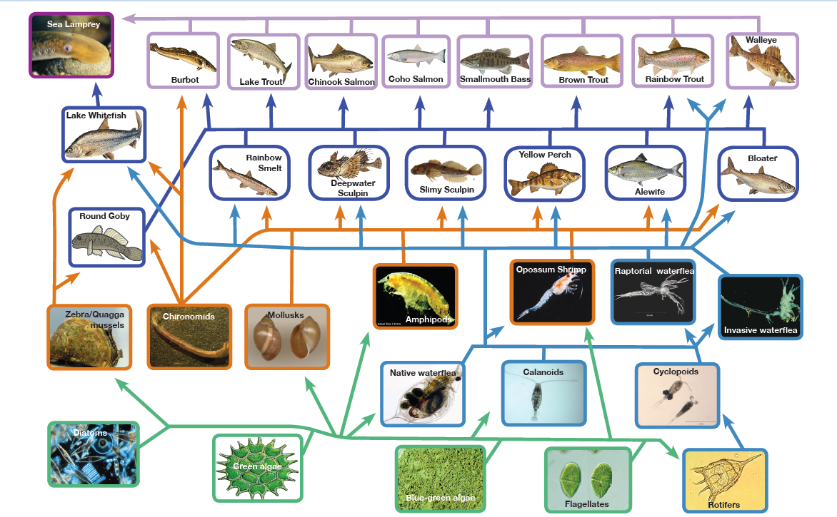
Fine-Scale Spatial and Temporal Dynamics of the Food Web
Doran Mason
Ecosystem Dynamics
1/12
Notes:
You heard earlier today from Steve Pothoven on GLERL’s Long-Term Research (LTR) program. What I will be presenting is the other half of that program which emphasizes spatial studies for understanding and forecasting food web interactions and impacts in response to multiple stressors, across various space and time scales.
This work aligns with the following NOAA Goals:
Climate Adaptation and Mitigation:
Improved scientific understanding of the changing climate system and its impacts
Healthy Oceans:
Improved understanding of ecosystems to inform resources management decisions
Healthy habitats that sustain resilient and thriving marine resources and communities
Sustainable fisheries and safe seafood for healthy populations and vibrant communities

Slide 2
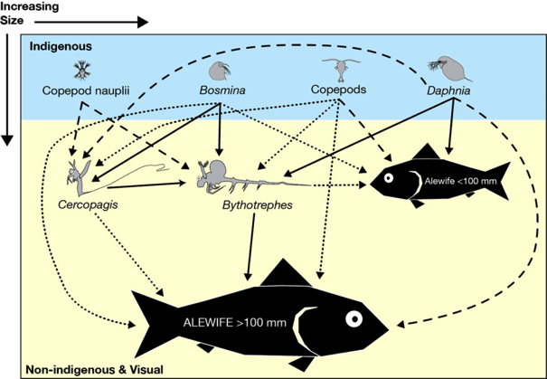
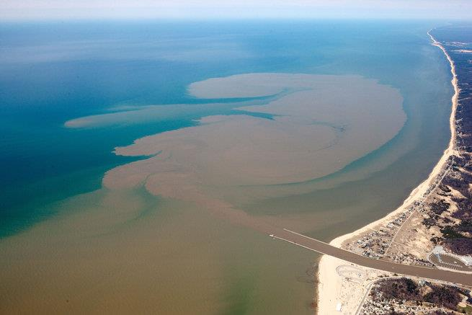
Guiding questions (subset)
EcoDyn | Fine-Scale Spatial and Temporal Dynamics of the Food Web
What factors determine the spatial distributions of pelagic organisms?
What are the effects of invasive species on food webs across spatial and temporal scales?
What are the spatial and temporal linkages between the lower food web, climate, lake physics, and fish recruitment?
Great Lakes pelagic food web
Grand River plume into Lake Michigan
2/12
Notes:
What are the factors affecting carrying capacity and spatial distribution of invasive species in the Great Lakes e.g., dreissenid mussels, invasive cladocerans, Asian carp?
What are the quantitative effects of high-risk invasive species on Great Lakes food webs across spatial and temporal scales and trophic gradients?
What are the spatial and temporal linkages between the lower food web and fish condition and recruitment?
How are nutrients captured by the pelagic food web as they move from tributaries to the nearshore and offshore regions?
How does interannual variability in weather and climate affect lake thermal structure, food web spatial structure and productivity, as well as fish recruitment?
What are the synergistic interactions between climate change, nutrient loading and invasive species.
EcoDyn Approach in the GLERL Strategic Plan
Goal 1: A holistic understanding of the role of established and potentially future invasive species on Great Lakes ecosystems
Goal 2: An integrated understanding of the spatial organization of the food webs and nutrient use and transport from nearshore to offshore food webs.
Goal 3: The capacity to forecast effects of climate change on Great Lakes food webs.

Slide 3
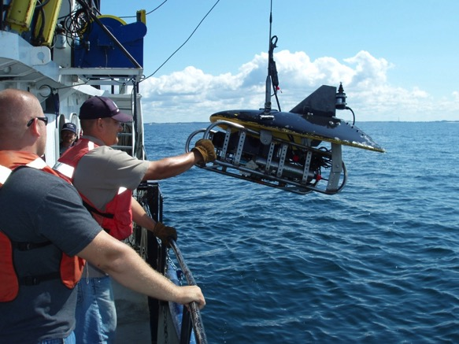
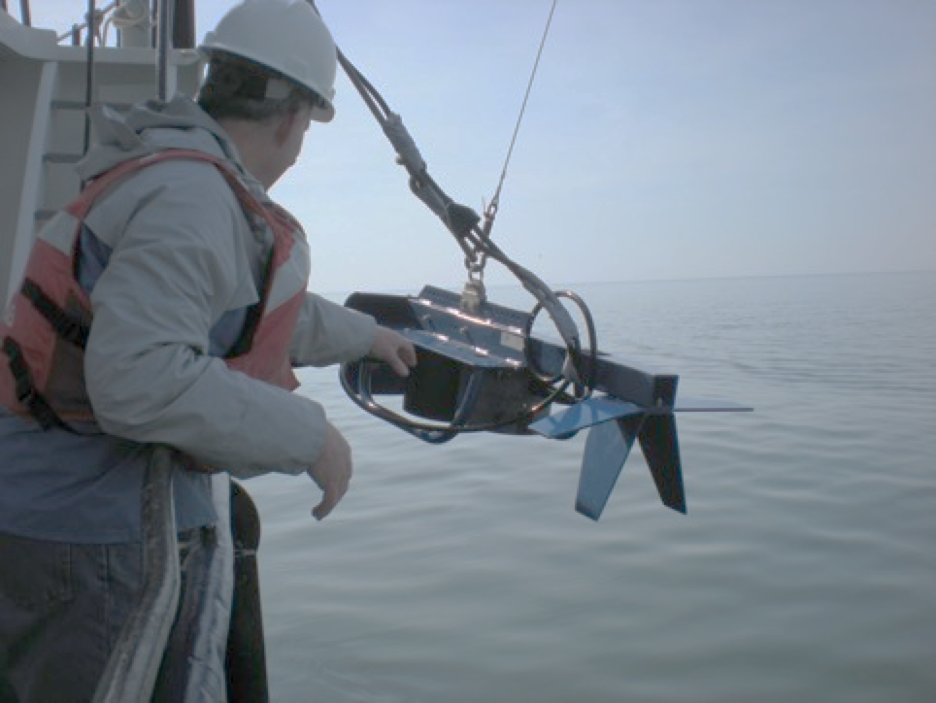
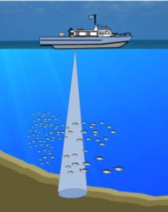
What factors determine the spatial distributions of pelagic organisms?
EcoDyn | Fine-Scale Spatial and Temporal Dynamics of the Food Web
Plankton Survey System
Zooplankton biomass
Zooplankton size structure
Water temperature
Dissolved oxygen
Light levels
Chlorophyll a
CDOM
Turbidity
Fisheries Acoustics
Fish biomass
Fish size
3/12
Notes:
To get at these questions we conduct spatial (nearshore to offshore) cruises in the spring, summer and fall every year collecting a suite of variables across time and space using various technologies. These measures include …
This provides us with quantitative spatial observations across temporal scales- day and night, seasonal, and across years for detecting change in the spatial distribution across these scales. These changes then provide the fodder for developing short-term questions that can be explored through additional field work and experimentation. In addition, these data support the development of models for scenario-based forecasts of food web change. Earlier, Ed Rutherford presented some of our modeling efforts using these data to forecast potential distribution and impacts of Asian carps if they were to invade the Great Lakes.
Much of this work is located in Lake Michigan at Muskegon, with the transect incorporating the stations highlighted by Steve Pothoven this morning. However, in response to our previous 5-year review, where it was suggested we should also expand this program to other lakes, we have added another site in Lake Huron that we sample every five years as part of the Cooperative Science and Monitoring Initiative (CSMI). This is an interagency (EPA, USGS, State of Michigan, etc.) program that rotates through all 5 lakes, GLERL participates in Lake Michigan and Lake Huron.
We work with partners to leverage our resources:
Purdue – Tomas Hook*
UM EE&B – Vincent Denef**
CMU – Hunter Carrick**
*Larval Fish
**Microbial food web

Slide 4
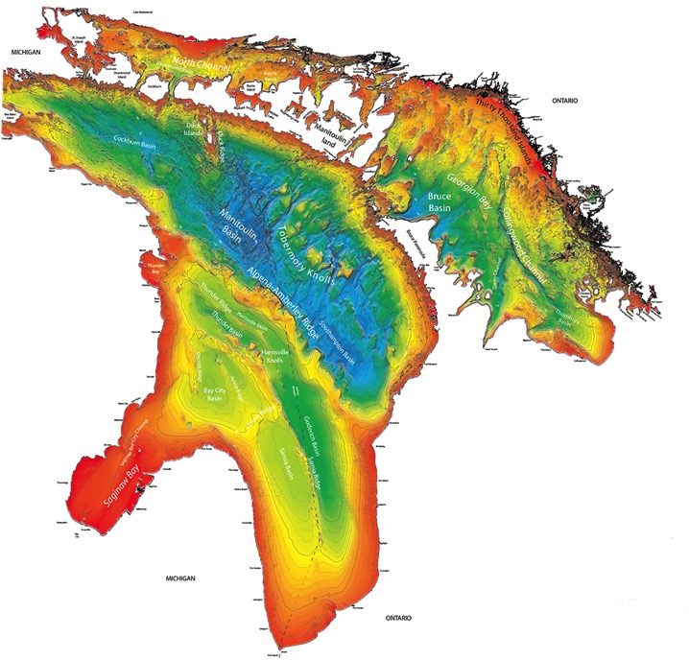
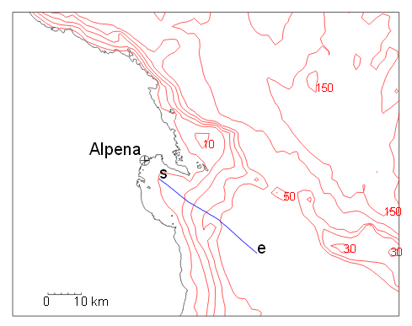
EcoDyn | Fine-Scale Spatial and Temporal Dynamics of the Food Web
What factors determine the spatial distributions of pelagic organisms?
Transect (~40 km)
Lake Huron
4/12
Notes:
To get at these questions we conduct spatial (nearshore to offshore) cruises in the spring, summer and fall every year collecting a suite of variables across time and space using various technologies.
This provides us with quantitative spatial observations across temporal scales- day and night, seasonal, and across years for detecting change in the spatial distribution across these scales. These changes then provide the fodder for developing short-term questions that can be explored through additional field work and experimentation. In addition, these data support the development of models for scenario-based forecasts of food web change. Earlier, Ed Rutherford presented some of our modeling efforts using these data to forecast potential distribution and impacts of Asian carps if they were to invade the Great Lakes.
Much of this work is located in Lake Michigan at Muskegon, with the transect incorporating the stations highlighted by Steve Pothoven this morning. However, in response to our previous 5-year review, where it was suggested we should also expand this program to other lakes, we have added another site in Lake Huron that we sample every five years as part of the Cooperative Science and Monitoring Initiative (CSMI). This is an interagency (EPA, USGS, State of Michigan, etc.) program that rotates through all 5 lakes, GLERL participates in Lake Michigan and Lake Huron.
We work with partners to leverage our resources:
Purdue – Tomas Hook*
UM EE&B – Vincent Denef**
CMU – Hunter Carrick**
*Larval Fish
**Microbial food web

Slide 5
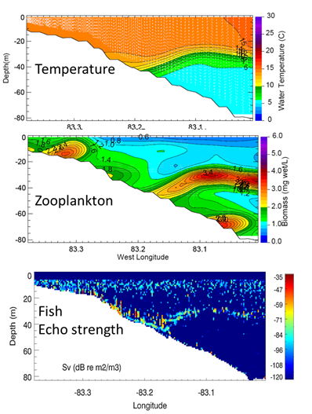
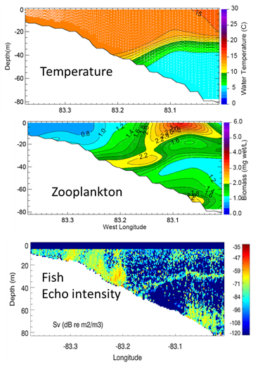
EcoDyn | Fine-Scale Spatial and Temporal Dynamics of the Food Web
What factors determine
the spatial distributions of pelagic organisms?
Day
Night
5/12
Notes:
Lake Huron Transect – September 2012

Slide 6
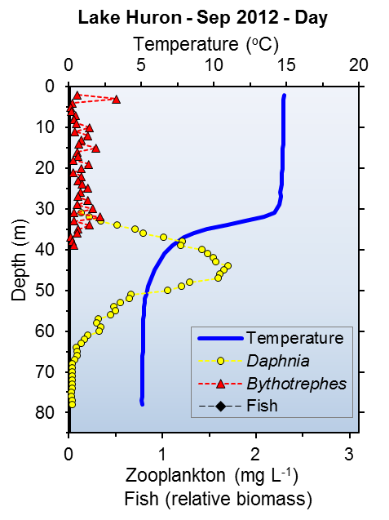
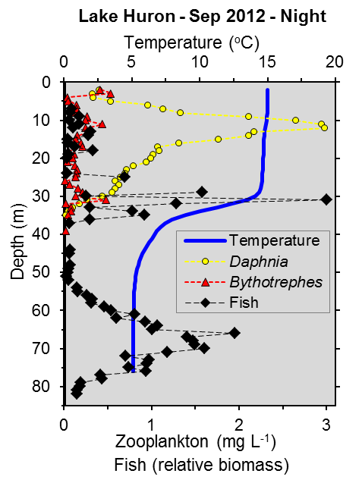
EcoDyn | Fine-Scale Spatial and Temporal Dynamics of the Food Web
What are the effects of invasive species
on food webs across spatial and temporal scales?
6/12
Notes:
These patterns reflect their potential vulnerability to the dominant visual predator, Bythotrephes in surface waters. These patterns are very similar to patterns we have seen and are seeing in Lake Michigan.
35 m change in Daphnia vertical distribution
In the Lake Michigan study, we demonstrated that detailed vertical and horizontal structure of the food web is important for predicting impacts of fish and Bythotrephes on small zooplankton that are important to larval fish.
Research findings:
Invasive predacious zooplankton Bythotrphes has effects on vulnerable native zooplankton:
Zooplankton are sandwiched between two different visual predators (Bythotrphes and fish)
Increased the extent of zooplankton vertical migration, thereby affecting energetics
Caused the decline of select native zooplankton species

Slide 7
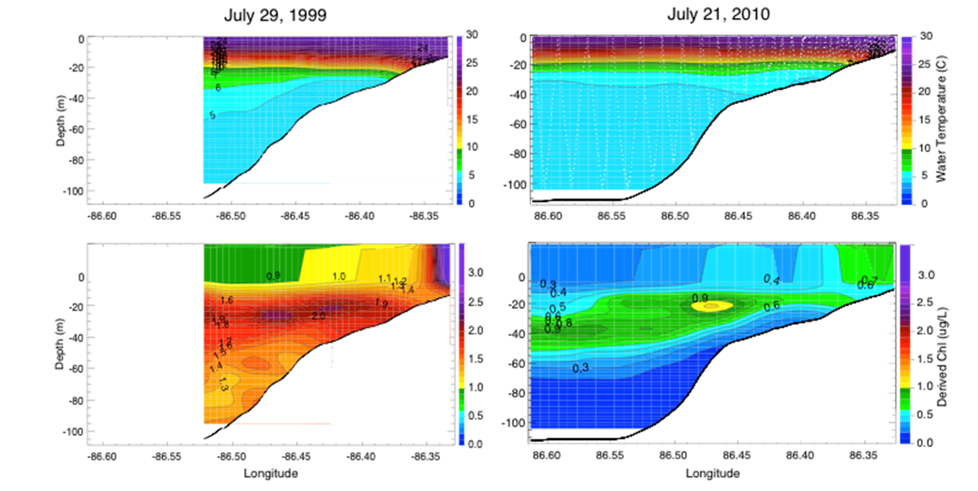
EcoDyn | Spatial Studies & Microbes
What are the effects of invasive species on food webs
across spatial and temporal scales?
Lake Michigan
7/12
Notes:
Lake Michigan LTR Transect
Bottom panel we observe a big change in the concentration and distribution of chlorophyll after dreissenid mussel invasion

Slide 8
EcoDyn | Fine-Scale Spatial and Temporal Dynamics of the Food Web
What are the spatial and temporal linkages
between the lower food web, climate,
lake physics, and fish recruitment?
Lake Michigan density of fish decreased over time
3 of 5 years larvae in the metalimnion
In 2014, highest density in epilimnion-upwelling
8/12
Notes:
For larval fish, we have some general understanding of their vertical distribution relative to broad depth zones This is an example from Lake Michigan and Lake Huron showing the vertical distributions.
This chart was generated averaging the densities of larvae from offshore stations from Lake Michigan in 2010-2011, 2013-2014, and Lake Huron in 2012 during day and night using the tucker trawl
Results:
In lake Michigan, the density of fish larvae decreased over time until 2014, when it increased.
In 3 of five years, most larvae were in the metalimnnion,
In 2014 they were most abundant in the epilimnion (due to upwelling and advection offshore of abundant alewife larvae- role of physical factors),
In 2013 larvae were most abundant in the epilimnion and metalimnion.
Take home message:
We know that during the day larvae feed, most prey are in the metalimmion.
Future work with the MOCNESS will better link fine-scale vertical distribution with their prey.
Next slide puts this in prospective

Slide 9
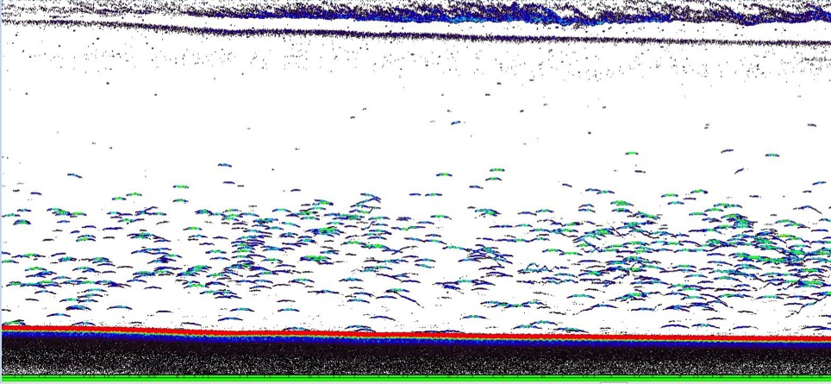
EcoDyn | Fine-Scale Spatial and Temporal Dynamics of the Food Web
Challenges we are addressing: fine scale vertical distribution and species identification
Large
July 2015
14 m
9 m
Night
Fish (Bloater?)
Depth (m)
Temperature
Backscatter from fisheries acoustics
Small
dB
9/12
Notes:
Lake Michigan
Multiple discrete backscatter data from acoustics which represent unknown species.
With our current sampling we are lumping species composition data in broad vertical layers- eplimnion, metalimnion and hypolimnion.
These discrete layers likely represent different species and predator prey interactions.
Take away message:
There’s fine scale vertical structure that may play a big role in species interactions.
Bottom Depth: 109 m
Acoustics shows acoustic scattering layers at night that are associated with the thermal structure.
At night we see in increase in the density and thickness of the shallower layer and a movement of the second layer slightly towards the surface. Upper layer is up to 6 m thick. Deeper layer is only a max up 1.5 m thick.
It’s difficult to identify what organisms are making up these layers.

Slide 10
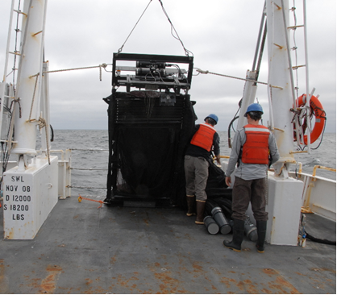
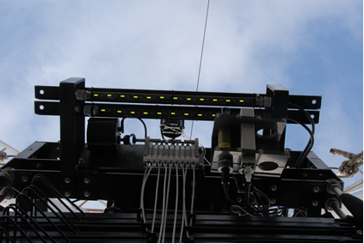
EcoDyn | Fine-Scale Spatial and Temporal Dynamics of the Food Web
Challenges we are addressing: fine scale vertical distribution and species identification
Large
July 2015
14 m
9 m
Night
Fish (Bloater?)
Depth (m)
Strobe diodes on frame
Temperature
Backscatter from fisheries acoustics
Small
dB
10/12
Notes:
We have recently purchased, and beginning to test a MOCHNESS system with strobes, to improve our ability to sample these scattering layers.
The upper left picture is the MOCNESS that has 10 opening and closing nets, a CTD that provides real time data on board the ship for aiming the nets a various depth strata or water temperatures. The lower right picture highlights a state-of-the-art strobe system. The strobes are used to “stun” marcozooplankton and larval fish to improve capture efficiency and provide improved estimates of density. This system will allow us to accurately aim the gear at thin scattering layers, identify the taxa creating these layers, and provide detailed information on the fine-scale vertical distribution of these taxa.
These taxa could be: larval fish, Mysis, Bythotrephes, dense aggregations of other zooplankton

Slide 11
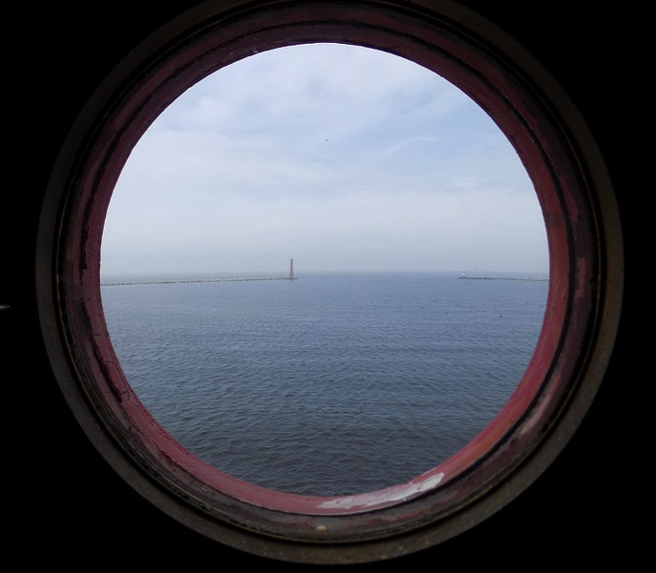
EcoDyn Fine-Scale Spatial and Temporal Dynamics of the Food Web
Future direction
Continue to determine the factors controlling the spatial and temporal distribution of pelagic organisms and invasive species impacts on food-web interactions.
Integrate the MOCNESS into spatial studies for understanding the horizontal and fine-scale vertical distribution of macro-zooplankton and larval fish.
Develop approaches that use fine-scale spatial and temporal data to characterize the state of the system and forecast the likelihood for change.
Use these data to develop models to forecast the effects of multiple stressors on Great Lakes food webs.
11/12
Notes:
Continue to define and understand the factors controlling the spatial and temporal distribution of nutrients and invasive species and their effects on food-web interactions. Towards this effort, we will try to determine the appropriate space and time scale(s).
Integrate the MOCNESS into spatial studies for understanding the horizontal and fine-scale vertical distribution of macro-zooplankton and larval fish.
Develop approaches that use fine-scale spatial and temporal data to characterize the state of the system and forecast the likelihood for change.
Use these data to develop models to forecast the effects of multiple stressors on Great Lakes food webs.
E.g., biomass spectra and production by spatial habitat (nearshore, offshore, epilimnion, metalimnion, hypolimnion), changes in variance across space and time

Slide 12
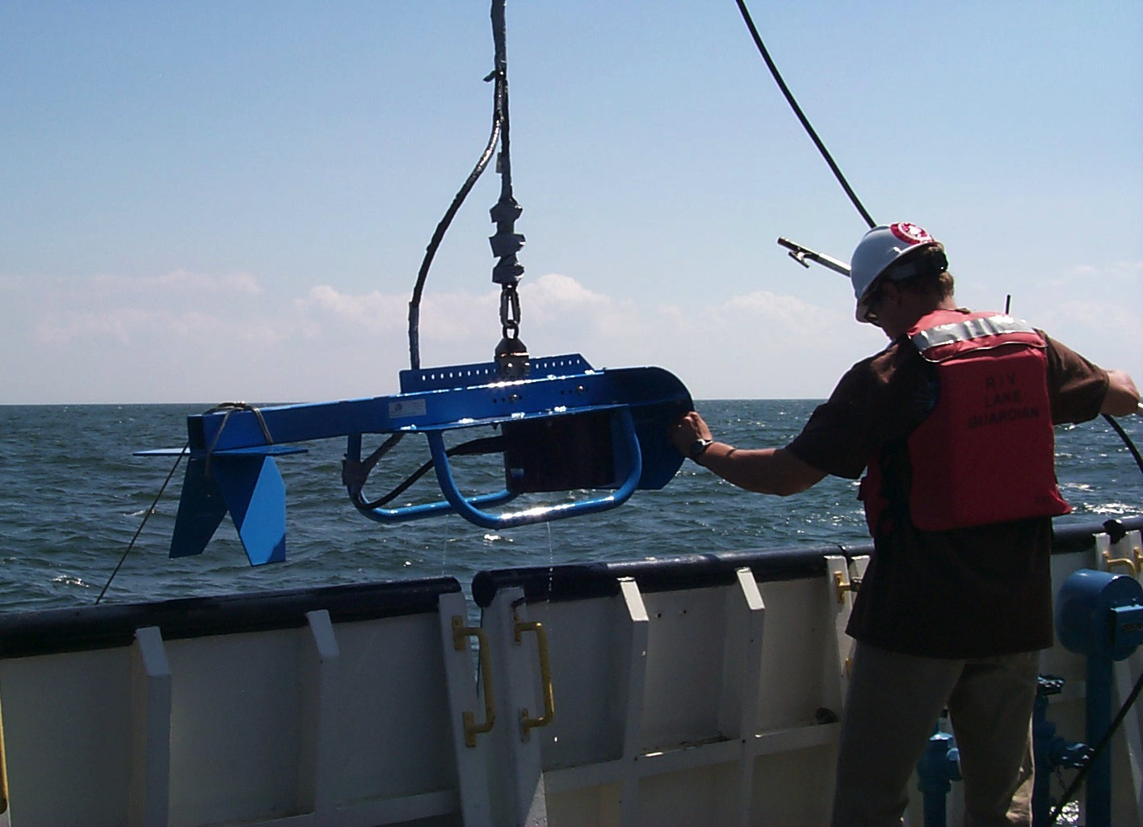
EcoDyn | Fine-Scale Spatial and Temporal Dynamics of the Food Web
Questions?
10/10

