Slide 1
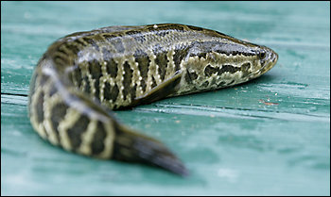
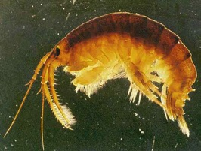
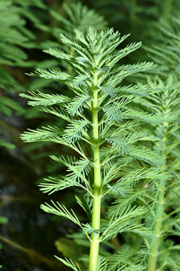
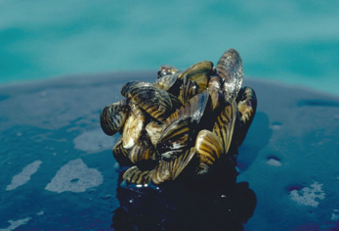
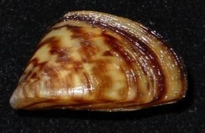
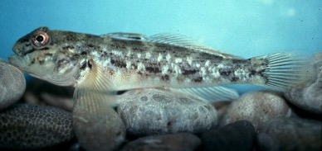
Forecasting Invasive Species Impacts and Distributions in the Great Lakes
Ed Rutherford
Ecosystem Dynamics
National Centers for
Coastal Ocean Science
Center for Sponsored
Coastal Ocean Research
1/16
Notes:
In addition to climate change, HABs, and hypoxia, the most pressing issue facing our Great Lakes ecosystems are Impacts from Invasive Species.
This presentation highlights efforts to develop forecasting capabilities for future invasive species impacts and distributions. Many ideas and research presented here are results of ongoing research by myself and colleagues at NOAA GLERL, our university cooperative institute at Univ. Michigan, and colleagues at Univ. Notre Dame, University of Georgia, The Nature Conservancy, Michigan DNR, and University Nevada-Reno.

Slide 2
EcoDyn | Forecasting Invasive Species Impacts and Distributions in Great Lakes Food Webs
2/16
Notes:
Over 184 nonindigenous species are in the Great Lakes and most are well integrated into GL food webs. Some species like Pacific salmonids (circled in blue) were intentionally introduced and provide significant ecosystem services, while others (circled in red) are invasive and provide little benefit.

Slide 3
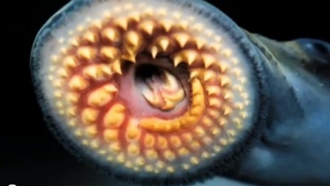
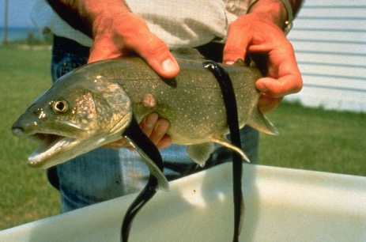
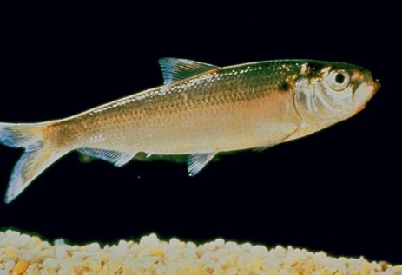
Most harmful invasive species
EcoDyn | Forecasting Invasive Species Impacts and Distributions in Great Lakes Food Webs
Sea Lamprey
Entered upper Great Lakes in 1920s-30s
Extirpated lake trout and deepwater whitefishes in many Great Lakes
Alewife
Entered upper Great Lakes in 1930s
Eats larvae of native fishes, alters zooplankton community, but is prey for salmonines
3/16
Notes:
Of all the 184+ aquatic nonindigenous species in the Great Lakes, the most harmful have been the Sea Lamprey Petromyzon marinus, which entered the Great Lakes in the 1920s and 30s, and the alewife Alosa pseudoharengus which entered the Lakes in the 1930s. Sea Lamprey parasitism, along with overfishing, extirpated lake trout and deepwater whitefishes from 4 of the 5 Great Lakes, and was finally controlled through chemical treatments of tributary nursery areas in the 1960s-1970s. Alewife altered zooplankton communities and suppressed natural reproduction of native fishes through predation on larvae. Alewife also affected reproductive success of Coho salmon and Lake trout through its high concentrations of thiaminase which causes Early Mortality Syndrome, a fatal disease of salmonine eggs and larvae. Lately, Alewife are considered a mixed blessing as they are the preferred prey of Pacific salmonids, which support a multi-billion $/yr recreational fishery.

Slide 4
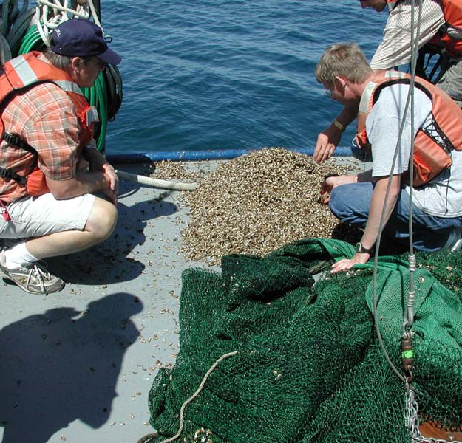
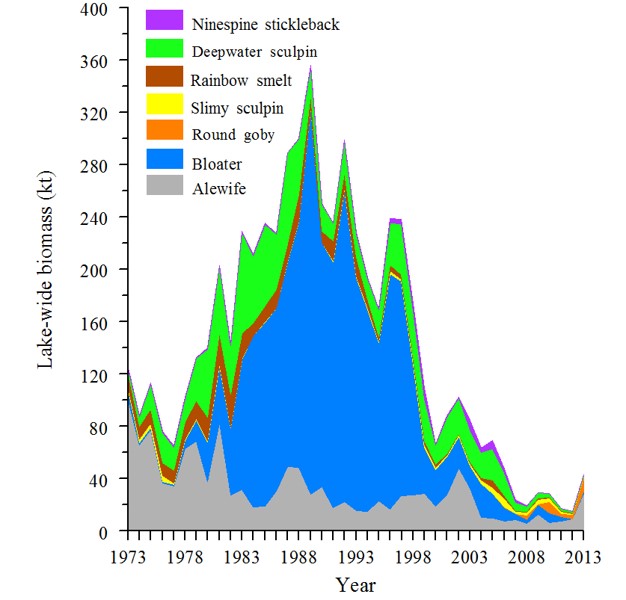
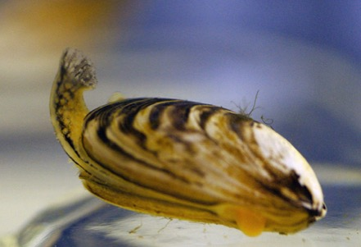
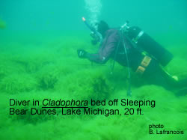
Invasive mussel effects on Great Lakes food webs: prey fish
EcoDyn | Forecasting Invasive Species Impacts and Distributions in Great Lakes Food Webs
Increased Water Clarity
Decreased 1° Production
Changed Phosphorus Cycling
Zebra Mussel
Quagga Mussel
HABs and Cladophora Blooms
Kao, Adlerstein and Rutherford. (In press). Assessment of Top-down and Bottom-up Controls on the Collapse of Alewives (Alosa pseudoharengus) in Lake Huron. Ecosystems.
4/16
Notes:
The latest and arguably the most impactful invasive species in the Great Lakes is the quagga mussel, a relative of the zebra mussel, which irrupted during the early 2000s. The Journal of Great Lakes Research devoted a special issue to changes in the lower food web (Vol. 36, Supplement 3, 2010) and their effects on prey fish and fisheries production, which are largely attributed to Quagga mussel impacts, and were produced by NOAA GLERL scientists and collaborators.
Quagga’s impacts have been felt in Lakes Huron, Michigan, Erie and Ontario, and include:
Filtration of phytoplankton with a doubling of water clarity,
the loss of spring phytoplankton bloom,
a shunt of phosphorus to the nearshore zone
Increased HABs and Cladophora growth
Decline in available nutrients and food for forage fishes and with resultant crash in salmon populations and fisheries in Lake Huron.
Our recent paper (Kao, Adlerstein, and Rutherford 2016) analyzed the collapse of alewife in Lake Huron and indicated that nutrient reduction, excessive predation by salmon and trout, and quagga mussel effects that reduced biomass of zooplankton and benthos prey for alewife, led to alewife’s collapse. Managers are concerned that this dramatic alteration of the food web will be replicated in other food webs.

Slide 5
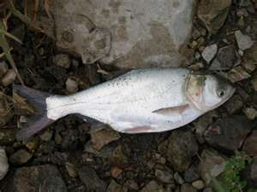
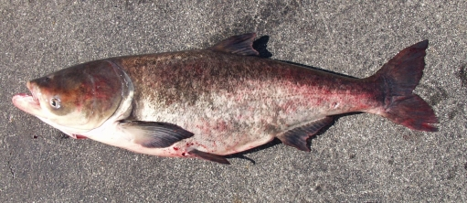
EcoDyn | Forecasting Invasive Species Impacts and Distributions in Great Lakes Food Webs
And now Asian carp may enter the Great Lakes and further deplete plankton available for fish…
Phytoplankton
Zooplankton
Prey fish
Fish harvest
Silver Carp
Bighead Carp
5/16
Notes:
Given our current state of altered food webs and lower productivity in the GL, we now are faced with the threat from Bighead and Silver carps, voracious planktivores.
Hongyan Zhang, Doran Mason and Rutherford have recently completed a model forecast of Asian carp effects on the Lake Erie food web. They are expanding their modeling effort to forecast Asian carp effects on food webs in other Great Lakes. You will hear more about this modeling effort from Hongyan Zhang in a later presentation.
In addition to planktivorous silver and bighead carp, Asian carp refers to the grass carp, which is already established in Lake Erie and eats submerged plants, and the black carp, which is in the Mississippi River drainage and eats molluscs. Here I refer to silver carp and bighead carp. They were introduced into Arkansas to control plankton in fishery ponds in the early 1970s, and are believed to have escaped into the Mississippi River during flooding events in the early 1990s. They have since become one of the most abundant species in some areas of the River.
Silver and bighead carp are now abundant in the Illinois River, which connects the Mississippi River to Lake Michigan. They are large filter- feeders, and compete for food with other planktivores including larval fish. Carps can grow up to 100 pounds, and reach lengths of more than four feet. Due to their large size, their ability to consume large amounts of food, and their rapid rate of reproduction, these fish could pose a significant risk to the Great Lakes Ecosystem and fisheries
Silver carp (Hypophthalmichthys molitrix) and bighead carp (H. nobilis)
Introduced into US in early 1970s
Spread into Mississippi River system since early 1990s
Large filter feeders and compete with other planktivorous fish including larval fish
Consume equivalent of 40% of their body weight daily
Max wt 100 lbs; Max length 4+ ft
Rapid reproductive rate
Zhang, H., E. S. Rutherford, D. M. Mason, J. T. Breck, M. E. Wittmann, R. M. Cooke, D. M. Lodge, J, D. Rothlisberger, X. Zhu, and T. B. Johnson. 2016. Forecasting Impacts of Silver and Bighead Carp on the Lake Erie Food Web. Transactions of the American Fisheries Society 145: 136-162

Slide 6
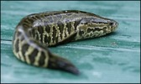
NOAA/CILER/Univ. Invasive Species Research
EcoDyn | Forecasting Invasive Species Impacts and Distributions in Great Lakes Food Webs
Species in Pathway
GLANSIS
(Presentation by Sturtevant, NOAA Great Lakes Sea Grant, forthcoming)
Prob_{Dispersal}
Introduced
Prob_{Suitable Habitat}
Establish
Prob_{Move}
Spread
Prob_{Impact}
Watchlist of 53 Aquatic Nonindigenous Species
Impact
6/16
Notes:
On the left is a diagram of the invasion sequence by Dr. David Lodge (Univ. Notre Dame) and colleagues. Species that are outside the Great Lakes but have the potential to be introduced must have means of dispersal, via physical or anthropogenic mechanisms. Once introduced, there must be suitable habitat to become established, and the non-indigenous species must move or be advected or transported to spread and ultimately impact the ecosystem. Our scientists and university collaborators have worked on quantifying several steps in this process.
You will hear from Dr. Rochelle Sturtevant about the GLANSIS program, which has identified species outside of the Great Lakes basin that are most likely to enter the basin.

Slide 7
EcoDyn | Forecasting Invasive Species Impacts and Distributions in Great Lakes Food Webs
NOAA/CILER/Univ. Invasive Species Research
Species in Pathway
Prob_{Dispersal}
Introduced
Prob_{Suitable Habitat}
Is habitat suitable for invasive species?
Collaborators: Wittmann, U. Nevada-Reno, Kramer and Drake, U. Georgia; Mason, Riseng, Beletsky, U. Mich; Chadderton and Annis, TNC; Rutherford, GLERL; Lodge, U. Notre Dame
Establish
Prob_{Move}
Spread
Prob_{Impact}
Impact
7/16

Slide 8
Forecasting Invasive Species Habitat Suitability
EcoDyn | Forecasting Invasive Species Impacts and Distributions in Great Lakes Food Webs
Envt’l Niche Model Algorithm/Approach
Occurrence Records
Estimate
Environmental Layers
(Diagram From A. Kramer and J. Drake, Univ. Georgia)
8/16
Notes:
This slide illustrates a basic approach (and challenges) to predicting distribution and relative abundance of invasive species. Generally speaking, one uses occurrence records and habitat information for the invasive species in its native range, match the habitat information on its native range with habitat data from the Great Lakes, to produce an estimate of the invader’s potential distribution and relative abundance in the Great Lakes.
Habitat data are provided by the Great Lakes Aquatic Habitat Framework project, led by Drs. Catherine Riseng (University of Michigan) and Kevin Wehrly (Michigan DNR). Other collaborators include E. Rutherford (NOAA GLERL;, L. Mason, R. Goodspeed (Univ. Mich.); L. Wang (Int’l Joint Commission), M. Robertson (Ontario Ministry of Natural Resources), J. McKenna (USGS-Great Lakes Science Center), L. Johnson (Univ. Minnesota).
Wang, L., C. M. Riseng, L. A. Mason, K .E. Wehrly, E. S. Rutherford, J. E. McKenna, Jr., C. Castiglione, L. B. Johnson, D. Infante, S. E. Sowa, M. Robertson, J. Schaeffer, M. Khoury, J. Gaiot, T. Hollenhorst, C. Brooks, and M. Coscarelli. 2015. A Hierarchical Spatial Classification and Database for Management, Research, and Policy Making: the Great Lakes Aquatic Habitat Framework Journal of Great Lakes Research. Journal of Great Lakes Research 41: 584–596
Challenges to predicting future invasive spp impacts and distribution are:
Limited environmental data from native range
Environmental data from native range may not overlap GL environment
Uncertainty of “niche”
Does the native range represent true physiological constraints?
Food web response largely unknown

Slide 9
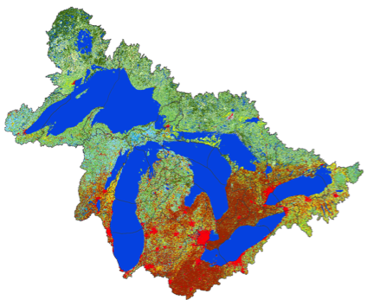
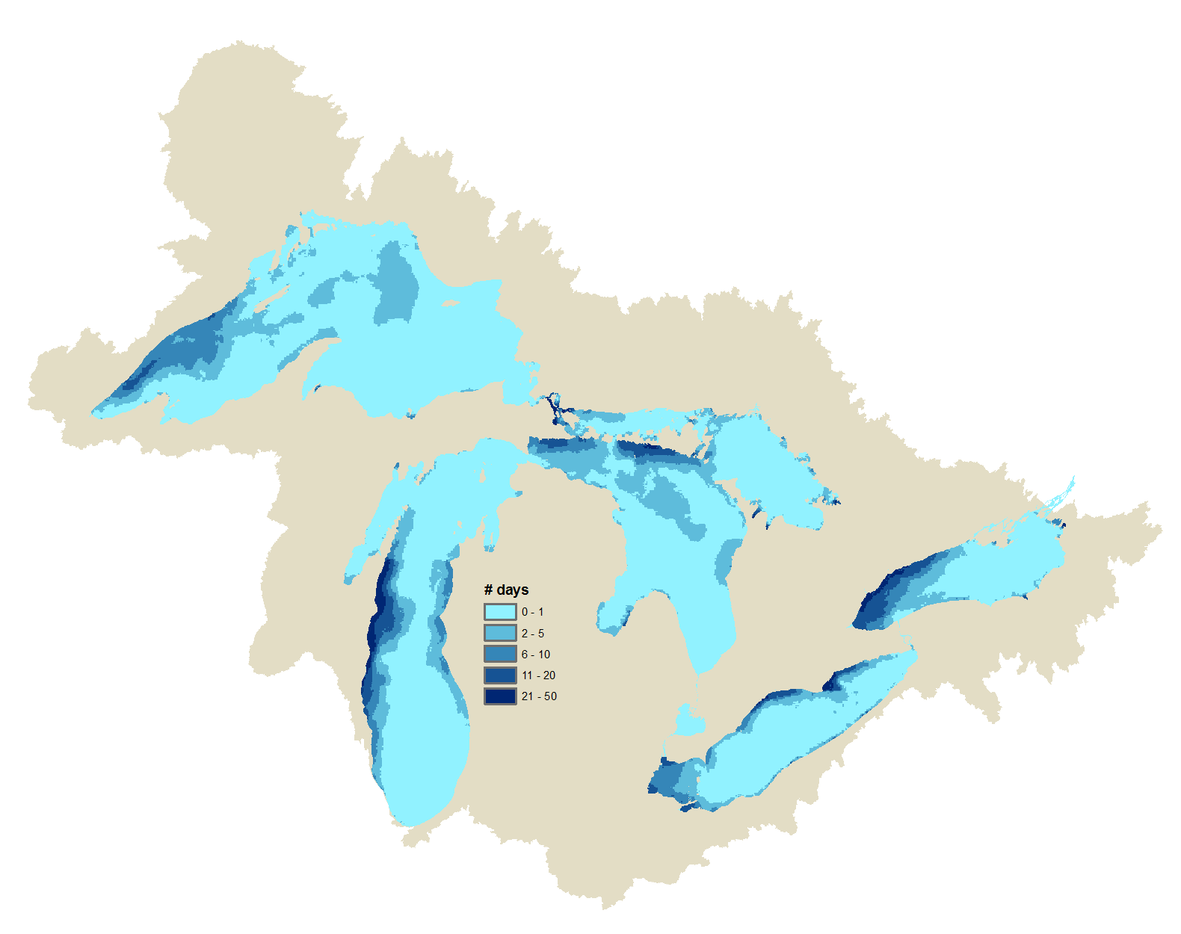
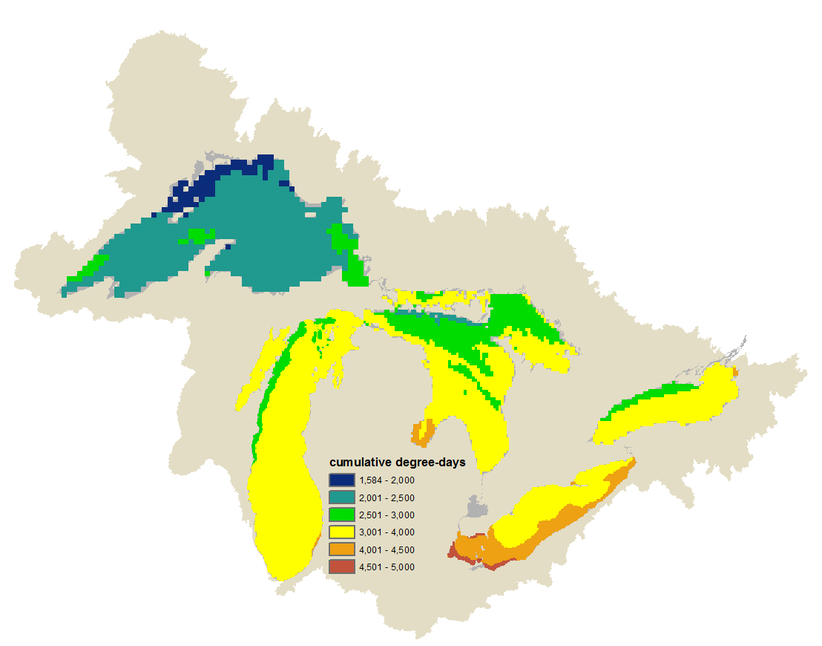
GLAHF COMPREHENSIVE DATABASE http://glahf.org/explorer/
landcover
Administrative Boundaries - 16
Lake & land units, Political boundaries
Management Units
Biological – 61+
Aquatic invasive species, Benthos, Fish
Environmental/Chemical - 37
Water chemistry
Geomorphology/Topobathymerty - 28
Hydrogeoforms
Substrate, Elevation, Relief, Slope
Landscape - 132
Land use/cover, Geology, Soils
Mechanical Energy - 19
Circulation, Upwelling, Waves
Rivers/Hydrology - 14
Flowlines, Watersheds, Dams & barriers
Temperature Energy - 19
Upwelling, Water temperature at depth, Growing Degree Days
Other Stressors - 4
upwelling
cumulative degree-days
2/2
9/16
Notes:
Note that variables highlighted in Green font are habitat data contributed by NOAA GLERL science branches: Integrated Physical and Ecological Modeling and Forecasting, Observing Sensors and Technology, and Ecosystem Dynamics branches. Data can be explored and downloaded from the Great Lakes Aquatic Habitat Framework (GLAHF) web site shown here.

Slide 10
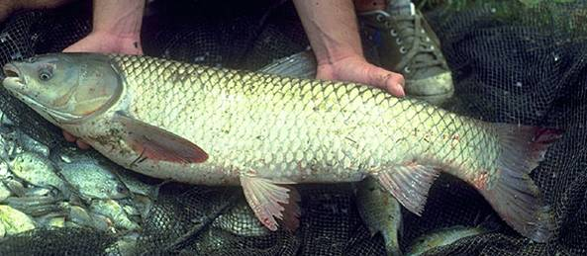
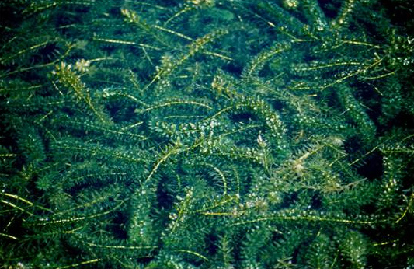
Example: Grass carp and Hydrilla
EcoDyn | Forecasting Invasive Species Impacts and Distributions in Great Lakes Food Webs
Grass carp - Ctenopharyngodon idella
Hydrilla - H. verticillata
(Established and reproducing naturally)
(Not yet established in Great Lakes)
10/16

Slide 11
EcoDyn | Forecasting Invasive Species Impacts and Distributions in Great Lakes Food Webs
Grass Carp –
Niche Centrality
Grass carp niche – modeled using GL climate data and Climate data where carp occur outside GL basin
Grass Carp niche centrality for entire Great Lakes region using air temperature, precipitation data
Grass carp niche centrality clipped using Submerged Aquatic Vegetation (SAV), Wetlands and predicted Hydrilla niche;
(Hydrilla niche modeled using GLERL water temperature, photic zone, substrate, and wave data)
Above clipped using GL SAV, wetlands data + Hydrilla niche
Wittmann, Rutherford et al. (In Review.) JGLR.
11/16
Notes:
The species distribution model used is called range bagging, developed by Dr. John Drake (2015) at University of Georgia. This methods uses bootstrap aggregation (“bagging”) of niche boundaries.
The resulting measure, is called “niche centrality”, refers to the proportion of times an environment occurs within the environmental range of a species across the bootstrapped combinations of environmental variables (2 dimensions at a time are compared).
Niche centrality is similar to a probability of occurrence. Its values are on a scale of zero to one, and, and can be projected to locations on a map.
The input data are species occurrence records—presences.
And environmental data which describe climate related variables on a global scale. These are the WorldClim dataset and are comprised of 19 temperature and precipitation variables.
Reference:
Wittmann, Rutherford et al. (In Review.) Refining species distribution model outputs using landscape-scale habitat data: Forecasting Grass Carp and Hydrilla establishment in the Great Lakes region. J. Great Lakes Res.
Niche centrality for Grass Carp for the comprehensive Great Lakes watershed region
Clipped using a submersed aquatic vegetation (SAV) and wetlands data layer
Last panel shows Grass carp clipped using a combined SAV, Wetlands and predicted Hydrilla verticillata niche.
The takeaways from this analysis:
Grass carp are typically restricted by food availability, which in the Great Lakes does not necessarily represent a great deal of lake surface area, but does represent some of the most sensitive areas of the nearshore region which are important for a number of ecological processes.
Considering predicted Hydrilla habitat increases the amount of area for which Grass carp may establish in the Great Lakes. Hydrilla have been found in watersheds adjacent to the Great Lakes and are considered a threat.
Millions have been spend in GLRI funds and other resources to rehabilitate or restore wetlands in the Great Lakes, which are habitats in which both Hydrilla and Grass carp may establish – both of these species threaten valuable ecological resources in the Great Lakes basin.
The information is useful for managers to constrain and target their monitoring efforts for Asian carp.

Slide 12
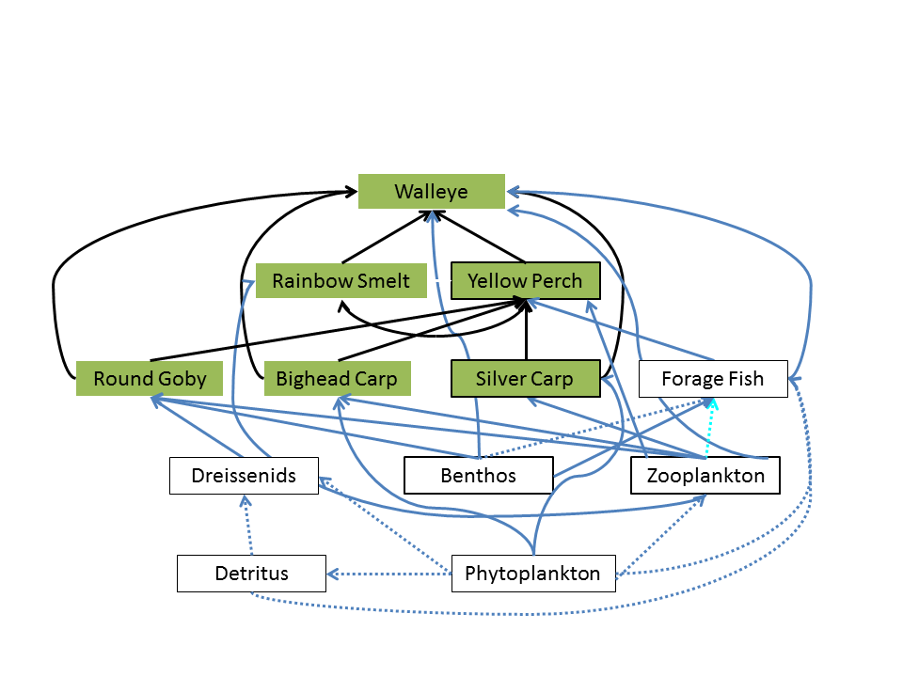
NOAA/CILER/Univ. Invasive Species Research
EcoDyn | Forecasting Invasive Species Impacts and Distributions in Great Lakes Food Webs
Species in Pathway
Prob_{Dispersal}
Introduced
Prob_{Suitable}
Establish
Will Invasive Species Establish ?
Bythotrephes
Prob_{Move}
Spread
Prob_{Impact}
Individual Based Model
Impact
Research Team: Ivan, Mich. State U.; Zhang, U. Michigan;’ Rutherford, Mason, Hunter, GLERL; Hoff, USFWS.
12/16
Notes:
NOAA GLERL (Rutherford, Mason, Tim Hunter) and UM-CILER scientists (Dr. Lori Ivan - UM-CILER postdoc; Dr. Hongyan Zhang) developed an individual-based model to simulate Asian carp impacts on nearshore and offshore fish and plankton communities in Lake Huron, Lake Michigan and Lake Erie. The model tracks biomass of plankton and benthos prey, and individual fish consumption, growth, movement, mortality and reproduction of 6 species through their life cycles in heterogeneous environments. The initial framework of the multi-species individual-based model was first developed by Drs. Shaye Sable and Kenneth Rose (Louisiana State University) and then by Dr. Aaron Adamack (UM CILER postdoc).
We calibrated the model to existing data on densities, growth rates, survival, diets, and movements of the resident species, and also to information available on Asian carp from work in the Illinois and Mississippi Rivers and in Asia. We ran simulation experiments to determine the minimum number of individuals needed to establish viable populations in the Great Lakes. The answer depended upon assumptions of juvenile survival – assuming high juvenile survival rates, Silver and Bighead carp could establish a population with at least 10 individuals. At low juvenile survival rates, many more Asian carp individuals are needed to establish viable populations.
The Ecopath with Ecosim food web model and results will be discussed further in an In Focus presentation by Dr. Hongyan Zhang.
To quantify potential food web response to Asian carps, we are using Ecopath with Ecosim (EwE). This framework is a widely used food web model that was developed to simulate food web response to fishing, and which has been applied in aquatic ecosystems worldwide. It can simulate a complex foodweb. External nutrient loading and fishery harvest are typically used to drive dynamics of the modeled food web. We have been applying this model to Great Lakes, and using nutrients and invasives as drivers of GL food web and fisheries. We have used this model approach, and other model frameworks that are more mechanistic and spatially explicit, to address impacts of stressors including invasive species, hypoxia in the central basin of Lake Erie, eutrophication, and contaminant (methylmercury) bioaccumulation. We are collaborating with teams at University of Notre Dame, Resources for the Future, and University of Wyoming to incorporate uncertainty analysis in the EwE model and to link EwE with an economics model, CGE (Computable General Equilibrium) to assess the impacts of invasive species on the Great Lakes ecosystems and economics.

Slide 13
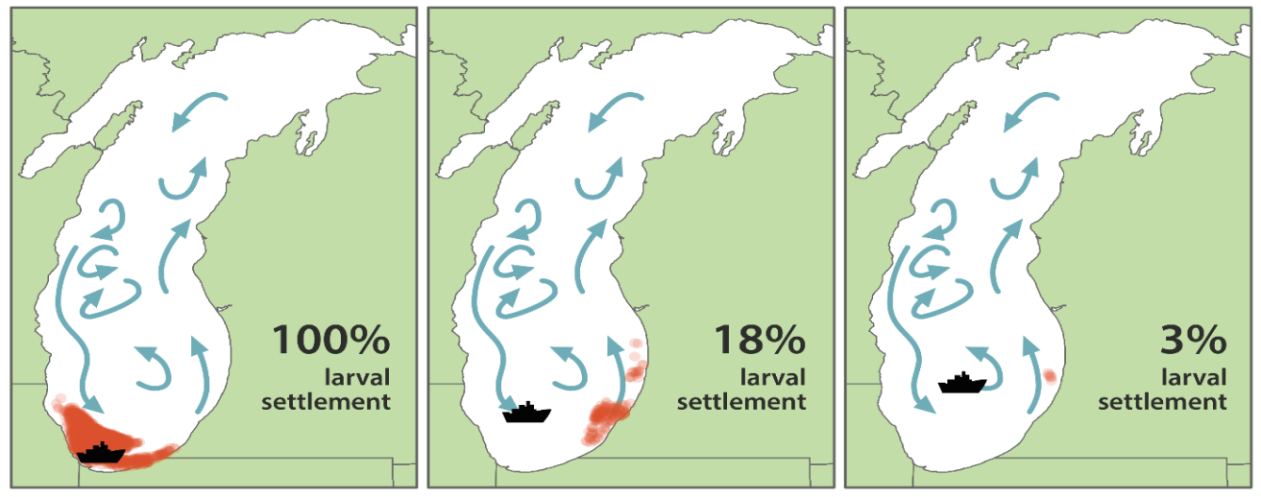
NOAA/CILER/Univ. Invasive Species Research
EcoDyn | Forecasting Invasive Species Impacts and Distributions in Great Lakes Food Webs
Species in Pathway
Prob_{Dispersal}
Introduced
Prob_{Suitable Habitat}
Eurasion Ruffe, Golden mussel larvae dispersed by currents vs release from ship deballast
Establish
Prob_{Move}
Spread
Will Invasive Species Spread?
Prob_{Impact}
Impact
Fig. from Lodge, Zhang, Beletsky, Rutherford et al. (In review). ARER.
D. Beletsky, R. Beletsky, Rutherford, et al. (In review). JGLR.
13/16
Notes:
Dima and Raisa Beletsky are hydrodynamics modelers at NOAA GLERL, with whom we have collaborated to model potential dispersal of selected non-indigenous species by currents in Lake Michigan and Erie. Current – mediated dispersal was compared against ship-mediated dispersal modeled by Univ. Toledo colleagues (Jon Bossenbroek, Jen Sieraki) to help inform areas where spread of invasives could be slowed or stopped.
Dima Beletsky also modeled current-mediated dispersal of Hydrilla in Lake Huron and Ontario. He will present results of this work later during the review.

Slide 14
NOAA/CILER/Univ. Invasive Species Research
EcoDyn | Forecasting Invasive Species Impacts and Distributions in Great Lakes Food Webs
Species in Pathway
Models
Individual-Based Models
Biophysical Models (FVCOM): Mark Rowe
Bioeconomic Food Web models (Ecopath w/ Ecosim): Hongyan Zhang In Focus Presentation
Ecosystem models (Atlantis)
Prob_{Dispersal}
Introduced
Prob_{Suitable Habitat}
Establish
Prob_{Move}
Spread
Prob_{Impact}
Will invasive species affect food webs, fisheries?
Impact
14/16
Notes:
Our invasive species modeling group at GLERL and UM-CILER is using a suite of models to quantify invasive species effects on Great Lakes food webs. You will hear more from Mark Rowe on modeling quagga mussel effects using a biophysical model, and from Hongyan Zhang on modeling Asian carp effects.
In future, we plan to use these models to simulate impacts of other invasive species, and other stressors (climate change, contaminant loads) on coastal Great Lakes food webs.
Kao, Y-C, S. A. Adlerstein, and E. S. Rutherford. 2016. Top Down and Bottom Up Controls on the Collapse of Alewives (Alosa pseudoharengus) in Lake Huron. Ecosystems.
Zhang, H., E. S. Rutherford, D. M. Mason, J. T. Breck, M. E. Wittmann, R. M. Cooke, D. M. Lodge, J, D. Rothlisberger, X. Zhu, and T. B. Johnson. 2016. Forecasting Impacts of Silver and Bighead Carp on the Lake Erie Food Web. Transactions of the American Fisheries Society 145: 136-162

Slide 15
Stakeholders for Invasive Species Modeling and Habitat Data
EcoDyn | Forecasting Invasive Species Impacts and Distributions in Great Lakes Food Webs
Invasive Species Model Results:
US Army Corps of Engineers
Asian Carp Regional Coordinating Committee
Great Lakes Fishery Commission
Council of Lake Committees
US Fish and Wildlife Service
Habitat Data:
State DNRs
Ontario Ministry NR
Env’t Canada
Int’l Joint Commission
Lake Habitat Task Groups
15/16
Notes:
There have been several stakeholder groups using our model forecasts of invasive species, and also requesting basin wide habitat data. The Great Lakes Fishery Commission coordinates research and management on Great Lakes fisheries. Council of Lake Committees is the group that decides on fishery policy that affects the whole basin. The International Joint Commission implements the Great Lakes Water Quality Agreement and annexes to that agreement, two of which deal with invasive species and habitat.

Slide 16
Future Challenges and Opportunities
EcoDyn | Forecasting Invasive Species Impacts and Distributions in Great Lakes Food Webs
Improve forecasts of invasive species spread and impact
Understand interactive effects of invasive species, land use change, climate change and fisheries on food webs
Couple economic models with food web models to inform invasive species risk assessment and management
16/16
Notes:
Challenges for the future are to understand interactive effects of multiple stressors, and improve forecasts of invasive species spread and impacts on food webs.
We plan to continue using the GLAHF habitat database and biophysical modeling to predict invasive species habitat suitability and spread. Our use of ecosystem models (Ecopath with Ecosim, Individual-based models, Atlantis Ecosystem model) allows scenario forecasting of invasive species effects over a range of spatial scales and model complexities. We feel that obtaining consistent results from multiple models lends confidence to forecasts of invasive species impacts.
Invasive species impacts may be facilitated or enhanced by other stressors which adds an additional layer of complexity for forecasting. Climate change affects timing of lake stratification, phenology and energetics of food web members, ice cover, and lake levels. Land use change is increasing in many areas of the Great Lakes and is known to affect coastal food webs. For example, urbanization increases runoff of sediments, contaminants and nutrients in tributaries and nearshore areas, and agricultural practices (crop rotation, tillage) can increase total loads of both phosphorus and nitrogen. Increased precipitation in fall and winter from climate change may interact with land use practices to increase episodic delivery of nutrients to coastal food webs (Michalak et al., 2014; Scavia et al. 2014). How people react to changing food webs and develop management strategies depends on their perceptions of which stressor(s) is causing the problem. We have used food web models to understand the relative contributions of nutrient reduction, invasive species and salmon predation to the collapse of the alewife population and salmon fishery in Lake Huron.
Recently, we used food web models to identify the relative effects of nutrients and invasive species on the Saginaw Bay Lake Huron food web. We are continuing to quantify effects of land use stressors and define tipping points for other coastal food webs with funding from the Great Lakes Restoration Initiative.
We need to continue developing dynamic linkages between economic models and food web models. Currently Hongyan Zhang, Doran Mason and Rutherford are collaborating with economists at Univ. Wyoming and US Forest Service to estimate costs/benefits of reducing invasive mussel abundance in the Great Lakes (Barnes et al., in prep). We also are funded to work with economists to develop bioeconomic forecasts of invasive mussel and Asian carp effects on the Lake Michigan economy and food web.

Slide 17
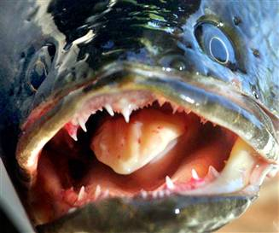
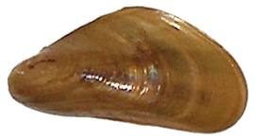
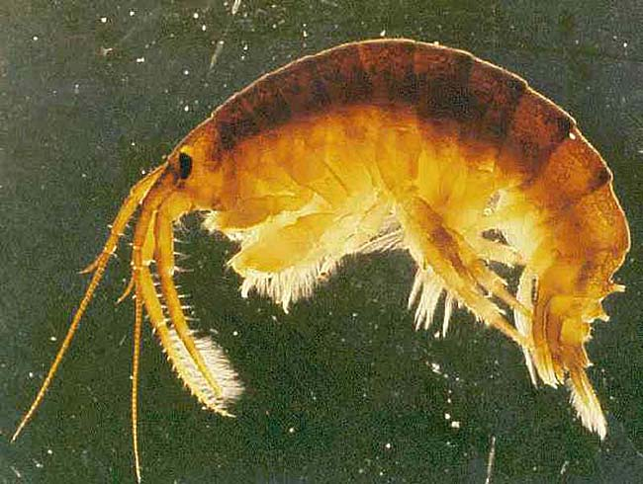
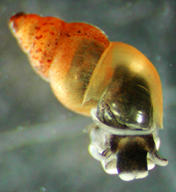
Questions?
EcoDyn | Forecasting Invasive Species Impacts and Distributions in Great Lakes Food Webs
Notes:
Coming to a theatre near you…
Four species that are likely to invade and spread in the Great Lakes, or have already established.
Top left: Golden mussel Limnoperna fortunei
Top Right: Northern snakehead Channa argus
Lower Left: Killer shrimp Dikerogammarus villosus
Lower Right: New Zealand mud snail Potamopyrgus antipodarum (already established in GL)

