Slide 1
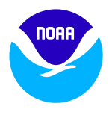
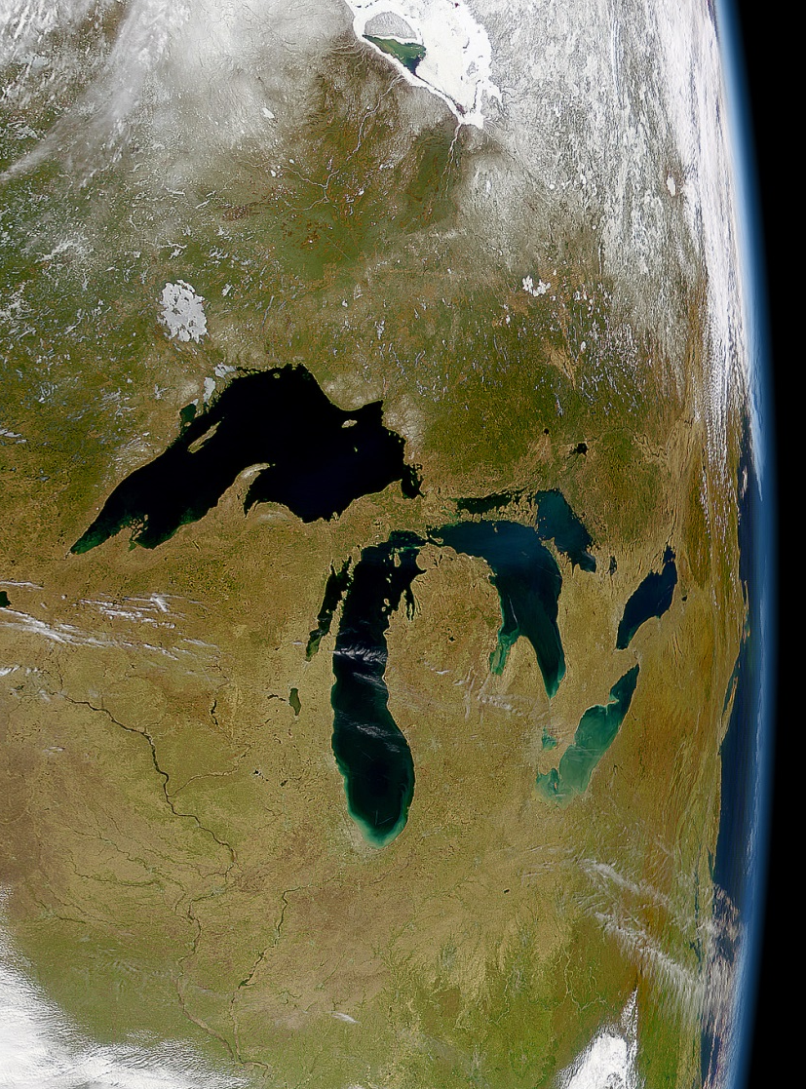
Great Lakes Environmental Research Laboratory
2010 – 2015 Review
Deborah Lee, PE, PH, D.WRE
Director
Great Lakes Regional Team Lead
March 22-24, 2016
Notes:
US Department of Commerce
National Oceanic and Atmospheric Administration
Office of Oceanic and Atmospheric Research
2016 Great Lakes Environmental Research Laboratory Review
GLERL’s Establishing Order
Office of the Secretary [Dept. Organization Order 25-5B] NOAA Organization and Function, April 25, 1974
“The Great Lakes Environmental Research Laboratory shall conduct research directed toward an understanding of the environmental processes in the Great Lakes and their watersheds. Emphasis shall be placed upon an interdisciplinary systems approach to solving problems in resource management and environmental services for that region.”

Slide 2
Director | Overview
Outline
Great Lakes Overview
GLERL Overview
Who Is GLERL?
Workforce
Budget
Quality
Awards
Service
Publications
Relevance
To NOAA, OAR, Congress
To Decision-makers
To Stakeholders
Performance
Strategic Accomplishments
Leveraging Collaborations
Leadership & Innovation
Path to the future
Next Three Days

Slide 3
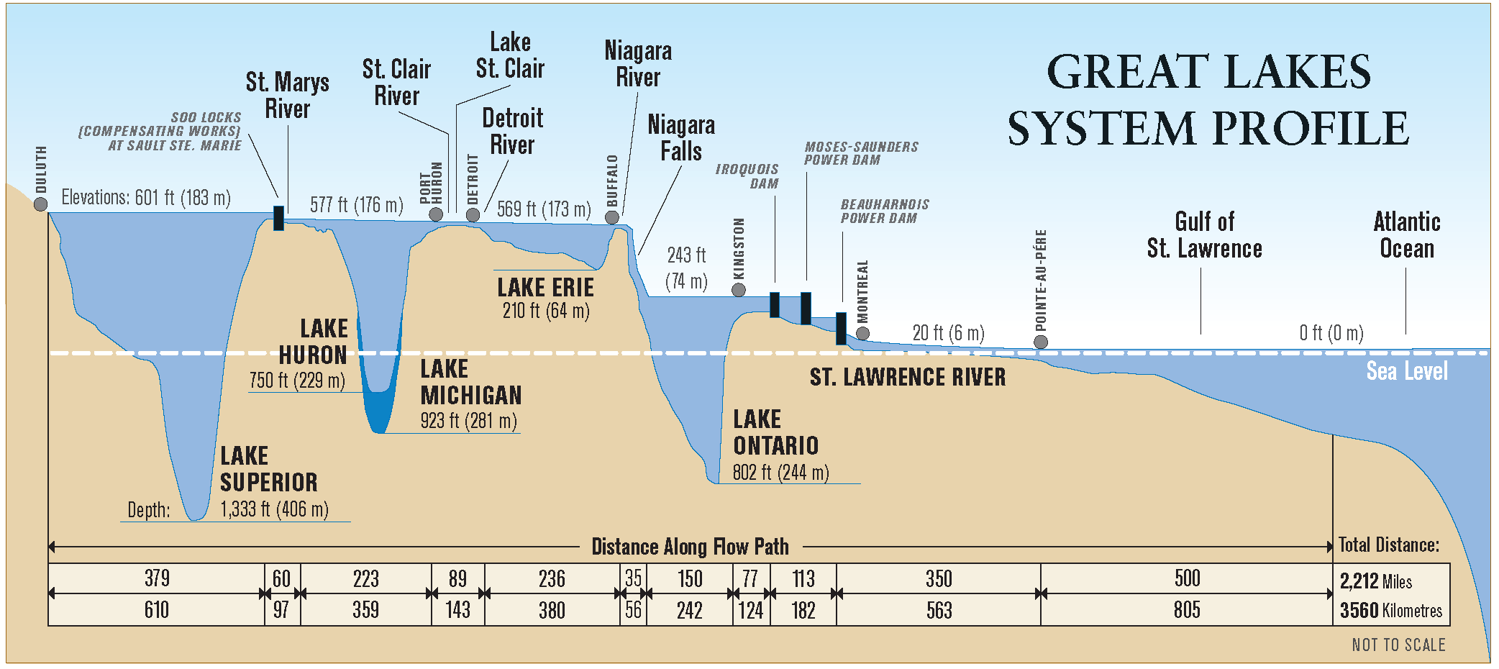
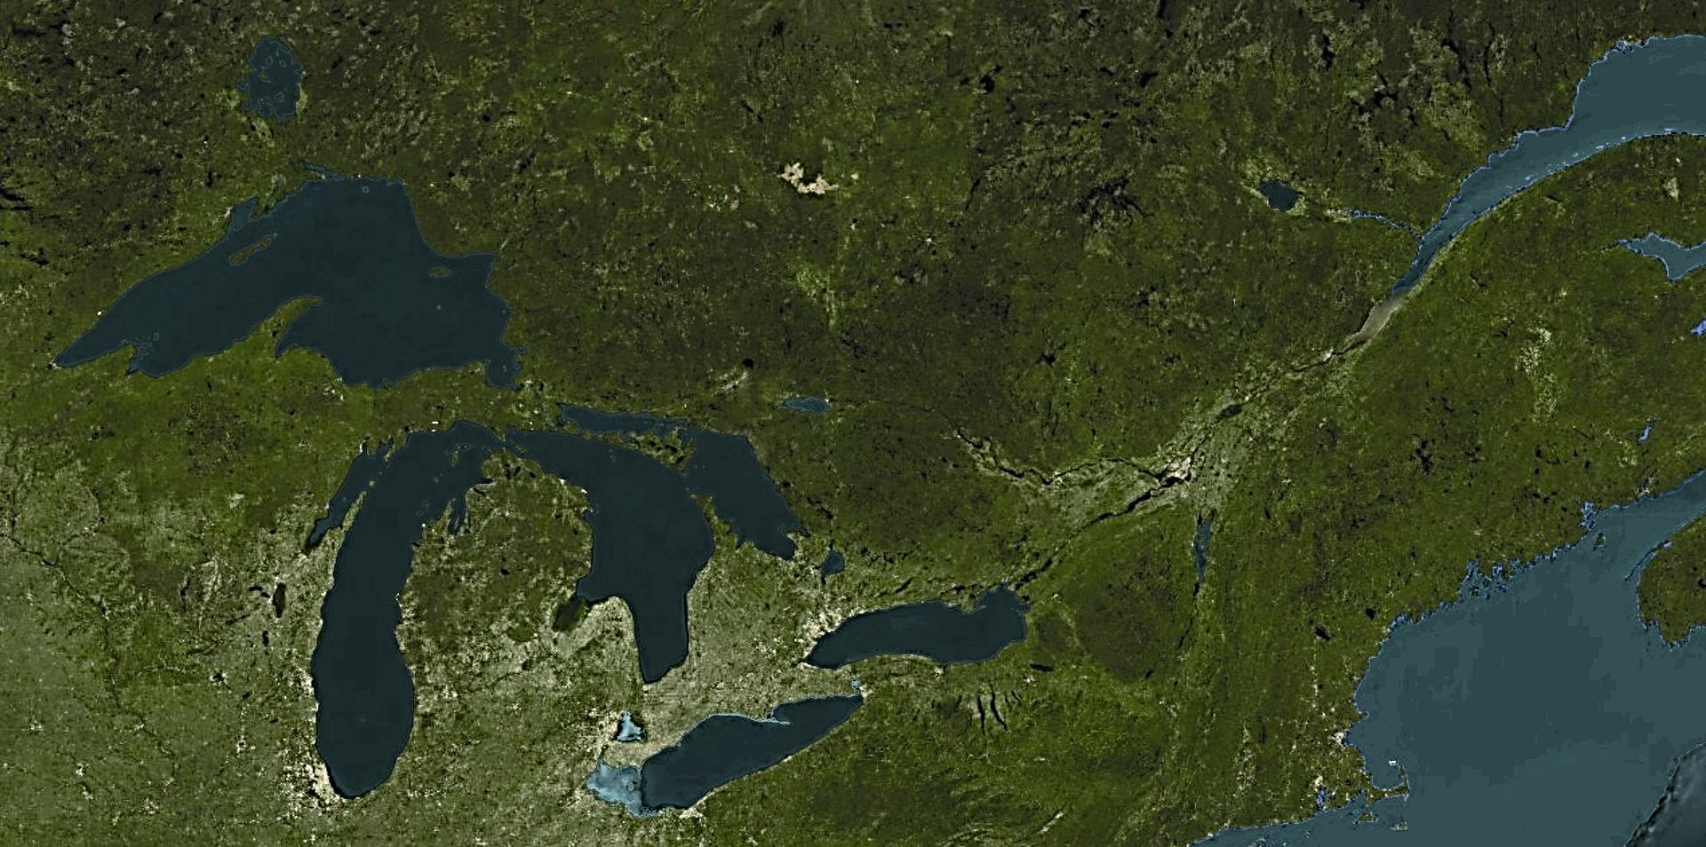
Director | Overview
The Great Lakes - Largest freshwater system on Earth
The Great Lakes hold 6 quadrillion gallons of fresh water; this constitutes 20% of the world’s fresh surface water
and 95% of the U.S. supply.
Notes:
The value of the Great Lakes cannot be overstated. In combination, the Great Lakes contain 95% of the United States’ fresh surface water. Their volume, at 6 quadrillion gallons, would submerge the continental U.S. under nearly 10 feet of water. At 94,000 square miles in area, the Great Lakes are the earth’s largest single supply of fresh surface water. Sheer size and volume make the lakes an important and reliable source of drinking water, transportation, and power for the region and nation.
AREA: The water surface area of the Great Lakes is more than 94,000 square miles—larger than Maryland, Virginia, West Virginia, and New Jersey combined. The total Great Lakes basin is 295,200 square miles.
MAXIMUM DEPTHS: Lake Superior - 1,333 feet, Lake Michigan - 923 feet, Lake Ontario - 802 feet, Lake Huron - 750 feet, Lake Erie - 210 feet.

Slide 4
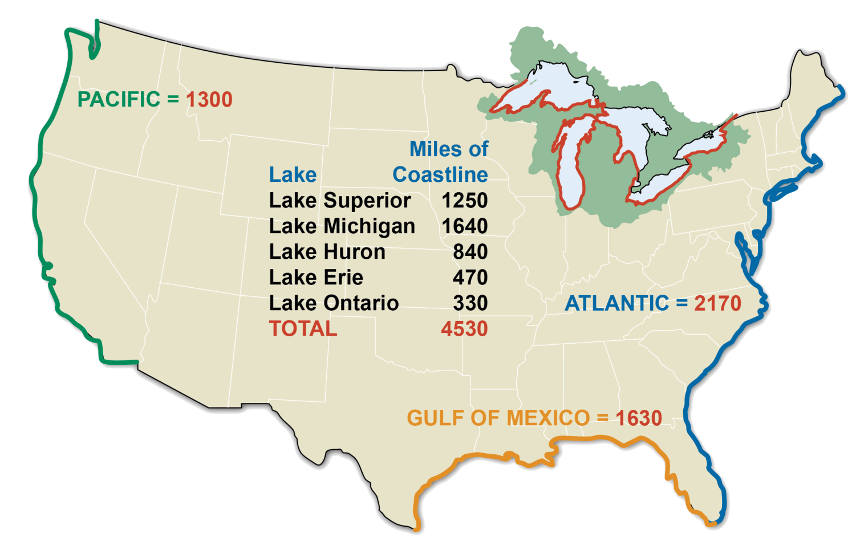
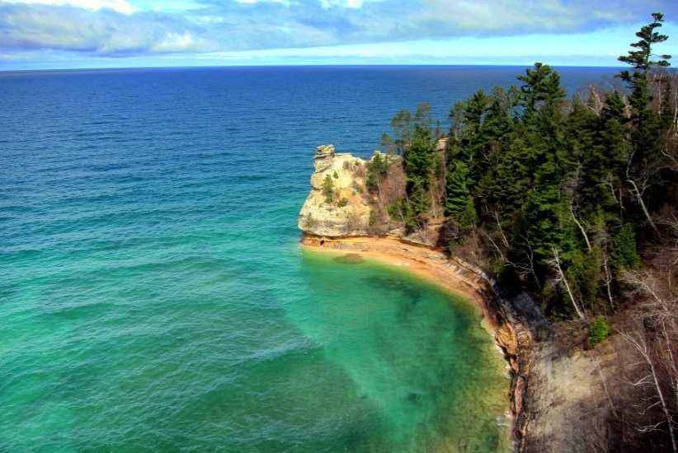
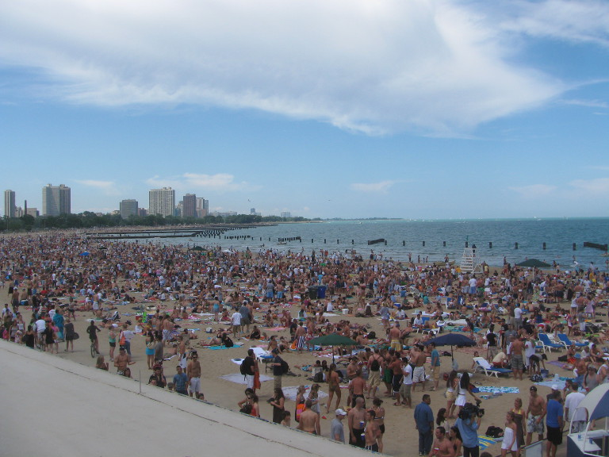
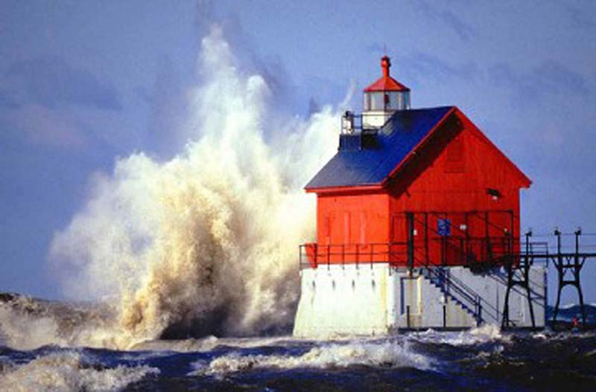
Director | Overview
The Great Lakes U.S. Coastline
Pictured Rocks National Lakeshore,
Lake Superior
North Avenue Beach, Chicago, Lake Michigan
Grand Haven Pier, Lake Michigan
Notes:
COASTLINE: 4,530 miles of U.S. coastline, more than twice the length of the nation’s Atlantic coastline.
DEMOGRAPHICS:
Population: An estimated 105 million people, approximately 33% of the U.S. population, live in the eight states bordering the Great Lakes.
Tribes: There are 37 federally recognized American Indian tribes in the Great Lakes basin.
Geography: The Great Lakes are bordered in the U.S. by Illinois, Indiana, Michigan, Minnesota, New York, Ohio, Pennsylvania, and Wisconsin. The basin includes 158 U.S. counties and 13 major urban areas. In Canada, the basin includes the provinces of Ontario and Québec.
-----------------------------------------------------------
All numbers rounded to the nearest 10 miles. Source: The Coastline of the United States. U.S. Dept. of Commerce, NOAA, NOAA/PA 71046 (Rev. 1975).
Photo credit: (Top right) Pictured Rocks by Bilnkit’s Travel Journal
Photo: North Ave Beach by TonyTheTiger, CC-BY-SA-3.0

Slide 5
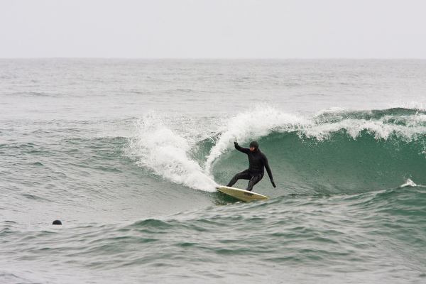
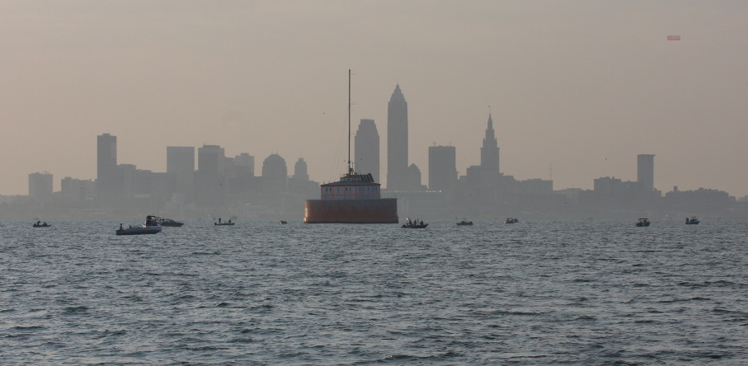
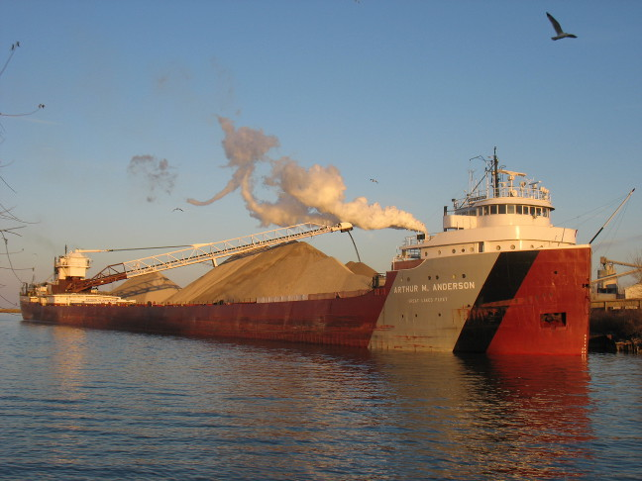
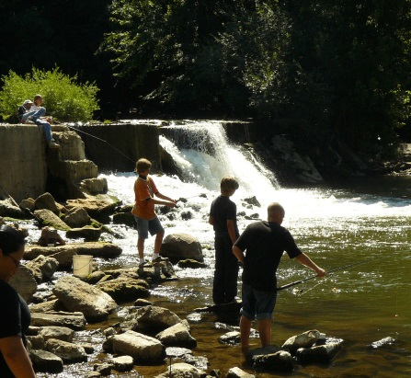
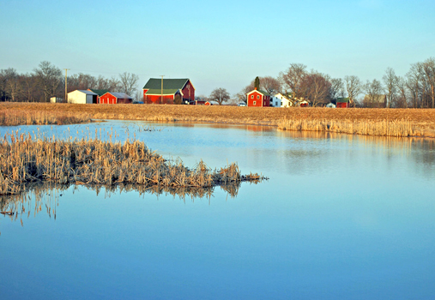
Director | Overview
The Great Lakes – Regional Economy and Natural Resources
Cleveland Water Intake Crib
Recreational Fishing
Surfing on Lake Michigan
The Arthur M. Anderson unloading at Huron, Ohio
Agriculture
Notes:
ECONOMIC IMPACT: The lakes directly sustain more than 1.5 million jobs and generate $62 billion in annual wages. Despite the economic downturn, in 2009, the region was responsible for 27% of the U.S. GDP and 24% of its exports. The Great Lakes region’s GDP in 2015 was $5.8 trillion, or 28% of combined U.S. and Canadian activity.
NATURAL RESOURCE: The Great Lakes provide drinking water to 40 million people in the U.S. and Canada. They also provide 56 billion gallons of water per day for municipal, agricultural, and industrial use. The Great Lakes’ commercial and recreational fisheries contribute more than $7 billion to the regional economy.
Billions of dollars of economic activity is directly tied to Great Lakes environmental quality
Great Lakes tourism and recreation support 217,000 jobs (1):
$16 billion spent on recreational boating -2011 (1)
$11.5 billion spent on wildlife watching in Great Lakes States (2011) (2)
$3 - 7 billion spent on recreational fishing – 2011 (3)
$22.5 million commercial fishery harvest – (4)
Sources:
2011 report, Michigan Sea Grant.
2011 National Survey of Fishing, Hunting, and Wildlife-Associated Recreation U.S. Fish and Wildlife Service and U.S.
Census Bureau.
Sportﬁshing in America: An Economic Force for Conservation. 2012. Produced for the American Sportﬁshing Association (ASA) under a U.S. Fish and Wildlife Service (USFWS) Sport Fish Restoration grant
Commercial Fisheries Baseline Economic Assessment - U.S. Waters of the Great Lakes, Upper Mississippi River, and Ohio River Basins. 2012. US Army Corps of Engineers.
Photos:
(Top Left) Cleveland Water Intake Crib by Andy Jones, Cleveland Museum of Natural History, CC-BY-NC-SA-2.0
(Bottom Left) A.M. Anderson by Zars, CC-BY-SA-3.0
(Bottom Right) Farm wetland in Michigan. Farm conservation programs are essential for Great Lakes restoration. Photo by Stephen J. Brown.

Slide 6
Director | GLERL Overview
40 Years of Great Lakes History
1909 Boundary Waters Treaty
Clean Water Act:
Established the structure for regulating discharges of pollutants into U.S. waters and regulating quality standards for surface waters
Great Lakes Restoration Initiative (GLRI)
U.S. Federal Investment
Implements GLRC Strategy
GLERL is 1 of 16 agencies partnering on GLRI
GLWQA Protocols Updated
Invasives
Chemicals of Mutual Concern
NOAA GLERL is established
GLWQA Renewed
1987
2002
2005
1909
1972
1974
1978
2010
2012
Amendments to GLWQA
Designated 43 “Areas of Concern” (AOCs)
26 in U.S. waters
2 in Canadian waters
5 binational
Great Lakes Regional Collaboration (GLRC)
Coalition of states, tribes, municipalities, federal partners, etc.
Identified restoration and protection priorities
Developed “Strategy to Restore and Protect the Great Lakes”
Great Lakes Water Quality Agreement (GLWQA)
Expresses the commitment of U.S. and Canada to “restore and maintain the chemical, physical and biological integrity of the Great Lakes Basin Ecosystem”
Great Lakes Legacy Act
Provides funding to clean up contaminated sediment in U.S. and binational AOCs
Notes:
Boundary Waters Treaty: The stage for addressing the environmental challenges of the binational Great Lakes watershed was set as far back as 1909, with the signing of the Great Lakes Boundary Waters Treaty by the United States and Canada.
Great Lakes Water Quality Agreement (GLWQA):
Almost 70 years later, in 1972, the two countries reaffirmed their rights and obligations to restore and maintain the chemical, physical, and biological integrity of the Great Lakes basin ecosystems, through the signing of the Great Lakes Water Quality Agreement (GLWQA).
Clean Water Act: In the same year, the United States further strengthened their commitment to environmental protection with the passage of the Clean Water Act. The GLWQA—amended in 1983, 1987, and 2012—is driven by ongoing efforts to advance the restoration and protection of the Great Lakes.
Great Lakes Regional Collaboration:
Although progress followed these policy developments, recovery from severe disruptions to the Great Lakes system required expanded efforts for ecological recovery, which led to the enactment of the Great Lakes Regional Collaboration (GLRC) in 2004. Built upon a Presidential Executive Order in 2003, a unique partnership of federal, state, tribal, and local governments convened under the GLRC to develop recommendations for action that are based on more than three decades of restoration planning, water quality study, and resource management.
Great Lakes Restoration Initiative (GLRI): In 2010, Congress appropriated funding to implement these recommendations under the Great Lakes Restoration Initiative (GLRI). Serving as a catalyst for federal agency coordination, the GLRI has funded the implementation of more than 2,669 projects from 2011-2015 that address Great Lakes environmental problems, such as water quality improvement, restoration and protection of native habitat, and the prevention and control of invasive species.

Slide 7
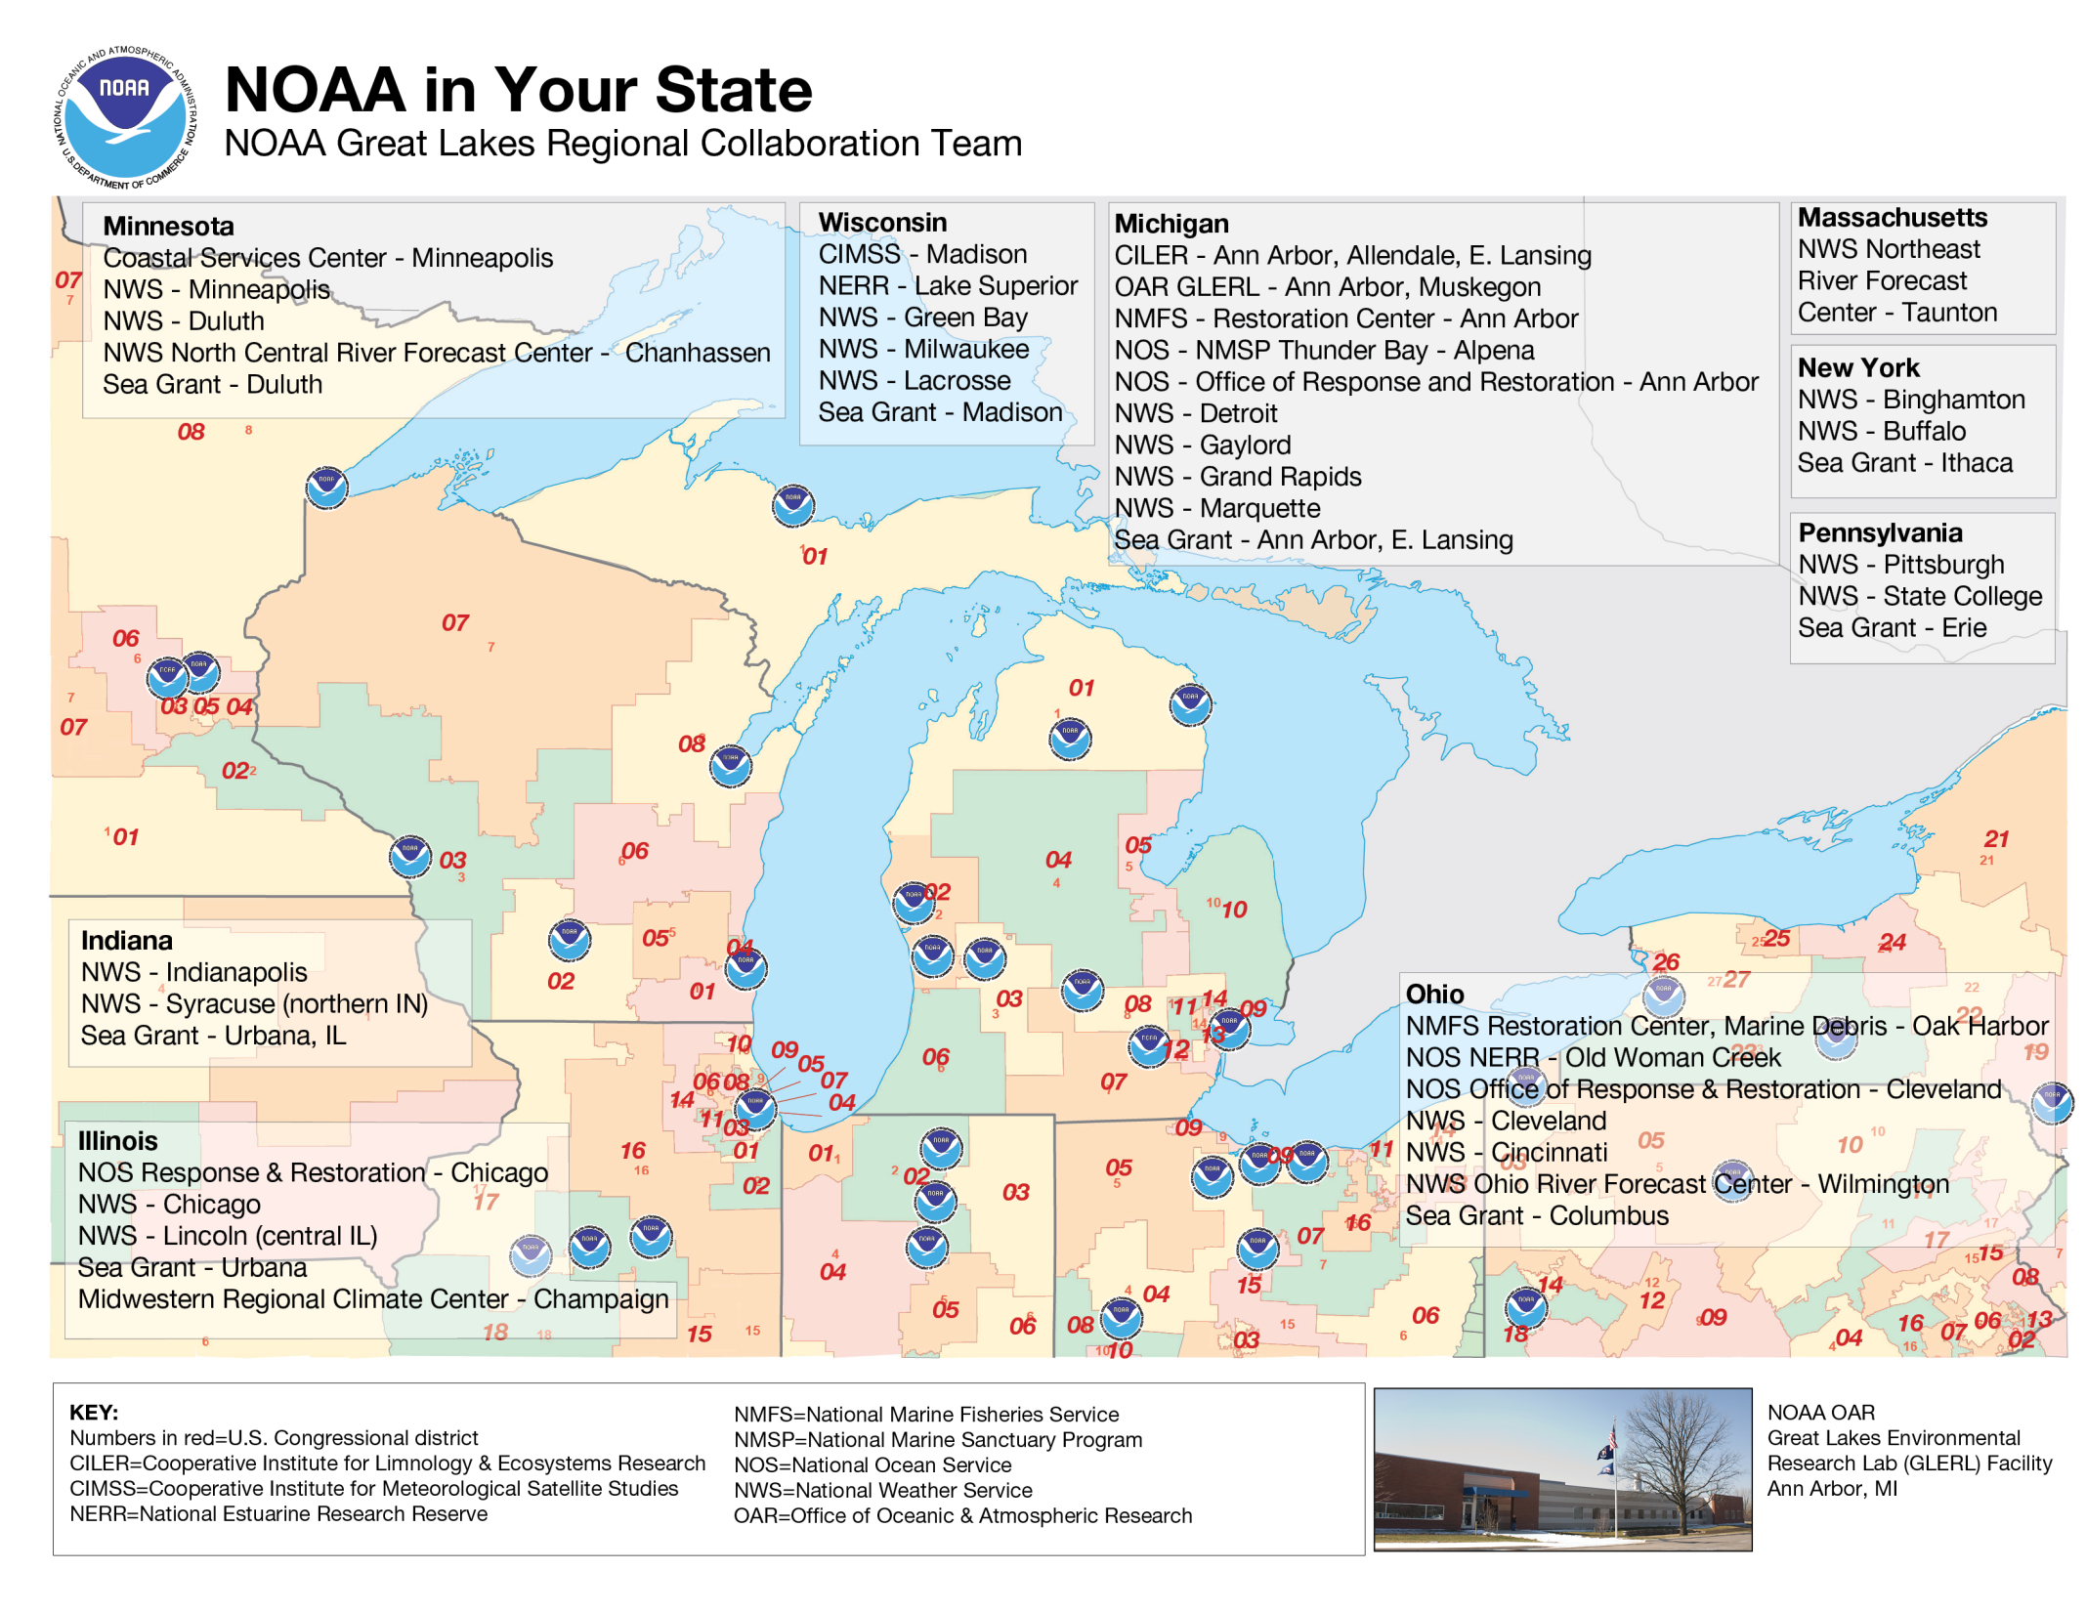
Director | Overview
7/52
Notes:
NOAA provides individuals, communities, businesses, and nations with the information each needs to make smart decisions when it comes to the atmosphere, oceans, and Great Lakes.
NOAA’s services in the Great Lakes region include weather warnings and climate forecasts, research and habitat restoration, and coastal protection and management.
Red numbers on figure = Congressional Districts, there are 8 states with 36 Congressional Districts on Great Lakes & connecting waterways coastline
Minnesota – District 8 Lake Superior
Wisconsin – District 7 Lake Superior, Districts 1, 4, 6 & 8 Lake Michigan
Illinois – Districts 1, 2, 5, 7, 9 & 10 Lake Michigan
Indiana – District 1 Lake Michigan
Michigan –
Districts 1 Lakes Superior, Michigan & Huron,
Districts 1, 2, 6 Lake Michigan
District 7, 12 Lake Erie,
District 9 Lake St. Clair
District 1, 5, 10 Lake Huron
Districts 12 & 13 St. Clair River
District 14 Lake St. Clair, St. Clair River
Ohio – Lake Erie Districts 9,11 & 14
Pennsylvania – Lake Erie Districts 3,5
New York –
Lake Erie Districts – 23, 26, 27
Lake Ontario Districts – 21,22, 24, 25 & 27

Slide 8
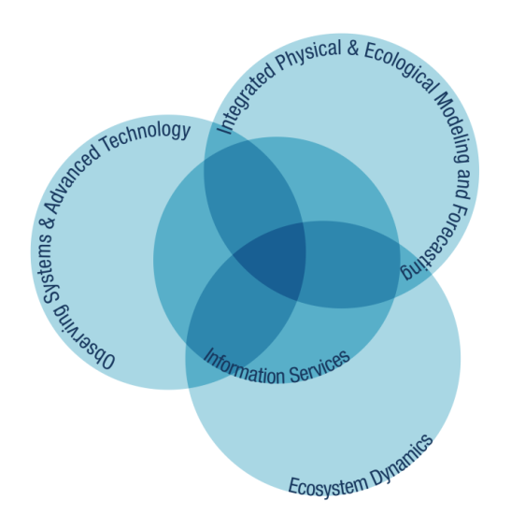
Where we are in NOAA
Director | Overview
Notes:
NOAA is an agency that enriches life through science. Our reach goes from the surface of the sun to the depths of the ocean floor as we work to keep citizens informed of the changing environment around them.
GLERL is champion of NOAA’s Oceanic and Atmospheric Research (OAR) Freshwater Mission. There are three “wet” labs in OAR, GLERL is the only freshwater laboratory.
Integrated Scientific Research on the Great Lakes and Coastal Ecosystems
GLERL researchers possess a wide range of scientific disciplines and expertise, allowing them to pursue a unique, multidisciplinary, ecosystem research approach. This focus has advanced our understanding of the underlying physical, chemical, and biological processes in the lakes, and how they affect ecosystem dynamics. GLERL is organized into three cross-cutting research programs.
GLERL’s Three Cross-Cutting Research Programs:
OSAT: Through the development of cutting-edge instrumentation and observing and remote sensing technologies, OSAT team members acquire the data and develop information needed to improve understanding of the Great Lakes ecosystem and support decision-making for improved resource management.
EcoDyn: The EcoDyn branch strives to anticipate, monitor, analyze, understand, and forecast changes in the Great Lakes ecosystem to strengthen capacity for managing water quality, fisheries, and ecosystem and human health.
IPEMF conducts innovative research and develops numerical models to predict the physical, chemical, biological, and ecological response in the Great Lakes due to weather, climate, and human-induced changes. The forecast models and quantitative tools developed by IPEMF researchers allow scientists, coastal resource managers, policy makers, and the public to make informed decisions for optimal management of the Great Lakes and to maintain a healthy, sustainable, resilient ecosystem.
Information Services: IS Coordinates and support information flow internally among staff, throughout NOAA, and externally with stakeholders and the general public to advance science, service, and stewardship of the Great lakes and coastal ecosystems.

Slide 9
GLERL Core Competencies
Director | Overview
Harmful Algal Blooms Research
Great Lakes Regional Climate Modeling
and Forecasting
Great Lakes
Water Level Forecasting and Lake Hydrology
Great Lakes
Long-term Ecological Research
GLERL Core Competencies
Real-Time Environmental Coastal Observing Network
Ice Research, Monitoring, and Forecasting
Great Lakes Coastal Forecasting System
Invasive Species Research
Great Lakes
Regional Fleet
Great Lakes
CoastWatch
Communication
and Outreach
Notes:
Based on its core competencies, GLERL develops a wide range of products that aid decision-making to sustain resilient ecosystems, communities, and economies. These transferable products include;
observational data sets
visualization tools
analysis and forecast products
decision support and situational awareness tools
physical process model parameterizations
assessments
model outputs
climate
ice-hydrodynamic
water budget analyses and reanalyses
These tools are developed in partnership with operational entities across NOAA, foreign and domestic governmental agencies, academic institutions, private industry, and region-specific stakeholders.

Slide 10
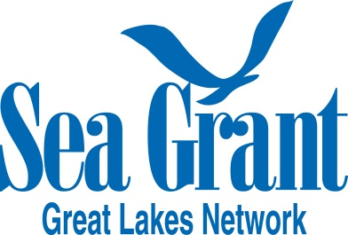
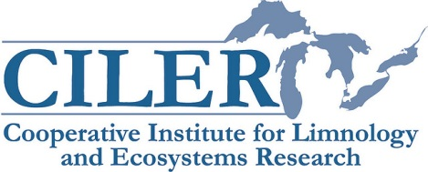
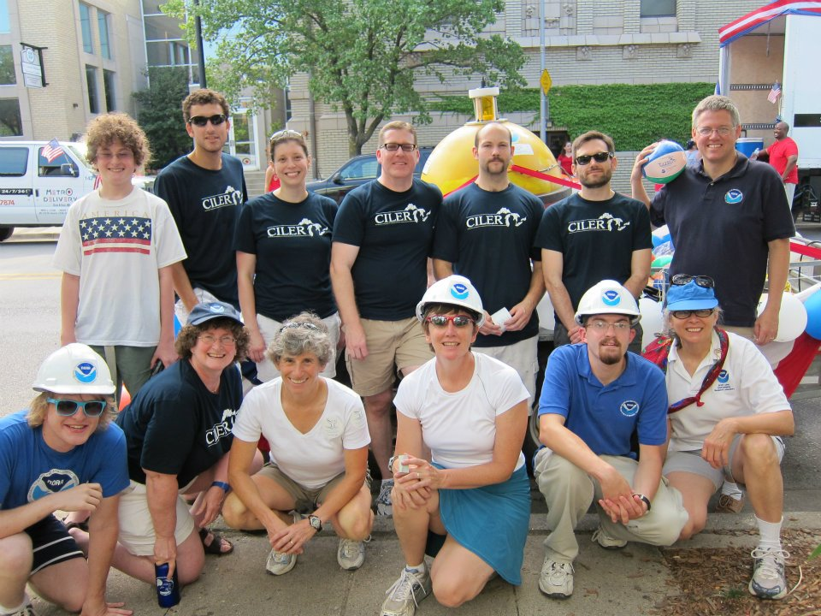
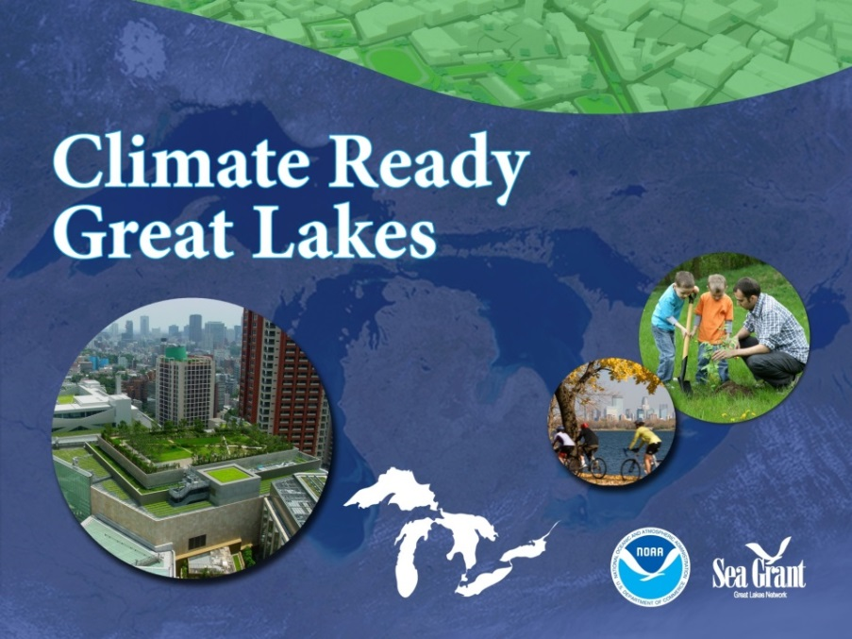
Director | Overview
Key Partnerships
Scientific
Communications and Outreach
Notes:
GLERL’s research capacity is strengthened by its in-house partnership with NOAA’s Great Lakes Cooperative Institute, comprised of a consortium of academic institutions in the region. In addition, NOAA’s Great Lakes Sea Grant Network serves as a vital in-house partnership that functions to connect NOAA research to the communication and outreach capabilities of NOAA Sea Grant.
CILER
1989 – CILER established with signing of an Memorandum of Understanding between the University of Michigan and the Undersecretary of Oceans and Atmosphere, Department of Commerce to foster University and NOAA partnerships in the Great Lakes
In July 2007, new CILER was awarded to the University of Michigan as a host institution and 9 partner universities. (Ohio State University, Michigan State University, Pennsylvania State University, Stony Brook University, University of Illinois, University of Minnesota, University of Toledo, University of Wisconsin, Grand Valley State University)
SEA GRANT
The Great Lakes Sea Grant Network is comprised of the eight Great Lakes state Sea Grant programs. In 2001, an innovative position was established to enhance connectivity between GLERL research and Great Lakes Sea Grant programs. Located at GLERL, the Regional Sea Grant Specialist position facilitates information exchange between GLERL and Sea Grant regarding Great Lakes-related research, extension, education, and other programs. Additionally, the specialist develops collaborative extension, communications, and outreach programs that draw upon the work of GLERL and Sea Grant, directed towards specific Great Lakes stakeholder audiences and/or the general public.

Slide 11
Director | Overview
Who is GLERL?
Vision
“A trusted scientific enterprise to advance observation, modeling, understanding, and prediction of the Great Lakes and coasts to sustain resilient ecosystems, communities, and economies.”
Mission
“Conduct scientific research on the Great Lakes and coastal ecosystems; develop and transition products and services; and share knowledge and information to advance science, service and stewardship.”
Notes:
GLERL Organizational Goals: (Strategic Plan 2016-2020 draft)
http://www.glerl.noaa.gov/review2016/reviewer_docs/GLERLStrategicPlan2016.pdf
Preeminent Research | Conduct preeminent research aligned with NOAA goals to advance the state of science, increase knowledge, and promote sound decision-making and ecosystem management.
Organizational Excellence | Achieve excellence by building the capacity of NOAA personnel, infrastructure, and business practices that advance and support NOAA’s mission of science, service and stewardship.
Integrity and Quality | Execute research with integrity and quality, abiding by environmental compliance, quality management and safety standards, and acknowledging uncertainty.
Diversity | Secure a diverse workforce that is supported by an organizational culture of inclusiveness.
Interdisciplinary and Partnership Approach | Integrate an interdisciplinary approach and use partnerships, such as those with the NOAA Cooperative Institutes, to strengthen capacity in reaching institutional goals.
Balanced Research Portfolio | Balance GLERL’s portfolio between fundamental and applied research.
Transition to Application | Facilitate transition to operations and application (R2X) as part of the development and implementation of research programs.
Addressing Stakeholder Needs | Serve NOAA’s customer base through communication, including needs assessment, consistent messaging and accessibility of GLERL’s observations and data, scientific knowledge and information, and products and services.
Return on Investment | Provide value to the nation through effective use of taxpayers’ investment.
Physical Access to the Great Lakes | Serve as a resource to NOAA and regional partners by providing physical access to the Great Lakes through GLERL’s Lake Michigan Field Station and vessel fleet.

Slide 12
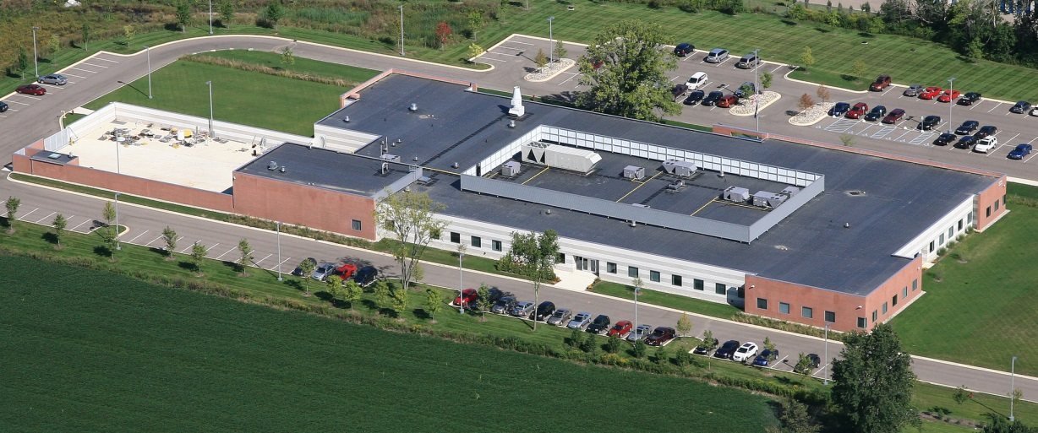
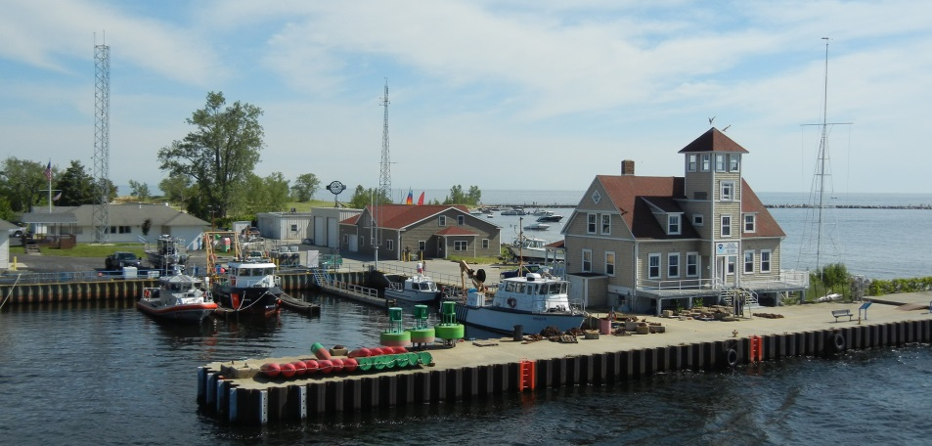
Director | Overview
GLERL Today
Notes:
GLERL leases a customized 45,000 square foot facility in Ann Arbor, Michigan which houses: 101 offices, 5 conference spaces (including a 150-seat lecture hall), 17 laboratories (11 wet labs, 6 dry labs), 2 computer labs, 14 storage areas, 10,000 square foot outdoor wareyard.
Shared office space serves as a base for staff from NOAA’s Great Lakes Cooperative Institute as well as partner agencies including NOAA National Ocean Service (NOS) Marine Sanctuary Program, NOAA National Marine Fisheries Service (NMFS) Habitat Restoration Program, NOAA Great Lakes Regional Collaboration Team, Great Lakes Sea Grant, and the International Association for Great Lakes Research. The facility also serves as a physical hub for regional collaboration within its conference spaces
The laboratories—managed and coordinated by the GLERL lab team—house instrumentation and equipment for use by GLERL and NOAA Cooperative Institute and visiting scientists. The facilities design allows for both dedicated and flexible lab spaces.
Lake Michigan Field Station: http://www.glerl.noaa.gov/lmfs/index.html
Located on Lake Michigan's Muskegon Channel, GLERL's field station occupies three buildings. The main building (1) was originally built in 1905 to serve the U.S. Life Saving Service. It was restored in 2005 to mark the 100th anniversary.
The LMFS is strategically positioned on Lake Michigan to provide support to the local and regional community by further developing NOAA’s role in freshwater ecology, ecosystems management, coastal management, and water-based commerce. This field station promotes long-term observations, field work, and process studies essential for understanding and developing future ecological services. Additionally, the proximity of the field station to Lake Michigan provides a unique opportunity for engagement with tourists, recreational users, and members of the community
Vessel operations, based at the LMFS, support GLERL science branches by providing a safe and secure work environment in the conduct of scientific research. Additionally, vessel operations provide expertise to NOAA in small research vessel (SRV) operations. The mobility of GLERL vessels offers unique place-based opportunities for communications and education at Great Lakes Ports of Call.
Muskegon - Building 1: 3,764 sq. ft. Office, lab, meeting space
Muskegon - Building 2: Newly rebuilt since last review; Includes consolidation of boat operations, storage, office space and a small lab space
Focused on going Green
Muskegon - Building 3: 2,400 sq. ft. Office and lab space; Working to renovate building 3
.

Slide 13
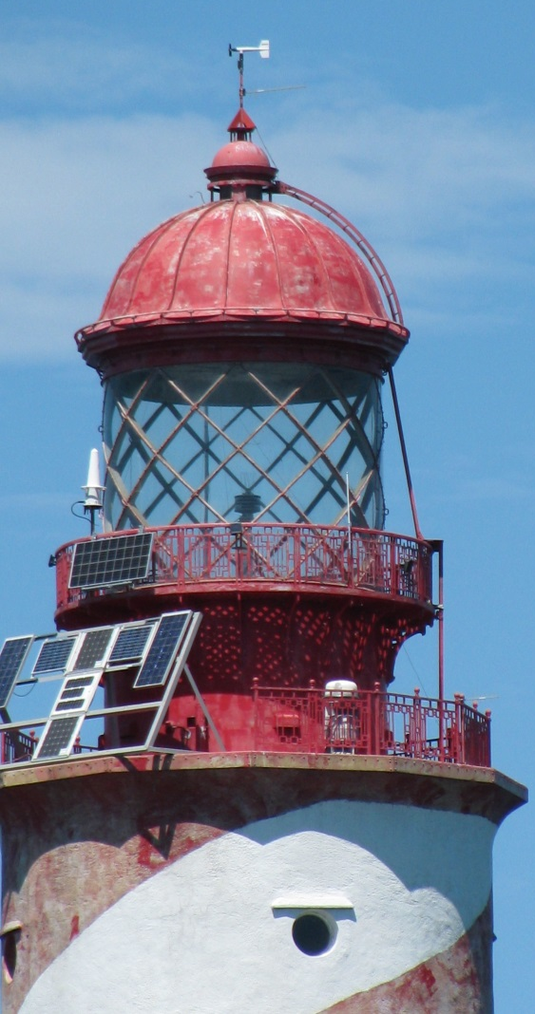
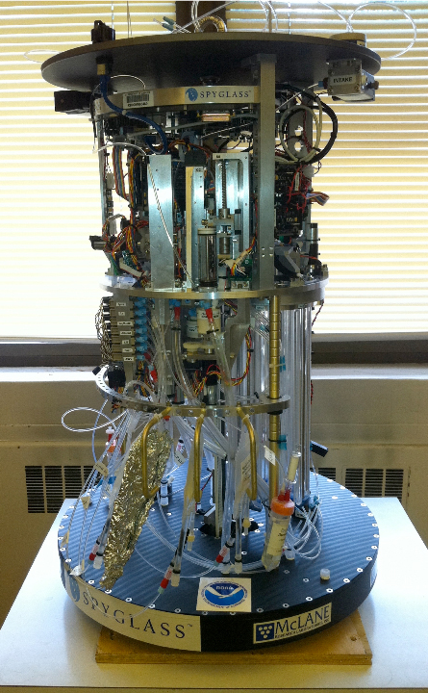
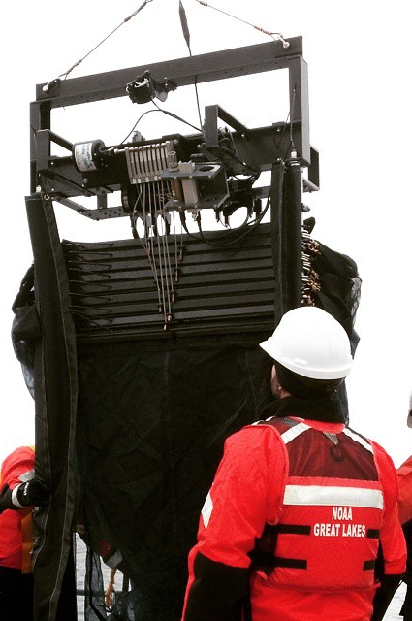
Innovative
Director | Overview
Eddy Covariance Station
ESP
MOCNESS
Notes:
Cutting-edge instrumentation
Eddy Covariance Station
Installation of new equipment on the White Shoal Light in northern Lake Michigan established telemetry so that the data being gathered at the Eddy Covariance Station there can be monitored and collected at GLERL. An eddy covariance station measures atmospheric fluxes that allow over-lake evaporation to be estimated.
GLERL has 5, year round, off-shore, real-time observing stations deployed on navigations structures:
Stannard Rock – Middle of Lake Superior
White Shoal - Northern Lake Michigan
Spectacle Reef – Lake Huron
Toledo channel marker #2 – Lake Erie
Chicago Water Intake
GLERL has been providing a leadership role in collecting and transmitting data from these unique offshore platforms in partnership with Environment Canada, University of Colorado - Boulder, Limnotech, GLOS and the University of Toledo
ESP: GLERL and CILER have maintained observing systems and sampling programs in Western Lake Erie for several years, and have received support from the Great Lakes Restoration Initiative to expand these capabilities since 2010. To expand these efforts, NOAA-GLERL will be responsible for three integrated projects that will increase our capacity to monitor and forecast bloom events: 1) deploy instrumentation capable of detecting harmful algal bloom (HAB) toxicity in near real-time, 2) use airborne sensors to track areal extent, and 3) deploy in situ sensors on autonomous vehicles to detect bloom initiation. The first part of the project will be the acquisition of and microcystin assay development for the Environmental Sample Processor (ESP). These data will help inform operators of drinking water utilities in western lake Erie of changing HAB conditions in the lake that are likely to impact the quality of their raw water.
MOCNESS: The MOCNESS cam sample fine-scale (m) vertical and horizontal distributions of mesozooplankton, large zooplankton such as Bythotrephes, and micronekton including Mysis and larval fishes. There is extreme diel vertical migration of zooplankton, micronekton, and fishes, and their densities are highly concentrated in relatively thin layers associated with thermal structure and phytoplankton concentrations that can be sampled well only by this technology.

Slide 14
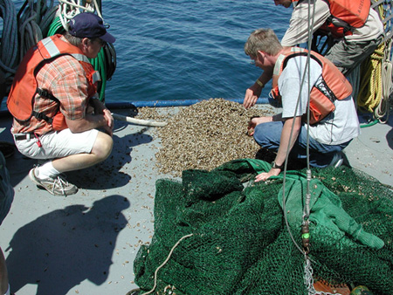
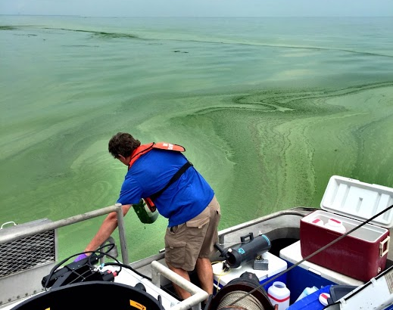
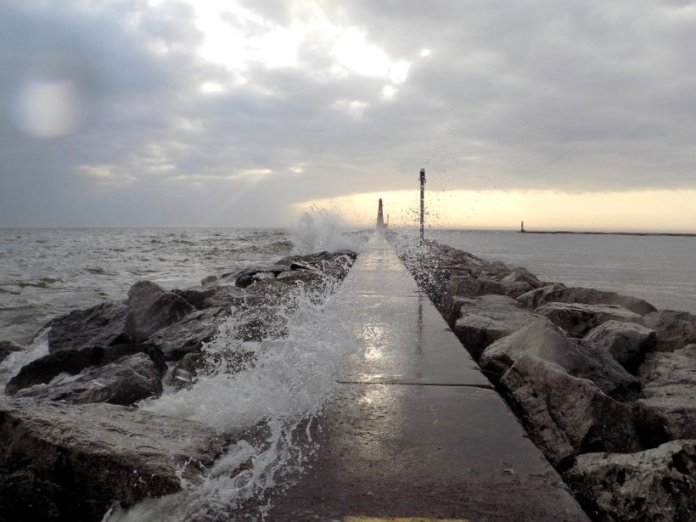
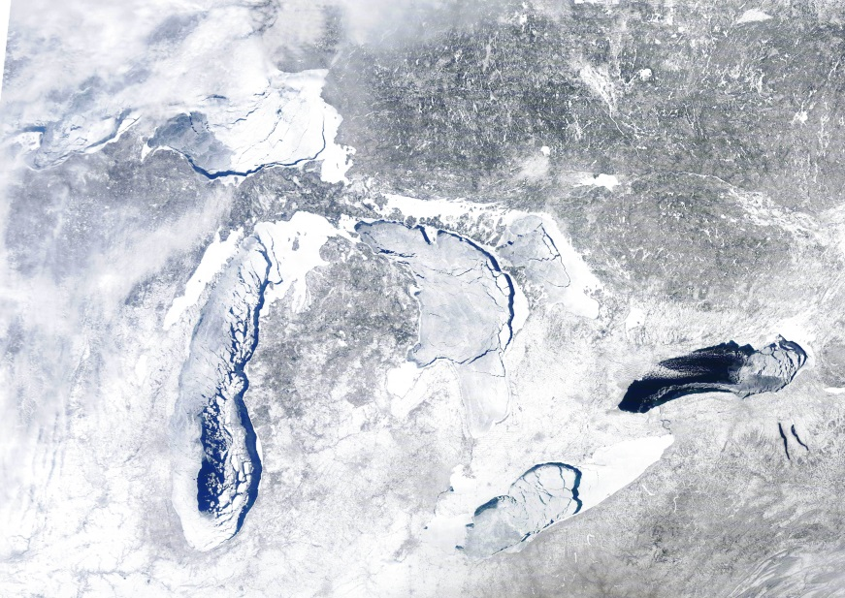
Relevant
Director | GLERL Overview
Addressing Great Lakes Issues:
Invasive Species
Harmful Algal Blooms
Fluctuating Lake Levels
Climate
Notes:
Aquatic Invasive Species (AIS) – Over 180 nonindigenous species have been identified as being established in the Great Lakes. More than 40% of these species were discovered after the 1959 opening of the St. Lawrence Seaway, which enabled ocean-going ships to enter the Great Lakes. Nonindigenous species are considered to be invasive when their introduction and spread cause economic or environmental harm or risks to human health. NOAA collects long-term ecological data, conducts fundamental research on ecosystem processes, and develops physical and ecological models to predict potential AIS impacts.
Harmful Algal Blooms (HABs) - During warm weather, areas of the Great Lakes such as Green Bay on Lake Michigan, Saginaw Bay on Lake Huron, and in particular, the western basin of Lake Erie experience intense harmful algae blooms. Often, these blooms contain toxins such as microcystin, leading to the degradation of water quality and unsafe conditions for aquatic life and humans. This affects fishing, recreation, and especially municipal drinking water. NOAA is working to determine the factors controlling microcystin production and to develop methods for predicting location, intensity, and movement of HABs from satellite imagery and lake circulation. NOAA’s HAB bulletin provides a weekly forecast for these blooms in Western Lake Erie, while its HAB Tracker combines remote sensing, monitoring, and modeling to produce 5-day forecasts of bloom extent, intensity and movement. These real-time predictions are updated twice daily and can provide water intake managers, anglers, recreational boaters, and beach users timely information for decision-making.
Climate - A changing climate presents unique challenges for the Great Lakes. Long-term studies conducted by NOAA show diminishing duration and thickness of ice cover. The 2014 National Climate Assessment forecasts changes in the range and distribution of important commercial and recreational fish species, increases in numbers and success of invasive species, declines in beach health, increases in harmful algal blooms, and declines in ice cover. Heat wave intensity, extreme rainfall events, and flooding are expected to increase, with negative impacts on transportation, agriculture, human health, and infrastructure. In light of these forecasted impacts, NOAA has developed resources that enable coastal community planners, conservation practitioners, and decision-makers to better adapt to and plan for the effects of climate change in their communities.
Water Levels - NOAA is addressing water level management through multiple venues including understanding of historical trends and reasons for recent record low levels on Michigan-Huron, improving forecasting tools, and improving access to publicly-available water level information using state of the art visualization tools such as our Great Lakes Water Level Dashboard and Lake Level Viewer. Regional federal agencies (including NOAA/GLERL, the U.S. Army Corps of Engineers, and Environment Canada) continuously monitor and forecast Great Lakes water levels through a binational federal agency research-to-operations partnership. For example, the shoreline water level gauging stations throughout the Great Lakes are operated by both NOAA National Ocean Service (NOS) Center for Operational Oceanographic Products and Services (CO-OPs) and the Canadian Hydrographic Service (CHS). This network has contributed to one of the longest continuous sets of water level measurements for a large water body or coastal area on the planet. In addition, NOAA, the U.S. Army Corps of Engineers, and Environment Canada, through this ongoing research-to-operations collaboration, continue to develop, improve, and publicize monthly Great Lakes water level forecasts. The Coordinating Committee on Great Lakes Basic Hydrologic and Hydraulic Data, formed in 1953, meets bi-annually to discuss and coordinate regional federal agency efforts related to Great Lakes water levels and the regional water budget.

Slide 15
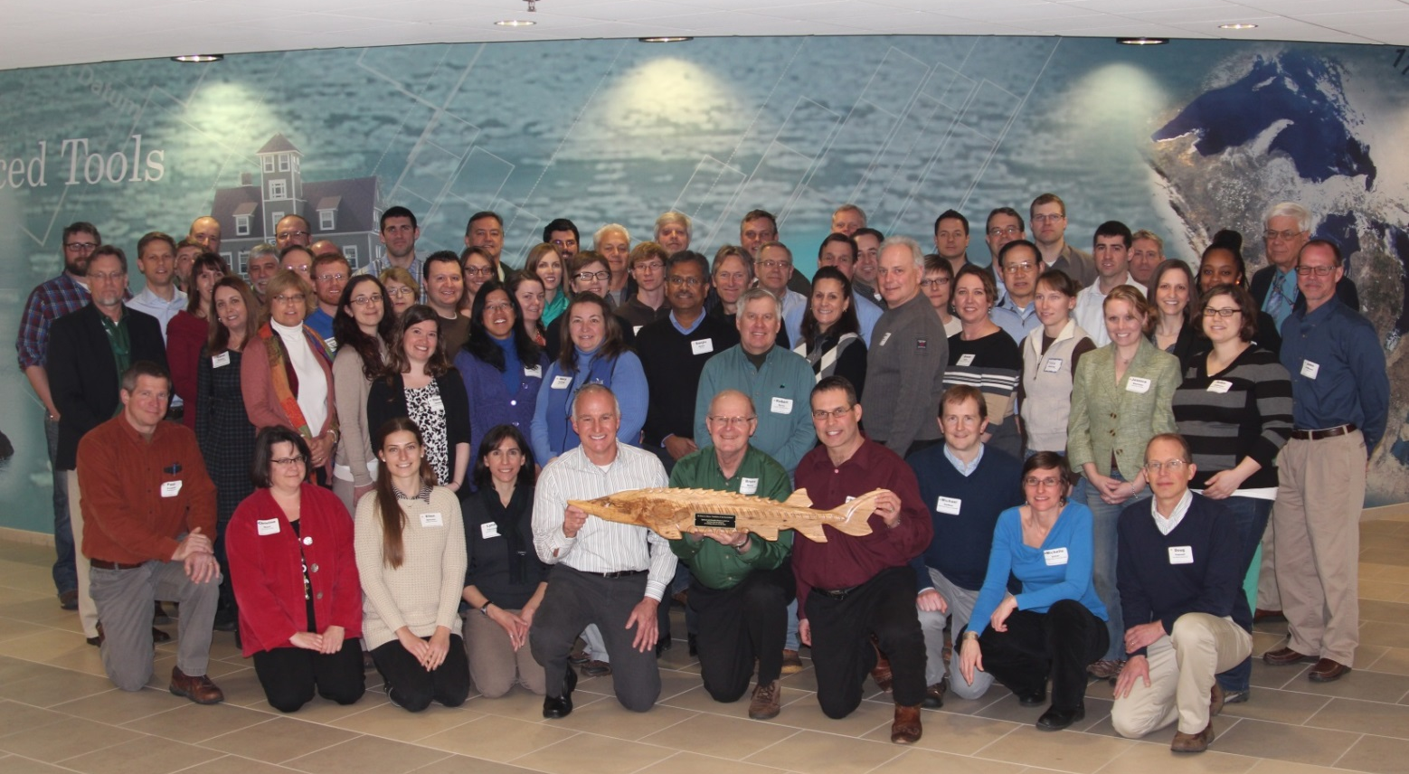
Collaborative
Director | Overview
GLERL promotes synergy and connectivity among local, regional, national, and international partners
Notes:
GLERL serves as both a physical and virtual hub for the Great Lakes region and the nation.
Recent Outreach & Communications efforts by GLERL & partners:
See the Service to Society page on the review web site for complete listing and descriptions of events
http://www.glerl.noaa.gov/review2016/service_to_society.html
Image: group shot from 2015 SCDRS conference hosted at GLERL
St. Clair - Detroit River System Initiative The SCDRS Initiative is a bi-national collaborative partnership with more than 30 organizations, including U.S. and Canadian natural resource-related agencies, Tribes/First Nations, units of local government, industry and university partners, non-profits, and interested citizens.
2015 Collaborative Activities Hosted by GLERL
National Estuarine Research Reserve (NERR) Symposium
NOAA Science Media Briefing on Harmful Algal Blooms (HABs).
Great Lakes Water Budget Workshop
Great Lakes Water Quality Annex 4 Subcommittee Meeting
NOAA Modeling Uncertainty Workshop
Great Lakes Soil Erosion and Sedimentation Workshop
Science Communication Workshop
Webinar: Restore our Water International: Great Lakes Hydrologic Outlook Outlook for water levels on the Great Lakes through 2015
GLERL Hosts National Ocean Science (NOS) Leadership Visit to Initiate Research Collaboration on Ecological Forecasting and Modeling.
The Great Lakes Panel Meeting on Aquatic Nuisance Species (ANS)
Great Lakes Water Quality Agreement (GLWQA): Annex 6: Aquatic Invasive Species
Meeting of the Council of Great Lakes Governors
Great Lakes Water Quality Agreement (GLWQA): Annex 4: Nutrients
The Great Lakes Subgroup of the Harmful Algal Bloom and Hypoxia Research and Control Act (HABHRCA) Interagency Working Group
Coordinating Committee on Great Lakes Basic Hydraulic and Hydrologic Data Semi-annual Meeting of U.S. and Canadian Agencies
Inter-Agency Media Teleconference: Potential Impacts of El Nino on Great Lakes Water Levels
Lake Michigan-Huron Operational Forecasting System Use/Partner Workshop
Regional Coordinating Committee Identifying Future Improvement of Great Lakes Indicators Workshop
Inaugural Meeting of the Great Lakes HABs Collaboratory

Slide 16
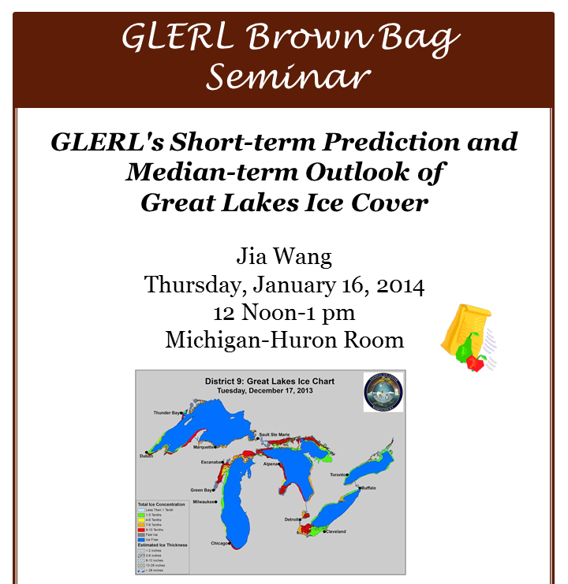
Communicative
Director | Overview
Web Site
Publications
Data Access
Experimental Forecasts
Seminar Series / Webinars
Social Media
Publications
Workshops
Conferences
Notes:
Complete list on Communications Activities & Outreach tab on the Service to Society web page http://www.glerl.noaa.gov/review2016/service_to_society.html
Great Lakes Seminar Series – a collaborative effort between GLERL & CILER (5 in FY15)
GLERL seminars (not broadcast but advertised to local network) (3 in FY15)
GLERL Brown Bags – informal (9 in 2015)
Summer Fellow Brown Bags – Educational series for summer fellows program (4 in 2015)
Summer Fellow final presentations – each student presents at the end of their fellowship ~15 in 2015
Community Events
Recreational Boating Educational Conference: The Michigan Clean Marine Program: Preparing for an Uncertain Future
Ludington Regional Fishery Workshop sponsored by Michigan Sea Grant
Detroit Boat Show
Rotary Club – Great Lakes Water Levels presentation
15th Annual Ann Arbor Mayor's Green Fair, sponsored by the City of Ann Arbor, is held to celebrate the community's environmental leadership exhibited by citizens, nonprofits, government and businesses.
Educational Activities (K-12, undergraduate, and graduate)
Classroom Lesson: St. Matthew Lutheran School: 4th Grade
Eastern Michigan University Tour of GLERL
Great Lakes National Ocean Science Bowl
Information exchange with education leads of Children's Science Museum of Indianapolis
South East (SE) Michigan Science Fair
Science Olympiad Regional Competition
Washtenaw Community College Earth Day
GLERL: Take Your Kid to Work Day
Lansing Catholic Central High School – classroom presentation
Career Pathways Expo on Science, Technology, Engineering, Arts, and Math (STEAM)
College-level Class: University of Michigan Biological Station Field Methods in Great Lakes Oceanography
Media Briefings – recent examples
Media Briefing on Great Lakes Water Levels
Impacts of El Nino on Great Lakes water levels media teleconference

Slide 17
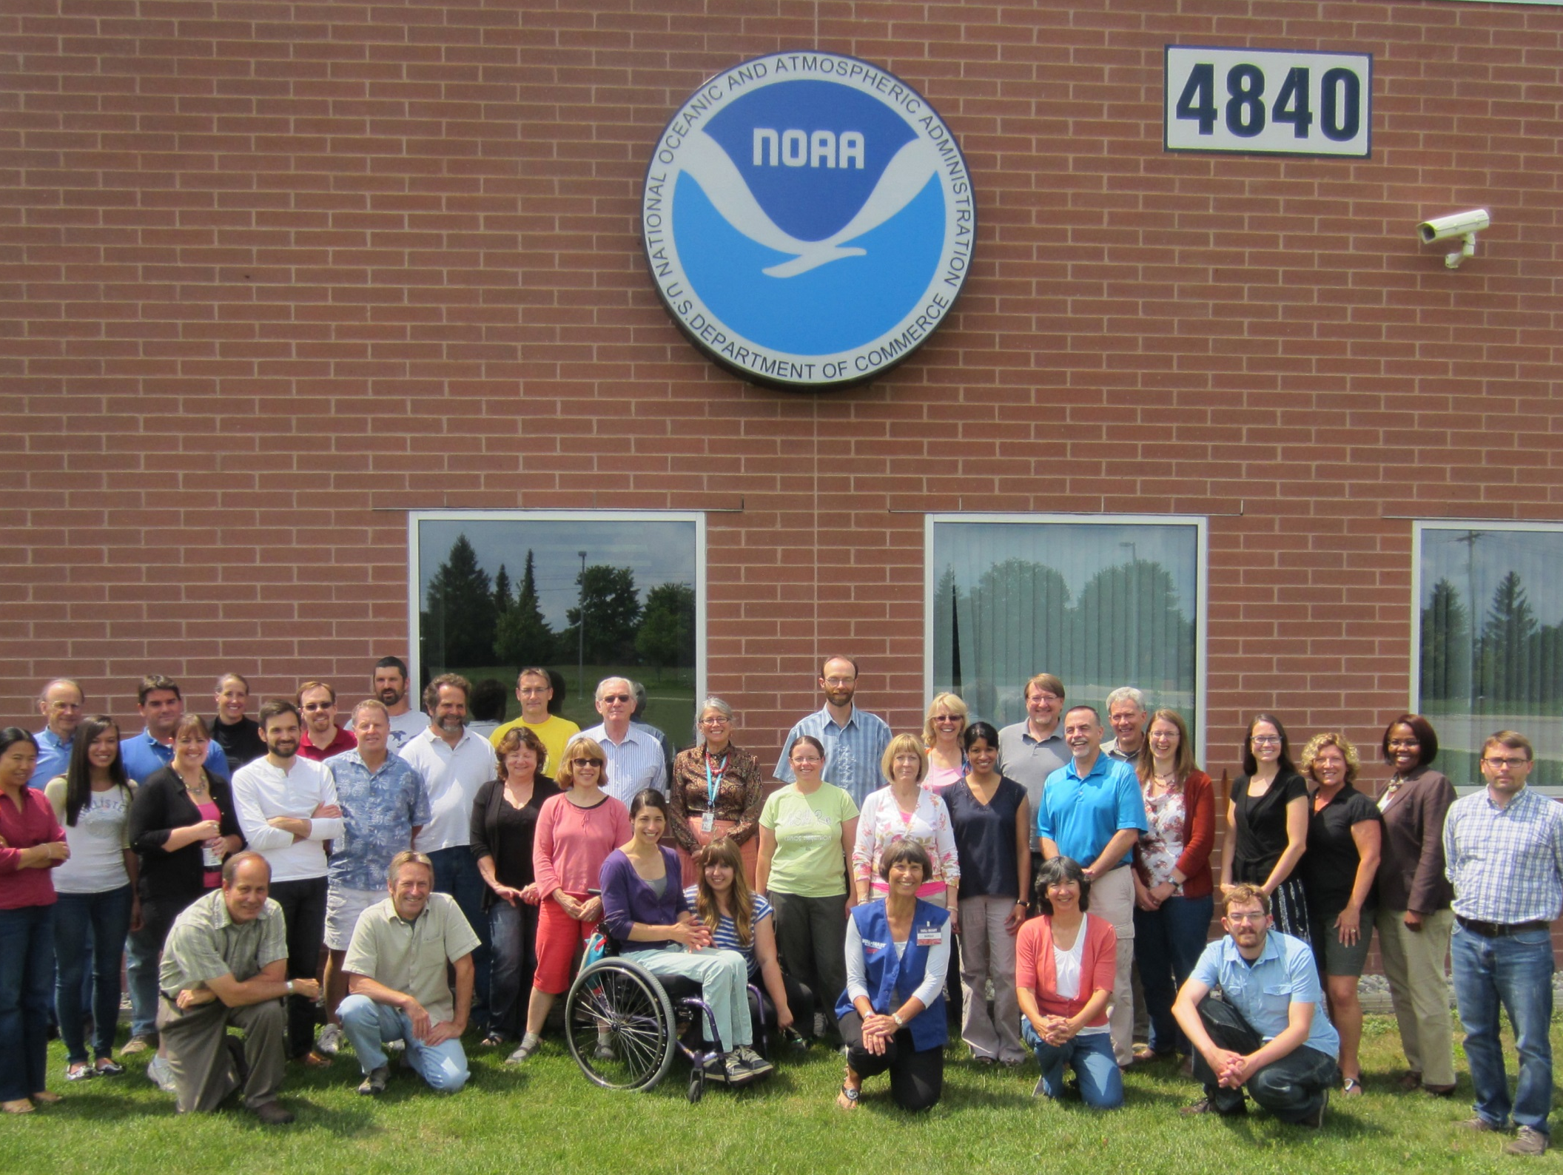
GLERL Workforce
Director | Overview
17/30
Notes:
Partnership Council:
The Partnership Council is comprised of union and management representatives. The Partnership Council meets monthly with standing members including the GLERL director and the administrative lead, serving as the facilitator. Rotating membership includes three union members and two TLERL managers. The forum provides an opportunity for constructive and proactive problem-solving.
AFGE Local 3908
1981 – January American Federation of Government Employees Local 3908 established in order that employees and management may work together toward the common goal of the accomplishment of the agency mission and increasing the efficiency of the agency.

Slide 18
GLERL Workforce
Director | Overview
Notes:
GLERL Structure since 2011
For a complete description of the GLERL organizational structure and advising councils (Science, Director’s, Infrastructure, and Partnership Council) please see page 15 of the draft Strategic Plan 2016-2020.
http://www.glerl.noaa.gov/review2016/reviewer_docs/GLERLStrategicPlan2016.pdf
GLERL’s staffing plan is included in the appendices of the draft Strategic Plan 2016-2020.
http://www.glerl.noaa.gov/review2016/reviewer_documents.html
The staff updates are on the NOAA GLERL Organization Chart on the GLERL website:
http://www.glerl.noaa.gov/about/org/
Staff Numbers By GLERL Branch
Total number of Federal FTE (Full Time Equivalent) Principle Investigators = 14
OSAT: 13 total - 8 Feds, 5 contract (4 = vessel crew, 1 MIL tech)
EcoDyn: 14 total - 11 Feds, 2 contract (both contract @ LMFS), 1 visiting scientist
IPEMF: 12 total - 9 Feds 3 visiting Scientists
IS: 2.5 total - 2 Feds, ½ time contract
Admin: 7 total - 5 Feds, 2 contract
IT: 5 total - 3 Feds, 2 contract
Quality, Safety & Environment: - 1 Fed
Great Lakes Sea Grant Network: 1 position - 0.4 GLERL / 0.6 Sea Grant

Slide 19
Director | Overview
GLERL 2005 – 2016 Staffing Profile
Notes:
*As of 1 Oct for the FY shown (i.e., 1 Oct 11 for 2012) or as close to 1 Oct as possible
*2016 numbers as of Jan 2016
*Additional 10-15 Summer Fellows per year, mostly CILER, and ~10 Visiting Scientists
*Gradual decline in federal staff due to hiring freeze and Workforce Management hiring delays
*Increase in CILER and Contract due to GLRI funds starting in FY10
Staffing changes since 2010:
Total hires = 13 Steve Ruberg, OSAT Lead - Backfill Fahnenstiel Ashley Baldridge, Benthic Ecologist - Backfill Nalepa Eric Anderson, Research Physical Scientist
Tim Davis, Molecular HAB Ecologist - Backfill Dyble Philip Chu IPEMF Lead, Supervisory Physical Scientist – Backfill Schwab
Travis Nester, IT Specialist - Backfill Muhr Kyle Beadle, General Engineer - Backfill Lane Brad Sagowitz, IT Lead - Backfill Fenton Deborah Lee, Director - Backfill Marie John Bratton, Deputy Director - Backfill Sellinger Nicole Rice, Editor - Backfill Darnell
Mike Ryan, Office Automation Assistant /Mgmt. & Program Analyst Margaret Lansing, Communications Specialist – Series change
Total departures = 14
9 Retired Gary Fahnenstiel Tom Nalepa Steve Lozano Dave Schwab John Fenton John Lane Glenn Muhr Nathan Hawley Cathy Darnell
5 left the agency Giselle Maira Julie Dyble Bressie Mike Taetsch Tom Joyce
John Bratton

Slide 20
Director | Overview
FY16 Federal Staff Diversity
(29)
(12)
Ethnicity | #
White/Caucasian | 37
Asian | 2
African American | 1
Native American | 1
Age
Notes:
*Total males = 29 and total females = 12
Gender ratio 2:1, but overall diversity for Federal FTE’s remains an issue. GLERL Hiring capacity is limited by an FTE cap of 50 permanent.
The overall diversity and age range of on-site staff at GLERL is enriched by:
Cooperative Institute for Limnology and Ecosystems Research staff http://ciler.snre.umich.edu/
For a list of GLERL Principle Investigator adjunct academic appointments as well as mentorships (post-graduate, graduate, undergraduate, and K-12) see: http://www.glerl.noaa.gov/review2016/service_to_society.html
Great Lakes Summer Fellows Program http://ciler.snre.umich.edu/education/undergraduate-graduate-fellowships
As part of its efforts to educate and train a new generation of research scientists, CILER administers an annual Great Lakes Summer Student Fellows Program. This program is a true partnership with NOAA's Great Lakes Environmental Research Lab (GLERL) and helps place promising young undergraduate and graduate students with both University and Federal research mentors.
NOAA Educational Partnership Program (EPP) http://www.epp.noaa.gov/
The goal of the Educational Partnership Program with Minority Serving Institutions is to increase the number of students from underrepresented communities who are educated, trained and graduated in fields that directly support NOAA's mission.
NOAA Hollings Scholarship Program http://www.oesd.noaa.gov/scholarships/hollings.html#page=program
The Hollings Scholarship Program provides successful undergraduate applicants with awards that include academic assistance (up to a maximum of $9,500 per year) for full-time study during the 9-month academic year; a 10-week, full-time internship position ($700/week) during the summer at a NOAA facility; and academic assistance (up to a maximum of $9,500) for full-time study during a second 9-month academic year.
NRC Post Doctoral Fellows
PACE Fellowship
Postdocs Applying Climate Expertise The goal of this postdoctoral program is to grow the pool of scientists qualified to transfer advances in climate science and climate prediction into climate-related decision framework(s) and decision tools. The program pairs early-career climate scientists with two co-hosting institutions: one host provides the climate research expertise guidance, and the other host is a decision-making institution that provides the opportunity for the PACE fellow to immerse themselves in a decision-making culture and learn from each other.
University of Michigan Water Center and CILER
University Corporation for Atmospheric Research (UCAR) Visiting Scientist Program

Slide 21
Director | Overview
FY16 Federal Staff Diversity
Notes:
GLERL quality goals, criteria and metrics can be found starting on page 63 of the Strategic Plan 2016-2020 draft: http://www.glerl.noaa.gov/review2016/reviewer_docs/GLERLStrategicPlan2016.pdf
Goal - Diversity: Secure a diverse workforce that is supported by an organizational culture of inclusiveness.
Criteria: Is GLERL making an effort to promote a diverse workforce (all demographics)?
Metrics: Number of career fairs and educational events attended to target under- represented groups; number of NOAA equal opportunity fellows e.g., Educational Partnership Programs (EPP) and Minority Serving Institutions (MSI) recruited; examples of efforts made to recruit under-represented speakers.
Does staff feel included in how GLERL is being managed? Does GLERL create an atmosphere of inclusiveness?
Metrics: Number of: in-house trainings, Equal Employment Opportunity (EEO) seminars, All Hands meetings, Partnership Council meetings, GLERL management requests for staff input, incorporation of bottom up strategic planning, Baldridge Survey Outcomes.
Do we work towards reaching diverse audience groups?
Metrics: Number of communication and outreach events targeting underserved audience groups.
Value added: GLERL’s criteria of a diverse workforce and inclusiveness of all members of the workforce have been an important standard held at GLERL that also has been applied in the development of the strategic plan. As part of plan development, opportunities were provided to engage staff (from the beginning of the process), build consensus on the plan structure and content, and integrate staff feedback on the plan at various stages of development. The culture of inclusiveness, striving towards consensus, is a business practices that ensures robustness of GLERL’s products and services, for which a range of perspectives are integrated. GLERL is committed to using this practice of inclusiveness of a diverse work force as we move forward in the implementation of the strategic plan and other activities at GLERL.

Slide 22
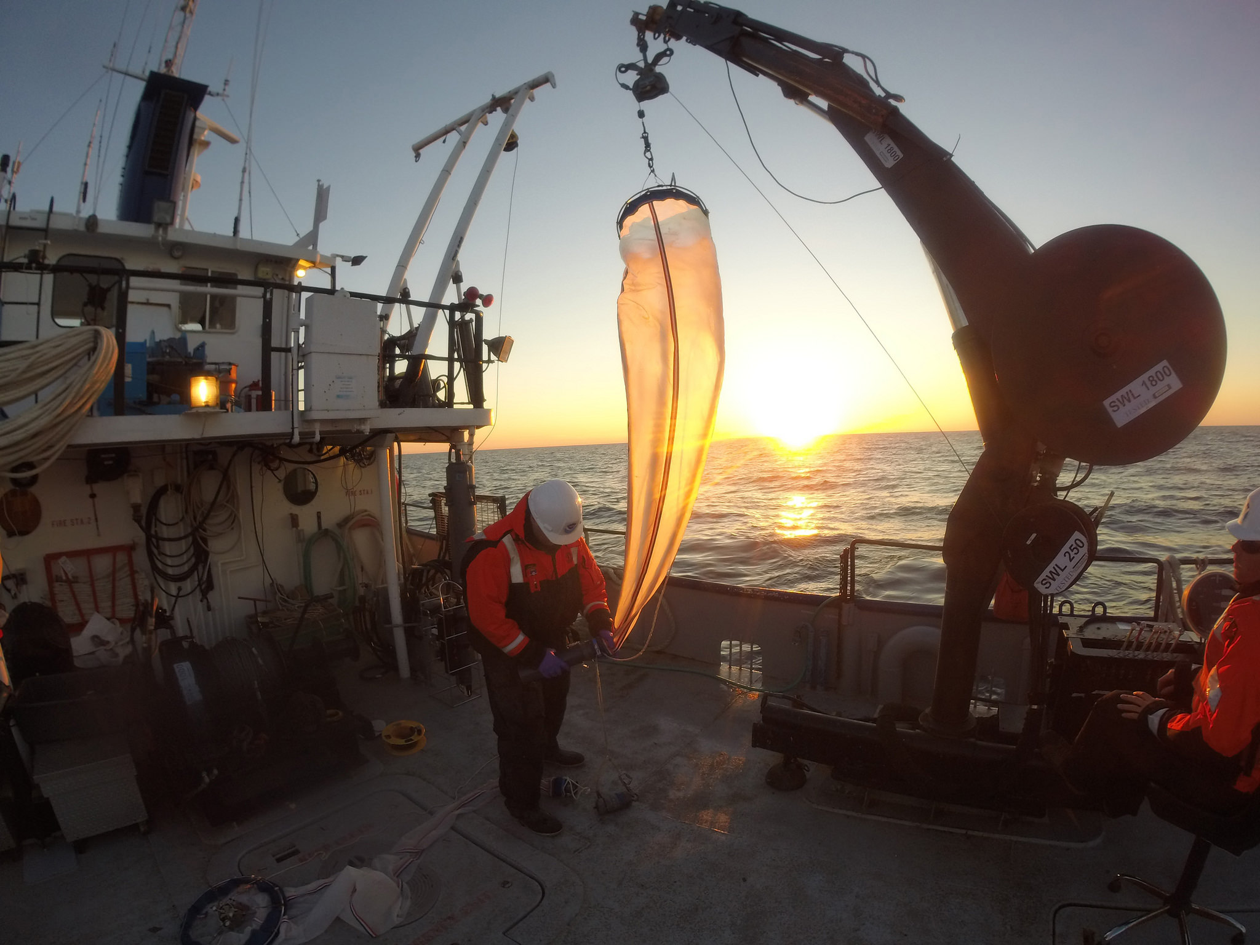
GLERL Budget
22/30

Slide 23
Director | Overview
10-Year Funding Profile
Income by Source ($ in thousands)
Notes:
The base funding number is after assessments.
99% Other Agency is Great Lakes Restoration Initiative (GLRI)
GLERL's base funding (shown in blue, after assessments) is presently about $9.5M. Although it has risen slightly over the past decade, in terms of real dollars it has not kept pace with increasing fixed costs (labor, rent, etc.) so that today about $1M is available to fund science projects. Beginning in 2010, Great Lakes Restoration Initiative funding has played a significant role in funding our science, presently at about $2.3M in FY15. NOAA funding has declined substantially for a variety of reasons.

Slide 24
Director | Overview
FY15 Base Funding Expenditures
$9.97M
Notes:
Shown here is the breakdown of our FY15 expenses. As you can see:
labor comprises our biggest expense at $5.163M or about 52%
Our next largest expense is our facilities cost at $1.729 or 17%
About $1M is available for our science projects, or 11%, about the same as our assessments
followed by information services and vessel operations, each near $400K or 4%
Director's expenses are near 1%

Slide 25
Director | Overview
FY15 Base Science Expenditures
$1,044.6K
20%
39%
41%
25/30
Notes:
Of the $1M available from base funds for our science program:
OSAT receives about $405K
EcoDyn branch receives about $434K
IPEMF branch receives about $205K.
This may appear unbalanced, but the EcoDyn and OSAT infrastructure is more expensive than that of the IPEMF whose infrastructure mainly consists of computing resources.

Slide 26
Director | Overview
Great Lakes Restoration Initiative
FY15 GLERL Funds = $2,324.3
Notes:
NOAA participates in several regional initiatives providing mission-directed leadership and valuable products and services. The Great Lakes Restoration Initiative (GLRI), has provided more than $1.6 billion to support Great Lakes restoration including more than $125 million to NOAA since 2010. The GLRI supports NOAA’s mission-focused work in the areas of toxic chemical remediation, habitat restoration, invasive species, nearshore modeling, observation and ecosystem forecasting, and climate change adaptation.
Of the $2.3M of GLRI funding received by the laboratory in FY15:
SOAR - FY15 Funding: $1,084,269
Summary: The SOAR system coordinates & integrates regional coastal observations supporting. SOAR activities include the deployment & support of on-water and remote sensing platforms where observations from these systems are used to create database products for assessment and decision support.
SOAR will provide up to date information on ecosystem health, drinking water source information and information useful to bathing beaches through observations, data management, and forecast model development
Climate Change - FY15 Funding: $403,495
Summary: Expanding on previous years’ work, we are more completely integrating coupled models of the regional atmosphere, of the Great Lakes basin water budget, nutrient loading of tributary streams, and of the circulation of the lakes.
Our modeling system will be comprehensive in that it will include full interaction among the atmosphere, terrestrial hydrology (including fate and transport of water), 3-dimensional dynamics of the lakes and ice, and simulation of the lower food web in the lakes.
HABs Watershed FY15 Funding: $473.4
Summary: This project will aid in the implementation of a decision support tool framework for environmental and public health officials that encompasses several measurements of nutrient loads and water quality in the nearshore.
This project will provide near real-time measurements of phosphorus and other nutrients in support of notifications for potential impairments due to water quality conditions from harmful algal blooms.
HABs Nearshore - FY15 Funding: $363,091
Summary: This project will provide both (1) measurements of nutrients and other contaminants from urban watersheds and (2) predictive models of expected water quality in the nearshore, forming the development of a decision support tool framework for environmental and public health officials.
Specifically, this framework will aid in characterization of water quality constituents such as contaminants, loads, and bacteria in the nearshore and be used in the development/refinement of models to assess changes in runoff and transport from urban watersheds.

Slide 27
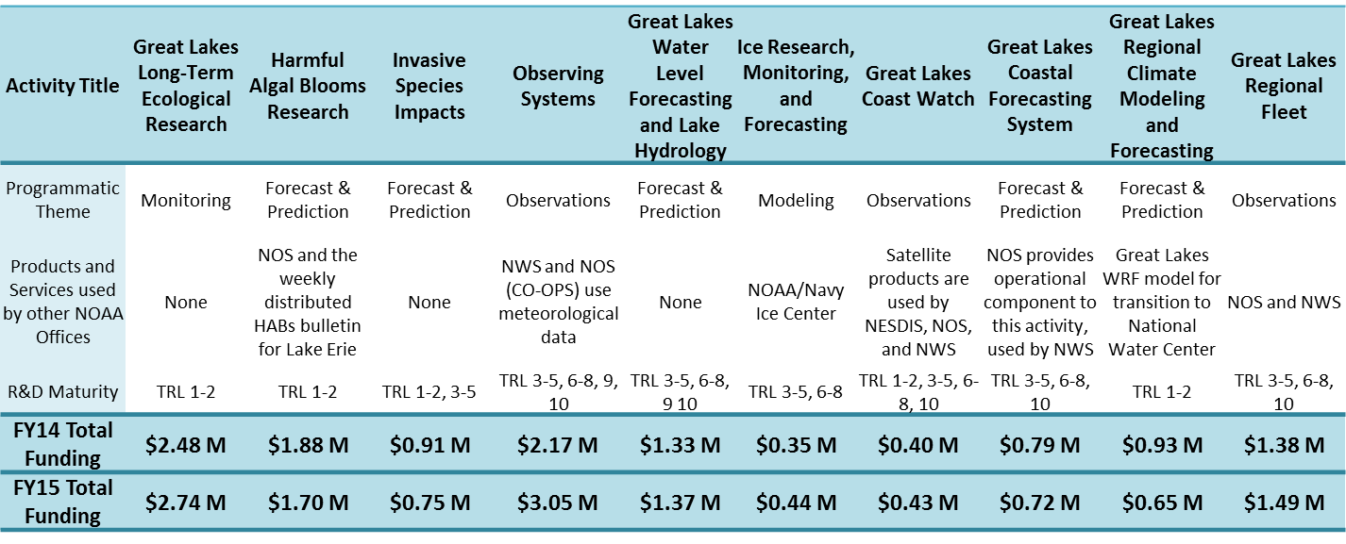
Director | Overview
GLERL Key Activities:
Notes:
Another way to look at GLERL base funding is by key activity, as many of these activities cross-cut the branches and include labor, facility costs and science expenses. A few highlights: the Real-time Environmental Coastal Observing Network in FY15 cost $3.05M; followed by the Long-term Ecological Monitoring Program at $2.74M, and the regional fleet (vessel operations) at $1.49M.
Funding here represents both base funds + external funds (e.g., GRLI, GLOS).

Slide 28
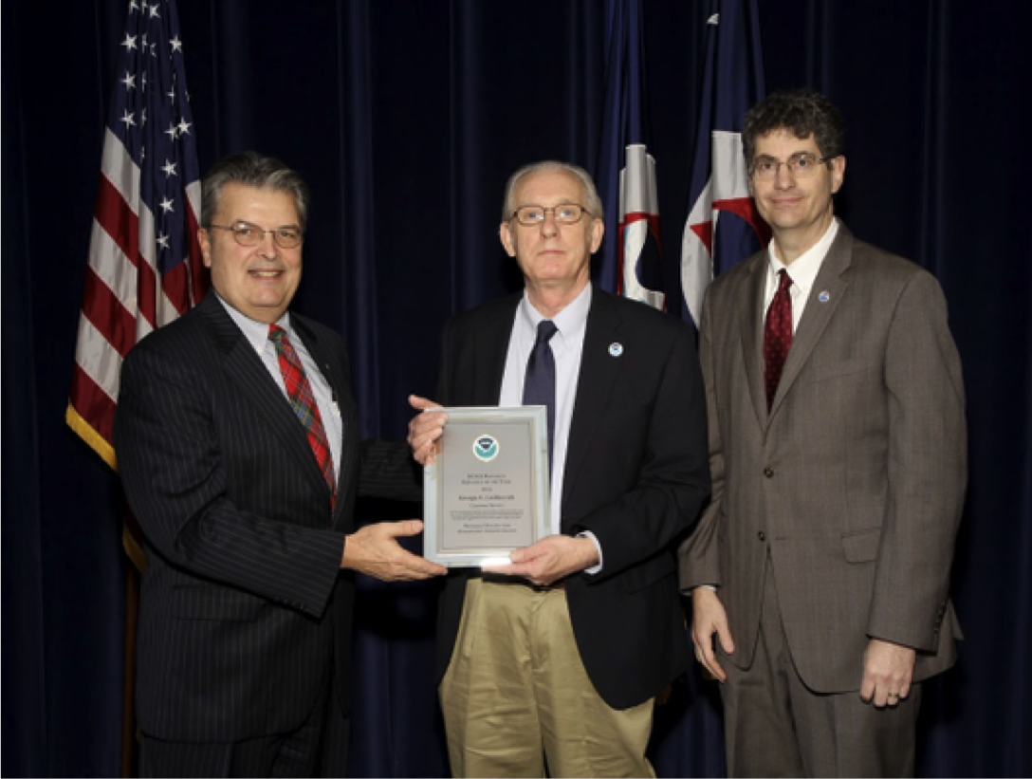
Director | Overview
Evaluation Criterion:
Quality
“Quality” is “a measure of the novelty, soundness, accuracy, and reproducibility of a specific body of research.” This refers to the merit of Research and Development (R&D) within the scientific community.
Notes:
GLERL quality goals, criteria and metrics can be found starting on page 63 of the Strategic Plan 2016-2020 draft: http://www.glerl.noaa.gov/review2016/reviewer_docs/GLERLStrategicPlan2016.pdf
Example:
Goal - Integrity and Quality: Execute research with integrity and quality, abiding by environmental compliance, quality standards, safety standards, and acknowledging uncertainty.
Criteria: Are scientists trained in ethically-based research and are they implementing best practices?
Metrics: Ethics and integrity training required on a regular basis, implementation of best ethics practices incorporated as part of annual performance reviews.
Criteria: Does the laboratory acknowledge uncertainty in research and outreach publications as well as in verbal communication through the development of best practices?
Metric: Review of publications and presentations for inclusion of uncertainty.
→ Value added: The importance NOAA attributes to ethics and integrity in the conduct of research, including uncertainty best practices, generates public confidence in the research, products and services offered by NOAA.

Slide 29
Director | Overview
Quality: DOC and NOAA Awards
2013 DOC Bronze Medal Award – George Leshkevich
Communicating the meaning and value of NOAA-related science and research to non-scientific audiences
2011 DOC Bronze Medal 2011 - Greg Lang, Dave Schwab
Implementation of the Great Lakes Operational Forecast System in NOAA’s high performance computing environment
2015 NOAA Technology Transfer Award – Tim Hunter
Transferring hydrometeorological research to operations which was well beyond his programmer and IT specialist role
2014 NOAA Research Employee of the Year – George Leshkevich
Harmful Algal Bloom crisis in the western Lake Erie basin and record Great Lakes ice cover
2013 NOAA Research Outstanding Science Communicator Award – Margaret Lansing Communicating the meaning and value of NOAA-related science and research to non-scientific audiences
2012 NOAA’s Administrator Award - Greg Lang, Dave Schwab
Integration of Great Lakes marine forecasts from NOAA line offices, assuring consistency throughout the NOAA marine product suite.
Notes:
The Department of Commerce Bronze Medal is the highest honor award that the Under Secretary of Commerce for Oceans and Atmosphere may bestow. Winners are recognized annually at a formal ceremony held in the Washington Metropolitan area. The medals are awarded to individuals, groups (or teams), and organizations.

Slide 30
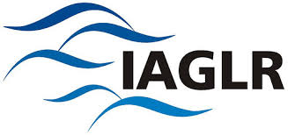
Director | Overview
Quality: Service
The International Association for Great Lakes Research
IAGLR Chandler-Misener Award – Most Notable Paper
2015 - Dmitry Beletsky, Ed Rutherford, Hongyan Zhang, Doran Mason
2011 - David J. Schwab, Henry Vanderploeg
IAGLR Lifetime Achievement Award 2013 – David J. Schwab
IAGLR Editor’s Award
2013 - Edward Rutherford
2011 - Gary Fahnenstiel
IAGLR Anderson - Everett Award 2011 – GLERL
Notes:
GLERL's scientists are also highly recognized by the International Association For Great Lakes Research. Over the past 5 years, GLERL scientists have twice received the Chandler-Misener Award in recognition of the most notable paper; the Lifetime Achievement Award for important and continued contributions to the field of Great Lakes research over a period of 20 years or more; two Editor's Awards for outstanding support of the journal's review process; and in 2011, GLERL as a whole was recognized with the Anderson Everett Award for important and continued contributions to the Association over a period of years.
IAGLR: The International Association for Great Lakes Research (IAGLR) is a scientific organization made up of researchers studying the Laurentian Great Lakes, other large lakes of the world, and their watersheds, as well as those with an interest in such research. IAGLR members encompass all scientific disciplines with a common interest in the management of large lake ecosystems on many levels. A member-run professional association that holds an annual Conference on Great Lakes Research. The Journal of Great Lakes Research is a highly respected professional publication with broad distribution.
IAGLR Chandler-Misener Award - Presented for the most notable paper
2015 “Assessing and addressing the re-eutrophication of Lake Erie central basin hypoxia” (Dmitry Beletsky, Ed Rutherford, Hongyan Zhang, Doran Mason)
2011 “Approaching storm: Disappearing winter bloom in Lake Michigan” (W. Charles Kerfoot, Foad Yousef, Sarag A. Green, Judith W. Budd, David J. Schwab, Henry Vanderploeg )
IAGLR Lifetime Achievement Award 2013 – David J. Schwab
Recognizes important and continued contributions to the field of Great Lakes research over a period of 20 years or more
IAGLR Editor’s Award Presented for "outstanding support of the journal's review process”
2013 – Edward Rutherford
2011 – Gary Fahnenstiel
IAGLR Anderson - Everett Award 2011 – ALL GLERL
Recognized for important and continued contributions to the Association over a period of years.

Slide 31
Director | Overview
Quality: Publications
Notes:
GLERL's research productivity is reflected in the total number of publications and the average number per scientist which at 3 exceeds the expected average of 2 per year. GLERL's publication productivity has continued to increase despite a decrease in the number of principal investigators. Reports and proceedings continue to also be an important element of GLERL publication, as well as its data sets. Not only to our principal investigators publish peer reviewed articles, but our technical support staff also make significant contributions to peer reviewed literature.
Total authorships per pub (counts all GLERL authors per pub)
All GLERL peer reviewed publications available on the GLERL web site (organized by fiscal and calendar year): http://www.glerl.noaa.gov/pubs/
Publications by each principle investigator are linked to from their researcher pages:
http://www.glerl.noaa.gov/res/Profiles/
Peer-reviewed, book chapters, proceedings are listed on each researchers page:
e.g. for Dr. Jia Wang: http://www.glerl.noaa.gov/about/pers/profiles/specs/wang_list_allpub.html
NOAA Technical Memorandums are available on a separate tab the web site here:
http://www.glerl.noaa.gov/pubs/#techRep

Slide 32
Quality: Citations
Director | Overview
H-Index values – Individual GLERL research staff
Using the Web of Science Core Collection
H-index | Total Publications | Total Citations
30 | 105 | 2517
28 | 107 | 2893
23 | 71 | 1490
22 | 37 | 1072
22 | 48 | 1246
20 | 55 | 1168
19 | 37 | 1663
18 | 60 | 1039
17 | 28 | 1204
15 | 22 | 551
14 | 21 | 971
11 | 36 | 426
10 | 23 | 371
10 | 20 | 291
10 | 16 | 542
10 | 37 | 278
9 | 26 | 194
7 | 13 | 113
3 | 8 | 81
2 | 5 | 10
Each row represents an individual scientist.
Notes:
The H-index is an index to quantify an individual’s scientific research output. The H-index is an author-level metric that attempts to measure both the productivity and citation impact of the publications of a scientist. The index is based on the set of the scientist's most cited papers and the number of citations that they have received in other publications.
The H-index gives an estimate of the importance, significance and impact of an individual scientist’s cumulative research contributions. • The index is computed on the number of publications and number of citations • Useful criteria to evaluate scientific achievement • With large error bars, at major research universities, an H-index of ~10 to 12 might be a value for an Associate Professor and an H-index of ~18 and higher for a full Professor.

Slide 33
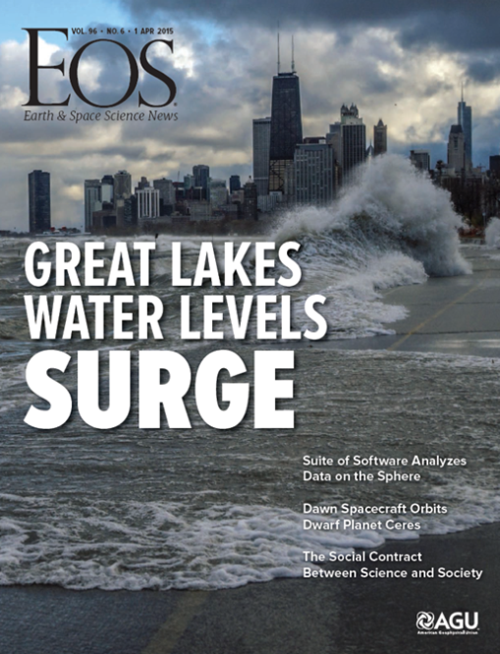
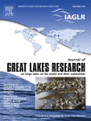
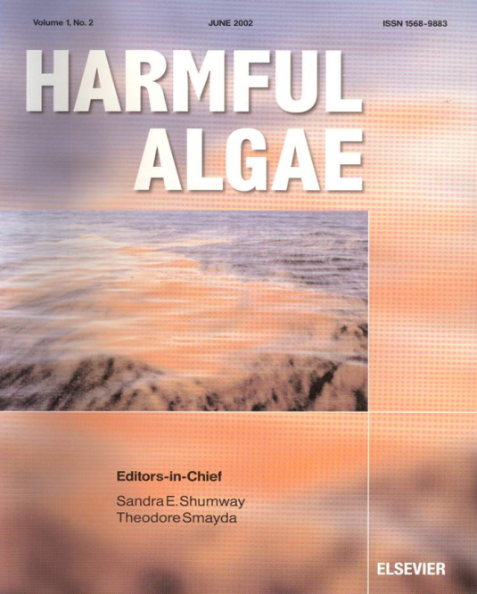
Director | Overview
Quality: Special Publications 2010-2015
Global Expansion of Harmful Cyanobacterial Blooms: Diversity, ecology, causes, and controls
Water Loss from the Great Lakes
2014
Andrew D. Gronewold
and Craig A. Stow
2015
Andrew D. Gronewold et al.
2015
Editors: Henry A. Vanderploeg, David "Bo" Bunnell, Hunter J. Carrick and Tomas O. Höök
In print in April 2016 Guest Editors: Timothy Davis and Christopher Gobler
2013
Quagga and Zebra Mussels: Biology, Impacts, and Control, Second Edition
by Thomas F. Nalepa and Don W. Schloesser
Notes:
The quality of GLERL's science is also reflected in special publications. In the past five years, GLERL has made the front cover of Science and EOS, and GLERL principle investigators have served as guest editors on special editions of journals. GLERL principle investigators efforts on special issues underscore the collaborative nature of GLERL scientists with researchers from academia and other agencies and demonstrate scientific leadership.
Depicted on slide:
Science: Andrew D. Gronewold and Craig A. Stow. Water Loss from the Great Lakes. Science 7 March 2014: Vol. 343 no. 6175 pp. 1084-1085 (note: a recommendation from 2010 Review: was to plan for publication in Science or Nature to boost deserved recognition)
EOS: 2015 GRONEWOLD, A.D., A.H. CLITES, J. Bruxer, K.A. Kompoltowicz, J.P. SMITH, T.S. HUNTER, and C. Wong. Water levels surge on the Great Lakes. Eos 96(6):7 pp. (DOI:10.1029/2015EO026023) (2015). https://eos.org/project-updates/water-levels-surge-on-great-lakes
Special Issue:
2015 Journal of Great Lakes Research Volume 41, Supplement 3, Pages 1-232 (2015) Special Issue
Complex interactions in Lake Michigan's rapidly changing ecosystem
22 papers address direct and indirect impacts of nonindigenous species on the Lake Michigan ecosystem.
Guest Editors: Henry A. Vanderploeg, David "Bo" Bunnell, Hunter J. Carrick and Tomas O. Höök
Special Issue:
Harmful Algae: will appear in print April 2016 - Guest Editors: Timothy Davis and Christopher Gobler. Harmful Algae Global Expansion of Harmful Cyanobacterial Blooms: Diversity, ecology, causes, and controls
Book:
2013 Thomas F. Nalepa and Don W. Schloesser. Quagga and Zebra Mussels: Biology, Impacts, and Control, Second Edition (Nalepa retired, but based on GLERL work.)
Additional Journal of Great Lakes special issues not depicted on slide:
2014 The Continuing Effects of Multiple Stressors in Saginaw Bay, Lake Huron. 21 papers 7 with GLERL first authors , Guest editor: Craig Stow
2013 Remote Sensing of the Great Lakes and other Inland Waters - 19 papers Guest Editors: Robert Shuchman and George Leshkevich.
2012 The Lower Food Web of Lake Michigan: Long-term trends and the Dreissenid Impact. Guest Editor: Henry Vanderploeg
Sample of Web of Science High Impact Publications (for a complete listing see review web site) http://www/review2016/supporting_documents.html
Harke, M.J., T.W. DAVIS, S.B. Watson, and C.J. Gobler. Nutrient-controlled niche differentiation of western Lake Erie cyanobacterial populations revealed via metatranscriptomic surveys. Environmental Science & Technology (2016).
DAVIS, T.W., G.S. Bullerjahn, T. Tuttle, R.M. McKay, and S.B. Watson. Effects of increasing nitrogen and phosphorus concentrations on phytoplankton community growth and toxicity during Planktothrix blooms in Sandusky Bay, Lake Erie. Environmental Science & Technology 49:7197-7207 (2015). http://www.glerl.noaa.gov/pubs/fulltext/2015/20150039.pdf
DAVIS, T.W., S.B. Watson, M.J. Rozmarynowycz, J.J.H. Ciborowski, R.M. McKay, and G.S. Bullerjahn. Phylogenies of microcystin-producing cyanobacteria in the lower Laurentian Great Lakes suggest extensive genetic connectivity. PLOS One 9(9):9 pp. (DOI:10.1371/journal.pone.0106093) (2014). http://www.glerl.noaa.gov/pubs/fulltext/2014/20140048.pdf

Slide 34
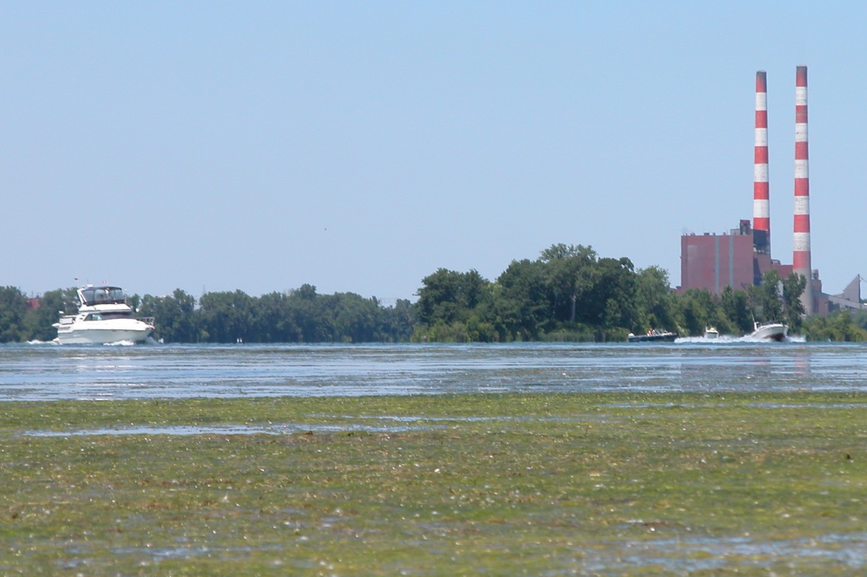
Director | Overview
Evaluation Criterion: Relevance
“Relevance” is “a measure of how well a specific body of research supports NOAA’s mission and the needs of users and the broader society.” Primarily refers to value of R&D to users beyond the scientific community. Includes not only hypothetical value, but actual impact.
Notes:
GLERL quality goals, criteria and metrics can be found starting on page 63 of the Strategic Plan 2016-2020 draft: http://www.glerl.noaa.gov/review2016/reviewer_docs/GLERLStrategicPlan2016.pdf
Example:
Goal - Transitioning Research Products: Facilitate transition to operations (R2O) and application (R2A) as part of the development and implementation of research programs.
Criteria: Does an appropriate portion of GLERL’s research make the transition to operations/applications (R2X)?
Metrics: Number of products transitioned to other NOAA line offices, number of products transitioned to other agencies or partners, number of technical reports or other data archives transitioned to an operational level.
Criteria: Does GLERL effectively communicate about research products in the R2O pipeline that will be transitioned?
Metric: Number of transition plans in place.
→ Value added: NOAA’s goal to transition research to application ensures that society receives full benefits from products and services that has been built upon preeminent research, excellence, integrity, and quality driven by stakeholder needs!

Slide 35
Director | Overview
Relevance: NOAA’s Overarching Grand Science Challenge
NOAA Overarching Science and Technology Grand Challenge:
Develop and apply holistic, integrated Earth system approaches to understand the processes that connect changes in the atmosphere, ocean, space, land surface, and cryosphere with ecosystems, organisms, and humans over different scales.
NOAA
Science & Technology Objective
GLERL Element
GLERL
Provides
Accurate and reliable data from sustained and integrated earth observing systems
Observations and Advanced Technology
Sustained, robust, year-round, observing systems
Holistic understanding of the Earth System through research & Interdisciplinary Ecosystem Dynamics
Ecosystem Dynamics
Interdisciplinary ecosystem dynamics and decision making tools
Integrated Ecological Modeling to produce forecasting for proactive management of resources & communities
Integrated Ecological Modeling and Forecasting
Great Lakes ecological forecasting system on a variety of scales
Notes:
Illustrated here, one can see how GLERL maps to NOAA's Science and Technology Grand Challenge of developing and applying holistic, integrated, Earth system approaches to understand the processes that connect the physical world to the biological world.
GLERL provides sustained and robust Great Lakes observing systems.
GLERL develops understanding of ecosystem dynamics and applies this understanding to predictive tools.
GLERL develops ecological forecasting systems on a variety of scales.

Slide 36
Director | Overview
Relevance: NOAA’s Strategic Plan
GOAL | OBJECTIVE
SCIENCE: RESILIENT COASTAL COMMUNITIES AND ECONOMIES | Resilient coastal communities that can adapt to the impacts of hazards and climate change
 | Comprehensive ocean and coastal planning and management
 | Safe, efficient and environmentally sound marine transportation
 | Improved coastal water quality supporting human health and coastal ecosystem services
 | Safe, environmentally sound Arctic access and resource management
SCIENCE: HEALTHY OCEANS | Improved understanding of ecosystems to inform resource management decisions
 | Recovered and healthy marine and coastal species
 | Healthy habitats that sustain resilient and thriving marine resources and communities
 | Sustainable fisheries and safe seafood for healthy populations and vibrant communities
SCIENCE; WEATHER-READY NATION | Reduced loss of life, property, and disruption from high-impact events
 | Improve freshwater resource management
 | Improve transportation efficiency and safety
 | Healthy people and communities due to improved air and water quality services
 | A more productive and efficient economy through information relevant to key sectors of the U.S. economy
SCIENCE: CLIMATE ADAPTATION AND MITIGATION | Improved scientific understanding of the changing climate system and its impacts
 | Assessments of current and future states of the climate system that identify potential impacts and inform science, service, and stewardship decisions
 | Mitigation and adaptation efforts supported by sustained, reliable, and timely climate services
 | A climate-literate public that understands its vulnerabilities to a changing climate and makes informed decisions
Notes:
GLERL has high relevance to NOAA's mission. Shown here are the four main goals of NOAA's Strategic Plan. Correlated to each of these goals are the objectives that GLERL is contributing to meeting. It may surprise you to see "Safe and environmentally sound Arctic access and resource management." This is representative of how GLERL's expertise in one area, ice modeling and forecasting, finds application and synergy outside of the Great Lakes region.
The GLERL & NOAA Goals Matrix at http://www.glerl.noaa.gov/review2016/guiding_docs/GoalsMatrix.pdf, shows how the goals of each of GLERL's science branches (OSAT, EcoDyn, IPEMF and IS) align to the overarching NOAA Science and Education Goals and Objectives, as seen in the NOAA Next Generation Strategic Plan.

Slide 37
Director | Overview
Relevance: R2X Technical Readiness Levels
Technology Readiness Level
Broadly Relevant to NOAA Mission
Basic principles have been observed and reported
Technology concept and/or application have been formulated
Analytical and experimental critical function and/or characteristic proof-of-concept
Component/subsystem validation in laboratory environment
System/subsystem/component validation in relevant environment
System/subsystem model or prototyping demonstration in a relevant end-to-end environment
System prototyping demonstration in an operational environment
Actual system completed and "mission qualified" through test and demo in operational environment
Actual system "mission proven" through successful mission operations
Strictly speaking, there is no TRL “10,” however, data on maturity were collected this way for this exercise to mean “operational.”
1
RESEARCH
TRLs 1-2
2
3
DEVELOP
TRLs 3-5
4
5
DEMONSTRATE
TRLs 6-8
6
7
8
DEPLOY
TRL 9
9
“10”
Tailored to Requirements
Notes:
How do we measure how well GLERL is meeting the needs of users and broader society?
One way is by how much of our research is transitioned to operations, applications or users - R2O, R2A or R2U - for shorthand, "R2X". Further, we track the maturity of this transition process via Technical Readiness Levels, or TRLs.
A product moves through the transition funnel beginning with basic research, progressing to development, demonstration and finally deployment.
The number of projects at the various TRLs is one indication that GLERL is meeting the needs of users and society.
Definitions of R2X:
R2X
“Application of the best available science and technology is essential to meeting the NOAA mission. This demands an operations enterprise that is able to quickly recognize and apply significant new research products and methods; a research and development enterprise focused on the ultimate application of emerging science and technology to user needs; and a formalized management structure that ensures that both the research and development enterprise encourage and support the transfer of research to operational status or information services to meet mission responsibilities.” (NAO 216-105: Policy on Transition of Research to Application)
Research to Operations (R2O)
R2O is the pathway by which fundamental research is developed into a useful tool or product that is run regularly and automatically. These tools and products provide routine real time and forecast guidance for application and use by the public.
Research to Application (R2A)
R2A is the pathway by which information from fundamental research is transferred to decision-makers or other end users in a non-operational framework.

Slide 38
Director | Overview
GLERL R2X Portfolio
1
2
3
4
5
6
7
8
9
Notes:
Shown here are the current number of projects at GLERL and their TRLs.
This graphic reflects R2A, R2O and data products.

Slide 39
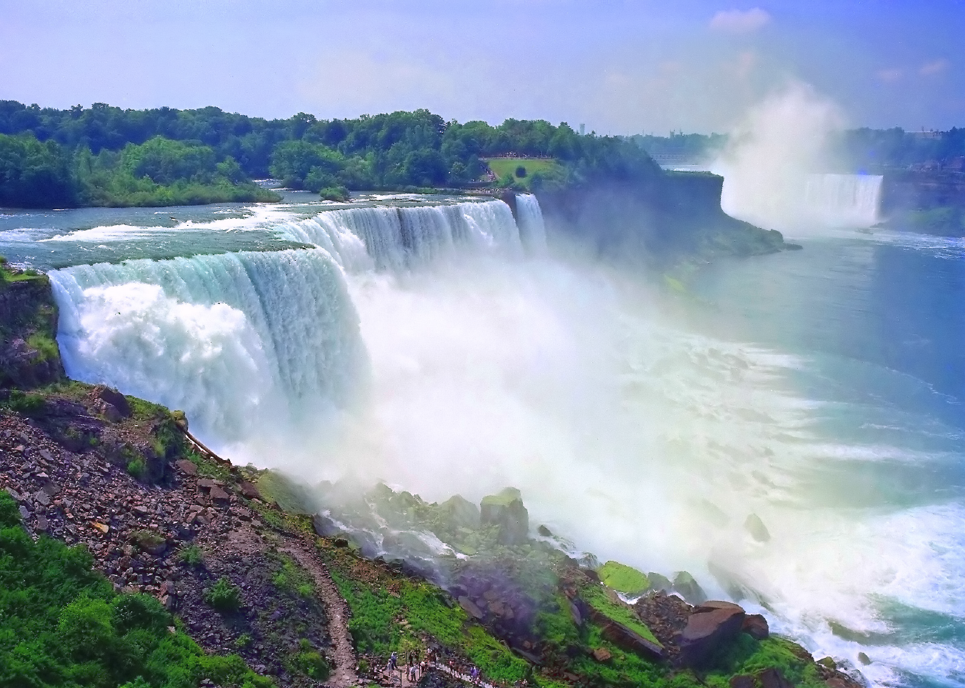
Director | Overview
Short-term and seasonal flow forecasting for the Niagara River – TRL 3
Developing forecasting tools for optimizing hydropower production
Notes:
We strive to develop an understanding of drivers of the Great Lakes seasonal water balance, and to propagate that understanding into data sets, models, forecasting systems, and other forms of information for the general public. These products and services are used to manage coastal water resources, protect property and commerce, and improve the quality and safety of human lives throughout the region.
One particular example of our strong research-to-operations partnerships is an ongoing collaboration with regional hydropower authorities. For the past two decades, NOAA-GLERL hydrological and hydrodynamic models have been used by the New York Power Authority (NYPA) and Ontario Power Generation (OPG) to manage short- and long-term power supplies, and to mitigate potential hazards to commerce and human traffic along the Niagara and St. Lawrence Rivers. We are currently partnering with NYPA, OPG, the US Army Corps of Engineers and the NOAA Northeast River Forecasting Center (NERFC) to improve representation of future climate scenarios in long-term forecasts, and to develop a new operational short-term forecasting node within the NERFC for the Upper Niagara River.
TRL 3 - Analytical and experimental critical function and/or characteristic proof-of-concept

Slide 40
Director | Overview
Technical Readiness of GLERL Products 6-9
Technical Readiness Level
1
2
3
4
5
6
7
8
9
Climate Change Simulations
Lake Erie HAB Operational Forecasting System
Lake Michigan-Huron Operational Forecasting System
MODIS/VIIRS CPA
NWS Rip Current Warning
ReCON GLRI/GLOS/NDBC Buoys
SAR Ice Classification
6
System/subsystem model or prototyping demonstration in a relevant end-to-end environment
Area Ratio Method
Huron-Erie Connecting Waterways Forecasting System
Large Basin Runoff Model
Large Lakes Thermodynamics Model
Nutrient Buoy Network
Saginaw Bay Chlorophyll-a Prediction
Spill Transport Table for the St. Clair River
St. Lawrence River Basin Cumulative Impact Assessment Dashboard
Temperature and Precipitation Forecast Web Portal
Upper St. Lawrence River Forecast System
7
System prototyping demonstration in an operational environment
Great Lakes Dashboard Project
Lake Erie Operational Forecasting System
Long-Term Ice Cover Database for the Great Lakes
Statistical Regression Model for Seasonal Lake Ice Projection
8
Actual system completed and "mission qualified" through test and demo in operational environment
Hypoxia Warning System
NWS Met stations
9
Actual system "mission proven" through successful mission operations
Notes:
Listed above on this slide are examples of GLERL projects in the Technical Readiness Level range of 6-9.
Listed below are links to the products:
TRL Level 6:
Lake Erie HAB - http://www.glerl.noaa.gov/res/HABs_and_Hypoxia/habsTracker.html
Lake Michigan Operational Forecast System - https://tidesandcurrents.noaa.gov/ofs/lmofs/lmofs.html
Lake Huron Operational Forecast System - https://tidesandcurrents.noaa.gov/ofs/lhofs/lhofs.html
ReCON: http://www.glerl.noaa.gov/res/recon/
NWS Rip Current Warning: http://www.weather.gov/mkx/rip-current
TRL Level 7:
Huron to Erie Connecting Waterways Forecasting System - http://www.glerl.noaa.gov/res/hecwfs/
Large Basin Runoff Model Software: http://www.glerl.noaa.gov/wr/lbrmexamples.html
Large Lakes Thermodynamics Model: http://www.glerl.noaa.gov/pubs/posters/Gronewold_AMS_Ops_2015.pdf
Spill Transport Table for the St. Clair River: http://www.glerl.noaa.gov/review2010/posters/anderson_poster.pdf
St. Lawrence River Basin Cumulative Impact Assessment Dashboard: http://www.glerl.noaa.gov/data/dashboard/GLSLRCIAD/
Temperature and Precipitation Forecast Portal -http://www.glerl.noaa.gov/data/now/wlevels/tpForecasts/testbed/
Upper St. Lawrence River Forecast System: http://www.glerl.noaa.gov/res/usl/
TRL Level 8:
Great Lakes Dashboard Project: http://www.glerl.noaa.gov/data/dashboard/portal.html
Lake Erie Operational Forecasting System - https://tidesandcurrents.noaa.gov/ofs/leofs/leofs.html
Long-Term Ice Cover Database for the Great Lakes - http://www.glerl.noaa.gov/data/ice/#historical
TRL Level 9:
Hypoxia Warning System: http://www.glerl.noaa.gov/res/HABs_and_Hypoxia/hypoxiaWarningSystem.html
GLERL Real-Time Meteorological Observation Network: http://www.glerl.noaa.gov/metdata/

Slide 41
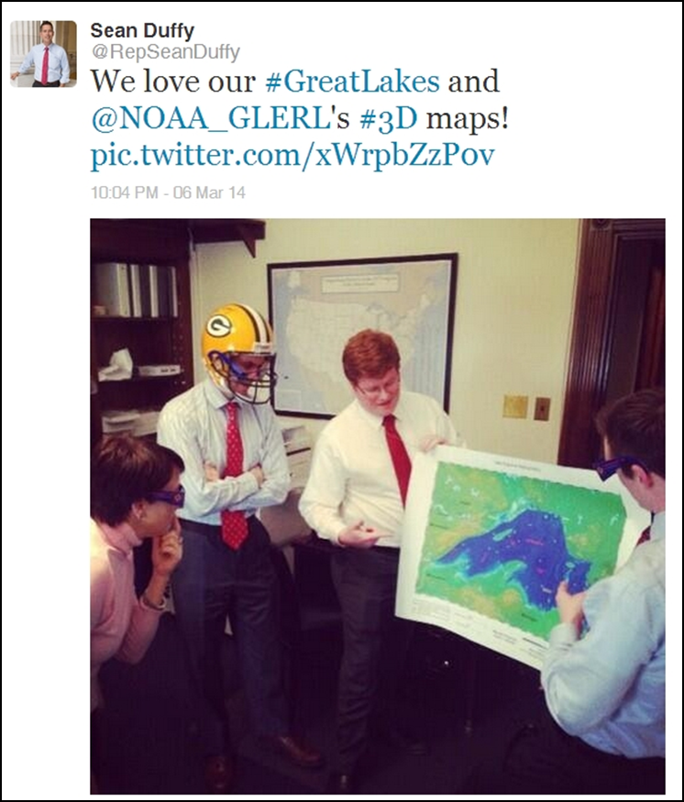
Director | Overview
Relevance: Congress
Congressional Engagement
Great Lakes Week on Capitol Hill
Regional district office visits
Congressional testimony
Responsive to issues of concern to the Great Lakes Task Force
Asian Carp Regional Coordinating Committee
Great Lakes Mississippi River Inter-basin Study
Harmful Algal Bloom and Hypoxia Research Control Act
Notes:
GLERL coordinates with NOAA Legislative Affairs to prioritize visits with members and staffers from:
The Great Lakes Task Force: Members of the Bi-Partisan Lakes Task work together to build support for key regional programs to enhance environmental quality and economic development throughout the Great Lakes basin.
NOAA Relevant House and Senate and House Committees
Important Districts to NOAA (e.g. MI-2 location of Lake Michigan Field Station; MI-10, location of numerous GLRI restoration projects)
Great Lakes champions, NOAA supporters, New Members, Members not previously visited
The Asian Carp Regional Coordinating Committee (ACRCC) with support from federal, state, and local agencies, and other private stakeholder entities, will create a sustainable Asian carp control program to prevent introduction and implement actions to protect and maintain the integrity and safety of the Great Lakes ecosystem from an Asian carp invasion via all viable pathways. The goals and actions of the ACRCC are outlined in the annual Asian Carp Control Strategy Framework and the Monitoring and Response Plan.
Great Lakes Mississippi River Inter-basin Study- is a U.S. Army Corps of Engineers study that presents a range of options and technologies to prevent aquatic nuisance species (ANS) movement between the Great Lakes and Mississippi River basins through aquatic connections.
Harmful Algal Bloom and Hypoxia Research and Control Act - In 1998, Congress recognized the severity of these threats and authorized the Harmful Algal Bloom and Hypoxia Research and Control Act (HABHRCA 1998). The Harmful Algal Bloom and Hypoxia Research and Control Amendments Act of 2004 (HABHRCA 2004, Public Law 108–456) and 2014 (HABHRCA 2014, Public Law 113–124) reaffirmed and expanded the mandate for NOAA to advance the scientific understanding and ability to detect, monitor, assess, and predict HAB and hypoxia events
Great Lakes Week on Capitol Hill: Each year GLERL coordinates with the NOAA Office of Legislative and Intergovernmental Affairs to meet with interested Great Lakes regional members and staff to discuss GLERL’s mission and recent activities, and to raise awareness about the various environmental issues, and research conducted in the their states or districts. Below is a summary of all the Capitol Hill visits from 2010-2016.

Slide 42
Director | Overview
Relevance: Decision makers
Policy |  | GLERL Contribution
Great Lakes Water Quality Agreement |  | Updated phosphorus loading targets for Lake Erie
Harmful Algal Bloom and Hypoxia Research and Control Act |  | Leading the development of the Congressionally mandated science assessment of Harmful Algal Blooms in the Great Lakes
International Joint Commission |  | Evaluate management options for regulating levels and flows of the Lake Ontario and St. Lawrence Seaway system
Invasive Mussel Collaborative |  | To provide intelligence on the mussel ecology, distribution, and impact on the food web and fisheries
Great Lakes Restoration Initiative |  | As one of 16 major federal partners NOAA has completed $150 million of restoration efforts through the leadership of the NOAA Great Lake Regional Collaboration Team.
Great Lakes Fishery Commission |  | Annually provide data and information to the Lake Michigan Technical Committee on the lower food web.
42/53
Notes:
GLERL expertise is often sought to help inform and shape regional and binational policies. Not all inclusive, this list illustrates recent contribution's of GLERL's subject matter expertise to shaping policy. GLERL also provides service to society through its support of and leadership in professional associations.
For a complete listing of GLERL Service activities 2010-2015 see web site:
http://www.glerl.noaa.gov/review2016/service_to_society.html
Invasive Mussel Collaborative: (Ashley Baldridge)
Provides a framework for communication and coordination, identifies the needs and objectives of resource managers, prioritizes the supporting science, recommends communication strategies, and aligns science and management goals into a common agenda for invasive mussel control.
International Joint Commission
Canada and the United States created the International Joint Commission because they recognized that each country is affected by the other's actions in lake and river systems along the border. The two countries cooperate to manage these waters wisely and to protect them for the benefit of today's citizens and future generations.
GLERL research informs: regulating shared water uses
The Great Lakes Water Quality Agreement is a commitment between the United States and Canada to restore and protect the waters of the Great Lakes. The Agreement provides a framework for identifying binational priorities and implementing actions that improve water quality.
The U.S. and Canada first signed the Agreement in 1972. It was amended in 1983 and 1987. In 2012, it was updated to enhance water quality programs that ensure the “chemical, physical, and biological integrity” of the Great Lakes.
The 2012 agreement will facilitate United States and Canadian action on threats to Great Lakes water quality and includes strengthened measures to anticipate and prevent ecological harm. New provisions address aquatic invasive species, habitat degradation and the effects of climate change, and support continued work on existing threats to people’s health and the environment in the Great Lakes Basin such as harmful algae, toxic chemicals, and discharges from vessels.
https://www.epa.gov/glwqa
Lake Michigan Committee (LMC) of the Great Lakes Fishery Commission: The LMC provides recommendations for the management of the fisheries to the surrounding states to help coordinate fisheries management decisions

Slide 43
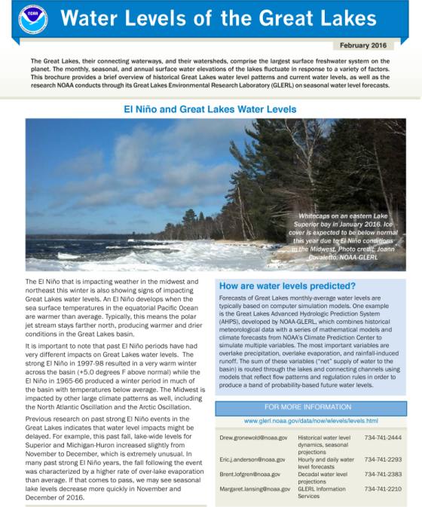
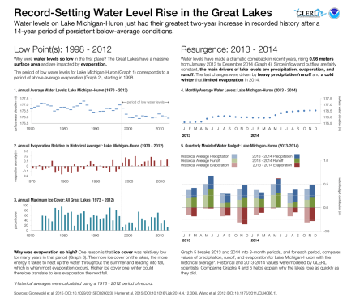
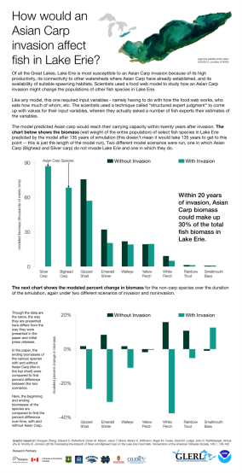
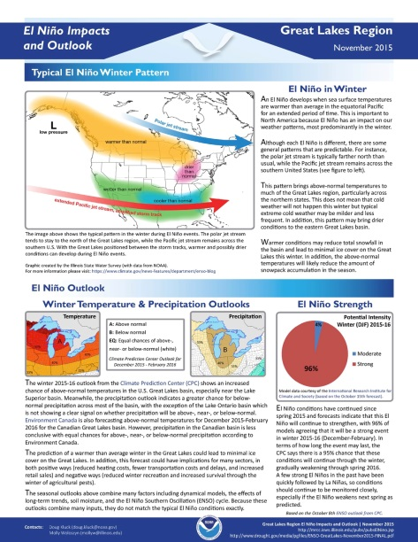
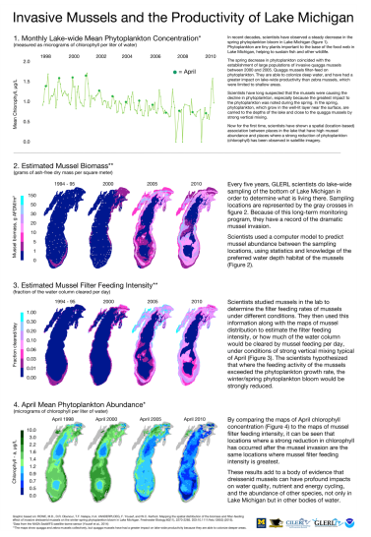
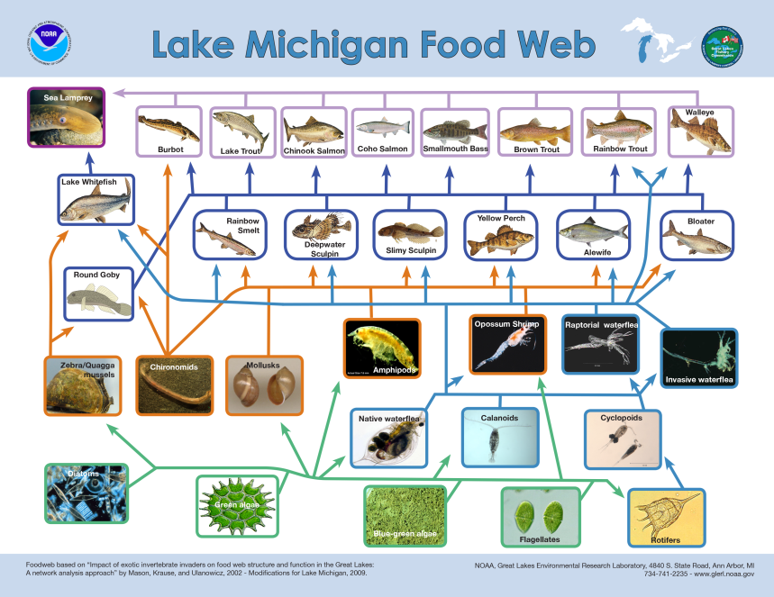
Director | Overview
Relevance: Stakeholders
Posters
Brochures/Factsheets
Infographics
Science Translation: In 2015, there were 146,663 downloads of GLERL publications, posters, fact sheets and brochures.
Notes:
Top 5 FY15 Downloads from the GLERL website:
19230 downloads - Great Lakes water levels
http://www.glerl.noaa.gov/pubs/brochures/lakelevels/lakelevels.pdf
10821 downloads - Lake Michigan foodweb
http://www.glerl.noaa.gov/pubs/brochures/foodweb/LMfoodweb.pdf
8052 downloads - Lake Erie foodweb
http://www.glerl.noaa.gov/pubs/brochures/foodweb/LEfoodweb.pdf
6898 downloads - Lake Superior foodweb
http://www.glerl.noaa.gov/pubs/brochures/foodweb/LSfoodweb.pdf
6713 downloads - Exotic, invasive, alien, nonindigenous, or nuisance species: No matter what you call them, they're a growing problem
http://www.glerl.noaa.gov/pubs/brochures/invasive/ansprimer.pdf
GLERL staff make it a priority to respond to customer and stakeholder inquiries within 2 business days. Such requests come in through a variety of means, including phone calls and emails to the general information address at www.glerl@noaa.gov, as well as emails to individual staff. In FY2015, GLERL Information Services documented 612 data requests, web inquires, media interviews and general information requests from all sectors.
Number of Information Requests, by sector:
Non-Profit – 15
Schools – 23
Private Industry – 75
Government – 90
Universities – 130
Private Citizens – 138
Media – 141

Slide 44
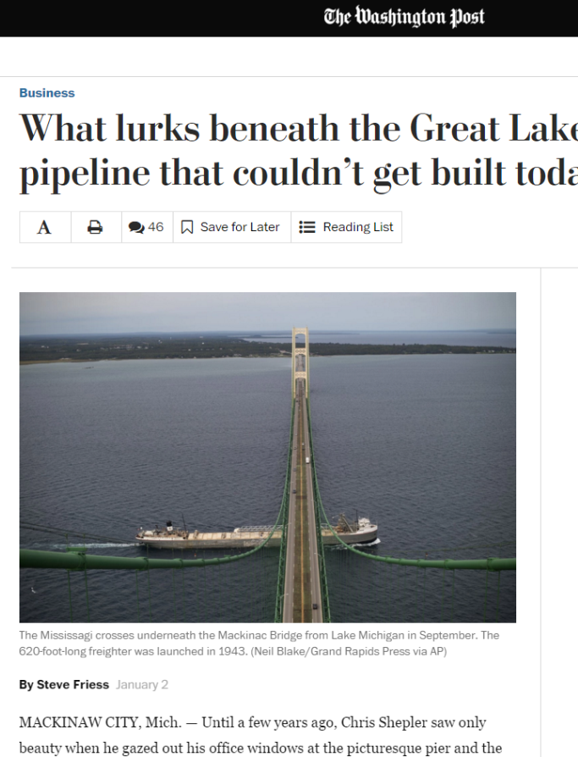
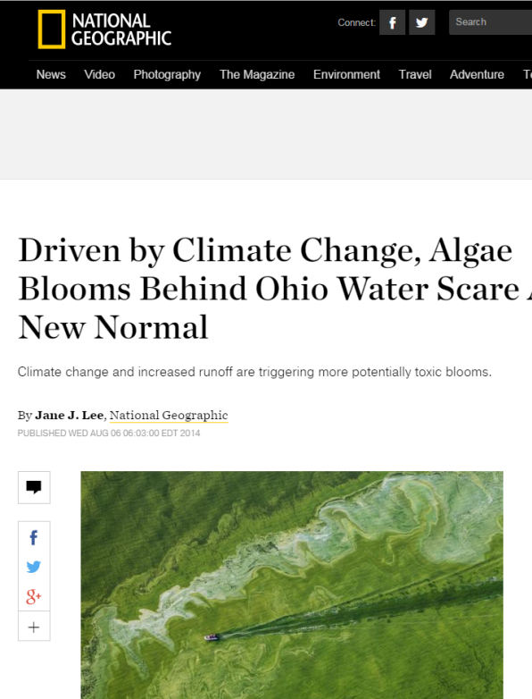
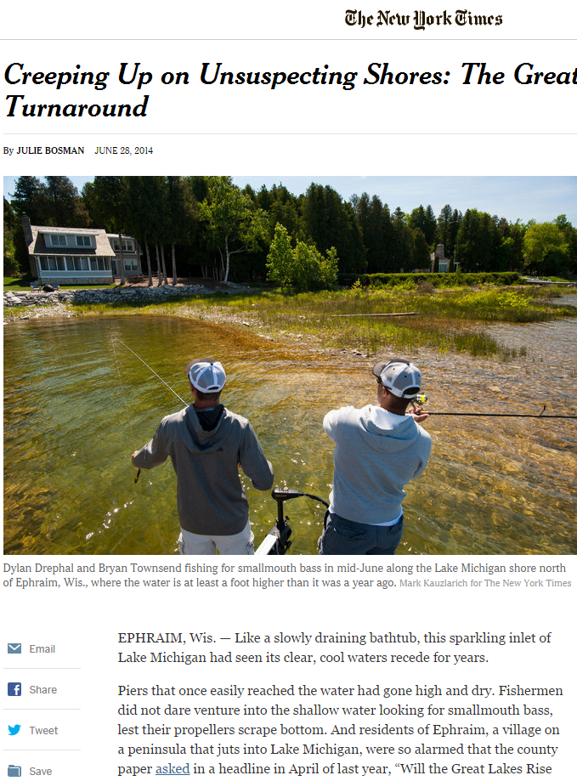
Director | Overview
Relevance: Stakeholders
Traditional Media
Media Briefings – recent examples
Media Briefing on Great Lakes Water Levels
Impacts of El Nino on Great Lakes water levels media teleconference
Notes:
NOAA’s activities in the Great Lakes were mentioned nearly 500 times in the news in 2015, including in articles by high-profile news organizations such as National Geographic, The Washington Post, and the New York Times.
In FY15 GLERL captured 468 media mentions, including original news articles, wire pickups and radio/tv interviews.
Top 5 media mentions by topic for FY 2015:
HABs and Muck - 172
Ice - 133
Water Levels – 81
Water Temps - 14
Weather/Meteorology- 13

Slide 45
Director | Overview
Relevance: Stakeholders
Social Media
Total ‘Likes’ = 3,518
(Up from 1809 in FY14)
5,165 followers
(Up from 3,600 Followers in FY14)
1597 photos, 155 followers
48,944 views, 112 subscribers, 123 videos

Slide 46
Director | Overview
Evaluation Criterion: Performance
“Performance” is “a measure of both effectiveness (the ability to achieve useful results) and efficiency (the ability to achieve quality, relevance, and effectiveness in timely fashion and with little waste).” It refers to the effectiveness and efficiency with which R&D activities are organized, directed, funded, and executed.
Notes:
See GLERL Draft Strategic plan 2016-2020 p. 63 at: http://www.glerl.noaa.gov/review2016/reviewer_docs/GLERLStrategicPlan2016.pdf
Example:
Goal - Interdisciplinary and Partnership Approach: Integrate an interdisciplinary approach and use partnerships, such as those with NOAA Cooperative Institutes, to strengthen capacity to advance GLERL’s mission and vision.
Criteria: Does GLERL’s staff have the expertise to conduct research integrating the range of disciplines necessary for quality Great Lakes environmental research?
Metrics: Number of cross branch projects, number of disciplines represented on a project, program and laboratory level.
Criteria: Does GLERL build partnerships (both internal and external to NOAA) to enhance the capacity to produce results?
Metrics: Number of partners, co-PIs from other institutions, multidisciplinary publications, workshops, conferences, seminars, and research initiatives with GLERL participation.
→ Value added: Interdisciplinary and Partnership Approach provides the foundation for GLERL to conduct integrated scientific research.

Slide 47
Director | Overview
Performance: Strategic Accomplishments
Strategic Direction
GLERL’s Strategic Plan 2016-2020: A Commitment to Integrated Scientific Research on the Great Lakes
Succession Planning
New Staffing Plan
Organizational Excellence
Individual Development Plans (IDPs)
Baldrige Criteria for Performance Excellence
Notes:
GLERL follows the U.S. Department of Commerce template for Individual Development Planning.
The Individual Development Plan (IDP) employs a concept that emphasizes discussion and joint decisions by the employee and the supervisor, with input from mentor(s), on the specific developmental experiences necessary to fulfill the mutual goals of individual career development and organizational enhancement. Each IDP is uniquely tailored to the needs of the individual and the organization.
The Baldrige Excellence Framework empowers organizations to accomplish their mission, improve results, and become more competitive. This leadership and performance management framework includes the Criteria for Performance Excellence, core values and concepts, and guidelines for evaluating and scoring your processes and results.

Slide 48
Director | GLERL Overview
Performance: Technical Strategic Accomplishments
Research Transition Acceleration Program (RTAP) special funding to accelerate the transition of GLOFS and HAB Tracker
Of 120 submitted, 10 were selected NOAA-wide, and GLERL received 2
IT Transformation
Dramatically improved cybersecurity
Obtained a trusted Internet connection for both Ann Arbor and Muskegon
Consolidated servers
Reconfigured the High Performance Computers (HPC)
Improving fleet engineering capabilities
Rebuild to science mission requirements
Renovation of Building 2 at the
Lake Michigan Field Station
Network Architecture
Building 2
Notes:
FY17 RTAP (Research to Transition Acceleration Plans) Proposals - special funding to accelerate the transition of GLOFS and HAB Tracker.
Of the 120, 10 were selected NOAA-wide, GLERL received two.
Transition of FVCOM-Ice model from the GLOFS to NOS/CO-OPS
Transition of 3D HAB particle model (HAB Tracker) for Lake Erie to NOS/CO-OPS
Multi Line Office (LO) collaboration: OAR/GLERL, CILER, NOS/CO-OPS, NOS/OCS/CSDL, NOS/NCCOS
IT Transformation
Cybersecurity risk improved from 42% to 86% compliance
Obtained a trusted Internet connection for both Ann Arbor and the Lake Michigan Field Station in Muskegon
Consolidated 27 discrete servers into 2 Virtual Machines
Reconfigured the High Performance Computers (HPC)
Fleet Efficiency
Best use of available funds
13 vessels that cover 4 of 5 Great Lakes
FY 15 funding was
Rebuild to mission requirements
Integrate emerging technologies
Green ship initiative
GLCFS | Great Lakes Coastal Forecasting System is a set of hydrodynamic computer models that predict lake circulation and other physical processes (e.g., thermal structure, waves, ice dynamics) of the lakes and connecting channels in a real-time nowcast and forecast mode.
NOS | NOAA National Ocean Service
FVCOM | Finite Volume Community Ocean Model is a modeling tool that enables high resolution (30 meters – 2 km) unstructured grid (i.e., triangular shapes of adaptable size) representation of the coastal system; a better approximation of the integral form of the equations of motion; tracking of seasonal lake level fluctuations; inflows and outflows at major connecting channels; expanded coverage to connecting waterways (Straits of Mackinac, St. Clair River, Lake St. Clair, Detroit River, upper St. Lawrence River).
NCCOS | NOAA National Centers for Coastal Ocean Science

Slide 49
Director | Overview
Performance: Effectiveness of NOAA in the region
NOAA Great Lakes Regional Collaboration Team
Program and financial management of GLRI
Management of fleet resources
Integration of communications
Coordination of NOAA’s multi-line office emergency response communication
Management of regional initiatives
Notes:
Elevate GLERL expertise, programs, products, and services to NOAA programs, NOAA leadership and Congress
Meet information needs of government agencies, resource managers, decision-makers, researchers, media, private industry, educational institutions, NGO’s, and the general public
Cooperative Institute for Limnology and Ecosystems Research (CILER). The Cooperative Institute for Limnology and Ecosystems Research (CILER) was established in 1989, with the mission to foster University and NOAA partnerships in the Great Lakes region. As a Center of Excellence at the School of Natural Resources and Environment at the University of Michigan, CILER brings together expertise in Great Lakes science and outreach through research focused in thematic areas: Great Lakes Observing and Forecasting Systems, Invasive Species, Ecological Risk Assessment, Protection and Restoration of Ecosystem Resources, and Education and Outreach.
Great Lakes Sea Grant Extension Office. Sea Grant - a national network of universities - is a unique partnership of public and private sectors that combines research, education and technology transfer for public service. Through its network of Advisory Service (Extension) agents and its use of modern communications and education techniques, the Great Lakes Sea Grant Network plays a central role in supplying the region and the nation with usable solutions to pressing problems and providing the basic information needed to better manage Great Lakes resources.
Thunder Bay Marine Sanctuary Office. NOAA's Office of National Marine Sanctuaries focuses on protecting our nation's ocean and Great Lakes resources - both natural and cultural. In October 2000, NOAA and the State of Michigan entered into an agreement to jointly manage the 448-sqaure mile Thunder Bay National Marine Sanctuary. Expanded to 4,300 square-miles in 2014, the sanctuary protects shipwrecks ranging from nineteenth century wooden side-wheelers to twentieth century steel-hulled steamers.
Restoration Initiative (GLRI) President Barack Obama has committed to making Great Lakes restoration a national priority. Some 30 million Americans get their drinking water from the Great Lakes which also support a multi-billion dollar economy based on fishing, boating and recreational activities. In February 2009, President Obama proposed $475 million for a Great Lakes Restoration Initiative, the most significant investment in the Great Lakes in two decades. Congress approved that funding level and President Obama signed it into law in October. The Great Lakes Restoration Initiative Action Plan was developed by a task force of 16 federal departments and agencies to help guide the administration’s efforts to carry out the President's historic initiative. It calls for aggressive efforts to address five urgent priorities: cleaning up the most polluted areas in the lakes, combating invasive species; protecting watersheds from run-off; restoring wetlands and other habitats, and working with strategic partners on outreach.
NOAA Habitat Conservation Restoration
The Restoration Center’s work in the region is focused on supporting community-identified restoration priorities in Areas of Concern—environmentally degraded areas within the Great Lakes basin. Much of this work is supported through the President’s Great Lakes Restoration Initiative and aims to improve fish passage, clean up marine debris, restore coastal wetlands, and remove invasive species. The Restoration Center also works to protect and restore Great Lakes coastal habitats through recovery of damages from natural resource damage claims.

Slide 50
Director | Overview
Performance: Collaborations
International
U.S. Federal Agencies
Other NOAA Line Offices
State Agencies
Academia
Municipalities
Tribes
Private Industry
Not-For-Profit Research
Notes:
Another source of support is through partnerships, especially for non-resident expertise needed in collaborative projects.
for a full list of Collaborative Partners see GLERL web site:
http://www.glerl.noaa.gov/par/

Slide 51
Director | Overview
Path to the future:
GLERL is poised to contribute to formal ecosystem management as a:
Key provider of observing technology innovation,
Leader in cutting edge experimental research,
Developer of advanced ecosystem models, and
Communicator of science-based products and services, as well as a
Contributor of science advice to the Great Lakes management community.
www.glerl.noaa.gov/review2016/reviewer_docs/GLERLStrategicPlan2016.pdf

Slide 52
Director | Overview
Next Three Days: Overview
Tuesday:
Science Presentations: OSAT and EcoDyn
Tours: High Bay, Preserved Biology Lab, Chemistry Lab
In Focus Presentations: Field Observing Technologies, Invasive Species
Closed Reviewer lunch with Federal support scientists
All other attendees in the Michigan-Huron room
Wednesday:
Science Presentations: EcoDyn (continued) and IPEMF
In Focus Presentations: Modeling
Closed Reviewer lunch with CILER support scientists
All other attendees in the Michigan-Huron room
Thursday:
Closed Stakeholder Sessions

Slide 53
Director | Overview
Questions?

