Slide 1
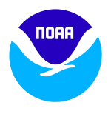
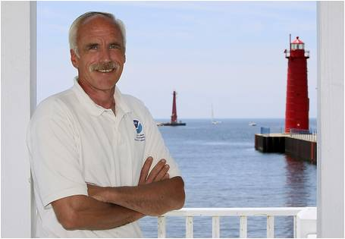
Great Lakes Field Stations & Vessels
Dennis Donahue
Observing Systems & Advanced Technology
Place Photo Here
1/16
Notes:
This work aligns with the following NOAA Goals:
Science: Climate Adaptation and Mitigation
Improved scientific understanding of the changing climate system and its impacts
Assessments of current and future states of the climate system that identify potential impacts and inform science, service, and stewardship decisions
Mitigation and adaptation efforts supported by sustained, reliable, and timely climate services
A climate-literate public that understands its vulnerabilities to a changing climate and makes informed decisions
Science: Weather-Ready Nation
Reduced loss of life, property, and disruption from high-impact events
Improve freshwater resource management
Improve transportation efficiency and safety
Healthy people and communities due to improved air and water quality services
A more productive and efficient economy through information relevant to key sectors of the U.S. economy
Science: Healthy Oceans
Improved understanding of ecosystems to inform resource management decisions
Recovered and healthy marine and coastal species
Healthy habitats that sustain resilient and thriving marine resources and communities
Sustainable fisheries and safe seafood for healthy populations and vibrant communities
Science: Resilient Coastal Communities and Economies
Resilient coastal communities that can adapt to the impacts of hazards and climate change
Comprehensive ocean and coastal planning and management
Safe, efficient and environmentally sound marine transportation
Improved coastal water quality supporting human health and coastal ecosystem services
Education: Science-Informed Society
Youth and adults from all backgrounds improve their understanding of NOAA-related sciences by participating in education and outreach opportunities
Formal and informal education organizations integrate NOAA-related science content and collaborate with NOAA scientists on the development of exhibits, media, materials, and programs that support NOAA’s mission
Education: Safety and Preparedness
Youth and adults from all backgrounds are aware of, prepare for, and appropriately respond to environmental hazards that impact health, safety, and the economy in their communities
Education: Organizational Excellence
Leaders internal and external to NOAA recognize and support education investments as a way to achieve agency mandates, mission, and goals
NOAA educators and partners collaborate at local, regional, and national levels to coordinate efforts, build capacity, and better serve educational audiences
NOAA develops and supports a coordinated portfolio of products, programs, and partnerships that improves education opportunities in NOAA-related content areas for underserved audiences

Slide 2
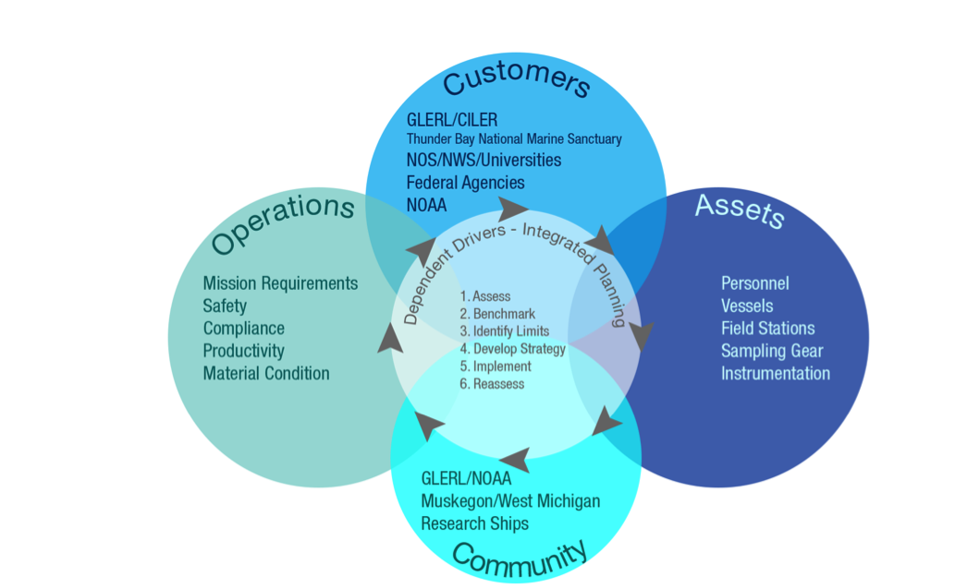
OSAT | Great Lakes Field Station & Vessels
Drivers
2/16
Notes:
GLERL’s LMFS and Vessel Operations are coordinated to provide safe, reliable, and innovative service to support integrated scientific research for NOAA and external partners. In addition, both the field station and vessels provide opportunities for communication, outreach, and education for NOAA and partners, academic institutions, and local and regional communities. Integral to GLERL’s Vessel Operations is planning for short-term and future needs, driven primarily by scientific goals and objectives.
Guiding Principles
Facilitate the conduct of field science (e.g., observations and process studies) that meet the requirements for GLERL researchers, NOAA interests in the Great Lakes, and partner institutions.
Achieve safety and regulatory compliance in all aspects of operations and asset management.
Maintain uninterrupted vessel service by addressing unmet needs on a proactive basis.
Establish resources and systems for best management of vessel material condition and platform effectiveness.
Advance marine technology initiatives that support NOAA’s stewardship and operational goals.
Invest in personnel development and create career path opportunities.
Embrace the “One NOAA” concept through support of all NOAA interests in the Great Lakes region and contribute to NOAA’s priorities for vessel management.
Provide value as a national, regional, and community resource.
To address the challenges encountered in the operation of GLERL’s vessels, consideration is given to the following business elements: addressing customer needs, providing effective capital and asset management, developing operations, and serving community. Simultaneous examination of these elements provides a holistic and sustainable long-term strategy to meet GLERL’s research needs as well as those of other Great Lakes customers.
Addressing Customer Requirements and Needs: Identify customers, partners, relationships, and responsibilities in the Great Lakes region.
Management of Assets: Create a vessel inventory and fleet renewal plan based on customer requirements and best management of assets. As part of this element, maintain development of LMFS facility infrastructure in support of long term group activities e.g., scientific research and outreach.
Development of Operations: Define resource capabilities and professional development plans accounting for long-term product development, vessel and customer requirements.
Serving Community: Ensure peer and public engagement in the operations of vessels supporting research and outreach that is integrated with local, national, and regional community initiatives.
This comprehensive approach, inclusive of all of customer needs, helps to balance the cyclical nature of GLERL research. Changes in GLERL’s geographic focus and scientific priorities are best supported by maintaining capabilities for a diverse customer base.

Slide 3
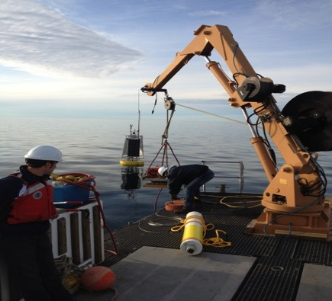
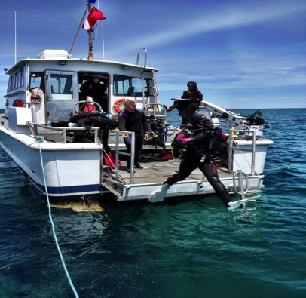
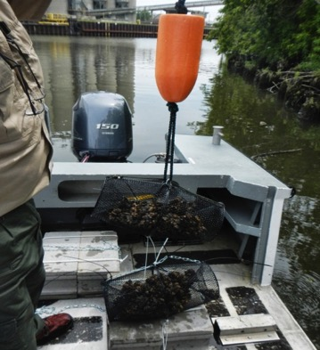
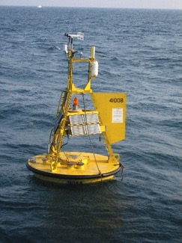
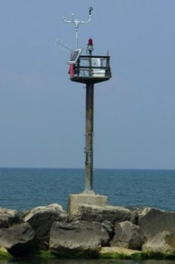
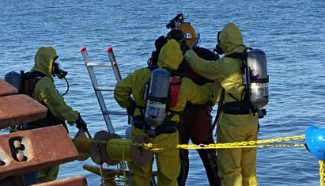
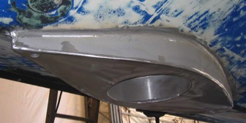
OSAT | Great Lakes Field Station & Vessels
One NOAA - Regional Vessel Support
Great Lakes Environmental Research Lab
Thunder Bay National Marine Sanctuary
National Ocean Service
Mussel Watch
Moon pool for mounting instrumentation
National Data Buoy Center
Office of Response
and Restoration
Office of Coast Survey
National
Weather Service
3/16

Slide 4
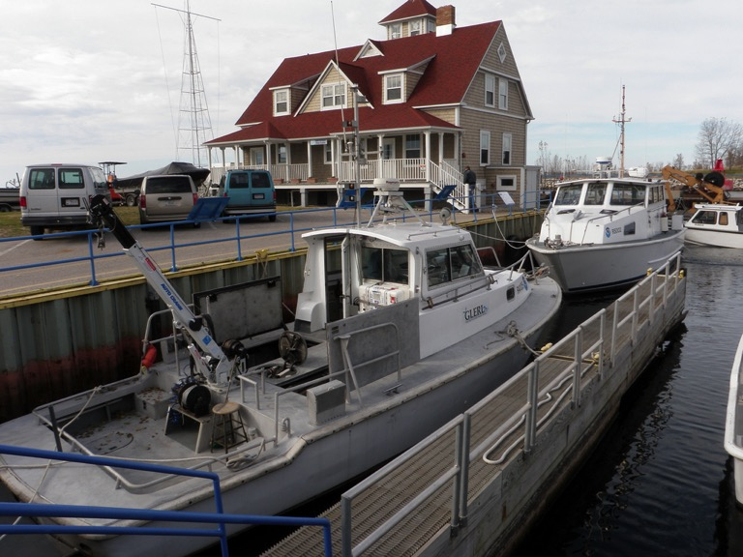
OSAT | Great Lakes Field Station & Vessels
Lake Michigan Field Station
Home Port – Great Lakes Vessel Operations
1200’ Deep water dockage
Small boat basin
Logistics
Engineering
Fabrication
Biodiesel fueling
Community outreach
4/16

Slide 5
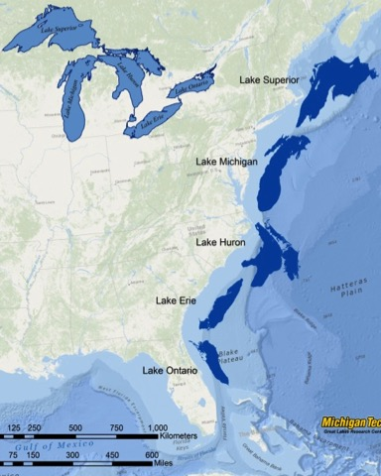
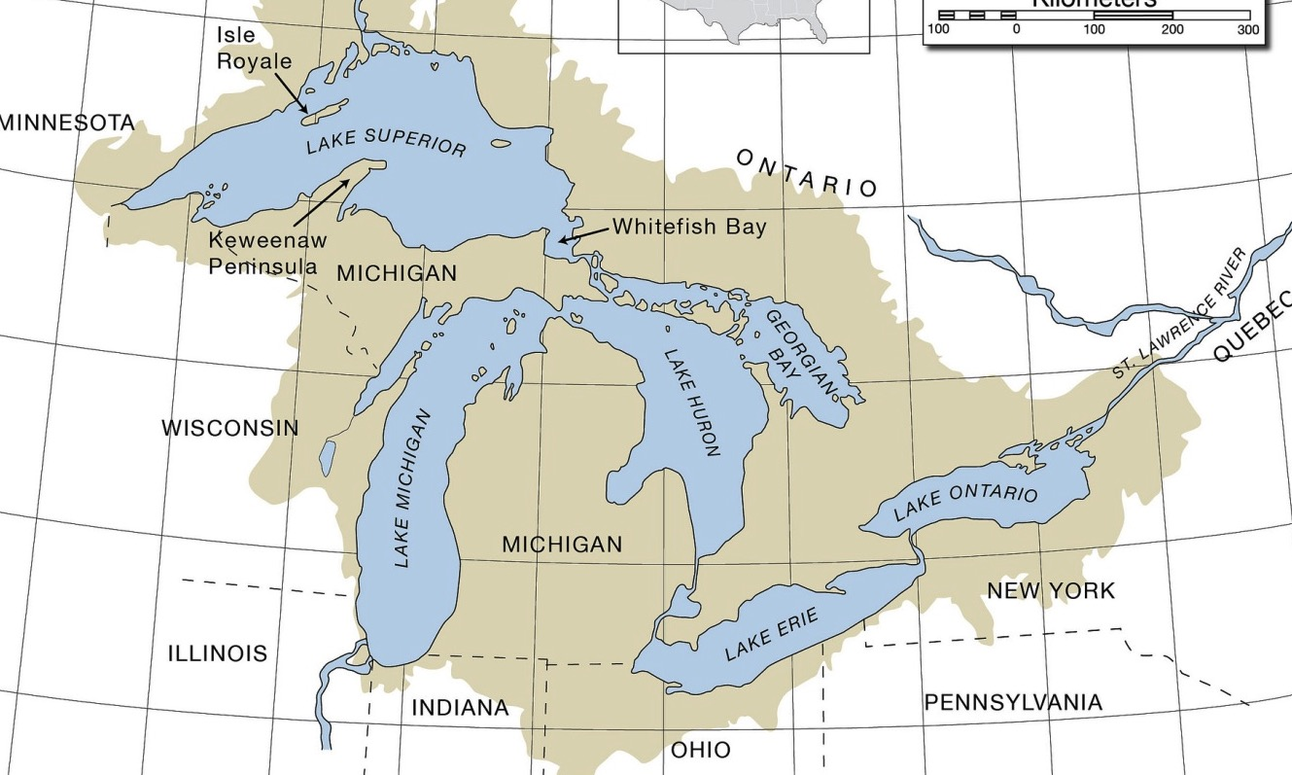
OSAT | Great Lakes Field Station & Vessels
Field Stations / Vessel Bases
Alpena
Muskegon
Bay City
Monroe
Cleveland
Full season vessel base
Transient vessel base
5/16

Slide 6
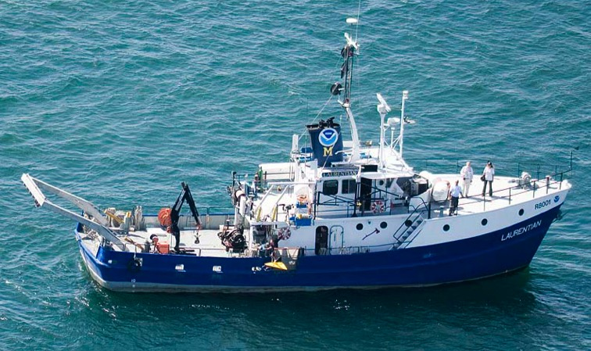
OSAT | Great Lakes Field Station & Vessels
SRV - Laurentian
Built 1974 - UNOLS
Operated by GLERL since 2002
Multi discipline platform
20 day duration
14 berths
Heavy lift and trawl capable
Limited Winter season
Fueled by B100 Biodiesel
Primary platform for GLERL programs
Long Term Research monitoring
Spatial studies
Plankton Survey System (PSS)
MOCNESS
Winter operations
Outreach and education
Supports NOAA regional missions
Deep water hydrographic surveys
Archeological exploration
NDBC buoy support
Realities
Nearing end of service life
Ownership limits capital improvements
Dated infrastructure and technology
Scheduling challenges
Choice of one
No viable backup, reserve capacity
6/16
Notes:
SRV – Small Research Vessel
UNOLS – University-National Oceanographic Laboratory System
LTR | Long Term Research, a program led by GLERL’s EcoDyn’s team that integrates a core set of long-term observations on biological, chemical, and physical variables on Lake Michigan, accompanied by process studies and field experiments, for understanding and forecasting change on the Great Lakes ecosystem. The term is used in the context of a site and in particular, regarding the Lake Michigan LTR program, that is, the LTR program on southern Lake Michigan. although we currently have research programs on other lakes, none are consistent or extensive enough through all seasons to characterize them as LTR sites.
MOCNESS | Multiple Opening Closing Net and Environmental Sensing System is an apparatus used for fine-scale sampling of Bythotrephes, Mysis, and larval fishes
NDBC – National Data Buoy Center

Slide 7
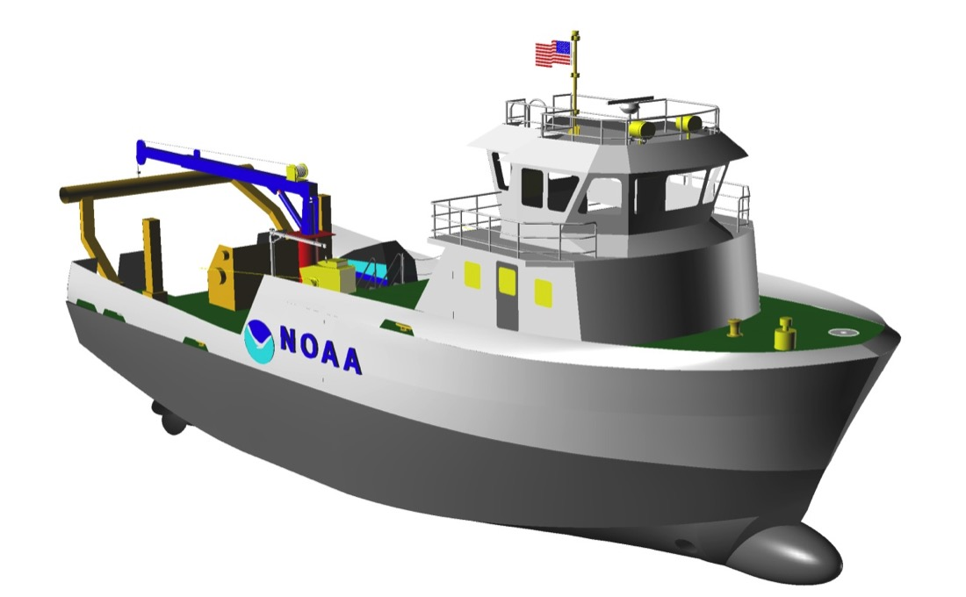
OSAT | Great Lakes Field Station & Vessels
Strategy for the next 50 years
Address Regional Gaps
Ice strengthened hull
Full SRV capabilities
Hydro Survey Capable
Dynamic Positioning
Laboratories and infrastructure to best support Science initiatives
NOAA Regional asset
Collaborative management plan
Length 90 -110 feet
Beam - 29 feet
Speed - 15 knots
Draft – 7’ 2”
Propulsion – Twin 600 hp
Bow thruster
Twin 99kw generators
Berthing 12-14
Endurance 7-10 days
7/16

Slide 8
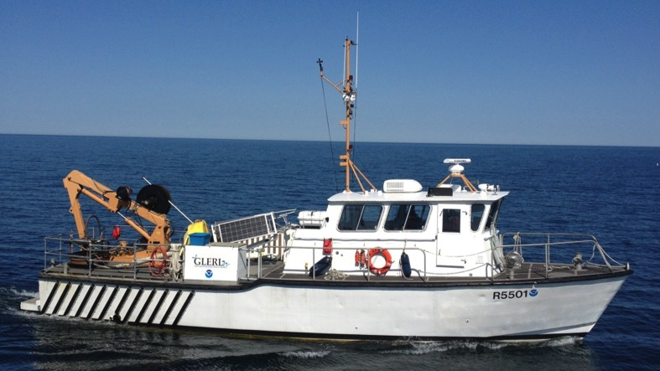
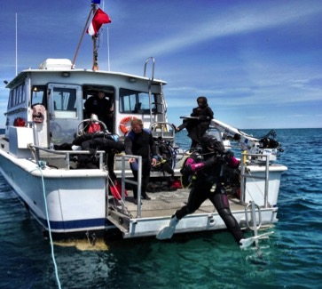
OSAT | Great Lakes Field Station & Vessels
Class III Vessels (40-65’) – 4
R5501 / R5504
Heavy lift
High speed
Transient and logistic advantages
Supports
ReCON and GLOS buoys
HABS ESP
Event response
Sanctuary mooring buoys
R5002
Dive support
Multi-beam sonar
Side scan sonar
Onboard survey processing
Supports NOAA Thunder Bay National Marine Sanctuary initiatives
8/16
Notes:
ReCON | Real-time Coastal Observation Network is a project focused on the development of a national network of low cost coastal buoys capable of seabed to sea-surface observations. ReCON is built upon a wireless Internet observation system, with each system collecting meteorological data and providing sub-surface measurements of chemical, biological, and physical parameters.
GLOS | Great Lakes Observing System is one of 11 Regional Associations of the Integrated Ocean Observing System (IOOS®), working to enhance the ability to collect, deliver, and use ocean and Great Lakes information. IOOS is a partnership among federal, regional, academic and private sector parties that works to provide new tools and forecasts to improve safety, enhance the economy, and protect our environment.
HAB | Harmful Algal Bloom is the proliferation of cyanobacteria or algae resulting from rapid growth in response to high nutrient and/or light levels. These events can have severe impacts on the ecology of systems where they occur as well as on the socioeconomics of surrounding regions and the health of humans, wildlife, pets and livestock.
ESP | Environmental Sample Processor is the current state-of –the-art instrumentation providing an in situ platform for identifying and quantifying marine organisms and their gene products. This electromechanical/fluidic instrument is designed to collect discrete water samples, concentrate microorganisms, and autonomously analyze samples utilizing molecular probe assays that will help in expanding our scientific understanding of the cyanobacterial community composition and toxicity during harmful algal blooms (HABs) in western Lake Erie.

Slide 9
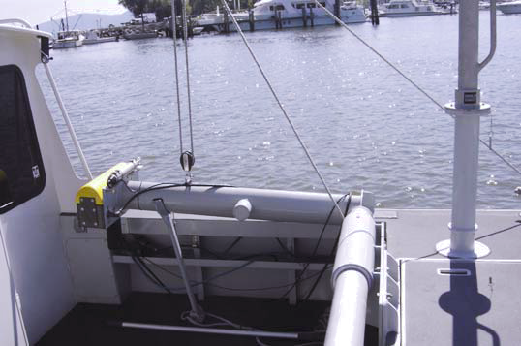
OSAT | Great Lakes Field Station & Vessels
Class II Vessels (25-40’) - 4
Near shore support / sampling
Hydro survey capable
Dive operations
Event response
Remote locations
Side Scan / Multi-beam sonar capable
AC and hydraulic power
Since 2013, all Class II Vessels have been completely rebuilt by the Lake Michigan Field Station staff.
9/16

Slide 10
OSAT | Great Lakes Field Station & Vessels
Vessel Operations Guiding Principles
Maritime Heritage Walkway
Caretaker of oldest NOAA facility
Public access
Stewardship
Cultural Heritage - LMFS
Environmental - Alternative Fuels
Asset management
Best Management Practices
Manage by metrics – benchmarks
Cost and productivity
Customer focus
Leadership / Engagement
Federal Green Fleet Working Group
Committee for Marine Transportation (CMTS) Alternative Fuels Task Team
Federal Green Fleet Working Group
UNOLS Green Fleet
Cooperative programs – MARAD, Corps of Engineers
Resource for vessel reutilization
OAR, NOS, NMFS
“Laidley”, “Grayling” projects
NOAA Small Boat Program
Great Lakes Association of Science Ships
NOAA Regional Vessel Working Group
11/16

Slide 11
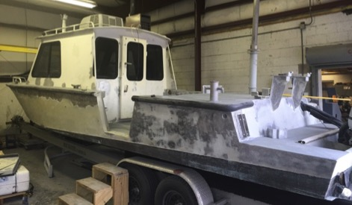
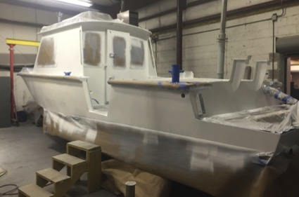
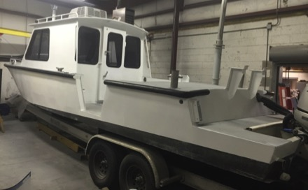
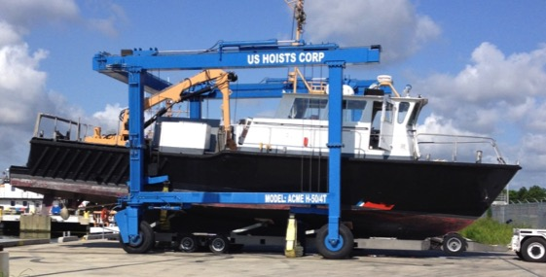
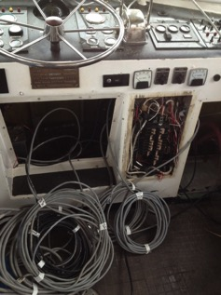
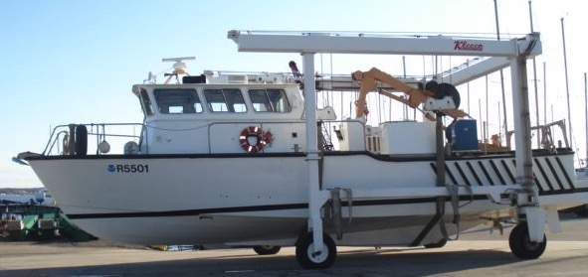
OSAT | Great Lakes Field Station & Vessels
Vessel Support Capabilities
Best use of available funds
Invest in employee skill sets and talent
Rebuild to mission requirements
Integrate emerging technologies
Reduce operational downtime
10/16

Slide 12
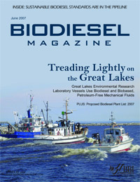
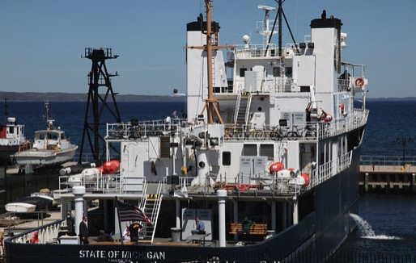
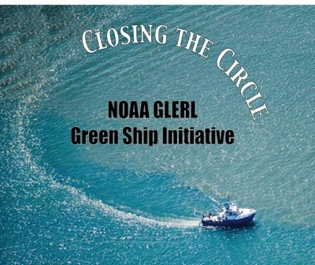
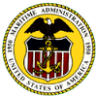
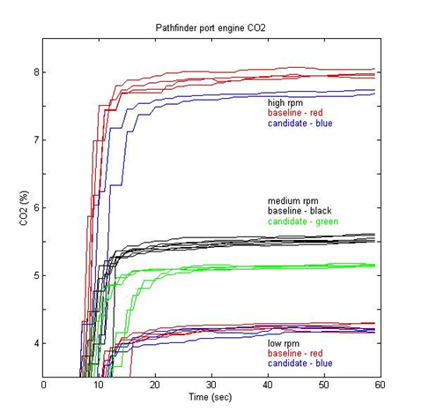
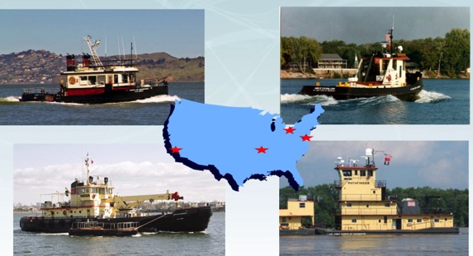
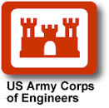
Technology Exchanges
OSAT | Great Lakes Field Station & Vessels
Industry
Validation
Maritime Administration
Large Power Plants
GLERL
Proof of Concept
Focal point
EPA
Emissions Studies
Corps of Engineers
Increase Scale
14/16

Slide 13
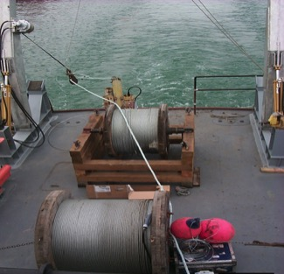
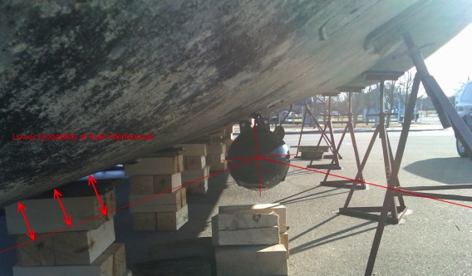
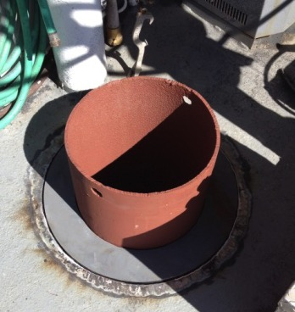
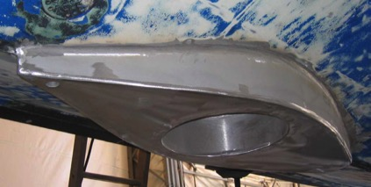
Technology Objective Balance Operations and Innovations
OSAT | Great Lakes Field Station & Vessels
Accomplish Current Mission
Support Traditional Sampling
Optimized Platform
Support Science Direction
– Anticipate Future Opportunities
– Provide for Emerging Technologies
– Maintain Versatility
– Offer Alternatives
Offshore cable laying
Multi-beam installation
Transducer well – R8001
High speed transducer fairing
12/16

Slide 14
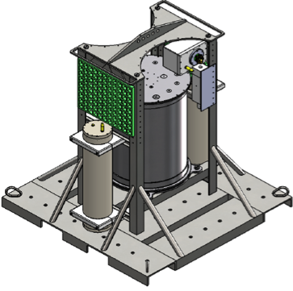
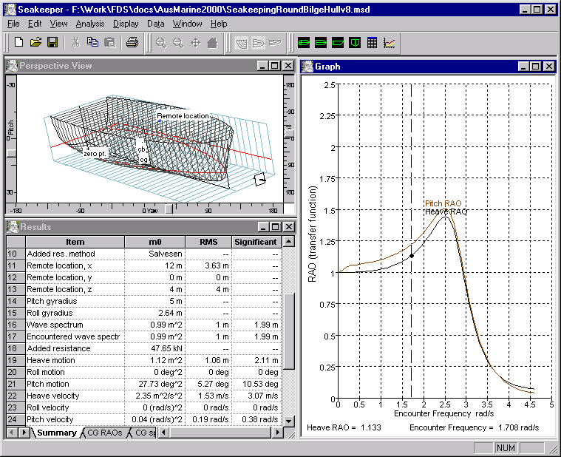
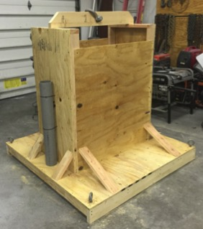
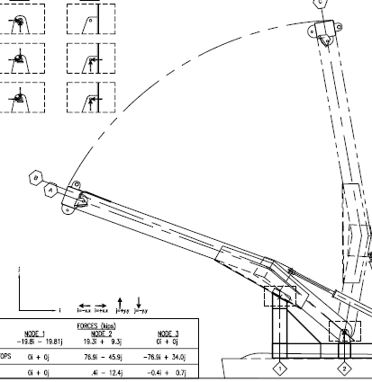
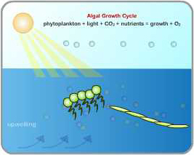
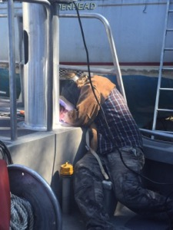
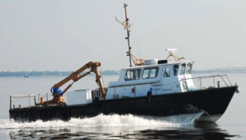
OSAT | Great Lakes Field Station & Vessels
Vessel Support and Science Objectives
HABs ESP Lander
Lander Design Version #6
Physical Model Validation
Science Objective
Computer Engineering
Early Risk Mitigation
Define Operational Margins
Develop Engineering Controls
Implement Platform Enhancements
Provide Alternatives
Platform Modifications
Alternative Platforms
13/16

Slide 15
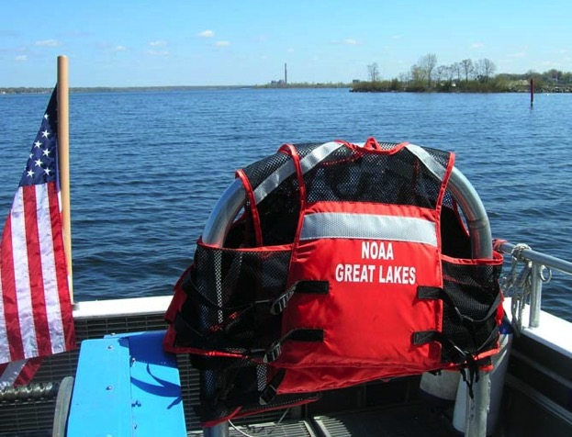
OSAT | Great Lakes Field Station & Vessels
Vision for vessel operations
Enhance current initiatives
Personnel development
Evaluation of emerging technologies
Marine technology and operations leadership
Contributions to Regional and National vessel interests
Facilitate 2, 5 and 10 year field project planning
Organize NOAA Regional vessel requirements and create a comprehensive and sustainable management plan
Consolidate NOAA support for a new Regional SRV
15/16

Slide 16
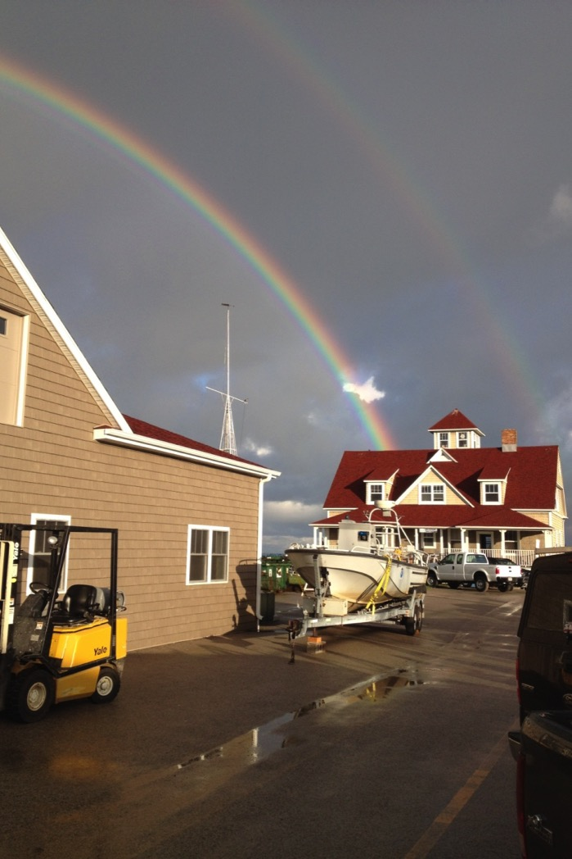
OSAT | Great Lakes Field Station & Vessels
Questions?
Feedback?
Place Photo Here
16/16

