Slide 1



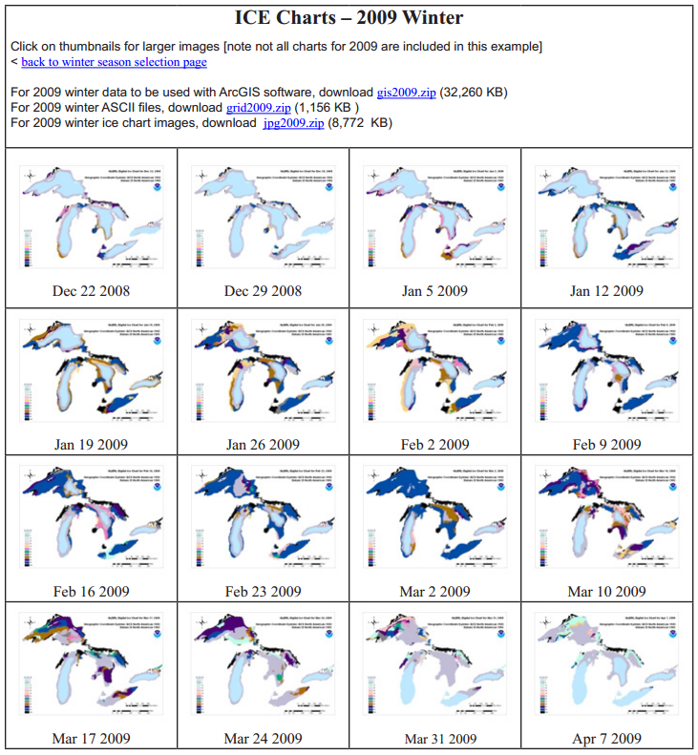
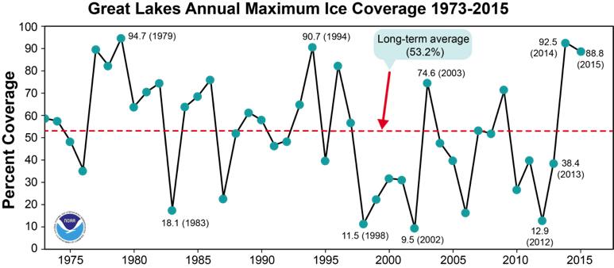
Great Lakes Ice & Climate Research, Modeling, and Applications
Jia Wang
Integrated Physical & Ecological Modeling & Forecasting
Place Photo Here
Great Lakes Ice Database, 1973-present
1/15
Notes:
Outline:
1 - Seasonal forecasting of lake ice using indices of climate teleconnections that was transferred to medium-range lake ice projection
2 - Development of Great Lakes Ice-circulation Model (GLIM) that was transferred to short-term ice forecasting in GLCFS
3 - Development of five-lake FVCOMice model for research and forecast
4 - Arctic climate: Arctic Dipole Anomaly (DA) and Arctic Oscillation (AO)
5 - Coupled Ice-Ocean Model (CIOM) and coupled (ice-ocean) Physical-Ecosystem Model (PhEcoM) in the Bering-Beaufort-Chukchi Seas and the Arctic Ocean
6 - Summary and future efforts
This work aligns to the following NOAA goals:
Science: Climate Adaptation and Mitigation
Improved scientific understanding of the changing climate system and its impacts
Assessments of current and future states of the climate system that identify potential impacts and inform science, service, and stewardship decisions
Mitigation and adaptation efforts supported by sustained, reliable, and timely climate services
A climate-literate public that understands its vulnerabilities to a changing climate and makes informed decisions
Science: Weather-Ready Nation
Improve freshwater resource management
Improve transportation efficiency and safety
A more productive and efficient economy through information relevant to key sectors of the U.S. economy
Science: Healthy Oceans
Improved understanding of ecosystems to inform resource management decisions
Science: Resilient Coastal Communities and Economies
Resilient coastal communities that can adapt to the impacts of hazards and climate change
Comprehensive ocean and coastal planning and management
Safe, efficient and environmentally sound marine transportation
Safe, environmentally sound Arctic access and resource management
Education: Science-Informed Society
Youth and adults from all backgrounds improve their understanding of NOAA-related sciences by participating in education and outreach opportunities
Formal and informal educators integrate NOAA-related sciences into their curricula, practices, and programs
Formal and informal education organizations integrate NOAA-related science content and collaborate with NOAA scientists on the development of exhibits, media, materials, and programs that support NOAA’s mission
Education: Future Workforce
Graduates completing NOAA-supported student opportunities continue education, enter the workforce, and advance in careers that support NOAA’s mission

Slide 2


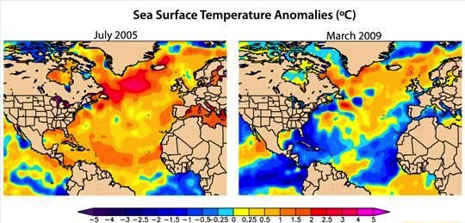
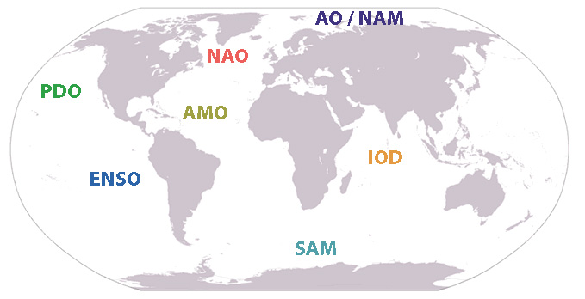
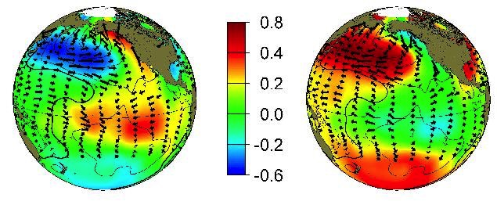
1) R&D: Major global-scale atmospheric teleconnection patterns
IPEMF | Great Lakes Ice & Climate Research
Warm Phase Cold Phase
Wang et al. (submitted)
Great Lakes ice correlates to
AMO (linear: r=-0.31) and PDO (non-linear: r=0.19)
2/15
Notes:
AMO – Atlantic Multidecadal Oscillation
PDO – Pacific Decadal Oscillation

Slide 3
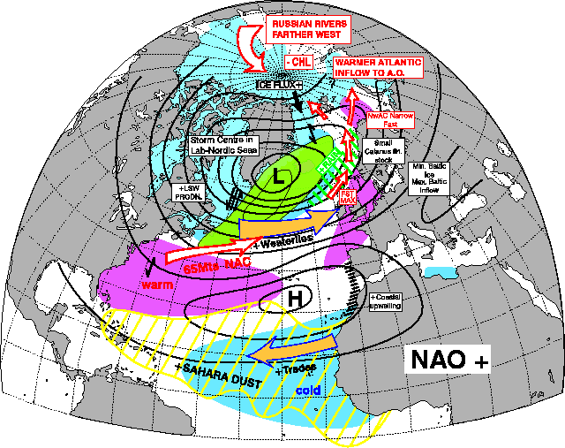
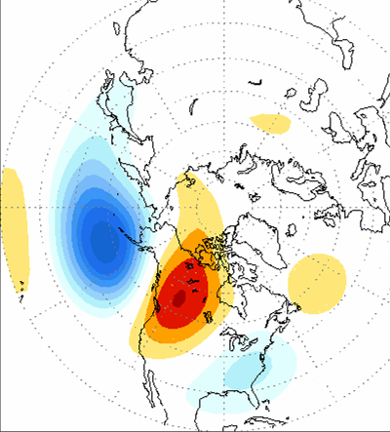
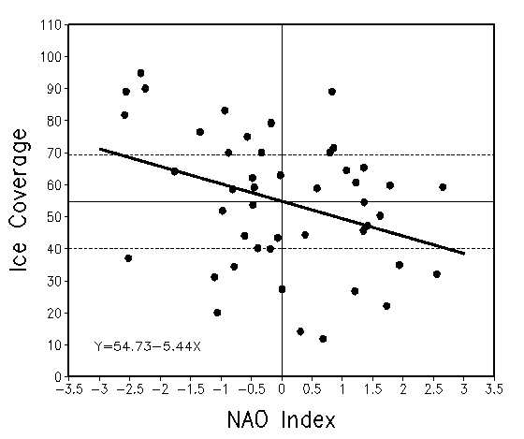
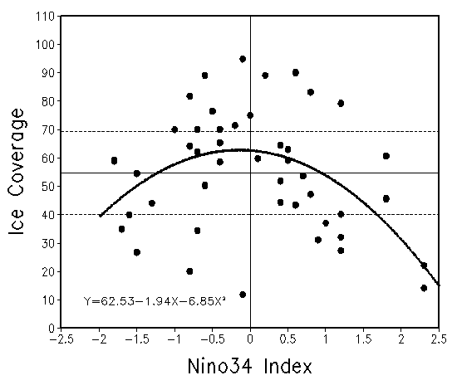
Great Lake ice correlates to
NAO/AO (linear: r=-0.29), ENSO (nonlinear: r=-0.22)
IPEMF | Great Lakes Ice & Climate Research
North Atlantic Oscillation (NAO)
(Arctic Oscillation)
Pacific North America Pattern (PNA)
(El Nino/La Nina, ENSO)
Ice and NAO:
Linear relationship
Ice and ENSO:
Nonlinear and asymmetric relationship
3/15
Notes:
The Great Lakes are not the action center – we are on the periphery of the action center.
ENSO – El Nino and Southern Oscillation
NAO – North Atlantic Oscillation
Bai et al. (2012, JGR);
Wang et al. EOS, 2010
Wang et al., 2010 EOS; 2012 JC; Bai et al. 2011 JAMC, 2012, JGR; Wang et al. submitted
(Joint efforts by GLERL and CILER)

Slide 4
Strategy of Projecting Lake Ice
IPEMF | Great Lakes Ice & Climate Research
????
Hard to predict
on medium range
C (SAT,ice)=-0.8 to -0.9
Climate Teleconnection Indices
500mb-height, SLP, surface air temperature and wind changes
Lake Ice Cover
➔
➔
4/15
Notes:
If we go from Climate Teleconnection Indices to 500mb-height, SLP, surface air temperature and wind changes
to Lake Ice cover we add room for error and large uncertainty. If we skip from teleconnection indices to Lake Ice cover we remove a large margin of error.

Slide 5
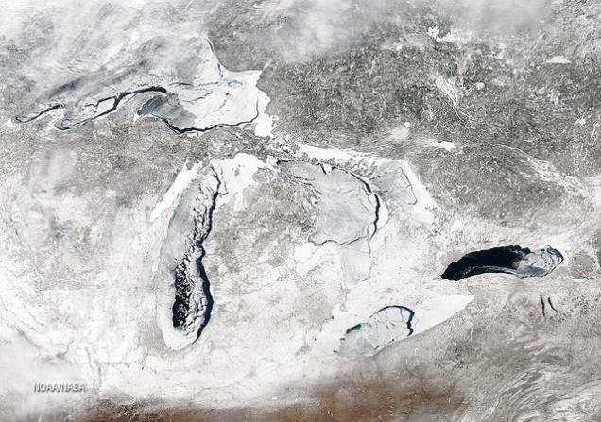
R2A: Medium-range projection of lake ice using climate indices of NAO, Nino3.4, AMO, and PDO
IPEMF | Great Lakes Ice & Climate Research
(GLERL led the efforts with CILER, NIC, academia, LimnoTech)
Hindcast
MODIS 03/06/2014
R2A: Seasonal prediction model:
Blue – old model (Using NAO and ENSO only), r=0.44
Red – new model (Using NAO, ENSO, and AMO, PDO) r=0.68
Using the models, GLERL has provided a seasonal ice outlook since 2010:
This winter—Annual Maximum Ice Coverage (AMIC) was projected to be 31% in November 2015; On 2/14/2016, AMIC was 34% (average is 53%)
5/15
Notes:
(Bai et al. 2012 JGR; Wang et al. submitted)
R2A: Seasonal prediction model:
Y=0.45 -0.13xNino34 -0.4xNino34**2 -0.4xNAO+ 0.21xNAO*Nino34**2 (ENSO&NAO on intera.)
-0.5xAMO+0.15xPDO+0.05xPDO**2 (AMO&PDO linear and squared on decadal)
+0.01xAMO*NAO-0.08xPDO**2xNino34**2 (crossing decadal and interannual interactions)
+0.16xPDO**2xAMO (AMO&PDO interactions on decadal time scales)
R=0.68, R**2=0.46 (Best)
Red – new model
Blue – old model
AMIC – Annual maximum ice cover

Slide 6
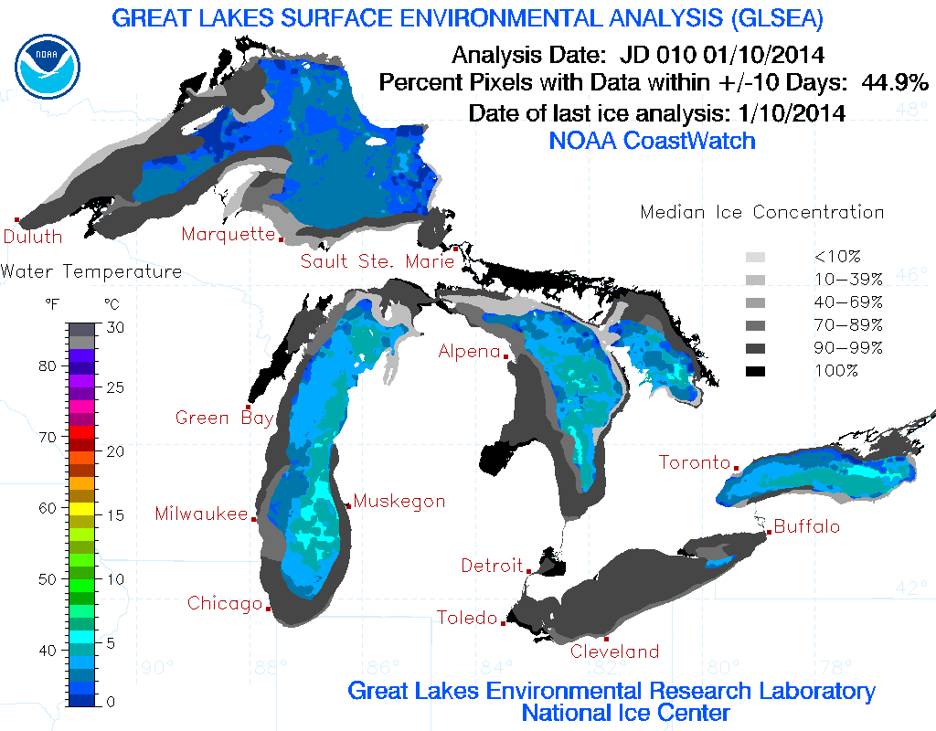
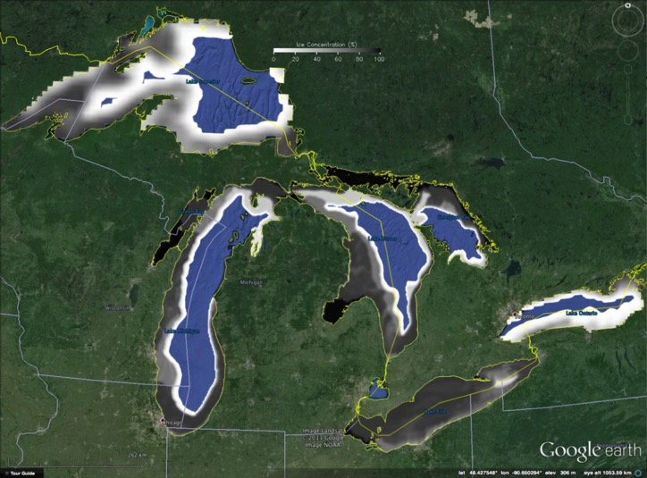
R2O: GLIM 5-day Prediction during 2013-14 (heavy) ice season
IPEMF | Great Lakes Ice & Climate Research
2) R&D: Development of Great Lakes Ice-circulation Model (GLIM): Satellite and in situ data used to validate GLIM
(Joint efforts by GLERL and CILER)
Prediction skill has been improved from 2012 to 2014 by nudging daily ice concentration from National Ice Center.
Wang et al. (2010). JGLR.
6/15
Notes:
GLIM – Great Lakes Ice-circulation Model
Quality of prediction – 5-day prediction using data assimilation

Slide 7
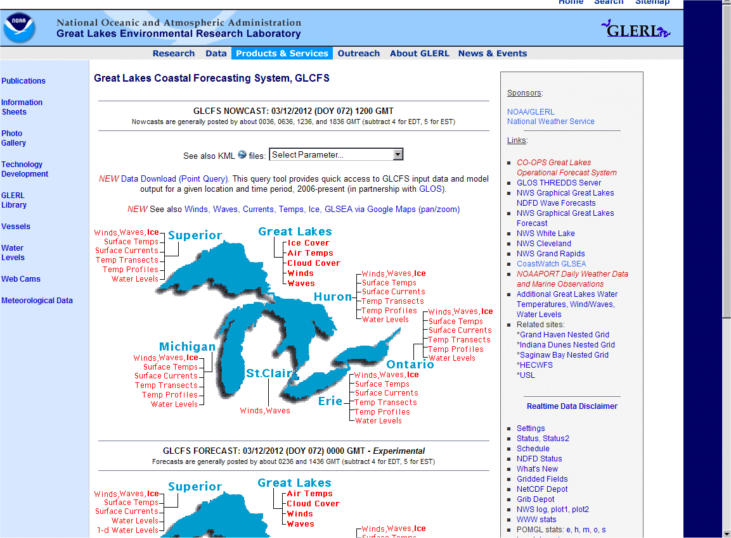
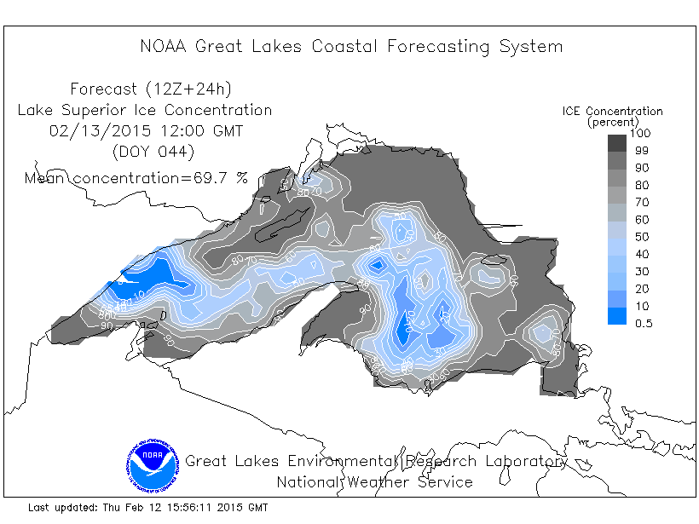
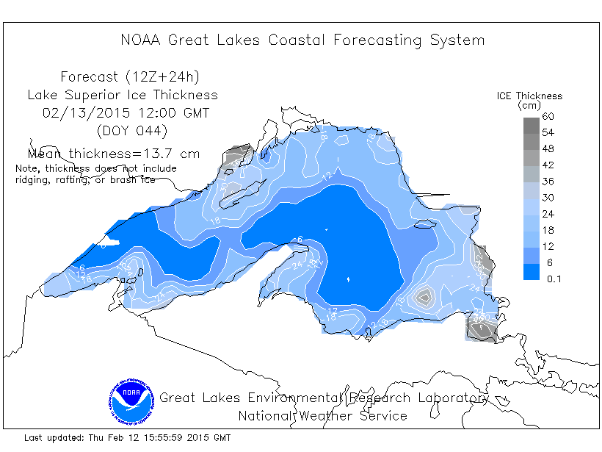
R2O: GLERL Ice Forecast (GLIM) has been incorporated into the GLCFS since 2010
IPEMF | Great Lakes Ice & Climate Research
http://www.glerl.noaa.gov/res/glcfs/
5-day Forecast
Ice Concentration
Select “Ice”
Ice Thickness
Wang et al. (2010). JGLR; Fujisaki et al. (2012). JGLR;
Fujisaki et al. (2013). JGR.
7/15

Slide 8
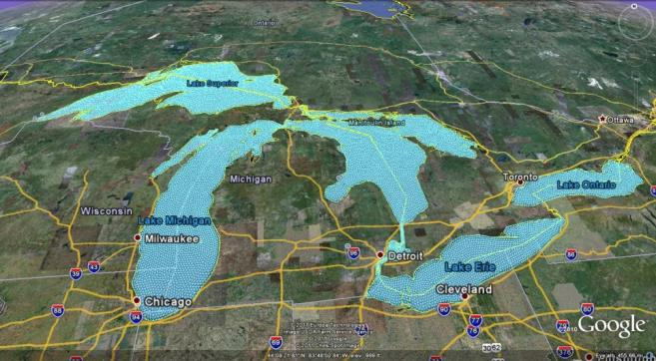
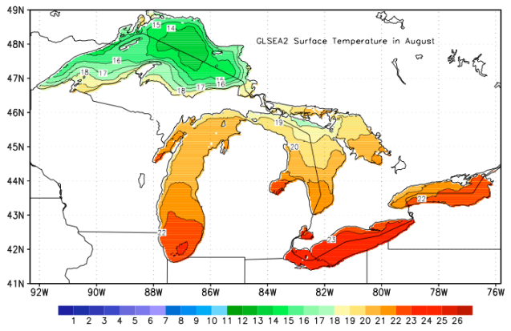
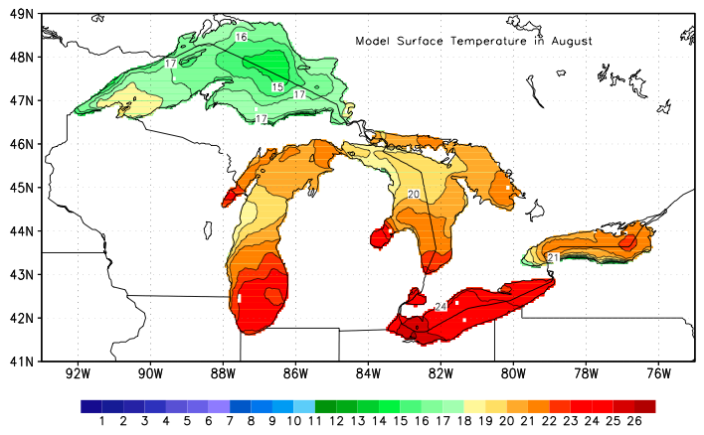
IPEMF | Great Lakes Ice & Climate Research
3) R&D: Development of 5-lake unstructured-grid FVCOM with ice
Grids
Modeled summer circulation
Measured Lake Surface Temperature
Modeled Lake Surface Temperature
Aug
Bai et al. (2013). Ocean Modelling; Luo et al. (2012). JGR)
8/15
Notes:
FVCOM – Finite Volume Community Ocean Model
(Joint efforts by GLERL and CILER)

Slide 9
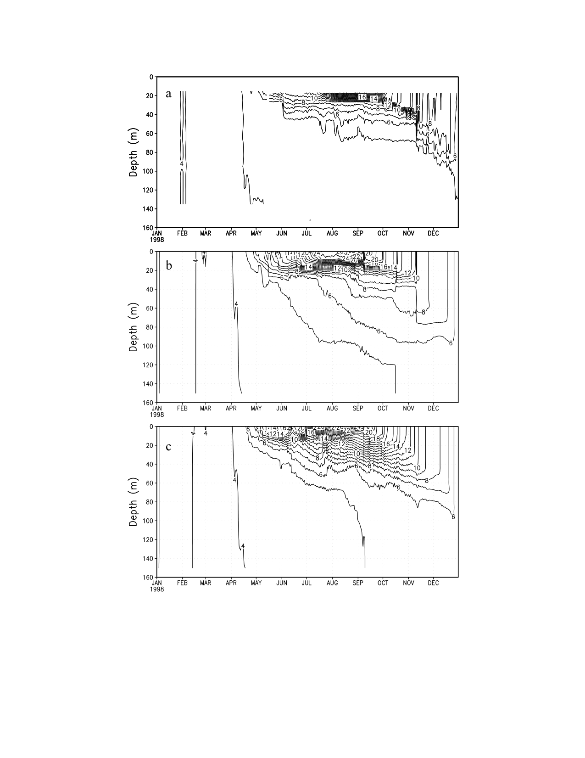
R&D: Implement the Modified FVCOM-Ice to All Five Great Lakes
IPEMF | Great Lakes Ice & Climate Research
Observed FVCOM-ice
.
1998
Observed (Lake Michigan) Centered differencing Original: EF+RK4
Manome and Wang (submitted)
9/15
Notes:
Producing 3D structure of the thermocline
(Transition efforts with ice to NOS/CO-OPS use of FVCOM in coastal ocean and GLCFS/GLOFS
with Eric Anderson; potential coupling to ESRL’s HRRR, and NCEP’s models)
Manome and Wang (submitted): We modified the unstable numerical time integration schemes of Euler forward (EF) and Runge-Kutta order 4 (RK4) in original version to centered differencing scheme, and significantly improve the model simulations.

Slide 10
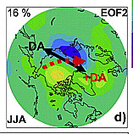
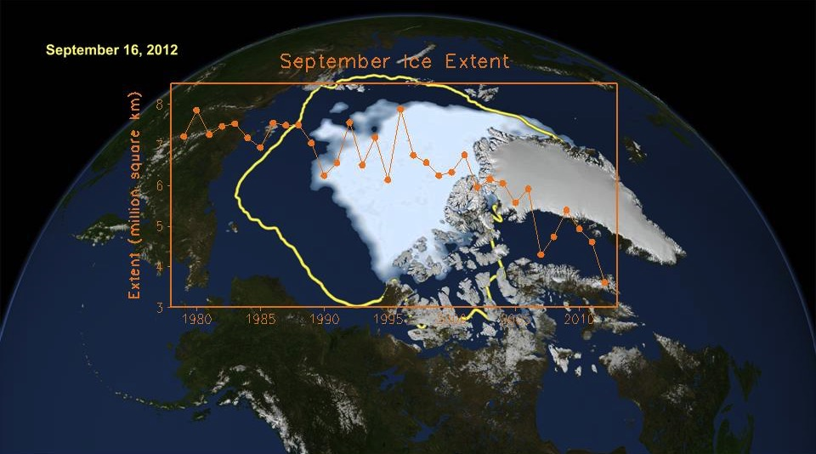
IPEMF | Great Lakes Ice & Climate Research
4) R&D: Arctic Dipole Anomaly (DA) is the major forcing
that accelerates Arctic summer sea ice decline
DA is the 2nd EOF mode of Sea Level Pressure Anom. north of 70N
(Collaborated with PMEL)
Ice-free
in 2035?
Wang et al., (2009, 2014).
10/15
Notes:
Beyond R&D: Application to walrus, fisheries, whales, Inuit life style and
support of new leadership of Arctic Council by U.S. in 2015-2017
Wang et al. (2009) GRL, (2014) Chapter Book,

Slide 11
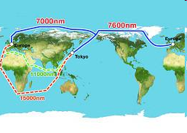
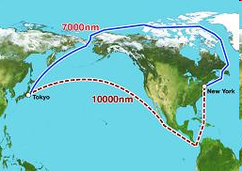
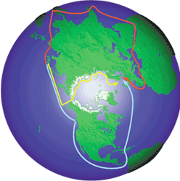
R2A: Impacts of diminishing summer sea ice on commercial shipping
IPEMF | Great Lakes Ice & Climate Research
7000nm
7600nm
7000nm
11000nm
10000nm
15000nm
nm = Nautical Mile = 1.852 km
Support of new leadership of Arctic Council by U.S. in 2015-2017
Lei et al. (2015). Cold Regions Science and Technology.
Lei et al. (2016). Polar Research.
11/15
Notes:
**Highlight the economic impact
Arctic sea routes
Northeast passage (NEP)
Northern Sea Route (NSR)
Northwest passage (NWP)
Exact definition of the Northern Sea Route is the route between the Kara Gate and the Bering Strait under the NSR Administration Agency.

Slide 12
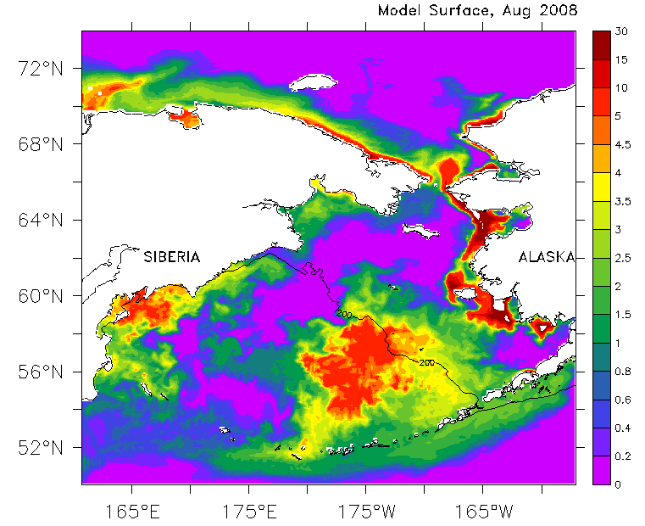
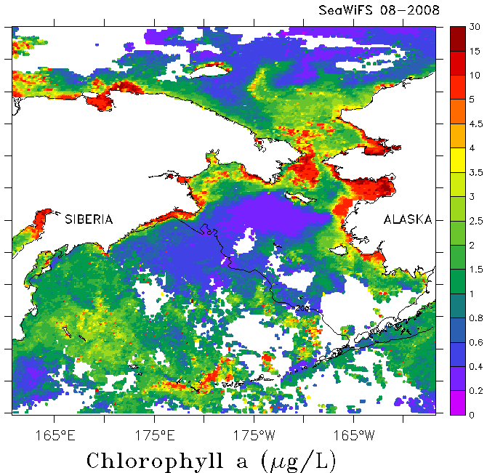
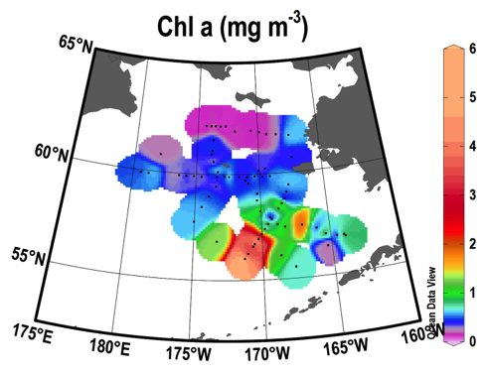
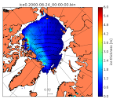
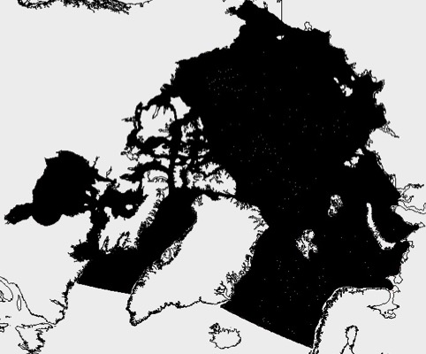
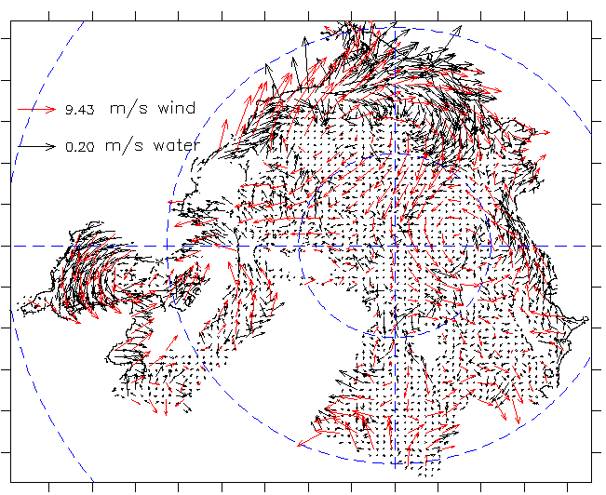
5) R&D: GLERL’s Coupled Ice-Ocean-Ecosystem Models in the Arctic Ocean
IPEMF | Great Lakes Ice & Climate Research
CIOM-PhEcoM chl-a Satellite In situ August 2008
μg/L
Cloud
cover
ICEPOM (20km), thickness Arctic-FVCOM-ice grids (1-10km) Arctic-FVCOM-ice, V_sfc
Wang et al. (2013, 2014). JGR.
(Potential R2X in near future)
12/15
Notes:
Joint efforts by GLERL, CILER, PMEL, academia

Slide 13
IPEMF | Great Lakes Ice & Climate Research
Summary
Research revealed the relationships between Great Lakes ice cover and 4 major teleconnection patterns, and led to development of statistical regression models, providing seasonal projection of lake ice using indices of NAO, ENSO, AMO and PDO
Great Lakes Ice-circulation Model (GLIM) (POM-based) was developed for studying interactions between water and ice (heat flux, energy transport), which was transferred to short-term ice forecasting in GLCFS
5-lake FVCOM-ice model was implemented and refined to the entire Great Lakes for investigate seasonal and interannual variability, which will be transferred to nowcast/forecast system for NOS, and seasonal projection of lake ice cover at GLERL
Arctic teleconnection patterns, DA and AO, are the major forcing to the Arctic sea ice, while AO is also the major forcing to the Great Lakes ice cover. The Northern Sea Route opening and closing are more closely correlated with DA than AO
Develop Coupled Ice-Ocean Model (CIOM) and coupled (ice-ocean) Physical-Ecosystem Model (PhEcoM) in the Bering-Beaufort-Chukchi Seas and the Arctic Ocean for application and prediction in the near future
13/15

Slide 14
IPEMF | Great Lakes Ice & Climate Research
Future Efforts
Continue to update the climate ice database for research and applications by the Great Lakes community, and to provide seasonal forecast of lake ice
Run GL-FVCOM-Ice from 1993-present and validate the model using observation data
Seasonal forecast/projection of lake ice using GL-FVCOM-Ice
Transition of GL-FVCOM-Ice to NOS/CO-OPS for short-term operational prediction (with Anderson)
Coupled GL-FVCOM-Ice with GL-WRF (with Lofgren)
Implement FVCOM-Ice to the Arctic Ocean (with CILER)
14/15

Slide 15
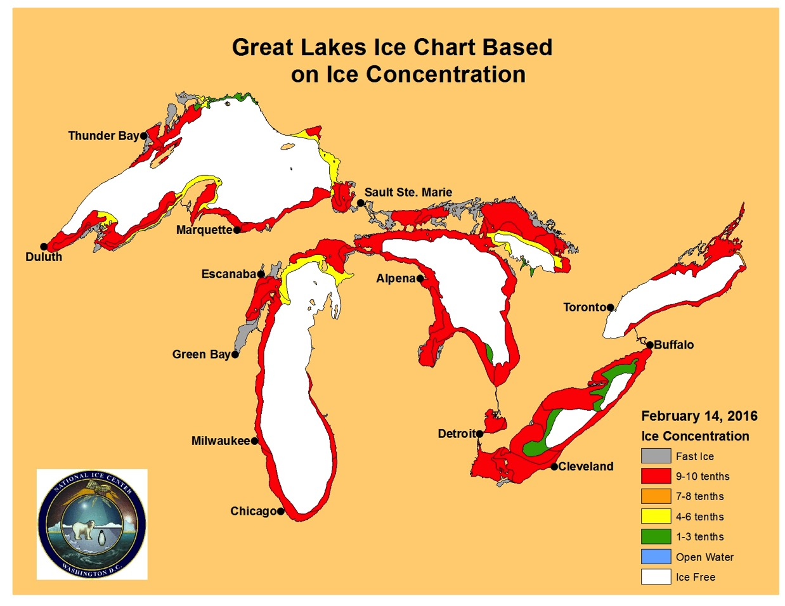
IPEMF | Great Lakes Ice & Climate Research
Questions?
2015/16 winter:
Projected: 31%
Observed: 34%
15/15

Slide 16
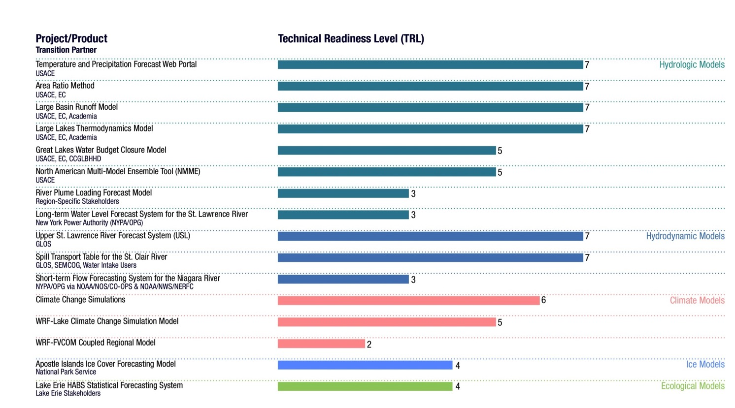
IPEMF | Great Lakes Ice & Climate Research
Technical readiness level of IPEMF
research to application (R2A) products
Seasonal Regression Forecast Model for all Great Lakes Ice Cover: 7
Additional Information

Slide 17
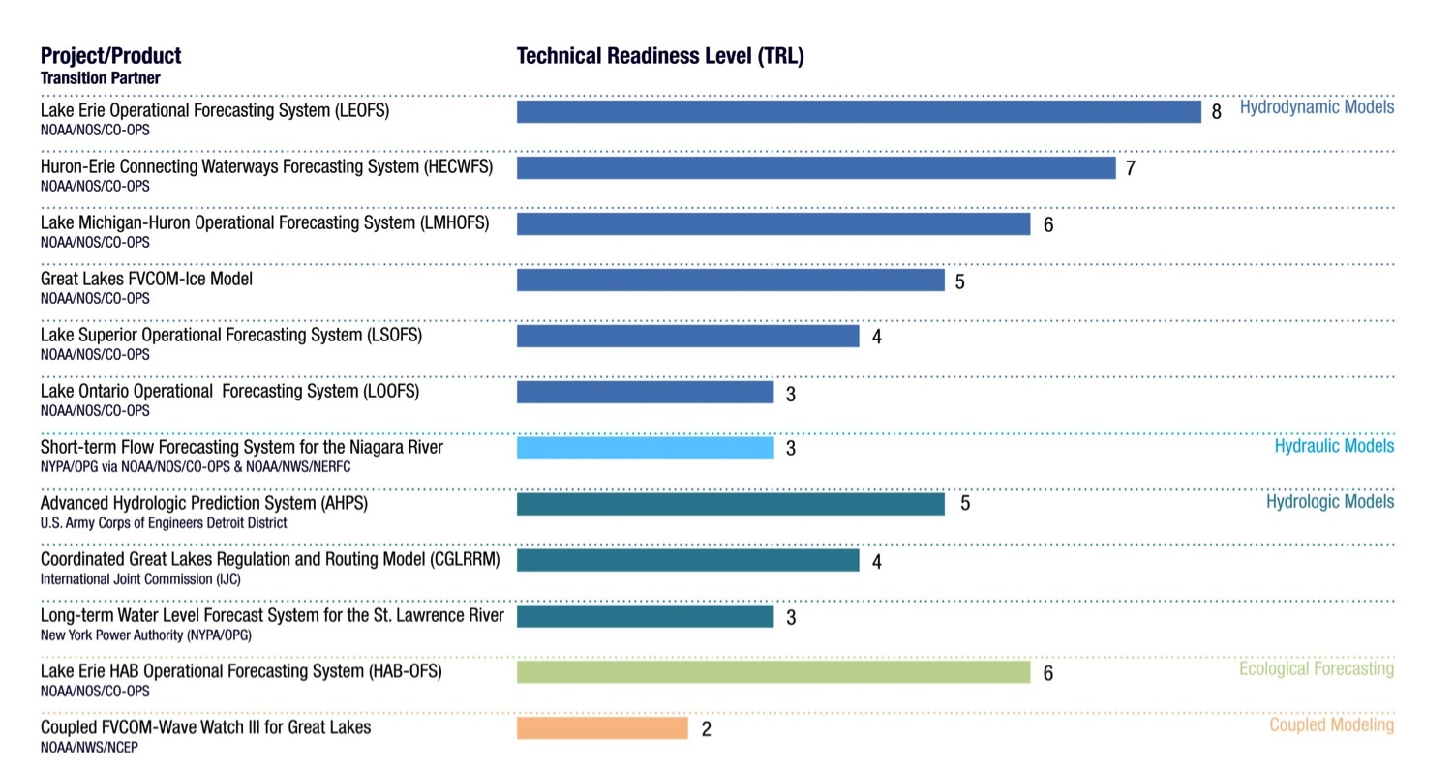
IPEMF | Great Lakes Ice & Climate Research
Technical readiness level of IPEMF
research to operation (R2O) products
Additional Information

