Slide 1



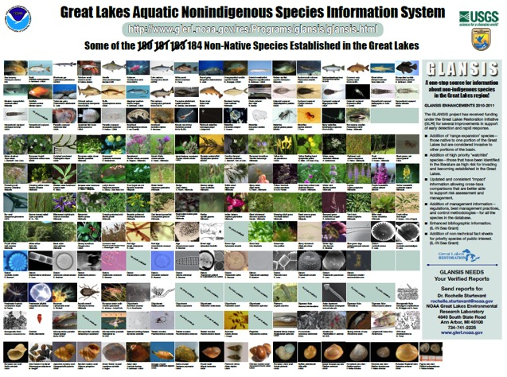
Great Lakes Nonindigenous Species Information System (GLANSIS)
Rochelle Sturtevant
Great Lakes Sea Grant Network
http://www.glerl.noaa.gov/res/Programs/glansis/glansis.html
1/9

Slide 2

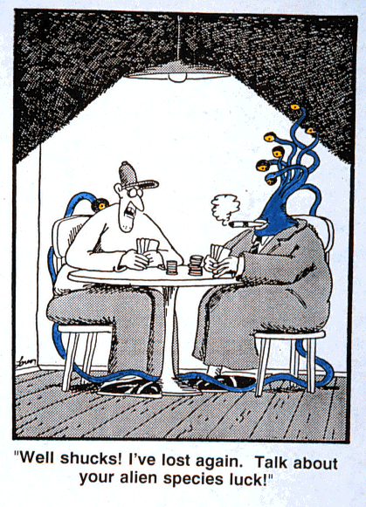
EcoDyn | GLANSIS
Why Do Invasive Species Cause Problems?
Aggressive and prolific
Mature quickly
Leave behind diseases, parasites, predators, and competitors
Difficult to eradicate because they reproduce
2/9

Slide 3
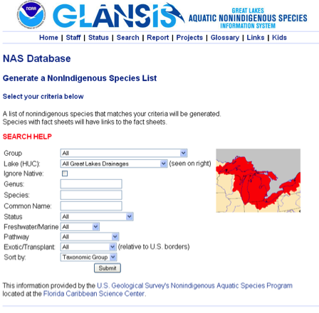
EcoDyn | GLANSIS
GLANSIS* is …
A Great Lakes specific node of the USGS Nonindigenous Aquatic Species (NAS) database
A NOAA project to enhance access to information on non-native species in the Great Lakes region
GLANSIS provides…
A simple interface for accessing Great Lakes specific content from the national (USGS NAS) database
Advanced search capacity supporting research on the patterns and particulars of Great Lakes invasion biology
GLANSIS contains…
Comprehensive technical fact sheets on each of the 186 non-native species established in the Great Lakes, 12 species identified as expanding ranges within the Great Lakes, and 67 species identified as at risk of invading the Great Lakes.
Species-specific information supporting early detection, rapid response, risk assessment and control efforts.
Detailed collection records for thousands of individual reports of non-native species in the Great Lakes basin
3/9

Slide 4
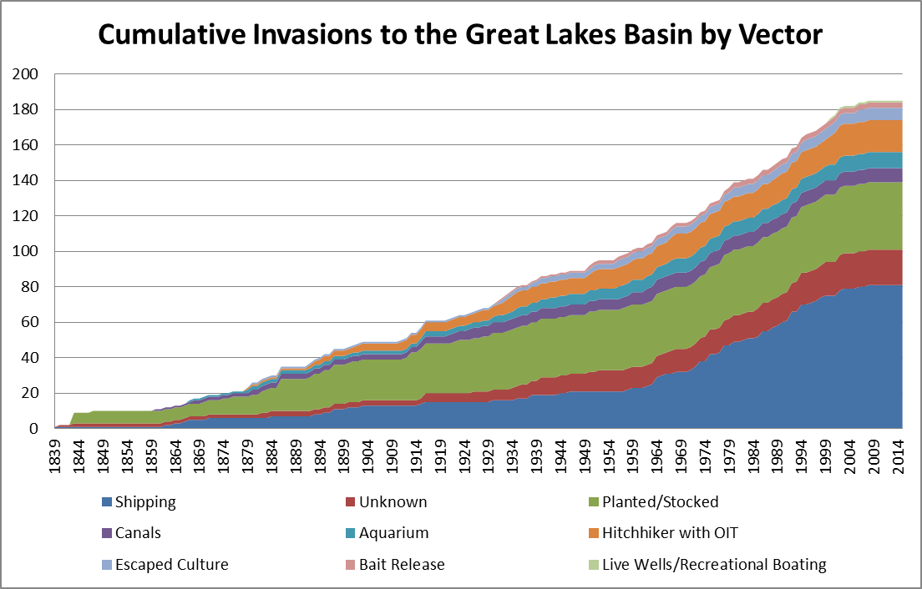
EcoDyn | GLANSIS
Invasion History
No new invaders confirmed since 2006!
4/9
Notes:
Newest version will appear in State of the Lakes Ecosystem Conference indicators report – an EPA Great Lakes National Program Office product

Slide 5
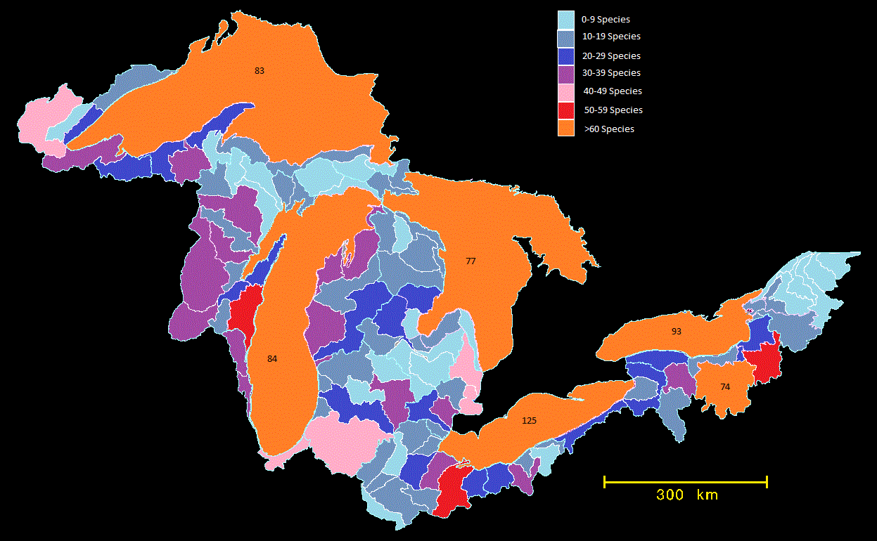
EcoDyn | GLANSIS
Distribution of Invasive Species By Watershed
Not every species is in every watershed
5/9
Notes:
In fact, NO single aquatic nonindigenous species is reported in every sub-watershed of the Basin.
Note: The orange region south of Lake Ontario is heavily invaded due to the presence of a large number of nonindigenous species in the Erie Canal

Slide 6
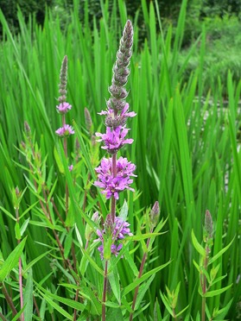
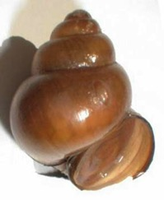
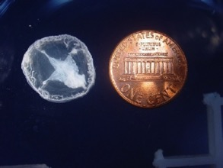
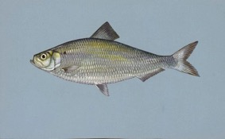
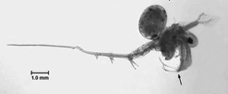
EcoDyn | GLANSIS
46 invasives are widespread
— found in all 6 lake basins
Alewife
Chinese
mystery snail
Freshwater
jellyfish
VHS
Purple Loosestrife
Spiny Waterflea
6/9
Notes:
Notice that of the species that have become widespread:
-Purple Loosestrife was the first recorded Great Lakes invader – established in 1839. Only plants are reported in the first 25 years. Overall, more than half of the widespread invasives are plants that have been here since the early 1900s.
-Alewife was the first nonindigenous fish recorded. Many nonindigenous fishes were stocked in the Great Lakes region in the late 1800s.
-Chinese mystery snail was the first mollusk reported to go on to become widespread (some mollusks invaded earlier, but still have much more spatially limited distributions)
VHS: Viral Hemorrhagic Septicemia
Note: Lake St. Clair is considered the 6th lake basin

Slide 7
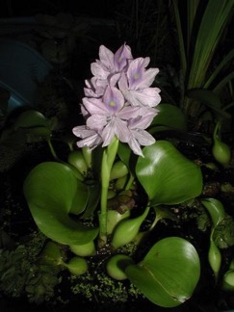
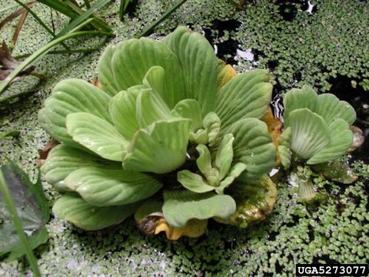
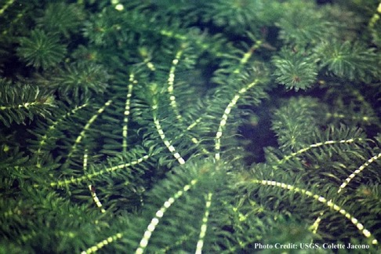
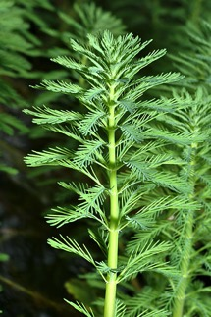
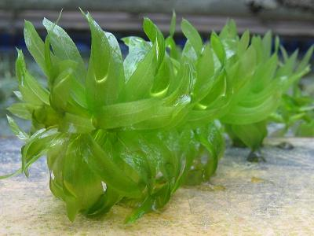
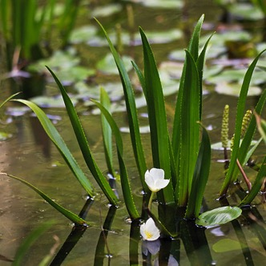
EcoDyn | GLANSIS
Watchlist – Organisms in Trade
67 species identified as at risk of invading the Great Lakes
Water hyacinth, water lettuce
both reported multiple times in Lake St. Clair but not currently believed to overwinter
Hydrilla, parrotfeather, Brazilian waterweed, and water soldiers are all reported in trade in the Great Lakes region with a high probability of introduction and establishment
7/9
Notes:
67 species identified as at risk of invading the Great Lakes. Many were predicted as likely to arrive via ballast water. Organisms in trade, particularly aquatic plants used in aquariums and water gardens, have been more recently identified as having a high probability of invasion.

Slide 8
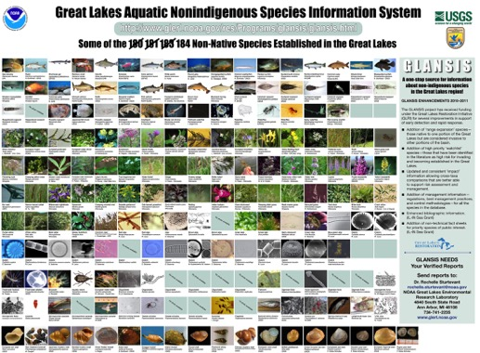
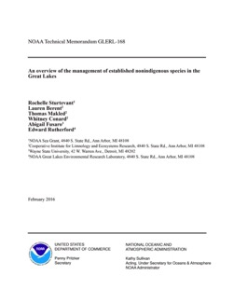
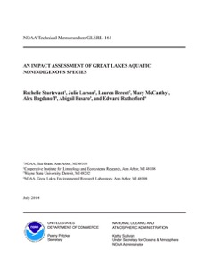
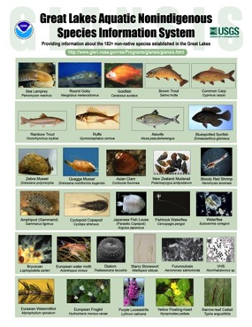
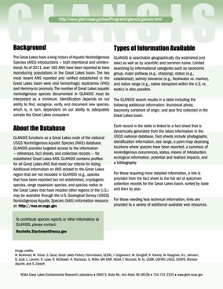












EcoDyn | GLANSIS
Collaborations and Products
Current Staff: Ed Rutherford and Rochelle Sturtevant
Current Volunteers: Michele Wensman and Cameron Seeley (UM UROP)
Collaborators: Anthony Ricciardi (McGill University, QC, Canada), Pam Fuller (USGS, Gainesville, Florida)
Emeritus Staff: David F. Reid, David Raikow, James Liebig, Erynn Maynard, Abigail Fusaro
Past Student Support: Emily Baker, Alex Bogdanoff, Ling Cao, Mary Hejna, Ling Jie Gu, Katie Thompson, Kyle Dettloff, Katherine Hanson, Julie Larson, Mary McCarthy, Rachel Nagy, Gabriela Núñez, Renee Spencer, Lauren Berent, Thomas Makled, Whitney Conard
Expert Review: Anthony Ricciardi (Chair), Sarah Bailey (Fisheries and Oceans Canada), Hunter Carrick (Central Michigan University), Susan Galatowitsch (University of Minnesota), Jeff Gunderson (Minnesota Sea Grant), Rex Lowe (Bowling Green), Nicholas Mandrak (Fisheries and Oceans Canada), Robin Scribailo (Purdue), Pat Chow-Fraser (McMaster University, ON, Canada), Hugh MacIsaac (University of Windsor, ON, Canada), Eugene Stoermer (University of Michigan), Rebekah M. Kipp (McGill University, Montreal, Canada), Steve Hensler, Tim Campbell, Titus Selheimer, Kevin Irons, Blake Ruebush, and Lisa Huberty
8/9
Notes:
GLANSIS DataBase – http://www.glerl.noaa.gov/res/Programs/glansis/glansis.html
Sturtevant et al. 2014. TM-161 An Impact Assessment of Great Lakes Aquatic Nonindigenous Species
Sturtevant et al. 2016. TM-68 An Overview of the Management of Established Nonindigenous Species in the Great Lakes (In Press)
GLANSIS Poster, Fact Sheets

Slide 9
EcoDyn | GLANSIS
Questions?
www.glerl.noaa.gov/res/Programs/glansis/glansis.html
9/9

