Slide 1
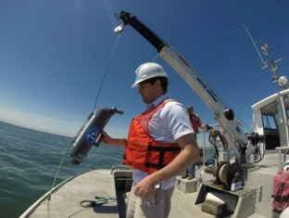
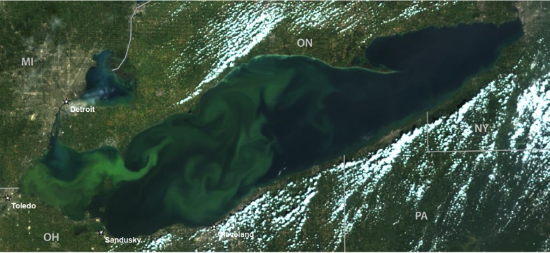
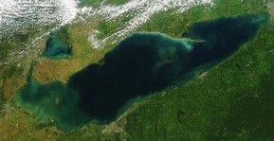
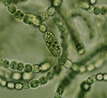
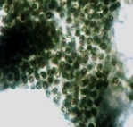
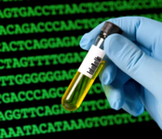
Harmful Algal Blooms
satellites to genomes
Timothy Davis
Ecosystem Dynamics
Place Photo Here
Notes:
This work aligns with the following NOAA Goals:
Science: Climate Adaptation and Mitigation
Assessments of current and future states of the climate system that identify potential impacts and inform science, service, and stewardship decisions
Mitigation and adaptation efforts supported by sustained, reliable, and timely climate services
Science: Weather-Ready Nation
Reduced loss of life, property, and disruption from high-impact events
Improve freshwater resource management
Improve transportation efficiency and safety
Healthy people and communities due to improved air and water quality services
A more productive and efficient economy through information relevant to key sectors of the U.S. economy
Science: Healthy Oceans
Improved understanding of ecosystems to inform resource management decisions
Healthy habitats that sustain resilient and thriving marine resources and communities
Sustainable fisheries and safe seafood for healthy populations and vibrant communities
Science: Resilient Coastal Communities and Economies
Resilient coastal communities that can adapt to the impacts of hazards and climate change
Improved coastal water quality supporting human health and coastal ecosystem services
Safe, environmentally sound Arctic access and resource management
Education: Science-Informed Society
Youth and adults from all backgrounds improve their understanding of NOAA-related sciences by participating in education and outreach opportunities
Formal and informal educators integrate NOAA-related sciences into their curricula, practices, and programs
Formal and informal education organizations integrate NOAA-related science content and collaborate with NOAA scientists on the development of exhibits, media, materials, and programs that support NOAA’s mission
Education: Safety and Preparedness
Youth and adults from all backgrounds are aware of, prepare for, and appropriately respond to environmental hazards that impact health, safety, and the economy in their communities
Formal and informal educators use and produce education materials and programs that integrate and promote consistent science-based messaging on hazards, impacts, and societal challenges related to water, weather, and climate
Formal and informal education institutions integrate water, weather, and climate hazard awareness, preparedness, and response information into curricula, exhibits, and programs that create learning opportunities for youth and adults
Education: Future Workforce
Postsecondary students, particularly from underrepresented groups, pursue and complete degrees in disciplines critical to NOAA’s mission
Graduates completing NOAA-supported student opportunities continue education, enter the workforce, and advance in careers that support NOAA’s mission
Education: Organizational Excellence
Leaders internal and external to NOAA recognize and support education investments as a way to achieve agency mandates, mission, and goals
NOAA educators and partners collaborate at local, regional, and national levels to coordinate efforts, build capacity, and better serve educational audiences

Slide 2
EcoDyn | Harmful Algal Blooms
Overarching research statement:
Understanding the drivers of bloom ecology will aid in enhancing predictive models that forecast bloom size, location AND toxicity
Notes:
Overarching research statement:
Understanding the drivers of bloom ecology will aid in enhancing predictive models that forecast bloom size, location AND toxicity

Slide 3
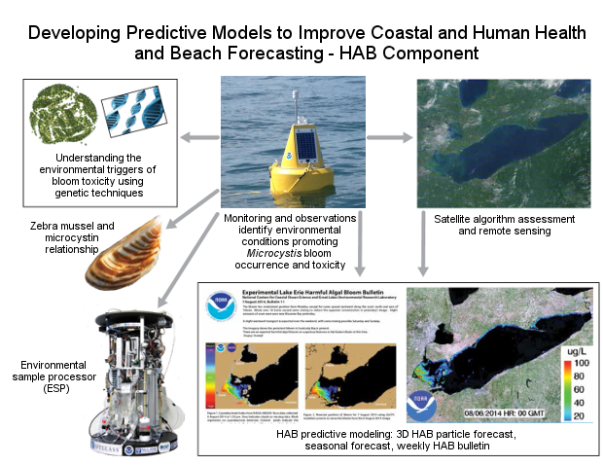
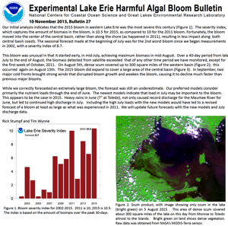
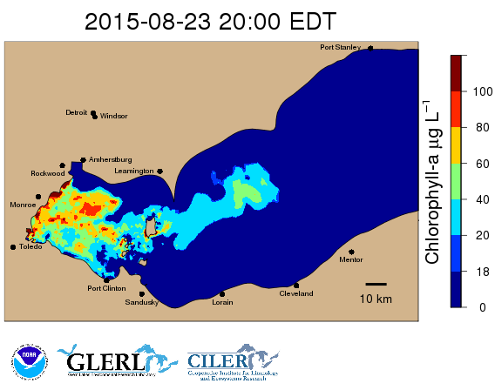
EcoDyn | Harmful Algal Blooms
An integrated approach to studying HABs

Slide 4
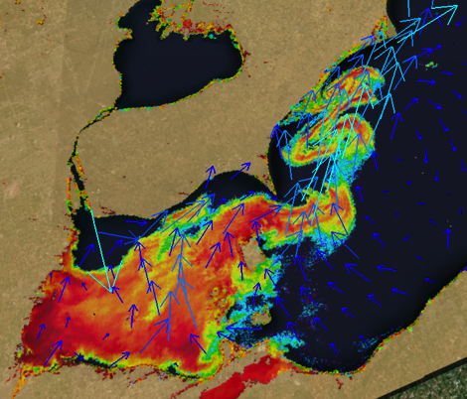
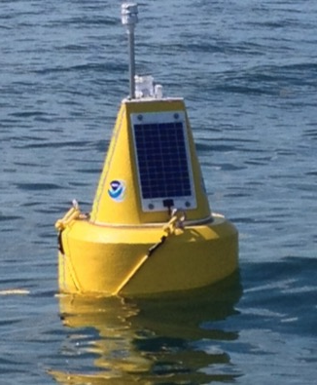
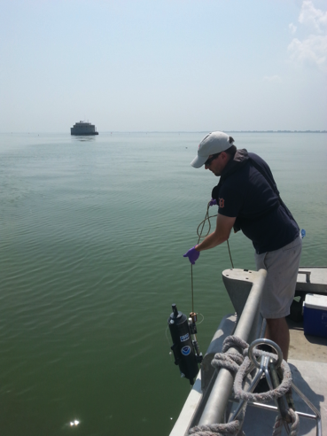
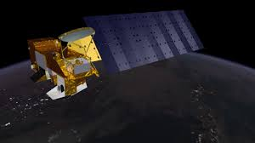
EcoDyn | Harmful Algal Blooms
GLERL’s cross-branch HAB Team
Monitoring & Experiments
Timothy Davis
Duane Gossiaux
Tom Johengen*
Ashley Burtner*
Danna Palladino*
Heidi Purcell*
Hank Vanderploeg
Alicia Ritzenthaler*
Remote Sensing
Steve Ruberg
Andrea Vander Woude*
Steve Constant
George Leshkevich
Ron Muzzi
Russ Miller
Modeling
Eric Anderson
Mark Rowe*
Greg Lang
Communications
Sonia Joseph Joshi*
Joe Smith*
BOLD = HAB team leads
* = CILER employees

Slide 5
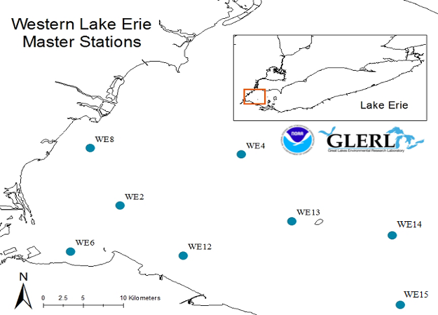
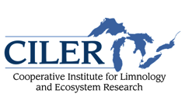
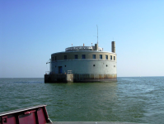
EcoDyn | Harmful Algal Blooms
Western Lake Erie weekly sampling
4/10

Slide 6
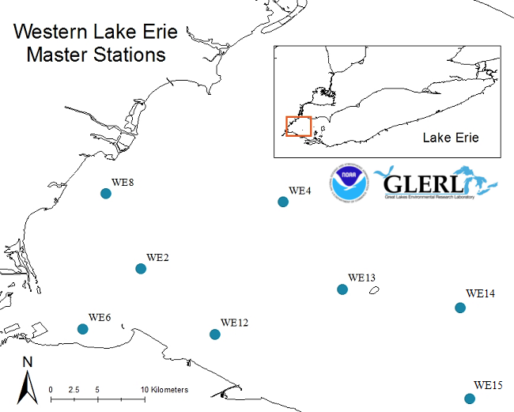
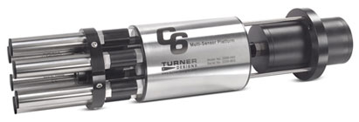
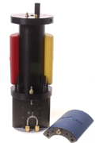
EcoDyn | Harmful Algal Blooms
Western Lake Erie real-time HABs monitoring
Sensors:
Turner C6, Cyclops sensors
YSI EXO sondes
Chlorophyll, Phycocyanin, Turbidity, CDOM
Wetlabs Cycle -PO₄
= Real-time observation station in 2015

Slide 7
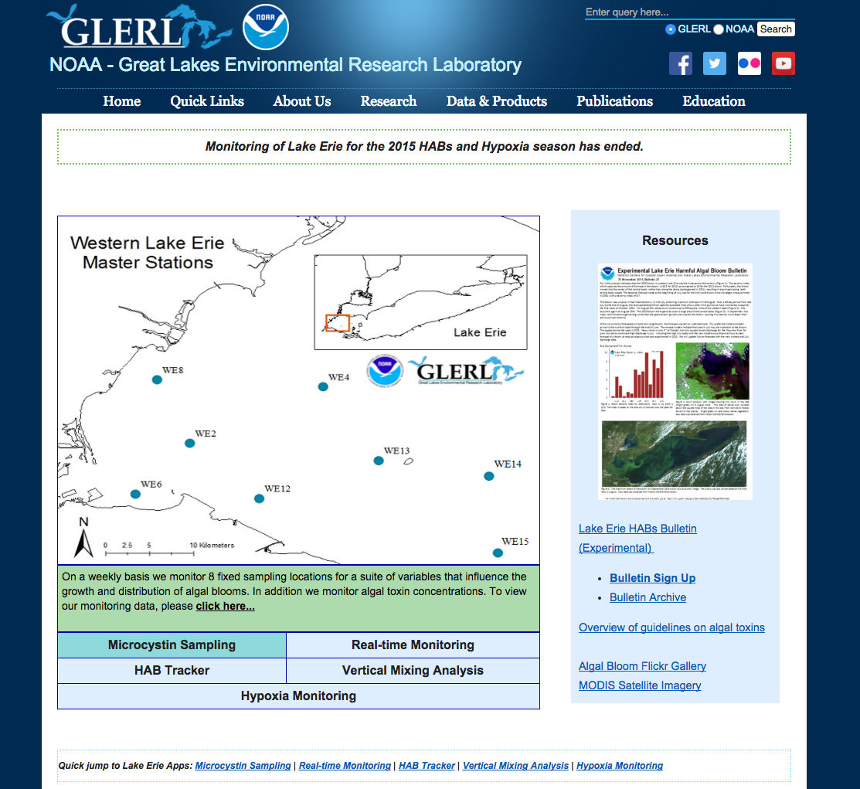
EcoDyn | Harmful Algal Blooms
NOAA GLERL HAB webpage

Slide 8
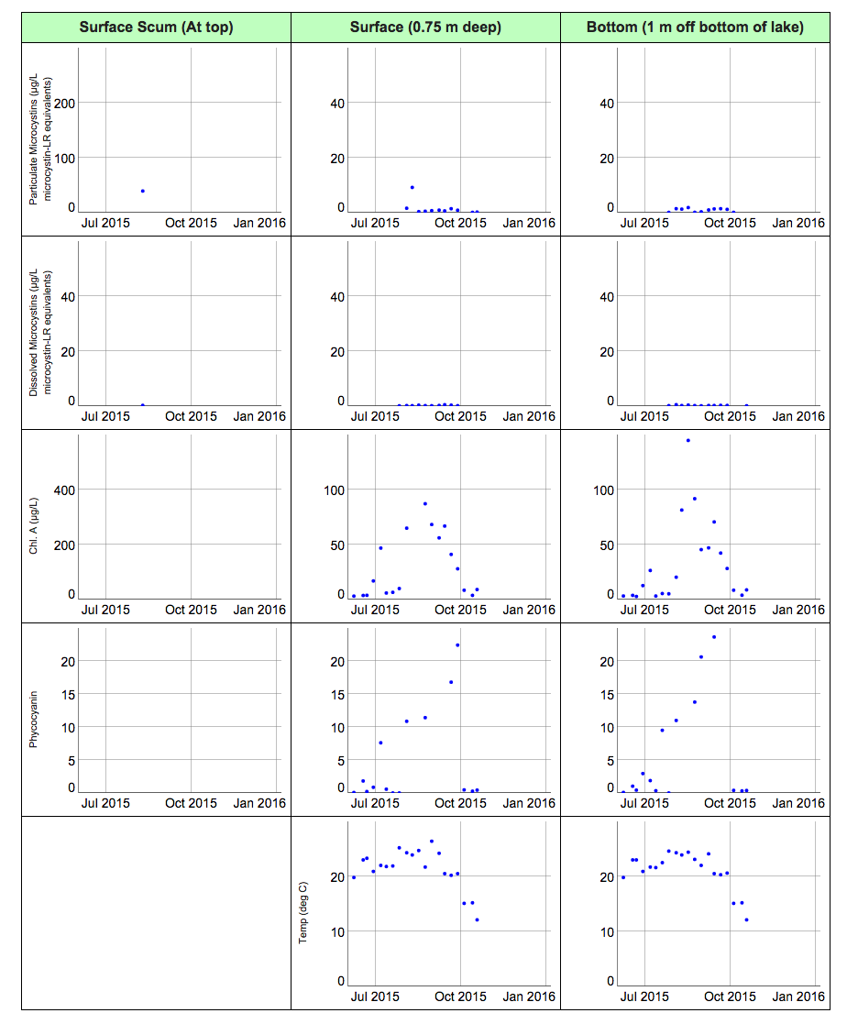
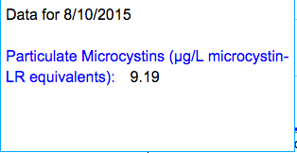
EcoDyn | Harmful Algal Blooms
Critical water quality data provided to stakeholders
Weekly data shared with over 30 regional partners
Allows stakeholders to view trends in bloom biomass and toxicity
Surface and bottom measurements
Data for 8/10/2015
Particulate Microcystins (µg/L microcystin-LR equivalents): 9.19

Slide 9
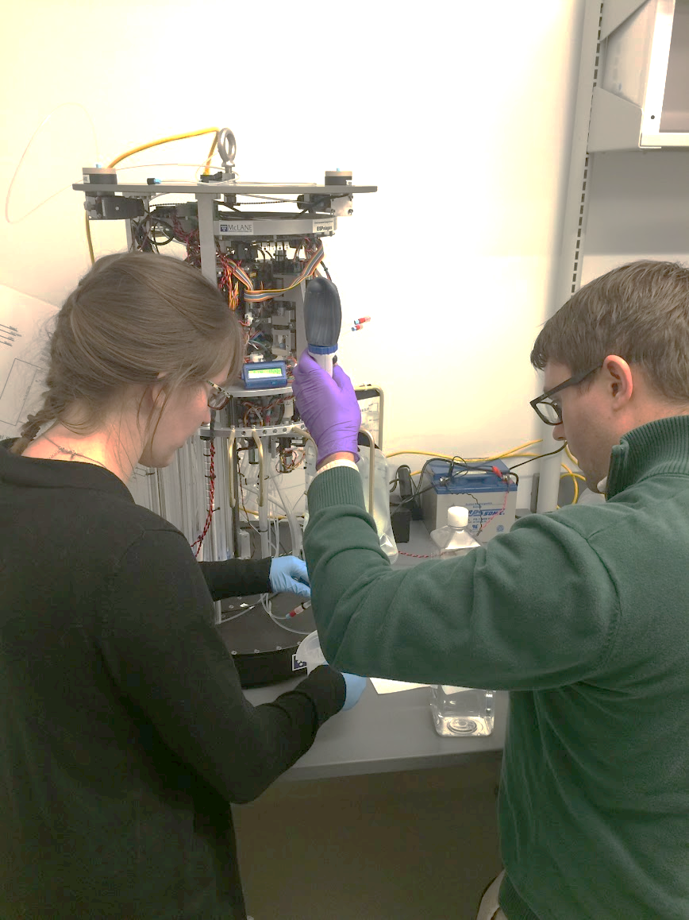
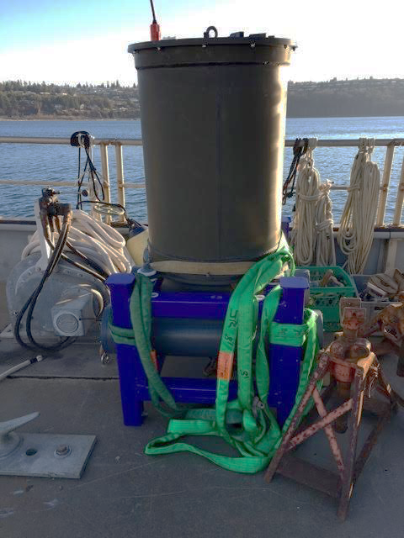
EcoDyn | Harmful Algal Blooms
Autonomous near real-time toxin detection for Lake Erie
FY14 EPA-Great Lakes Restoration Initiative supplemental funds
First ESP to be deployed in the Great Lakes
Cross line office collaboration (GLERL/National Ocean Service)
Would be able to track blooms toxicity at a resolution that was previously unattainable with traditional sampling
Will be referenced against physical, chemical and biological conditions
Will be extremely valuable in the development of more accurate bloom forecasting products

Slide 10
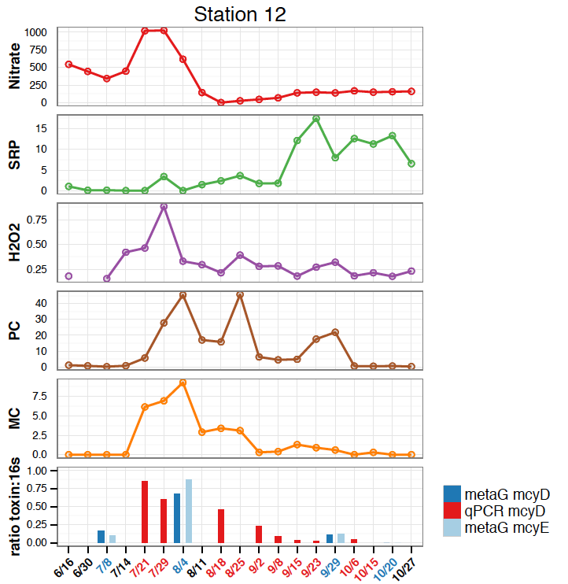
Toledo Water Intake (Station 12)
Weekly sampling reveals important trends that highlight potential environmental drivers and inform future experiments
Toxicity changes throughout the bloom
Relationship between nitrogen, toxicity and toxic Microcystis
Microcystis blooms occur even when phosphorus concentrations are low
Other factors beyond nutrients may be important in driving bloom structure and function
(mg L⁻¹)
(μg L⁻¹)
(nM)
H₂O₂
(μg L⁻¹)
Toxicity
(μg L⁻¹)
% Toxic Microcystis

Slide 11
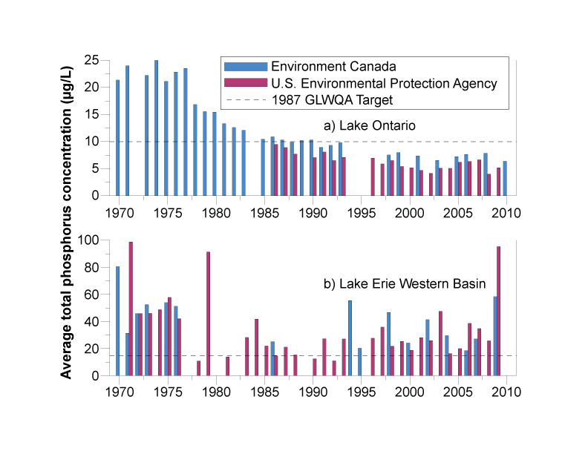
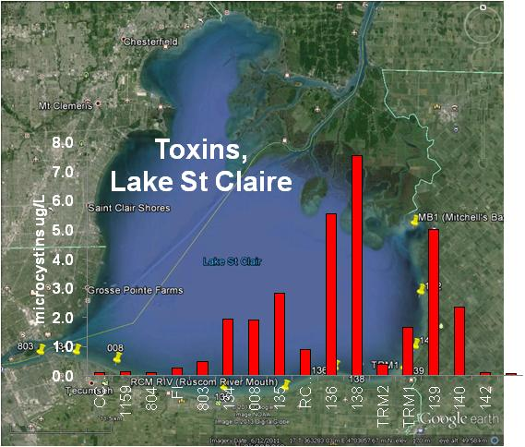
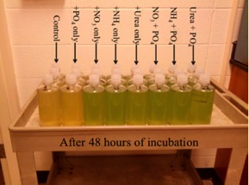
EcoDyn | Harmful Algal Blooms
Nutrients and Harmful Cyanobacterial Blooms
Combined field & molecular approaches to:
Origins & toxicity of cHAB species in relation to nutrients, physical processes & climate
Factors controlling toxin gene abundance & expression
diversity of toxic cHAB species & resilience to climate change
models for predicting bloom toxicity
Results have clear implications for management:
direct influence of tributaries (Thames R) on toxin levels.
Genomics: identical HAB strains across LSC-Lake Erie-Lake Ontario i.e. widespread potential for HABs, enabled by anthropogenic stressors
Significant positive effect of N on growth and toxin production in open Lake Erie and tributaries (Sandusky Bay)
7/10

Slide 12
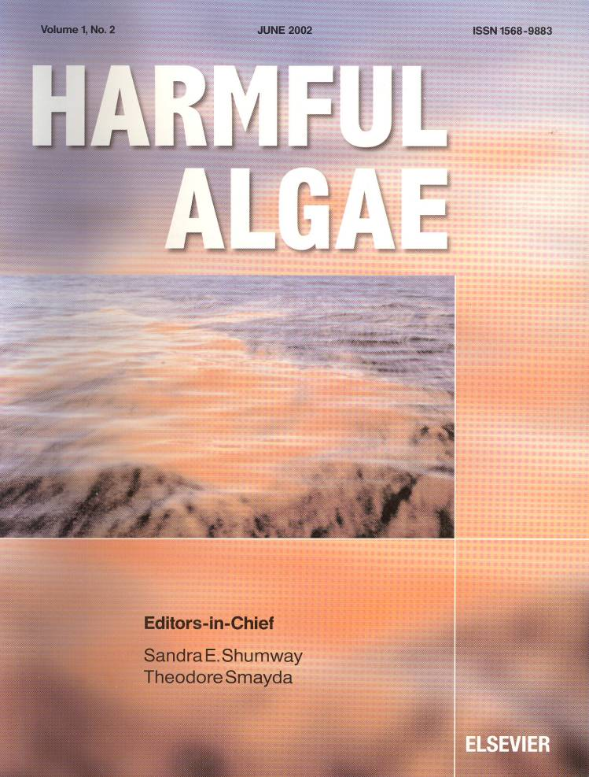
EcoDyn | Harmful Algal Blooms
High-impact publications:
Harmful Algae
2014 Impact Factor: 3.874
5-year impact factor 3.765
15 manuscripts on genera, ecology, drinking water, human health, toxin and taste and odor, grazing and synthesis review
Research from Europe, USA, Australia, China, South America
This issue features the work of:
5 NOAA researchers
3 CILER researchers
In print in April 2016
Global Expansion of Harmful
Cyanobacterial Blooms: Diversity, ecology, causes, and controls
Guest Editors:
Timothy Davis and Christopher Gobler
3/10

Slide 13
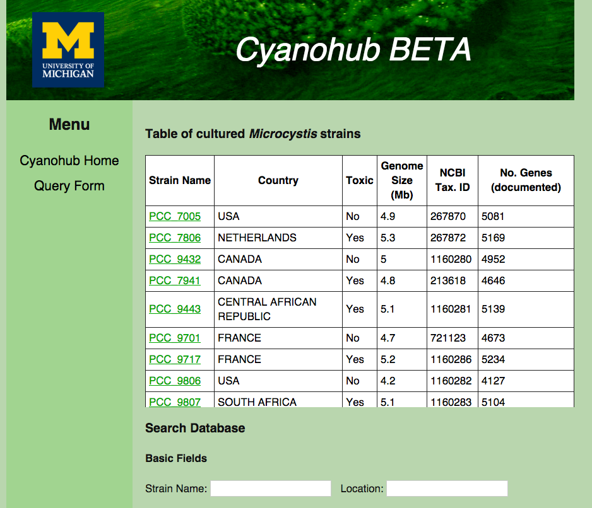
EcoDyn | Harmful Algal Blooms
Genomic database will fuel research in the Great Lakes and beyond
Searchable genomic database for CHAB genera including Great Lakes strains
Publicly available resource
Serves as a link between environmental and genomic data
Critical to further understand the response of CHAB genera to environmental drivers
Notes:
Great Lakes cyanobacterial cultures and experiments

Slide 14
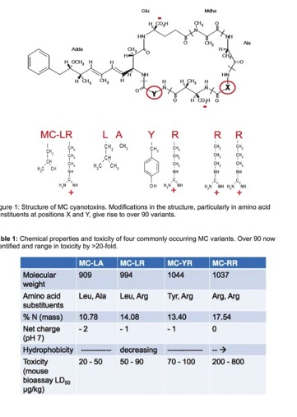
EcoDyn | Harmful Algal Blooms
Future directions and challenges
Develop an ESP network for Western Lake Erie
Further develop the ESP capabilities
Investigate the ecological adaptations of Great Lakes CHAB species
Further understanding the interactive roles of light, nutrients, and temperature on toxin production and community composition
Investigate changes in microcystin congeners over time
Microcystins
>100 congeners
Notes:
ESP: sandwich hybridization assay, microfluidic block for qPCR, multiplex toxin assay (microcystins + saxitoxins)
Microcystis blooms (Western Basin Lake Erie, Lake St. Clair, Green Bay, Hamilton Harbor) Anabanea blooms (Cleveland area & Western Basin of LE, Bay of Quinte) and Planktothrix blooms in Sandusky Bay
This would involve investigating the molecular response of these phytoplankton to different environmental variables (light, nutrient, temperature, CO₂) on a global level (comparative genomic/transcriptomic studies)

Slide 15
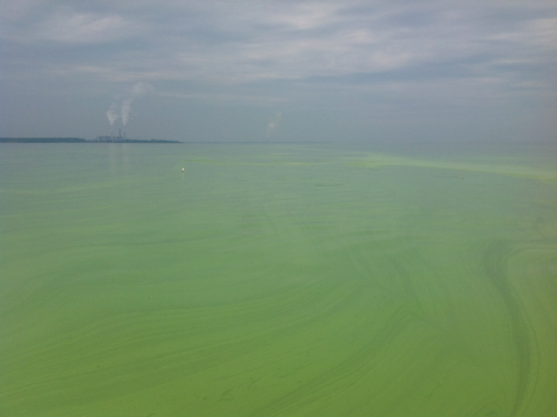
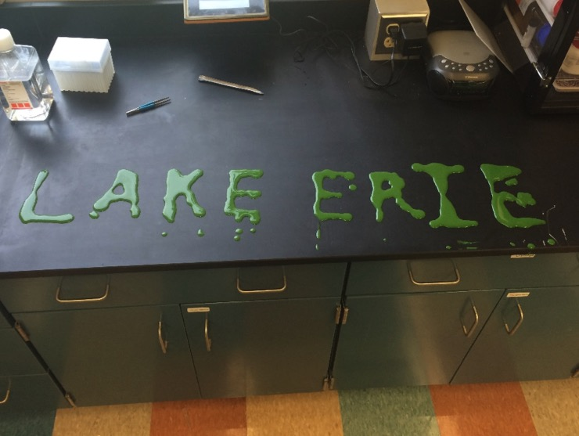
EcoDyn | Harmful Algal Blooms
Questions?
Place Photo Here

