Slide 1


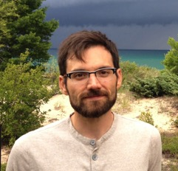
Hydrodynamic Modeling
Eric J. Anderson, Ph.D.
Integrated Physical & Ecological Modeling & Forecasting
Notes:
The domain of the next-generation Great Lakes Operational Forecast System (GLOFS) and approximate timeline for transition (Research-to-Operations; R2O) to NOS/CO-OPS. The new FVCOM-based GLOFS improves coastal resolution, expands the model domain into critical areas, and includes the connecting channels between the lakes, a gap in the current GLOFS implementation.
Lake Erie Operational Forecast System (LEOFS), transitioning to CO-OPS in end of March, 2016
Lake Michigan-Huron Operational Forecast System (LMHOFS), transitioning to CO-OPS in 2018. Slated to include the FVCOM-Ice model
Lake Superior Operational Forecast System (LSOFS), transitioning to CO-OPS in 2019
Lake Ontario Operational Forecast System (LOOFS), transitioning to CO-OPS in 2020
Huron-Erie Corridor Operational Forecast System (HECOFS), transition to CO-OPS in 2021. First transition of a connecting channel hydrodynamic model.
This work aligns with the following NOAA Goals:
Science: Climate Adaptation and Mitigation
Improved scientific understanding of the changing climate system and its impacts
Assessments of current and future states of the climate system that identify potential impacts and inform science, service, and stewardship decisions
Mitigation and adaptation efforts supported by sustained, reliable, and timely climate services
A climate-literate public that understands its vulnerabilities to a changing climate and makes informed decisions
Science: Weather-Ready Nation
Reduced loss of life, property, and disruption from high-impact events
Improve freshwater resource management
Improve transportation efficiency and safety
Healthy people and communities due to improved air and water quality services
A more productive and efficient economy through information relevant to key sectors of the U.S. economy
Science: Healthy Oceans
Improved understanding of ecosystems to inform resource management decisions
Recovered and healthy marine and coastal species
Healthy habitats that sustain resilient and thriving marine resources and communities
Science: Resilient Coastal Communities and Economies
Resilient coastal communities that can adapt to the impacts of hazards and climate change
Comprehensive ocean and coastal planning and management
Safe, efficient and environmentally sound marine transportation
Improved coastal water quality supporting human health and coastal ecosystem services
Safe, environmentally sound Arctic access and resource management
Education: Science-Informed Society
Youth and adults from all backgrounds improve their understanding of NOAA-related sciences by participating in education and outreach opportunities
Formal and informal educators integrate NOAA-related sciences into their curricula, practices, and programs
Formal and informal education organizations integrate NOAA-related science content and collaborate with NOAA scientists on the development of exhibits, media, materials, and programs that support NOAA’s mission
Education: Safety and Preparedness
Youth and adults from all backgrounds are aware of, prepare for, and appropriately respond to environmental hazards that impact health, safety, and the economy in their communities
Formal and informal educators use and produce education materials and programs that integrate and promote consistent science-based messaging on hazards, impacts, and societal challenges related to water, weather, and climate
Formal and informal education institutions integrate water, weather, and climate hazard awareness, preparedness, and response information into curricula, exhibits, and programs that create learning opportunities for youth and adults

Slide 2


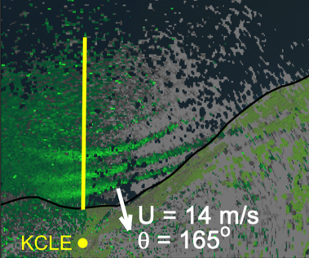
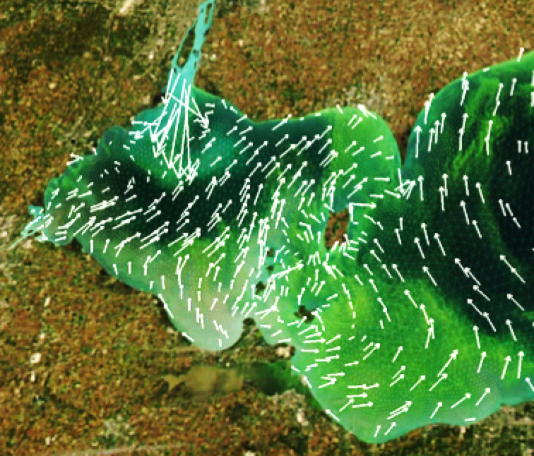
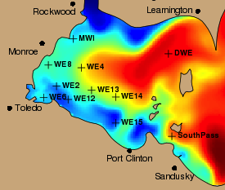
IPEMF | Hydrodynamic Modeling
Meteotsunami Detection
Research Questions
How do we improve our ability to forecast extreme conditions?
How do we improve our understanding of physical processes to support coastal resiliency and ecological forecasting?
How do we translate innovative research into useful products for the public?
HAB Tracker
LEOFS

Slide 3
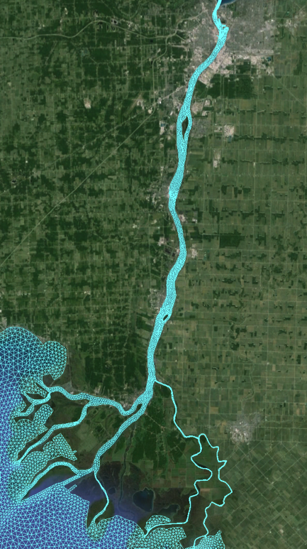
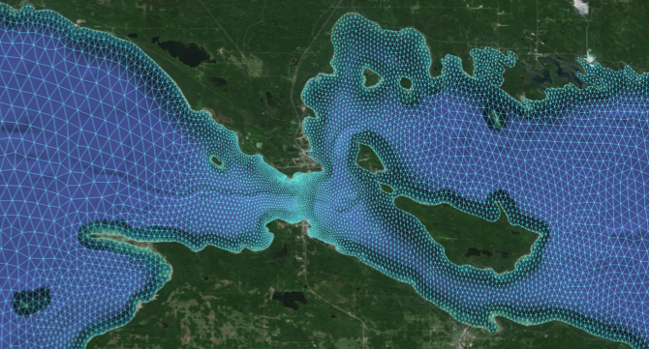
IPEMF | Hydrodynamic Modeling
Resilient Coastal Communities: Spill Transport
St. Clair River
Michigan
Straits of Mackinac
Upper Peninsula
Ontario
Lake Michigan
Lake Huron
Lower Peninsula
Michigan
Notes:
Examples of support for resilient coastal communities are contaminant tracking (or toxic spill transport) in areas such as the Straits of Mackinac or the St. Clair River.

Slide 4
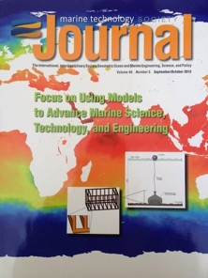
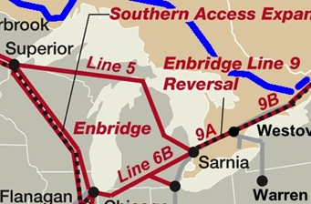


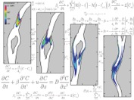

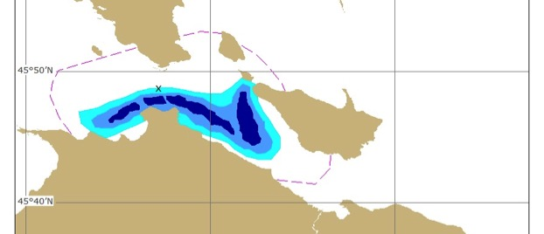

IPEMF | Hydrodynamic Modeling
Resilient Coastal Communities: Spill Transport
Straits of Mackinac
St. Clair River
R2U: Spill scenarios to Response Units
R2U: Spill Transport Tables to Water Intake Managers
4/10
Notes:
In both cases, understanding the science resulted in tangible Research-to-Application (R2A) products for key stakeholders such as:
Water intake managers
State and local health departments (e.g. South East Michigan Council of Governments; SEMCOG)
EPA
United State Coast Guard (USCG)
Department of Environmental Quality
Department of Natural Resources
other Line Offices (LO) in NOAA (e.g. NOS/ORR)
Industry (e.g. Enbridge. RPS-ASA)
ANDERSON, E.J., and M.S. Phanikumar. Surface storage dynamics in large rivers: Comparing three-dimensional particle transport, one-dimensional fractional derivative, and multirate transient storage models. Water Resources Research 47(W09511): 15 pp. (DOI:10.1029/2010WR010228) (2011)
Sun, Y., M.G. Wells, S.A. Bailey, and E.J. ANDERSON. Physical dispersion and dilution of ballast water discharge in the St. Clair River: Implications for biological invasions. Water Resources Research 49:1-13 (DOI:10.1002/wrcr.20201) (2013)
ANDERSON, E.J., and D.J. SCHWAB. Contaminant transport and spill reference tables for the St. Clair River. Marine Technology Society Journal 46(5):34-47 (2012). http://www.glerl.noaa.gov/pubs/fulltext/2012/20120035.pdf
ANDERSON, E.J., and D.J. SCHWAB. Predicting the oscillating bi-directional exchange flow in the Straits of Mackinac. Journal of Great Lakes Research 39(4):66671 pp. (DOI:10.1016/j.jglr.2013.09.001) (2013)

Slide 5
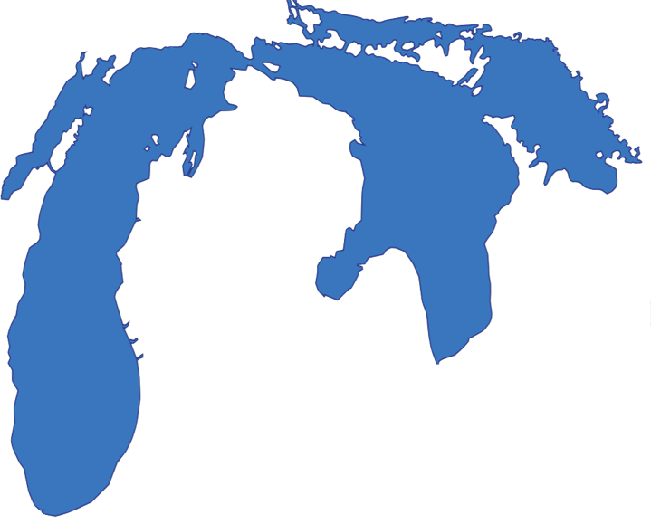
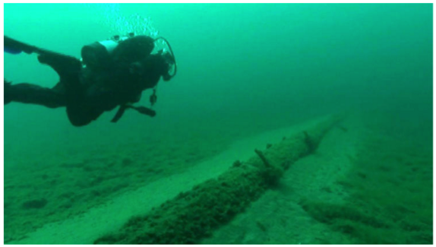
IPEMF | Hydrodynamic Modeling
Spill Transport in the Straits of Mackinac
Upper Peninsula
Lake Huron
Lake Michigan
Lower Peninsula
1 of 2 - 20” oil pipelines

Slide 6
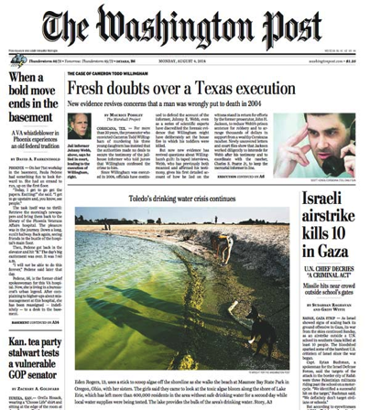


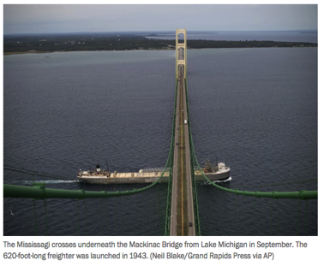
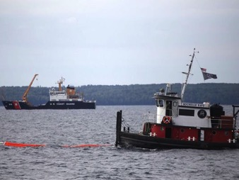
IPEMF | Hydrodynamic Modeling
Spill Transport in the Straits of Mackinac
Upper Peninsula
Lake Huron
Lake Michigan
Lower Peninsula
1 of 2 - 20” oil pipelines
Notes:
3 important factors in the Straits of Mackinac:
One of the most dynamic places in the Great Lakes (currents up to 1 m/s, oscillating exchange flow, bi-directional flow in summer)
Don’t have a clear understanding of what drives flow in the straits
NOAA has no operational models of Straits (gap in forecast capability)
In the event of a release, contaminants could spread rapidly into both lakes within a few hours/days (up to 150 km, with heavy shoreline impact).

Slide 7
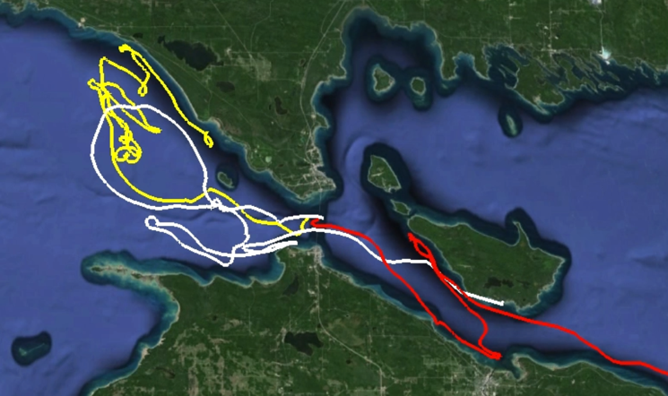
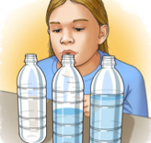


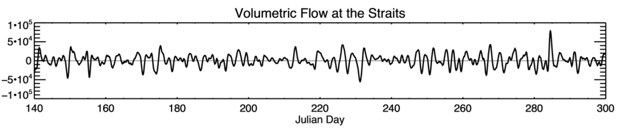
IPEMF | Hydrodynamic Modeling
Spill Transport in the Straits of Mackinac
Drifter tracks
What drives the flow in the Straits?
Oscillating flow (3-day period)
Bi-directional during stratification
Helmholtz Resonance
Lake Huron
Lake Michigan
(1)
(2)
Oscillating Straits flow due to Helmholtz Mode (m³/s)
Huron
Michigan
Anderson and Schwab, (2013). J. Great Lakes Res.
Anderson and Schwab, (2016). J. Geophysical Res.
Notes:
Goals:
understand the science
get information to stakeholders (R2A – NOAA/ORD/ERR, USCG, EPA, etc.)
transition understand to operations (R2O – Lake Michigan-Huron Operational Forecast System (LMHOFS))
Partners:
NOS/ORD/ERR
U. Michigan
Michigan Tech. University
USCG
ANDERSON, E.J., and D.J. SCHWAB. Predicting the oscillating bi-directional exchange flow in the Straits of Mackinac. Journal of Great Lakes Research 39(4):66671 pp. (DOI:10.1016/j.jglr.2013.09.001) (2013)
ANDERSON, E.J., and D.J. SCHWAB. Geostrophic control of exchange flow in the world’s largest lake. Journal of Geophysical Research Oceans (submitted)

Slide 8
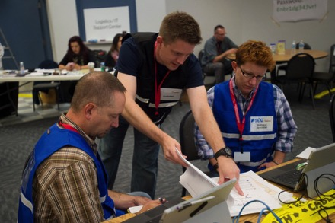

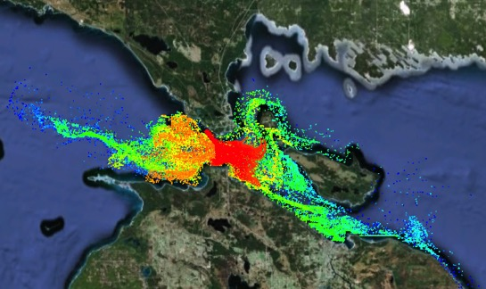

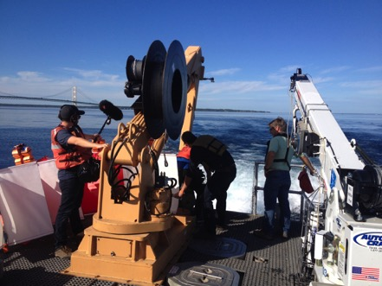
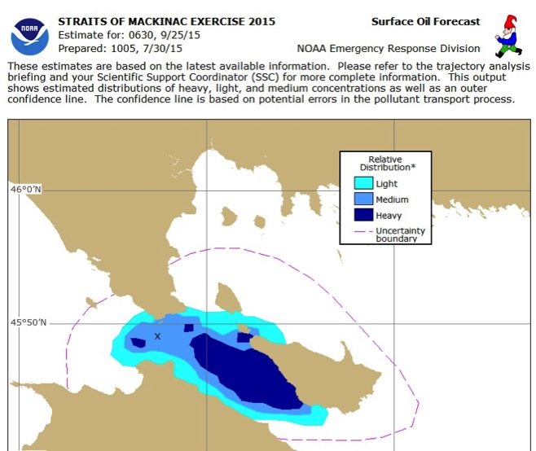
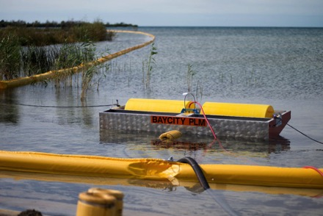
IPEMF | Hydrodynamic Modeling
Spill Exercise in the Straits
Spill Scenarios
Notes:
Goals:
understand the science
get information to stakeholders (R2A – NOAA/ORD/ERR, USCG, EPA, etc.)
transition understand to operations (R2O – Lake Michigan-Huron Operational Forecast System (LMHOFS))
Partners:
NOS/ORD/ERR
U. Michigan
Michigan Tech. University
USCG
Federal collaboration:
http://www.regions.noaa.gov/great-lakes/index.php/highlights/prep-oil-spill-drill-in-the-straits-of-mackinac/
- Photo credit in right column: Neil Blake (Mlive.com)
- Surface Oil Forecast courtesy of NOS/ORR/ERD

Slide 9
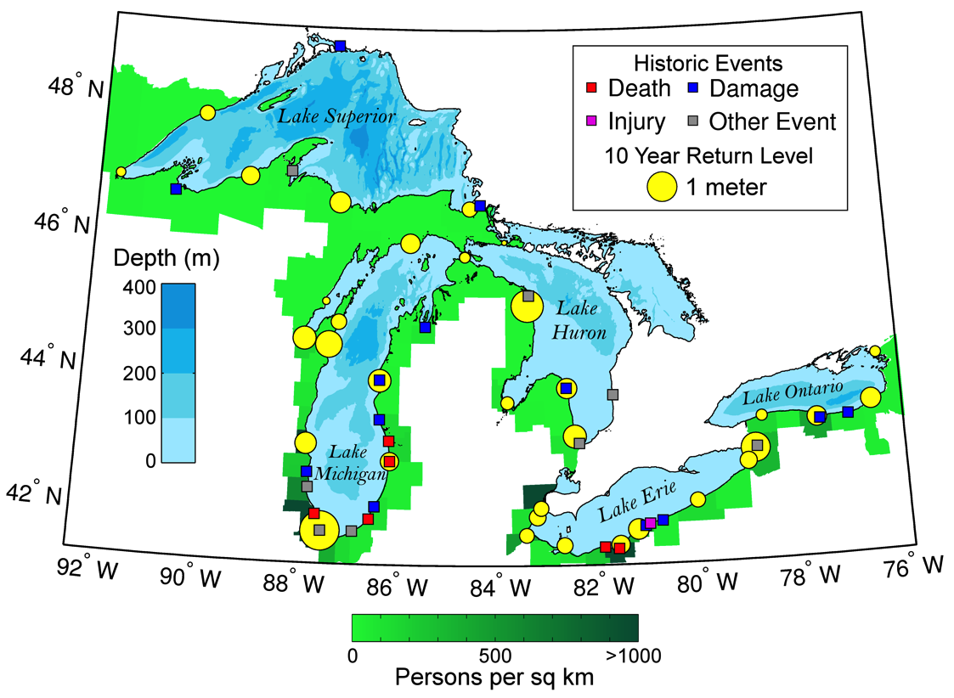
IPEMF | Hydrodynamic Modeling
Resilient Coastal Communities: Extreme Storm Forecasting
Meteotsunami Occurrence
Anderson et al., (2015). J. Geophysical Research Oceans.
Bechle et al., (2016). Geophysical Research Letters.
Notes:
Experimental “high-risk” research: meteotsunami forecasting (meteorological tsunami = meteo-tsunami)
Meteotsunamis are waves with periods between 2 minutes and 2 hours, similar to seismic tsunami waves, but driven by atmospheric disturbance (e.g. squall line, derecho)
current gap in our ability to predict waves-hydrodynamics in coastal zones (Great Lakes & ocean coasts)
source of several historic events (fatalities, injury, damage) along Great Lakes coasts
may often be the cause of rip current incidents in the Great Lakes
Partners:
NWS WFO Cleveland and Detroit
University of Wisconsin-Madison
University of Michigan
University of Illinois
Anderson E.J., et al., 2015. Reconstruction of a meteotsunami in Lake Erie on May 27, 2012: roles of atmospheric conditions on hydrodynamic response in enclosed basins, J. Geophys. Res. Oceans, 120, 8020–8038, doi:10.1002/2015JC010883
Bechle et al., 2016. Regional characteristics of meteotsunamis in the Laurentian Great Lakes, Geophysical Research Letters, (submitted)

Slide 10

IPEMF | Hydrodynamic Modeling
Resilient Coastal Communities: Extreme Storm Forecasting
Meteotsunamis in the Great Lakes
What drives meteotsunami formation in Great Lakes?
What coastal communities are vulnerable?
Why don’t present forecast models resolve them?
Anderson et al., (2015). J. Geophysical Research Oceans.
Bechle et al., (2016). Geophysical Research Letters.
Notes:
Experimental “high-risk” research: meteotsunami forecasting (meteorological tsunami = meteo-tsunami)
Meteotsunamis are waves with periods between 2 minutes and 2 hours, similar to seismic tsunami waves, but driven by atmospheric disturbance (e.g. squall line, derecho)
current gap in our ability to predict waves-hydrodynamics in coastal zones (Great Lakes & ocean coasts)
source of several historic events (fatalities, injury, damage) along Great Lakes coasts
may often be the cause of rip current incidents in the Great Lakes
Partners:
NWS WFO Cleveland and Detroit
University of Wisconsin-Madison
University of Michigan
University of Illinois
Anderson E.J., et al., 2015. Reconstruction of a meteotsunami in Lake Erie on May 27, 2012: roles of atmospheric conditions on hydrodynamic response in enclosed basins, J. Geophys. Res. Oceans, 120, 8020–8038, doi:10.1002/2015JC010883
Bechle et al., 2016. Regional characteristics of meteotsunamis in the Laurentian Great Lakes, Geophysical Research Letters, (submitted)

Slide 11
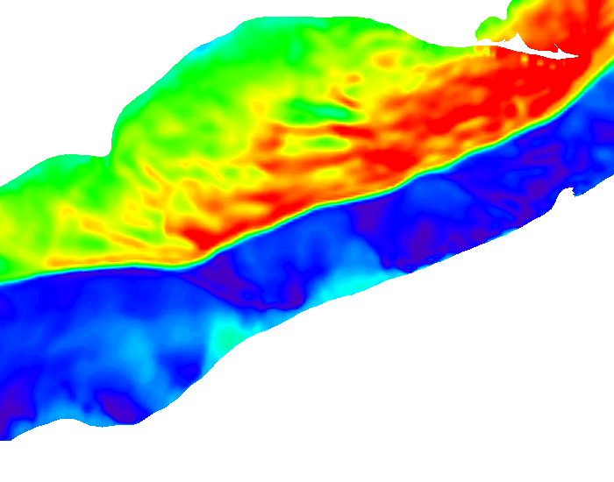
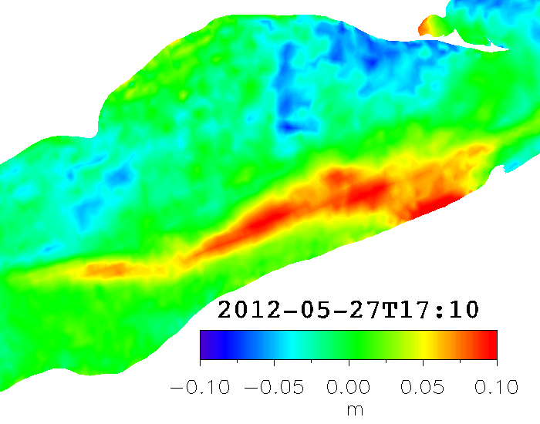
IPEMF | Hydrodynamic Modeling
Resilient Coastal Communities: Extreme Storm Forecasting
Radar detection
WRF simulation
FVCOM simulation
meteotsunami wave height
wind speed
Atmospheric Drivers
What drives meteotsunami formation in Great Lakes?
  Complex/Linear convection (wind + pressure)
  Wave reflection/focusing
What coastal communities are vulnerable?
  Hot spots along southern L. Michigan & Erie
Why don’t present forecast models resolve them?
  Gaps in observations
  Atmospheric forecast limitations
  Hydrodynamic limitations
Anderson et al., (2015). J. Geophysical Research Oceans.
Bechle et al., (2016). Geophysical Research Letters.
Notes:
Great Lakes pose a unique threat given that they are enclosed basins, which enables reflection and focusing of meteotsunami waves to increase coastal danger. Presents a new paradigm in meteotsunami formation.
Partners:
NWS WFO Detroit and WFO Cleveland
University of Wisconsin-Madison
University of Michigan
University of Illinois
Anderson E.J., et al., 2015. Reconstruction of a meteotsunami in Lake Erie on May 27, 2012: roles of atmospheric conditions on hydrodynamic response in enclosed basins, J. Geophys. Res. Oceans, 120, 8020–8038, doi:10.1002/2015JC010883
Bechle et al., 2016. Regional characteristics of meteotsunamis in the Laurentian Great Lakes, Geophysical Research Letters, (submitted)

Slide 12
IPEMF | Hydrodynamic Modeling
Transitioning Research to Products & Services
Research-to-Operations (R2O)
Operational Forecast Systems (OFS) to NOS/CO-OPS
  Lake Erie Operational Forecast System (LEOFS) [April 2016]
  Lake Michigan-Huron OFS [2018]
  Lake Superior OFS [2019]
  Lake Ontario OFS [2020]
  Huron-Erie Corridor OFS [2021]
Ecological Forecast System to NOS/CO-OPS
  Lake Erie HAB particle model (“HAB Tracker”) [2019]
Research-to-Application (R2A)
St. Clair River Contaminant Spill Transport Tables to Drinking Water Intake Operators, IOOS/GLOS, local health departments [2014]
Niagara River Short-Term Flow Forecasting to NYPA/OPG [July 2016]
Water level and seiche forecast guidance to NRC [ongoing]
Notes:
Upgrade to the Great Lakes Operational Forecast System (GLOFS) models (LEOFS, LMHOFS, LSOFS, LOOFS, HECOFS) is a collaboration between OAR/GLERL, NOS/CO-OPS, and NOS/OCS/CSDL.
Development of the Lake Erie HAB particle model (in FVCOM; aka HAB Tracker) is a collaboration between OAR/GLERL, CILER, and NOS/NCCOS.
Niagara River Short-Term flow forecasting model is a collaboration between OAR/GLERL, USACE Detroit and Buffalo Districts, and NWS/NERFC, with transition to industry partners New York Power Authority (NYPA) and Ontario Power Generation (OPG).
Water level and seiche forecast products for the Nuclear Regulatory Commission (NRC) is a collaboration between OAR/GLERL, NRC, and USACE Detroit District.

Slide 13
IPEMF | Hydrodynamic Modeling
Extreme Storm Forecast
Research Directions
Further our understanding of over-water meteorology and hydrodynamic processes
  Extreme storm conditions (weather & water)
  Mixing processes and thermal structure
Integrate physical & ecological models
  Improve ecological forecasting by reducing error in physical predictions
Transition cutting-edge science to application and operations
  Foster partnerships within Great Lakes basin and across NOAA, Federal Agencies
HAB Tracker
GLOFS

Slide 14
IPEMF | Hydrodynamic Modeling
Extreme Storm Forecast
Questions?
Place Photo Here
HAB Tracker
GLOFS

Slide 15
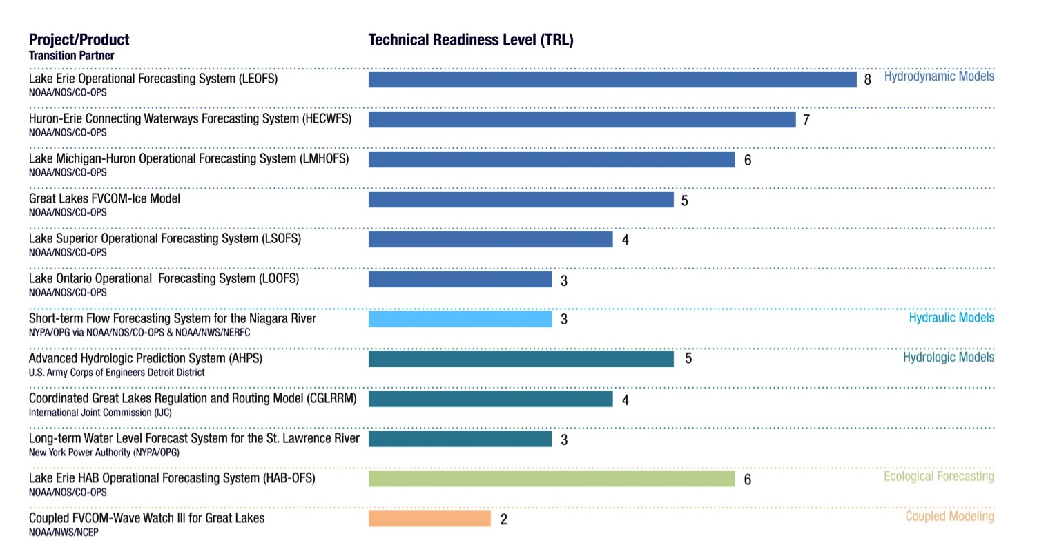
IPEMF | Hydrodynamic Modeling
Technical readiness level of IPEMF
research to operation (R2O) products
Additional Information

