Slide 1



Hydrological Modeling
Andrew D. Gronewold, Ph.D., P.E.
Integrated Physical & Ecological Modeling & Forecasting
1/9
Notes:
NOAA-GLERL’s hydrological science program is supported by a strong team of federal employees and academic partners. In addition to our core team of scientists and staff from NOAA-GLERL and CILER, we have leveraged a variety of programs to sponsor over 20 post-doctorate, graduate, and undergraduate fellows over the past five years. This team-building strategy has greatly increased the scope and depth of our research while providing young scientists with an important career-building stepping stone.
The satellite image of the Great Lakes above (looking from west to east; courtesy of NASA) underscores the spatiotemporal scale and variability of the hydrological processes we are trying to understand and represent in models. The image was taken in December 1999; seasonal evaporation typically reaches a peak in late fall, and elevated evaporation rates on the lakes from 1999 through 2013 were strongly influenced by a rise in surface water temperatures coincident with the strong 1997-1998 winter El Nino.
This work aligns with the following NOAA Goals:
Climate Adaptation and Mitigation
Improve scientific understanding of the changing climate system and its impacts
Assessments of current and future states of the climate system that identify potential impacts and inform science, service, and stewardship decisions
A climate-literate public that understands its vulnerabilities to a changing climate and makes informed decisions
Weather-Ready Nation
Reduced loss of life, property, and disruption from high-impact events
Improve freshwater resource management
Improve transportation efficiency and safety
A more productive and efficient economy through information relevant to key sectors of the U.S. economy
Resilient Coastal Communities and Economies
Resilient coastal communities that adapt to the impacts of hazards and climate change
Comprehensive ocean and coastal planning and management
Improved coastal water quality supporting human health and coastal ecosystem services
Science-Informed Society
Youth and adults from all backgrounds improve their understanding of NOAA-related sciences by participating in education and outreach opportunities
Formal and informal educators integrate NOAA-related sciences into their curricula, practices and programs
Future workforce
Students, particularly from underrepresented groups, consider education and career pathways in disciplines that support NOAA’s mission
Postsecondary students, particularly from underrepresented groups, pursue and complete degree in disciplines critical to NOA’s mission
Graduates completing NOAA-supported student opportunities continues education, enter the workforce, and advance in careers that support NOAA’s mission

Slide 2


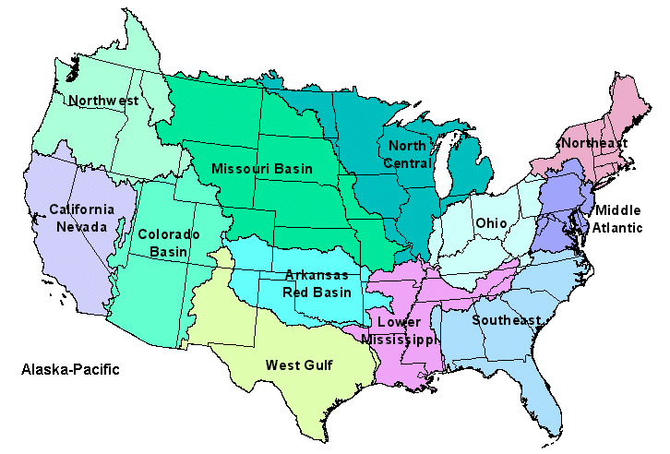
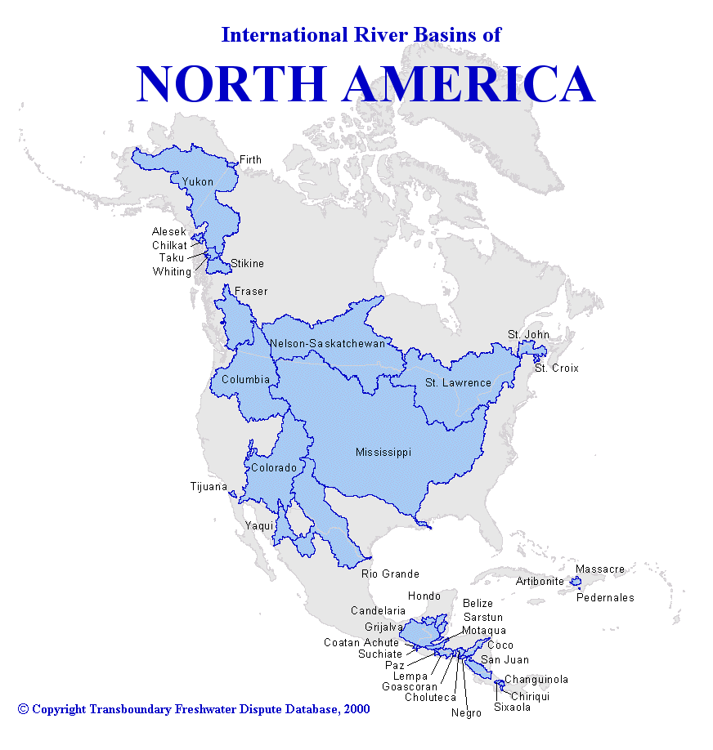
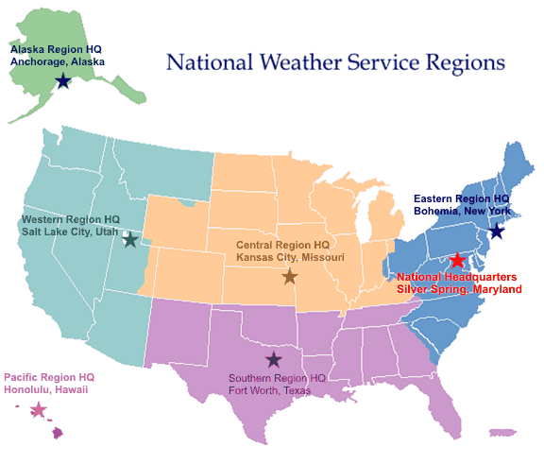
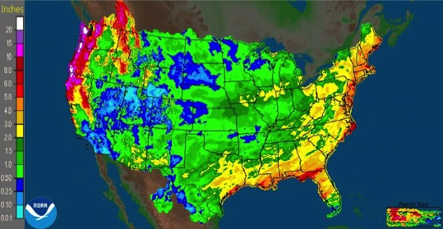
IPEMF | Hydrological Modeling
National Weather Service River Forecast Centers
National Weather Service Regional Headquarters
2/9
Notes:
Understanding the hydrology of the Great Lakes requires a holistic, international, basin-scale perspective. Conventional political and geographical boundaries of NOAA’s operational programs typically bisect (along the international border) or omit entirely the land and lake surfaces of the Great Lakes. Over the past five years, we have overcome this hurdle by working across the line offices of NOAA to develop new products, and to expand the domain of existing products to meet the needs of the Great Lakes region.
The left-hand image above represents international river basins of North America, and the Great Lakes-St. Lawrence River basin is highlighted in red. The three images on the right-hand side represent the boundaries of the NWS river forecasting centers (top), the NWS regions (middle), and an image of daily NWS precipitation estimates (bottom). It is informative to note how the domain of the NWS precipitation product (bottom right) includes the land surfaces of the Columbia and Rio Grande River basins because they drain through the United States, but excludes the land surfaces of the Great Lakes basin because the St. Lawrence River drains through Canada. NOAA-GLERL has worked with the NWS and regional RFCs over the past several years to implement a plan for expanding the NWS precipitation domain, and to incorporate QA/QC procedures into NWS operational protocols for over-lake precipitation. We applied a similar approach in spearheading the development of a region-specific Great Lakes climate quarterly report (previously, the Great Lakes had been a “back-page” story as part of the mid-west climate quarterly report).

Slide 3
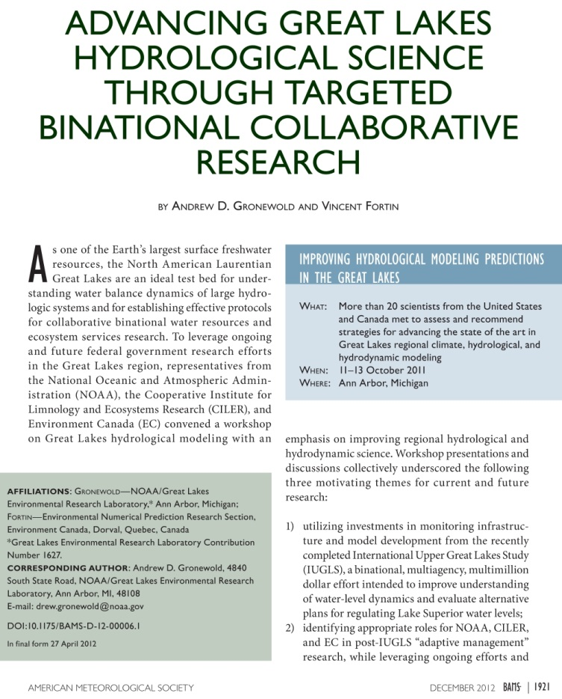
IPEMF | Hydrological Modeling
Gronewold & Fortin (2012). BAMS.
3/9
Notes:
A robust understanding of land surface hydrology in the Great Lakes basin hinges on consistent international watershed boundaries and hydrological data. NOAA-GLERL is an integral part of the National Water Center team focused on developing a new basin-wide land surface scheme (referred to as a ‘geofabric’) for supporting state-of-the-art Great Lakes basin-wide distributed hydrological modeling. We are hosting a workshop this June with partners from the National Weather Service to plan the development and application of these new hydrological models.
This research trajectory, and other research priorities, were synthesized in a BAMS article Dr. Gronewold wrote with colleague Vincent Fortin from Environment Canada, in which they identified gaps in regional hydrological science (including a need for two-way coupled models), the importance of simulating energy fluxes over the lakes, and other advancements in land surface hydrology.

Slide 4
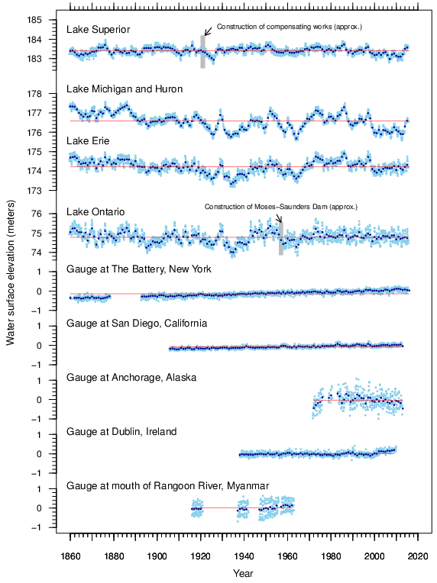
IPEMF | Hydrological Modeling
Great Lakes water levels:
Long, continuous record
High variability
Ideal research platform
Gronewold et al., (2013). Climatic Change.
4/9
Notes:
One of our primary motivations for understanding the Great Lakes hydrologic cycle is to develop scientifically defensible explanations of historical water level variability, and accurate forecasts of future water level variability. The water levels of the Great Lakes (top four rows in figure) have relatively high seasonal and interannual variability (blue dots are monthly averages, black dots are annual averages) compared to variability along most marine coasts. The water level gaging station at Battery Park (NY), for example, indicates a persistent annual coastal water level rise of roughly 10 inches per century. In contrast, water levels on Lake Michigan-Huron rose by roughly 5-6 feet over several years in the 1970s, and declined by roughly 3 feet over 2-3 years in the late 1990s. These changes are all-the-more significant when considering the Great Lakes coastline is roughly 10,000 miles long; longer than the United States Atlantic, Gulf of Mexico, and Pacific coastlines combined.
The above figure also underscores the unique length and continuity of the Great Lakes water level record. It is informative to note this is one of the longest continuous hydrological records of any system on Earth, and is currently maintained by NOAA’s National Ocean Service (along with the Canadian Hydrographic Service), with whom we partner on this topic through multiple initiatives including the Coordinating Committee on Great Lakes Basic Hydraulic and Hydrologic Data.

Slide 5
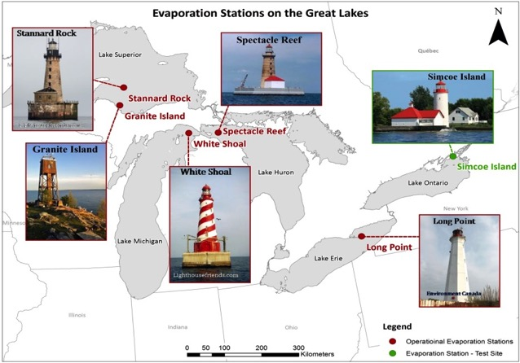
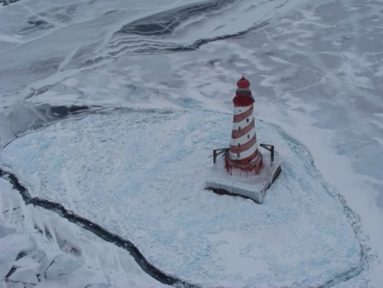
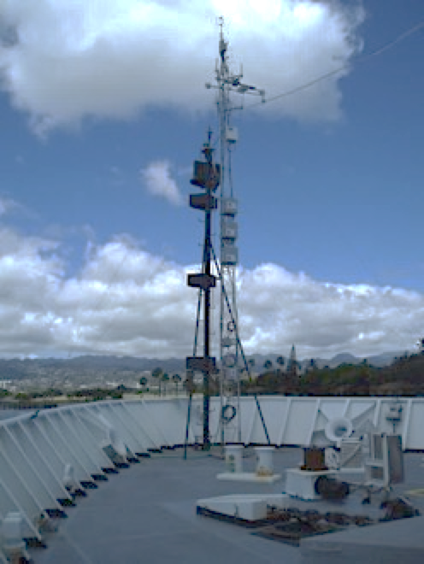
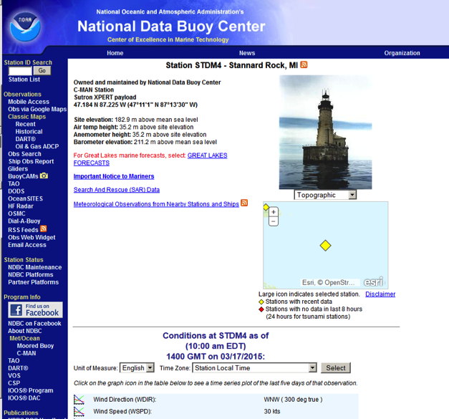
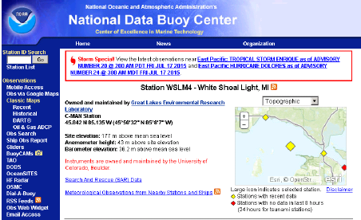
IPEMF | Hydrological Modeling
Understanding the hydrologic cycle: over-lake evaporation
5/9
Notes:
NOAA-GLERL’s historical estimates of seasonal evaporation on the Great Lakes have been based on one-dimensional thermodynamics models and simple mass balance methods. Uncertainties in these estimates are presumably large but, to date, have not been routinely quantified. To address this gap in regional knowledge, NOAA-GLERL has taken a leadership role in the establishment of the Great Lakes Evaporation Network (GLEN), an informal collaboration of research scientists from NOAA, academia, and Environment Canada focused on maintaining off-shore year-round eddy-covariance instruments across the lakes, and incorporating the associated measurements into water budget estimates and operational forecasting systems.
The five lighthouse-based stations that currently constitute GLEN are shown in the upper-left panel above (in addition to a proposed site on Simcoe Island). A detailed image of the White Shoal lighthouse station (in northern Lake Michigan) is in the upper-middle panel (courtesy Dick Moehl, Great Lakes Lighthouse Keepers). NOAA-GLERL has advanced the GLEN effort by providing real-time telemetry for the eddy-covariance instruments at three of these stations, and feeding the data through newly-established NDBC portals (bottom two panels). The current phase of the GLEN initiative focuses on incorporating the lighthouse-based measurements into NOAA-GLERL and NOS hydrodynamic models and, through an exciting technology transfer application, working with UC-Boulder and ESRL on the deployment of vessel based sensors on Canadian Steamship Authority commercial carriers (upper-right panel).

Slide 6
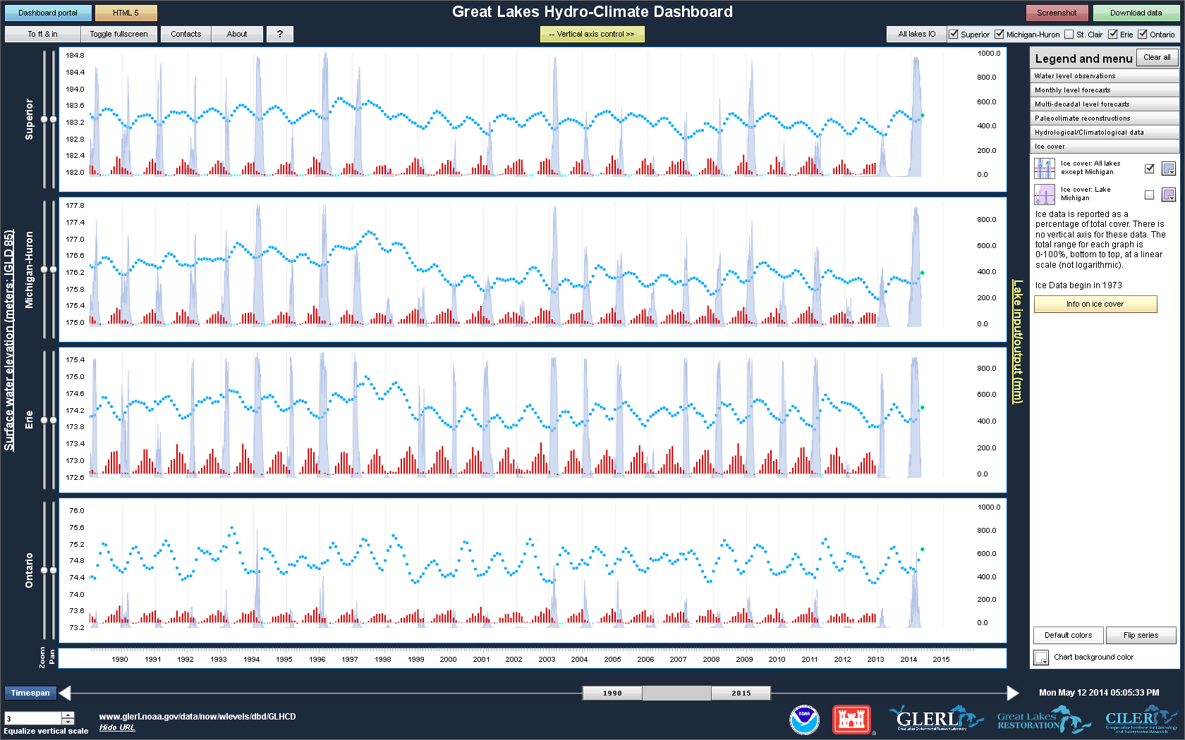
IPEMF | Hydrological Modeling
Propagating preeminent science through products….
Gronewold et al., (2013). Environmental Modelling and Software.
Clites et al., (2014). Journal of Great Lakes Research.
Hunter et al., (2015) Journal of Great Lakes Research.
Smith et al., (2016). Environmental Modelling and Software.
6/9
Notes:
The image above reflects our approach to synthesizing and disseminating products from the hydrology program and other programs within IPEMF. The image itself comes from the Great Lakes Hydro-Climate Dashboard, a web-based interactive tool that allows users to view and download a wide range of hydrological and climatological data. It was developed through a collaboration with CILER, and represents the type of high-impact products we are capable of creating through that partnership. This particular image of the Dashboard includes monthly over-lake evaporation estimates (red vertical bars), a subset of our long-term Great Lakes monthly hydrometeorological database. This database is currently the only available record of long-term (dating back decades) estimates of the major components of the Great Lakes water budget (including not only evaporation, but also over-lake precipitation and runoff) across the entire (i.e. binational lake and land surfaces) basin. The image above also includes NOAA-GLERL’s ice cover data (grey bars) and NOS-based monthly-averaged water levels (blue dots). This particular combination of data sets has been critical to helping us address inquiries from the media and the public regarding complex seasonal interactions between ice, evaporation, surface water temperatures, and water level fluctuations.

Slide 7
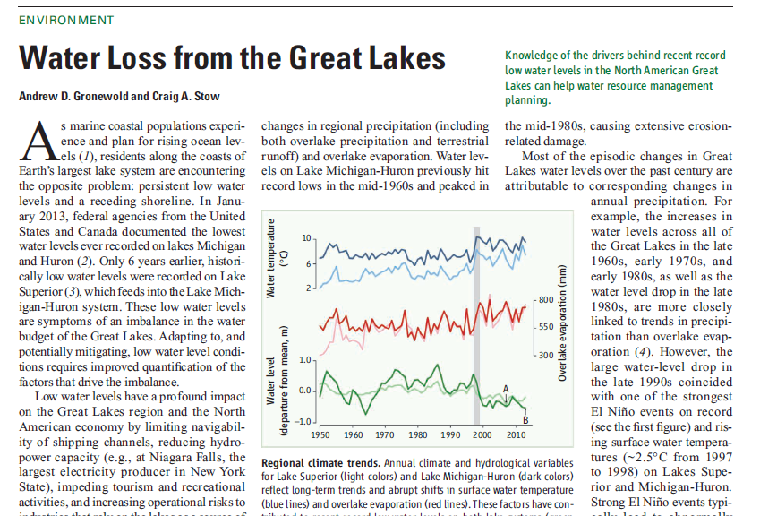
IPEMF | Hydrological Modeling
…into prudent water resources management decisions,
Gronewold & Stow (2013) Science.
7/9
Notes:
In addition to development and dissemination of data sets and models, we provide science-based perspectives on important regional hydrological and climatological phenomena. In December 2012 and January 2013, water levels on Lakes Michigan and Huron hit historical lows during a 15-year period of persistent below-average levels (see green lines in image above). This event catalyzed regional public demands for new flow control structures to be installed along the St. Clair River to increase water levels across the Lake Michigan-Huron system. These demands were based on the supposition that water losses over the past few decades were a direct consequence of historical and ongoing dredging operations in the channels that connect the Great Lakes. In the above Science paper, we presented scientific evidence of the strong role of climate patterns and the hydrologic cycle in driving water levels, with a particular emphasis on the pronounced increase in evaporation and surface water temperatures in the late 1990s. We believe this approach to communicating science, in addition to the other products we developed and appearances we made during this period, had a profound impact on how the public perceived drivers of water loss.

Slide 8
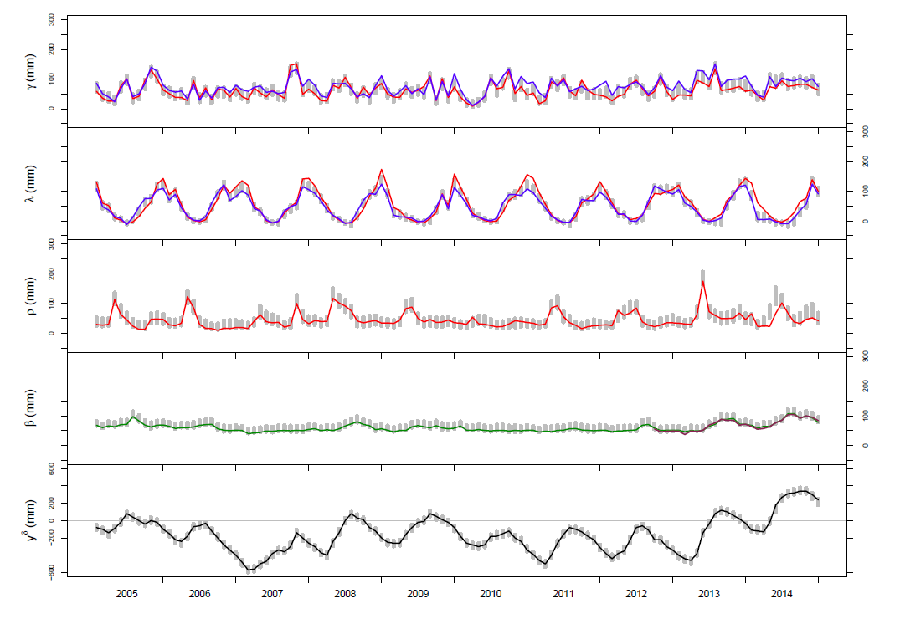
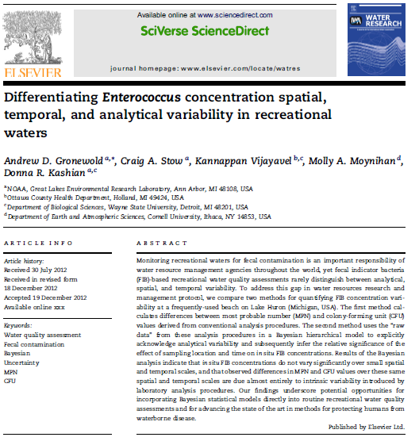
IPEMF | Hydrological Modeling
…all-the-while acknowledging and quantifying uncertainty.
Gronewold et al (Under invited revision).
Gronewold et al (2011), Water Research.
Gronewold et al (2013), Water Research.
Wu et al (2014), Science of the Total Environment.
8/9
Notes:
Identifying sources of uncertainty and quantifying uncertainty in models and model forecasts is a major goal of our research group. Communicating that uncertainty in a manner relevant to water resources management planning is one of the challenges that we continue to meet in new and creative ways. We take pride in our leadership role as an advocate for probabilistic hydrological forecasting in the region, and for our application of Bayesian statistical methods for quantifying uncertainty in both water quantity and water quality problems.
In the image above, the left-hand panel represents a time series of water budget components for Lake Superior including (from top panel to bottom) over-lake precipitation, over-lake evaporation, tributary runoff (into the lake), outflow (through the St. Marys River), and month-to-month changes in cumulative lake storage. Red, blue, green, purple, and black colored lines represent estimates of these water budget components from computer models and in situ measurements. The grey vertical bars in each panel represent 95% intervals of the Bayesian posterior probability distribution for each component; these “new” estimates not only reconcile differences between model- and measurement-based estimates of each water budget component, they also “close” the lake’s water balance; to our knowledge, these estimates are the first ever to achieve this goal. The right-hand panel is from a representative paper we published in 2013 in Water Research that focused on differentiating sources of uncertainty and variability in fecal indicator bacteria measurements. This paper reflects a portion of our research program that, while strong, has taken a back seat to water level research over the past 5 years. We hope to re-invigorate this research trajectory over the coming 2-5 years.

Slide 9
IPEMF | Hydrological Modeling
9/9
Notes:
At the end of the last external review, we were advised to “be bold”. Our hydrology team has taken this message to heart while recognizing that to do big things, we need strong partnerships. We believe this focus has led to a high degree of success over the past few years, and we look forward to your comments and suggestions on how we can continue to improve in the future.

Slide 10
Additional Information . . .
IPEMF | Hydrological Modeling
Additional Information

Slide 11
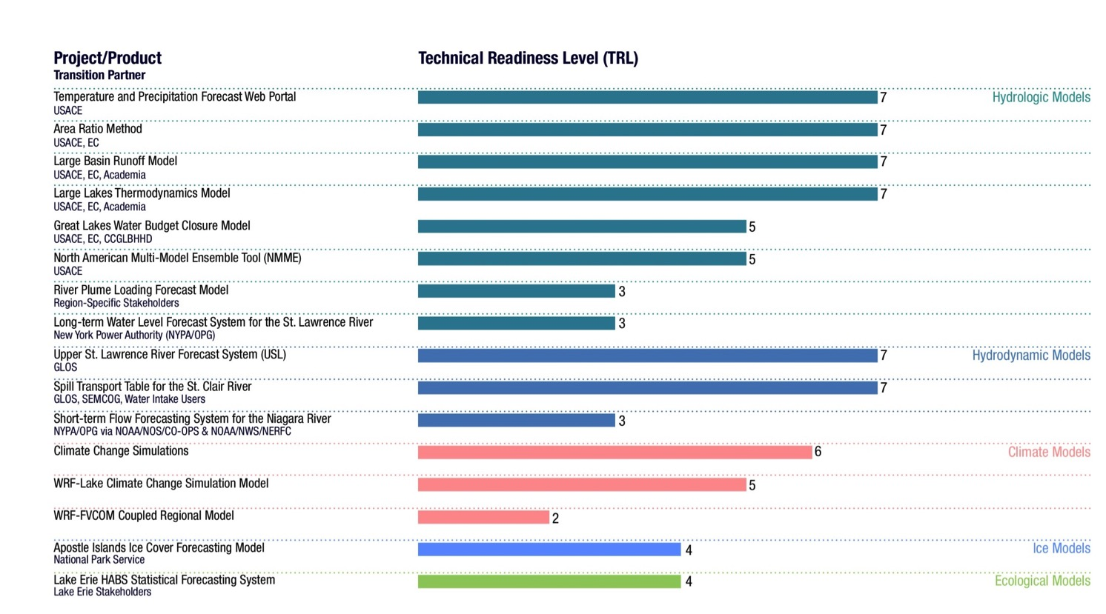
IPEMF | Hydrological Modeling
Technical readiness level of IPEMF
research to application (R2A) products
Additional Information

Slide 12
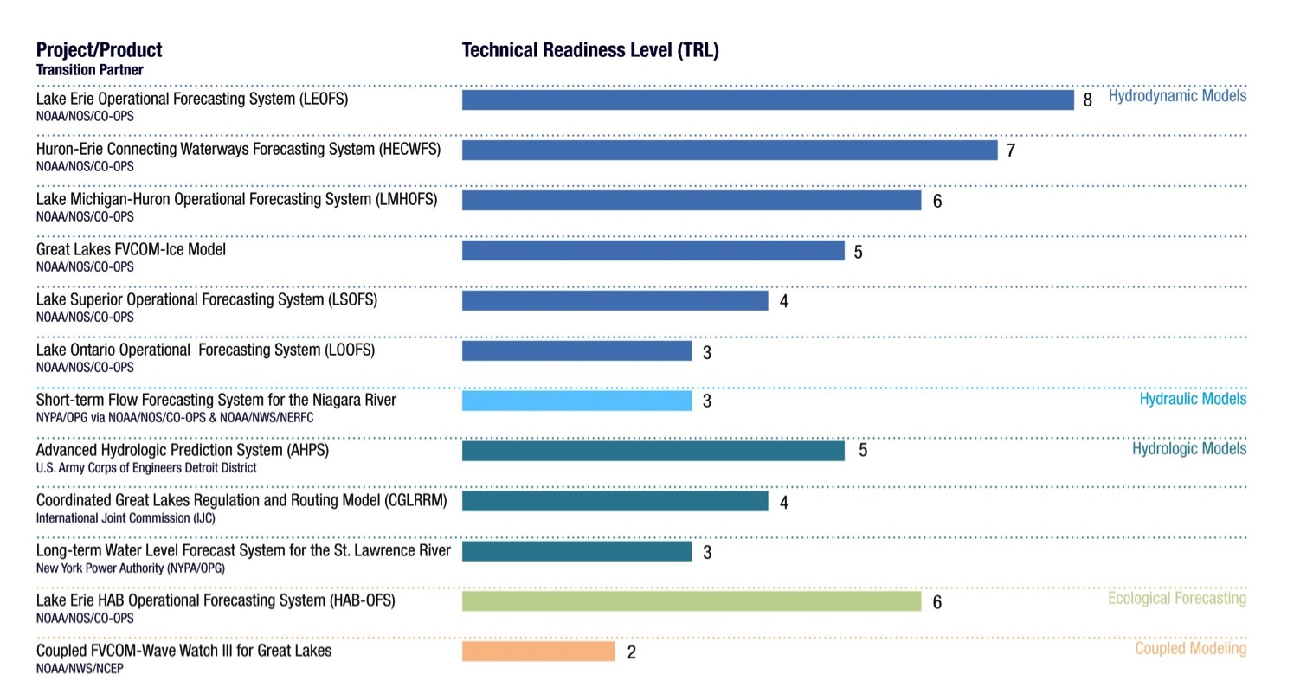
IPEMF | Hydrological Modeling
Technical readiness level of IPEMF
research to operation (R2O) products
Additional Information

Slide 13
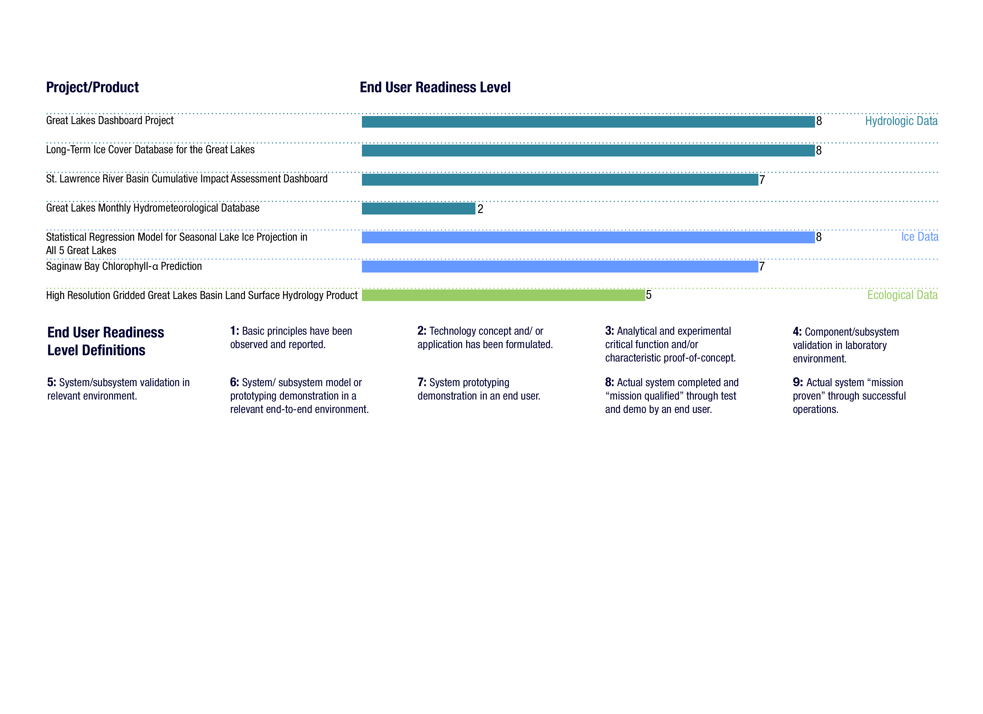
IPEMF | Hydrological Modeling
End user readiness level of IPEMF
data products
Additional Information

Slide 14
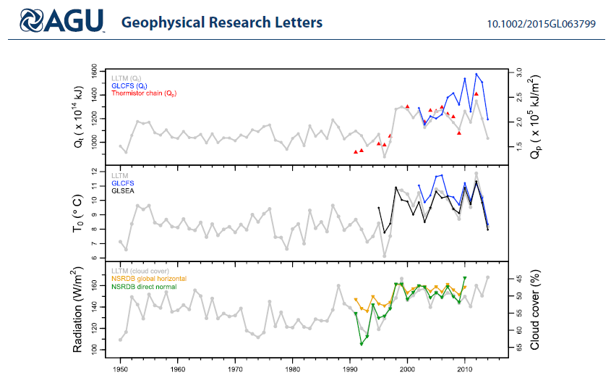
IPEMF | Hydrological Modeling
Additional Information
Notes:
Extra slide – time series (from recent GRL paper) indicating long-term changes in Lake Michigan’s heat content (top row), surface water temperature (middle row), and radiative forcings (bottom row). These results (and the paper in which they appeared) indicate that the changes in lake levels in the late 1990s were strongly associated with a shift in the lake’s thermal regime; current research is focusing on the extent to which the recent cold winters (and the current warm El Nino winter) might continue altering that regime. This paper is also one of the only in GLERL’s history to include all members (at the time of publication) of the IPEMF team and the laboratory director.

Slide 15
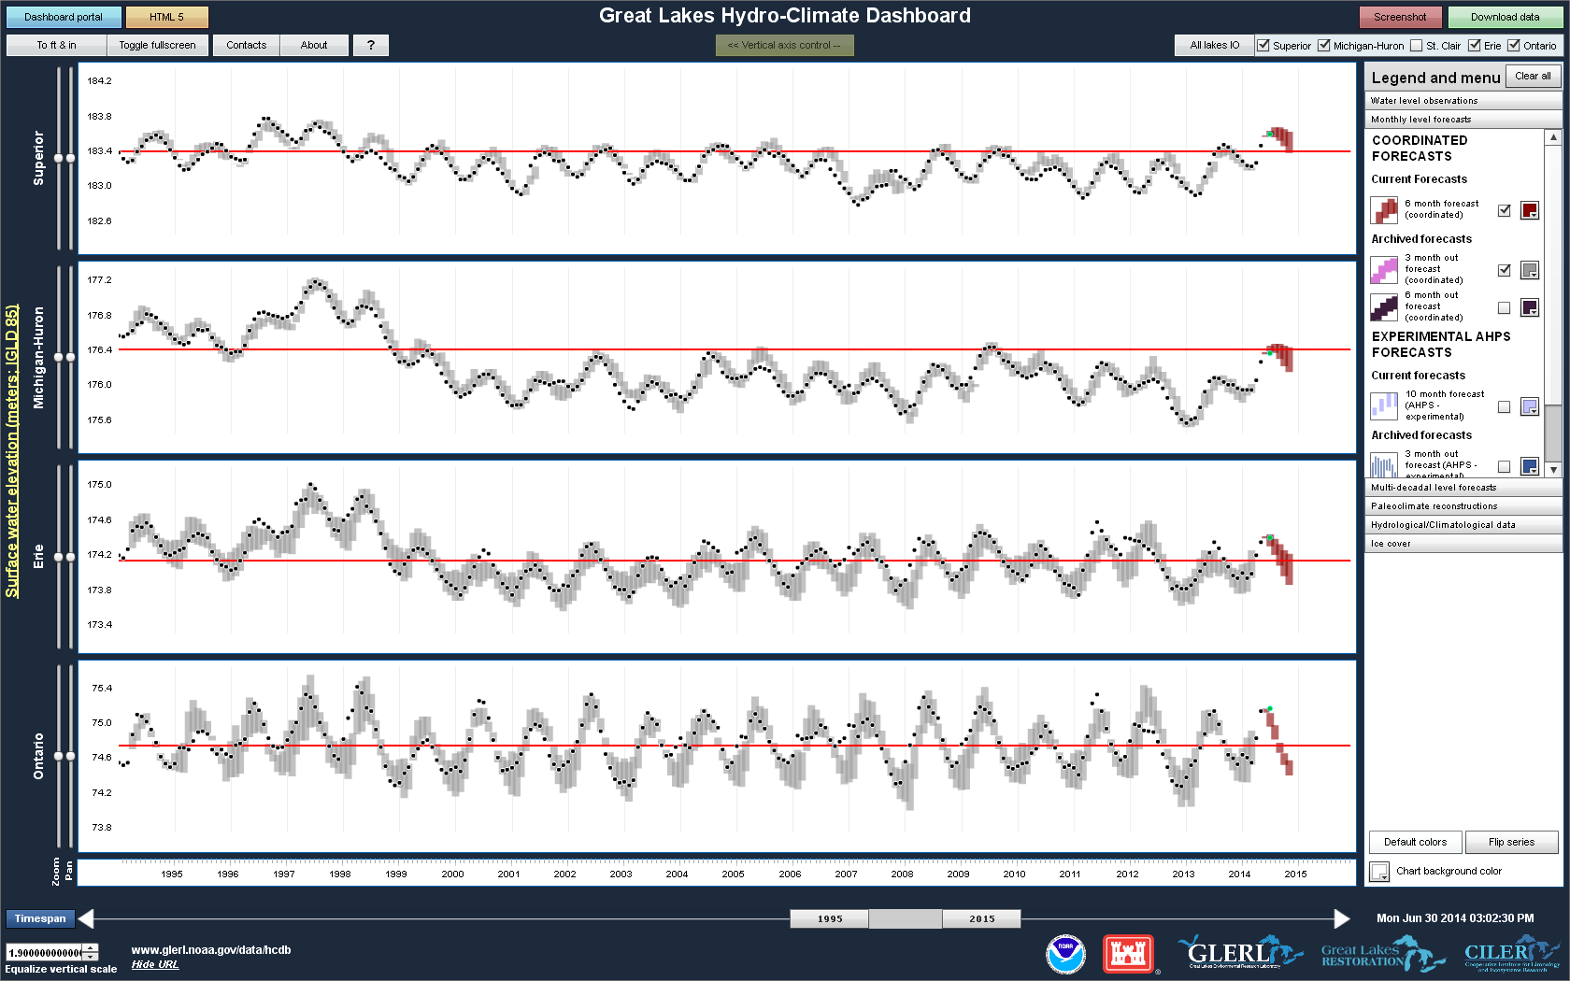
IPEMF | Hydrological Modeling
Additional Information
Notes:
Snapshot image of the Great Lakes water levels and hydro-climate dashboard, demonstrating how it allows for retrospective skill analysis. Dots are observed monthly average water levels, and grey shaded bars are 95% prediction intervals . Red bars (to right of each panel) represent 6-month ahead water level forecasts.

Slide 16
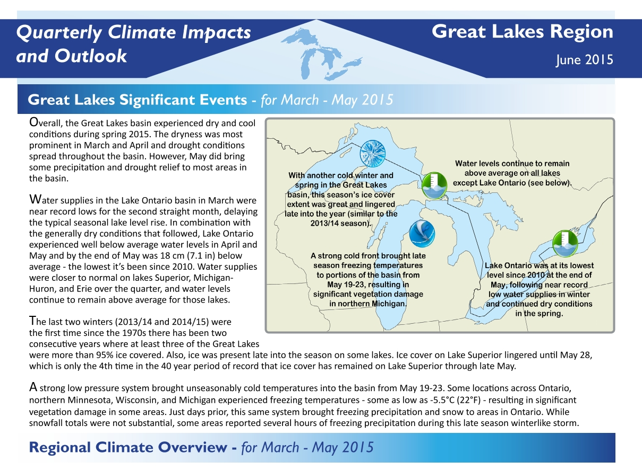
IPEMF | Hydrological Modeling
Additional Information
Notes:
This above image is from one of our recent binational products, the Great Lakes Climate Quarterly. Before NOAA-GLERL helped develop the idea for this product, Great Lakes climate information was often reported as part of the mid-west climate quarterly report. NOAA-GLERL recognized the need for a “stand-alone” product that summarized climate conditions across the land and lake surfaces of the Great Lakes.

Slide 17
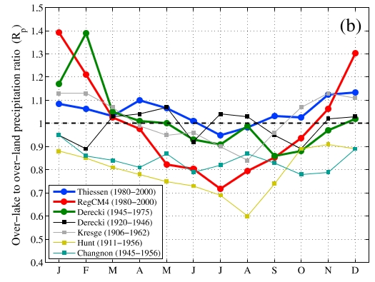
IPEMF | Hydrological Modeling
Understanding the hydrologic cycle: over-lake precipitation
Holman et al., (2013). Geophysical Research Letters.
Additional Information
Notes:
Our research on understanding and forecasting over-lake precipitation has focused on quantifying biases in historical monitoring infrastructure (much of it based along the shorelines of the Great Lakes) and updating estimates and forecasts with novel technologies in use at the NOAA Regional Forecast Centers (RFCs) and our partner laboratories (including, for example, the Multi-radar Multi-sensor (MRMS) system developed at National Severe Storms Laboratory (NSSL)).
The figure above is a representative example of this research in which we compare simulations from a regional climate model (RegCM4; red line) to a series of shoreline-based station estimates, all of which (in contrast to the model simulation) potentially misrepresent differences between over-land and over-lake precipitation throughout the year (the lead author of this paper, Katie Holman, conducted this research as a NOAA-GLERL CILER summer fellow). We are currently partnering with the Earth Systems Research Laboratory (ESRL), NSSL, the RFCs, and Environment Canada to improve model simulations and verification of over-lake precipitation. Initial phases of this partnership were supported by the efforts of Carlos Wah-Gonzalez, a student from the University of Puerto Rico sponsored by the NOAA’s Cooperative Remote Sensing Science and Technology (CREST) program.

Slide 18
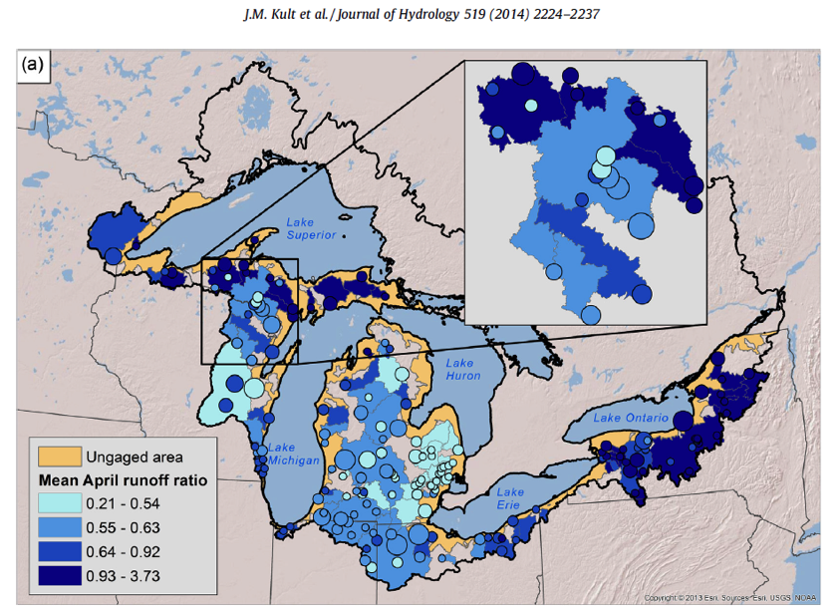
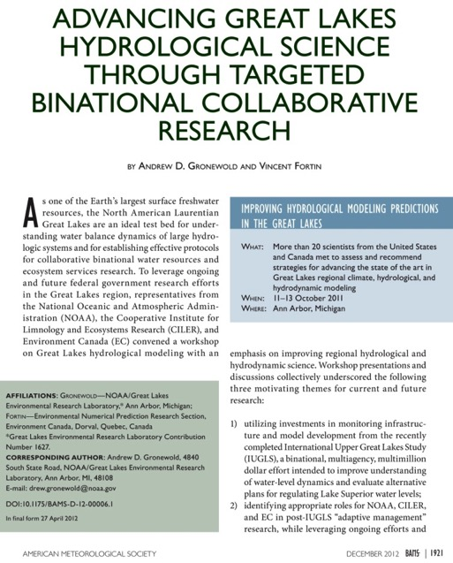
IPEMF | Hydrological Modeling
Understanding the hydrologic cycle: runoff
Kult et al., (2014). Journal of Hydrology.
Gronewold & Fortin (2012). BAMS.
Additional Information
Notes:
The image above represents a snapshot of NOAA-GLERL’s hydrological science research over the past several years, much of which has focused on understanding the relative skill of different modeling systems and, in particular, the relative benefits of distributed vs. lumped conceptual models (particularly from a basin-scale water balance perspective). The image on the left is from a recent Journal of Hydrology paper that documented important insights into spatial variability of hydrologic response, with a particular emphasis on guidance for translating hydrologic response in gaged portions of the basin (blue areas) to ungauged portions. This research trajectory, and other research priorities, were synthesized in a BAMS article I wrote with my close colleague Vincent Fortin of Environment Canada, in which we identified critical gaps in regional hydrological science including a need for two-way coupled models, the importance of simulating energy fluxes over the lakes, and other advancements in land surface hydrology. The Journal of Hydrology paper was lead authored by Jonathan Kult, a CILER summer fellow, and co-authored by Dr. Lauren Fry, and CILER post-doctoral fellow at the time who is now the lead forecaster at the Detroit US Army Corps of Engineers office.

Slide 19
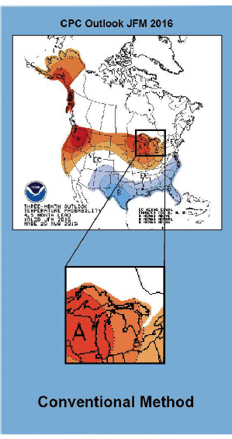
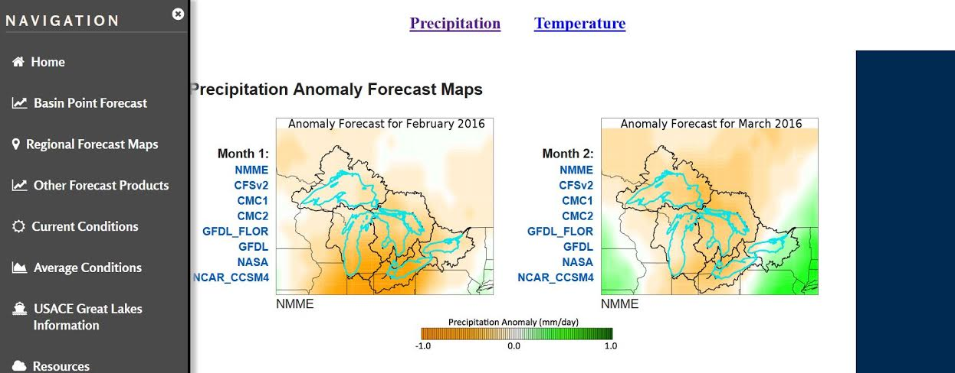
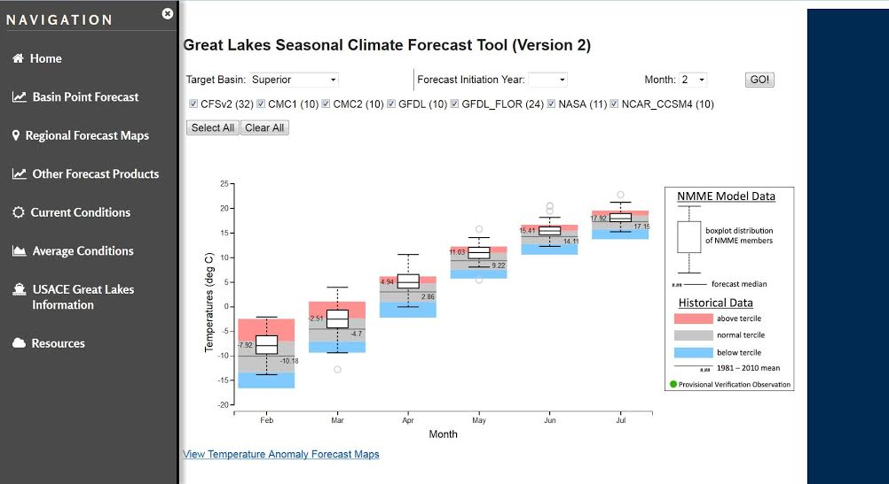
IPEMF | Hydrological Modeling
…into operational regional forecasting systems
Bolinger et al., (in revision).
Additional Information
Notes:
Through a partnership with UCAR, we are currently hosting two PACE (post-doctoral applications in climate expertise) fellows focused improving regional operational hydrological forecasting. One example, represented in the image above, includes the work of Dr. Becky Bolinger, who has been working closely with the US Army Corps of Engineers to improve seasonal water supply forecasts. Early in the project, Becky and other team members identified a need for improved regional climate projections; historically, climate projections for the region (left-hand image above) were based on NCEP/CPC outlooks that were truncated at the US-Canadian border, and only provided an indication of expected probability distribution shifts within the historical ranges of precipitation and temperature. Becky has since developed a novel new product (right-hand side) that has been adopted by the USACE allowing forecasters to create an ensemble forecast (and map) using a combination of individual members of the North American Multi-Model Ensemble (NMME). This approach not only allows users to select models that have historically demonstrated greater skill in the Great Lakes region, it also allows for the possibility of extreme precipitation and temperature values outside the range of historical observations. Dr. Lisi Pei, also a UCAR PACE fellow, is working to bring similar climate expertise into our partnership with regional hydropower authorities.

