Slide 1


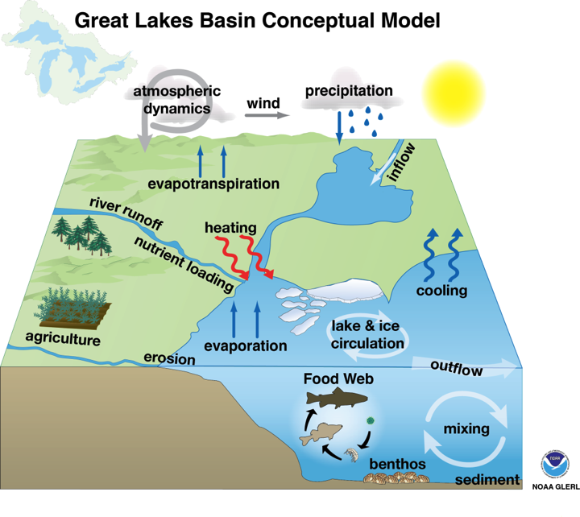

Integrated Physical & Ecological Modeling & Forecasting (IPEMF) Overview
Philip Chu, Ph.D., PE, MBA
1/18
Notes:
Align with NOAA’s mission on
Climate Adaptation and Mitigation
Weather-Ready Nation
Healthy Oceans
Resilient Coastal Communities and Economies
Science Informed Society
Safety and Preparedness
Future Workforce
1

Slide 2


IPEMF | Overview
IPEMF Team
Brent Lofgren – Climatologist
Eric Anderson – Hydrodynamic Modeler
Drew Gronewold – Hydrologist
Jia Wang – Ice Climatologist
Craig Stow – Ecosystem Modeler
Anne Clites – Physical Scientist
Greg Lang – Physical Scientist
Tim Hunter – IT Specialist
Becky Bolinger, Lisi Pei (UCAR PACE fellow)
Jam Charusombat (NRC postdoc)
Ayumi Manome, Dima Beletsky, Raisa Beletsky, Haoguo Hu, Andy Xiao, Heather Lucier, Joeseph Smith, James Kessler (CILER)
2/18
Notes:
People first, mission always!
This team is highly skilled with diverse backgrounds and research interest, and are experts in their fields!
Brent is going to talk about Climate-land surface modeling (climate adaptation and mitigation)
Eric will cover the hydrodynamic modeling aspect and extreme event (weather ready nation and healthy ocean)
Drew will talk about hydrologic modeling
Craig will cover ecosystem modeling approaches and nutrient loading
2

Slide 3
IPEMF | Overview
IPEMF Goals
Conduct innovative research and model development on key processes of the Great Lakes
Transition research/models/tools/knowledge to operations and applications
Promote internal and external collaborations
Data management, data sharing and product dissemination
3/18
Notes:
3

Slide 4
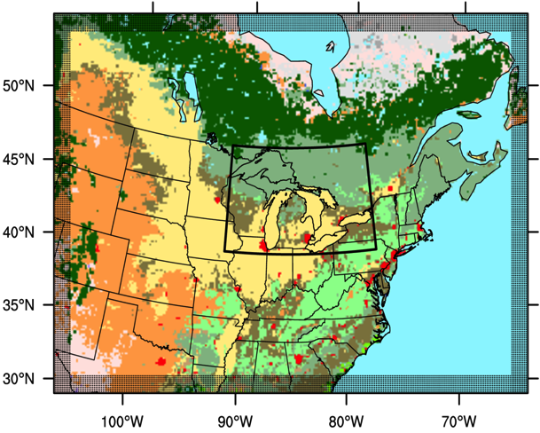
IPEMF | Overview
Climate Modeling – Brent Lofgren
Research and Development
  Climate Weather Research and Forecast Model (WRF) and RegCM4 (Regional Climate Model system) applications
  WRF-Hydro development for the Great Lakes
  Lake surface heat fluxes evaluation and comparison
Products & Services
  Extensive community outreach to decision makers and citizens
NOAA Goals: Climate Mitigation, Weather-Ready Nation
4/18
Notes:
WRF-Hydro | Weather Research and Forecast Model for Hydrology
GLOFS | Great Lakes Operational Forecast System
4

Slide 5
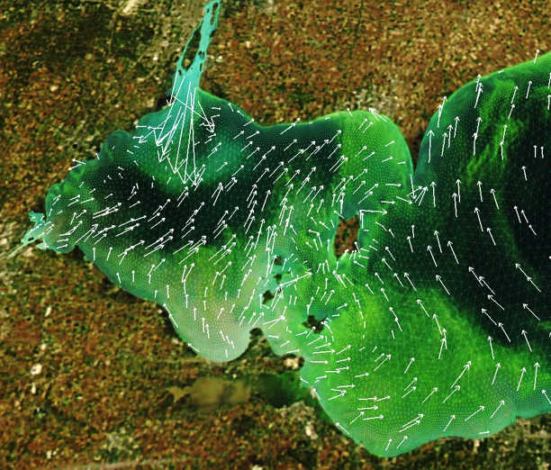
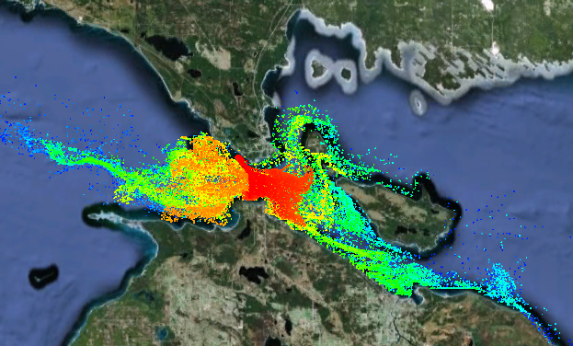
IPEMF | Overview
Hydrodynamic Modeling – Eric Anderson
Research and Development
  HAB forecasting
  Contaminant transport
  Meteotsunami & extreme
    water level events
Research to Operations
  Next-Gen GLOFS to NOS
  LEOFS to NOS in April 2016
  1 lake/yr for the next 5 years
  2 RTAP (Research Transition Acceleration Program) funded to speed up transition
NOAA Goals: Weather-Ready Nation, Healthy Oceans, Resilient Communities
5/18
Notes:
NOS | NOAA National Ocean Service
LEOFS | Lake Erie Operational Forecast System
RTAP | Research Transition Acceleration Program
5

Slide 6
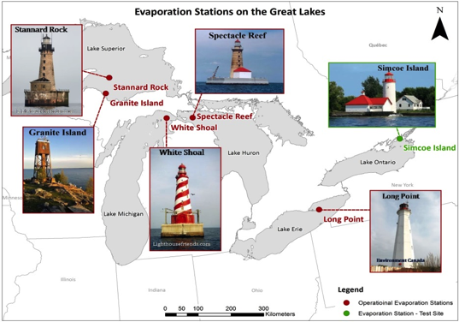
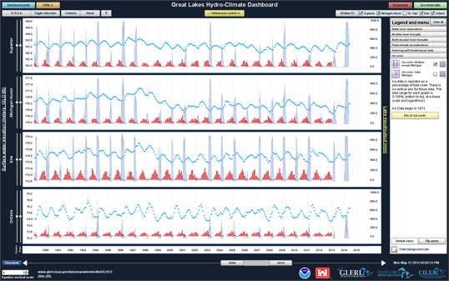
IPEMF | Overview
Hydrologic Research – Drew Gronewold
Research and Development
  Establish Great Lakes evaporation network
  Develop novel statistical models
  Develop WRF-Hydro framework for the Great Lakes
Transition to Operations (R2O)
  Water level forecast system for Niagara River to NYPA/OPG and NERFC
  AHPS and hydraulic model to USACE & IJC
Products & Services
  Serves on scientific and interagency committees
  Extensive public education and public outreach
  Various hydro-meteorological database and
  Long term water level software applications
NOAA Goals: Climate Mitigation, Weather-Ready Nation, Resilient Communities
6/18
Notes:
AHPS - Advanced Hydrologic Prediction System
NERFC – Northeast River Forecast Center
NYPA - New York Power Authority
OPG - Ontario Power Generation
6

Slide 7
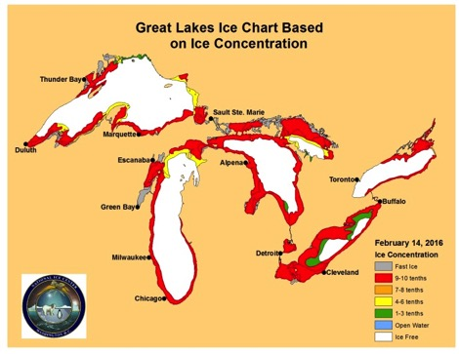
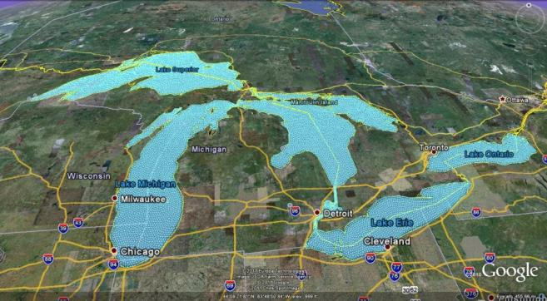
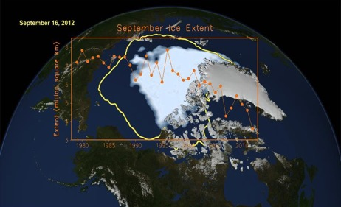
IPEMF | Overview
Ice & Climate Research & Modeling – Jia Wang
Research and Development
  Coupled ice-ocean model for the Great Lakes and Arctic region
  FVCOM-Ice to evaluate long-term variability and climate change
Transition and Application
  FVCOM-Ice for next-gen GLOFS
Products & Services
  Long-term Great Lakes ice coverage database and statistical model (34% ice coverage in 2016)
NOAA Goals: Climate Mitigation, Weather-Ready Nation
7/18
Notes:
FVCOM | Finite Volume Community Ocean Model is a modeling tool that enables high resolution (30 meters – 2 km) unstructured grid (i.e., triangular shapes of adaptable size) representation of the coastal system; a better approximation of the integral form of the equations of motion; tracking of seasonal lake level fluctuations; inflows and outflows at major connecting channels; expanded coverage to connecting waterways (Straits of Mackinac, St. Clair River, Lake St. Clair, Detroit River, upper St. Lawrence River).
7

Slide 8
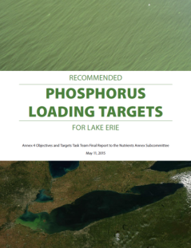
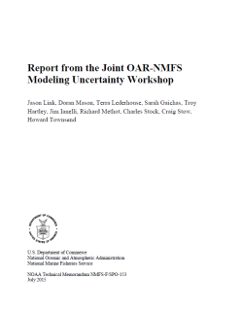

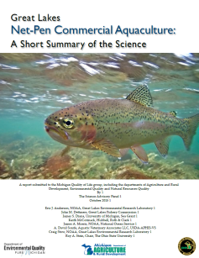
IPEMF | Overview
Ecosystem Research and Modeling – Craig Stow
Research and Development
  Bayesian network
  Ecological modeling
  Model uncertainty analysis
Products & Services
  Great Lakes Water Quality Agreement Annex 4 subcommittee on nutrient loading reduction
  OAR Modeling Uncertainty workshop
  Cladophora Workshop
NOAA Goals: Healthy Oceans, Resilient Coastal Communities
8/18
Notes:
8

Slide 9
IPEMF | Overview
Innovative Research
Improve understanding of the interactions between the physical, biological, and ecological components of the whole Great Lakes ecosystem
Develop and implement numerical models (climate, atmosphere, lake circulation, hydrology, wave, ice, and ecology) through improved physics, better forcing, higher spatiotemporal resolution
9/18
Notes:
Align with NOAA’s mission on
Climate mitigation
Weather-ready Nation
Healthy Oceasn
Resilent coastal community
9

Slide 10
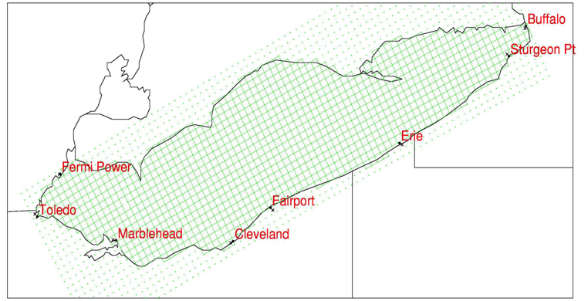
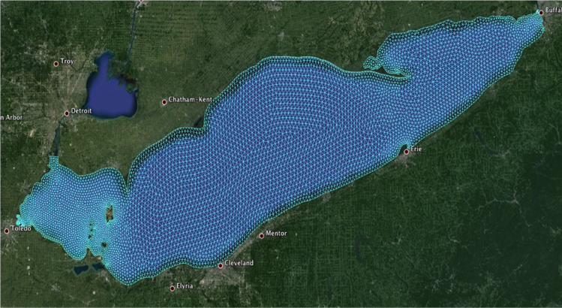
IPEMF | Overview
What’s new on the Next-Gen GLOFS?
Unstructured grid Finite Volume Ocean Model (FVCOM) to resolve complex shoreline, channels and islands
High spatial resolution (200m) with extended forecast range (120 hours out)
Improved initial and boundary forcing fields
Fully-coupled ice module to provide ice guidance
10/18
Notes:
Upgrade from 5km grid to 200 m in the coastal and bay areas.
Original Lake Erie has 1600 grid cells, the new Lake Michigan-Huron has more than 130,000 element!
10

Slide 11
IPEMF | Overview
Great Lakes Operational Forecast System R2O Transition Milestones
LEOFS transition
to NOS
in April, 2016
Lake Erie HAB tracker to NOS/CO-OPS
2019
Coupled GL Lake-Wave-Ice system
to NWS/NCEP
2025
11/18
Notes:
HEC - Huron-Erie Corridor
11

Slide 12
IPEMF | Overview
Collaborating Partners
NOAA
NOS: CO-OPS, NCCOS and CSDL
NWS: NCEP, NWC, WFO and RFC,
OAR: ESRL, PMEL, NSSL and GFDL
Other federal government agencies
Environment Canada, IJC, USACE, USGS, EPA, USCG
Academic Institutions
U. Michigan, U. Wisconsin, MTU, MSU, U. Toledo, Tulane U., CU Boulder, UNC Chapel Hill, NC State U., U. of Waterloo, Emory University
Stakeholders
NYPA, OPG, NRC, Limno-Tech, GLOS, and GLIN
12/18
Notes:
UW Madison: Meteotsunamis research. Thesis and dissertation research
MTU: Lake Superior long term climate impact and model coupling research
MSU: Climate-land surface interaction study
U Toledo: Bayseian network approach for nutrient loading
Tulane University: NOAA RESTORE project focusing on Mississippi River and Gulf of Mexico interactions
Thesis and dissertation committee
12

Slide 13
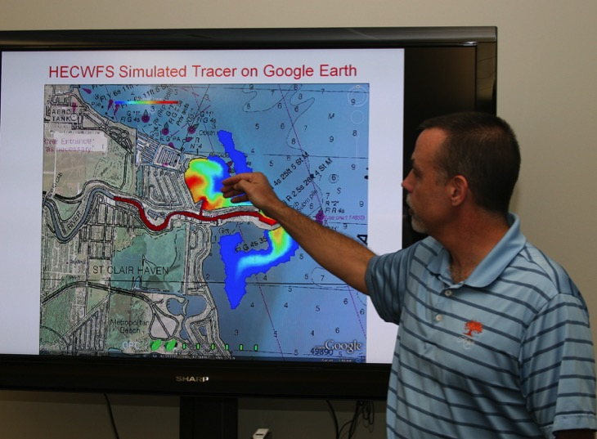
IPEMF | Overview
What’s Next?
Continue to conduct innovative research
Continue to improve model accuracy and extend forecast capability
Continue to promote collaboration
Promote environmental data management and data sharing practice
Rebuild in-house GIS capability
13/18
Notes:
Image: Meteorological data displayed using Google maps, G. Lang. September 2, 2010.

Slide 14
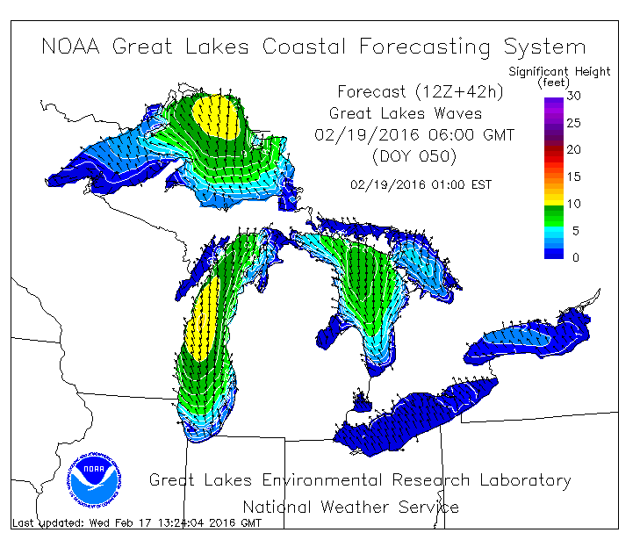
IPEMF | Overview
Model Improvement Strategy
An integrated environmental modeling system through model coupling
Data Assimilation using in-situ obs/satellite data to improve short-term forecast accuracy
Ensemble probabilistic forecast to convey uncertainty for medium and long term forecasts
14/18
Notes:
For the fast 10- 15 years, model improvements pretty much focus on improving model physics, processes, increasing spatial resolutions or improving boundary forcing. Each model (atmos, hydrodynamic, wave, hydrology) are run on either loosely coupled or uncoupled mode.
For the next 5-10 years, we plan to apply NOAA’s objective of developing and implement an integrated environmental modeling approach.
14

Slide 15
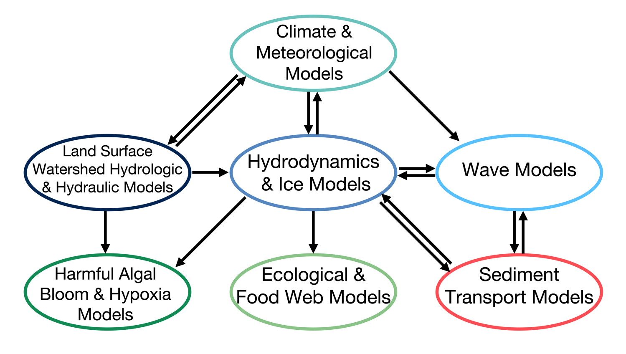
IPEMF | Overview
An Integrated Environmental Modeling System
?
15/18
Notes:
15

Slide 16
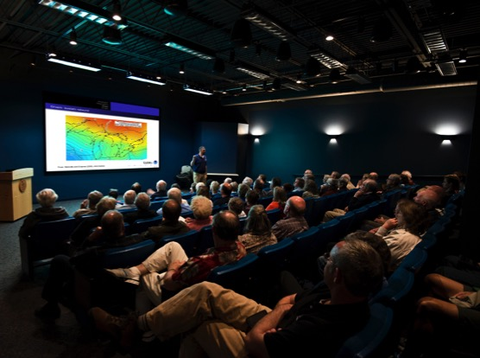
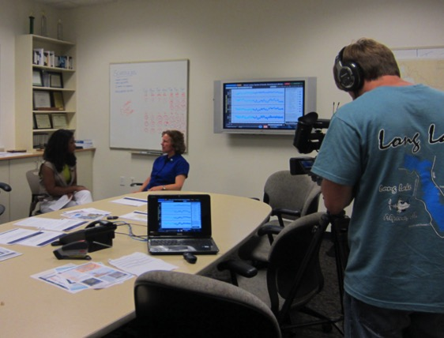
IPEMF | Overview
Summary
IPEMF scientists conduct high quality, innovative research on all aspects of the Great Lakes ecosystem
The knowledge and modeling systems developed are relevant and being transitioned to NOAA operational line offices and other government agencies
Performance of the team is demonstrated in hi-impact publications, awards, patent and product transitions
16/18
Notes:
This team conducts high quality research, not limited to the Great Lakes, but also throughout other geographic regions, such as the Gulf of Mexico and the Arctic.
The research and products we produce are relevant to NOAA’s mission and are transitioned to NOAA operational line offices and other decision-making agencies.
Images:
Top: Researcher D. Gronewold presentation on Great Lakes water levels at the Thunder Bay National Marine Sanctuary, Alpena, MI.
Bottom: Scientist Anne Clites is interviewed about water levles by Alpena News at Thunder Bay National Marine Sanctury, June 27, 2013.
16

Slide 17
IPEMF | Overview
What do our product users say
“We look at GLOFS wind, wave, ice forecasts everyday for search and rescue missions (SAR), GLERL’s products save lives!” Jerry, USCG 9th District Cleveland Office
“We regularly check GLOFS forecasts for high/low water levels and waves for all the nuclear power plants operation around the Great Lakes!” Jack, Nuclear Regulatory Commission
“We use GLOFS water level forecasts to determine how much water to release to Niagara River, accurate forecasts save $30M/year!” Peter, (NYPA)
17/18
Notes:
We held a community user outreach meeting for the next generation of GLOFS in last October.
For years we know the system and products we produced are very popular for commercial and recreational fishermen, and surfers.
What we did not expect is the heavy users from the above industry!
17

Slide 18
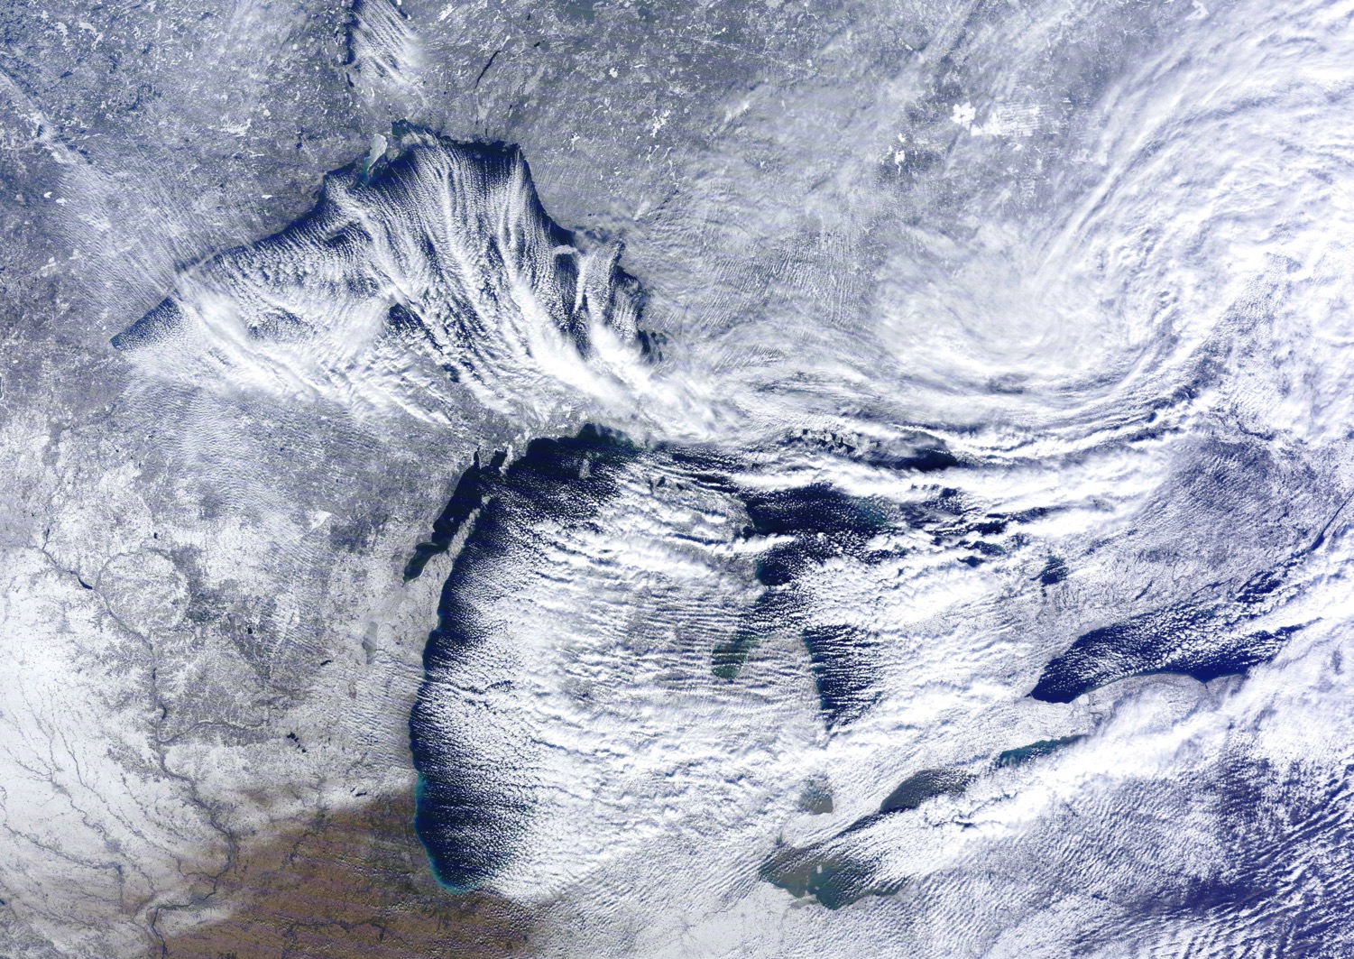
IPEMF | Overview
Questions?
Notes:
18

Slide 19
IPEMF | Overview
Recommendations from 2010 science review
Continue to develop the increasing important connection to NOAA’s National Ocean Service (including CSDL and CO-OPS)
Continue to develop and communicate complex model forecast results and uncertainty in critical areas related human health and safety
Additional Information
Notes:
Hold weekly GLOFS conference call between GLERL, CSDL and CO-OPS to discuss status and issues
Quarterly meeting with modeling advisory panels and gateway manager to check progress and milestone schedule
Biannual face-to-face meeting and workshop at Silver Spring
Integrated modeling approach to predict hypoxia, HABs and other ecological and water quality parameters
19

Slide 20
IPEMF | Overview
Brief History of IPEMF’s R2O effort
1989: Developed GLFS with OSU
1991: First 3-D Lake Erie nowcast on CRAY
1992: GLFS workstation version running at GLERL
1993: First 3-D forecasts
2000: GLFS team won the AMS Special Award
2003-2005: Transitioned GLFS to NOS/CO-OPS
2016-2021: Next-generation GLOFS being transitioned to NOS/CO-OPS and NWS/NCEP
Additional Information

Slide 21
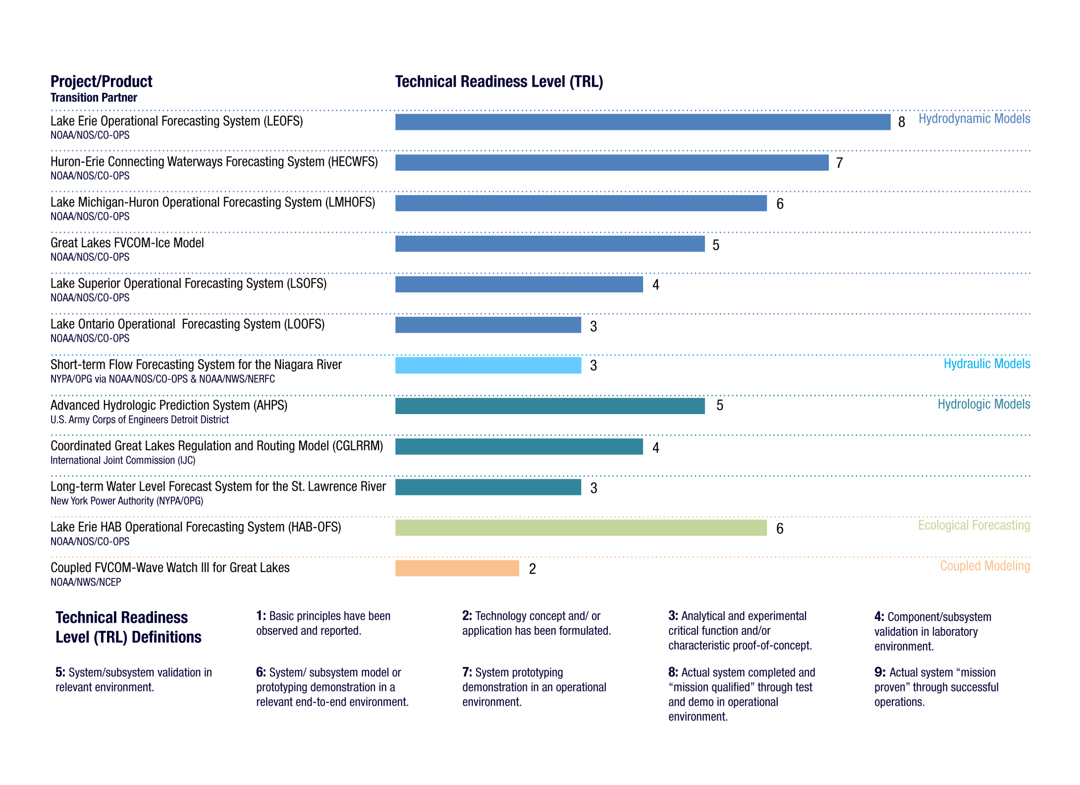
IPEMF | Overview
Transition to Operations (R2O)
Additional Information

Slide 22
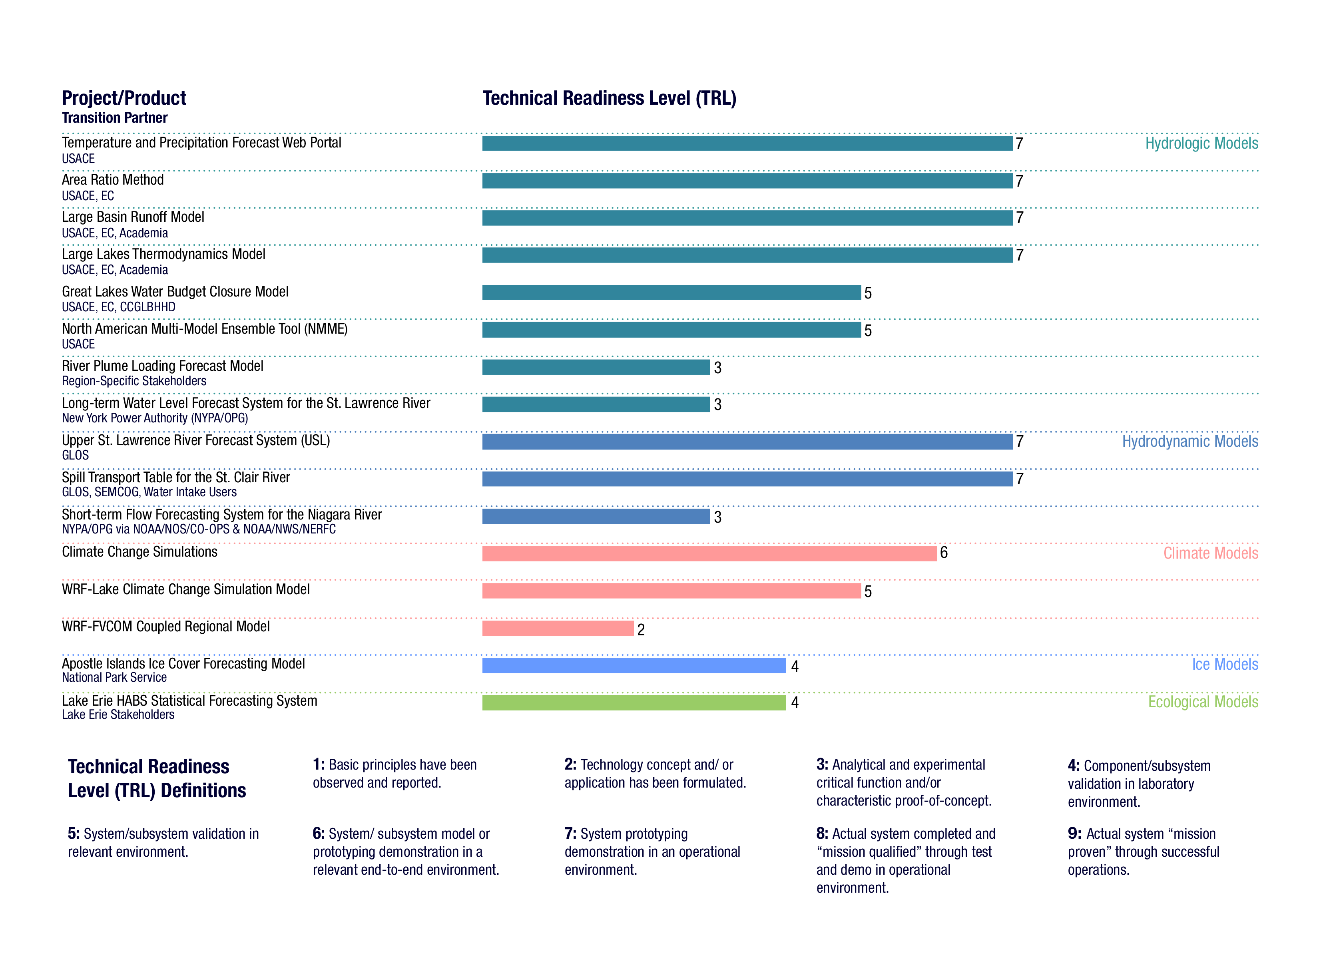
IPEMF | Overview
Transition to Applications (R2A)
Additional Information

