Slide 1
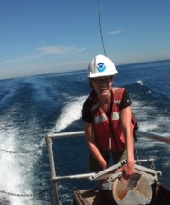
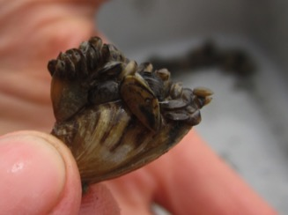
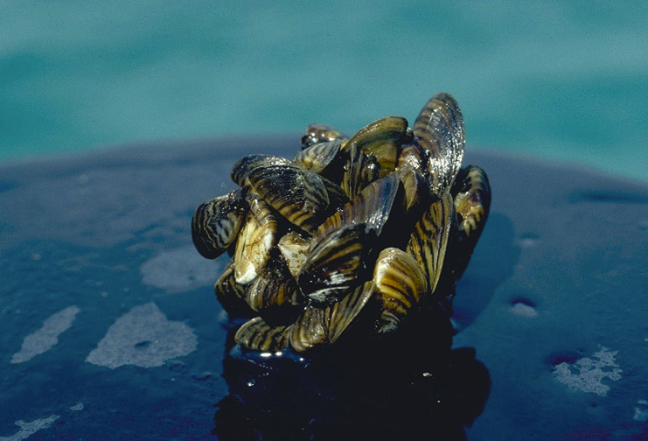
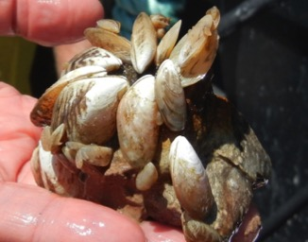
Dreissenid Mussel Population Dynamics & Processes
Ashley Baldridge
Ecosystem Dynamics
Place Photo Here
1/13
Notes:
The Primary focus of the GLERL Benthic Ecology Program is invasive dreissenid mussels because they dominate the benthic environment and impact the entire lake ecosystem. Dreissenid mussels are a high profile invader not just in the Great Lakes, but throughout North America.
GLERL has been at the forefront of studying dreissenid mussels:
-Surveys to document the initial expansion and subsequent spread
-Documenting changes in benthic and pelagic communities
-Complementary process studies to explore mechanisms of the ecological impacts of mussels
This work aligns with the following NOAA Goals:
Science: Climate Adaptation and Mitigation
Improved scientific understanding of the changing climate system and its impacts
Assessments of current and future states of the climate system that identify potential impacts and inform science, service, and stewardship decisions
Science: Weather-Ready Nation
Improve freshwater resource management
Science: Healthy Oceans
Improved understanding of ecosystems to inform resource management decisions
Recovered and healthy marine and coastal species
Science: Resilient Coastal Communities and Economies
Comprehensive ocean and coastal planning and management
Improved coastal water quality supporting human health and coastal ecosystem services
Education: Science-Informed Society
Youth and adults from all backgrounds improve their understanding of NOAA-related sciences by participating in education and outreach opportunities
ForFormal and informal education organizations integrate NOAA-related science content and collaborate with NOAA scientists on the development of exhibits, media, materials, and programs that support NOAA’s mission
Education: Safety and Preparedness
Formal and informal education institutions integrate water, weather, and climate hazard awareness, preparedness, and response information into curricula, exhibits, and programs that create learning opportunities for youth and adults

Slide 2
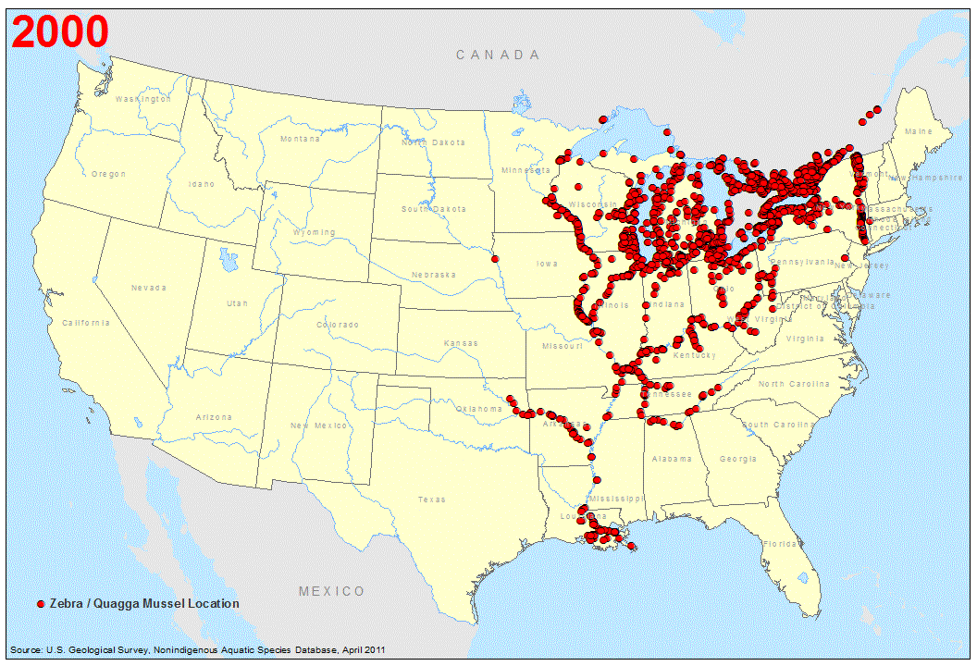
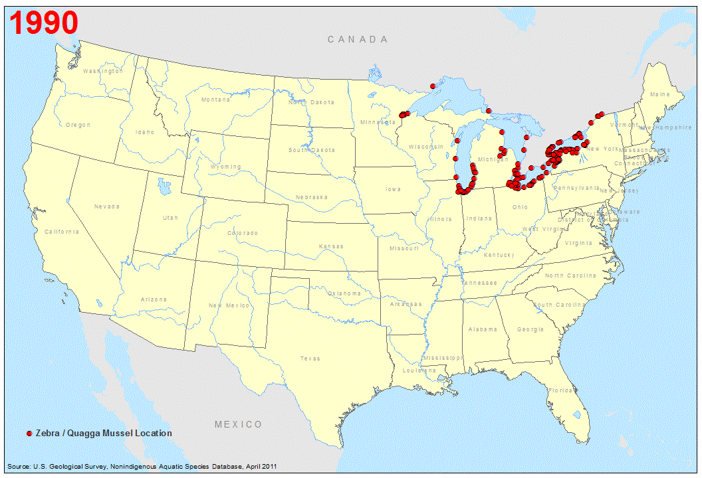
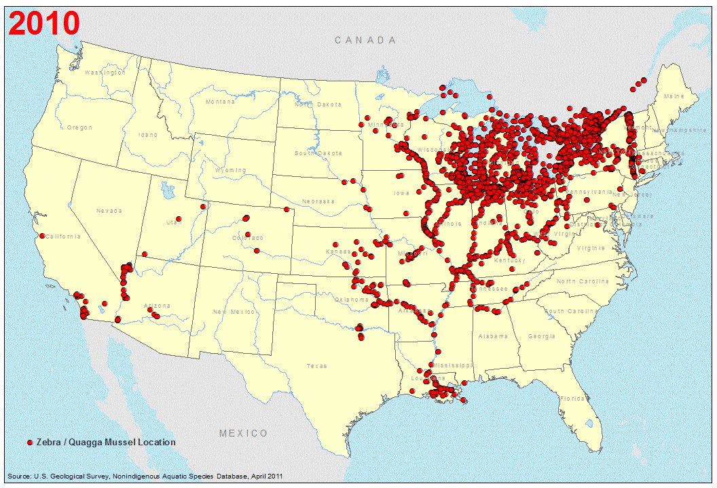
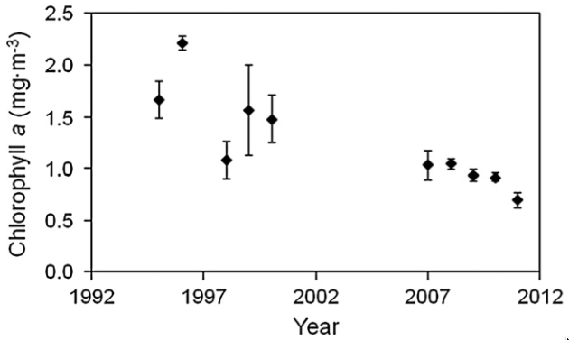
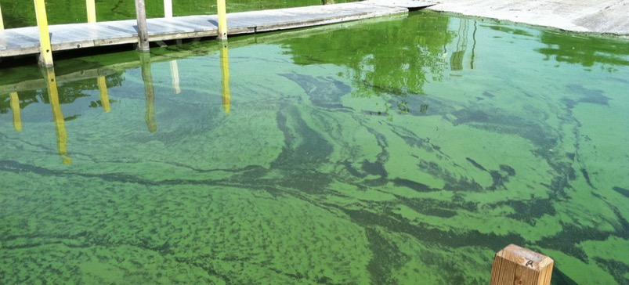
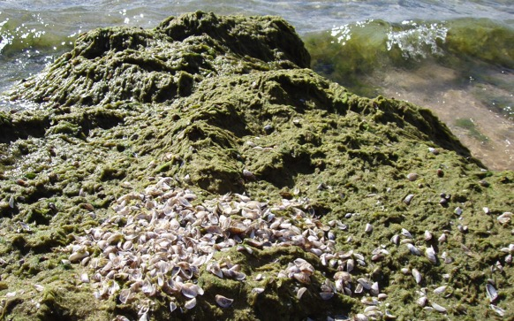
EcoDyn | Dreissenid Mussel Population Dynamics & Processes
Invasive Dreissenid Mussels in the Great Lakes
Reduced primary production
Post-Quagga
Pre-Quagga
Pothoven and Fahnenstiel (2013). JGLR.
Selective filter-feeding can favor
harmful algal species
Increased nuisance
benthic algae
Vanderploeg et al. (2013) Quagga and Zebra Mussels: Biology, Impacts, and Control
2/13
Notes:
The Great Lakes were the beachhead for the invasion of dreissenid mussels. After arriving in the Great Lake region in the late 1980s, the mussels first spread throughout waterways adjacent to the Great Lakes basin, and then leapt to the western region in 2007.
Dreissenid mussels are associated with negative impacts on infrastructure, the lake ecosystem, and potentially human health.
They are highly efficient benthic filter feeders that remove phytoplankton from the water column.
Their impacts are system-specific, and include
reduced primary production, which undermines the food web and fisheries,
enhancement of nuisance benthic algae through increased water clarity and nutrient excretion
in eutrophic systems, selective filter feeding can select for toxic cyanobacteria over non-toxic species of phytoplankton.
Pothoven, S. A., and G. L. Fahnenstiel. 2013. Recent change in summer chlorophyll a dynamics of southeastern Lake Michigan. Journal of Great Lakes Research 39:287–294.
Vanderploeg, H.A., A.E. Wilson, T.H. Johengen, J. Dyble Bessie, O. Sarnelle, J.R. Liebig, S.D. Robinson, and G.P. Horst. 2013. Role of selective grazing by dreissenid mussels in promoting toxic Microcystis blooms and other changes in phytoplankton composition in the Great Lakes. In Quagga and Zebra Mussels: Biology, Impacts, and Control, Second Edition. T.F. Nalepa, and D.W. Schlosser (Eds.). CRC Press, Boca Raton, FL.

Slide 3
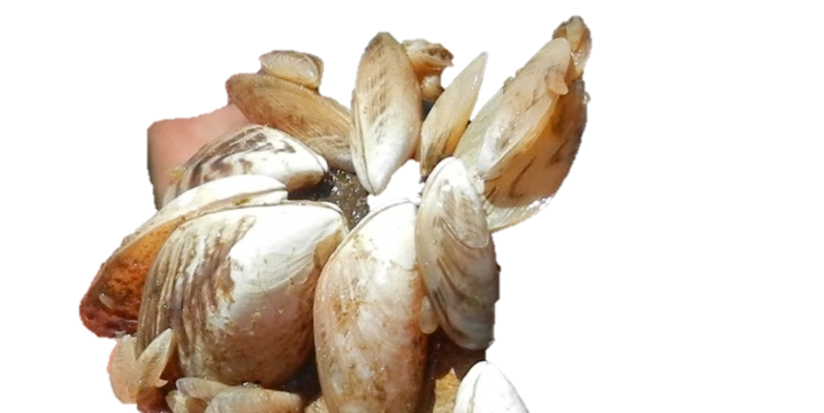
EcoDyn | Dreissenid Mussel Population Dynamics & Processes
Motivating Questions
What is the status of mussels in the Great Lakes, and how is that changing?
How are dreissenid mussels impacting the lower food web?
How can we produce more
accurate models to predict
mussel populations?
3/13
Notes:
We are in a unique position to address the first question because of our established long term benthic data set in Lake Michigan that predates the arrival of dreissenid mussels. The survey was originally designed to measure the impacts of phosphorus reduction, but now serves as a record of the changing benthic community over the course of the dreissenid mussel invasion.
I am interested in learning more about the natural history of quagga mussels so that we can better characterize their population dynamics in predictive models (e.g., projecting mussel population trajectories, modeling impacts on phytoplankon, HABs, cladophora, etc.)

Slide 4
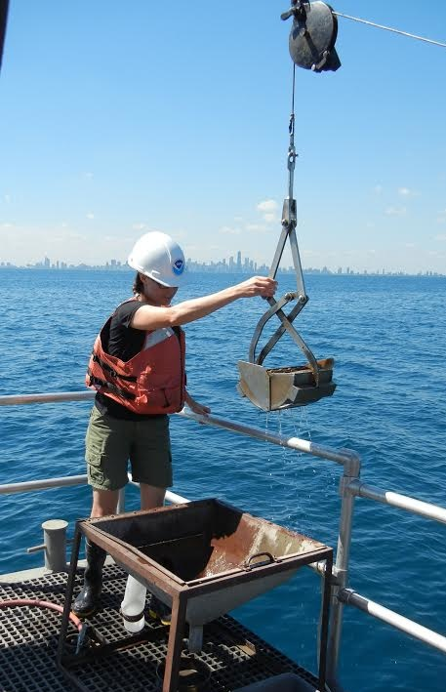
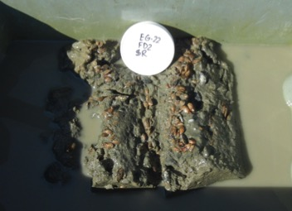
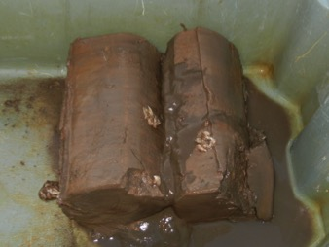
EcoDyn | Dreissenid Mussel Population Dynamics & Processes
GLERL Strategic Plan Research Path
EcoDyn Path #3:
Continue to monitor the status of benthic macroinvertebrate and dreissenid mussel populations in Lake Michigan and conduct experiments to evaluate factors that affect mussel abundance, feeding, growth and condition in the Great Lakes as well as mussel impacts on Great Lakes food webs.
EcoDyn Mantra:
Observations → Experiments → Concepts → Models/Applications
High Density Low Density
4/13
Notes:
The importance of understanding the impacts on dreissenid mussels in the Great Lakes is captured by research goals and paths defined in our Strategic Plan.
EcoDyn Path #3 captures the motivation behind my research program. My research contributes to all aspects of the EcoDyn Mantra of Observations → Experiments → Concepts → Models/Applications.
Shown here is the method that we use for collecting mussels- Replicate ponars collected at multiple sites spanning a wide depth range (~15-205m).
The two bottom images illustrate high and low density mussel sites, respectively.

Slide 5
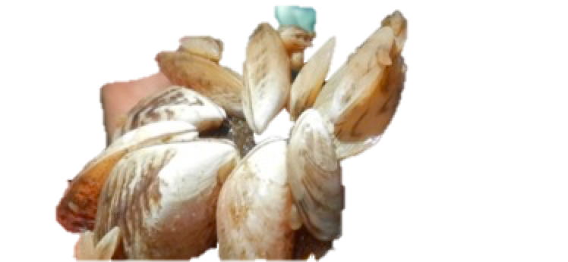
EcoDyn | Dreissenid Mussel Population Dynamics & Processes
Southern Lake Michigan Invasive Mussel Population Trends
Data Sources: Nalepa et al. (2013); Baldridge (unpub.)
5/13
Notes:
This figure summarizes the mussel biomass for Southern Lake Michigan. This data set is unique in the high frequency and broad spatial coverage of the survey and high quality due to the consistent methods used over time. This is exactly the type of data needed if looking to connect mussels to observed changes in the ecosystem since their arrival.
The population trajectories are species and depth specific:
-Zebra mussels were the first to appear and expand, and were generally only found at depths <50m.
-Starting in 2004, zebra mussels declined
-Around that time, quagga mussels had reached the southern basin were starting their rapid spread
-Quagga growth was most pronounced at 30-50m and this is the depth where we have detected the greatest declines.
-Biomass peaked at 50-90m a little later, then also declined
-Biomass increase has been more gradual >90m, and is from a combination of increasing density and also an increase mean biomass per mussel.
-Mean biomass, as weighted by lake area within each depth zone, shows the basin-wide mean to be holding somewhat steady.
Our long term data on mussel condition (i.e., tissue mass at a given shell size) shows declines at all depths over time and that condition is consistently lowest in the 30-50m depth zone.
It is important to continue these surveys because of the recent dynamics. Are there characteristics of the system and signs in the mussels themselves that can be used to predict population trajectories?
Nalepa et al. 2013. Variation of the Quagga Mussel (Dreissena rostriformis bugensis) with Emphasis on the Deepwater Morphotype in Lake Michigan. In Quagga and Zebra Mussels: Biology, Impacts, and Control, Second Edition. T.F. Nalepa, and D.W. Schlosser (Eds.). CRC Press, Boca Raton, FL.

Slide 6
EcoDyn | Dreissenid Mussel Population Dynamics & Processes
Cross-Lake Comparison: Invasive Mussel Biomass
Data Source: Nalepa et al. (2014); Nalepa et al. (unpub)
6/13
Notes:
Looking at the most recent whole lake surveys in each of the three lakes, we can compare depth specific trends.
Lake Ontario biomass is comparable to Lake Michigan, Lake Huron is considerably lower.
The Huron 2012 and Ontario 2013 data are from the Combined Science and Monitoring Initiative (CSMI) surveys conducted in those lakes. We are already starting to plan for the next round of surveys in both lakes and it will be interesting to see how the mussel distributions may change.
The 2015 Lake Michigan CSMI samples are currently being processed.
Nalepa, TF, Fanslow, DL, Lang, GA, Mabrey, K, and Rowe, M. 2014. Tech Memo 164: Lake-wide benthic surveys in Lake Michigan in 1994-5, 2000, 2005, and 2010: Abundances of the Amphipod Diporeia spp. and abundances and biomass of the mussels Dreissena polymorpha and Dreissena rostriformis bugensis. Page 22. NOAA Tech Memo, NOAA, GLERL.

Slide 7
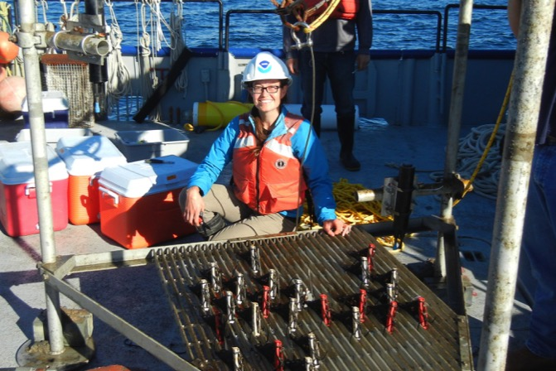
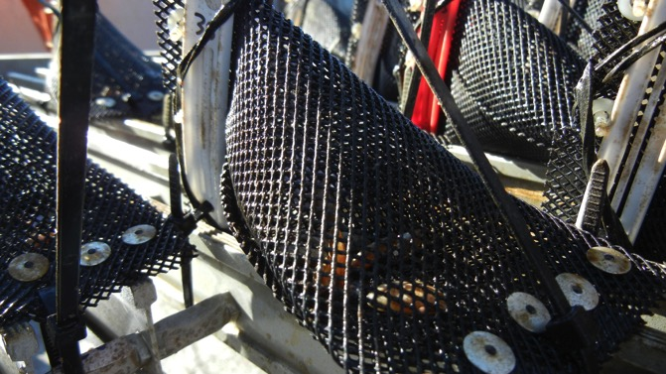
EcoDyn | Dreissenid Mussel Population Dynamics & Processes
Invasive Mussel Field Growth Experiment
GOALS
Improve year-round growth estimates at relevant depths
DESIGN
One tripod at 45 meters
Measure mussel growth at 5 and 12 months
INITIAL FINDINGS/CONCLUSIONS
Small mussels grew 10% in length during the season
Field growth experiment takes advantage of NOAA’s unique vessel capabilities to produce more realistic year-round growth estimates.
Baldridge (in prep)
7/13
Notes:
To examine if individual growth patterns can help explain the observed population-level patterns, I designed this field growth experiment.
One tripod was placed at 45m depth in April 2015. Half of the mussel cages were removed after 5 months and the remaining half went back down to overwinter. This will produce a realistic year-round estimate of growth.
The tripod has two fluorometers and three thermistors-- to collect multiple chlorophyll and temperature readings each day.
This project is only possible due to coordination with the Marine Instrumentation Lab and the Lake Michigan Field Station:
-In house capabilities for mooring design and equipment fabrication
-Vessel and technician support
-instrumentation support from MIL

Slide 8
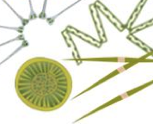
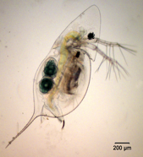
Examining relative impacts of climate change and invasive mussels on Lake Michigan zooplankton
EcoDyn | Dreissenid Mussel Population Dynamics & Processes
Method: Path Analysis
Chlorophyll
Total effect of dreissenid mussels is stronger than climate change
Zooplankton
Most influenced by seasonal fluctuations in water temperature
Dreissenid mussels have negative effect as mediated through effects on Chlorophyll
Climate change not significant
Future work to explore differences among zooplankton taxa
Baldridge et al. (in prep)
8/13
Notes:
There have been substantial differences in the seasonal thermal regime in Lake Michigan over the past several decades. At the same time, dreissenid mussels invaded and began having substantial impacts on Chlorophyll concentrations. We are using path analysis to examine the relative impacts of both mussels and climate change on the zooplankton community.

Slide 9
EcoDyn | Dreissenid Mussel Population Dynamics & Processes
Successes / Data Highlights
Promoting NOAAs involvement in projects beyond Lake Michigan
Lake Erie- collaboration with USGS and University of Michigan to assemble a long-term mussel biomass record for Western Lake Erie. These data will be used in a HABs forecasting model.
Lakes Huron and Ontario- We are proposing to lead the benthic surveys in 2017 and 2018 for the Cooperative Science and Monitoring Initiatives
Providing Data for Multiple Products
GLANSIS
Great Lakes Aquatic Habitat Framework (GLAHF)
State of the Great Lakes 2017 Report
Biophysical and ecosystem models (e.g., FVCOM, Ecopath w/ Ecosim)
Post-doc and Graduate Student research projects (Mich. State, Univ. Mich., Grand Valley State Univ.)
9/13

Slide 10
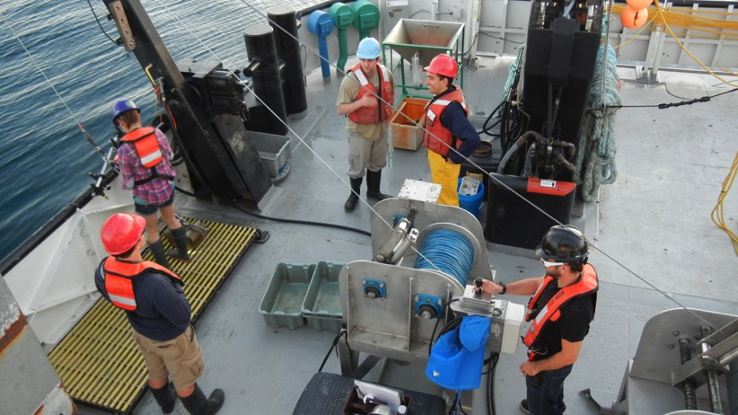
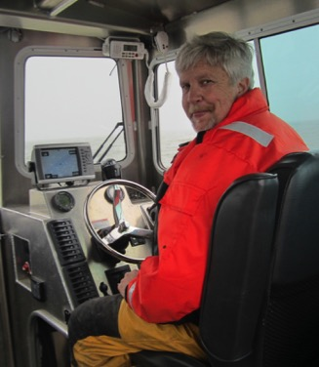
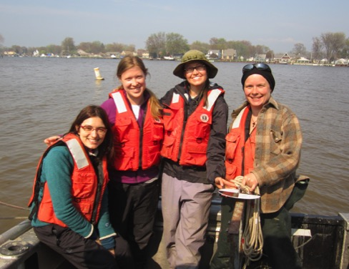
EcoDyn | Dreissenid Mussel Population Dynamics & Processes
Collaborations
Federal Partners
EPA
USGS
NOAA NOS (Mussel Watch Program)
Environment Canada
Academic Partners
Univ. of Michigan (CILER, Water Center)
Buffalo State College
Grand Valley State Univ.
Michigan State Univ.
Eastern Michigan Univ.
10/13

Slide 11
EcoDyn | Dreissenid Mussel Population Dynamics & Processes
Represent NOAA in the Invasive Mussel Collaborative: Co-lead of Science Team
IMC Mission
Advance scientifically sound technology for invasive mussel control to produce measurable ecological and economic benefits.
Provide a framework for communication and coordination, identify the needs and objectives of resource managers, prioritize the supporting science, recommend communication strategies and align science and management goals into a common agenda for invasive mussel control.
11/13
Notes:
The Invasive Mussels Collaborative is truly a multi-agency, multi-stakeholder effort.
Great Lakes State and Provincial and tribal agencies, industry representatives, academic researchers, non-profits, federal partners.
Science Team Goals:
Develop and guide management and research efforts for an adaptive control strategy
Convene and oversee working groups formed around topics of high research need

Slide 12
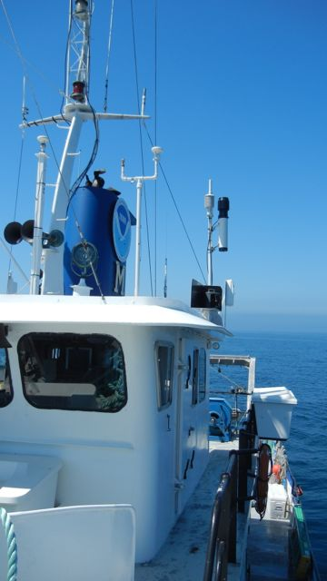
EcoDyn | Dreissenid Mussel Population Dynamics & Processes
Future Directions
Invasive mussel growth experiments:
Expand to deep and mid-depth stations of Lake Michigan in 2016
Incorporate into future research plans for Lake Huron (2017) and Lake Ontario (2018)
Lake Winnipeg project to examine impact of new zebra mussel invasion on cyanobacteria community (links to HABs)
Produce relevant estimates for parameters needed by the Dynamic Energy Budget model. Ultimately, this will improve predictions of quagga mussel biomass.
12/13
Notes:
Improving parameter estimates for a Dynamic Energy is a multi-year endeavor that will require designing and conducting a suite of experiments in the lab and field.
Mark Rowe, who will present later, will demonstrate how we incorporate mussels into biophysical models.

Slide 13
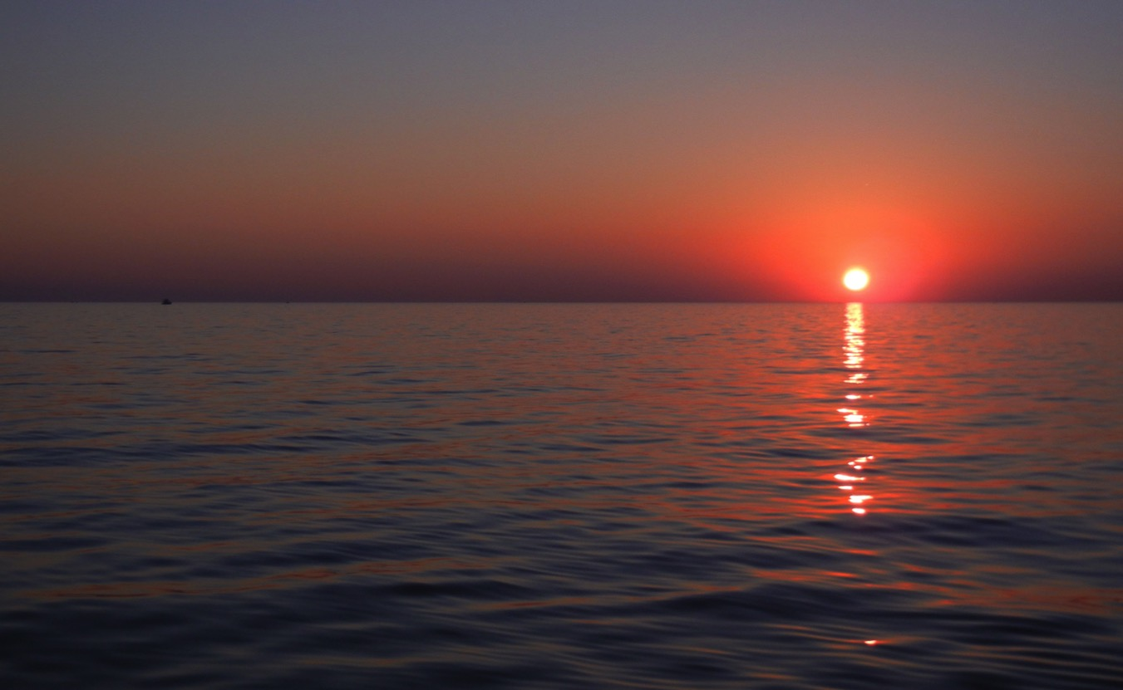
EcoDyn | Dreissenid Mussel Population Dynamics & Processes
Questions?
Place Photo Here
13/13

