Slide 1


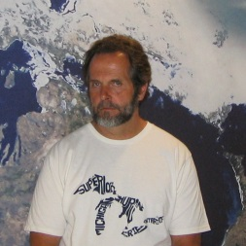
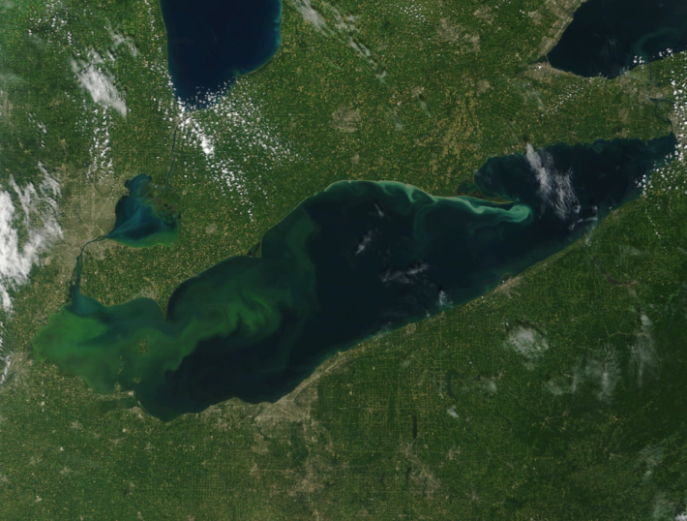
Phosphorus
^
Large Lake Ecosystem Modeling & Prediction
Craig Stow
Integrated Physical & Ecological Modeling & Forecasting
Image from
8-23-15
1/14
Notes:
Main topic:
The need for better Phosphorus (P) modeling
Involves interplay of everything we do here
Emphasizes our place in the broader Great Lakes community
As an example:
Groups Craig Stow/GLERL is involved in:
Lake Huron panel last fall
Hosted Cladaphora workshops Great Lakes Water Quality Agreement (GLWQA) ANNEX 4 at GLERL
Working on Lake Erie (done more or less), Moving forward to Lake Ontario, will circle back to Lake Huron and Saginaw Bay again
Recent data on Saginaw Bay:
Saginaw Bay isn’t meeting P targets
1978 targets
When the dreissenid mussels invaded Saginaw Bay the P retention capacity went up. Mussel filtering results in more P retention in Saginaw Bay, P not circulating out to Lake Huron.
Sag Bay is main source of P for Lake Huron.
P levels in main body of Lake Huron have dropped (below L Superior).
The food web has effectively collapsed, from bottom up to birds.
Further proposed reductions of P in Saginaw Bay would further reduce amount of P available to Lake Huron.
Deciding on a regulatory P level for Lake Huron will be a complex decision once ANNEX 4 rotates back around to the lake.
Guest editor for JGLR special issue “Managing multiple stressors in Saginaw Bay, 2012.
This work aligns with the following NOAA goals:
Science: Climate Adaptation and Mitigation
Improved scientific understanding of the changing climate system and its impacts
Science: Weather-Ready Nation
Improve freshwater resource management
Healthy people and communities due to improved air and water quality services
A more productive and efficient economy through information relevant to key sectors of the U.S. economy
Science: Healthy Oceans
Improved understanding of ecosystems to inform resource management decisions
Recovered and healthy marine and coastal species
Healthy habitats that sustain resilient and thriving marine resources and communities
Sustainable fisheries and safe seafood for healthy populations and vibrant communities

Slide 2

1978 GLWQA
Hear ye! Hear ye!
By Joint Proclamation
Henceforth and forever after
The Lake Erie phosphorus load shall not exceed:
11,000 tonnes/year
which probably translates to about 15 ug/L
4 Models provided guidance:
Vollenweider, DiToro et al., Chapra, Bierman et al.
Supported by info/technology available at that time
Notes:
Based on parallel development of 4 models. GLERL had an active part in one of them.

Slide 3
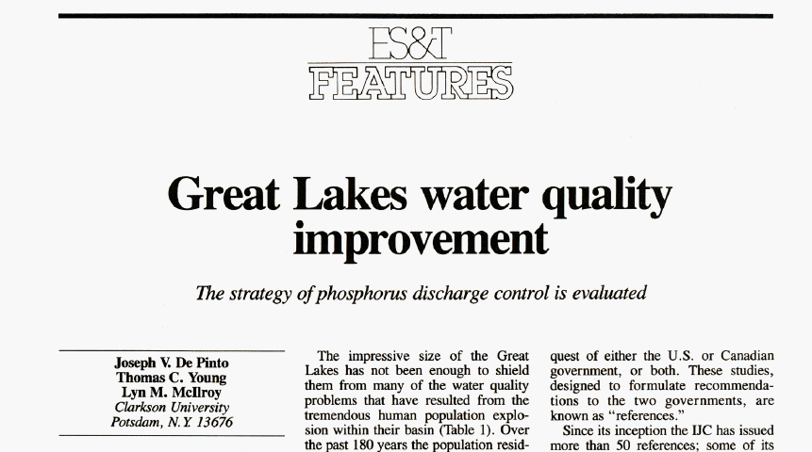
Mission Accomplished !
1986

Slide 4
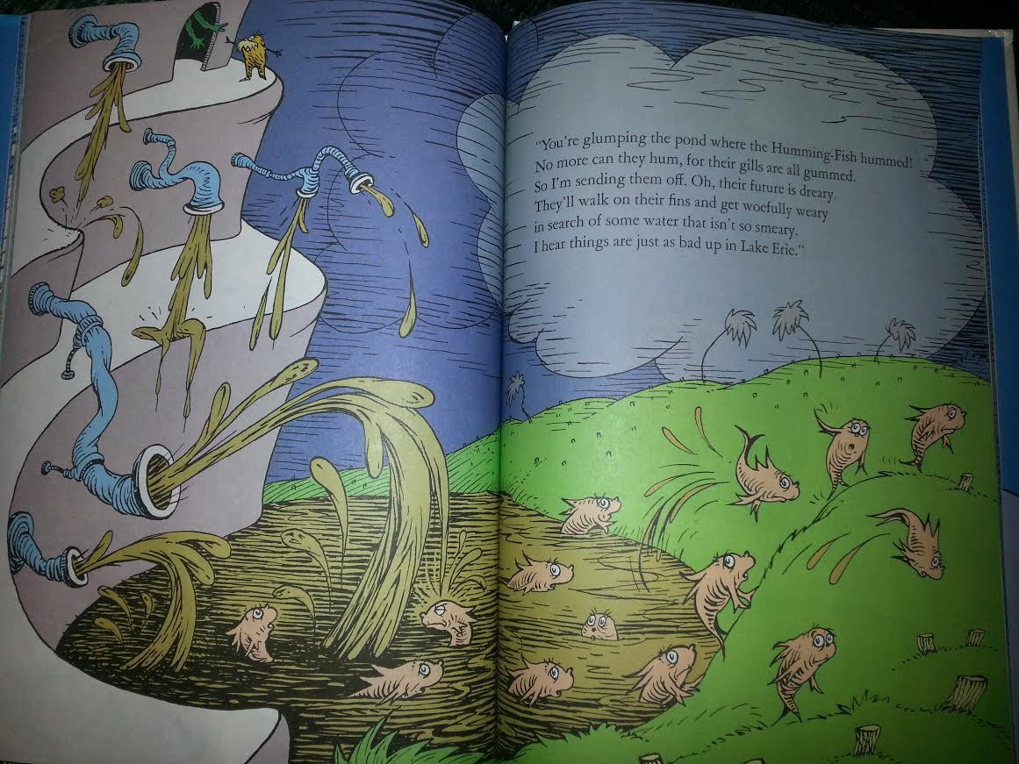
Mission Accomplished !
1986

Slide 5

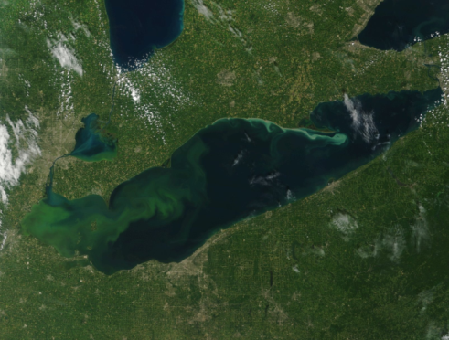
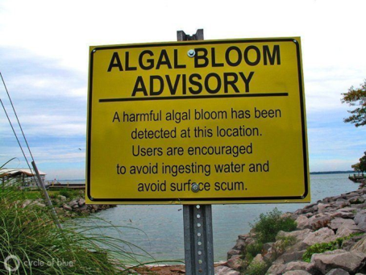
Mission Accomplished !
1986
Image from
8-23-15

Slide 6


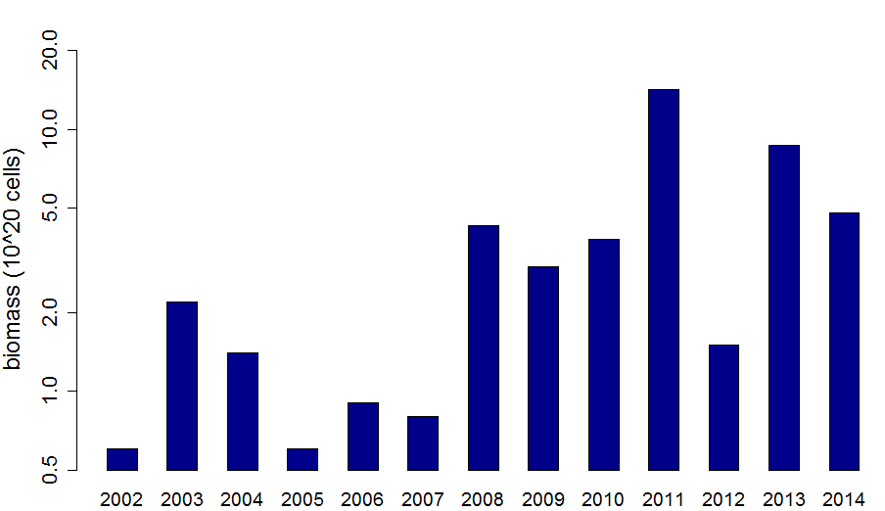
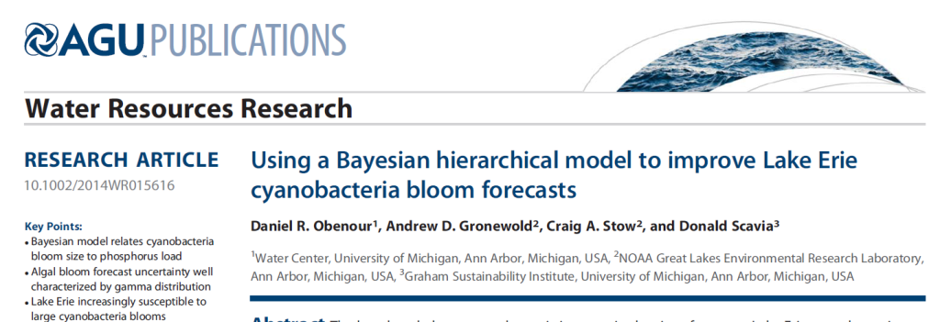
IPEMF | Large Lake Ecosystem Modeling & Prediction
Lake Erie Total Phosphorus Loading, 1967-2011
Target generally met since 1990s
increase in western basin HABs
6/14
Notes:
Data from Dave Dolan, University of Wisconsin Green Bay

Slide 7
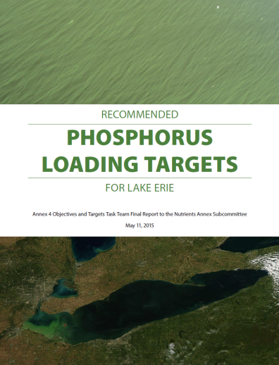
2012 – New GLWQA
IPEMF | Large Lake Ecosystem Modeling & Prediction
Annex 4 - Nutrients
Six Lake Ecosystem Objectives
Update Substance Objectives (target concentrations)
Update Phosphorus Load Targets
Do this for Lake Erie within 3 years (February 2016)
Annex 4 Subcommittee has been meeting regularly since late 2013
Recommended Phosphorus Loading Targets Report - May 2015
Developed using 9 parallel models
7/14

Slide 8
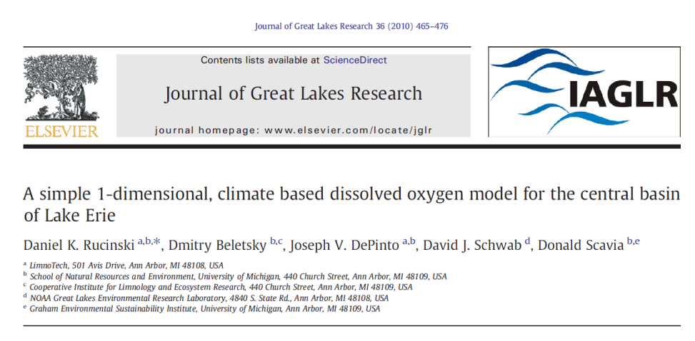
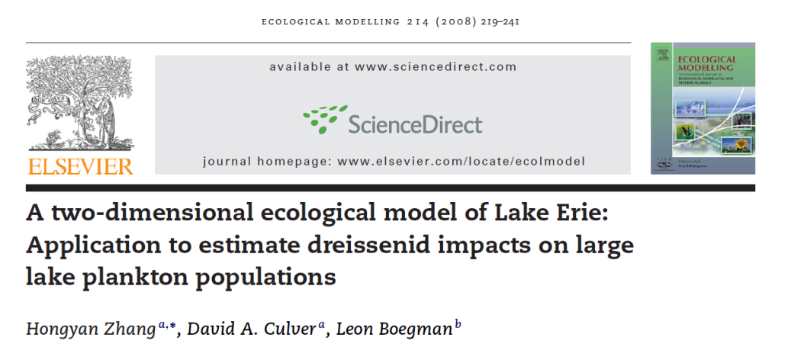
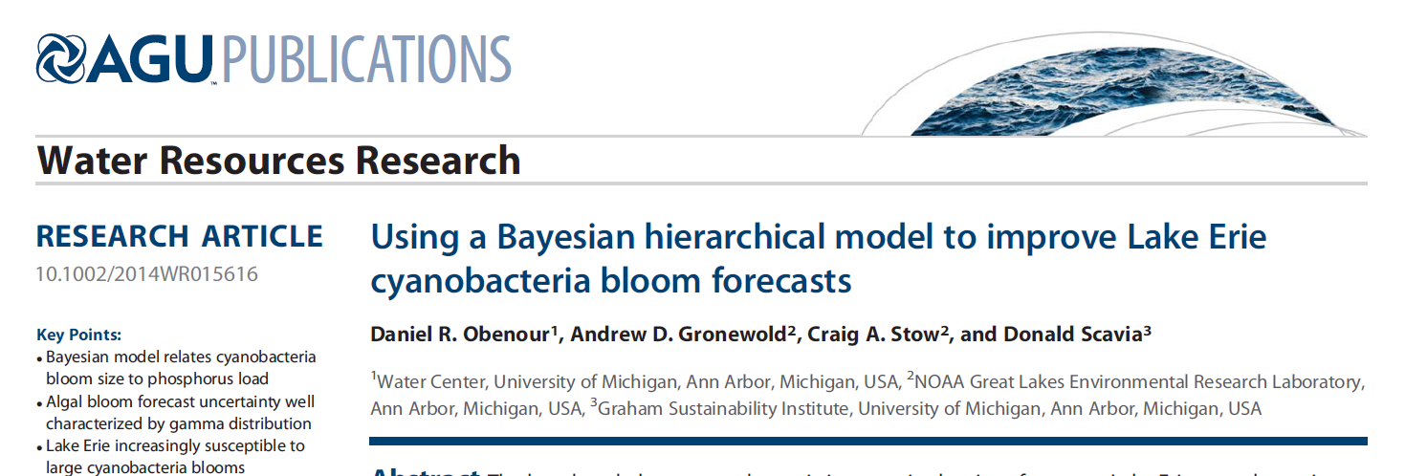
IPEMF | Large Lake Ecosystem Modeling & Prediction
2012 – New GLWQA
8/14

Slide 9

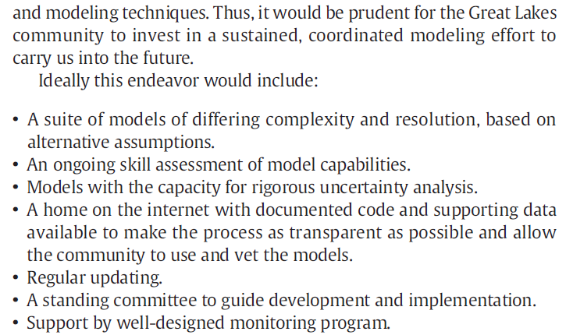
IPEMF | Large Lake Ecosystem Modeling & Prediction
Science Advisory Board – review modeling process - December 2014
Stow (2015). JGLR.
9/14

Slide 10
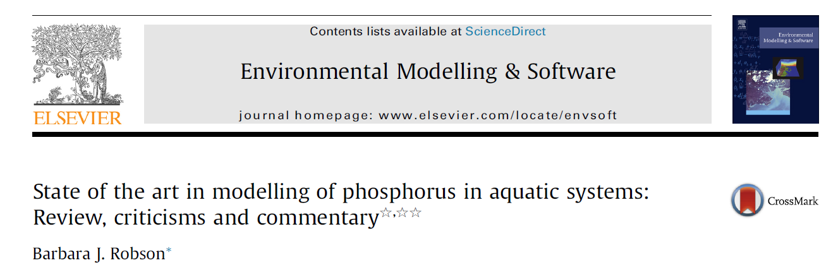
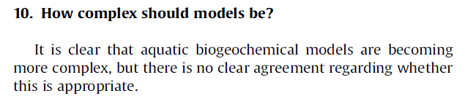
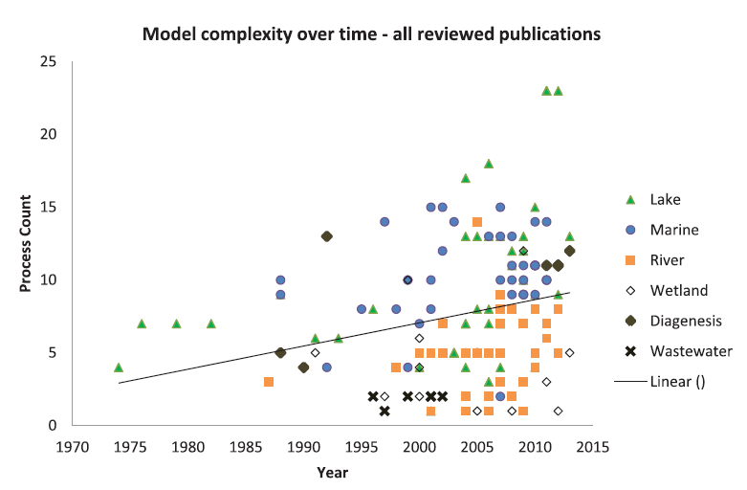
IPEMF | Large Lake Ecosystem Modeling & Prediction
Greater model complexity = greater predictive accuracy?
Results equivocal
As a community we are not very good about assessing, reporting accuracy/reliability
10/14

Slide 11


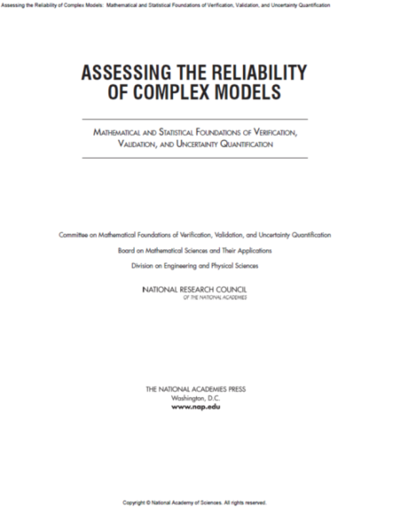
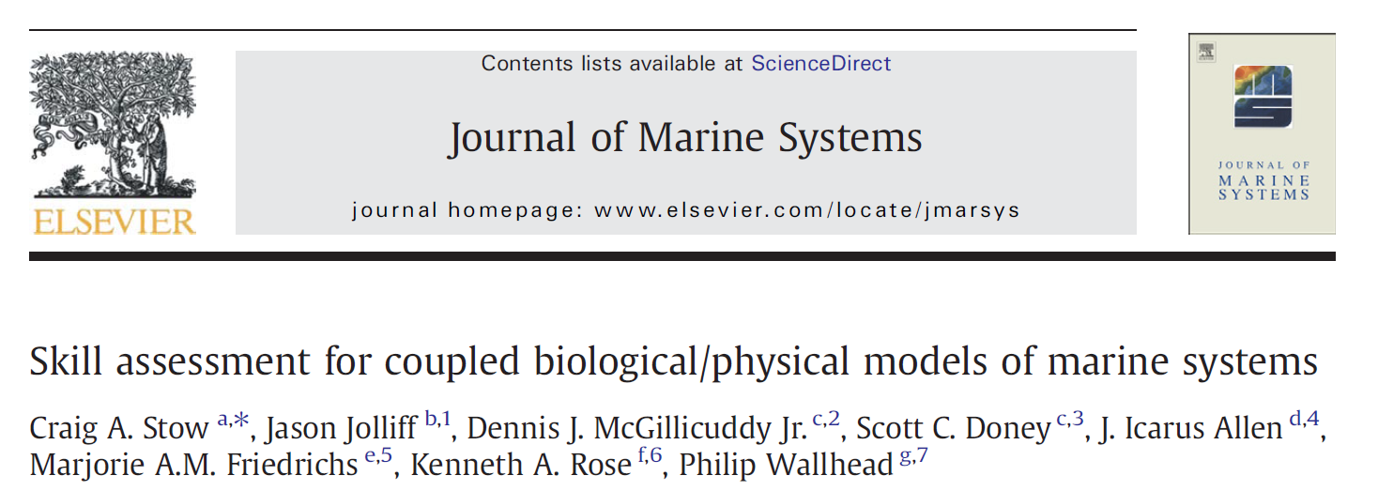
IPEMF | Large Lake Ecosystem Modeling & Prediction
Future Directions
Develop, test models of differing complexity, evaluate relative performance
11/14

Slide 12
IPEMF | Large Lake Ecosystem Modeling & Prediction
It is not appropriate to ask whether a model is right or wrong.
Instead we should ask:
What is its domain of utility?
12/14

Slide 13
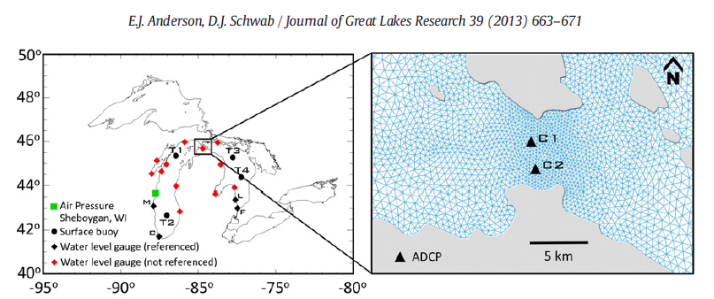
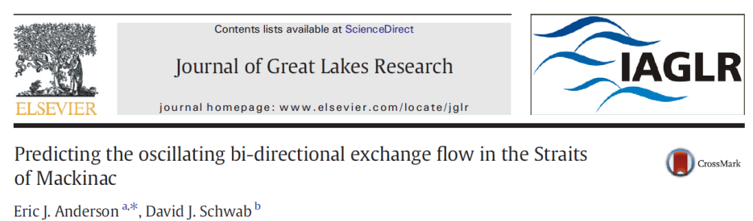
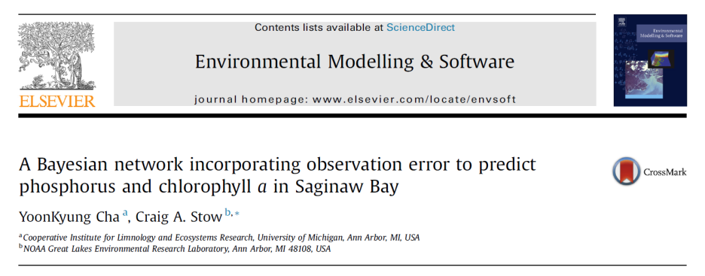
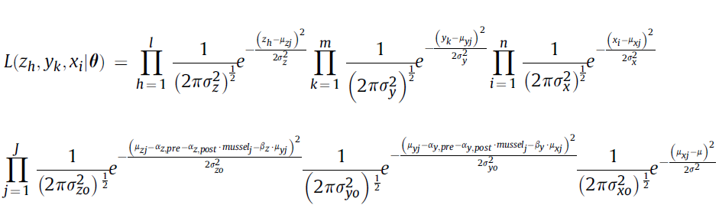
IPEMF | Large Lake Ecosystem Modeling & Prediction
GLERL has expertise in fine-scale, simulation modeling:
and contemporary, probabilistic approaches:
Clear implications for developing models for transition to operations
Draws on strengths (Modeling, Observations, Process Research)
Supports our HABs program
Serve a long-term need in the Great Lakes community
Partners Essential – Federal, State, Provincial Agencies, Academia
13/14

Slide 14
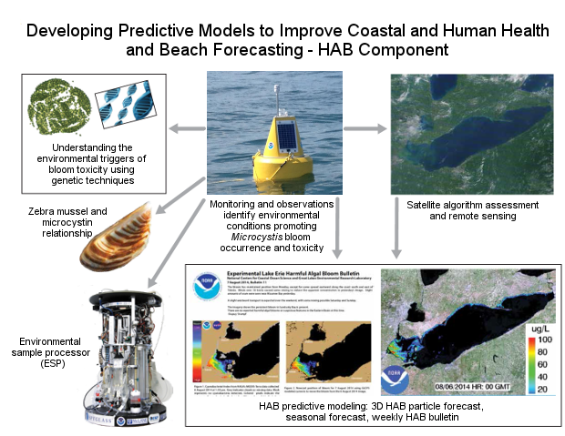
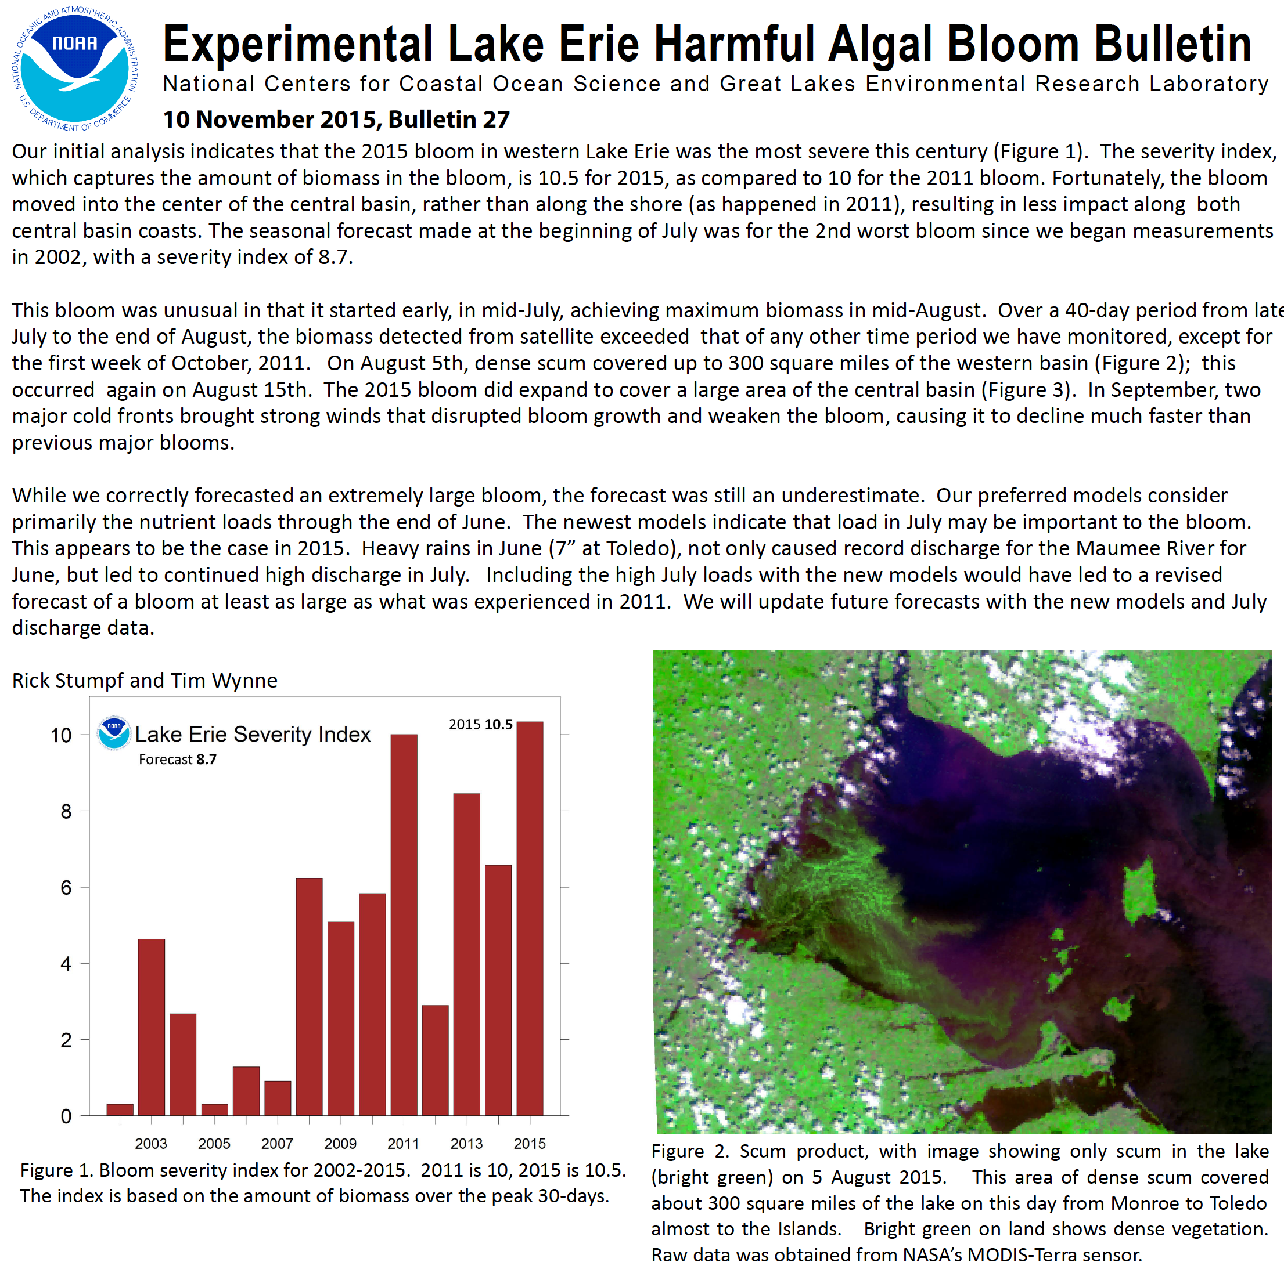
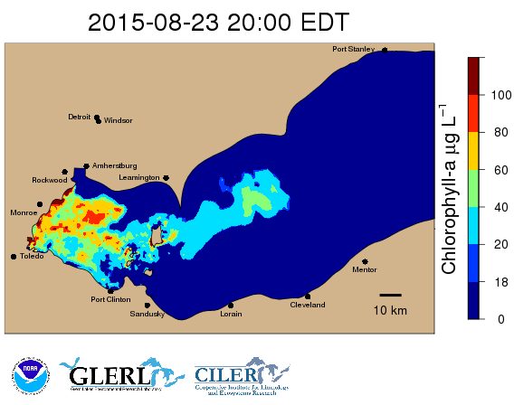
IPEMF | Large Lake Ecosystem Modeling & Prediction
An integrated approach to studying HABs
Notes:
Overarching research statement:
Understanding the drivers of bloom ecology will aid in enhancing predictive models that forecast bloom size, location AND toxicity

Slide 15
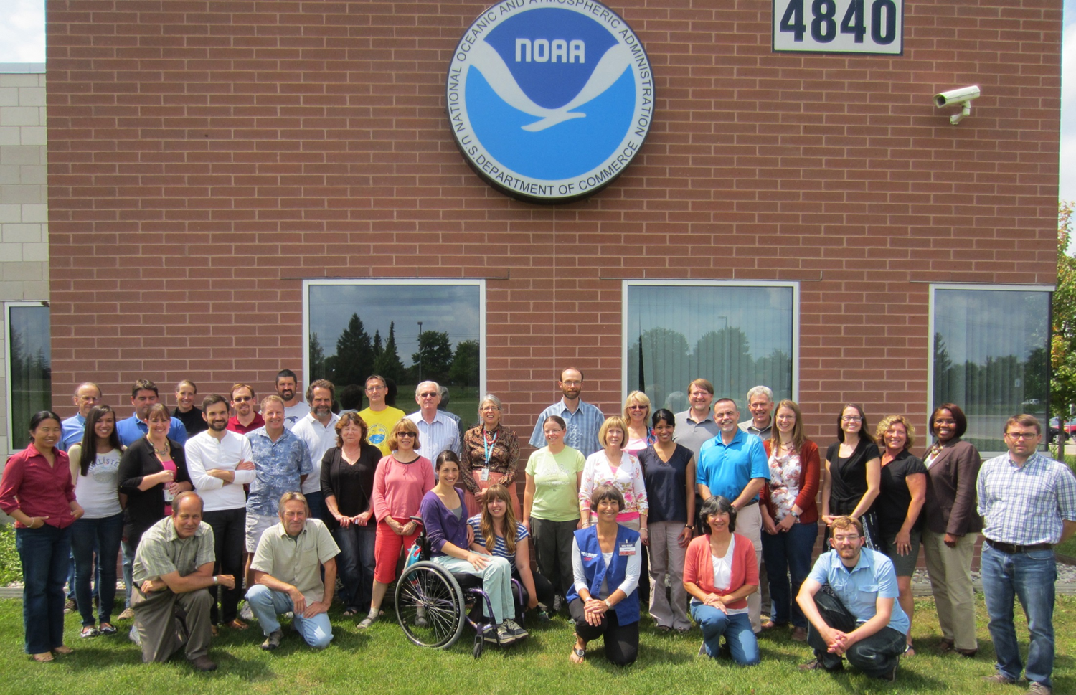
IPEMF | Large Lake Ecosystem Modeling & Prediction
^
Phosphorus
Thank You
Questions?
Place Photo Here
14/14

