Slide 1
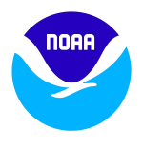
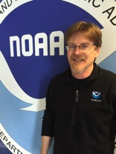
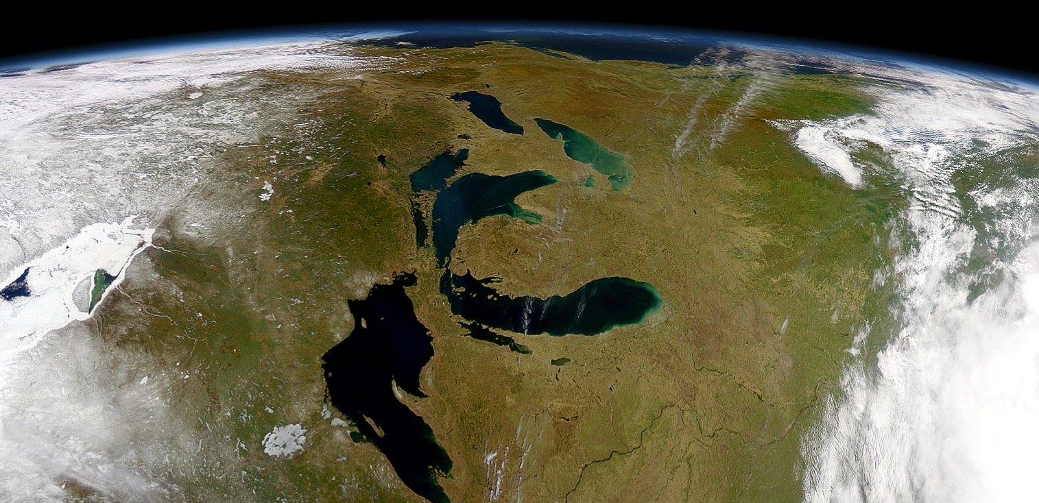
Observation Systems and Advanced Technology (OSAT) Overview
Steve Ruberg
Observing Systems & Advanced Technology
Place Photo Here
“NOAA’s global observing systems are the foundation of the environmental intelligence we provide.”¹
– Dr. Kathryn Sullivan, Under Secretary of Commerce for Oceans and Atmosphere and NOAA Administrator
1/10
Notes:
¹ NOAA News article entitled, “Statement from Dr. Kathryn Sullivan on NOAA’s Fiscal Year 2016 Budget Request”, February 3, 2015.
The work of the OSAT team aligns with the following NOAA Goals (www.ppi.noaa.gov/goals):
Science: Climate Adaptation and Mitigation
Improved scientific understanding of the changing climate system and its impacts
Science: Weather-Ready Nation
Reduced loss of life, property, and disruption from high-impact events
Improve freshwater resource management
Improve transportation efficiency and safety
Healthy people and communities due to improved air and water quality services
A more productive and efficient economy through information relevant to key sectors of the U.S. economy
Science: Healthy Oceans
Improved understanding of ecosystems to inform resource management decisions
Science: Resilient Coastal Communities and Economies
Resilient coastal communities that can adapt to the impacts of hazards and climate change
Safe, efficient and environmentally sound marine transportation
Improved coastal water quality supporting human health and coastal ecosystem services
Education: Science-Informed Society
Youth and adults from all backgrounds improve their understanding of NOAA-related sciences by participating in education and outreach opportunities
Formal and informal educators integrate NOAA-related sciences into their curricula, practices, and programs
Formal and informal education organizations integrate NOAA-related science content and collaborate with NOAA scientists on the development of exhibits, media, materials, and programs that support NOAA’s mission
Education: Safety and Preparedness
Youth and adults from all backgrounds are aware of, prepare for, and appropriately respond to environmental hazards that impact health, safety, and the economy in their communities
Formal and informal educators use and produce education materials and programs that integrate and promote consistent science-based messaging on hazards, impacts, and societal challenges related to water, weather, and climate
Formal and informal education institutions integrate water, weather, and climate hazard awareness, preparedness, and response information into curricula, exhibits, and programs that create learning opportunities for youth and adults

Slide 2
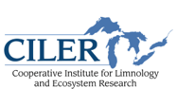
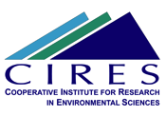
OSAT | Overview
OSAT Teams
Remote Sensing
George Leshkevich¹
Songzhi Liu²
Andrea VanderWoude²
Vessel Operations
Dennis Donahue¹
Steve Bawks⁵
Beau Braymer⁵
Dan Burlingame⁵
Bob Harvey⁵
Jack Workman¹
Andrew Yagiela¹
Marine Instrumentation Lab (MIL)
Ron Muzzi¹
Kyle Beadle¹
Steve Constant¹
Russ Miller²
Terry Miller¹
Synthesis Observations and Response (SOAR)
Steve Ruberg¹, Tom Johengen²
Eric Anderson ¹
Ashley Burtner²
Jim Churnside⁶
Tim Davis¹
Sonia Joseph-Joshi²
George Leshkevich¹
Brandi McCarty⁵
Russ Miller²
Dan Obenour³
Danna Palladino²
Heidi Purcell²
Mike Sayers⁴
Bob Shuchman⁴
Craig Stow¹
Dack Stuart²
Andrea Vander Woude²
2/5
Notes:
NOAA Great Lakes Environmental Research Lab
Cooperative Institute for Limnology and Ecosystems Research
University of Michigan Water Center
Michigan Tech Research Institute
NOAA Contractor
Cooperative Institute for research in Environmental Sciences
NOAA Earth Systems Research Laboratory

Slide 3
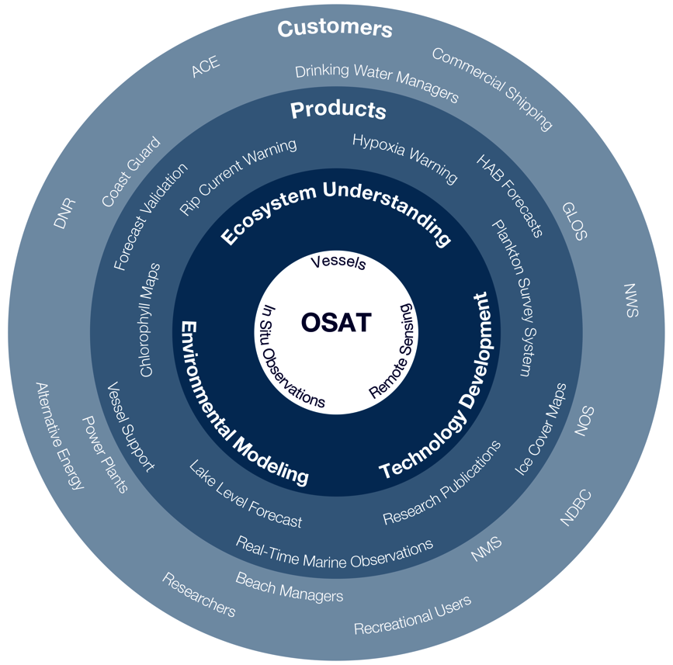
OSAT | Overview
The OSAT Perspective
3/5

Slide 4
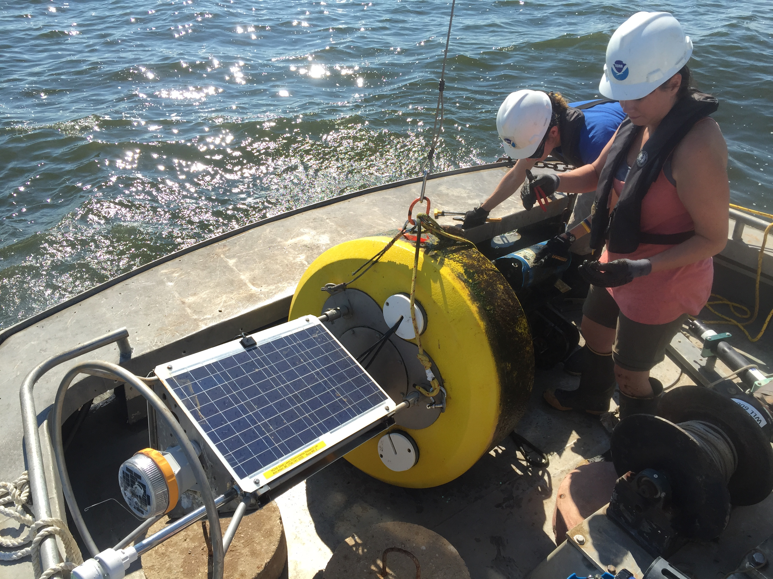
OSAT | Overview
OSAT Guiding Principles from the 2016 – 2020 GLERL Strategic Plan
Through the development of cutting-edge instrumentation, observing, and remote sensing technologies, OSAT team members acquire the data and develop information products needed to improve understanding of the Great Lakes and coastal ecosystems and support decision-making for resource managers and other stakeholders.
Guiding Principles
Enhance environmental intelligence and situational awareness
Develop technology to better observe the ecosystem
Transition technology into operation and application
Create freshwater remote sensing algorithms
Provide observational infrastructure for EcoDyn and IPEMF (e.g., boats, buoys, instrumentation)
4/5

Slide 5
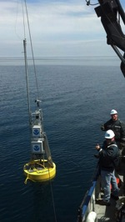
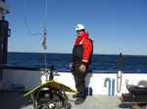
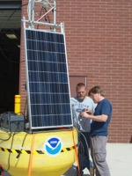
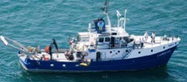
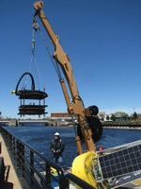
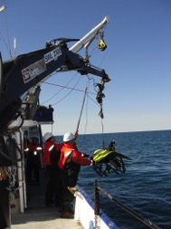
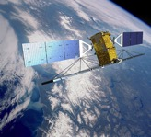
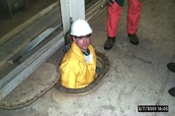
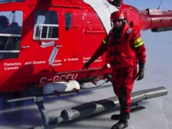
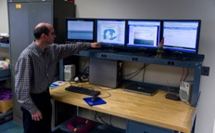
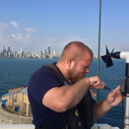
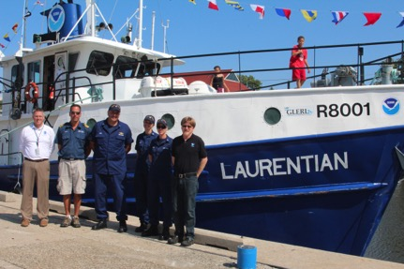
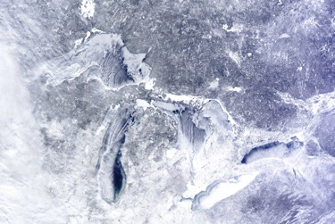
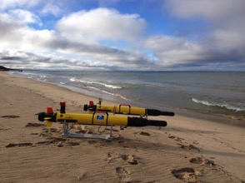
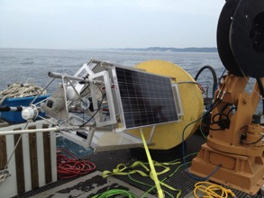
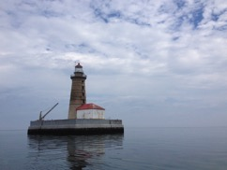
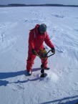
OSAT | Overview
OSAT Goals from the 2016-2020 GLERL Strategic Plan:
Expanded use and application of technology to enhance remote sensing capacity to assess ecosystem impacts and for use in modeling and operations (e.g. VIIRS, Sentinel 3, CubeSat)
Improved in situ observational capacity to track trends and determine change over time (e.g., nutrient and hypoxia monitoring).
Observational infrastructure (e.g., instrumentation and equipment, mobile and fixed platforms, and data management) provides reliability and flexibility needed for innovation on a long-term basis.
Operational capacity that supports current research requirements and anticipates future scientific direction.
2/10

