Slide 1
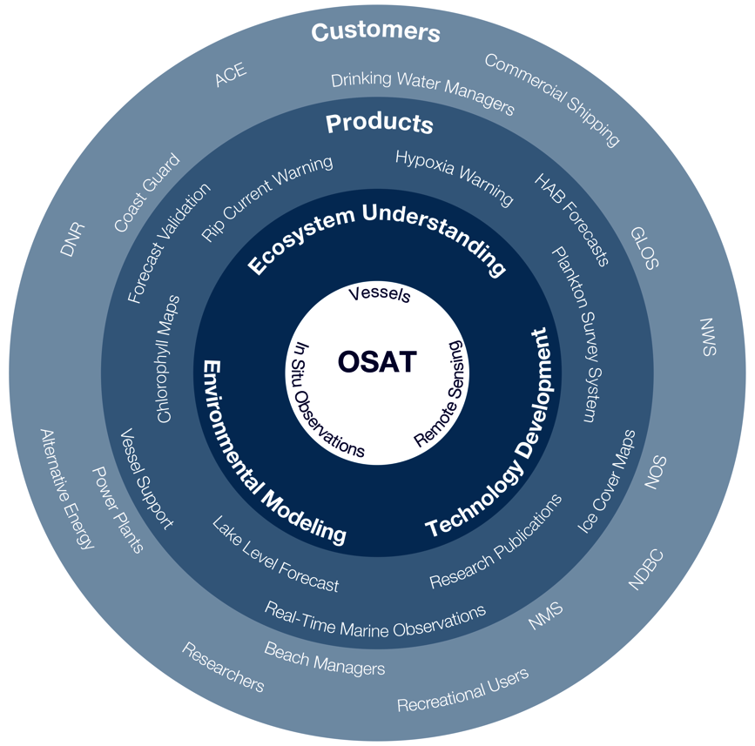
Observing Systems & Advanced Technology (OSAT)
Question & Answer Session
1/4

Slide 2
OSAT | Q&A
OSAT Take Home Messages
GLERL vessels provide one-NOAA Great Lakes vessel support
full-service vessel operations and maintenance facility
Remote sensing and coastal observations research and
development has:
resulted in R2X successes and laid the foundation for year-round observations
significantly increased environmental awareness
developed Great Lakes Water Quality Agreement adaptive management monitoring capacity
partnered with universities, industry and Great Lakes Observing System to deploy a coastal buoy network
2/4

Slide 3
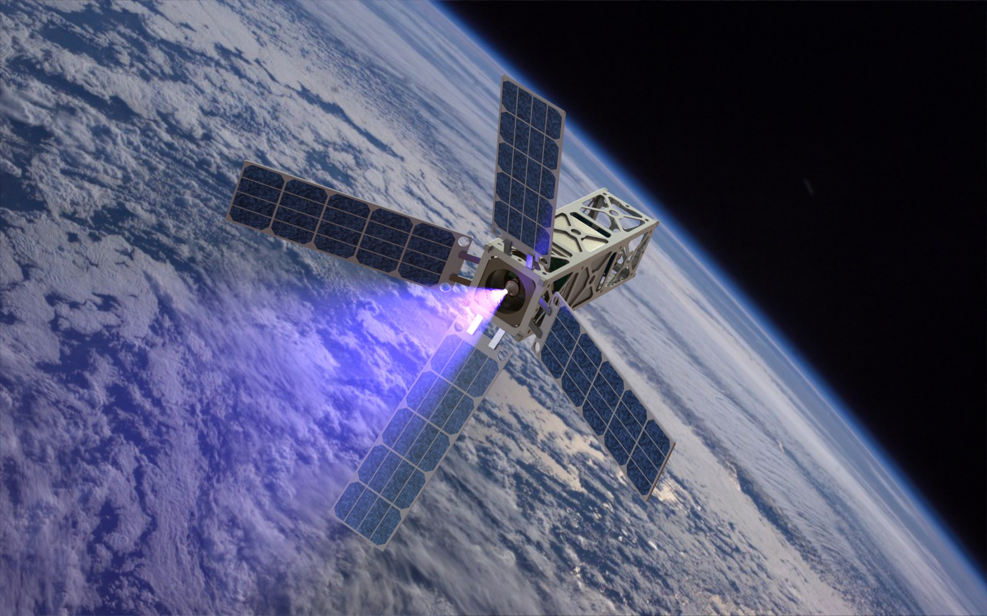
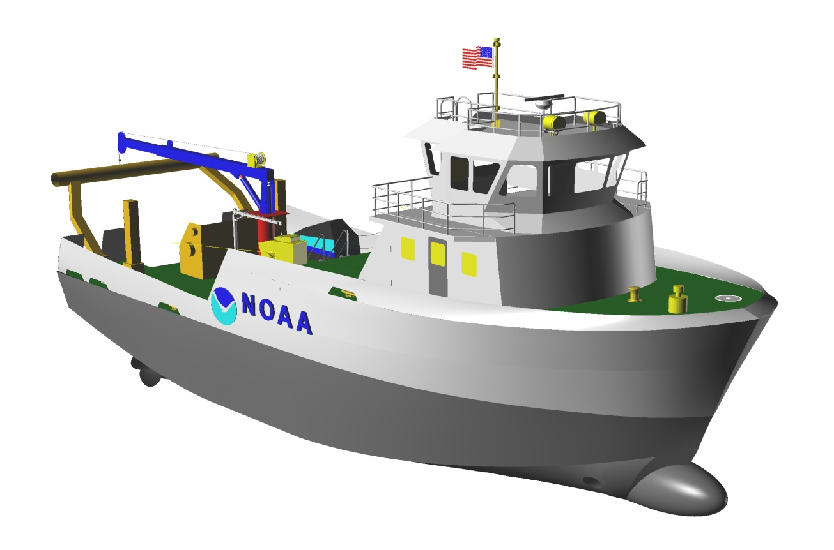
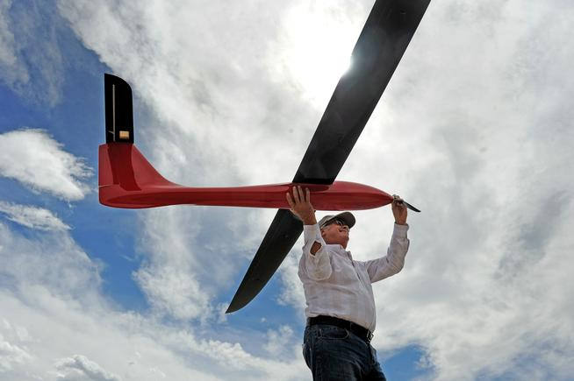
OSAT | Q&A
OSAT Theme Challenges / Future Plans
Organize NOAA Regional vessel requirements and create a comprehensive and sustainable management plan
Consolidate NOAA support for a new Regional Research Vessel
Develop techniques to collect real-time, year-round, under-ice observations using ReCON technology coupled with persistent autonomous vehicles.
Develop unmanned air systems for HAB detection, mapping, classification
Initiate discussion with NASA Glenn (Cleveland OH) on CubeSat Hyperspectral sensor
Develop and evaluate satellite derived products for the Great Lakes region including ice thickness and soil moisture
Develop a Decision Support Tool using database of CoastWatch and other geophysical data
2/3
3/4
Notes:
Proposal submitted to the Great Lakes Observing System Regional Association for real-time, year-round observing stations in four Great Lakes locations, August 7, 2015.
Unmanned aerial systems (UAS) proposal HABs detection and mapping submitted to NOAA UAS Program Office, February 24, 2016.

Slide 4
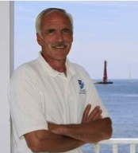
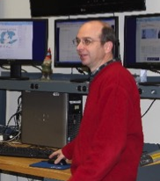
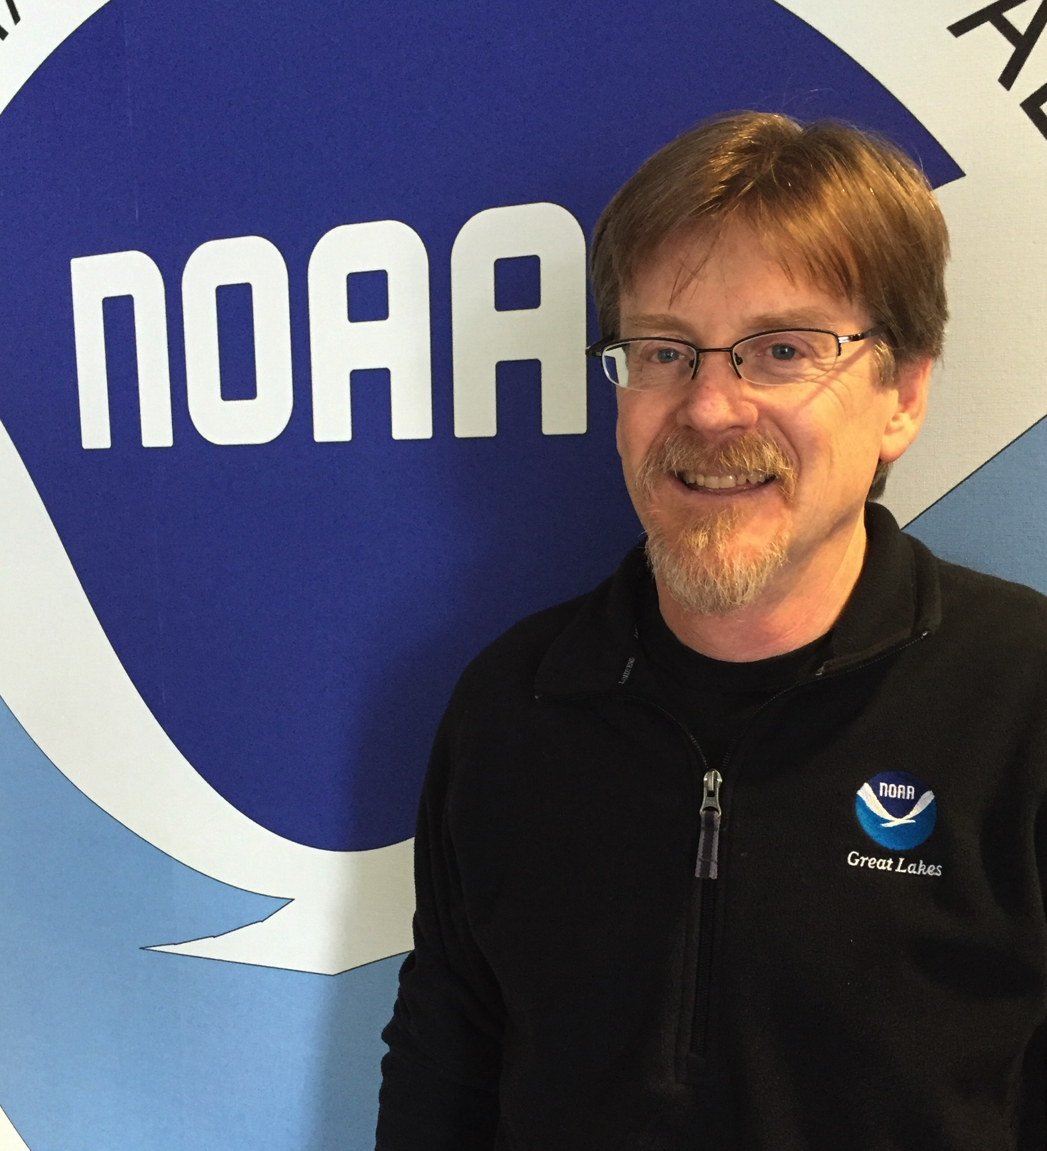
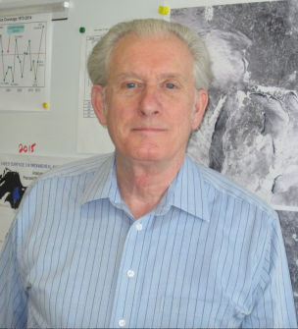
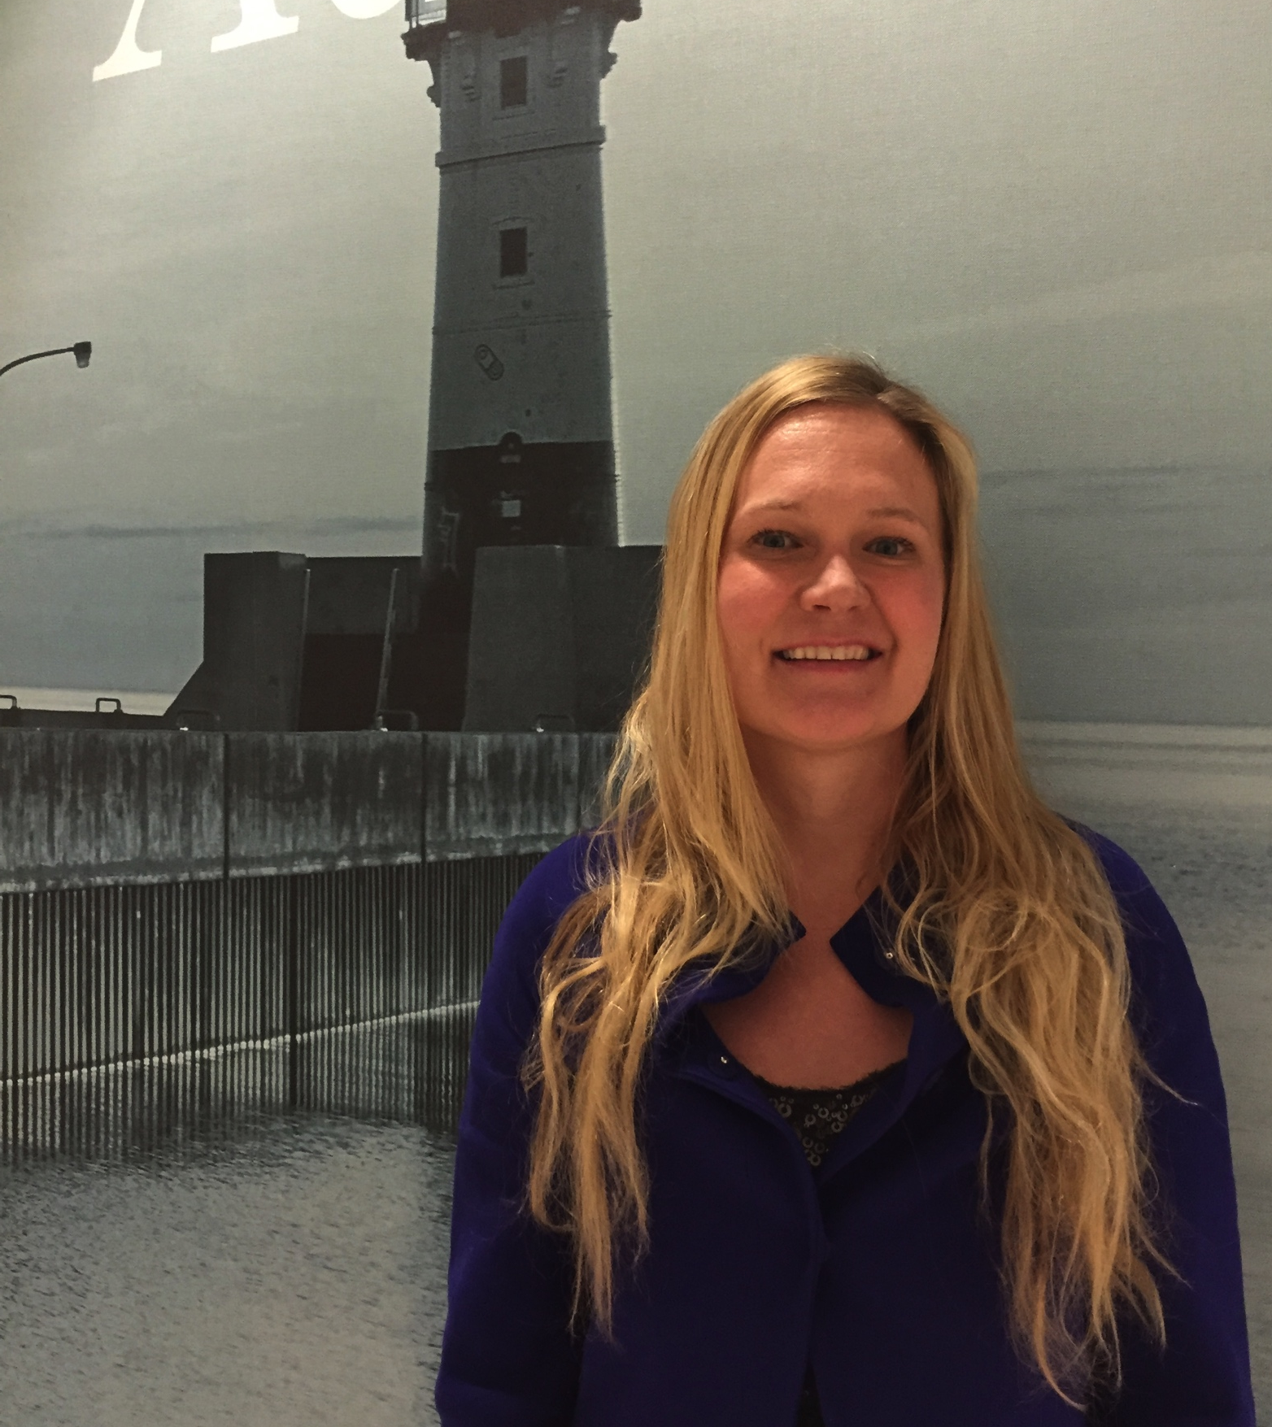
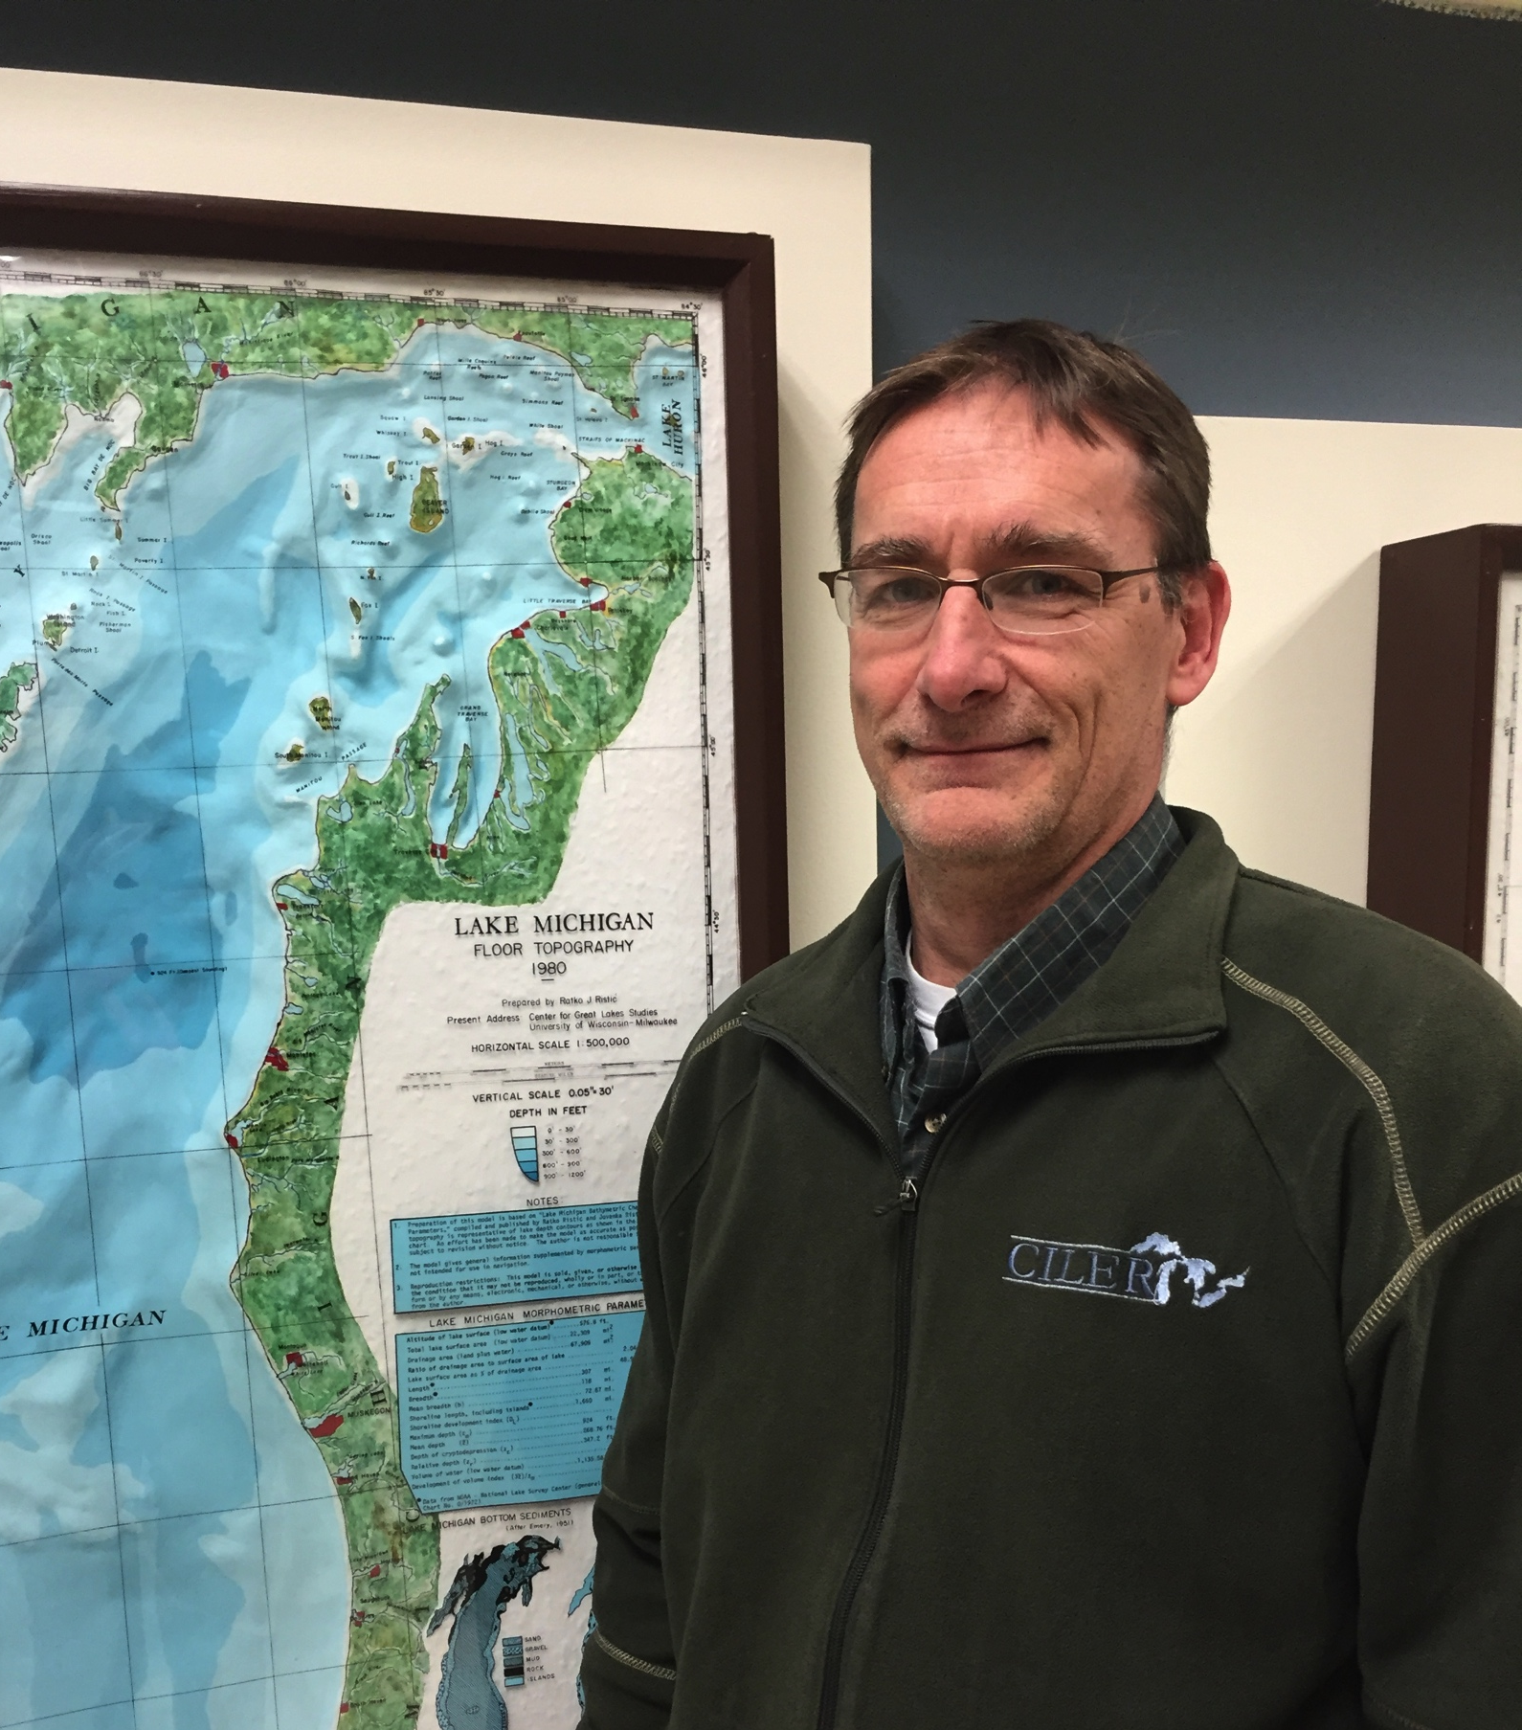
OSAT | Q&A
Questions for the OSAT Team?
Dennis Donahue
Great Lakes Field Stations and Vessels
Steve Ruberg (Theme Lead) Observing Systems Research and Technology Transition
Ron Muzzi
Observing System Data Acquisition & Data Management
George Leshkevich CoastWatch Satellite Research and Product Development
Andrea
Vander Woude Hyperspectral Airborne and Hand-held Sensors on Lake Erie
Tom Johengen Mobile and Buoy Monitoring Technologies
4/4

