Slide 1
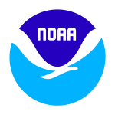
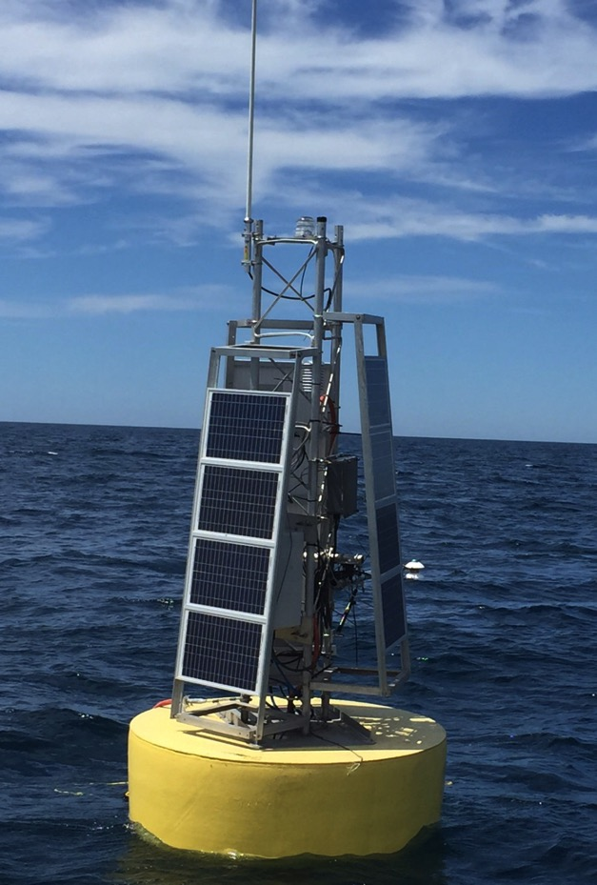
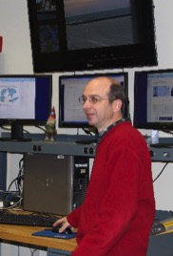
Observing System
Data Acquisition &
Data Management
Ron Muzzi, Electronics Engineer
OSAT - Marine Instrumentation Lab (MIL)
“NOAA’s global observing systems are the foundation of the environmental intelligence we provide.”
– Dr. Kathryn Sullivan, Under Secretary of Commerce for Oceans and Atmosphere and NOAA Administrator
1/13
Notes:
Photo: ReCON buoy in Lake Michigan, 7/29/2015 (All photos are NOAA photos, unless specified otherwise)
This work aligns with the following NOAA Goals:
Science: Climate Adaptation and Mitigation
Improved scientific understanding of the changing climate system and its impacts
Science: Weather-Ready Nation
Reduced loss of life, property, and disruption from high-impact events
Improve freshwater resource management
Improve transportation efficiency and safety
Healthy people and communities due to improved air and water quality services
A more productive and efficient economy through information relevant to key sectors of the U.S. economy
Science: Healthy Oceans
Improved understanding of ecosystems to inform resource management decisions
Recovered and healthy marine and coastal species
Healthy habitats that sustain resilient and thriving marine resources and communities
Sustainable fisheries and safe seafood for healthy populations and vibrant communities
Science: Resilient Coastal Communities and Economies
Resilient coastal communities that can adapt to the impacts of hazards and climate change
Comprehensive ocean and coastal planning and management
Safe, efficient and environmentally sound marine transportation
Improved coastal water quality supporting human health and coastal ecosystem services
Education: Science-Informed Society
Formal and informal educators integrate NOAA-related sciences into their curricula, practices, and programs
Education: Safety and Preparedness
Youth and adults from all backgrounds are aware of, prepare for, and appropriately respond to environmental hazards that impact health, safety, and the economy in their communities

Slide 2
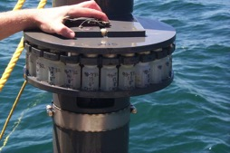
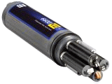
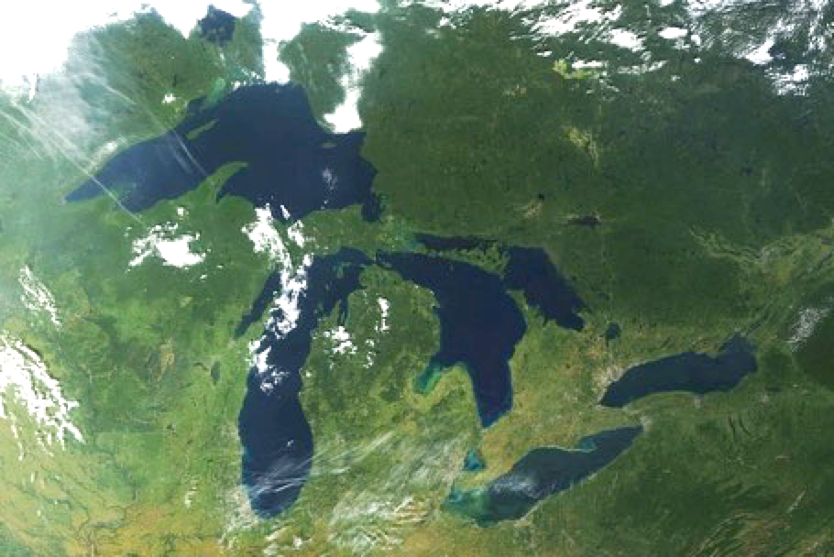
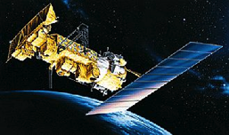
OSAT | Observing System Data Acquisition & Data Management
Converting real world observations to data:
Sample Collection
remove from environment
Observations
Data
+ Location & Time
Sensor
measure in environment
?
Remote Sensing
measure at distance
from environment
2/13
Notes:
We’re on the “front line” collecting the data from the Great Lakes
We’ll focus on sensors, remote sensing will come in a later presentation

Slide 3
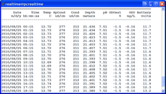
OSAT | Observing System Data Acquisition & Data Management
Managing Data
System
Management
Feedback
Data
Observations
Data
Processing,
QA/QC,
Data Archive
PostgreSQL
database*
GLERL &
Partners
Data Centers:
NDBC, GLOS
AWIPS
NOAAPORT
THREDDS
?
General
Public
3/13
Notes:
Data Observations – data collected from ReCON (Real-time Coastal Observation Network), moored instrumentation, etc.
Data Processing:
Quality control implemented through NDBC (National Data Buoy Center) protocols
Approved quality assurance plan for GLRI (Great Lakes Restoration Initiative) projects
Database Management:
The OSAT team is updating our database to a PostgreSQL database for rapid storage and retrieval of real-time Great Lakes monitoring data. This will permit researchers to query the database for specific data, and allow the lab to produce publicly accessible websites with the data that are more responsive and efficient than the prior database.
GLERL & Partners – includes PI’s (Principal Investigators), scientists, and institutions such as NWS (National Weather Service)
Data Centers – includes NDBC (National Data Buoy Center) and GLOS (Great Lakes Observing System); provides public real-time data access in the following formats:
AWIPS (Advanced Weather Interactive Processing System) – internet dissemination
NOAAPORT – Satellite dissemination
THREDDS (Thematic Realtime Environmental Distributed Data Services) – data and metadata database access from software
Web pages – general access from browsers

Slide 4
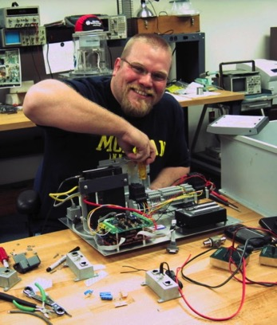
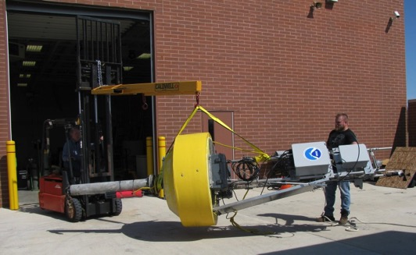
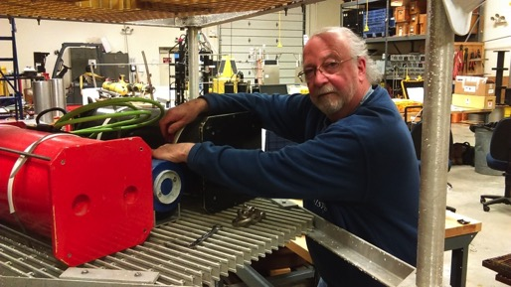
OSAT | Observing System Data Acquisition & Data Management
Getting the Data: Marine Instrumentation Lab (MIL)
• Expertise developed in-house through growing experience and long-term commitment
• MIL Capabilities:
- Electronic & Mechanical Design
- Software Development
- Electronic/electrical construction
- Mechanical construction & assembly
- Prototype development
- Testing, diagnostics, & calibration
- Mooring design & fabrication
- System assembly (buoys, platforms, etc.)
- Handling and storage.
4/13
Notes:
The MIL area can be viewed after the demonstration in the High Bay area following the morning presentations.
The priorities of the MIL team are to:
- Develop and prototype new and cutting-edge in-situ data collection techniques.
- Develop techniques to collect data year-round in the Great Lakes, including under-ice observations.
- Improve the efficiency of in-situ data collection.
- Improve the collection of real-time data for use by GLERL and its partners.

Slide 5
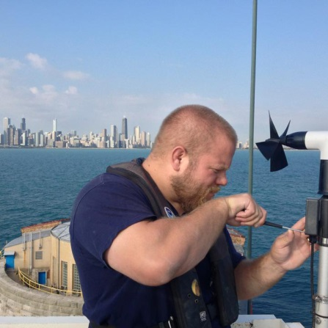
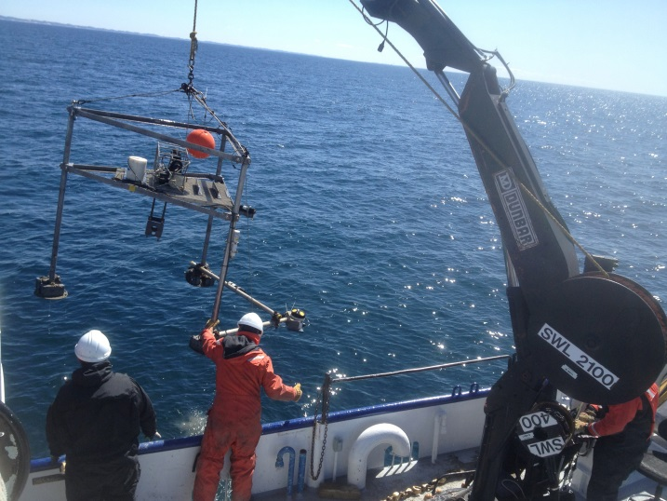
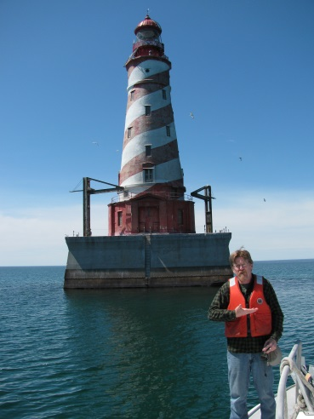
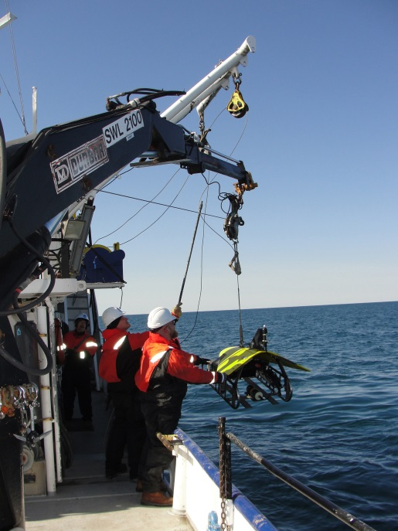
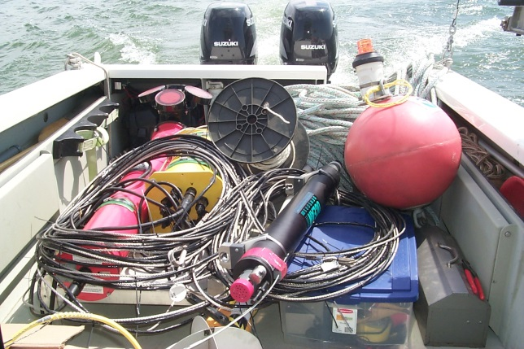
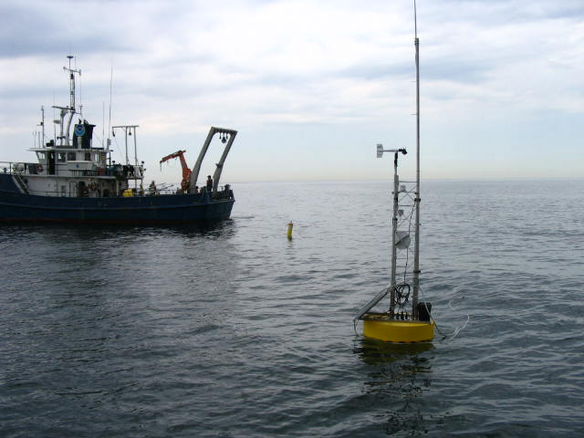
OSAT | Observing System Data Acquisition & Data Management
Working in the Field
Work on Sensors on Navigational Structures
Deploy & Retrieve Moorings
Work from
Small Boats
Deploy & Retrieve Buoys
Work with Towed Vehicles,
e.g. PSS
- Full Access to Lakes, Buoys, Structures & Coastal Sites
- Collaborate with Coast Guard, Corp of Engineers, Historical Societies, Public & Private Parties
5/13
Notes:
PSS = Plankton Survey System
Photos by GLERL:
Top Left – Tripod deployment in Lake Michigan off Muskegon
Bottom Left – ReCON buoy deployment in Lake Erie north of Cleveland
Left of Center – Towing the Plankton Survey System in Lake Michigan
Right of Center – White Shoal Light in northern Lake Michigan
Top Right – MET station maintenance on Chicago water intake crib
Lower Right – Deployment of ReCON underwater hub in Lake Erie north of Cleveland from small boat

Slide 6
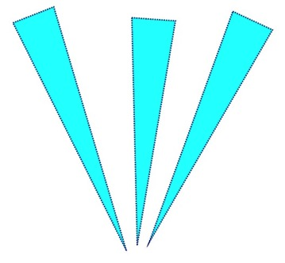
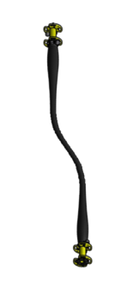
OSAT | Observing System Data Acquisition & Data Management
ReCON: Realtime Coastal Observation Network
• Advanced data collection platform from buoys, underwater hubs, fixed structures, and coastal locations
• Buoys operate seasonally,
fixed platforms operate year round
• Primarily powered by solar
(wind or A/C when available)
• Embedded Linux platform for data processing, control, and diagnostics
• Sensors: MET, air/water quality, radiation, acoustic, image/video
• Guest ports allow platform use by others
• Multiple communications options provides high bandwidth, real-time data from seafloor back to lab
ReCON Buoy
MET and
Surface
Sensors
Shore Base
Communications
Winched
Profiler
In-Situ Sensors
(0-60+ m)
Acoustic Sensors:
Waves, Currents, Fish
Flex Hose
Communications,
Power & Mooring
Sensors
(near bottom)
Winch
Motor
Underwater Hub
Anchor
6/13
Notes:
High bandwidth communications to lake floor:
- Allows real-time acoustics, video, and other high bandwidth data sensors
- Full power to lake floor systems
Communications options include private WiFi (for high bandwidth coastal applications), cell phone modem (low bandwidth coastal applications), or Iridium satellite (non-coastal sites)
MET = meteorological sensors, such as wind speed/direction, air temperature, relative humidity, dew point, rain

Slide 7
OSAT | Observing System Data Acquisition & Data Management
ReCON: Realtime Coastal Observation Network
• Developed with ideas adapted from:
- LISICOS (Long Island Sound)
- Martha’s Vineyard Coastal Observatory
- NEPTUNE (Vancouver Island, Canada)
- MARS (Monterey, California)
ReCON Buoy
MET and
Surface
Sensors
Shore Base
Communications
• Developed in partnership with:
- CILER
- Lake Erie Center, U of Toledo
- Thunder Bay NMS
- U.S. Coast Guard 9th District
• Experimented with adopting the MBARI SIAM system for platform data collection standard
Winched
Profiler
In-Situ Sensors
(0-60+ m)
Acoustic Sensors:
Waves, Currents, Fish
Flex Hose
Communications,
Power & Mooring
• Actively working on the development of cabled observatories for winter (under ice) measurements
Sensors
(near bottom)
Winch
Motor
Underwater Hub
Anchor
7/13
Notes:
Developed with Ideas from:
Austin, T. C., J. B. Edson, W. R. McGillis, M. Purcell, R. A. Petitt, M. K. McElroy, C. W. Grant, J. Ware, and S. K. Hurst. 2002. A network-based telemetry architecture developed for the Martha's Vineyard Coastal Observatory. IEEE J. Ocean. Eng. 27: 228-234. 10.1109/joe.2002.1002477
Observatories:
LISICOS (Long Island Sound Integrated Coastal Observing System) is operated by the University of Connecticut, Department of Marine Sciences
Martha’s Vineyard Coastal Observatory is operated by WHOI (Woods Hole Oceanographic Institute)
NEPTUNE (North East Pacific Time-series Undersea Networked Experiments) is located off Vancouver Island, Canada and was developed by the University of Victoria
MARS (Monterey Accelerated Research System) is located off Monterey, California, and is operated by MBARI (Monterey Bay Aquarium Research Institute)
Partnership List:
- CILER (Cooperative Institute for Limnology and Ecosystems Research)
- Lake Erie Center, University of Toledo
- Thunder Bay National Marine Sanctuaries & Underwater Preserve
- U.S. Coast Guard 9th District
- Great Lakes Water Institute, University of Wisconsin/Milwaukee, School of Freshwater Sciences
- ICON (Integrated Coral Observing Network), NOAA
- NASA Glenn Research Center
- NOAA High Performance Computing Center
- Ohio Supercomputer Center, Ohio State University
- Pier Wisconsin
- SEAKEYS (Sustained Ecological Research of the Florida Keys), Keys Marine Lab, Florida Institute of Oceanography
Sensor Management:
- MBARI (Monterey Bay Aquarium Research Institute) SIAM (Software Infrastructure and Applications for Monterey Ocean Observing System):
SIAM “consists of middleware and applications designed to enable automated platform configuration and data collection on sensor networks. SIAM has components to do data collection, archiving and telemetry.”
quoted from SIAM web page, www.mbari.org/products/research-software/siam-documentation/
- SIAM supports the PUCK protocol (also developed by MBARI):
The PUCK protocol is basically a plug-and-play protocol to integrate sensors into on observation system.
“Managing sensor network configuration and metadata in Ocean Observatories using instrument pucks.” Third International Workshop on Scientific Use of Submarine Cables and Related Technologies, 25-27 June 2003

Slide 8
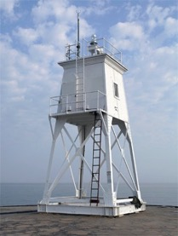
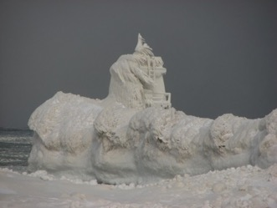
OSAT | Observing System Data Acquisition & Data Management
ReCON: Realtime Coastal Observation Network
• Developed with ideas adapted from:
- LISICOS (Long Island Sound)
- Martha’s Vineyard Coastal Observatory
- NEPTUNE (Vancouver Island, Canada)
- MARS (Monterey, California)
• Developed in partnership with:
- CILER
- Lake Erie Center, U of Toledo
- Thunder Bay NMS
- U.S. Coast Guard 9th District
• Experimented with adopting the MBARI SIAM system for platform data collection standard
Winched
Profiler
In-Situ Sensors
(0-60+ m)
Grand Marais Outer Light
Acoustic Sensors:
Waves, Currents, Fish
Cabled
Communications
& Power
• Actively working on the development of cabled observatories for winter (under ice) measurements
Sensors
(near bottom)
Winch
Motor
Underwater Hub
8/13
Notes:
Some cabled observatory experience with cable laying & long distance DSL/power applications
Challenges include the land/water interface especially in ice conditions
Examples of Published Papers about ReCON Network:
RUBERG, S.A., E. Guasp, N. HAWLEY, R.W. MUZZI, S.B. BRANDT, H.A. VANDERPLOEG, J.C. LANE, T.C. MILLER, and S.A. CONSTANT. Societal benefits of the real-time coastal observation network (ReCON): Implications for municipal drinking water quality. Marine Technology Society Journal 42(3):103-109 (2008). http://www.glerl.noaa.gov/pubs/fulltext/2008/20080057.pdf
RUBERG, S.A., S.B. BRANDT, R.W. MUZZI, N. HAWLEY, T. Bridgeman, G.A. LESHKEVICH, J.C. LANE, and T.C. MILLER. A wireless real-time coastal observation network. EOS Transactions 88(28):285-286 (2007). http://www.glerl.noaa.gov/pubs/fulltext/2007/20070022.pdf

Slide 9
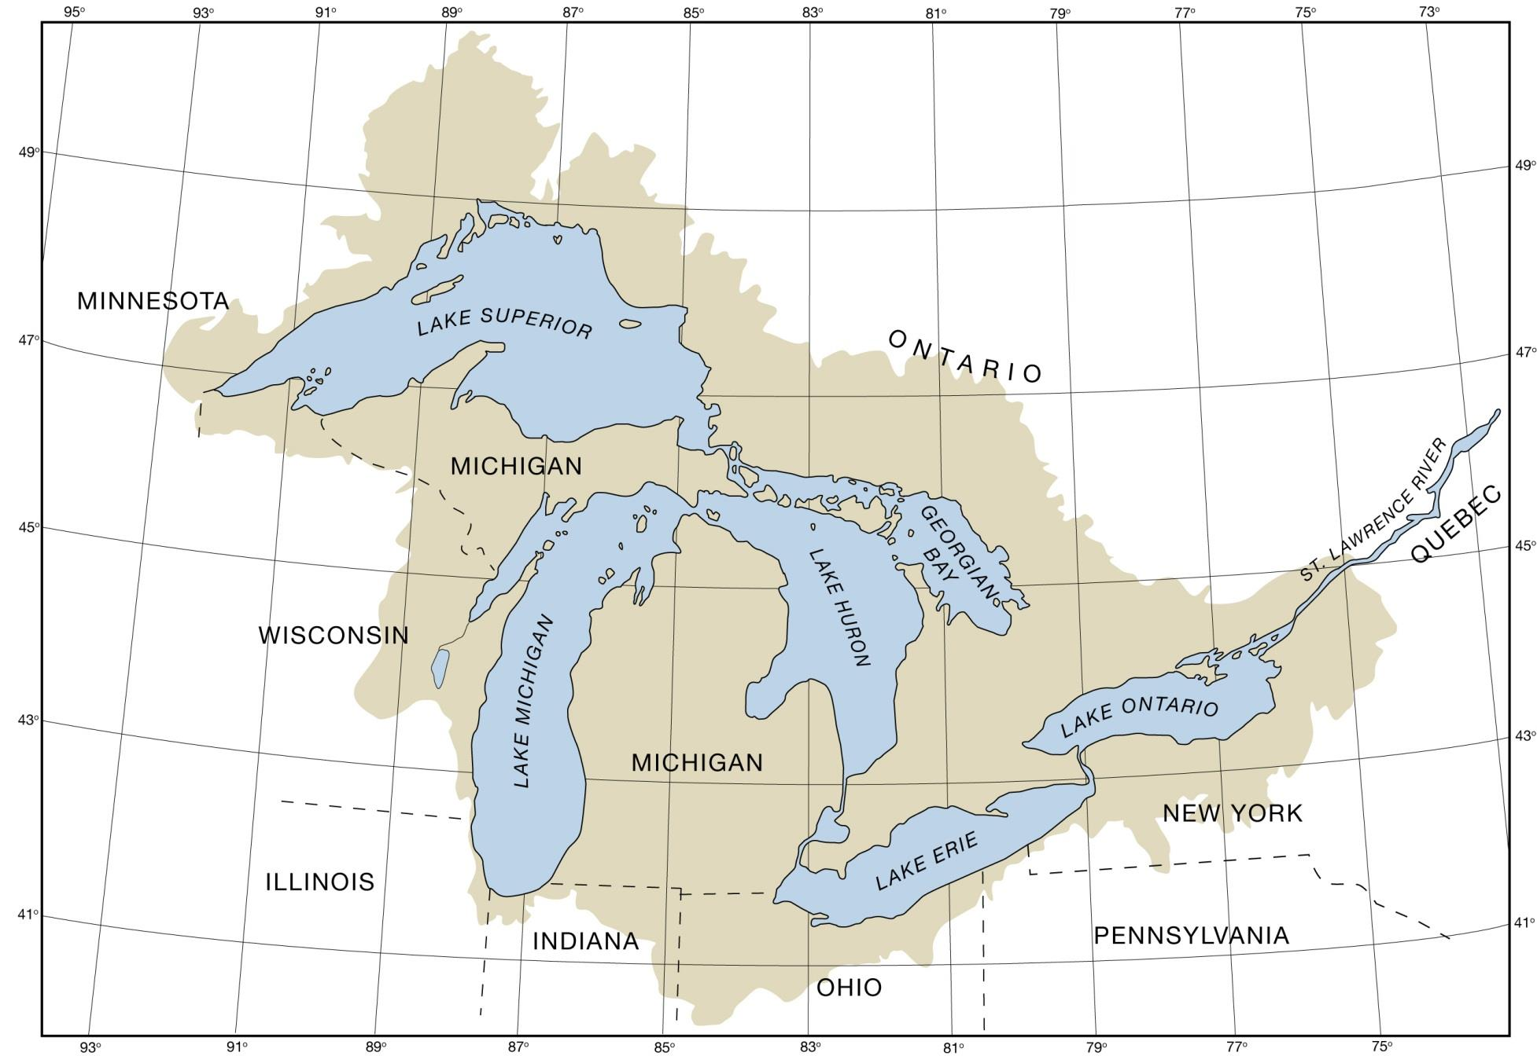
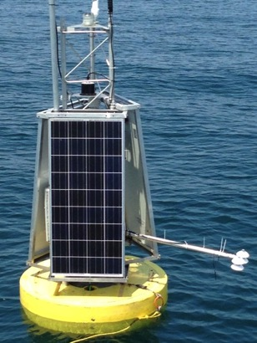
OSAT | Observing System Data Acquisition & Data Management
ReCON Station Locations:
MET Stations
E.C. Stations (Evaporation)
GLERL Buoys (seasonal)
- Classified as a “NOAA
Critical Observing System
of Record”
- Guest usage examples:
• U of Mich - Radiation Sensor
• Grand Valley State –
Water quality sensor
• Environment Canada &
U of Colorado – E.C.
- Recent improvements:
• Report on 10 or 20 min cycle
• DSL comm to bottom
• R2X transitions
Stannard Rock Light
Spec Reef Light
White Shoal Lt
Alpena
Thunder Bay Is.
Thunder Bay
incidental & reflected long & short wave radiation
Saginaw Bay
Milwaukee
x2
Muskegon
Muskegon
South Haven
Chicago
Cleveland
Cleveland (R2O)
Michigan City
Toledo Channel
Toledo Channel
9/13
Notes:
Map Notes:
MET (meteorological) stations are located on shore or on navigational structures.
E.C. (eddy covariance) stations measure evaporation. Requiring a fixed platform, they’re located on off-shore navigational structures.
NOAA Critical Observing System of Record:
The ReCON network is classified by the NOAA Observing Systems Committee as a Critical Observing System of Record (SoR), which is defined as “an observing system that provides sustained critical observations for long-term research and/or operations,” and critical is defined to mean that “the degradation or loss of the SoR would have significant impact on NOAA’s mission (including federated and international commitments).” cf. https://nosc.noaa.gov/OSC/oss.php
Guest Usage Examples:
- U of Mich Radiation Sensor is an experiment to measure eddy covariance from a buoy to estimate evaporation over the water, deployments in Cleveland & Muskegon
- We host the Grand Valley State University water quality sensor since the university doesn’t have their own buoys to make these measurements in Lake Michigan
- The U of Colorado & Environment Canada eddy covariance stations are co-located with our ReCON boxes to provide realtime measurements (Stannard Rock in Lake Superior, White Shoal Light in Lake Michigan, and Spectacle Reef Light in Lake Huron)
Improvements:
- The typical one hour data cycle has been increased to 20 minutes for buoys (wave measurements are on a 20 minute cycle) and 10 minutes for most other stations
- DSL (Digital Subscriber Line) is a communications protocol to transmit high bandwidth ethernet data over distances of 1000’s of feet
R2X Transitions:
- R2O: The Cleveland Buoy ReCON station in 2015 was fully transitioned—deployment, operation, and maintenance—to GLOS
- R2C: The System Power Controller (SPC) board developed by GLERL, now commercially manufactured based on the GLERL open source design
- R2C: Technology from the ReCON buoy has been used in the development of commercial buoys for the Great Lakes and other lakes:

Slide 10
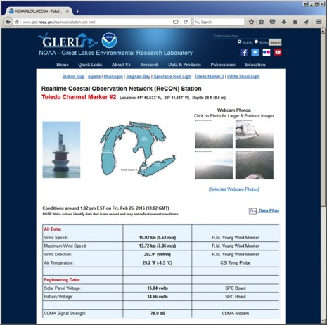
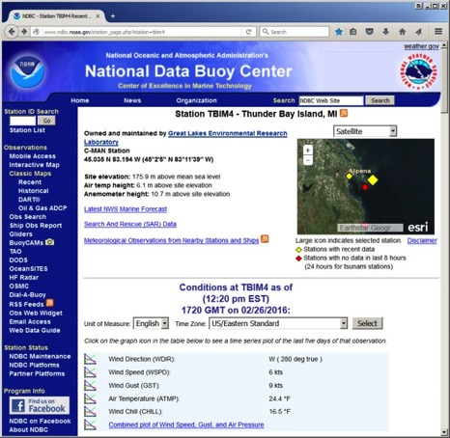
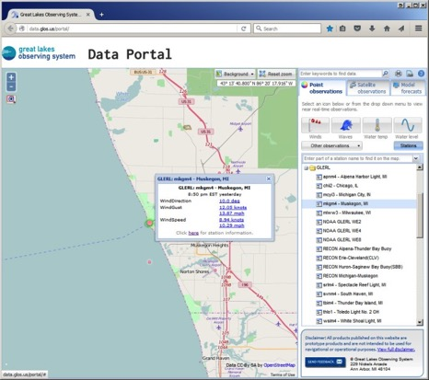
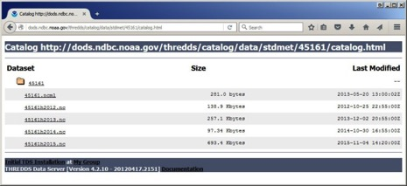
OSAT | Observing System Data Acquisition & Data Management
Data Access – Public Web Sites
GLERL Web
NDBC Web
GLOS Web
www.glerl.noaa.gov/metdata
www.glerl.noaa.gov/res/recon
www.ndbc.noaa.gov
www.data.glos.us/portal
NDBC THREDDS
dods.ndbc.noaa.gov/thredds/catalog.html
10/13
Notes:
Various other database formats are available to researchers to GLERL and partners, i.e., PostgreSQL

Slide 11
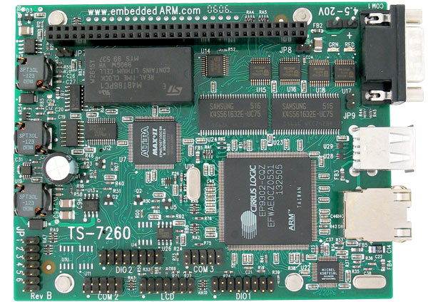
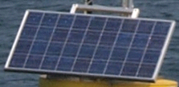
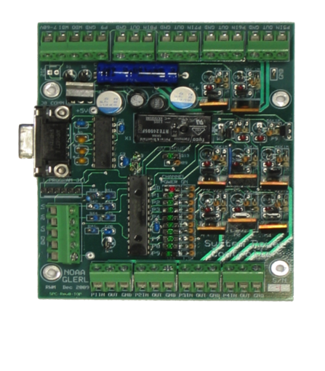
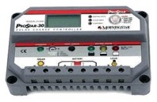
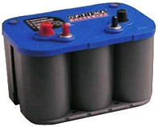
OSAT | Observing System Data Acquisition & Data Management
ReCON Technology
System Power Controller Board:
- Only major item w/o COTS solution
- MIL designed and fabricated
- Controls buoy and sensor power
- Monitors battery charge
- R2C to commercial manufacturer
Solar Panel
SPC Controller
Buoy/UW Hub Computer:
- COTS Technology
- General Purpose OS
- Interfaces to All Sensors
- Secure Communications
Charger
Batteries
Switched Power to Buoy Electronics & Sensors
11/13
Notes:
Buoy/Underwater Hub Computer:
COTS (Commercial, Off-The-Shelf) Technology:
- Economical and cutting edge
- Industrial grade, not consumer grade
- ARM Processor leverages smartphone technology
- PC104 form leverages embedded application technology - readily available stackable add-on modules
General Purpose OS (Operating System):
- Linux operating system – the penguin is the Linux mascot!
- Multi-tasking - simultaneous sampling, processing, data uploading, remote access
- Diagnostics - multiple operating system tools, debugging
- Any language - C, java, perl, kermit, matlab, etc.
- Onboard advanced data processing - intelligent, adaptive data collection and QA/QC
Interfaces to All Sensors:
- Supports various serial, ethernet, and USB sensor interfaces
- With data logger (Campbell Scientific series) supports analog and SDI sensors
- With intelligent programing, can interface to sensors not designed for real-time use
Secure Communications to Lab:
- Two-way communications from lab to the underwater hub & sensors
- Allows reconfiguration (or correcting mis-configurations) & diagnostics of sensors
- Communication tunnel is encrypted for secure access over the internet
System Power Controller (SPC) Board:
- Only major item without COTS solution
- MIL designed and fabricated
- Switches, monitors, and controls power to all buoy components and sensors
- Monitors battery charge and discharge
- R2C → now commercially manufactured by SeaView Systems

Slide 12
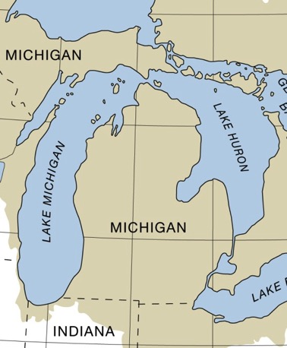
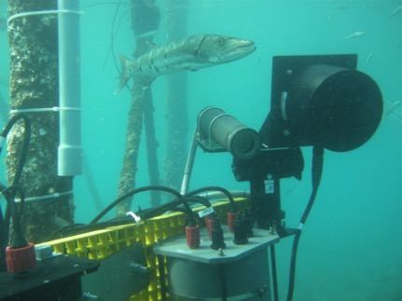
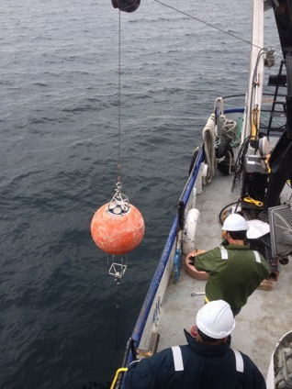
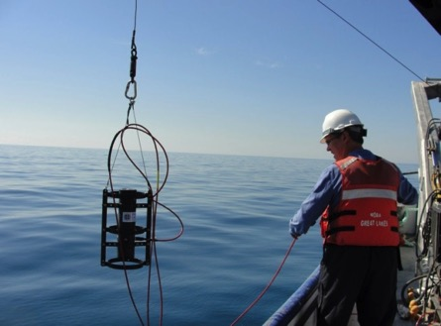
OSAT | Observing System Data Acquisition & Data Management
Other Observations/Data Collections:
• Long Term Research (LTR) moorings:
Yearly temperature profiles
• Moorings for specific projects:
Muskegon, W. Lake Erie, Mackinac Straits
• Buoys for specific projects:
HABs, hypoxia, spill response
• Future projects in development:
- Acoustics (active/passive)
- Cabled observatories
- Winched profiler
LTR Mooring Locations
Acoustics Prototype Testing
in the Florida Keys
UV Radiometer in Lake Michigan
ADCP in Straits of Mackinac
12/13
Notes:
LTR Moorings:
- Southern Lake Michigan mooring is our longest continuous year-round data record, collecting for over 30 years
- Other LTR moorings include Northern Lake Michigan, Lake Huron, etc.
HABs – Harmful Algae Blooms

Slide 13
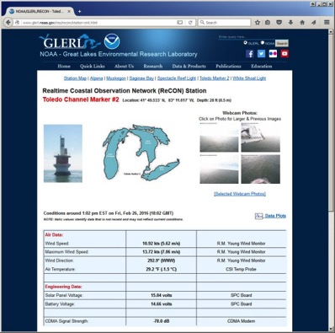
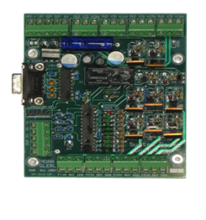
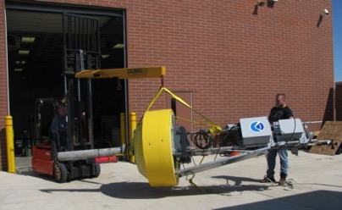
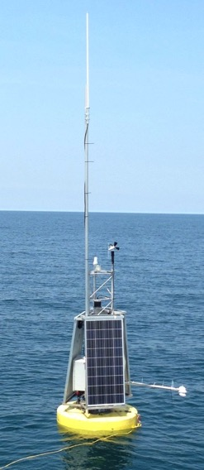
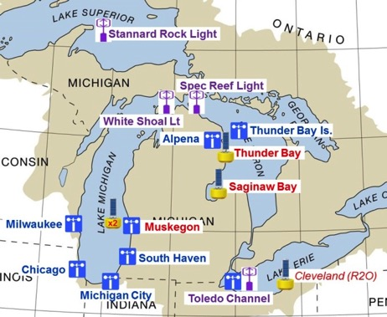
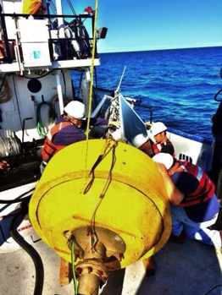
OSAT | Observing System Data Acquisition & Data Management
Questions or Feedback?
13/13

Slide 14
OSAT | Observing System Data Acquisition & Data Management
Additional Information

