Slide 1
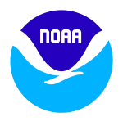
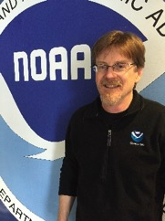
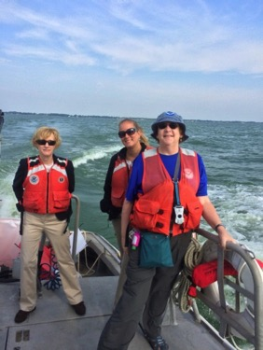
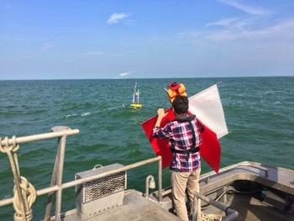
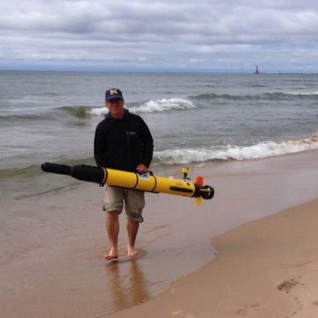
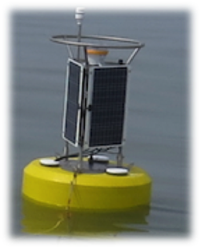
Observing Systems Research and Technology Transition
Steve Ruberg
Observing Systems & Advanced Technology
1/16
Notes:
OSAT Partners:
Cooperative Institute for Limnology and Ecosystems Research
IOOS/Great Lakes Observing System Regional Association
Regional Water Intake Managers
National Marine Sanctuaries
Regional National Weather Service Marine Weather Forecast Offices
Michigan Tech University
Michigan Tech Research Institute
University of Toledo Lake Erie Center
National Ocean Service/National Centers for Coastal Ocean Science
Oceans and Atmospheric Research/Earth Systems Research Laboratory
Grand Valley State University
Cooperative Institute for Research in Environmental Sciences
This work aligns with the following NOAA Goals:
Science: Climate Adaptation and Mitigation
Improved scientific understanding of the changing climate system and its impacts
Science: Weather-Ready Nation
Reduced loss of life, property, and disruption from high-impact events
Improve freshwater resource management
Improve transportation efficiency and safety
Healthy people and communities due to improved air and water quality services
A more productive and efficient economy through information relevant to key sectors of the U.S. economy
Science: Healthy Oceans
Improved understanding of ecosystems to inform resource management decisions
Healthy habitats that sustain resilient and thriving marine resources and communities
Science: Resilient Coastal Communities and Economies
Resilient coastal communities that can adapt to the impacts of hazards and climate change
Comprehensive ocean and coastal planning and management
Safe, efficient and environmentally sound marine transportation
Improved coastal water quality supporting human health and coastal ecosystem services
Education: Science-Informed Society
Youth and adults from all backgrounds improve their understanding of NOAA-related sciences by participating in education and outreach opportunities
Formal and informal educators integrate NOAA-related sciences into their curricula, practices, and programs
Formal and informal education organizations integrate NOAA-related science content and collaborate with NOAA scientists on the development of exhibits, media, materials, and programs that support NOAA’s mission
Education: Safety and Preparedness
Youth and adults from all backgrounds are aware of, prepare for, and appropriately respond to environmental hazards that impact health, safety, and the economy in their communities
Formal and informal educators use and produce education materials and programs that integrate and promote consistent science-based messaging on hazards, impacts, and societal challenges related to water, weather, and climate
Formal and informal education institutions integrate water, weather, and climate hazard awareness, preparedness, and response information into curricula, exhibits, and programs that create learning opportunities for youth and adults
Education: Future Workforce
Graduates completing NOAA-supported student opportunities continue education, enter the workforce, and advance in careers that support NOAA’s mission

Slide 2
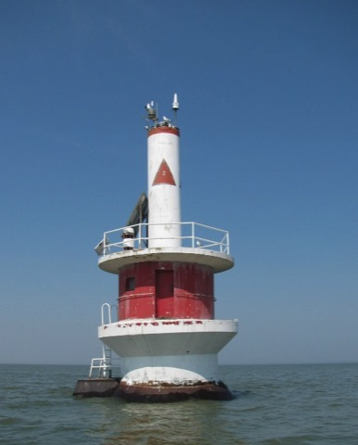
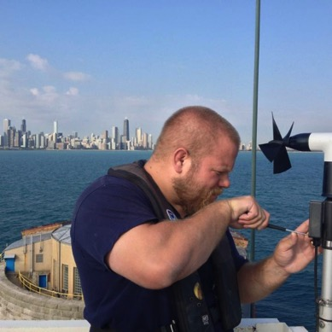
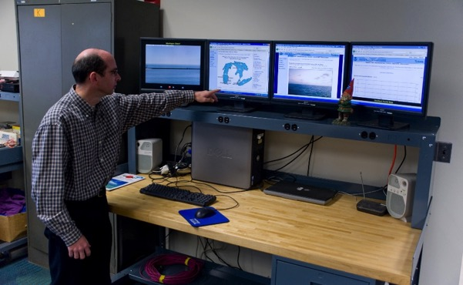
OSAT | Observing Systems Research and Technology Transition
Presentation Outline
Great Lakes Meteorological Technology Transition
SOAR Project
Enterprise Architecture Study
Hypoxia Monitoring/Warning System
HABs Project Overview
Remote Sensing Time Series
Nutrient Monitoring Network (Johengen Tour)
Hyperspectral Sensor Development (Vander Woude Tour)
Summary / Future Plans
2/16
Notes:
Photos:
Top Left: Toledo Light 2
Bottom Left: Steve Constant works on an anemometer on the Chicago Met Station.
Bottom Right: Ron Muzzi demonstrates at the Command and Control Center for Real-Time Meteorological Observation Station
The Synthesis, Observations and Response (SOAR) project addresses Great Lakes Restoration Initiative (GLRI) adaptive management needs under Great Lakes Water Quality Agreement (GLWQA) Annex 4:
Lake Ecosystem Objectives of Great Lakes Water Quality Agreement Annex 4 - Canada/U.S. Phosphorus Load Reduction Targets
Minimize the extent of hypoxic zones in the Waters of the Great Lakes associated with excessive phosphorus loading, with particular emphasis on Lake Erie
- 40% reduction in total phosphorus entering the Western Basin and Central Basin of Lake Erie – from the United States and from Canada - to achieve 6000 MT Central Basin load
Maintain cyanobacteria biomass at levels that do not produce concentrations of toxins that pose a threat to human or ecosystem health in the Waters of the Great Lakes
- 40% reduction in spring total and soluble reactive phosphorus loads from Canada/U.S. watersheds
Maintain cyanobacteria biomass at levels that do not produce concentrations of toxins that pose a threat to human or ecosystem health in the Waters of the Great Lakes
- 40 % reduction in spring total and soluble reactive phosphorus loads from the Maumee River (U.S.)

Slide 3
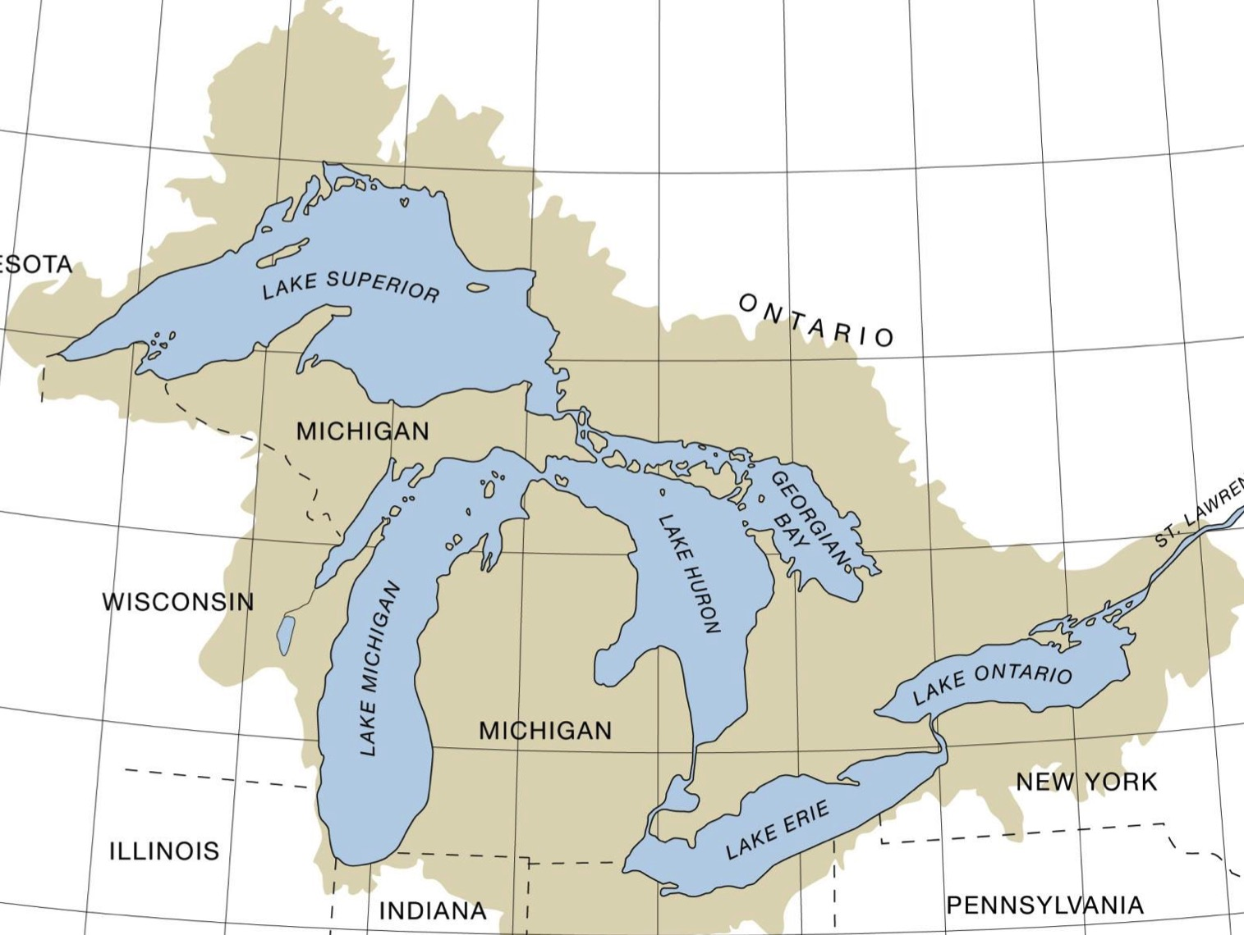
OSAT | Observing Systems Research and Technology Transition
ReCON Station Locations:
MET Stations
Stations with Webcams
E.C. Stations (Evaporation)
GLERL Buoys (seasonal)
Stannard Rock Light
Spec Reef Light
White Shoal Light
Alpena
Thunder Bay Is.
Thunder Bay
NWS Transition
Saginaw Bay
Milwaukee
x2
Muskegon
Muskegon
SOAR HABs
South Haven
Chicago
Cleveland (R2X)
SOAR Hypoxia
Michigan City
Toledo Channel
Toledo Channel
3/16
Notes:
ReCON: Real-Time Meteorological Observation Network – www.glerl.noaa.gov/metadata
The southern Lake Michigan met stations were used to transition technology to NWS Central and Eastern regions that greatly increased the number of near shore observing nodes. Data from buoys, pier-based met stations and evaporation stations is used operationally by the GLOS RA* and NDBC (National Data Buoy Center).
GLERL’s experience in advancing observational technology has led to:
. Invited talk at International Association for Great Lakes Research on session on Monitoring Technologies for Assessing the Health of the Great Lakes which will provide feedback to the International Joint Commission’s Great Lakes Science Advisory Board.
. Invitation from NOAA/IOOS** to National Moored Data Buoy Plan Workshop
. Invitation from NOAA/NDBC Deputy Director to discuss potential for deployment of year-round, under ice observing nodes
*GLOS RA is one of 11 Regional Associations of the Integrated Ocean Observing System (IOOS)).
**IOOS is a partnership among federal, regional, academic and private sector parties that works to provide new tools and forecasts to improve safety, enhance the economy, and protect the environment.

Slide 4
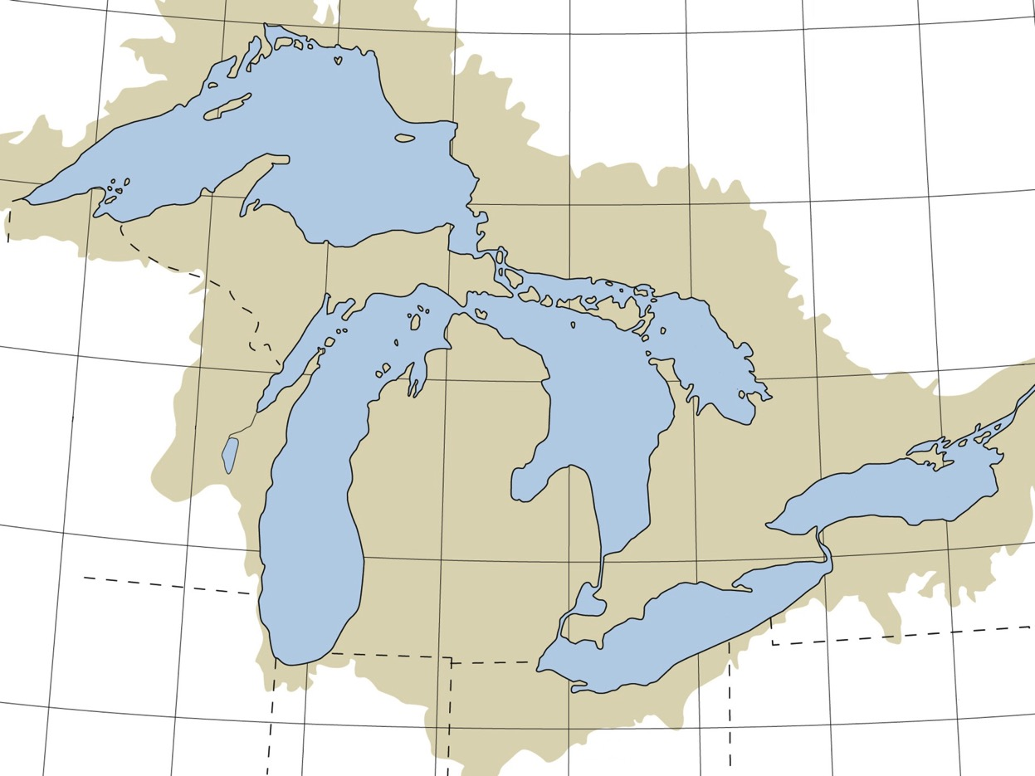
OSAT | Observing Systems Research and Technology Transition
Filling Observational Gaps: Minimal coastal coverage
PILM4
45136
ROAM4
45001
45006
45004
DISW3
STDM4
~ 1998
45154
Key:
NDBC Buoys (9)
NDBC C-MAN Stations (7)
Canadian Buoys (11)
GLERL (0)
NWS (0)
Total Stations = 27
45002
45003
45137
45143
SGNW3
45008
45135
45149
45159
45012
45139
45007
45132
45142
LSCM4
45147
DBLN6
SBIO1
45005
4/16

Slide 5
OSAT | Observing Systems Research and Technology Transition
Filling Observational Gaps: NWS collaboration
Improved forecast validation, wave and circulation model wind inputs
PILM4
45136
ROAM4
45001
45006
45004
DISW3
STDM4
Real-time Observation Stations ~ 2004
45154
45002
45003
45137
Key:
NDBC Buoys (9)
NDBC C-MAN Stations (7)
Canadian Buoys (11)
GLERL (7)
NWS (0)
Total Stations = 34
45143
SGNW3
45008
45135
45149
45159
45012
MLWW3
MKGM4
45139
KNSW3
45007
SAUM4
45132
45142
LSCM4
45147
DBLN6
CHII2
SVNM4
SBIO1
45005
MCYI3
5/16

Slide 6
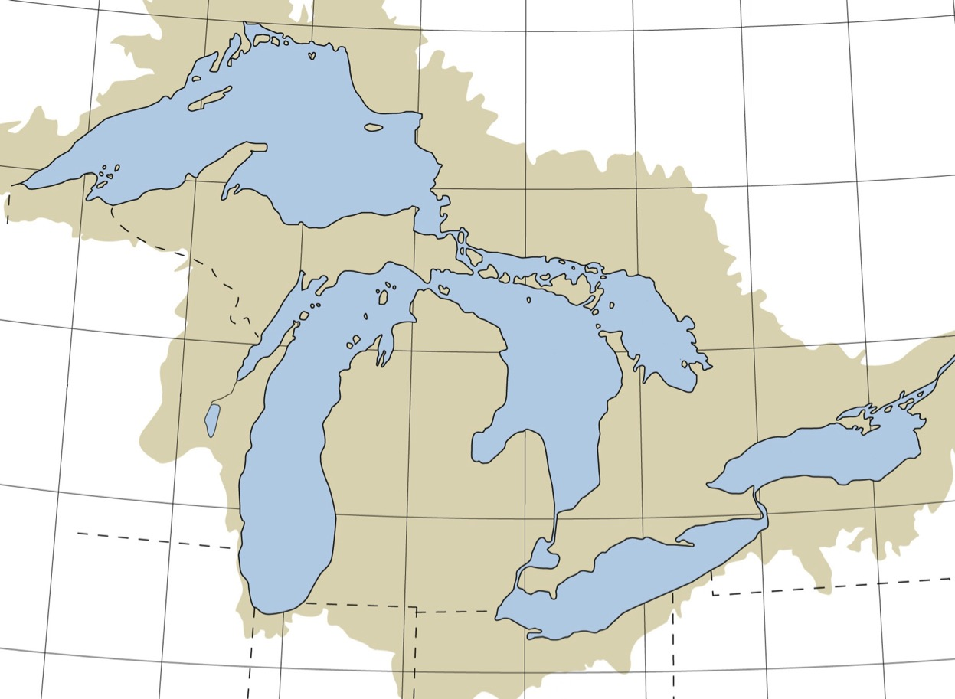
OSAT | Observing Systems Research and Technology Transition
Filling Observational Gaps: Technology Transition
PILM4
GLERL transitions to regional NWS Weather Forecast Offices
45136
SLVM5
KGNA
ROAM4
KP59
45001
STDEC
45004
DISW3
45006
PCLM4
GTRM4
STDM4
PNGW3
OTNM4
BIGM4
WFPM4
SXHW3
GRMM4
Real-time Observation Stations ~ 2015
KP53
NABM4
45154
FPTM4
WSLM4
SRLM4
Key:
NDBC Buoys (9)
NDBC C-MAN Stations (7)
Canadian Buoys (11)
GLERL (15)
NWS (43)
Total Stations = 85
CBRW3
NPDW3
GTLM4
PRIM4
45003
45137
SYWW3
45002
APNM4
TBIM4
GBLW3
AGMW3
45162
45143
SPTM4
TAWM4
MEBM4
GSLM4
KP58
SGNW3
BSBM4
45008
45135
SBLM4
45163
45149
45159
45012
PWAW3
OLCN6
MLWW3
45161
MKGM4
PSCM4
45139
NIAN6
RPRN6
KNSW3
45007
SAUM4
45132
45142
WHRI2
LSCM4
45147
DBLN6
“NWS views the GLERL Demonstration Network as a tremendous success. The demo network was actually a catalyst for NWS expanding the Great Lakes coastal observation network. NWS put quite a bit of money into duplicating the GLERL network. The sensors and data acquisition systems turned out to be exceptionally robust.”
- Richard Wagenmaker, Meteorologist in Charge, Detroit
CHII2
SVNM4
THLO1
GELO1
BARN6
CNII2
SJOM4
SBIO1
45005
CBLO1
BHRI3
MCYI3
HHLO1
6/16
Notes:
“NWS views the GLERL Demonstration Network as a tremendous success. The demo network was actually a catalyst for NWS expanding the Great Lakes coastal observation network. NWS put quite a bit of money into duplicating the GLERL network. The sensors and data acquisition systems turned out to be exceptionally robust.” - Richard Wagenmaker, Meteorologist in Charge, Detroit
These sites provide real-time conditions for commercial shipping and recreational users. NWS users benefit from imagery. The GLERL website receives over 1 million unique web hits per year.
Collaborations: NWS, Thunder Bay National Marine Sanctuary, Great Lakes Observing System Regional Association
Future Work: Extend to year-round, cabled systems at offshore and pier-based stations
Due to the contributions of NOS CO-OPS, GLOS RA, Universities, and GLRI, the observation network has now grown beyond this state. This slide is intended to show GLERL’s contribution to the NWS WFO marine observations expansion.

Slide 7
OSAT | Observing Systems Research and Technology Transition
Developing Observing Systems Capacity for HABs and Hypoxia
Synthesis Observations and Response (SOAR) Project
Data / Information Products and Services
Observations
Data Telemetry
Data Mgmt and Communications
Modeling and Analysis
Hypoxia Monitoring and Warning
Satellites
DMAC
HAB Seasonal Forecasting
Aircraft
Metadata standards
Data discovery
HAB Monitoring
Fixed Platforms
Data transport
Ships
Hyperspectral HAB Detection & Mapping
Online browsing
Drifters and Floats
Data Archival
Nutrient Monitoring Network
AUVs
Adaptive Management
Enterprise Architecture Framework
Technology Architecture
Data Architecture
Applications Architecture
7/16
Notes:
This project was initiated under the Great Lakes Restoration Initiative (GLRI). Through collaborations with federal, university and industry partners we have transitioned products and services into operation and application.
NOAA-GLERL received funding in 2010 under the GLRI to develop a near term design for the Great Lakes Observing System (GLOS) Enterprise Architecture. The GLOS Enterprise Architecture (EA) project scoped an integrated, holistic ecosystem observing system including the physical, chemical, and biological data collection necessary to support effective Great Lakes management. The EA focused on developing a system to observe change in the Great Lakes coastal environment resulting from the basin-wide implementation of the GLRI. A strategic plan was created for the near term GLOS enterprise design. The strategic plan is intended to leverage and build on the foundation of the existing programs and initiatives of GLOS, IOOS, NOAA-GLERL, and the GLRI. The EA final report provides recommendations for the design and implementation of prioritized elements of the system over the near term (next 5 years) towards a sustainable Great Lakes observing system over the long term. The EA report was a culmination of a multi-stakeholder collaborative effort with input and direction obtained directly from an expert advisory panel representing NOAA-GLERL, USEPA, USGS, USACE, and IOOS, as well as input provided to GLOS by numerous stakeholders over the past several years.
The Synthesis, Observations and Response (SOAR) project addresses Great Lakes Restoration Initiative (GLRI) adaptive management needs under Great Lakes Water Quality Agreement (GLWQA) Annex 4:
Lake Ecosystem Objectives of Great Lakes Water Quality Agreement Annex 4 - Canada/U.S. Phosphorus Load Reduction Targets
. Minimize the extent of hypoxic zones in the Waters of the Great Lakes associated with excessive phosphorus loading, with particular emphasis on Lake Erie
- 40% reduction in total phosphorus entering the Western Basin and Central Basin of Lake Erie – from the United States and from Canada - to achieve 6000 MT (metric ton) Central Basin load
. Maintain cyanobacteria biomass at levels that do not produce concentrations of toxins that pose a threat to human or ecosystem health in the Waters of the Great Lakes
- 40% reduction in spring total and soluble reactive phosphorus loads from Canada/U.S. watersheds
. Maintain cyanobacteria biomass at levels that do not produce concentrations of toxins that pose a threat to human or ecosystem health in the Waters of the Great Lakes
- 40 % reduction in spring total and soluble reactive phosphorus loads from the Maumee River (U.S.)
HAB – Harmful Algal Bloom

Slide 8
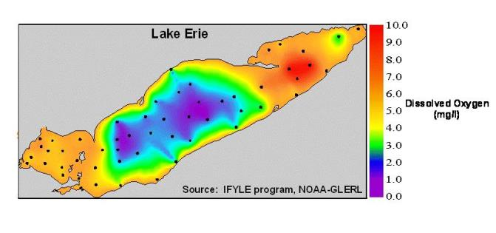
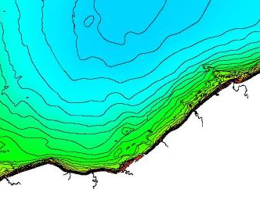
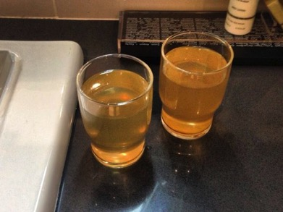
OSAT | Observing Systems Research and Technology Transition
Development of a Hypoxia Warning/Monitoring System
Lower oxygen
levels
Partial upwelling combined with hypoxic water can impact drinking water processing for about 2 million coastal residents
Real-time observations allow managers time to implement alternative processing
Cleveland
OH
ReCON Buoy
Water Intakes
Example of yellow water
8/16
Notes:
The Hypoxia Monitoring and Warning System provides observations for GLRI adaptive management and environmental intelligence for water intake managers in the central basin of Lake Erie. The central basin of Lake Erie hypoxic zone is the second largest in the US. The system provides time-series observations of oxygen and temperature relevant to water intake managers but also provides winds, waves, and currents important for commercial and recreational use and important in understanding the physics of hypoxia formation and hypolimnion movement.
Collaborations: US Environmental Protection Agency, United States Geological Survey, Great Lakes Observing System Regional Association, Limnotech
RUBERG, S.A., E. Guasp, N. HAWLEY, R.W. MUZZI, S.B. BRANDT, H.A. VANDERPLOEG, J.C. LANE, T.C. MILLER, and S.A. CONSTANT. Societal benefits of the real-time coastal observation network (ReCON): Implications for municipal drinking water quality.Marine Technology Society Journal 42(3):103-109 (2008).

Slide 9
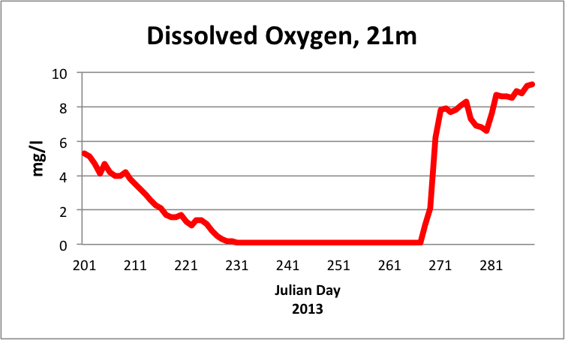
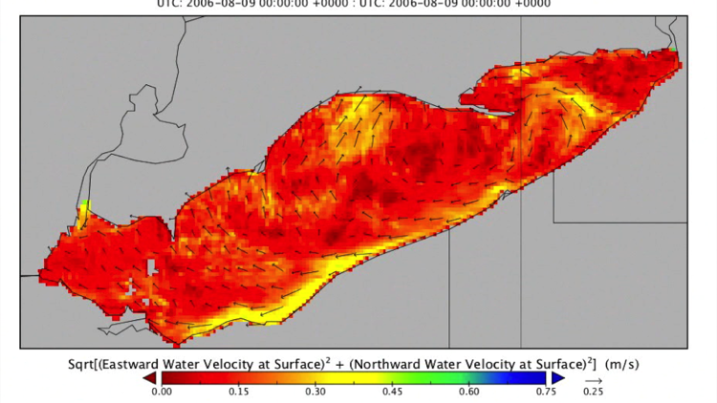
OSAT | Observing Systems Research and Technology Transition
Hypoxia Warning/Monitoring System
Cleveland Water Dept. (CWD) Decision Criteria:
Real-time buoy indicates hypolimnion oxygen levels below 2 mg/l.
Decision: stage KMnO4 and increase monitoring from 2 hours to 30 minutes.
Coastal surface currents forecast or detection of Mn at intake
Decision: change treatment technique to include pre-oxidation with KMnO4
Currents: Great Lakes Coastal Forecasting System
Transitioned to GLOS Regional Association for operations
Funded by CWD
Buoy deployed by LimnoTech
Sustainable ecosystem monitoring for Great Lakes Restoration Initiative Adaptive Management Process
9/16
Notes:
GLOS is an Integrated Ocean Observing System (IOOS) regional association
GLOS put out a competitive RFP, GLERL created the specification, and LimnoTech received the award.
LimnoTech is a consulting company.
Future Work: Dissolved oxygen modeling, FVCOM dissolved oxygen layer movement forecast.

Slide 10
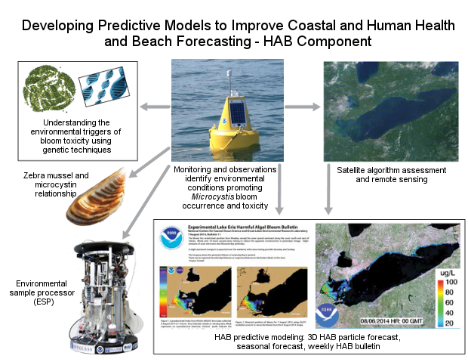
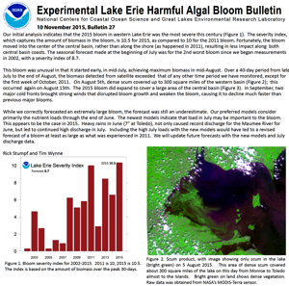
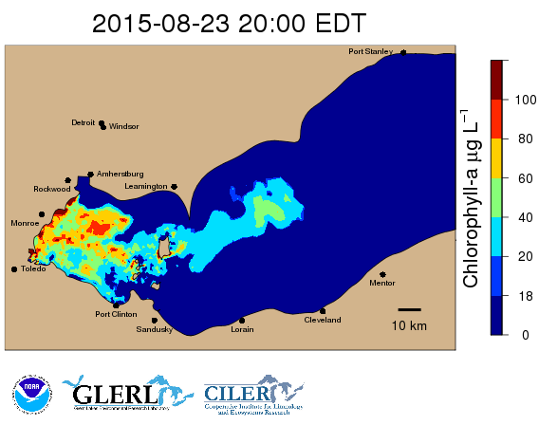
OSAT | Observing Systems Research and Technology Transition
An integrated approach to studying HABs
10/16
Notes:
Overarching research statement:
Understanding the drivers of bloom ecology will aid in enhancing predictive models that forecast bloom size, location AND toxicity
HAB (Harmful Algal Blooms)

Slide 11
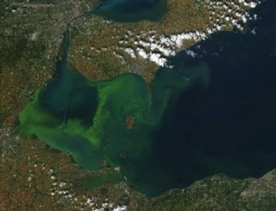
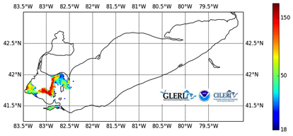
OSAT | Observing Systems Research and Technology Transition
SOAR HABs Project Components
Seasonal Forecast
Satellite-derived HAB: Cyanobacteria Index algorithm
Satellite HAB area estimation
Time-series Nutrient Monitoring
Airborne Hyperspectral Sensor Development
✔
✔
Satellite-derived
HABs
HAB Tracker
Particle/Circulation Model
MODIS Aqua
9/29/14
11/16
Notes:
Seasonal Forecast: Re-developed the bloom/TP load relationship (NOS/NCCOS, Stumpf et al) within a statistical framework where uncertainty is represented quantitatively. The model is capable of assessing the critical loading period (loads prior to February contribute minimally). Gradual decline in threshold required to stimulate large blooms.
R2X: Seasonal forecasts (2014 and 2015 ensemble forecast); applied to set P loading targets for the Great Lakes Water Quality Agreement Annex 4.
Publication: Obenour, D.R., A.D. Gronewold, C.A. Stow, & D. Scavia. (2014). Using a Bayesian hierarchical model to improve Lake Erie cyanobacteria bloom forecasts. Water Resources Research
Model has been used to make seasonal forecasts (2014 and 2015) and has been used to develop revised phosphorus loading targets for Annex 4 of the Great Lakes Water Quality Agreement.
Work done in collaboration with University of Michigan Water Center in the Graham Sustainability Institute
Project data and information is displayed on the Experimental HABs and Hypoxia web page on the GLERL website, http://www.glerl.noaa.gov/res/HABs_and_Hypoxia/
National Ocean Service (NOS) / National Centers for Coastal Ocean Science (NCCOS)
HAB (Harmful Algal Bloom)

Slide 12
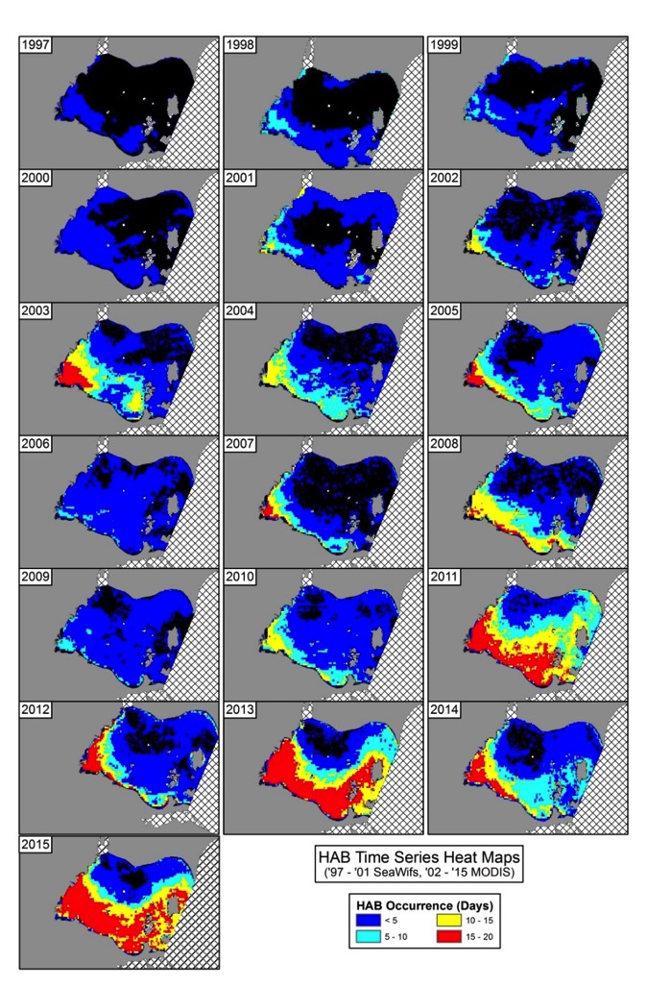
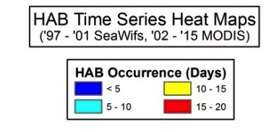
OSAT | Observing Systems Research and Technology Transition
Observing HAB Trends
R2A: HAB summary provided to EPA for GLRI adaptive management process and report to Congress
12/16
Notes:
This data is created using a MODIS satellite processing algorithm developed by George Leshkevich, GLERL, and Robert Shuchman, Michigan Tech Research Institute.
Time-series of heat map images and areal extent (sq. km) plot for the western basin of Lake Erie near Toledo, OH
- SeaWIFS 1997-2004
- MODIS 2002-2015
HAB: Harmful algal blooms

Slide 13
Establishing Western Lake Erie Nutrient Monitoring Capacity
OSAT | Observing Systems Research and Technology Transition
Continuous Parameters: SRP, Temp, Cond, CHL, PC, Turbidity, CDOM, pH, DO
R2A
Optical sensor data transitioned to GLOS HAB data portal in 2016
Annex 4 assessment of phosphorus loads
13/16

Slide 14
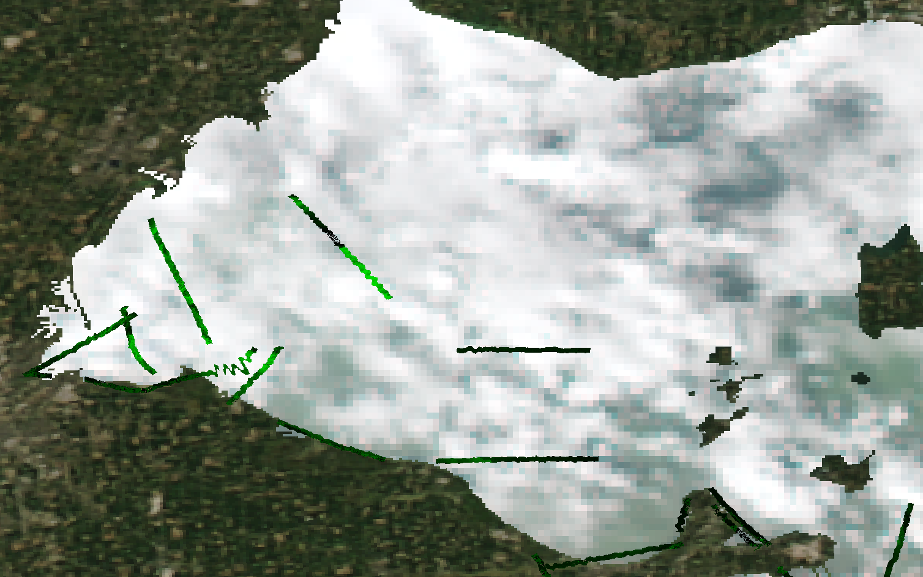
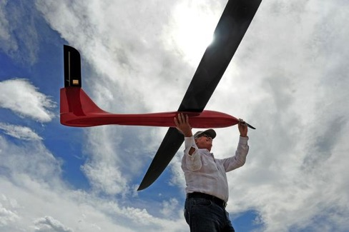
OSAT | Observing Systems Research and Technology Transition
Hyperspectral Detection of Cyanobacteria
Using Resonon Pika II Sensor
Water Leaving Radiance (W/m²/str)
Wavelength (nm)
14/16
Notes:
Hyperspectral system provides the ability to fly under clouds. As the 2015 HAB was forming in July, only a few good satellite images were available due to cloud cover.
Sensor: Spectral range 400-900 nm, Resolution 2.1 nm. Spatial resolution ~ 2 meters
Differentiation of Microcystis
Narrow reflectance peak centered at 560 nm
Absorption peak at approximately 625 nm with reflection peak at 650 nm
Both are indicated by reflection peak at approximately 710 nm
Project data used by Ohio EPA and water intake and beach managers. In 2016, weekly product in demonstration mode (TRL 6) for potential use in operational HAB Bulletin.
Collaborations: NOAA/OAR/ESRL, NASA Glenn Research Center, Michigan Tech Research Institute, Ohio Environmental Protection Agency
Future Work: Algal/HAB Classification, HAB mapping from aircraft and unmanned aerial system (UAS).

Slide 15
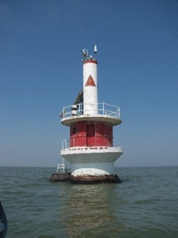
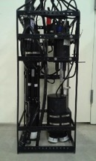
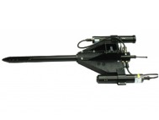
OSAT | Observing Systems Research and Technology Transition
SUMMARY/FUTURE WORK
SOAR project buoys developed as an extension of the ReCON project
Hypoxia Warning/Monitoring System transitioned into operations through GLOS with industry partner
Hypoxia and nutrient monitoring buoy data contributing to Annex 4 adaptive management feedback and HABs information for water intake managers
Continue hyperspectral flyovers to detect, map and classify HABs - plan for UAS integration
Continue optical property characterization and begin VIIRS / Sentinal 3 calibration/validation
15/16
Notes:
UAS – Unmanned Aircraft Systems
The Visible Infrared Imaging Radiometer Suite (VIIRS) cal/val is being done in collaboration with NOAA National Environmental Satellite, Data, and Information Service (NESDIS)
European Space Agency Sentinal 3A satellite launched February 16, 2016 with the Ocean and Land Color Instrument (OLCI) providing a multi-spectral image capability needed for global HABs detection. Sentinal 3B scheduled for 2017.

Slide 16
Questions

