Slide 1


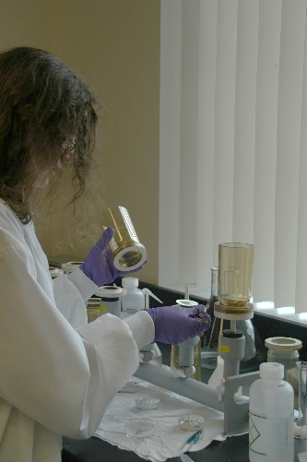
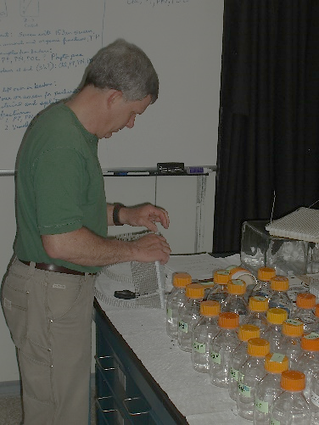
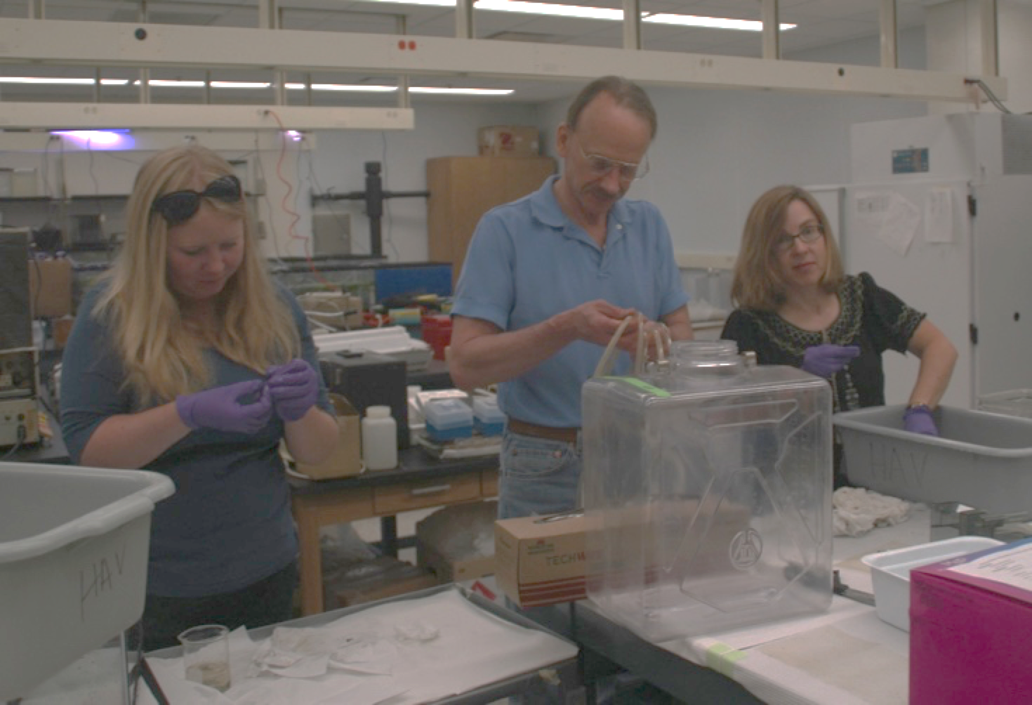
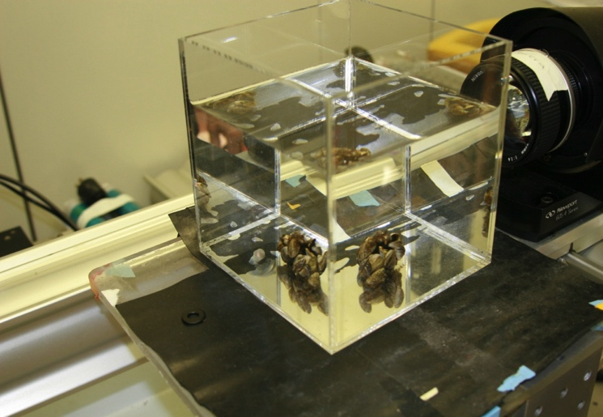
Process Studies: Invasive Mussel (Dreissena) example
Hank Vanderploeg
Ecosystem Dynamics
Mussel feeding & nutrient excretion:
  Team approach
  Lab
  Field
  Large Enclosures
  Genetic approaches
  Behavior
Observations → Experiments → Concepts → Models/Applications
1/13
Notes:
This work aligns with the following NOAA Goals:
Science: Climate Adaptation and Mitigation
Improved scientific understanding of the changing climate system and its impacts
Science: Healthy Oceans
Improved understanding of ecosystems to inform resource management decisions
Sustainable fisheries and safe seafood for healthy populations and vibrant communities
Science: Resilient Coastal Communities and Economies
Improved coastal water quality supporting human health and coastal ecosystem services

Slide 2


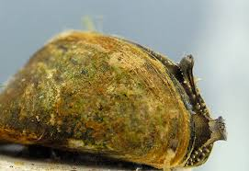
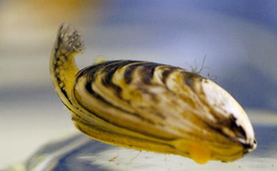
EcoDyn | Process Studies: Invasive Mussel (Dreissena) example
Foundational GLERL contributions
to understanding invasive mussel impacts
Zebra mussels promoted toxic Microcystis blooms in Saginaw Bay and Lake Erie through selective filter feeding (2001, 2002)
Quagga mussels decimated the spring phytoplankton bloom in Lake Michigan (2010).
Zebra mussel
Quagga mussel
Observations → Experiments → Concepts → Models/Applications
2/13
Notes:
References:
1. Vanderploeg H.A., Liebig J.R., Carmichael W.W., Agy M.A., Johengen T.H., Fahnenstiel G.L. & Nalepa T.F. (2001) Zebra mussel (Dreissena polymorpha) selective filtration promoted toxic Microcystis blooms in Saginaw Bay (Lake Huron) and Lake Erie. Canadian Journal of Fisheries and Aquatic Sciences, 58, 1208-1221. (215 Citations)
2. Vanderploeg H.A., Nalepa T.F., Jude D.J., Mills E.L., Holeck K.T., Liebig J.R., Grigorovich I.A. & Ojaveer H. (2002) Dispersal and emerging ecological impacts of Ponto-Caspian species in the Laurentian Great Lakes. Canadian Journal of Fisheries and Aquatic Sciences, 59, 1209-1228. (296 citations)
3. Vanderploeg H.A., Liebig J.R., Nalepa T.F., Fahnenstiel G.L. & Pothoven S.A. (2010) Dreissena and the disappearance of the spring phytoplankton bloom in Lake Michigan. Journal of Great Lakes Research, 36, 50-59. (64 citations)

Slide 3







What are the new fundamental, mission-relevant questions, directions and progress?
EcoDyn | Process Studies: Invasive Mussel (Dreissena) example
What are the effects of dreissenids on the phytoplankton community—including harmful algae—during all seasons?
What are the interactions of Dreissena and the microbial food web?
How can we predict nutrient excretion in mussels and its impact to harmful and nuisance algal blooms?
What is the combined impact of feeding and nutrient excretion on food webs?
3/13
Notes:
Logos show institutions of major partners in recent and present studies
Non-GLERL partners include:
Hunter Carrick of Central Michigan University
Tom Johengen of CILER
Orlando Sarnelle of Michigan State
Vincent Denef of the E, E, & B department at University of Michigan
Peter Lavrentyev of The University of Akron
Huijuan Tang of South China Agricultural University

Slide 4
EcoDyn | Process Studies: Invasive Mussel (Dreissena) example
Feeding preferences of quagga mussels on diatoms reflect changes seen in Great Lakes
Size
Loss of large diatoms in spring phytoplankton bloom reflects experimental results
Tang H., Vanderploeg, H.A., Johengen, T.H. & Liebig J.R. (2014). JGLR.
4/13
Notes:
The significance of feeding results for diatoms is that it explains the loss of the large diatoms (microphytoplankton) during the spring phytoplankton bloom (Vanderploeg et al., 2010). This pattern of changes has been observed throughout the Great Lakes in a variety of papers reviewed in Tang et al. (2012). Interestingly small Cyclotella (nanophytoplankton) was fed upon at very low rate. This is in contrast to high feeding rate observed for Cryptomonas of the same size in this and other studies.
The precise microscopic phytoplankton counting that was done for the 5 feeding experiments (spring through autumn) that make up this paper took 1 year.
Reference:
Tang H., Vanderploeg H.A., Johengen T.H. & Liebig J.R. (2014) Quagga mussel (Dreissena rostriformis bugensis) selective feeding of phytoplankton in Saginaw Bay. Journal of Great Lakes Research, 40, 83-94.

Slide 5
EcoDyn | Process Studies: Invasive Mussel (Dreissena) example
Feeding preferences of quagga mussels on blue greens reflect changes seen in Great Lakes
Size
Could selective feeding promote Microcystis dominance over N-fixing Anabaena?
Tang H., Vanderploeg H.A., Johengen T.H. & Liebig J.R. (2014). JGLR.
5/13
Notes:
Tang et al. (2014) extended the extensive literature produced by our team on Microcystis to other cyanobacteria (“blue-green algae”). Noteworthy is the preference shown for Anabaena a N-fixer, which we have not seen dominate in western Lake Erie despite nitrate falling to very low levels in late summer. So are dreissenids preventing a shift from Microcystis to Anabaena? More research is necessary. For the record our team has shown that feeding or rejection of Microcystis is strain-specific and not related to microcystin (toxin) content but must be to other secondary compounds. Strains found in Lake Erie, Saginaw Bay, and many inland lakes elicit the rejection response. Strains found in some rivers and hypereutrophic systems (e.g. Dutch Lakes) may be readily consumed. Listed below is some relevant literature on the Microcystis story as well as mussel-microzooplankton interactions in Saginaw Bay. In another study in Saginaw Bay, our team (Lavrentyev et al. 2014) showed that microzooplankton are important grazers of bacteria and Microcystis as well as serving as an important food source to quagga mussels. It is important note that working with natural algal communities is necessary because many species do not do well in culture and cyanobacteria such as Microcystis change their morphology and other characteristics in response to culture conditions.
References:
1. Vanderploeg H.A., Liebig J.R., Carmichael W.W., Agy M.A., Johengen T.H., Fahnenstiel G.L. & Nalepa T.F. (2001) Zebra mussel (Dreissena polymorpha) selective filtration promoted toxic Microcystis blooms in Saginaw Bay (Lake Huron) and Lake Erie. Canadian Journal of Fisheries and Aquatic Sciences, 58, 1208-1221.
2. Vanderploeg H.A., Nalepa T.F., Jude D.J., Mills E.L., Holeck K.T., Liebig J.R., Grigorovich I.A. & Ojaveer H. (2002) Dispersal and emerging ecological impacts of Ponto-Caspian species in the Laurentian Great Lakes. Canadian Journal of Fisheries and Aquatic Sciences, 59, 1209-1228.
3. Vanderploeg H.A., A.E. Wilson, T.H. Johengen, J. Dyble Bressie, O. Sarnelle, J.R. Liebig, S.D. Robinson, and G.P. Horst. (2014) Role of selective grazing by dreissenid mussels in promoting toxic Microcystis blooms and other changes in phytoplankton composition in the Great Lakes. In: Quagga and Zebra Mussels: Biology, Impacts, and Control, Second Edition. (Eds. T.F. Nalepa & D.W. Schloesser), pp. 509-523 CRC Press, Taylor and Francis Group, Boca Raton, FL
4. Vanderploeg, H.A., and J.R. Strickler. Video Clip 6: Behavior of zebra mussels exposed to Microcystis colonies from natural seston and laboratory cultures. In Quagga and Zebra Mussels: Biology, Impacts, and Control, Second Edition. T.F. Nalepa, and D.W. Schlosser (Eds.). CRC Press, Boca Raton, FL, 757 pp. (2013).
5. Lavrentyev P.J., Vanderploeg H.A., Franze G., Chacin D.H., Liebig J.R. & Johengen T.H. (2014) Microzooplankton distribution, dynamics, and trophic interactions relative to phytoplankton and quagga mussels in Saginaw Bay, Lake Huron. Journal of Great Lakes Research, 40, 95-105.

Slide 6
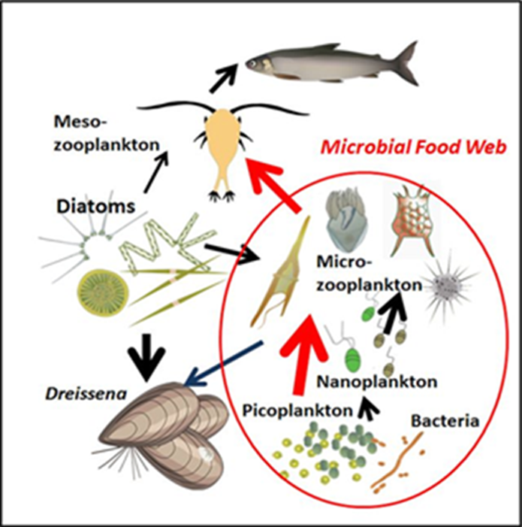
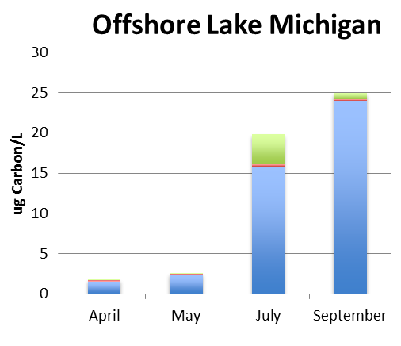
EcoDyn | Process Studies: Invasive Mussel (Dreissena) example
What are the interactions of Dreissena and the microbial food web?
Classic Food Web
Phytoplankton size fractionation
Microphytoplankton
Nanophytoplankton
Picophytoplankton
Lake Michigan 2013
Vanderploeg H.A., Bunnell D.B., Carrick H.J. & Hook T.O. (2015). JGLR.
Carrick et al., (in prep).
The food web is being restructured. Picophytoplankton (<2 µm) now dominates the phytoplankton community. Assumption: picophytoplankton are not consumed.
6/13
Notes:
Not only are chlorophyll and phytoplankton biomass very low now but picophytoplankton (<0.2- 2 µm) now dominates over nanophytoplankton (2 – 20 µm) and microphytoplankton (> 20 µm) in offshore zone.
Relevance: How can we best manage nutrient loading and fisheries in the restructured ecosystem if we don’t know how it works?
Related References
1. Carrick H.J., Butts E., Daniels D., Fehringer M., Frazier C., Fahnenstiel G.L., Pothoven S. & Vanderploeg H.A. (2015) Variation in the abundance of pico, nano, and microplankton in Lake Michigan: Historic and basin-wide comparisons. Journal of Great Lakes Research, 41, 66-74.
2. Vanderploeg H.A., Bunnell D.B., Carrick H.J. & Hook T.O. (2015) Complex interactions in Lake Michigan's rapidly changing ecosystem. Journal of Great Lakes Research, 41, 1-6.

Slide 7
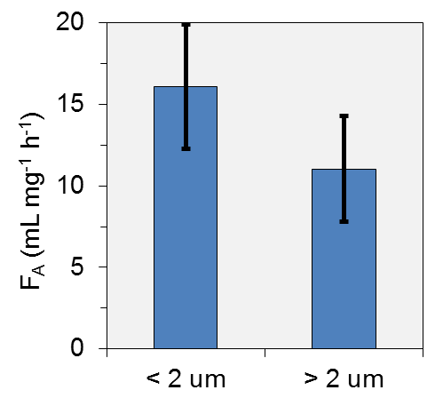
EcoDyn | Process Studies: Invasive Mussel (Dreissena) example
New discovery: Mussels fed on picophytoplankton (< 2µm)
Clearance rate (F_{A}) on chlorophyll in <2µm vs. > 2µm size fractions
7/13
Notes:
Preliminary study, subject for future research.
We used size fractioned chlorophyll method to calculate feeding (clearance rate).

Slide 8
EcoDyn | Process Studies: Invasive Mussel (Dreissena) example
What are the interactions of Dreissena and the microbial food web?
RNA/DNA sequencing showed only particle-associated bacteria are grazed.
Change in concentration in mussel feeding experiment
Index of free-living particles (15 m Lake Michigan site)
Index of free-living particles (110 m Lake Michigan site)
* = statistically significant difference ( p < 0.05 )
Denef et al. (in prep).
More
Particle association
Less
8/13
Notes:
Vulnerability of bacterial community to mussel grazing as shown by changes relative abundance in final relative to initial concentrations in experimental containers (red bars) as compared with the proportion of the bacterial classes’ association with particles (blue and green bars). The 10 most abundant (sub-)phyla, which on average included 95.2 % (±1.3%, 95% C.I.) of each sample’s sequences are ranked by most over- to most underrepresented after three hours of feeding relative to initial concentrations. In addition, differential representation of these phyla was determined in the field in the free-living (FL) relative to particle-associated (PA) fractions in bottom water samples taken at the 110 m and 15 m stations of GLERL LTR transect at Muskegon. Field data represents the average (error bars = standard deviation) of DNA and cDNA data from two sample times taken during the stratified period (July and September) Water used in the laboratory experiment were taken from a site between these two station (45 m depth), 10 days after the July field samples were taken. Field data ratios were log₁₀ transformed, while experimental data ratios were log₂ transformed. * denotes statistically significant differential representation. (*) denotes statistically significant when removing outlying replicate 1.
During the experiment the bacteria with higher proportion association with particles (>3 µm size) decreased in relative abundance. Both Chloroflexi and Actinobacteria are free-living in the sense that they are smaller than < 3 µm, i.e. not stuck on particles. Actinobacteria are very small and would be expected not to be grazed by mussels. Chloroflexi, although very large for a bacterium (0.7 – 0.9 µm), was not apparently grazed, which could be related it its cell wall characteristics (Denef et al., 2016).
Collections of the bacterial community were part of our “Spatial Studies and Microbes” seasonal cruises (Vanderploeg and spatial team) that were designed to examine the spatial structure of the food web from microbes to fishes. The characterization of Chloroflexi genetic traits and its capacity to thrive in hypolimnia of large cold lakes is described in Denef et al. (2016).
Reference:
Denef, V.J., Mueller, R.S., Chang, E., Liebig, J.R., Vanderploeg, H.A. (2016) Chloroflexi CL500-11 Populations That Predominate Deep-Lake Hypolimnion Bacterioplankton Rely on Nitrogen-Rich Dissolved Organic Matter Metabolism and C1 Compound Oxidation. Applied and Environmental Microbiology 82(5): 1423-1432.

Slide 9
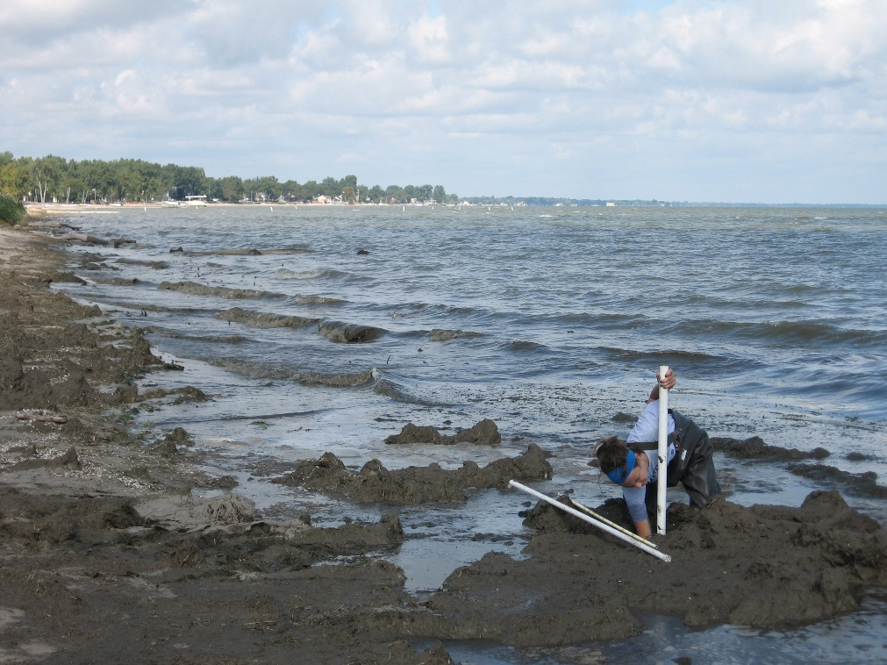
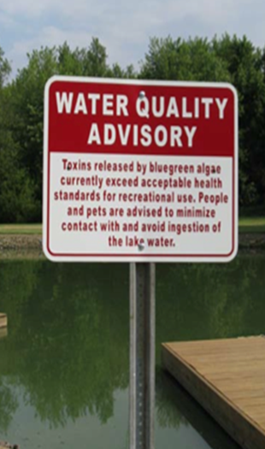
EcoDyn | Process Studies: Invasive Mussel (Dreissena) example
How can we predict nutrient excretion in mussels and its impact to harmful and nuisance algal blooms?
Cladophora (beach fouling)
Toxic Microcystis
The consequences of different nutrient loading strategies is not clear because of the unquantified impact mussel feeding and nutrient excretion.
9/13
Notes:
Light and nutrients are the main controllers of Cladophora growth (e.g. review of Bootsma et al., 2015). Some ecosystem models and conclusions of impact have assumed constant excretion rates of P in mussels, and some values used in the models have been based on experiments of dubious methodology. The factors that regulate P and N ingestion as well as the factors that affect both soluble excretion and egestion of nutrients are not well defined. Another important question is the time lag and availability of nutrients from egested material for both Cladophora and Microcystis. Egested N and P is usually higher than soluble excretion.
In the case of Microcystis, we have shown that selective rejection by mussels is an important part of their promotion of toxic Microcystis blooms. The role of nutrient excretion on promotion of toxic Microcystis is less clear.
Reference
Bootsma H.A., Rowe M.D., Brooks C.N. & Vanderploeg H.A. (2015) Commentary: The need for model development related to Cladophora and nutrient management in Lake Michigan. Journal of Great Lakes Research, 41, 7-15.

Slide 10
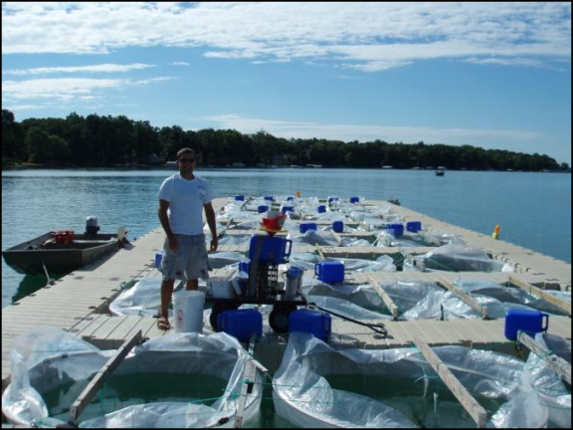
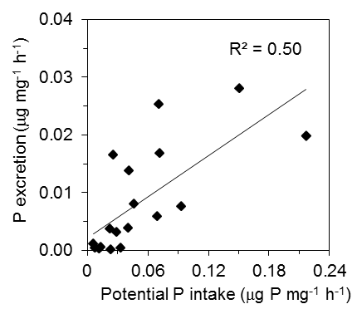
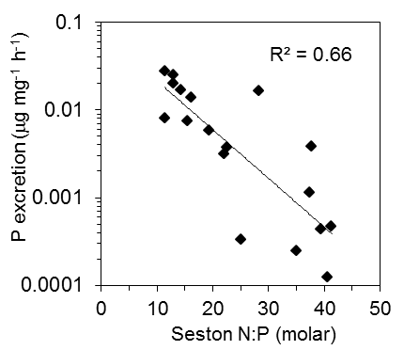
EcoDyn | Process Studies: Invasive Mussel (Dreissena) example
P excretion slows when feeding slows and food quality decreases
Mussel excretion in enclosures enriched with different levels of P
Food Quality
Vanderploeg et al., (Submitted)
10/13
Notes:
Mussels are key in nutrient recycling. Nutrient excretion affects proliferation of Cladophora and abundance and toxicity of Microcystis. Therefore, necessary to understand mussel impacts on nutrients for models.
Phosphorus excretion depends on the quality of the seston and the rate it is ingested. A low N:P ratio (near Redfield ratio) results in higher soluble P excretion. In this figure, the N:P range end points are representative of values found in Western Lake Erie (~10-18) and Saginaw Bay, Lake Huron (~ 32-40), and excretion rates observed in mussels from the enclosures are in the same ballpark. Some ecosystem models and conclusions of impact have assumed constant excretion rates based on experiments of dubious methodology. We did our “standard” feeding experiments in water from the enclosures and then placed the mussels in filtered water for 2 h to determine their excretion rate of soluble reactive phosphorus and ammonium. The story is different for ammonium (not shown). It is not very sensitive to feeding rate or N:P ratio.
Future research should focus on nailing down the whole process in the lab under controlled feeding and seston stoichiometry conditions tracing flow with radioisotopes. The other issue is rate at which egested material becomes available to primary producers.

Slide 11
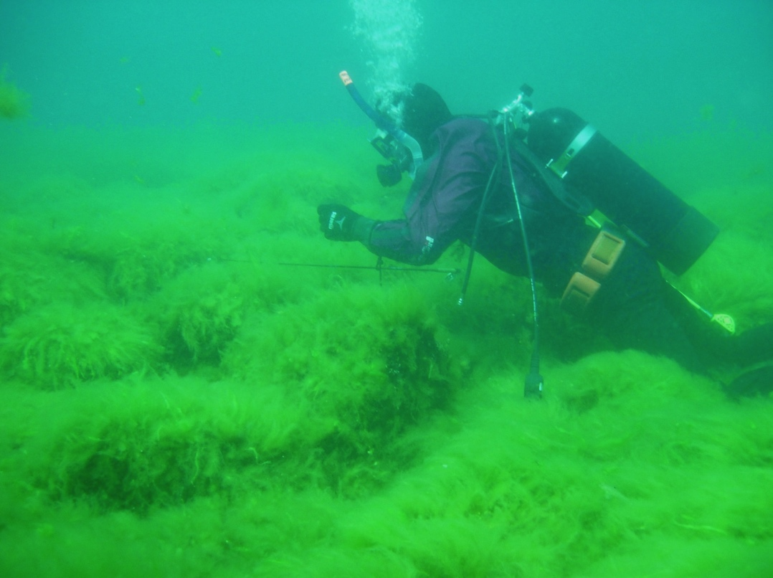
EcoDyn | Process Studies: Invasive Mussel (Dreissena) example
Summary
Dreissenid mussels have affected algal and microbial food web structure in all size categories with surprising results
Feeding and nutrient excretion may be working together to affect cyanobacterial and phytoplankton community structure
More work is necessary to quantify results and develop a new generation of water quality and fisheries models
11/13

Slide 12
EcoDyn | Process Studies: Invasive Mussel (Dreissena) example
Resources to advance future research
Continue to work with and support academic partners.
Replace retiring support staff and backfill primary production/microbial food web ecologist and biogeochemist positions.
Continue to adopt molecular tools to characterize microbial food web components.
Further invest in infrastructure for automatic counting and characterization of seston and measurement of algal growth and condition.
12/13
Notes:
The challenges mentioned here for this particular project are emblematic of general challenges to recapture GLERL’s traditional strengths in biogeochemistry and lower food web dynamics.
Infrastructure investments needed:
Renew radioisotope license to be able to clarify uptake, excretion and fate of ingested C and P.

Slide 13
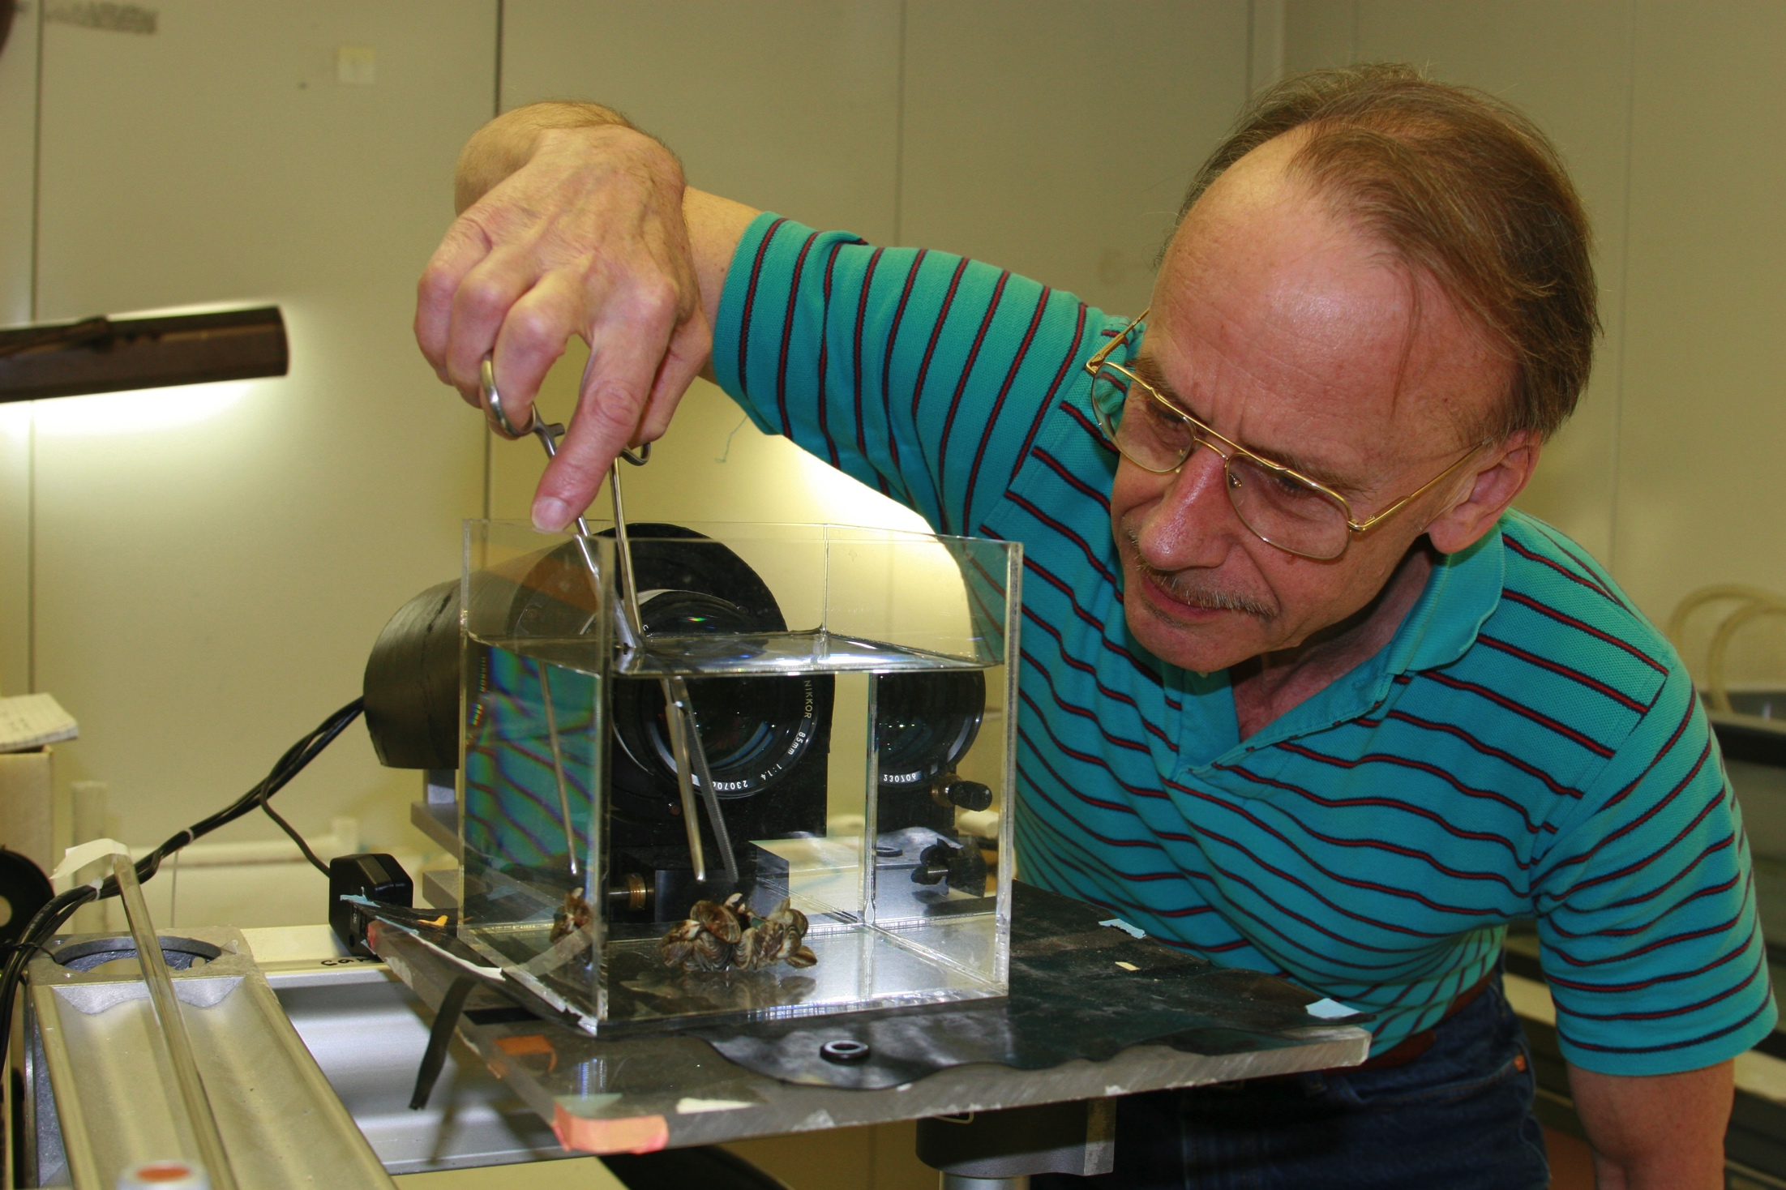
EcoDyn | Process Studies: Invasive Mussel (Dreissena) example
Questions?
13/13

