Slide 1


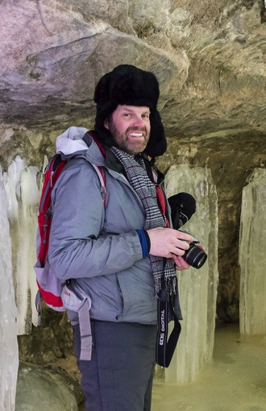
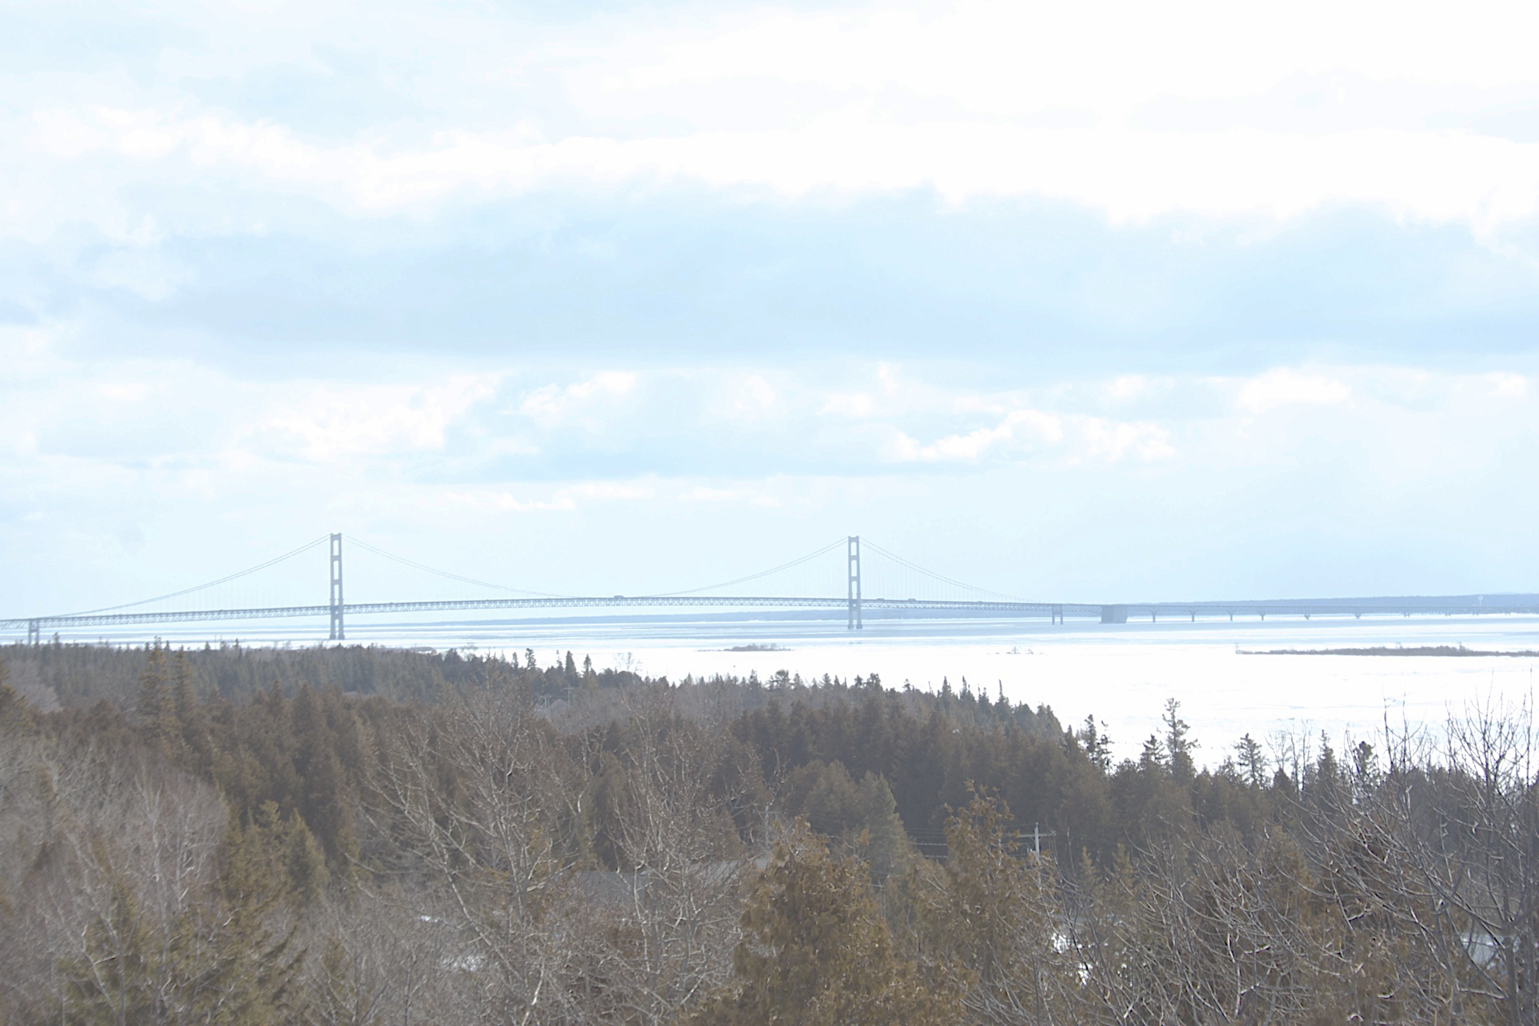
Regional Coupled Atmosphere-Lake-Land Modeling for Research & Applications
Brent Lofgren
Integrated Physical & Ecological Modeling & Forecasting
1/10
Notes:
This work aligns with the following NOAA Goals:
Climate Adaptation and Mitigation:
Improved scientific understanding of the changing climate system and its impacts
Assessment of current and future states of the climate systems that identify potential impacts and inform science, service and stewardship decisions
A climate-literate public that understands its vulnerabilities to a changing climate and makes informed decisions
Science: Weather-Ready Nation
Improve freshwater resource management
Education: Science-Informed Society
Youth and adults from all backgrounds improve their understanding of NOAA-related sciences by participating in education and outreach opportunities

Slide 2


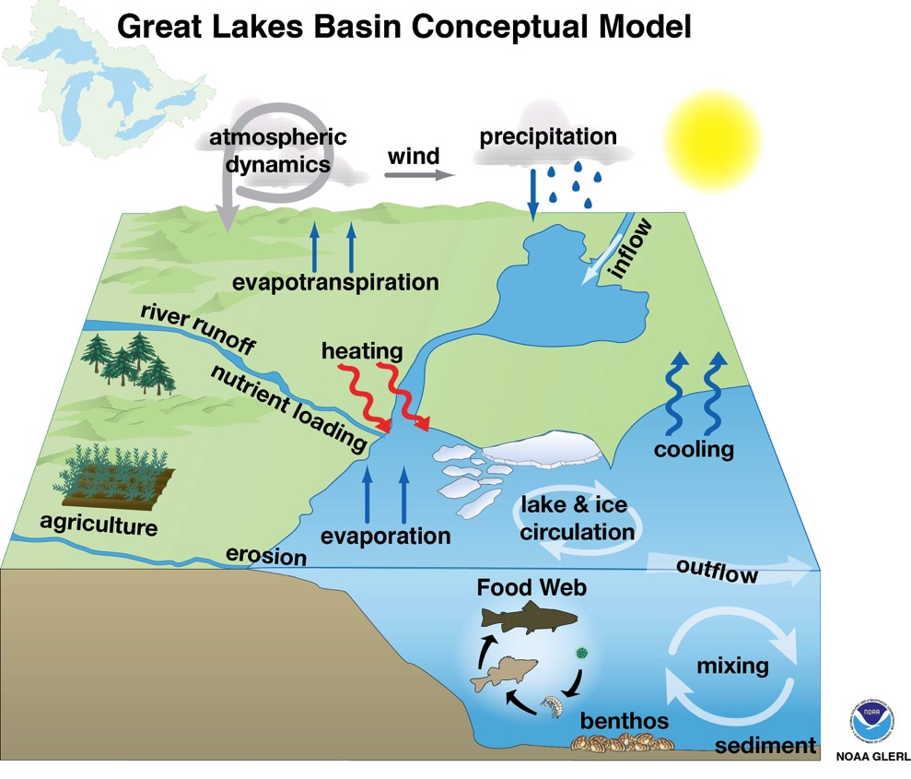
IPEMF | Regional Coupled Atmosphere-Lake-Land Modeling for Research & Applications
Great Lakes Coupled Model Concept
2/10
Notes:
The Great Lakes physical and ecological system includes many parts that traditionally fall under separate scientific disciplines. GLERL is a location where experts in various disciplines interact under one roof.

Slide 3
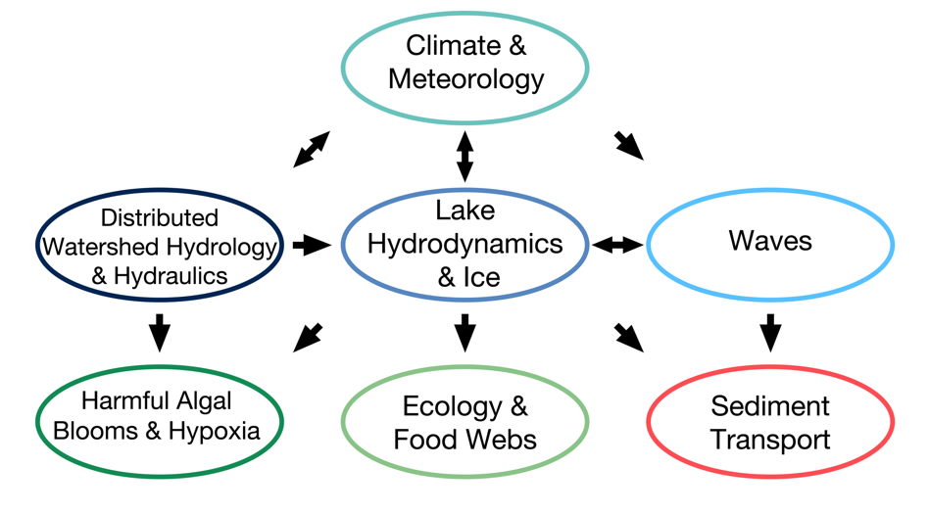
IPEMF | Regional Coupled Atmosphere-Lake-Land Modeling for Research & Applications
Research question: How are atmospheric, lake, and land processes mutually affected by conditions across time scales?
Traditional mindset—external cause, internal effect
Can this always be true?
The real picture is an exchange of energy (heat), water, and momentum.
Create not just a coupled model, but a coupled mindset
4/10
Notes:
The mindset of modeling within a single sub-system or science discipline usually says that the cause of phenomenon is outside of our subsystem, while the effect is inside.
Logically, this cannot be true in all cases.
The real picture is an exchange of energy (heat), water, and momentum. When looking at an individual sub-system, these can be gained or lost to another sub-system “outside the box”, but in the coupled system, they are conserved—they can be passed among sub-systems, but not gained or lost.
Create not just a coupled model, but a coupled mindset
Challenge: fitting this into the larger global picture
The Great Lakes region can also be thought of as a box that connects to the world as a whole
“As the atmosphere guy, this affects me greatly”

Slide 4
IPEMF | Regional Coupled Atmosphere-Lake-Land Modeling for Research & Applications
Where the Traditional Mindset Went Wrong
Superior potential evapotranspiration ratio
Superior water level
One-way coupled hydrologic projections of future Great Lakes levels show excessive increases in evapotranspiration and drops in lake level.
Lofgren and Rouhana, (2015).
5/10
Notes:
Part of the reason why this went wrong is that people insisted on using a method that was specific to the Great Lakes region.
It doesn’t link into the way that people treat this question globally.
The model (Large Basin Runoff Model; LBRM) that for decades has been considered the standard method for projecting lake levels under climate change is flawed.
Most of the past projections of the future impacts of climate change have been based on a suite of hydrologic models with a one-way coupling to the output of global general circulation models of climate. In this comparison for the basin of Lake Superior, the traditional method, labeled “TA” for “temperature adjustment”, is shown in the right box and whiskers in each panel, and compared to three more physically-based methods. The TA method has marked increases in evapotranspiration from the land in the Great Lakes basin, as well as decreases in runoff, net basin supply, and lake level, compared to the other methods. Its change in potential evapotranspiration is extreme, with the most extreme value showing an increase by more than 500-fold: mathematically equivalent to 567 suns in the sky. These results are shown in Lofgren and Rouhana (2015), currently published as a GLERL Technical Memorandum, with a shorter peer-reviewed version to come.
This points out that climate change is a process, not just a set of output data, and you need to figure out how your sub-system fits into that process.

Slide 5
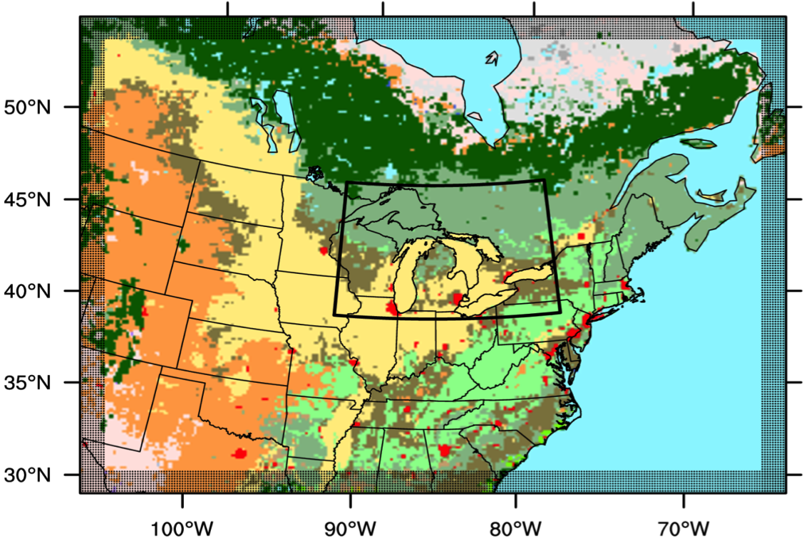
IPEMF | Regional Coupled Atmosphere-Lake-Land Modeling for Research & Applications
Weather Research and Forecasting Model (WRF)
A sample grid configuration of WRF for the Great Lakes region, showing MODIS land surface types. Xiao et al. (2016)
5/10
Notes:
A primary modeling tool that we use for the atmosphere and for coupling to land and lake surfaces is the Weather Research and Forecasting Model (WRF). This supplants the former Coupled Hydrosphere-Atmosphere Research Model (CHARM). WRF is a model standard across NOAA and many other users, and is well-supported in terms of both community of users and continuing development.
The figure illustrates how multiple telescoping grids can be nested in WRF to give both a continental-scale context and finer-scale concentration on a region of interest, such as the Great Lakes. It also illustrates the distribution of land surface types, derived from the Moderate-resolution Imaging Spectroradiometer (MODIS) satellite instrument. This particular illustration shows a “what-if” scenario in which the Great Lakes have land substituted for their surfaces—mixed forest for Lake Superior, and cropland for the other lakes.

Slide 6
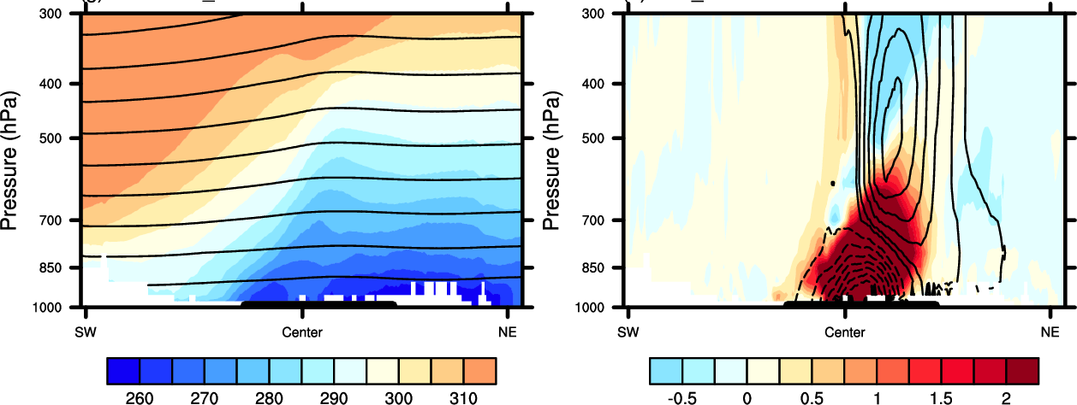
IPEMF | Regional Coupled Atmosphere-Lake-Land Modeling for Research & Applications
Influence of the Great Lakes Surface on Storm Systems
Results for air potential temperature and geopotential height from the Weather Research and Forecasting (WRF) model affects air temperature and geopotential height.
Dec 15 2013 with lakes
With lakes minus without
Kelvin
Kelvin
Vertical cross-section, southwest to northeast across the Great Lakes. The heavy border at the bottom indicates the lakes. Contours are geopotential height in m.
6/10
Xiao et al., (2016, submitted).
Notes:
Models enable us to use “what-if” scenarios of the absence of the Great Lakes. This figure shows how the presence vs. absence of the Great Lakes in the WRF model affects air temperature and geopotential height, and therefore atmospheric dynamics. The passage of low-pressure centers associated with storms during December is influenced by the warming influence of the Great Lakes at the surface, but the magnitude of the influence differs among the individual cases (Xiao et al, 2016, submitted to Journal of Geophysical Research—Atmospheres).
This work is in cooperation with CILER post-doc Chuliang “Andy” Xiao.

Slide 7
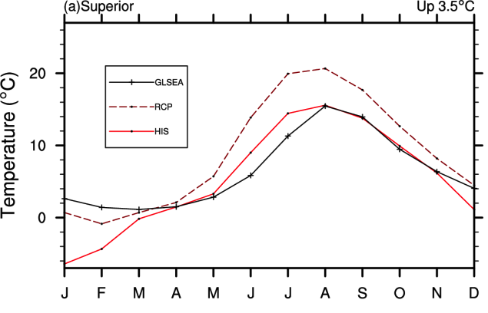
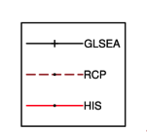
IPEMF | Regional Coupled Atmosphere-Lake-Land Modeling for Research & Applications
Multi-decadal Lake Surface Temperature Projection Using WRF
Climatological averages of lake surface temperature for Lake Superior as simulated by the WRF model, including the 1-dimensional lake module
(observation)
(future simulation)
(past simulation)
Xiao et al., (2016, in preparation).
7/10
Notes:
We currently have a package for simulating future climate change projections for the Great Lakes using the Weather Research and Forecasting (WRF) model, including full coupling of the atmosphere to the land surface and 1-dimensional lake simulations. The results here show warming of the lake surface temperature on all of the lakes for a late 21st century run compared to the late 20th century. The magnitude of this difference varies by season, but averages 3.5 degrees C.
(black) GLSEA observations, (HIS; solid red) late 20th century simulation, (RCP; dotted) late 21st century simulation

Slide 8
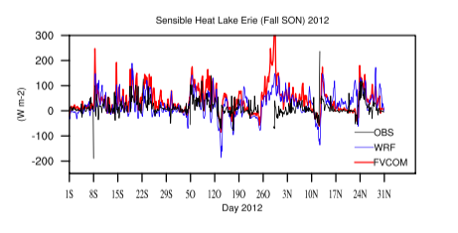
IPEMF | Regional Coupled Atmosphere-Lake-Land Modeling for Research & Applications
Comparison of Lake Surface Fluxes
7/10
Notes:
We have initiated comparison of lake surface heat fluxes among multiple sources, as a step toward improving and coordinating surface flux algorithms among various models used at GLERL that have lake surface fluxes of energy and moisture as their point of intersection. This paves the way toward full coupling between atmospheric and lake hydrodynamic models. The figure shows comparison between eddy-covariance-based observed sensible heat flux at the PERMS1 station in western Lake Erie and modeled output from WRF (with an atmospheric dynamics emphasis) and FVCOM (with a lake dynamics emphasis).
Some highlights of the comparison shown here are that the three datasets (observations from an eddy flux covariance station, and two models used by GLERL, WRF with an atmospheric emphasis and FVCOM with a lake dynamics emphasis) for fall 2012: 1. Most of the variance has all three datasets trending in the same direction, although often with different magnitude. 2. The late October period highlighted by the green oval on the left seems to be an interesting case in which both WRF and FVCOM have large positive excursions in sensible heat flux; unfortunately the observed data is missing during this time. 3. The late November period highlighted by the green circle on the right has FVCOM in very good agreement with the observations at near-zero values, but significant positive excursions in the WRF dataset. This warrants additional investigation to see whether WRF might be yielding poor simulation at this time due to inaccuracies outside of the surface flux algorithm.
This work is in cooperation with National Research Council post-doc Umarporn “Jam” Charusombat.

Slide 9
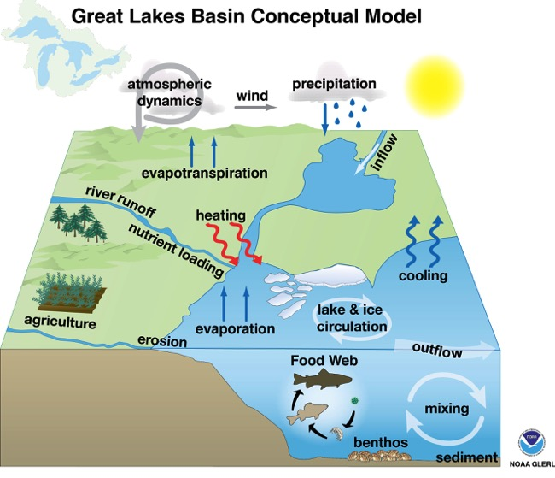
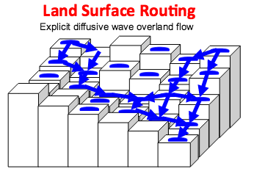
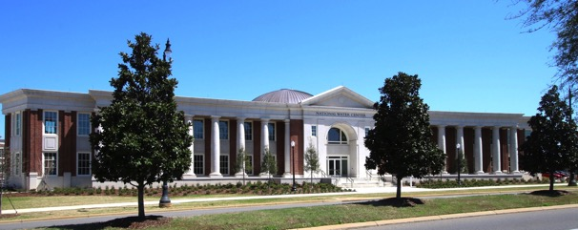
IPEMF | Regional Coupled Atmosphere-Lake-Land Modeling for Research & Applications
Moving forward: Planned Use of WRF-Hydro
Figure from David Gochis and WRF-Hydro developers
WRF-Hydro will fulfill the river runoff portion of this concept
Coordinates efforts with the
National Water Center
8/10
Notes:
A development planned for the 1-2 year horizon is implementation of the enhanced hydrologic package for the Weather Research and Forecasting Model (WRF-Hydro) for a Great Lakes domain. This advances the simulation beyond water exchange at the surface and includes the fate of water and river flow.
This coordinates with efforts at the new National Water Center, and aims at creating a unified forecasting system for the US and Canadian portions of the Great Lakes basin.
A major requirement is a coordinated dataset for land information, such as vegetation, soil, and topography.

Slide 10
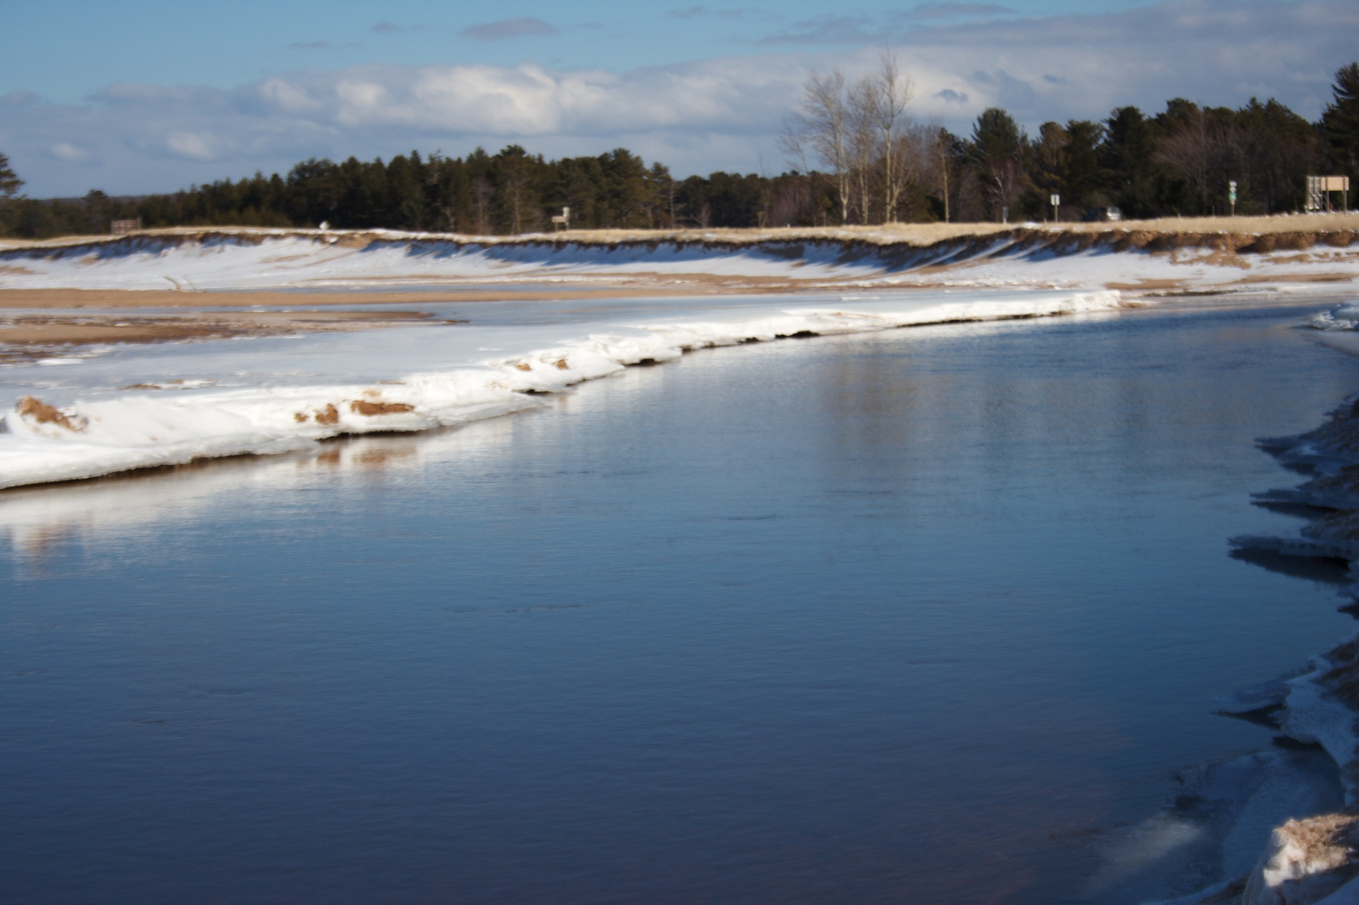
IPEMF | Regional Coupled Atmosphere-Lake-Land Modeling for Research & Applications
Longer Horizons in Research
Two-way coupling between atmosphere, 3-D lake hydrodynamics, and ice cover
Coupled atmosphere-land-lake modeling for
sub-monthly, seasonal, and multi-decadal time scales
Ensemble approach to aid in uncertainty estimation
9/10
Notes:
Two-way coupling between atmosphere, 3-D lake hydrodynamics, and ice cover
Coupled atmosphere-land-lake modeling for sub-monthly, seasonal, and multi-decadal time scales
Ensemble approach to aid in uncertainty estimation. This means that the same model is run several times (around 5-10) with initial conditions that are plausible, but different. These yield plausible but different outcomes that, as a set, demonstrate a range of uncertainty.

Slide 11

IPEMF | Regional Coupled Atmosphere-Lake-Land Modeling for Research & Applications
Questions?
Place Photo Here
10/10

