Slide 1


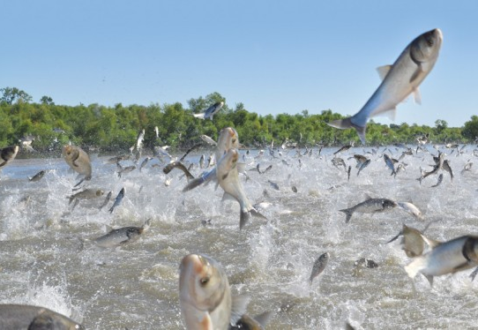





What if Asian Carp Establish in the Great Lakes?
Hongyan Zhang
Ecosystem Dynamics
Place Photo Here
1/11
Notes:
Currently, there are no Asian Carp in the Great Lakes. However, “What if Asian Carp establish themselves in the Great Lakes?” is the question that most concerns the people in the Great Lakes when thinking about invasive species. Why?

Slide 2


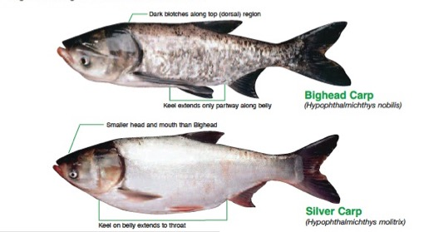
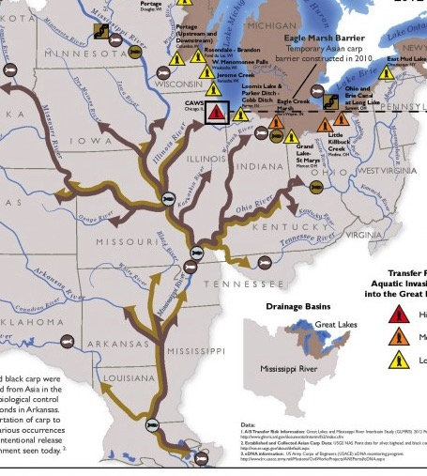
EcoDyn | Demo: Ecological Modeling of Asian Carp
Background on Asian Carp
http://www.thelocalq.com/blogs/outdoors/tag/asian-carp
Chick and Pegg (2001). Science.
2/11
Notes:
Asian carp here refer to Silver Carp and Bighead Carp that feed voraciously on plankton.
Asian carp were introduced in the United States in the 1970s to control water quality in fishery ponds and wastewater treatment plants. In early 1990s, Asian carp escaped from the ponds and move into the Mississippi River during flooding events.
This figure showed Asian carp population grows exponentially in the upper Mississippi River, indicated by the red star on the right.
Reference:
Chick, J. H., and M. A. Pegg. 2001. Invasive carp in the Mississippi River Basin. Science 292:2250-2251.

Slide 3
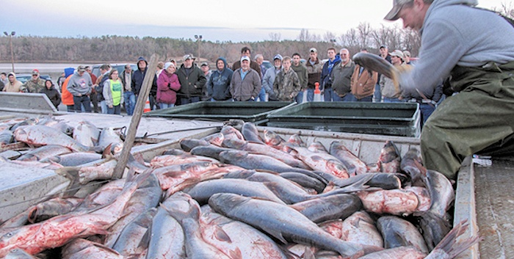
EcoDyn | Demo: Ecological Modeling of Asian Carp
Background on Asian Carp
http://www.thelocalq.com/blogs/outdoors/tag/asian-carp
Become abundant
Big
Feed on plankton
Threat the fisheries
Near the Great Lakes
Risk assessment
AsianCarp.net
Chick & Pegg 2001, Science
3/11
Notes:
Asian Carp can reach to a very abundant population, making up 80-90% of the total fish biomass in some reaches.

Slide 4
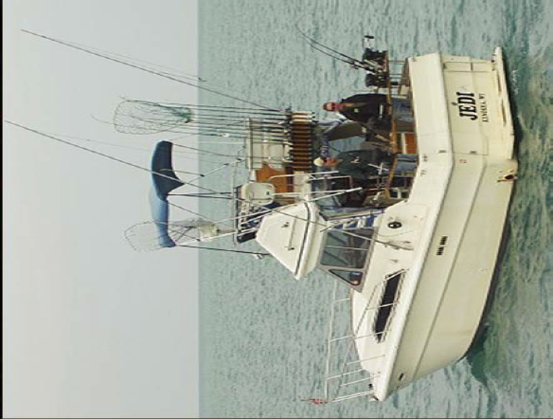

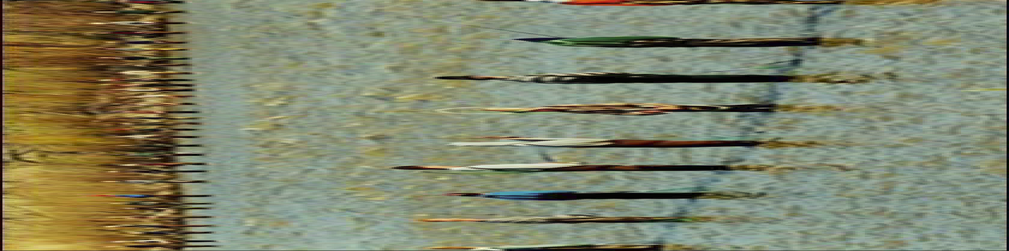


EcoDyn | Demo: Ecological Modeling of Asian Carp
Background on Asian Carp
Chick & Pegg 2001, Science
4/11
Notes:
Each individual can grow very big, more than 100 ponds and up to 4 ft long.
Asian carp compete food with prey fish and fish larvae, and consequently decrease commercial and recreational fish species.
So, if Asian carp invade in the Great Lakes region, it will pose a threat to its billions of dollars of fishery industry.
Not mention the damage of the jumping behavior by silver carp, which may harm tourism on the lakes

Slide 5
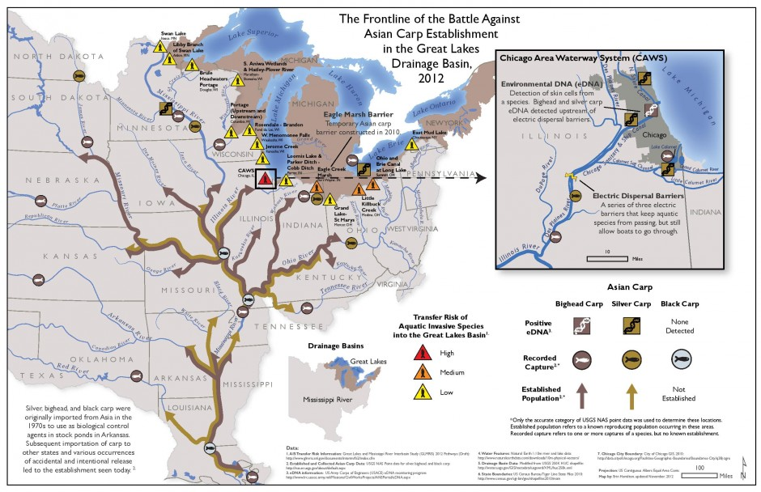
EcoDyn | Demo: Ecological Modeling of Asian Carp
Background on Asian Carp
Chick & Pegg 2001, Science
The big question is: What if Asian Carp establish in the Great Lakes?
5/11
Notes:
The threat is very real.
Asian carp are well established in the Mississippi River basin. This figure shows the frontline of the battle against Asian carp establishment in the Great Lakes Drainage basin in 2012.
Lake Michigan and Lake Erie are especially under high risk.
Now the answers to the question that has become critical to managers and the public – What if Asian Carp establish in the Great Lakes?

Slide 6

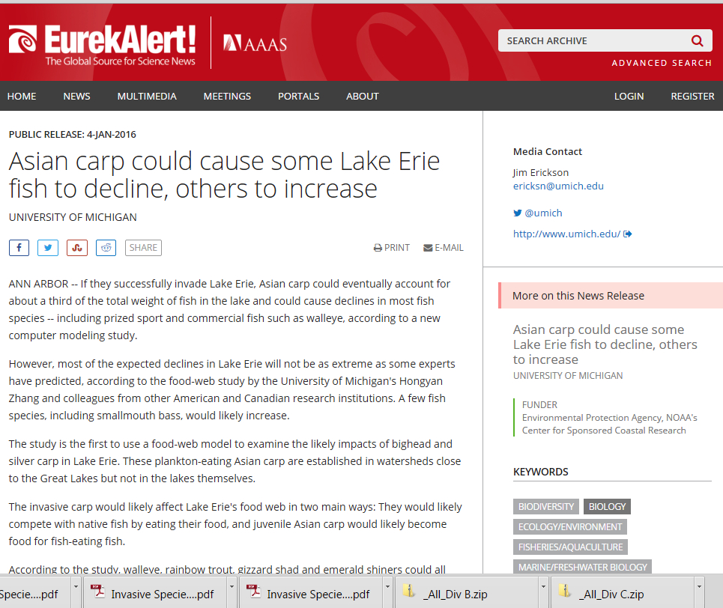
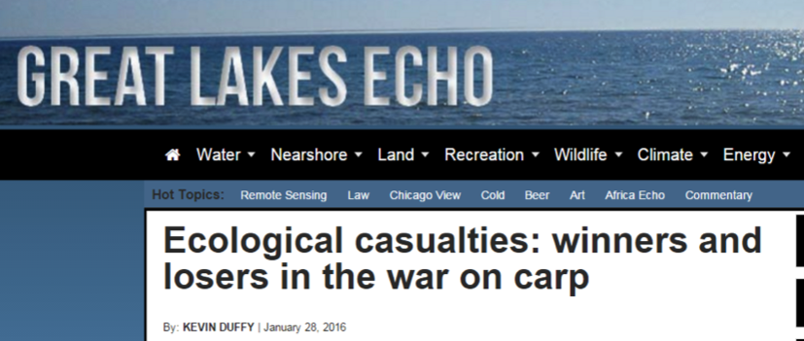
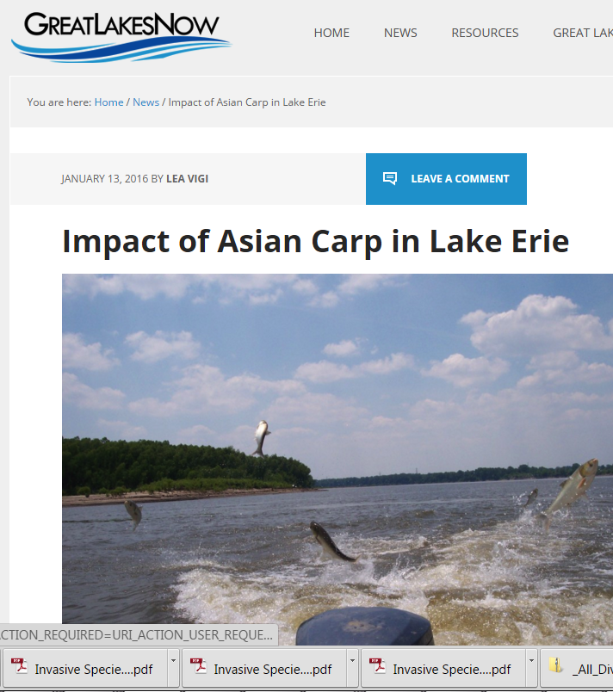
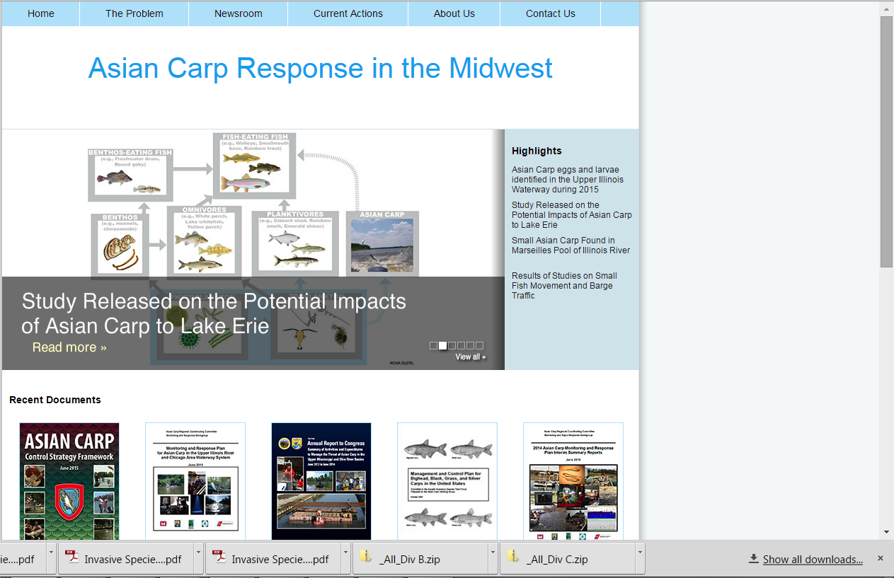

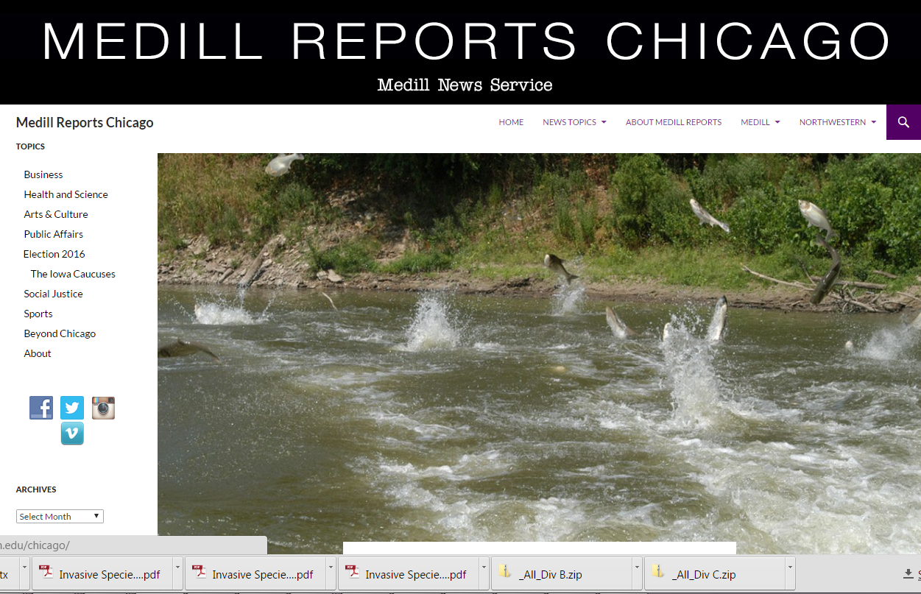
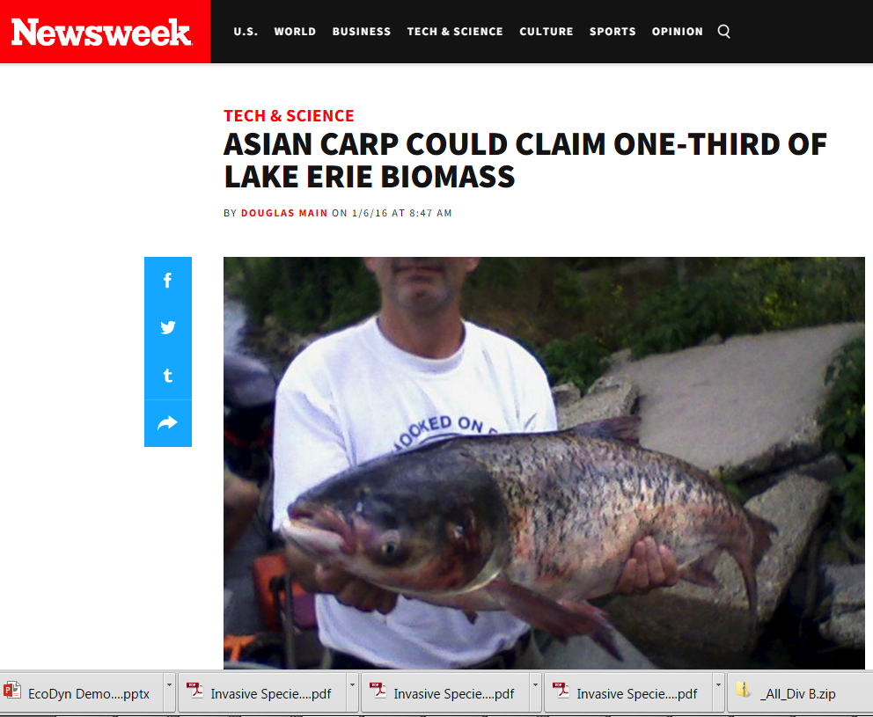
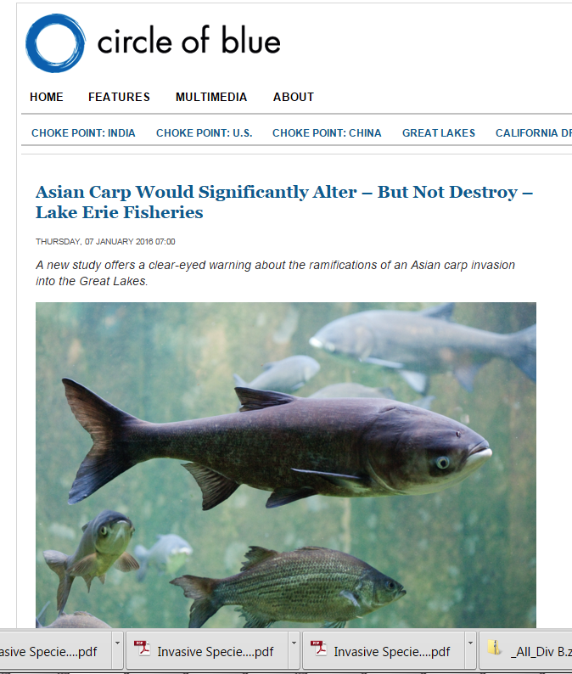

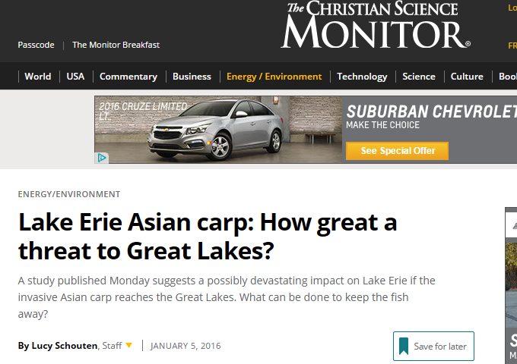
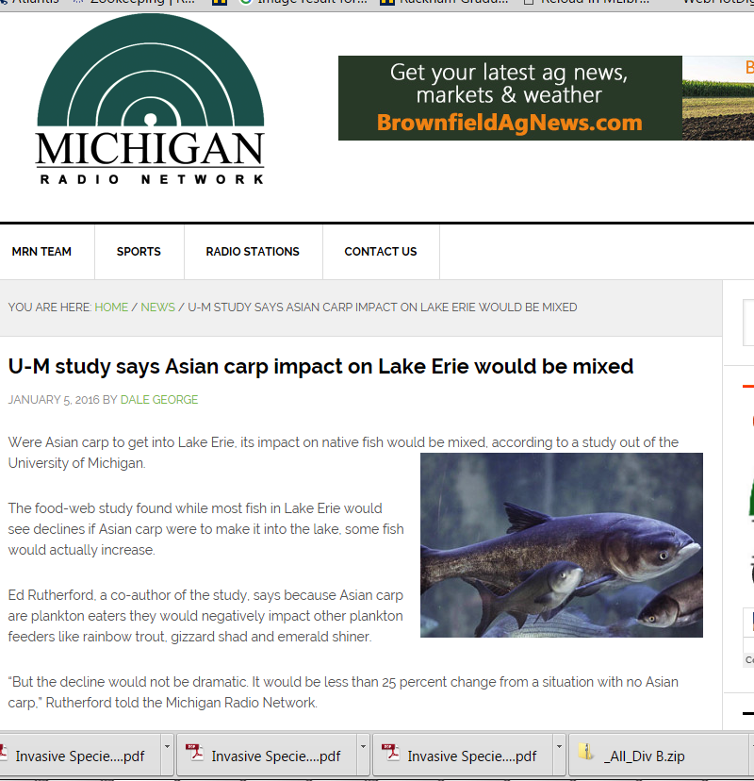
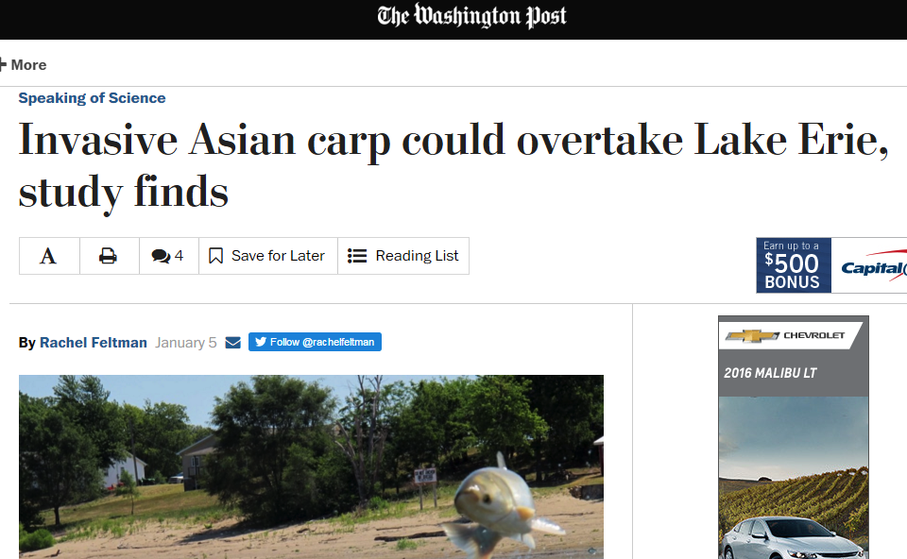

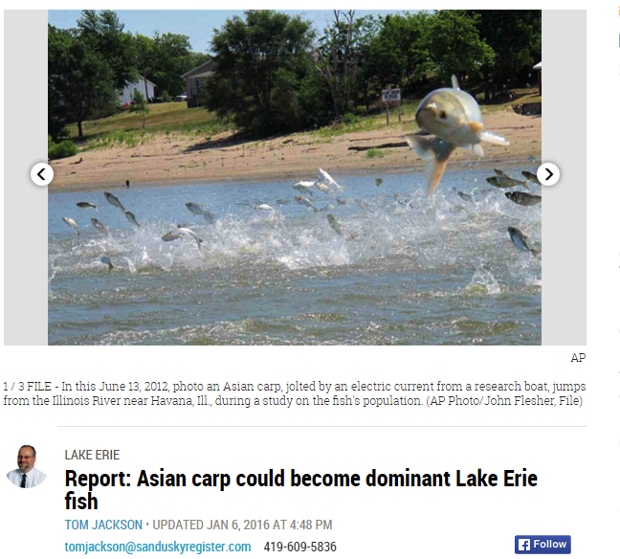

EcoDyn | Demo: Ecological Modeling of Asian Carp
Answer …
2/2
Notes:
Our research team recently published a paper and provided such critical information.
The findings have been well reported and accessed by the public.
Many newspapers, websites and radio stations reported the findings.
Associated Press has posted it on over than 150 news sites.
Here I put up some of them. This news even reached to Africa…

Slide 7
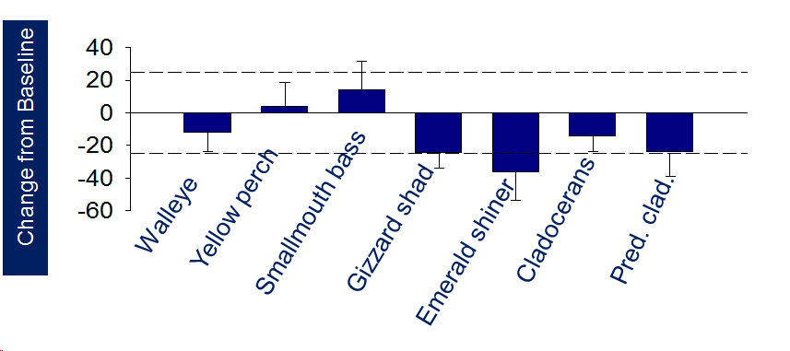
EcoDyn | Demo: Ecological Modeling of Asian Carp
Published findings: modeled Lake Erie food web impacts
Fish biomass
Asian carp can make up to 1/3 of the total fish biomass
Negative impact on most fish and zooplankton
Asian carp
Zhang et al. (2016). Trans. American Fisheries Society.
7/11
Notes:
We studied Lake Erie the most productive lake among the Great Lakes, where the Asian carp most likely to thrive.
We found that:
1) if Asian Carp establish in Lake Erie, they can make up to 1/3 of the total fish population. In another words, one of three pounds of fish will be Asian carp.
2) Most of the fish and zooplankton will be negatively affected, but a few of fish species that can feed on young Asian carp could benefit from Asian carp invasion and increase, e.g, Smallmouth bass.
Reference:
Zhang, H., E. S. Rutherford, D. M. Mason, J. T. Breck, M. E. Wittmann, R. M. Cooke, D. M. Lodge, J. D. Rothlisberger, X. Zhu, and T. B. Johnson. 2016. Forecasting the Impacts of Silver and Bighead Carp on the Lake Erie Food Web. Transactions of the American Fisheries Society 145:136-162.

Slide 8
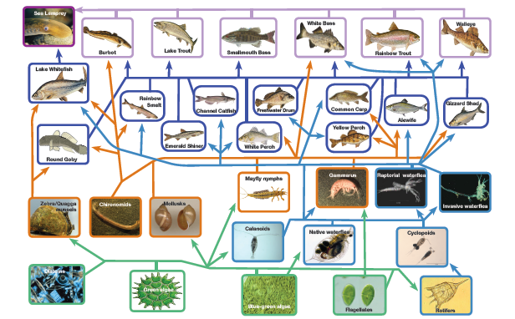
EcoDyn | Demo: Ecological Modeling of Asian Carp
Our approach: Food web modeling - Ecopath with Ecosim
nutrients
Fisheries
Asian carp
Structured Expert Judgment (SEJ)
8/11
Notes:
We used a food web model – Ecopath with Ecosim. First, we built an Ecopath model by defining the model groups, estimating the group biomass, turnover rate and the interactions among groups with consumption rates. Once the Ecopath model is balanced, we get a snapshot of the ecosystem. Then we put some driving forces, external nutrient loads and fisheries harvest, to run the model in Ecosim. After the model was calibrated, we then added Asian carp into the food web, and compared the changes in model groups between with and without AC.
One of the novel approaches was to incorporate the Structured Expert Judgment (SEJ) into our analysis. Since Asian carp is not in the Great Lakes yet, we asked 11 experts on the Great Lakes ecosystem or Asian carp, or both, to estimate the values of Asian Carp parameters. The SEJ integrated the values from experts and provided subjective distributions of each parameter. We randomly pick values from the distribution and run Ecopath with Ecosim for 100 times for each scenario to provide uncertainty in addition to predictions.

Slide 9
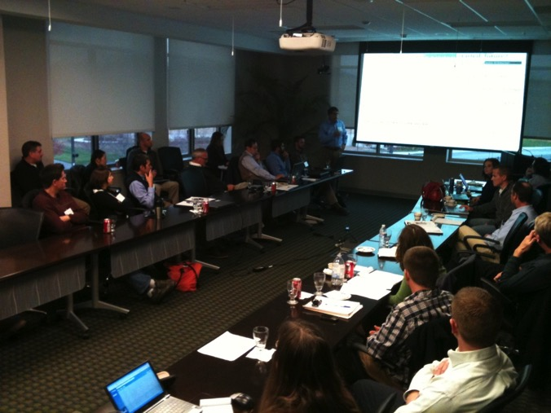
EcoDyn | Demo: Ecological Modeling of Asian Carp
Important interactions with managers and scientists
Management transition board
Structured Expert Judgment (SEJ)
External review
Stakeholders - USACE
9/11
Notes:
Over the study period, we have been actively interacting with managers and scientists. For example, we have periodically presented our study to our management transition board. Before we submitted this paper to a journal, we invited external reviewers for comments and suggestion. Professor Rose was one of them. We have also been contacted by agencies, like USACE, for model results to be used in risk analysis. Right now we are the only group they can find that is using ecosystem models to study Asian Carp impacts.

Slide 10
EcoDyn | Demo: Ecological Modeling of Asian Carp
Future work
Stressors
OSAT
Social Studies
Ecosystem models
EwE, IBM and Atlantis
EcoDyn
IPEMF
Economics
Management
10/11
Notes:
In the future, we will continue to use Ecopath with Ecosim model to study Asian carp impacts on other Great Lakes, and use other models, like IBM and Atlantis Ecosystem Mode. We will continue to using ecosystem models to integrate data from GLERL’s three research branch (OSAT, EcoDyn, and IPEMF), and link ecosystem models with social and economic studies. We are also extending our research to other stressors (e.g., eutrophication, climate change), and continue to interact with managers and provide critical information to support their management decisions.

Slide 11

EcoDyn | Demo: Ecological Modeling of Asian Carp
Questions?
11/11

